Slide 1
Top 10 User Mistakes with Static Analysis
Sate IV
March 2012

Slide 2
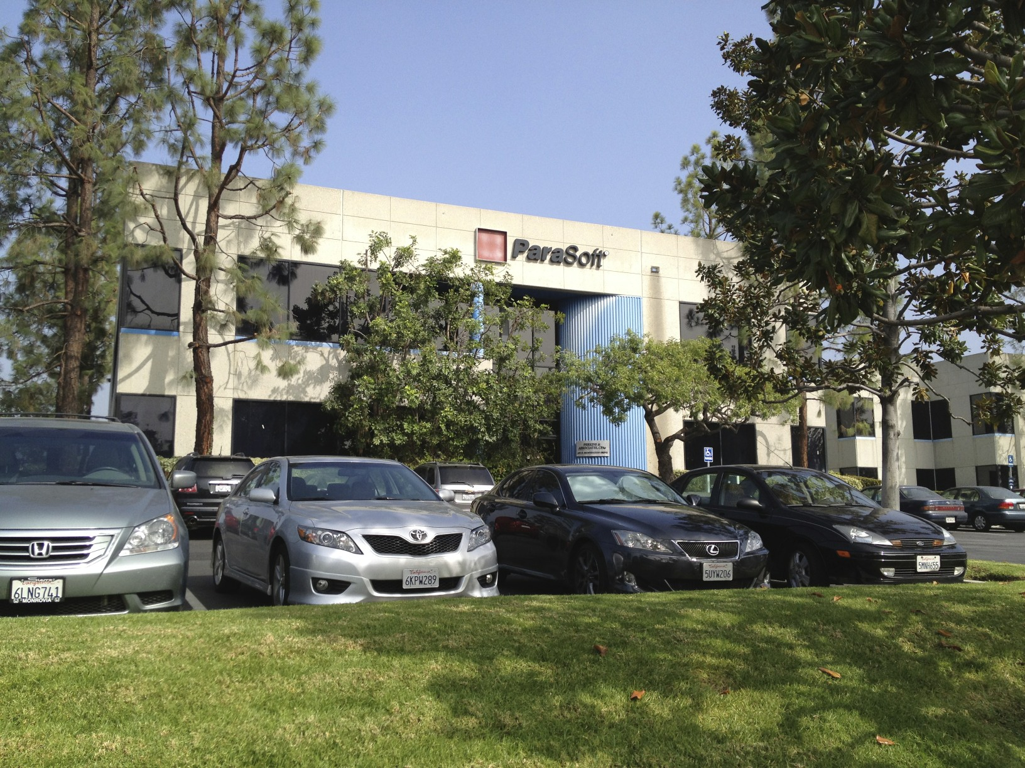
About Parasoft
Founded in 1987
27+ Patents for automated quality processes
Build quality into the process
Static Analysis tools since 1994
Notes:
So really brief, about Parasoft: Parasoft was founded in 1987.
We’ve got 27 patents around various automated quality processes.
Our core focus is looking into development process and find area where we can automate the process to free the human up.
To do in a such clever way to do so, that drive human away from boring work and human can focus and perform more difficult and important tasks.
We’ve been building static analysis tools since 1994 so we know a lot of experience and we are quite good at it.

Slide 3
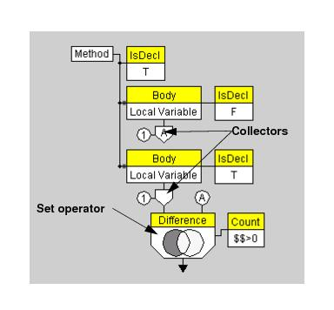
What IS Static Analysis?
Variety of methods
Peer Review / Manual Code Review / Code Inspection
Pattern-based code scanners
Flow-based code scanners
Metrics-based code scanners
Compiler / build output
Notes:
Definition of Static code analysis is the analysis of computer software that is performed without actually executing the software being tested.
We’re going to talk briefly about each of these techniques, when/where to use it, and why it’s helpful.
So coming into this presentation we’ve been getting a lot of questions and it seems that static analysis means different things to different people.
Static analysis can be one of those things in the list here:

Slide 4
Number 10: Developers
10) Developers not included in process evolution
Developer Insights
Rules / Issues drive need
Workflow
Usability
Correctness / Noise
Will our engineers really adopt it and use it?
Is this a long-term solution?
Notes:
•Will our engineers really adopt it and use it? •Is this a long-term solution? Will developers really adopt it and use it? The best tool in the world won’t deliver any value to your organization if it’s not deployable, if developers hate using it, or if it’s too much of a disruption to project progress. Figuring this out requires a comprehensive evaluation of all the vendor and tool. A robust and flexible rule set, the feasibility of approaching zero noise, a workflow that’s practical and repeatable for both your highly-skilled engineers and your junior developers, scalability to the enterprise, and a vendor committed to working with you to solve your problems—how all these factors work together make the difference between a great tool and a great tool for your organization.

Slide 5
Code Analysis Perceptions
“Static analysis is a pain”
False positives has varying definitions
I don’t like it
It was wrong
Notes:
Let’s talk about perception:
A lot of time we heard from our customers is that “we don’t have time for static analysis”
I would counter that with “you don’t have time not to do static analysis”.
But this perception comes from couple of different places:
One is people thinks static analysis is merely formatting issue.
And a lot of people/team don’t want to get into argument about where to put start curly braces or spaces or tabs for spaces.
This kind of static analysis is used for big team for consistency in the code base but that’s not big goal for static analysis.
Static analysis can find security, memory leak, performance and potential problems as we discussed earlier.
It is not just finding formatting issues or syntax. Let’s keep in mind for that.
Also big pain is a false positives.
This is where we really get into discussion about what is really false positive.
People tends to say mostly on static analysis issue is false-positive because first they don’t understand it.
When you look at the message and you don’t understand why it is the problem or you look at the message
and you find out that rule doesn’t apply to the code or you don’t believe in it and you don’t want to fix it
OR by definition, it tells me that pattern exists in the code but pattern may be wrong.
CODE ANALYSIS PERCEPTIONS: First we need to talk about bad perceptions in the industry. Let’s start with the issue of false positives. It’s a problem for the build manager. Its’ related to how you setup your infrastructure and how you run your static analysis. For details on setting up the build – see the Build Manager Training.
The term or idea of false positives seems to have two meanings. In the simplest sense, it means that the message that a rule was violated is incorrect, or in other words the rule was not violated – the message was false. Sometimes developers fall into the trap of labeling any error message they don’t like as a false positive, but this isn’t really correct. They may label it a false positive because they simply don’t agree with the rule, they may label it because they don’t understand how it applies in this situation, or they may label it because they don’t think it’s important in general or in this particular case. The best way to deal with this head-on is to make sure that the initial rule set you start with has a small number of rules that everyone can agree on. It should product reasonable results that can be dealt with in a reasonable amount of time.

Slide 6
Pattern based false positives
True false positives generally rule deficiency
Context
Does this apply here and now?
In-code suppressions to document decision
Notes:
This is where we define what static analysis doing earlier.
Static analysis is looking for a pattern in the code.
Another means a false positives should mean that static analysis find a pattern in your code but pattern doesn’t exist in your code when you review it.
Now, that would be real false positive.
Truth is that most static analysis any good static pattern analysis tool should not have false positive rules.
If you truly find a false positive not just because you don’t like
or it doesn’t apply to your code but pattern doesn’t exist in your code, then you should file problem report ticket with the tool vendor to fix the rule.
Most of claimed false positive issue here is that that pattern doesn’t apply here in my code.
This is contextual issue not pattern issue.
If so, you should use suppression mechanism that static analysis tool provides.
I cannot stress enough for suppression.
If you only suppress to single user desktop, it doesn’t work well because other people may have to do same suppression over and over again.
We normally recommend users to use in-line suppression mechanism if tool supports it.
This normally goes as comments to the code and it won’t add any executable lines.
I know some people doesn’t want to change in their code, but truth is you look at something like input validation or uncaught exception,
if this exception is handled by different places, it is good to document in source code that we know explicitly what’s going on.
When you use suppression comment in the area, other people will also able to share the information.
Ideally your tool can recognize the comment and not reporting over and over again.
It is important to pick carefully rule sets.
You don’t choose all good rules or all rules to scan.
If you gets too many violations, you and your team will start ignore the violations because it means no matter how good the rule is, it is too alienate to your developers and environment.
It will never get adopted as standard practice.
Start with small and important rule sets and increase coverage slowly.
PATTERN BASED FALSE POSITIVES: False positives and “not false” positives are in two different areas. One is pattern based static analysis, which also includes metrics. There is also flow-based static analysis. One thing to remember is that pattern based static analysis doesn’t have false positives. If it has a false positive, it’s really a bug in the rule, because the rule should not be ambiguous. If the rule doesn’t have a clear pattern to look for, it’s a bad rule.
This doesn’t mean that when a rule lists a violation that there is a bug, which is important to note. A violation simply means that the pattern was found. You have to look and say I am choosing these patterns and flagging these patterns because they are dangerous to my code. When I look at pattern, I ask myself, does this apply to my code, or doesn’t it apply? If it applies, I fix the code, if it doesn’t apply I suppress it. It’s best to suppress it in the code so that it’s visible and others can look at it, and you won’t end up having to review it a second time. It’s a bad idea to not suppress the violation explicitly, because then you will constantly be reviewing the same violation.
They beauty of in-code suppression is that it’s independent of the engine. Anyone can look at the code and see that the code has been reviewed and that this pattern is acceptable in this code.

Slide 7
Flow Analysis False Positives
False positives are inevitable
Finds real bugs
Flow analysis is not comprehensive
Notes:
Here is the problem flow analysis.
People likes flow analysis.
Problem is flow analysis false positives are inevitable.
Reason is that flow analysis is going to trying to create input to cause a certain path to be executed in the code.
Problem is that input maybe unrealistic even for level for impossible.
You have to deal with false positives.
It is very important to make sure that your flow analysis is configured to test most important things.
The best thing about flow analysis is it will find real bugs.
It will give you low hanging fruits for you.
It looks something like resource leaks, performance, security and threads problems.
Real question is amount of time you spend on flow analysis result to go over to find false positives
and suppressing them and fixing real bugs quickly before it goes into functional testing where it would be more difficult to find with debugging.
Let say you spend an hour to fix and suppress dozen flow analysis items let say 50:50.
And let say one or two of these real bugs leaks into field, by the time went back to field report and back to support and development,
it may cost half day or 2-3 days of time to address the issue.
It is your decision which way is more time saving and effective.
Very important point, Flow analysis is not comprehensive.
For example, we have thread issue, we turn on flow analysis rule for dead lock rule,
if flow analysis doesn’t report anything, does it mean that there is no deadlock.
Answer is no.
If I do security, and looking for possible SQL injection and enabled rule for SQL Inject flow analysis rule and static analysis didn’t find any violation,
does it mean that you don’t have any SQL injection?
Answer is no.
You have to think about flow analysis is a way to find low hanging fruit.
You have to understand it is essentially random.
It will never find every path in every application.
So it is great to run it. Ideally if you run well with heavy static analysis, code review and testing, flow analysis won’t find anything for you in this environment.
FLOW ANALYSIS FALSE POSITIVES: In flow analysis you have to address false positives because it will always have false positives. Flow analysis cannot avoid false positives, for the same reason unit testing cannot generate perfect unit test cases. When you have code that uses some kind of library, for instance your java code calls the OS and something come back, who knows what it’s sending? It’s going to be a false positive because we have to make assumptions about what’s coming back. We try to err on the side of caution. Be careful here, if it’s possible that something strange might be returned protect against this. This finds bugs, that’s why it’s so valuable. You also need to understand the power and weakness of flow analysis. The power of flow analysis is that it goes through the code and tries to find hot spots and find problems around the hot spots. The weakness is that it is going some number of steps around the code it’s testing, like a star pattern. The problem is that if you start thinking you’ve cleaned all the code because your flow analysis is clean, you are fooling yourself. Really, you’ve found some errors and you should be grateful for that.
In addition to flow analysis you should really think about using runtime error detection. Runtime error detection allows you to find much more complicated problems than flow analysis can find. Runtime error detection doesn’t have false positives.

Slide 8
Number 9: Expectations
9) Wrong expectations
Why do static analysis?
Because it’s the right thing?
Increase quality?
Decrease costs?
Reduce development time?
Flow analysis is enough
When will it pay-off?
How can I tell it’s paying off?
Notes:
Should be linked to actual business problems with costs, and configured to solve those problems. This may seem odd, as many organizations take the academic view that “people say static analysis is good, therefore we should be doing it. But in reality in a business it’s better to have an actual desired benefit associated with your choice of rules/standards. This makes it much easier to calculate ROI as well as explain to developers why they matter.

Slide 9
Number 8: Approach
8) Taking an audit approach
Running SA on all your code (Don’t)
It’s all about the reports (Or is it?)
Notes:
SA config isn’t about statistic or probability. You can make yourself crazy trying to look at all the possible rules available today. You can put a bunch of people in a room and try to figure out what the best configuration is for you from a purely academic sense. A more successful approach is to take a look at WHY you want to do SA. From there you can figure out which SA directly affects that, and then you have something that will do what you want and you can understand the ROI and costs. At the end of the day having a measure against all your code isn’t meaningful. Having pretty reports is always nice, but takes a backseat to having a usable tool and process with a rational configuration.

Slide 10
Number 7: Too Much
7) Starting with too many rules
Static Analysis is about process
It’s incremental
Avoid biting off more than you can chew
Avoid any rule you won’t stop the build for
Notes:
There is a common tendency to do static analysis all at once. Sit in a room for months, pick out the perfect ruleset, and live with it forever. This is of course ridiculous. Quality works best as incremental improvement. This reduces risk, and improves the schedule since you can get started much more quickly and tune as you go.
In the long term, you should constantly be upping the ante for developers by making a better and better ruleset as the old one is complied with.

Slide 11
Don’t Get Run Over
Same set of rules for everyone
Small set of rules
Less rules that are followed is better than more that are not
If you wouldn’t fix it, don’t check for it
Notes:
DON’T GET RUN OVER: It’s very important that static analysis doesn’t overrun people. This means that you need to make sure that the number of errors you report to people is reasonable – if you start to overrun them with errors you’ll have a problem.
It’s important that static analysis is applied uniformly, meaning that everyone adheres to the same set of rules. This requires a small set of rules. One of the most common problems with static analysis is starting with a set of rules that is too big. The first step in static analysis is to setup the right set of rules.
We recommend starting with one of the recommended built-in rule sets, such as “must have” or “AEP phase I” or “critical rules”. Copy that rule set to your user space, and look it over. Make sure that each of the rules is something that your developers will be glad they got a message about, rather than annoyed. You want the reaction of “wow, I’m glad the tool found that for me”, not a reaction that says “Ugh, another stupid static analysis error that doesn’t matter.” It’s better to start with a single rule that everyone thinks is wonderful than have a comprehensive rule set that checks for everything under the sun. Pay attention to feedback on static analysis rules you’re using. If you find a lot of people are questioning the same rule, or that it frequently has suppressions, it’s a good idea to review that rule and decide whether it’s really appropriate at this time. The rule-of-thumb you can use is “would I fix the code if I found this error”. If not, the configuration needs to change.
I rather have 1,2,10,20 rules that everyone follows and get valued on rather than 100 , 200 rules with “Wow these are great rules, someday, we will comply with these rules.” I rather comply with whatever I have now. Always start smaller and progressively increase rules.
“This code is very critical for me”: critical code frequently falls in to a policy that says “If it ain’t broken, don’t fix it” because of feared change on critical code. If your corporate has a policy that don’t touch critical code unless there is field report, then any static analysis from that code is noise to everyone. Noise would be anything you don’t want to see, you cannot do anything with it.
Very important to make sure not to turn any rules because they sound cool, you can’t actually follow. You are not turning on rule because you are trying to follow the rule next month, next year. Code that you just know you can’t change and you were told not to touch it, “If you are not going to fix it, don’t waste your time on it”
It gives you a false perspective on your world, it wastes everyone else’s time.

Slide 12
Number 6: Workflow
6) Workflow integration
Has to work with your development UI
Same configuration for desktop and server
Minimize negative impact
Minimize time to find / fix violations
Notes:
Poor workflow leads to poor adoption. It’s already an increase of work, at least initially, for people to comply with “yet another tool”. Avoid making them also live in “yet another GUI”. Put the results where they’re needed, whatever the tool is that the developers use to write code in should be the one where static analysis messages appear. Obviously this is not the email client.

Slide 13
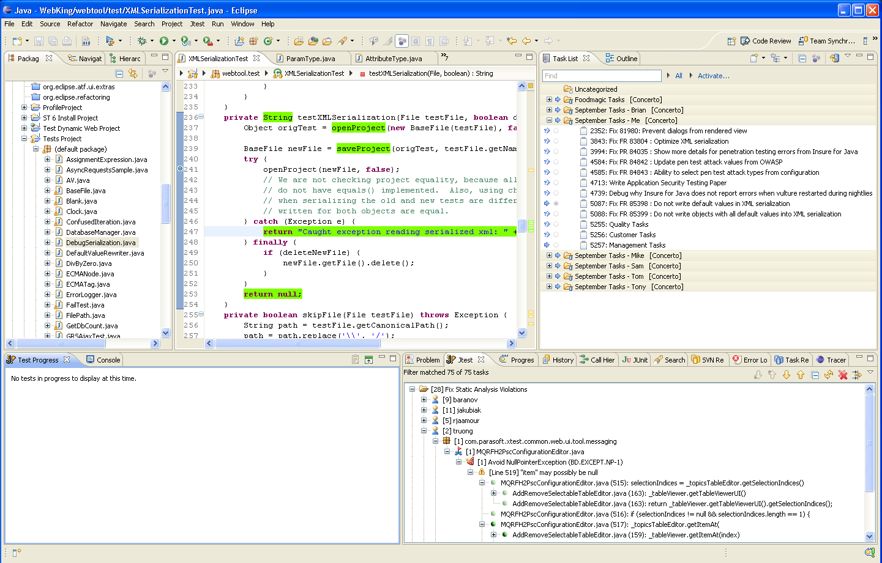
Results within IDE
2
Directly access line of code to fix
3
Check-in
1
Results delivered as uniform view within IDE
Notes:
Want to give you example in IDE, you probably have seen this before. This is Eclipse. If you use NetBeans or Visual Studio. It looks very similar like this anyway. On left, I have list of files and project and the middle I have code etc…
On bottom, I have a view that lists all my static analysis violations from tool. I can really click on to find out what the violations are. At the right, I have a window with my list of tasks that I’m supposedly working on.
My results deliver like anything I do inside of my IDE. I don’t have to learn anything special to use it or dealing with separate tools.
I’ve seen some extreme company doing developing code in one tool, build the code from another tool and accessing source control from another tool and run static analysis from other tool…
Actually have to gather up all data and put into another graphical tool. Guess what? It takes tons of time. It may look like very mature process but it could cost a lot on production.
Single uniform IDE will give you develop, build, test, review all in one place would give much simplicity and keep developers in focus for their tasks.
From IDE, you can easily access violations with file and line number and open up the line to review and quickly fix and check in to source control to update.

Slide 14
Number 5: Training
5) Lack of sufficient training
How to install the tool
How to configure the tool
How to setup the build
How to run the tool
How to mitigate violations
How/when to suppress
Notes:
There is not substitue for planning and training.

Slide 15
Number 4: Process
4) No defined process
Developers are not necessarily process experts
Process should minimize impact of SA
Consistent for teams and projects
Vetted in a pilot project

Slide 16
Number 3: Automation
3) No automated process enforcement
Reduce effort
Consistency
Compliance

Slide 17
Number 2: Policy
2) Lack of a clear policy
What teams need to do SA?
What projects require SA?
What rules are required?
What amount of compliance?
When can you suppress?
How to handle legacy code?
Do you ship with SA violations?

Slide 18
Number 1: Management
1) Lack of management buy-in
Requirements
Allowed time
Understanding of the ROI
Enforcement

Slide 19
The Whole Top 10
10) Developers not included in process evolution
9) Wrong expectations
8) Taking an audit approach
7) Starting with too many rules
6) Workflow integration
5) Lack of sufficient training
4) No defined process
3) No automated process enforcement
2) Lack of a clear policy
1) Lack of management buy-in

Slide 20
Honorable Mention: The Wrong Stuff
Wrong Tool
Wrong Process
Email reports
Blocking
Painful CI workflow
Wrong Rules
Unimportant rules
Too many rules
Wrong Code
Legacy strategy
Don’t test what you won’t / can’t change
Notes:
See the “what went wrong with sa” blog and what you think went wrong with SA poll

Slide 21
Honorable Mention: What’s Lacking
Lack of management buy-in
The edict
Allowed time & budget
Lack of development buy-in
Willful non-compliance
Lack of training
Notes:
See the “what went wrong with sa” blog and what you think went wrong with SA poll

Slide 22
Q&A / Further Reading
Automated Defect Prevention
(Huizinga & Kolawa) …Principles and processes to improve the software development process.
Effective C++ / More Effective C++ (Meyers) …Definitive work on proper C++ design and programming.
Effective Java
(Bloch) …Best-practice solutions for programming challenges.
Design Patterns
(Gamma, Helm, Johnson, Vlissides) …Timeless and elegant solutions to common problems.

