Slide 1
Static Analysis @ CTI
Richard Carback
<rtcarba@cti-usa.net>

Slide 2
Protecting Critical Infrastructure
Not just eliminating vulnerabilities:
  Compliance Issues
  Supply Chain Problem
  Functional Verification
Focus: static binary analysis (WYSINWYX)
Notes:
In addition to elimination of software vulnerabilities, our customers have other needs similar to the problems static analysis tries to solve. In general, we are worried about what ends up on the production system, and are indirectly concerned with code quality.
Sometimes there are compliance issues when there are restrictions on what compilers can be used, what libraries can be linked (statically or dynamically), and what types of functionality can be included in the final product (specifically, we want to ensure that debugging cruft is not included).
We also deal with a variation of the supply chain problem, which is ensuring that the approved software makes it to the production system unmolested. This is usually solved through fingerprinting, but any time between compilation and fingerprint the code can be hijacked by something malicious, so it can sometimes be the case that we will want to verify the fingerprinted binary to make sure it looks like it should.
Lastly, for really important stuff, we may want to verify at various levels, with the most extreme being a complete reverse engineering, that the code does what we think it does.
The general idea is that what you see Is not what you execute, and we tend to write a lot of tools that utilize static analysis ideas at the machine-code level.
We need to worry about device drivers, too, and sometimes those have machine-code-only components.

Slide 3
Overview
Combining Source and Static Binary Analysis Techniques
Utilizing Big Data Capabilities
Dynamic Whole-System Analysis

Slide 4
Combining Source and Binary Static Analysis Techniques

Slide 5
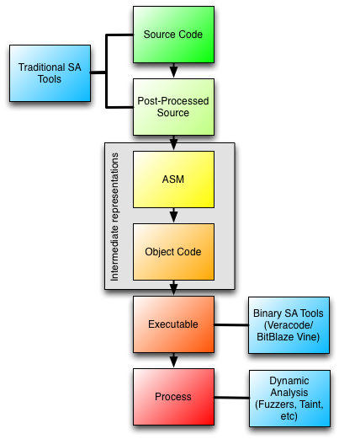
Notes:
In my experience, source-code analysis and machine-code analysis are the same idea on each end of the compilation process.
On one end you have traditional SA tools which are great at identifying poor coding practices and try to find vulnerabilities based on an incomplete view of the final product.
On the other end you have dynamic tools which have an incomplete view of the coding practices but are great at finding bugs which crash programs.
There are also more sophisticated static versions of these tools, which are great for taking crashes in these dynamic tools and turning them into exploits, as well as finding additional bugs.

Slide 6
WYSINWYX
…
memset(password, ’\0’, len);
free(password)
…
…
movq -8(%rbp),%rdi
movl $0, %eax
call _free
…
Notes:
To illustrate the general problem with source code analyzers -- sometimes compilers will optimize out things that are security-critical.
- The key problem is that tools based on source analysis unavoidably make assumptions about the compiler.
Also, most exploits rely on platform specific details. Memory layout, register usage, optimizations performed, and different artifacts of compiler bugs combine to create exploitable situations.
Similarly, if you have to add in any machine level glue code, or want to make any optimized routines in assembly, the source code analysis can’t help you.

Slide 7
Binary Analysis is Also Limited
Obviously, it is much harder
  Indirect control flow can get expensive
Limited utility
  Only this compilation is analyzed, what about updates? Other Architectures?
How do I fix problems?
Notes:
One good example is a jmp indirect via a register (or any indirect accesses possible with index registers) -- it is likely extremely difficult to predict where it will go
Vendors claim to have solved this, but I’m skeptical that they have done so in all cases.

Slide 8
Notes:
I think marrying the two together could present some very strong results, and this is one thing we are investigating.
You would be aware of how good the coding practices are, and also how that translates into bugs/crashes.
Even if you did not explicitly share information between the two techniques, simply comparing the output using some intermediary markers to ID problematic parts of code in the compiled and non-compiled versions of the code would be extremely useful.

Slide 9
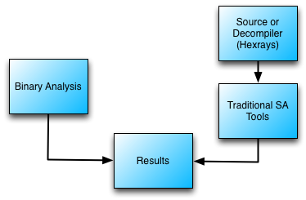
Notes:
One dumb way you could make a system to do this is to use an existing decompiler or (if you have access to it) the source+SA and binary analysis results.

Slide 10
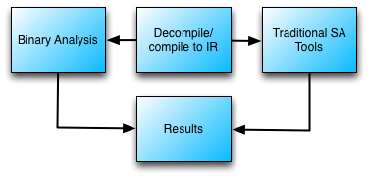
Notes:
Another way to do it is to share an intermediate representation which preserves information lost in the compilation process. Then we can use traditional SA techniques as well as binary analysis techniques to get results.
Coincidentally, I believe both BitBlaze and Veracode use their own intermediate languages to perform their static analysis. So, while they claim to be working on executables they are, in fact, decompiling to an intermediate language which makes the rest of their analysis easier.

Slide 11
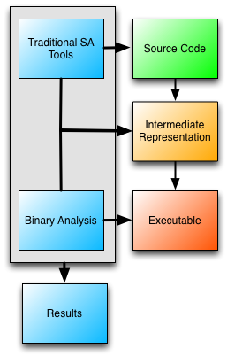
Notes:
If the binary side and the source side agree, we could compile into an intermediate representation framework, which could then be populated with behaviors for various hardware and language compilers.

Slide 12
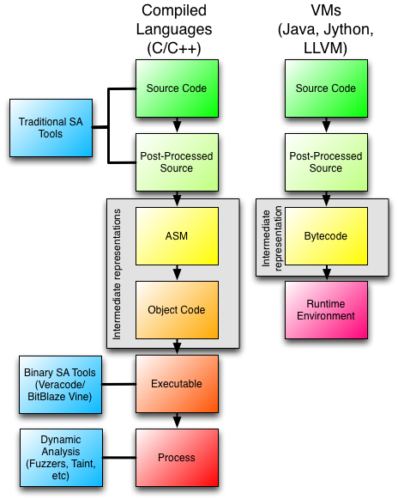
Notes:
Fortunately, that seems to be the way things are going. A great example of this is LLVM IR, which can compile many languages into many CPU’s.
This is one technique we are investigating at CTI.

Slide 13
Utilizing Big Data Techniques
Notes:
Tools and techniques that perform these functions are

Slide 14
Attribution Problems
What compiler?
What (static) libraries?
Is there any copied code?
Is there any (known) malicious code?
Is this a new version of a program I’ve analyzed previously?
  What changed?
Notes:
Using big data techniques, we can store and catalog work we have done in the past, then use it to analyze new binaries.

Slide 15
Fuzzy Match
Break up by function
Remove pre/post ambles
  focus on what is unique in each function
Convert to intermediate machine code representation
  Things which do the same thing collapse to the same representation

Slide 16
MapReduce It
Map
  Scan for matches
  Calculate match score
  Return if “good enough”
Reduce
  Return best answer(s)
Notes:
We basically turned the problem into a giant set intersection.
We were also able to implement a very similar technique with FPGAs.

Slide 17
Dynamic System Analysis

Slide 18
System State Monitoring Problem
Detect when state is “compromised”
Come up with a good way to create a virus signature on the fly to prevent further infection.
Notes:
The answer to this one is a hybrid dynamic/static analysis approach.

Slide 19
Defining “good” state
Measure State
  Watch system under normal operations with test data
  Run the system through a fuzzer
Record
  Current function
  Stack frames
  Heap usage

Slide 20
Detection
Watch network traffic
When state does not match observed record…
  Record anomaly and send alert
  Grab traffic and look for shell/exploit code
    Use static analysis to look for known patterns
    Generate signature if possible
  Record any new processes on system
Notes:
This required some hooks into the operating system, but the general idea was to look at the network traffic as if it were a static binary program blob and try to confirm that it was machine-code.

Slide 21
Conclusions
Think bigger
  SA has much wider applicability than looking for clean code
Think framework
  Can we agree on a common (pseudo-compiled) representation for all architectures?

