Slide 1
Coverity Analysis: Improving Quality in the Software Supply Chain
Peter Henriksen, Development Manager for Analysis, Coverity
October 1, 2010

Slide 2
Overview
Importance of SATE
Coverity results
Software certification
Recommendations

Slide 3
Importance of SATE
Helping the Space Mature
Important to have broad participation
Transparency
Pushing the envelope
Coverity Participation
Significant amount of work (~20 times more than 2009!)
C/C++ Track: Chrome, Wireshark & Dovecot
Coverity tools freely available for SATE researchers
3
ALL MATERIALS CONFIDENTIAL
3
Notes:
3

Slide 4
SATE 2010: Listening to the Community
Improved Classification
Security/Quality/Insignificant/False Positive
Broader Language Coverage
C, C++ & Java
Larger Code Bases
Addition of Chrome: large code base, widely used
CVE
Healthy challenge!
4
ALL MATERIALS CONFIDENTIAL
4
Notes:
4

Slide 5
Coverity SATE Results: C/C++ Track
SATE 2010 Selection: 30-40bugs
Improved SATE triage with new Quality classification
General agreement on the triage results
Number of Bugs
Total (estimated TP): ~2300
High & Medium Impact: ~1900
SATE selection: ~1%
Triage is hard!
Quality of event messages is important
Impact assessment is essential
5
ALL MATERIALS CONFIDENTIAL
5
Notes:
5

Slide 6
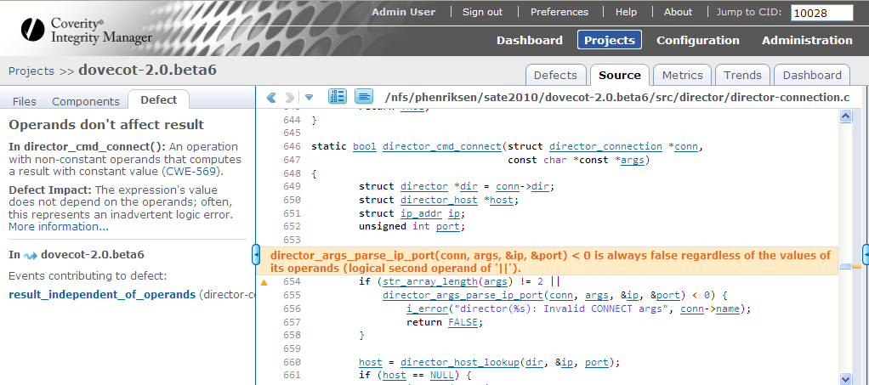
Coverity Integrity Manager
Notes:
6

Slide 7
The Software Supply Chain
The Problem
  Weakest link in the chain
  Defects in shared libraries can impact millions of devices (computers, phones, etc)
How Coverity Can Help
  Integrity Report with Integrity Rating
  Software Certification
Upstream Elimination of Defects
  Open source
  3rd party
  Company wide libraries
7
ALL MATERIALS CONFIDENTIAL
7
Notes:
7

Slide 8
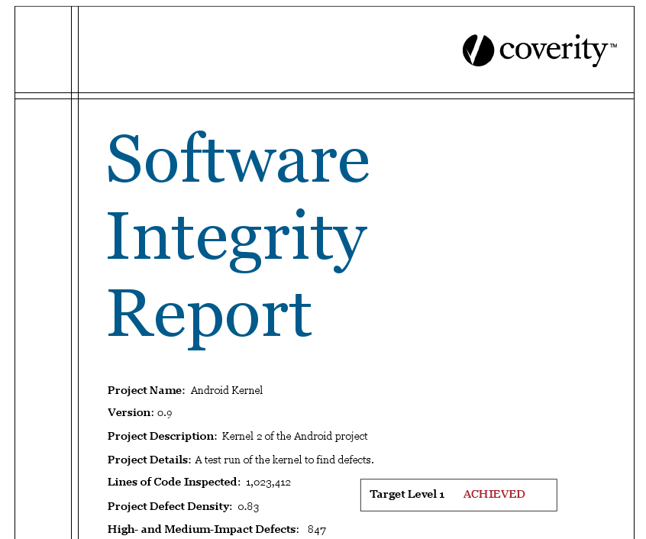
Coverity Integrity Report: Software Certification

Slide 9
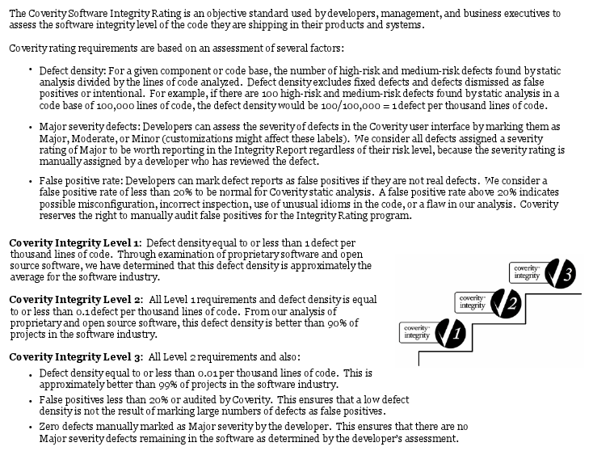
Coverity Software Integrity Rating
Notes:
9

Slide 10
How to Use Your Software Integrity Rating
Set software integrity standards for your projects, products and teams
Audit your software supply chain
Promote your commitment to software integrity
10
ALL MATERIALS CONFIDENTIAL
10
Notes:
10

Slide 11
Next Steps for SATE
Defect (& FP) Catalog
Select one code base (per language)
Fix the version
Perform deep & thorough triage
Resulting contents: Tools + Manual + CVE + FP
Minor Recommendations
Improve the CVE triage
More time (add 4-6 weeks)
Make Ubuntu VmWare VM’s available for C/C++ Track
11
ALL MATERIALS CONFIDENTIAL
11
Notes:
11

Slide 12
Q&A
Peter Henriksen : phenriksen@coverity.com

