Slide 1
Implementation of the RRBC Method
Notes:
Slides 1-5 meant for presentation.
Slides 6-9 are same as Slides 2-5 but different color and style and are meant for generating handouts.

Slide 2
System Integrator consults with User
Determines:
User applications
Accuracy requirements
Sensors used
  RRBC applicable if
    (sensor bias/sensor noise) > 2.5
Number of fiducial points
System Integrator develops software
User executes software

Slide 3
System Integrator and User Responsibilities
Sensor
User
Measures registration points with robot and with sensor
Determines and measures nominal/expected locations of objects (target points) with sensor
Determines variability of object placement in work volume
Location of target points
Software
(System Integrator)
Robot path planner
Corrected target point locations

Slide 4
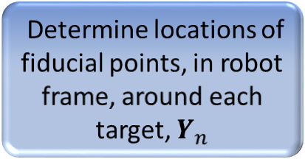
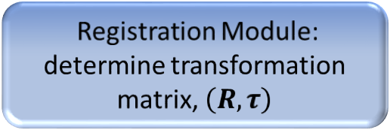
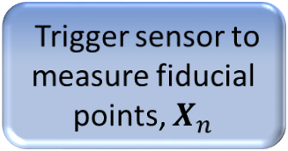
Software Developed by System Integrator
Measures registration points in robot and sensor frames
Send command to robot to move to fiducial pts.
Registration Module: determine transformation matrix, $\left(R, τ\right)$
Determine distance from fiducial pt. to target pt. based on variability of object placement and level of accuracy needed.
Nominal location of target points in sensor frame
Trigger sensor to measure fiducial points, $X_{n}$
A
Determine locations of fiducial points, in robot frame, around each target, $Y_{n}$

Slide 5

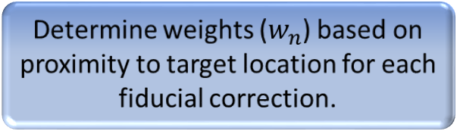
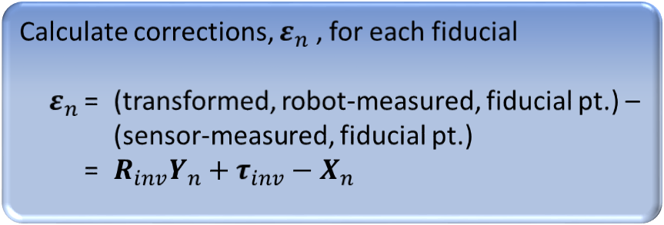
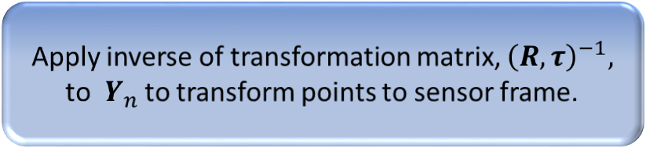
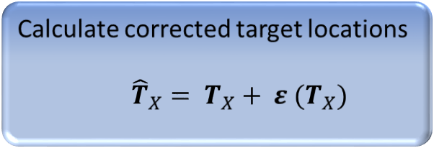
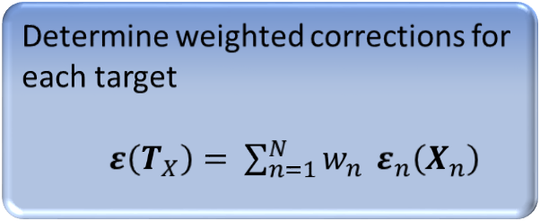
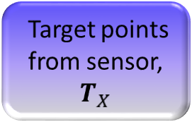
A
  Determine weighted corrections for
  each target
  $ε\left(T_{X}\right)= \sum_{n=1}^{N}{w_{n}} ε_{n}\left(X_{n}\right)$
Apply inverse of transformation matrix, ${\left(R,τ\right)}^{−1},$ to $Y_{n}$ to transform points to sensor frame.
  Calculate corrected target locations
  ${\hat{T}}_{X}= T_{X}+ ε (T_{X})$
Calculate corrections, $ε_{n}$ , for each fiducial
$ε_{n}$ = (transformed, robot-measured, fiducial pt.) –
(sensor-measured, fiducial pt.)
= $R_{inv}Y_{n}+τ_{inv}−X_{n}$
  Apply transformation matrix, $\left(R,τ\right)$, to ${\hat{T}}_{X}$.
Target points from sensor, $T_{X}$
  Determine weights ($w_{n}$) based on proximity to target location for each fiducial correction.
  Robot path planner

