Slide 1
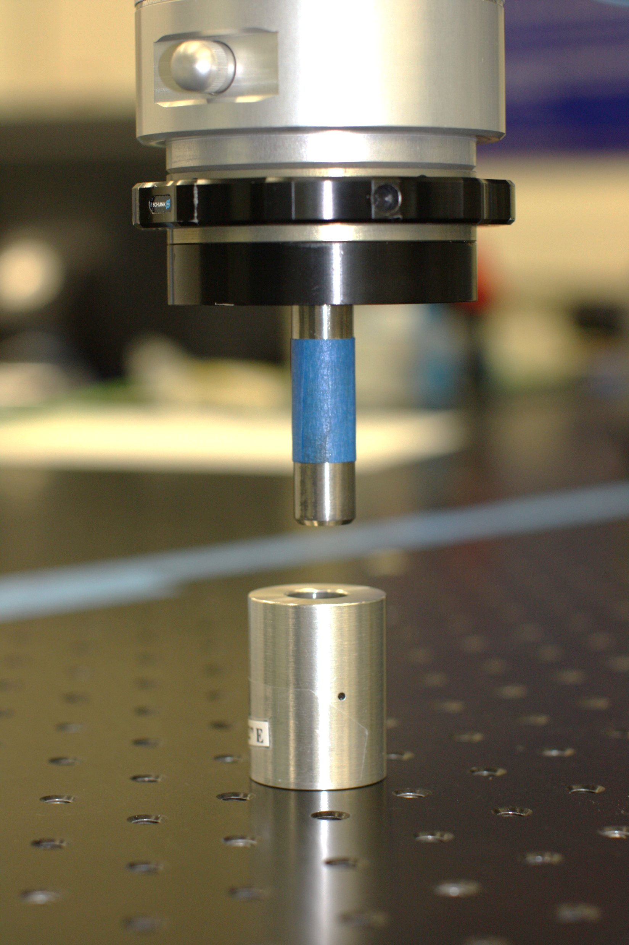
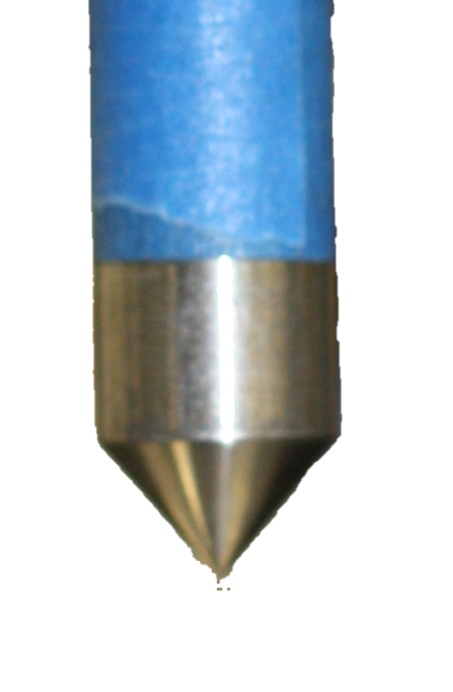
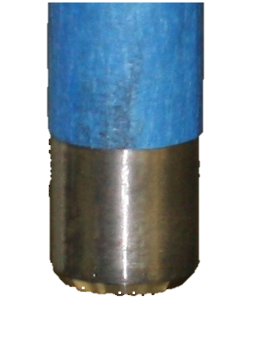
Peg-in-Hole Experiments
Three experiments (Exp. 1 – 3)
Robot in position control (no active compliance control)
Seven runs (repeats) in each experiment
Each run = inserting a 12.7 mm peg into 80 holes
Two peg types
Metric
Pass = Peg fully inserted
Fail
Peg not fully inserted or
Insertion force > 17 N
Exp. 1
Exp. 2 & 3

Slide 2
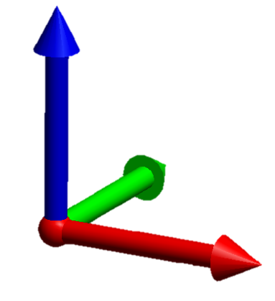
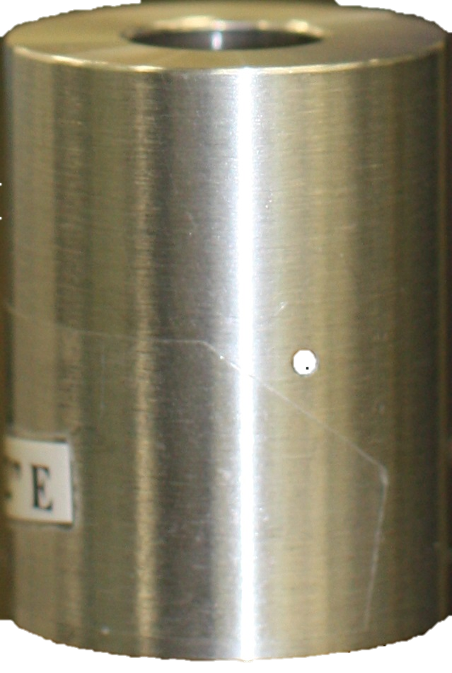
Optical Table
Optical table w/ threaded holes
Target points
World frame
Fiducial points.
Only 8 shown for clarity
Hole into which peg is inserted
Notes:
Hide slide if not needed.

Slide 3
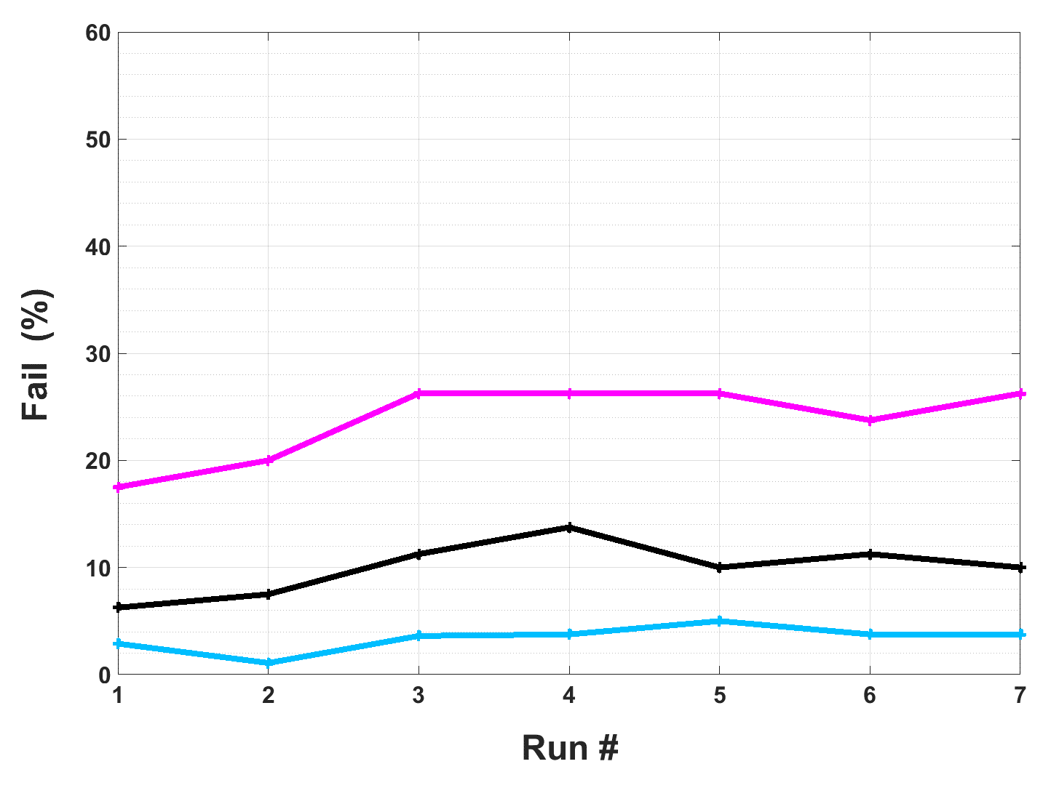
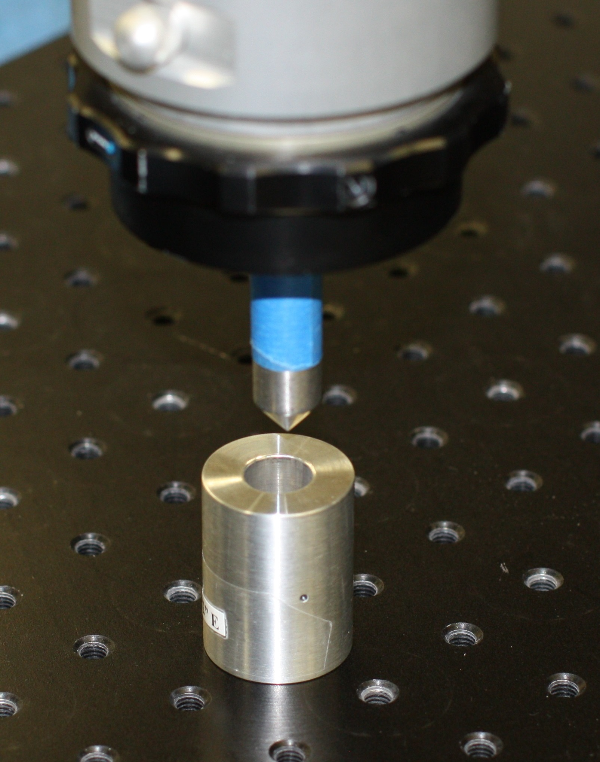
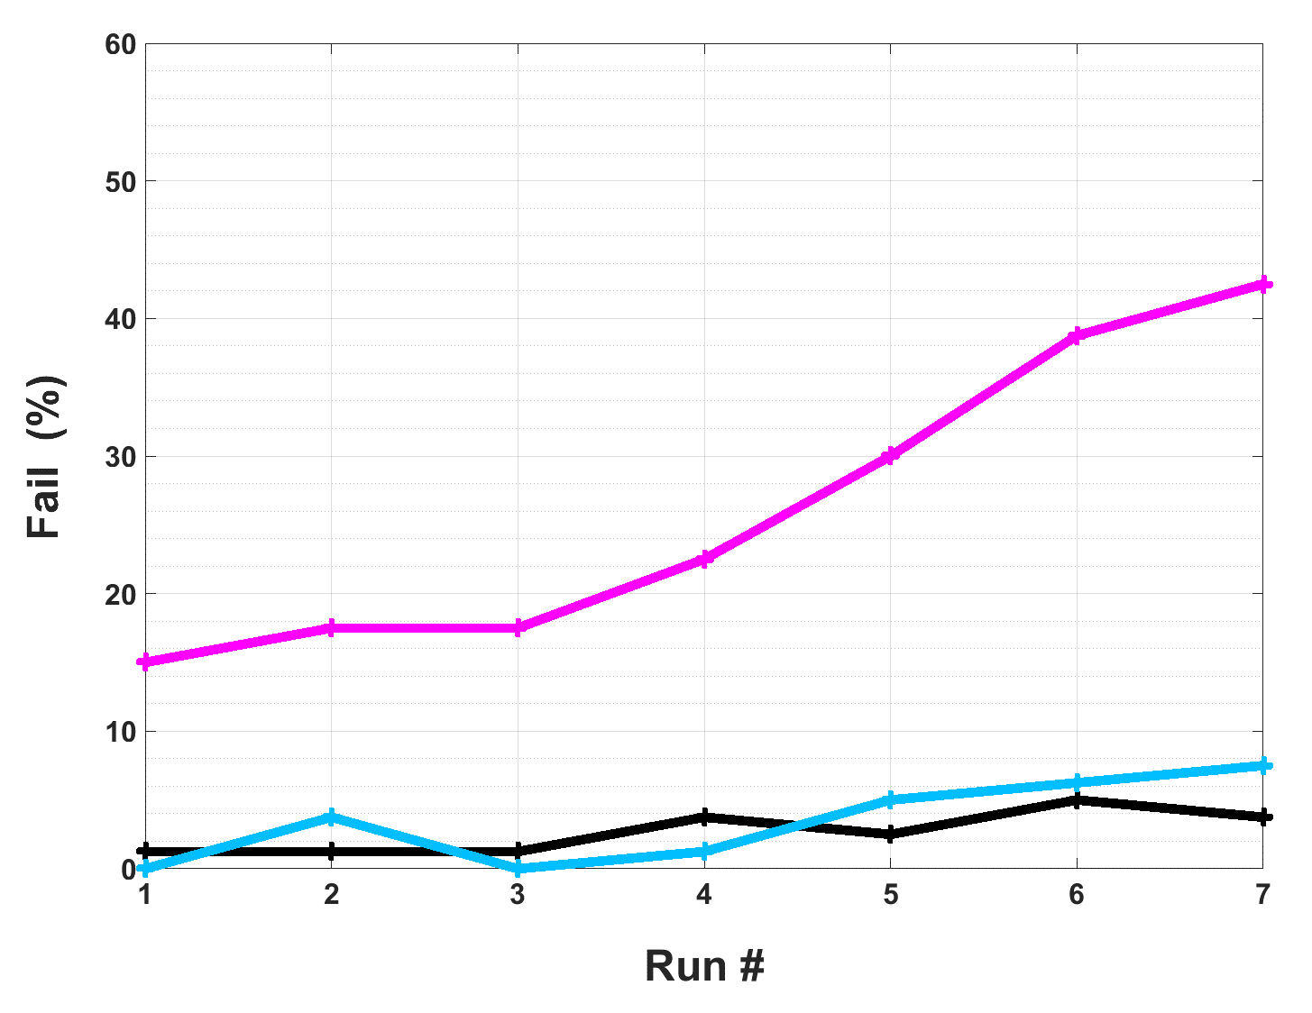
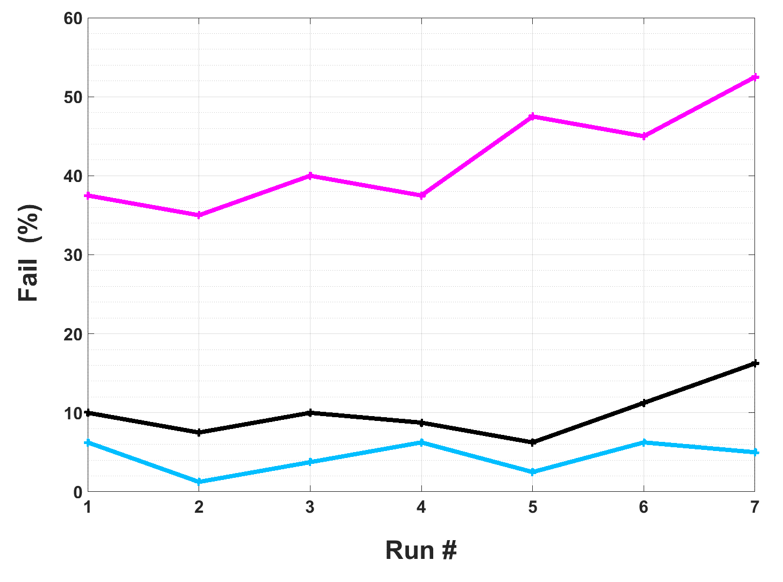
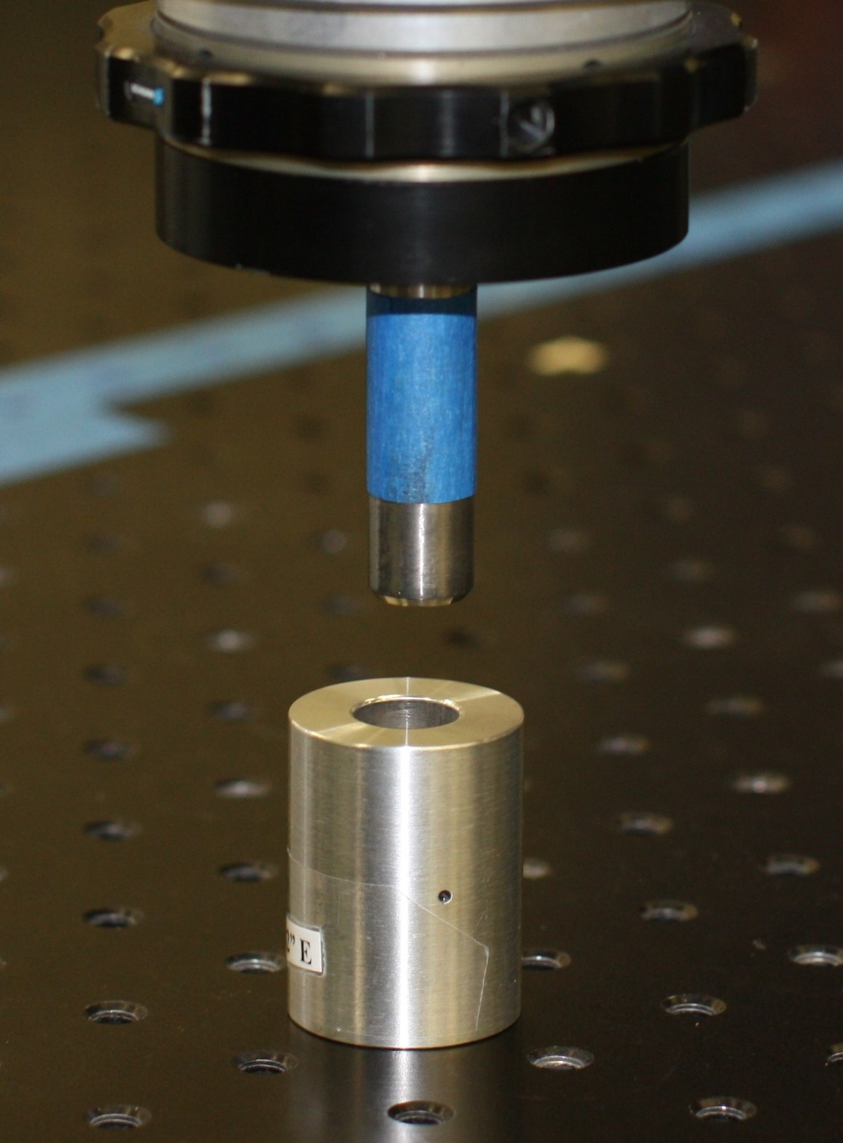
Experiment 1, 0.002” hole tolerance
UNCORRECTED = Conventional registration
CORRECTED = Conventional registration
w/ RRBC method applied
BASELINE = No registration applied
Experiment 2, 0.002” hole tolerance
Experiment 3, 0.001” hole tolerance

Slide 4
 | Peg type | Peg-Hole tolerance (in.) | Failed Insertions^{1, 2} (%)
 |  |  | Baseline³ | Uncorrected | Corrected | Uncorrected Corrected
Experiment 1 (7 runs) |  | 0.002 | 3.4 | 23.8 | 10.0 | 2.4
Experiment 2 (7 runs) |  | 0.002 | 3.4 | 26.3 | 2.7 | 11.0
Experiment 3 (7 runs) |  | 0.001 | 4.5 | 42.1 | 10.0 | 4.5
Values are averages for 7 runs in a given experiment.
Failed insertion = # failed insertions in a run/total # of holes.
Baseline = failures in this category are due solely to measurement noise.

Slide 5
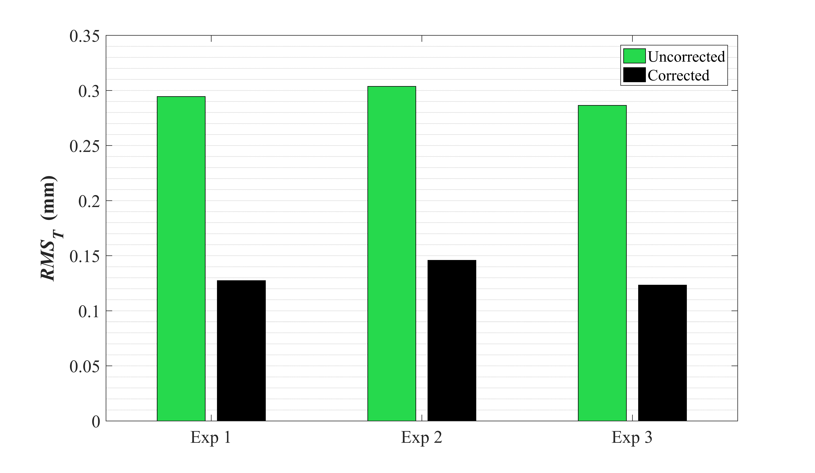
Target Registration Error
Target registration error (TRE)
metric for registration quality
calculated for all 80 target hole locations in an experiment
RMS_{T} = root mean square of TRE
Robot Frame
Target hole location as measured by robot
TRE
Target hole location transformed
from world frame to robot frame
Experiment 1
Experiment 2
Experiment 3

