Slide 1
RRBC Method National Institute of Standards and Technology Marek Franaszek and Geraldine Cheok

Slide 2
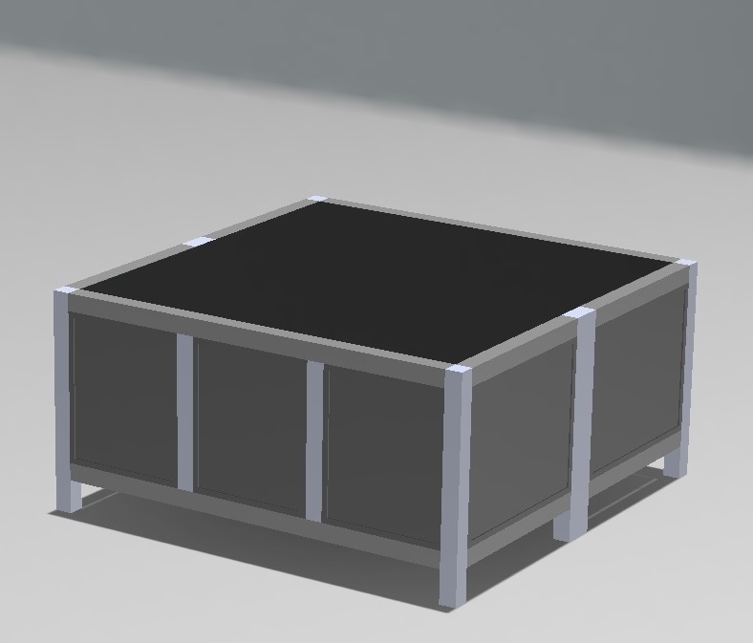
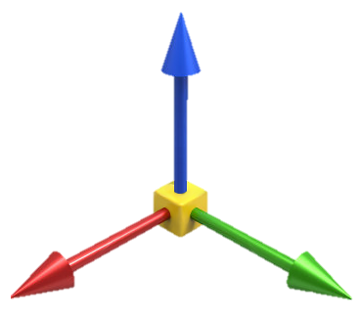
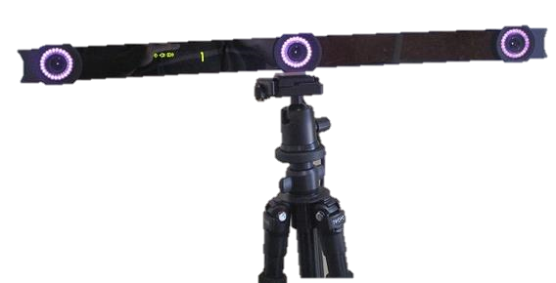
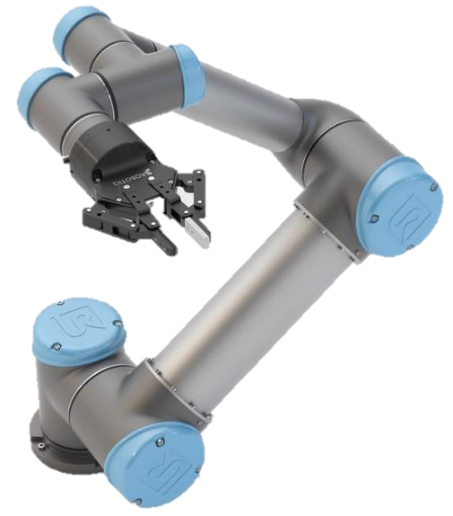
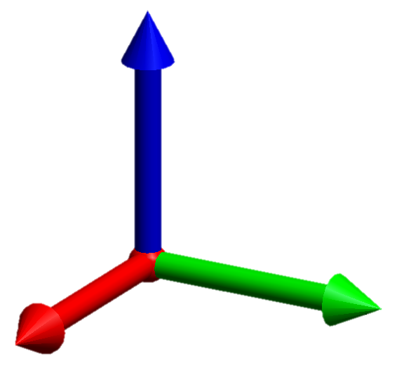
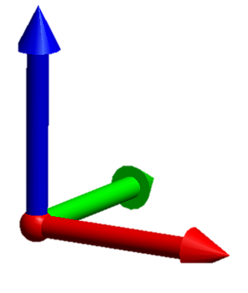
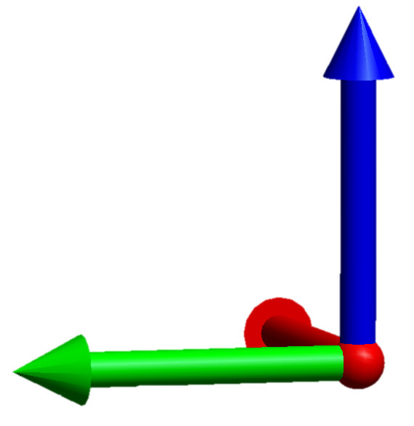
What is Registration?
Registration is a process to transform one coordinate frame to another coordinate frame.
For example, the sensor system, robot, and work table each have their own coordinate frames.
Sensor Frame
Table Frame
Robot Frame
World Frame

Slide 3
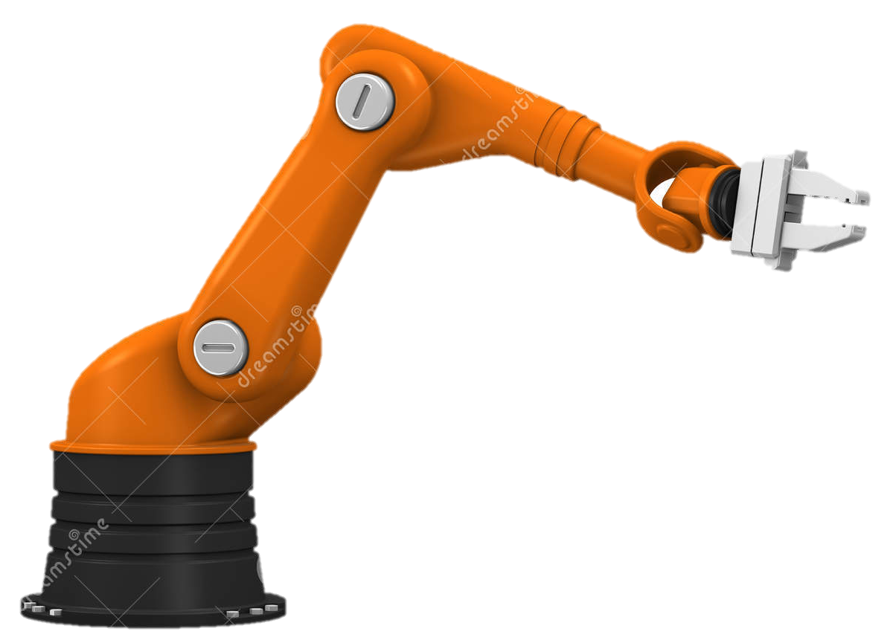
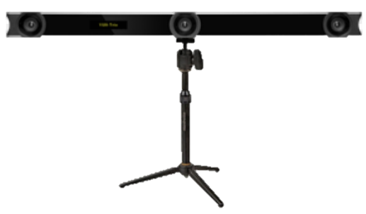
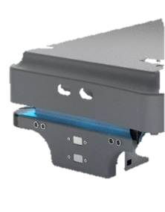
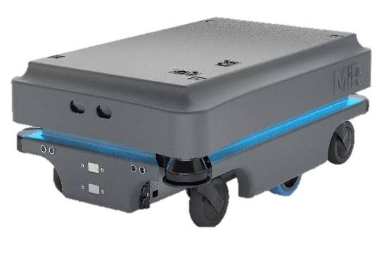
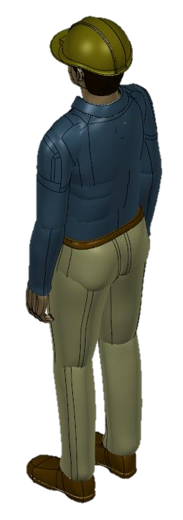
Why is registration needed?
It is required when locations of objects measured in one coordinate frame are needed in another frame. Examples:
Robots using sensors to determine location of work objects or obstacles need to register the sensor to the robot coordinate frame
Multiple robots carrying the same object need to register their respective coordinate frames
Applications:
Automated assembly and pick-and-place tasks
Humans/objects for collision avoidance and spatial awareness

Slide 4
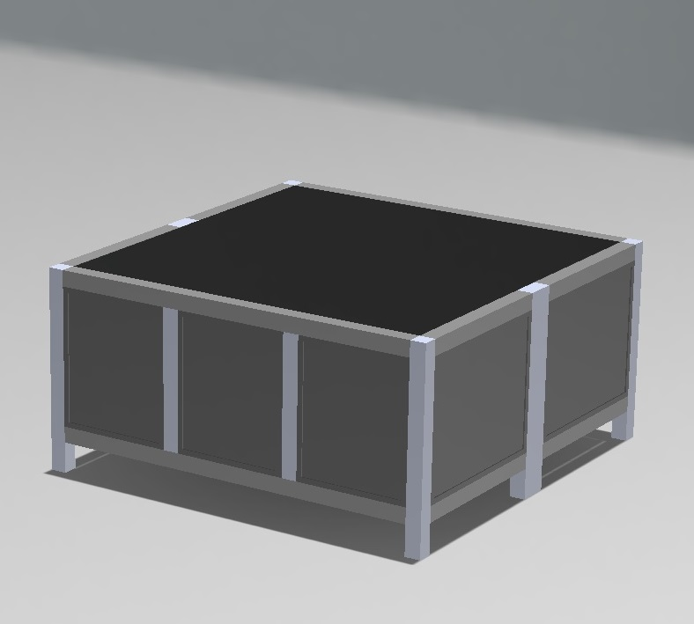
Point-Based, Rigid-Body Registration
Point-based, rigid-body registration is used in this presentation.
This type of registration requires a set of 3 or more registration points to determine the transformation matrix (R, t).
The set of registration points is measured in the frames (e.g., sensor and robot frames) to be transformed.
robot can measure the points by touching the points with its end effector.
Sensor Frame
A
Robot Frame
B
C
Registration points

Slide 5
Point-based, rigid-body registration in a nutshell …
Measure registration points in Frames 1 & 2.
Transform Frame 2 to Frame 1.
A
A
A’
A’
20
-20
20
B
B
10
-30
B’
C
C’
B’
10
C
-40
C’
0
10
20
30
50
60
70
80
Pts. A, B, C measured
in Frame 1
Pts. A, B, C measured
in Frame 2
0
10
20
30
Frame 1
Determine transformation matrix (R, t).
Many open source algorithms and commercial software available to perform this task, e.g.,
Arun, K. S. et al., Least-squares Fitting of Two 3_D Point sets, IEEE Pattern Analysis and Machine Intelligence, Sept. 1987
Software: e.g., Spatial Analyzer, Polyworks, Cyclone, CloudCompare, Matlab

Slide 6
Registration Error
After transforming to Frame 1, corresponding points are not mapped exactly onto each other.
For example, A and A’ should be in the same location after transformation of A’.
The distances between any two points (e.g., AB & A’B’ or BC & B’C’) should be the same but are not.
A
A’
B
B’
C
C’
= Points measured in Frame 1
= Points transformed to Frame 1

Slide 7
What does the RRBC (restoration of rigid-body condition) method do?
d
Point Q as measured in Frame 1
Point Q is a target point (see Slide 15) not a registration point.
Point Q after transformation from Frame 2 to Frame 1
d, positional error:
Due to measurement error (e.g., robot, sensor, environment) of point location
Consists of measurement error and registration error
If there is no measurement error, then registration error is zero.
If there is measurement error, then (R, t) will have errors which are propagated to ALL transformed points.
RRBC reduces d

Slide 8
Criteria for using RRBC Method
Need more positional accuracy
$ρ= {σ_{L}}/{σ_{noise}}$ > 2.5
where
$σ_{L}$ = sensor-robot differences*
$σ_{noise}$ = sensor noise from sensor spec
* See Franaszek, M. and Cheok, G. S., Improving Rigid-Body Registration Based on Points Affected by Bias and Noise," presented at the 8th Int. Precision Assembly Seminar, Chamonix, France, 2018 on how to determine this variable.

Slide 9
Next two slides list steps in RRBC method
(Illustration of the method follows)

Slide 10
RRBC Method
Measure minimum of 3 registration points with robot and sensor.
Registration points should be well distributed and encompass the work volume
Using any appropriate registration method, determine transformation matrix (R, t) that transforms registration points measured by sensor from sensor frame to robot frame.
Identify points of interest (target points*) within robot work volume.
Identify points (fiducial points*) around target points and measure them with
sensor and with robot.
Ensure that region bounded by fiducial points encompass the uncertainty of the target point location.
*Target and fiducial points are explained later in the presentation

Slide 11
RRBC Method (continued)
Apply inverse of transformation matrix (R, t)⁻¹ to fiducial points measured by the robot
(from Step 4) transforming them from robot frame to sensor frame.
Calculate differences between transformed, robot-measured, fiducial points (from
Step 5) and sensor-measured, fiducial points (from Step 4) to obtain corrections to sensor-
measured fiducial points.
Measure location of target points with the sensor.
Calculate and apply corrections (from Step 6, using the fiducials closest to the
target points) to the measured target points (from Step 7).
Transform corrected target points (from Step 8) from sensor frame to robot frame using (R, t).

Slide 12
Steps in RRBC illustrated using a 2D example

Slide 13
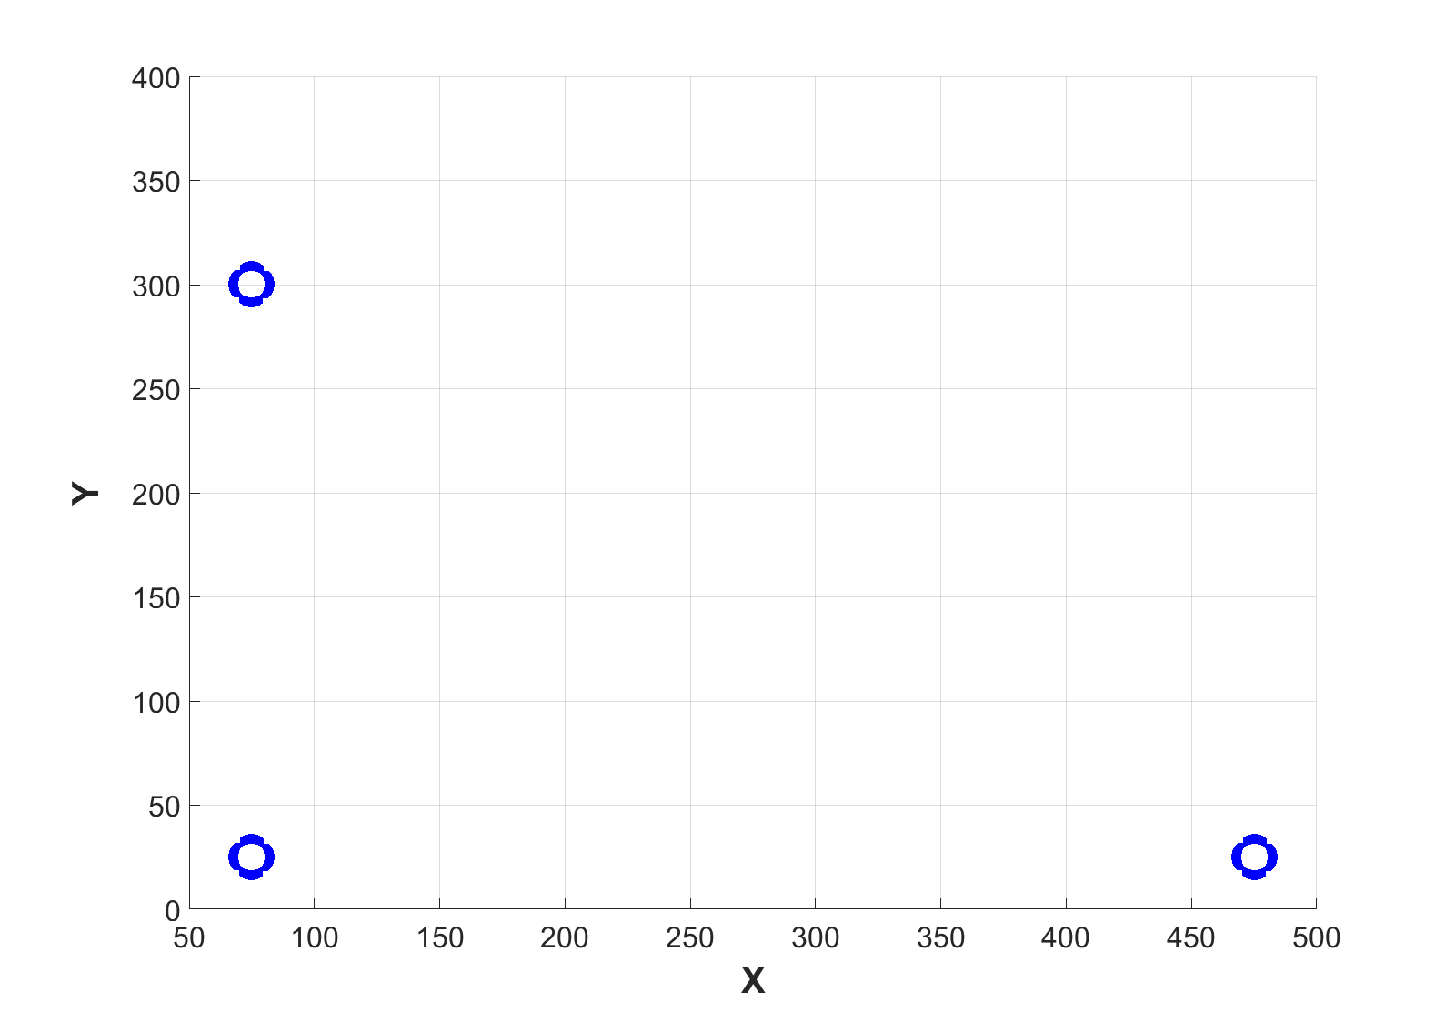
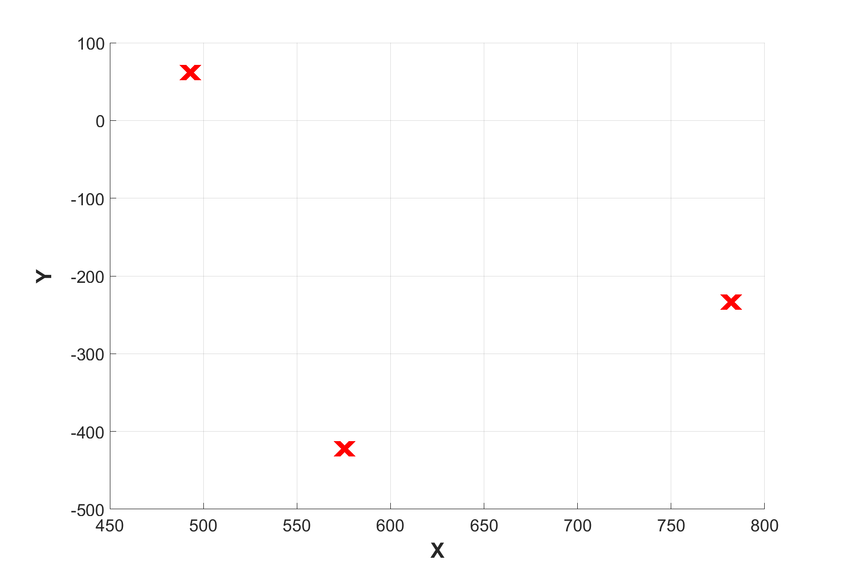
Measure a minimum of 3 registration points with robot and sensor.
Robot Frame
A
A
B
C
B
C
Sensor Frame
C’
B’
A’

Slide 14
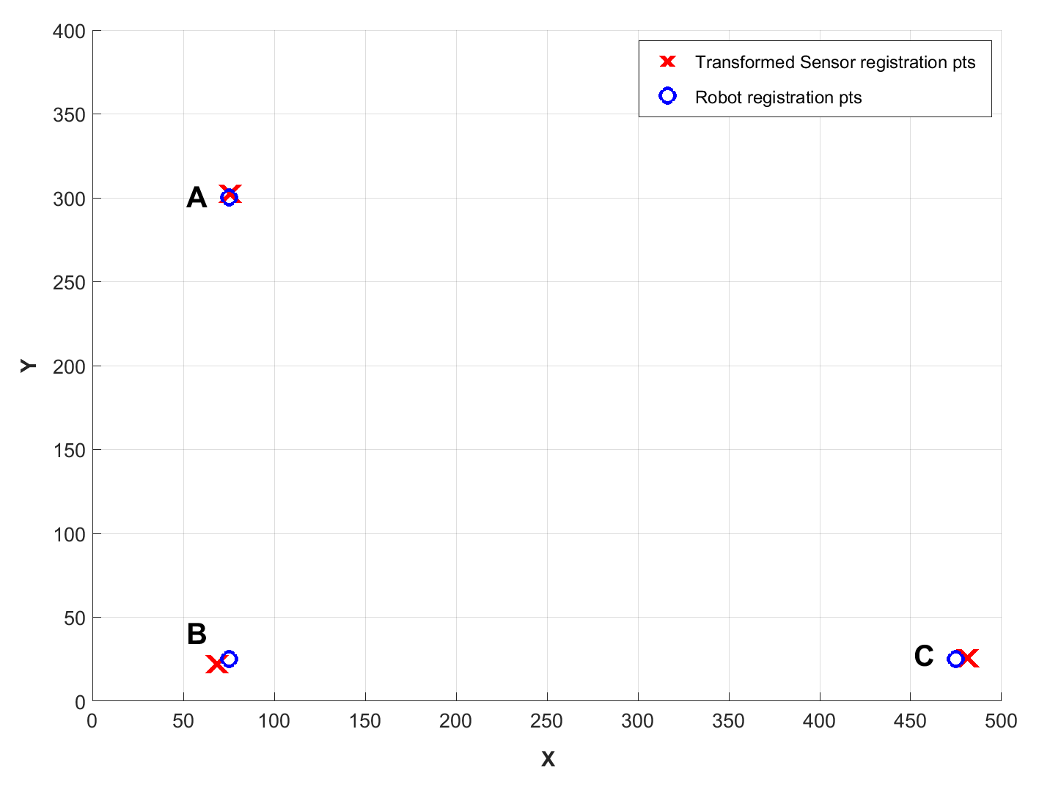
2. Using ANY appropriate registration method, determine the transformation matrix (R, t) that transforms the sensor registration points from sensor frame to robot frame.
Sensor Frame
Robot Frame
C’
Sensor registration pt.
B’
A’
Sensor registration points transformed to robot frame
Determine (R, t) to map sensor pts. to robot pts.

Slide 15
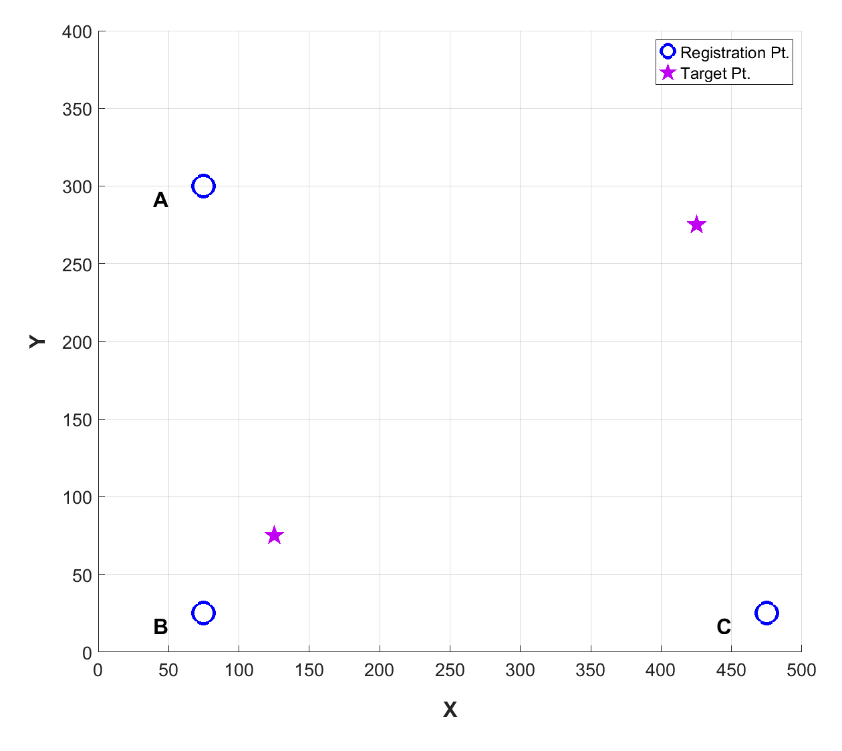
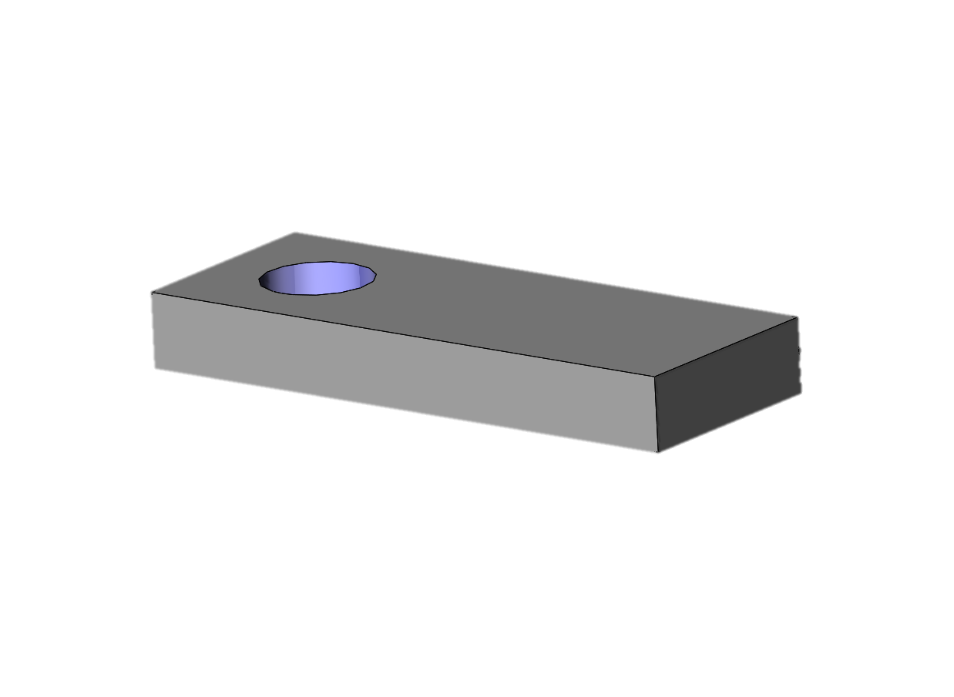
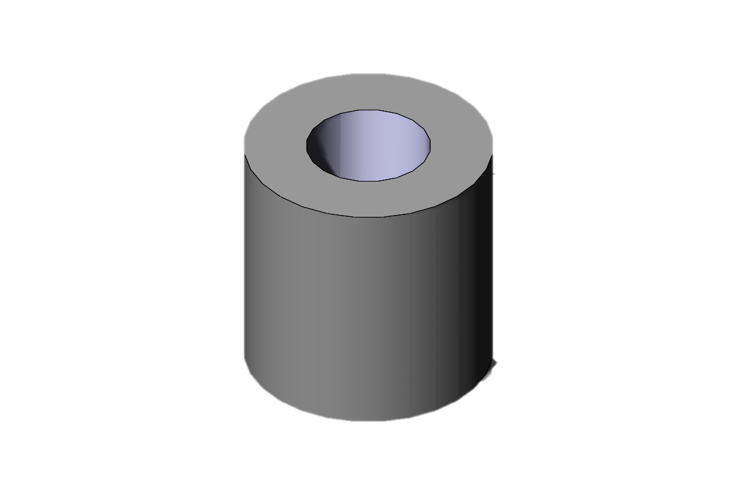
3. Identify points of interest (target points) within robot work volume.
Robot Frame
Robot Frame
Target pt.
Target pt.
A
A
B
C
B
C
In this example, target points are hole locations where the robot needs to insert a peg.
Generally, target “points” are centers of regions where a robot needs to perform a task such as drilling, insertion, or assembly or regions where accurate location is required.

Slide 16
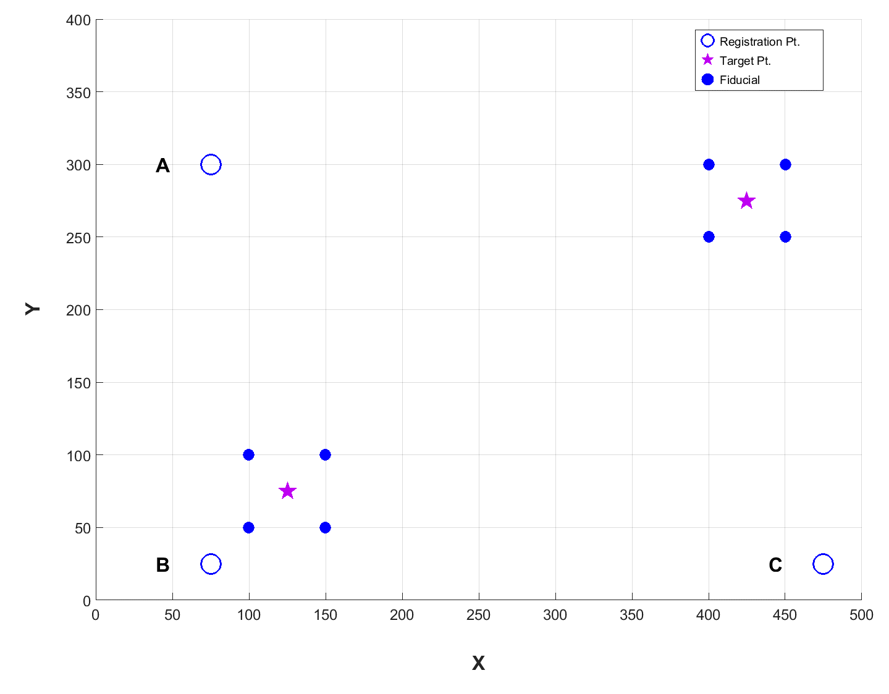
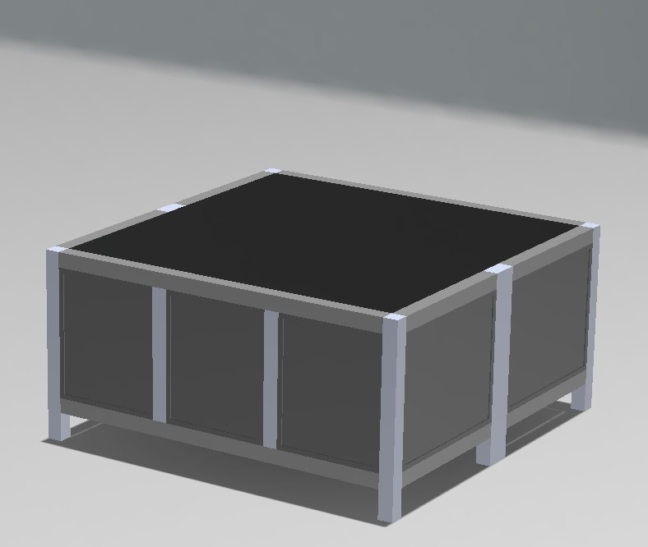
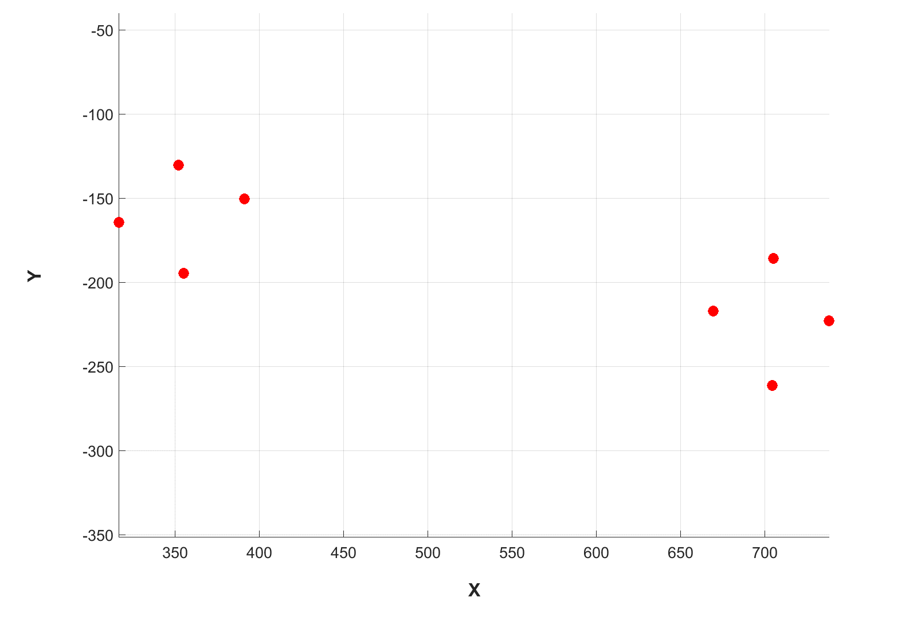
4. Select points (fiducial points) around target points. Measure their locations with sensor and with robot.
Robot Frame
A
F5
F7
F6
F8
F1
F3
F2
F4
B
C
A
B
Fiducials in Sensor Frame
C
F8’
F7’
F6’
F4’
F5’
F3’
F2’
F1’

Slide 17
Selecting Fiducial Locations
Select location of fiducial points so that the region bounded by the fiducials contains the region of variability of the target point location. It is expected that there will be some variability in the target placement within the robot work volume.
Nominal/expected location of target.
F1
F3
Region bounded by the fiducials.
F2
F4
Region of variability in the location of target point. That is, actual target location may be anywhere within this region.
B

Slide 18
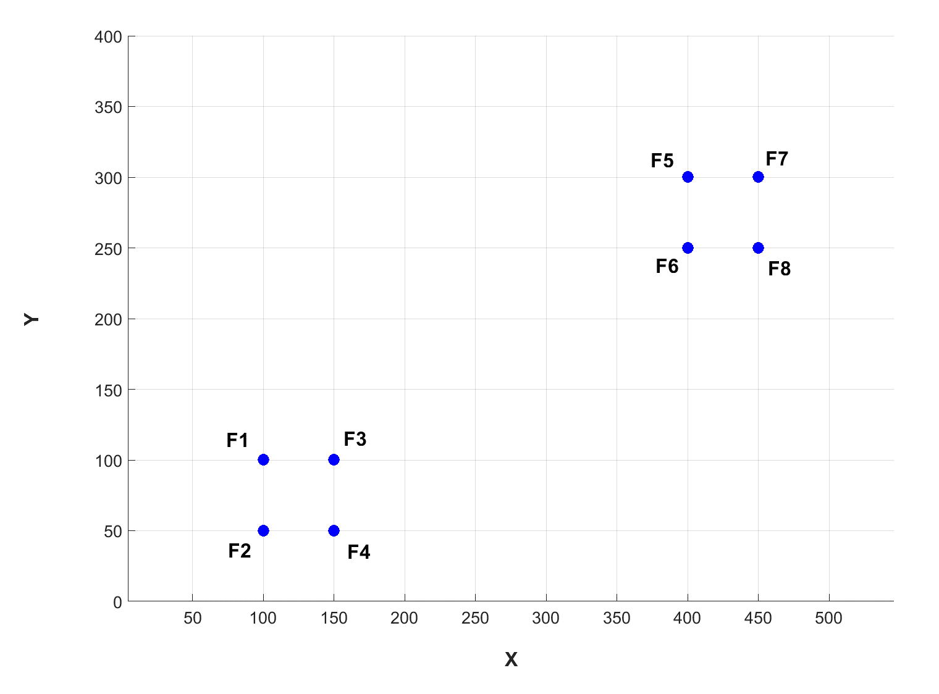
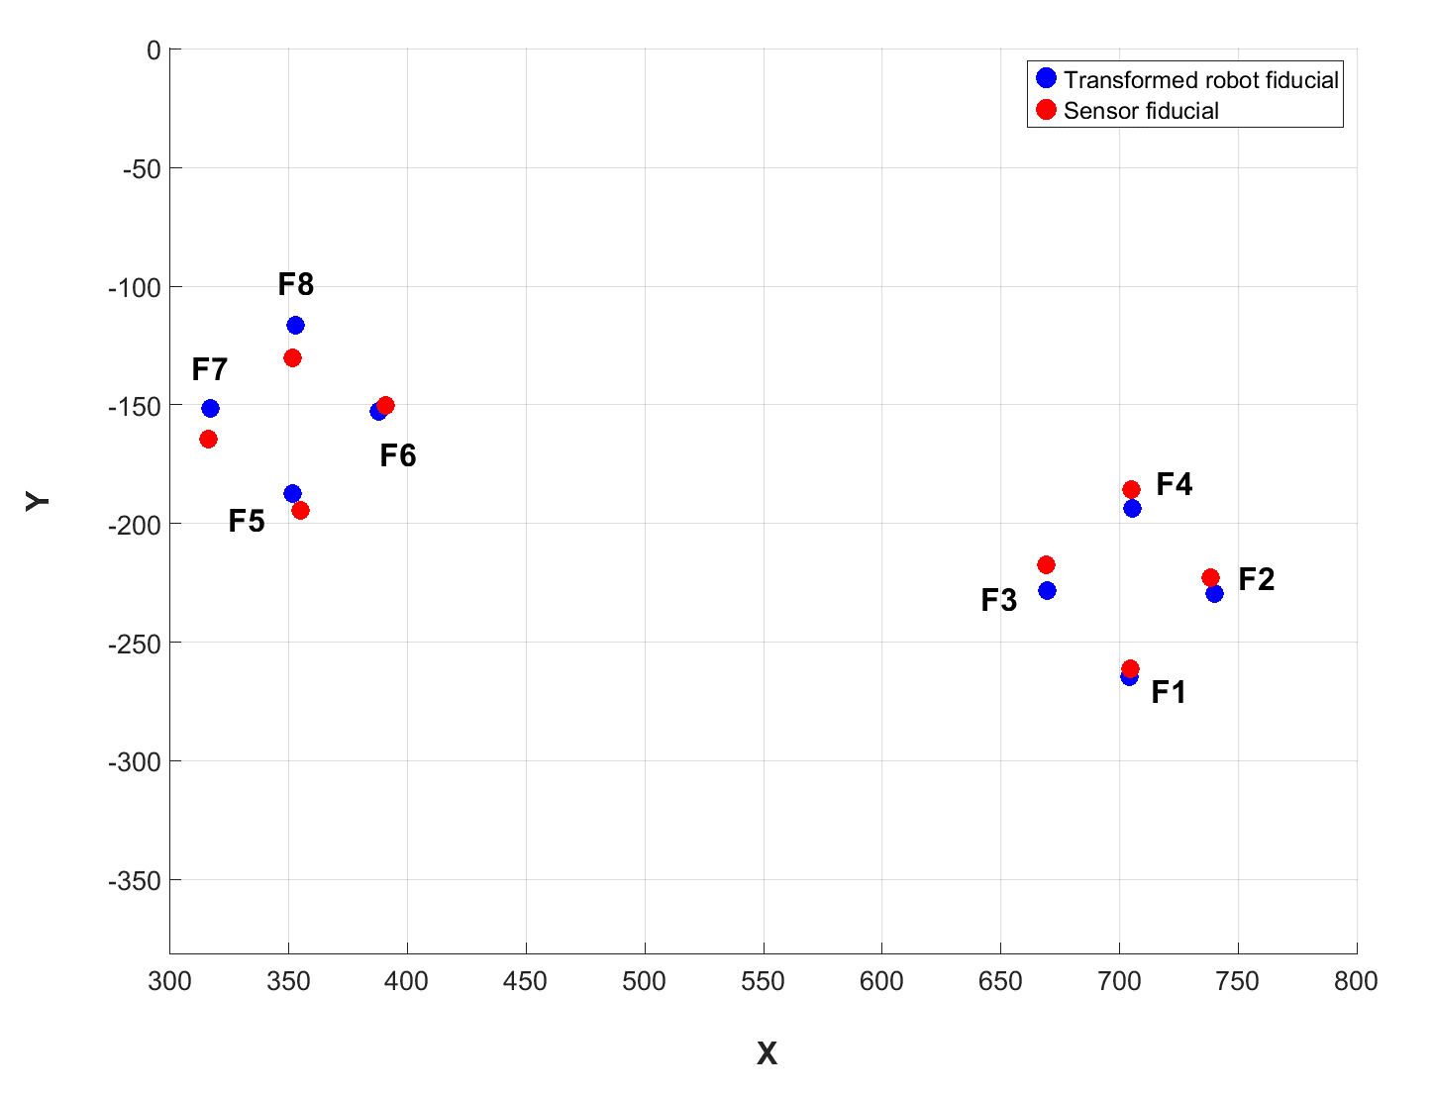
5. Apply the inverse of the transformation matrix (R, t)⁻¹ to robot-measured, fiducial points transforming them from robot frame to sensor frame.
Fiducials in Robot Frame
Sensor Frame
F5
F7
F8
F6
F8
F7
F1
F3
F6
F4
F5
F3
F2
F2
F4
F1
Apply (R, t)⁻¹ to fiducials

Slide 19
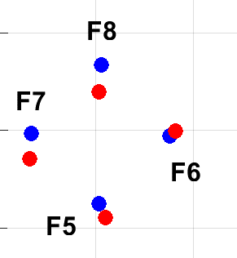
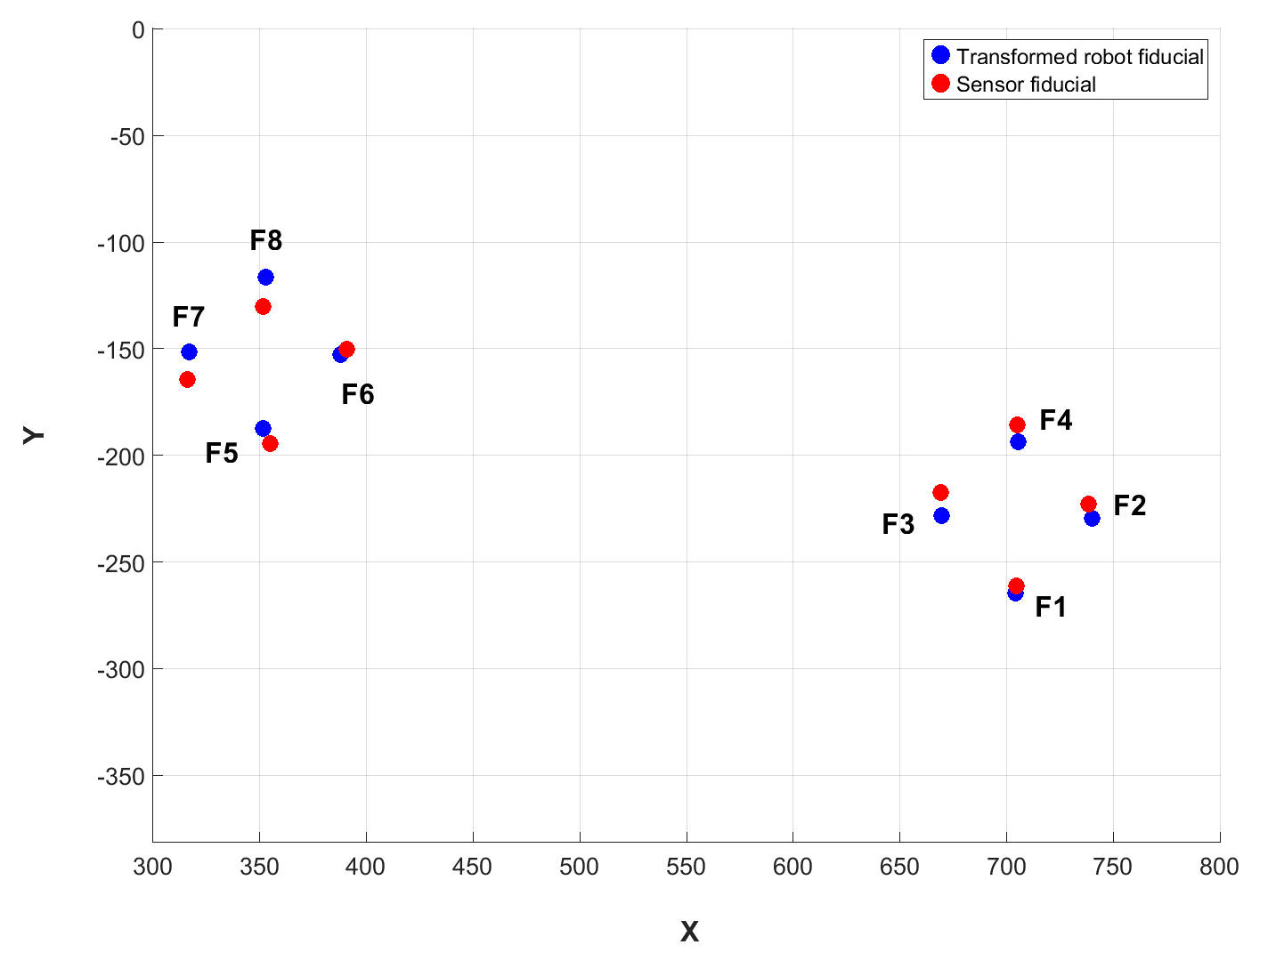
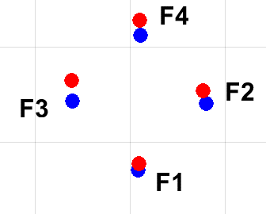
Calculate differences between transformed, robot-measured fiducial points and sensor-measured fiducial points to obtain corrections, e_{i} , for fiducial points in sensor frame. e_{i} are vectors.
e₈
(a)
e₆
e₇
See (a)
e₅
See (b)
e₄
(b)
e₃
e₂
Fiducials in sensor frame
e₁

Slide 20
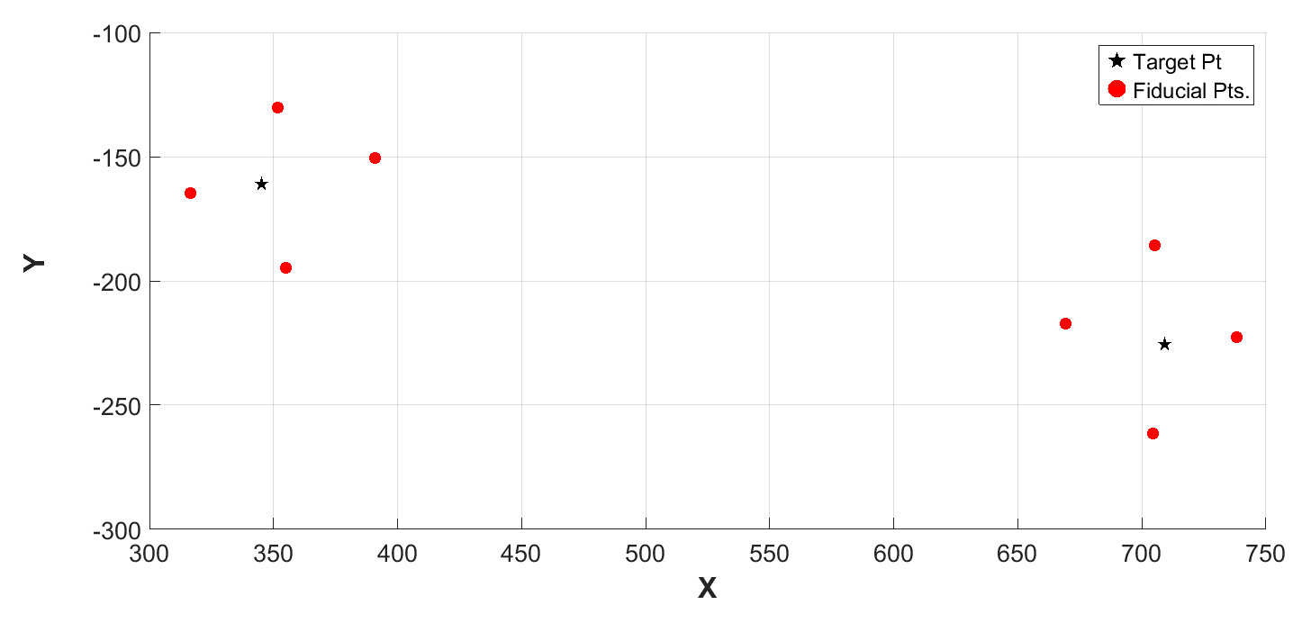
Measure locations of target points with sensor.
Sensor Frame
Fiducial pt.
Target pt.

Slide 21
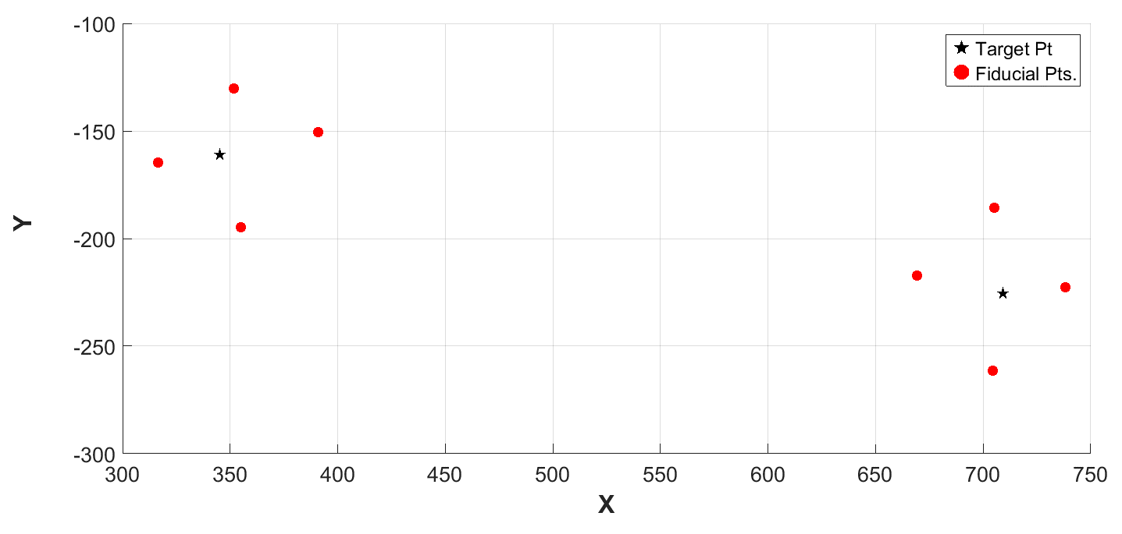
Calculate correction (using fiducials closest to target point) for the measured target point. Target corrections are linearly interpolated using fiducial corrections which are weighted based on their distance from the target point.
Apply correction to target point.
e₈
Sensor Frame
Target pt.
Fiducial pt.
e₇
Target correction
Fiducial correction
e₆
e₅
e₄
e₃
e₂
e₁
* Correction vectors exaggerated for illustration

Slide 22
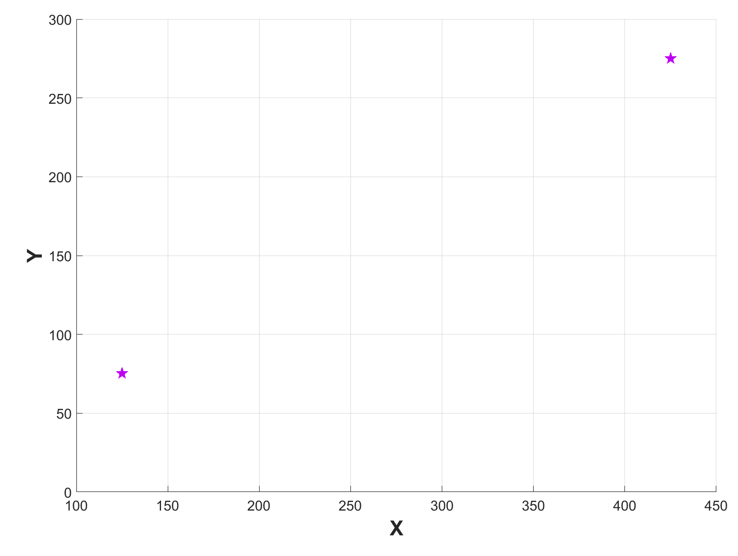
9. Transform corrected target points from sensor frame to robot frame using (R, t).
Sensor Frame
Fiducial
Corrected target pt.
Uncorrected target pt.
Robot Frame
Apply (R, t) to target points
Target measured in robot frame
Transformed corrected target
* Uncorrected target points also transformed using (R, t) and shown only to illustrate the benefit of using RRBC method. Transformation of uncorrected target points would not be performed in actual practice.
Transformed uncorrected target

Slide 23
Other methods to compensate for or reduce the positional error
Active compliance control based on feedback from force/torque sensors
Involves a robot with this capability or the addition of hardware to obtain this capability
Visual servo control
Involves image processing, computer vision, and robot control
Volumetric Error Compensation methods
Discussed in next slide

Slide 24
RRBC vs. Volumetric Error Compensation (VEC) methods
RRBC | VEC
RRBC compensates for position error but does not require in-depth knowledge of the robot or sensor. Steps are easy to perform. | VEC models compensate for position error by using an analytical model that combines robot and sensor error. This requires in-depth knowledge of robot and sensor to compensate for potential sources of error. This is a challenging task.
If a different sensor is used with robot, the interpolation scheme in RRBC method does not have to be modified. | If a different sensor (from the original sensor) is used with robot, VEC model needs to be updated.
Both methods require comparable amounts of data to be collected – to determine model parameters in VEC method and for the interpolation scheme in RRBC method.

