Slide 1
Safeguarding Health Information: Building Assurance through HIPAA Security - 2018
OCR & ONC Security Risk Assessment (SRA) Tool Walk-Through: New Features and New Functionality
October 18, 2018

Slide 2
Happy Cybersecurity Month-Privacy and Security: A Shared Responsibility

Slide 3
Security Risk Assessment (SRA) Tool
The HHS Office of the National Coordinator for Health Information Technology (ONC) and the HHS Office for Civil Rights (OCR) have updated the popular Security Risk Assessment (SRA) Tool to make it easier to use and apply more broadly to the risks to health information.
The tool is designed for use by small to medium sized health care practices – covered entities, and business associates to help them identify risks and vulnerabilities to ePHI.
The updated tool provides enhanced functionality to document how such organizations can implement or plan to implement appropriate security measures to protect ePHI.
Windows operating system- Download the Windows version of the tool at http://www.HealthIT.gov/security-risk-assessment.
The iOS iPad version was not updated, but the previous version is available at the Apple App Store (search under “HHS SRA Tool”).

Slide 4
SRA Tool Development Approach
ONC engaged the Technology Learning Community for Privacy and Security
User Stories>>> Testing>>>Feedback>>>Enhancement Requests
ONC and OCR conducted comprehensive usability testing of the SRA tool (version 2.0) with health care practice managers.
Analysis of the findings across the user base informed the development of the content and the requirements for the SRA Tool 3.0.
ONC and OCR then conducted testing of the SRA tool 3.0 to compare the user experience in completing the same tasks presented in the first round of testing.
Over the next year, ONC and OCR will continue to gather feedback on the tool to inform future SRA tool modifications and updates. You can give feedback or request help by emailing PrivacyAndSecurity@hhs.gov

Slide 5
New Features and Functionality
Enhanced User Interface
Modular Workflow with Question Branching Logic
Custom Assessment Logic
Progress Tracker
Improved Threats & Vulnerabilities Rating
Detailed Reports
Business Associate and Asset Tracking
Overall Improvement of the User Experience

Slide 6
Additional Features
Asset List/Vendor List import/export
Accommodates Multi-Location Practices
Document Tracking/Linking within Assessment Sections or within Documents Section [aggregates documents]
Audit Logging Across User Accounts
Dynamic Content within Assessment
Wizard-based Branching Logic within Assessment
Risk Guided Framework

Slide 7
SRA Tool Brief Overview- Content
Section 1: Security Risk Assessment (SRA) Basics (security management process)
Section 2: Security Policies, Procedures, & Documentation (defining policies & procedures)
Section 3: Security & Your Workforce (defining/managing access to systems and workforce training)
Section 4: Security & Your Data (technical security procedures)
Section 5: Security & Your Practice (physical security procedures)
Section 6: Security & Your Vendors (business associate agreements and vendor access to PHI)
Section 7: Contingency Planning (backups and data recovery plans)

Slide 8
Important Reminder!
The SRA Tool runs on your computer. It does not transmit information to the Department of Health and Human Services, The Office of the National Coordinator for Health IT, or The Office for Civil Rights.

Slide 9
Top 10 Myths of Security Risk Analysis
The security risk analysis is optional for small providers.
Simply installing a certified EHR fulfills the security risk analysis MU requirement.
My EHR vendor took care of everything I need to do about privacy and security.
I have to outsource the security risk analysis.
A checklist will suffice for the risk analysis requirement.

Slide 10
Top 10 Myths of Security Risk Analysis
There is a specific risk analysis method that I must follow.
My security risk analysis only needs to look at my EHR.
I only need to do a risk analysis once.
Before I attest for an EHR incentive program, I must fully mitigate all risks.
Each year, I’ll have to completely redo my security risk analysis.

Slide 11
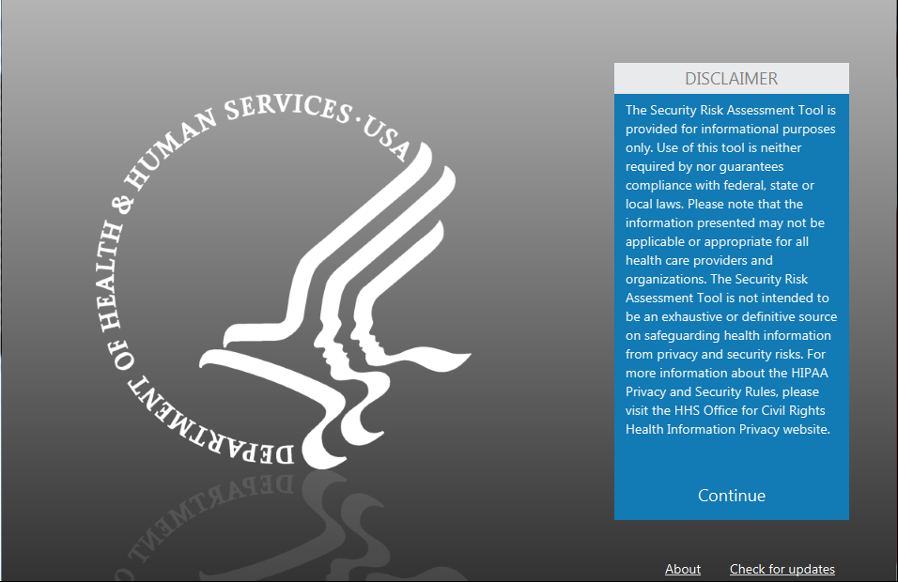
Create New SRA:
Enter your name
Pick a place to save your SRA
Name your SRA
Review the Disclaimer
Begin your SRA

Slide 12
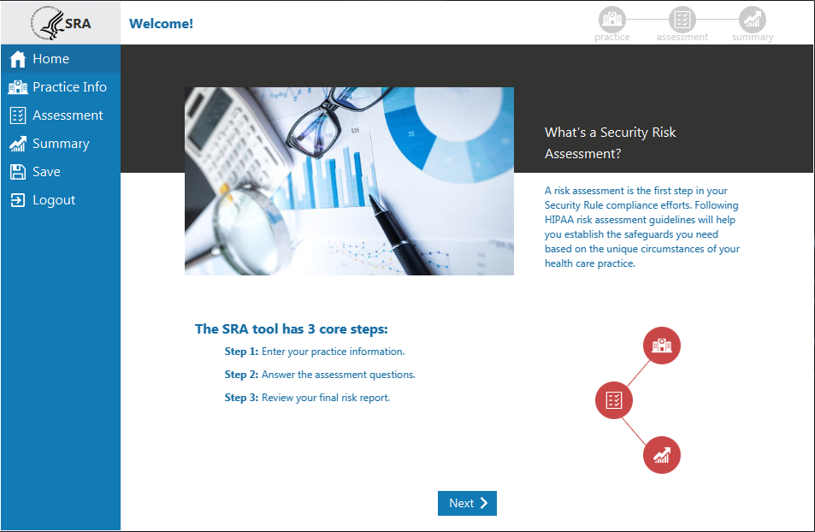
Create New SRA:
Enter your name
Pick a place to save your SRA
Name your SRA
Review the Disclaimer
Begin your SRA

Slide 13
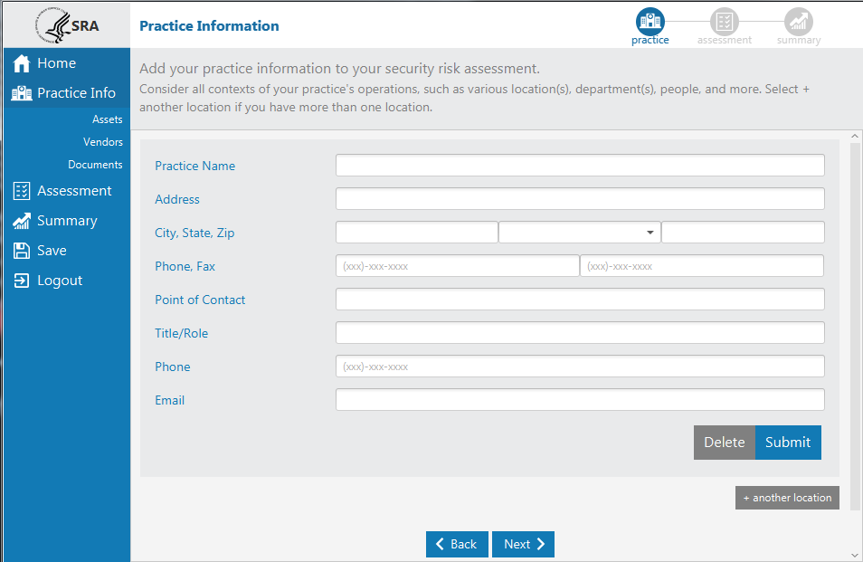
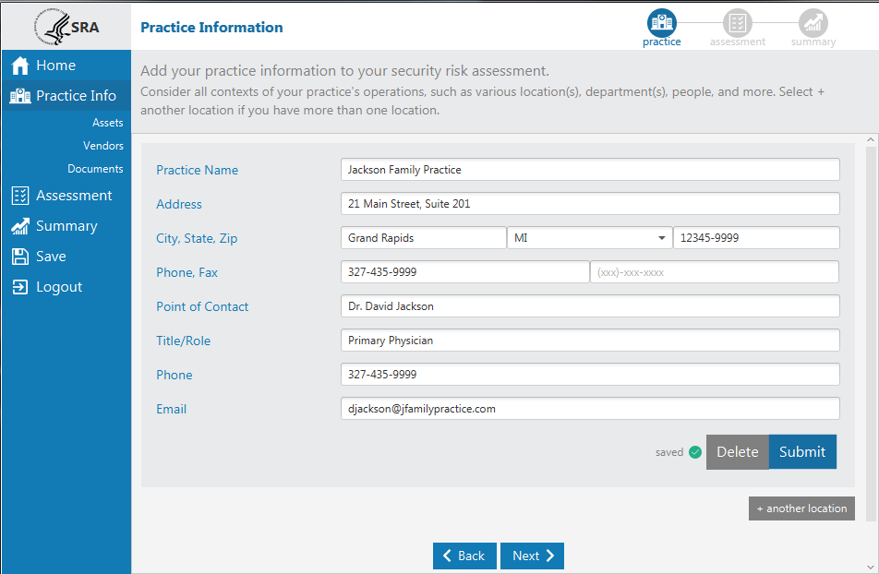
Entering your Practice Info:
Practice Information
Track Asset Inventory
Track BAs
Track Documentation

Slide 14
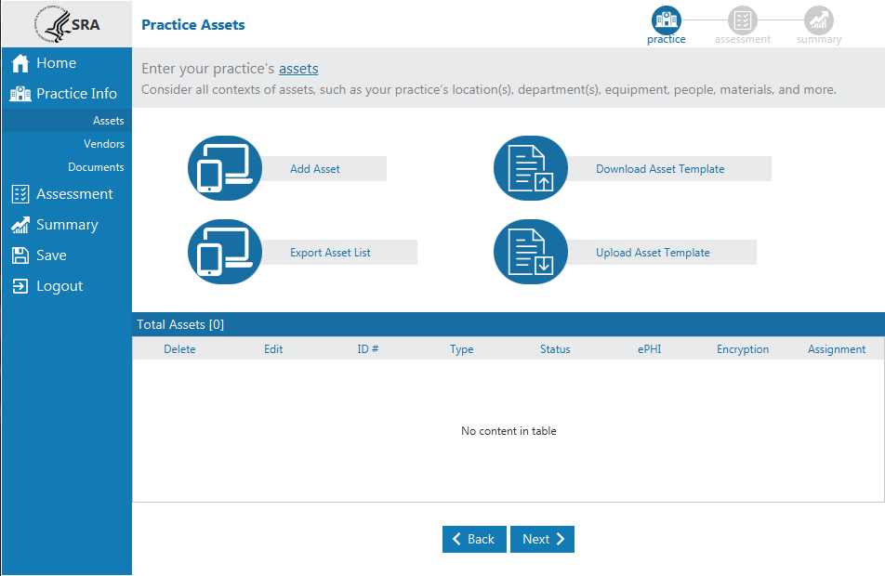
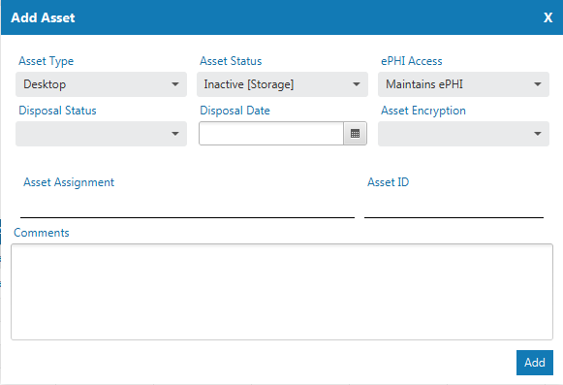
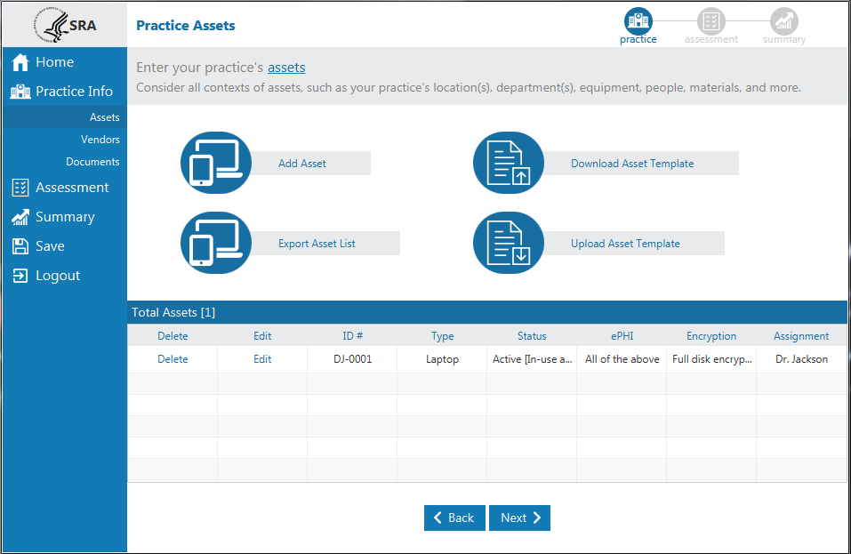
Asset Tracking:
Practice Information
Track Asset Inventory
Track BAs
Track Documentation

Slide 15
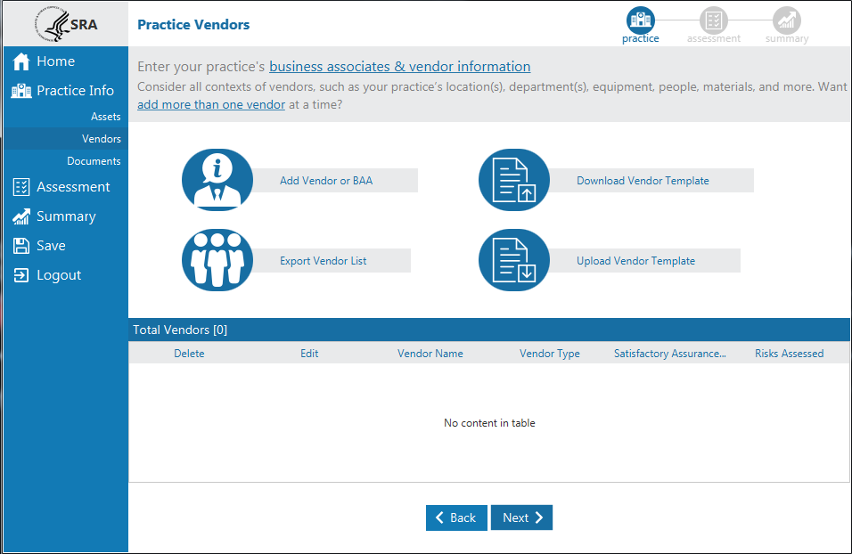
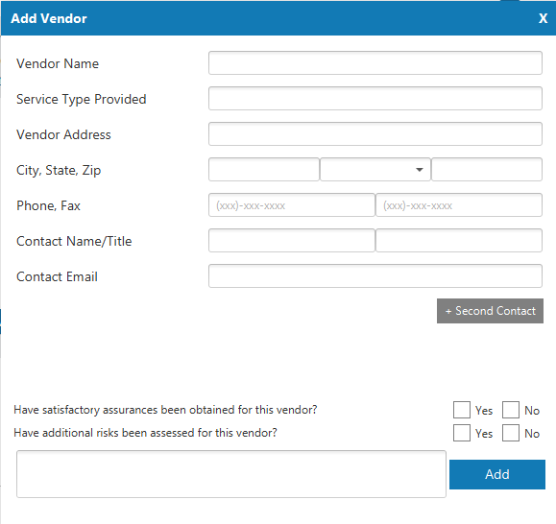
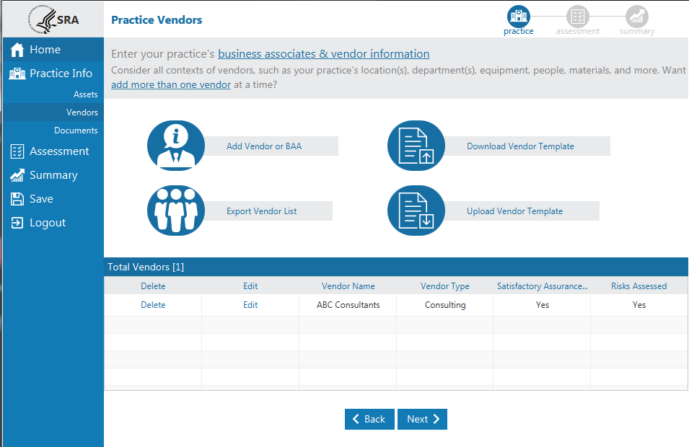
Vendor/BAA Tracking:
Practice Information
Track Asset Inventory
Track BAs
Track Documentation

Slide 16
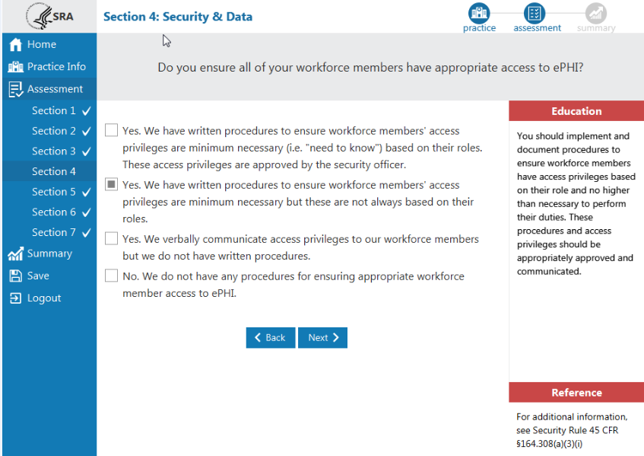
Assessment:
Assessment Sections
Wizard-based Logic
Multiple Choice Question & Answer format
Dynamic Education content
Related Standard Language
Progress Indicators

Slide 17
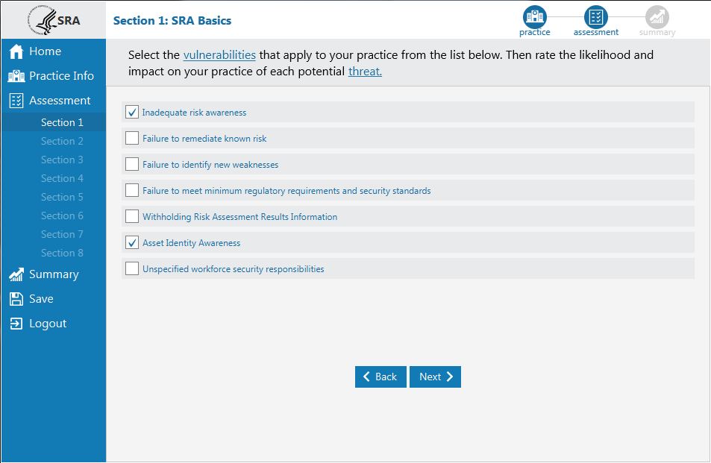
Identifying Vulnerabilities:
Multi-Select format
Guidance within ToolTips

Slide 18
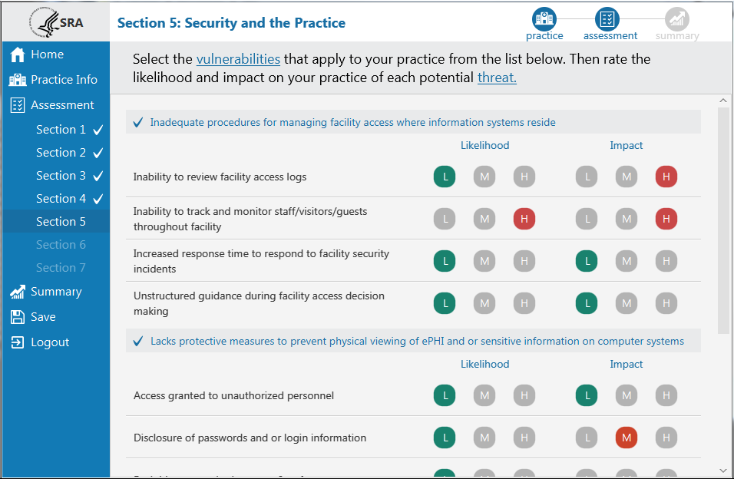
Rating Likelihood and Impact of Threats:
Likelihood & Impact Rating
Color coded rating system
Guided Risk Framework
Guidance within ToolTips

Slide 19
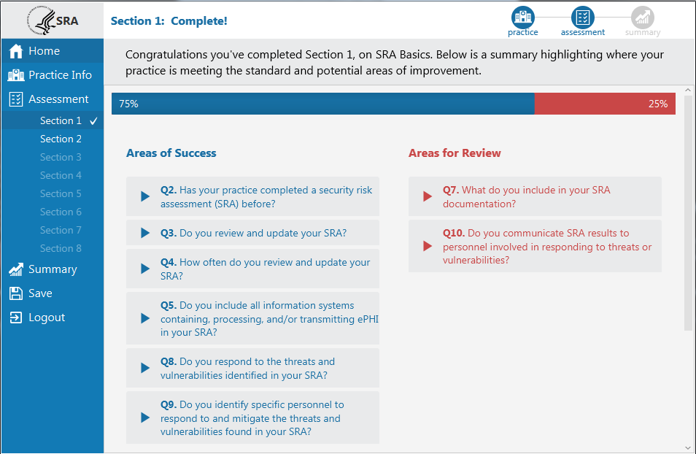
Reviewing the Section Summary:
Section Summary
Areas of Success
Areas for Review
Score
Comments & Documents
Final SRA Summary
Dashboard
Detailed Report

Slide 20
Understanding your scores:
Section Summary
Areas of Success
Areas for Review
Score
Comments & Documents
Final SRA Summary
Dashboard
Detailed Report

Slide 21
Risk Report

Slide 22
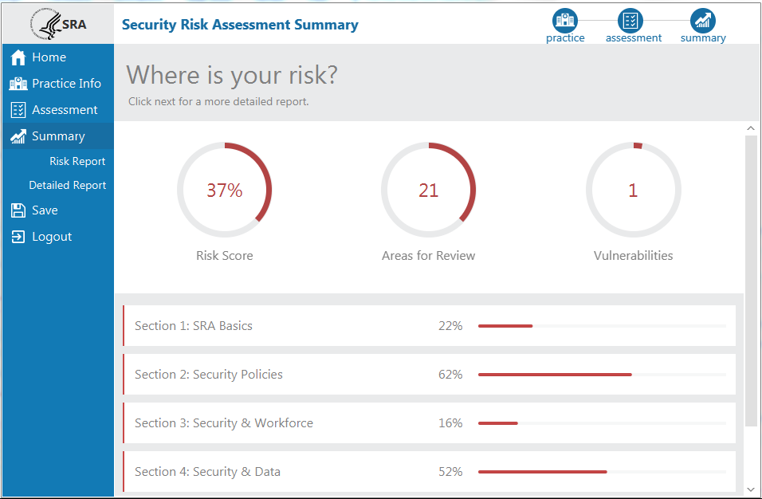
Final SRA Summary
Section Summary
Areas of Success
Areas for Review
Score
Comments & Documents
Final SRA Summary
Dashboard
Detailed Report

Slide 23
Final SRA Summary
Summary Dashboard
Cumulative Risk score
Risk score by section
Total Areas for Review
Total # of Vulnerabilities

Slide 24
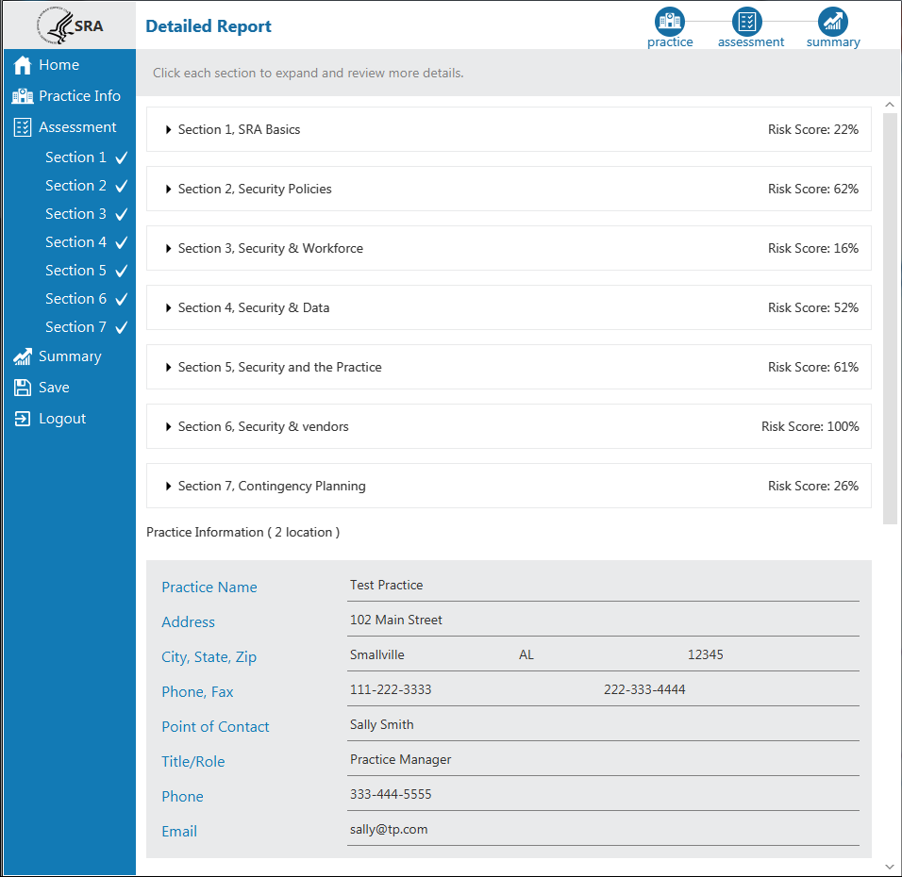
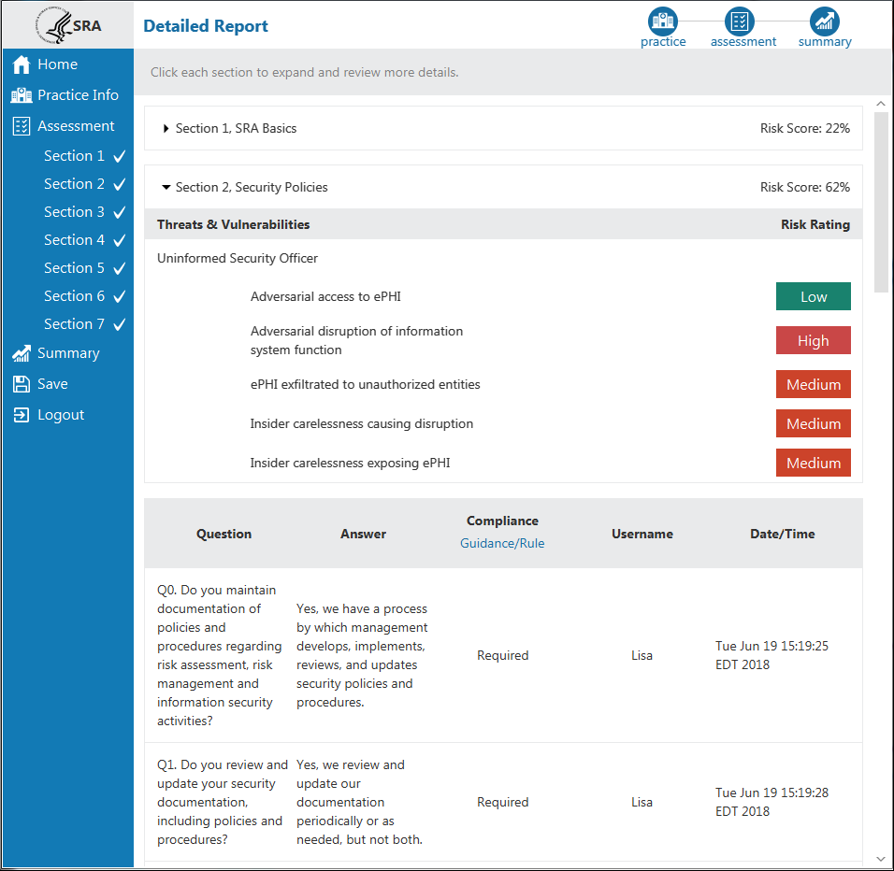
Final SRA Summary
Detailed Report
Risk scores for each section
Audit Log
Comprehensive report of SRA results
Risk ratings for Threats & Vulnerabilities

Slide 25
Questions?

