Slide 1
Wastewater Surveillance for SARS-CoV-2
Collaborative development of an analytical method audit checklist
Patsy Root, ACIL WW COVID workgroup, Chair
DHS/NIST Workshop: Standards to Support an Enduring Capability in Wastewater Surveillance for Public Health – June 18, 2021

Slide 2
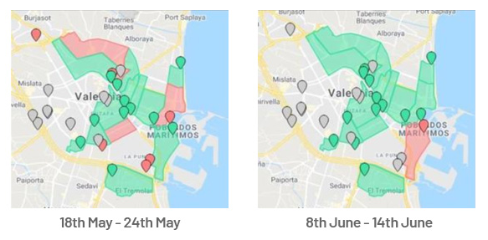
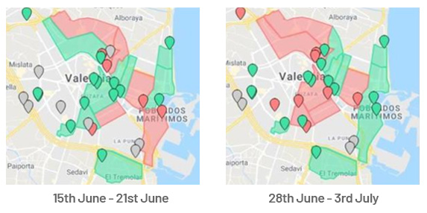
Wastewater surveillance has several advantages
Key Advantages of WW Surveillance
Independent of healthcare seeking behavior
Data available within days
Pooled sample
Can be used to identify trends at sub-region level
Can be used to make public health decisions
Inform decisions on public health communication
Monitor the impact of mitigation strategies
Inform decisions on clinical testing

Slide 3
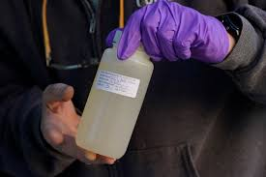
Environmental testing and clinical testing are equally important in public health decision-making
Human testing performed in a CLIA certified laboratory
Wastewater testing should be performed in an accredited/certified laboratory

Slide 4
Accreditation or Certification of labs ensure quality data and reduces error
“Laboratory accreditation is a widely accepted process of evaluation of a laboratory’s quality, performance, reliability and efficiency.
It is a means to promote and enforce better quality in laboratory testing and to ultimately reduce testing errors.”*
This is true for both Clinical and Environmental laboratories.
* https://globalhealthlaboratories.tghn.org/articles/laboratory-accreditation/

Slide 5
Accreditation or Certification is applied in other areas of environmental testing
EPA requires accreditation or certification for any laboratory reporting compliance drinking water test results
Several states, but not all, require the same for laboratories testing wastewater effluent
Many laboratories, but not all, voluntarily adopt accreditation or certification for any testing they perform for projects or customers
Some laboratories follow accreditation or certification principles but do not have official recognition
ALL these types of laboratories can produce good data, if they have the right tools.

Slide 6
Collaborative development of accreditation checklist

Slide 7
ACIL and key stakeholders agreed on the need for a WW/COVID laboratory accreditation checklist
Goal: To create and promote an accreditation checklist for WW/COVID testing that promotes high quality laboratory processes and procedures; assuring data are fit for purpose
Team:
ACIL ESS – American Council of Independent Laboratories – Environmental Sciences Section, several member laboratories and assessing bodies (auditors)
EPA – US Environmental Protection Agency
CDC – Centers for Disease Control and Prevention
WRF – Water Research Foundation
APHL – Association of Public Health Laboratories
TNI – The NELAC Institute

Slide 8
Any testing laboratory or accreditation body can use the WW/COVID checklist to improve their data
Such as:
Private labs that are accredited under a National Program, such as ISO 17025 or the TNI Standard
Private labs that are certified by a State program
Accredited or Certified Public Health environmental labs
Accredited or Certified wastewater utility-based labs
Non-accredited or certified labs that want high quality assurance of their data, such as academic labs
Any type of accreditation or certification body
The goal is to ensure quality data, every time, that’s fit for purpose

Slide 9
Confident public health decisions depend on limiting method variation and error – the checklist can help
Importance of Consistency
An Audit Checklist can help both labs, auditors and data users
Ensure QA/QC expectations for each step in an analytical method are clear
Simple and clear requirements can help reduce inter- and intra-lab variability
Accreditation/Certification assures data users that data are fit for purpose
Current State of the Field
Notes:
Jeff: everyone agrees we cannot do prevalence but we can trend over time;

Slide 10
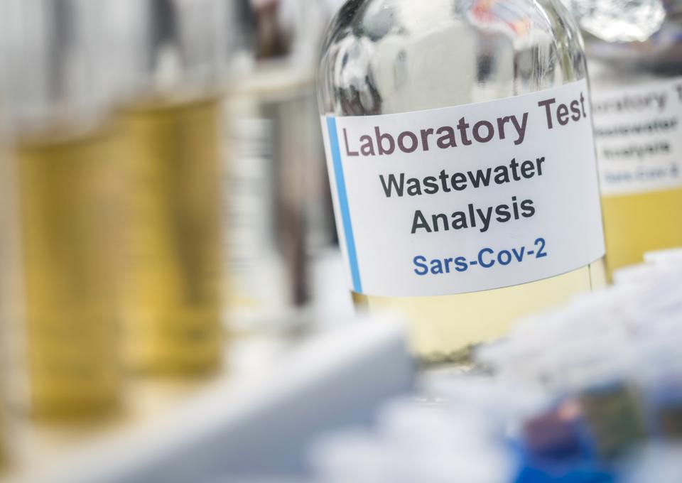
WW/COVID Checklist covers several steps in the testing process
Sample Checks
Standard Curve (RT-PCR)
Pretreatment
Concentration
Extraction of RNA
PCR, either RT-PCR or ddPCR
Results interpretation, data reporting

Slide 11
Checklist includes six parameters to consider for each step in the method
Quality Control Measure | Description | Frequency | Purpose | Control Limit | Corrective and Preventative Actions?
SAMPLE CHECKS
Chain of Custody | Details to identify specific sample under analysis | Every sample | Sample traceability through entire testing procedure | Documentation describing at a minimum: Sample ID; Client ID; Time and Date; Custodian, Analysis requested | Do not initiate analysis without information required OR contact client
Temperature of sample and subsamples | Temperature is measured upon receipt of sample; on initiation of analysis of sample/sub-sample (if >4h post-receipt) | See column B | Determine if there are significant temperature changes post-storage or subsampling | Temperature between samples should be within 5 C of each other | If >5C, discard sample/subsample and re-sample OR confirm sample use as agreed with client OR note deviation on report
pH of sample and subsamples | pH is measured upon receipt of sample and during the subsampling process if subsampling applied | At subsampling | Determine if there are significant pH changes during subsampling | pH of subsamples within ±1 of original sample pH | If >pH1, note on report

Slide 12
The quality checklist under review by stakeholders and multiple other reviewers
Align on key QA/QC variables– multiple reviewers
Final audit Checklist completed
Make available and promote
Reliable public health data
Notes:
Jeff

Slide 13
Promotion of WW/COVID checklist
Availability and promotion of checklist through stakeholder groups
Adoption of accreditation under ISO 17025 first
Explore and expand into TNI and State options for accreditation/certification
Determine how else to promote and communicate these tools to laboratories and other Accreditation Bodies
Future: Coordinate and share with other similar efforts globally and/or apply to other WW parameters/programs

Slide 14
WW COVID Checklist development stakeholders
Chair – Patsy Root, IDEXX Laboratories, Inc.
Patricia Atkins, SPEX CertiPrep
Angela Carlson, ALS Life Sciences
John Cosgrove, Eurofins Environment Testing America
Jack Farrell, Analytical Excellence, Inc.
David Friedman, ACIL ESS Consultant
Jay Garland, EPA
Amy Kirby, CDC
Mia Mattioli, CDC
Sharon Mertens, Milwaukee Metropolitan Sewerage District
Judy Morgan, Pace Analytical
Julianne Nassif, APHL
Michael Oscar, ACIL Government Relations Director
Jerry Parr, TNI
Agustin Pierri, Weck Laboratories
Zaneta Popovska, ANAB
Nicholas Slawson, A2LA
Sarah Wright, APHL
Kathleen Young, PerkinElmer, Inc.
Richard Burrows, Eurofins USA
David Ellis, Midland Scientific
Scott Griggs, ALS Life Sciences
Steve Hooper, Eufofins USA
Lisa Race, BSK Associates
Taylor Reynolds, MilliporeSigma
Jay Singh, RTI Laboratories
Tarun Anumol, Agilent
Josh Wyeth, Phenova
Julia Reynolds, CDC
Stacie Crandall, Hampton Roads Sanitation District

Slide 15
Questions / Discussion Contact Information: Patsy-Root@idexx.com 207-523-0835

