Slide 1
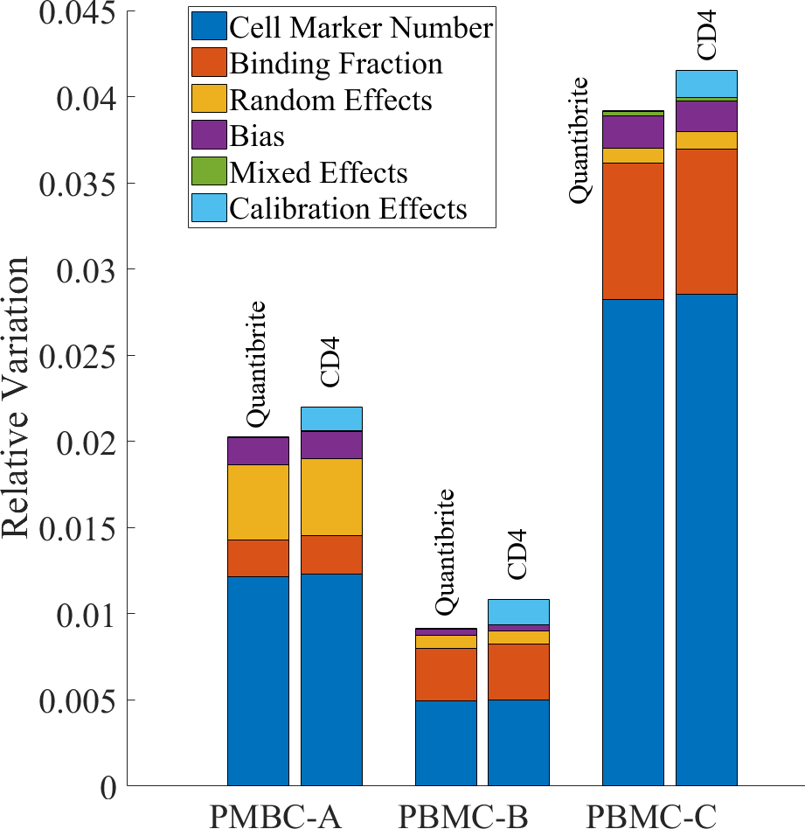
The Role of Uncertainty Quantification in Cytometry
Paul Patrone
Physicist
NIST
Applied and Computational Mathematics Division
https://doi.org/10.1371/journal.pone.0248118

Slide 2
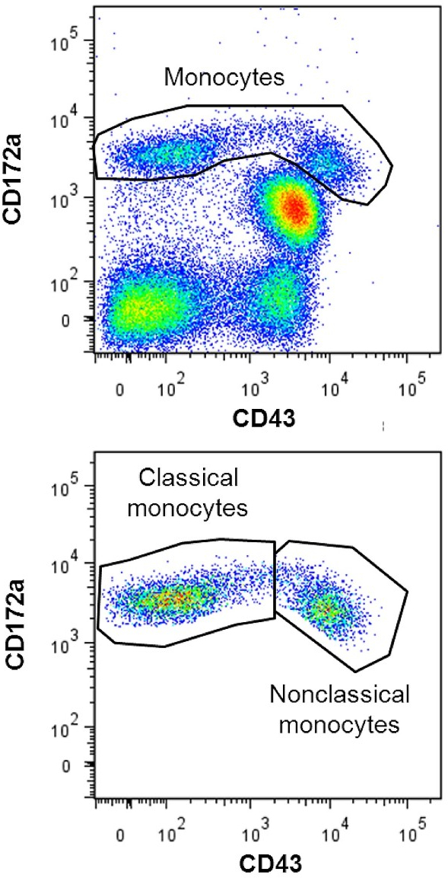
Uncertainty in Cytometry
Sample prep, reagent variability
Biological variability
Data analysis and interpretation
Calibration
Stochastic / random effects
Uncertainty can be up to 50% of MFI values,
hard to characterize in general!

Slide 3
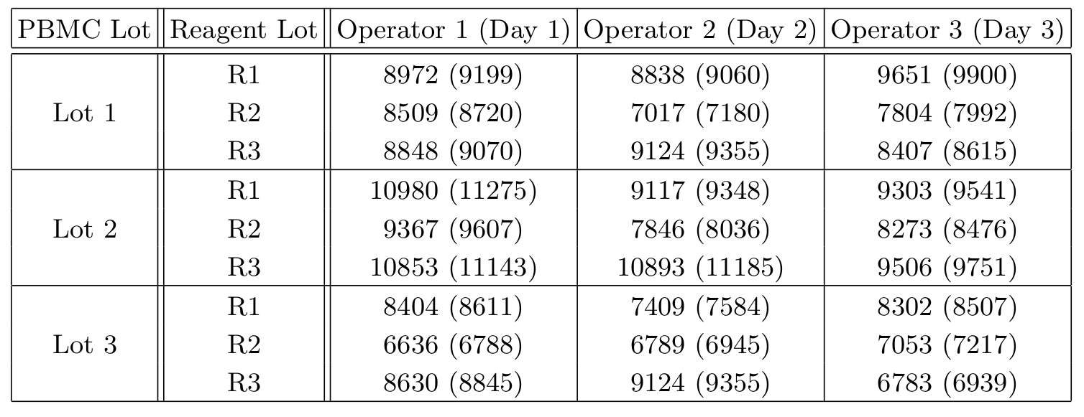
Preliminary study:
CD-19 Measurements in Cell Standards
Designed to establish peripheral blood mononuclear cells (PBMC) as CD-19 cytometry standard
Calibrated to beads; raw data in parentheses

Slide 4
Question: can we account for sources of variability

Slide 5
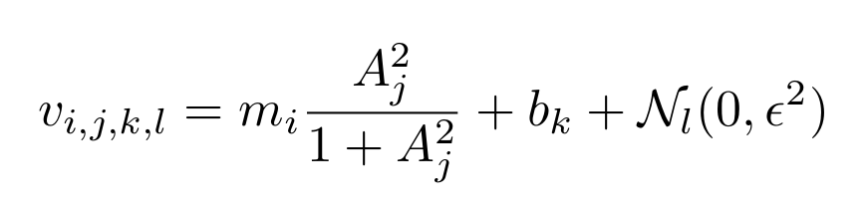
Question: can we account for sources of variability
Idea: probabilistic model of measurement process isolates phenomena
Mean # biomarkers
Operator bias
MFI value
Binding affinity
Stochastic effects
i,j,k,l index PBMC lot, reagent lot, operator, and experimental realization

Slide 6
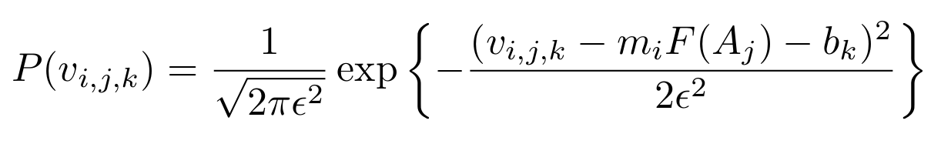
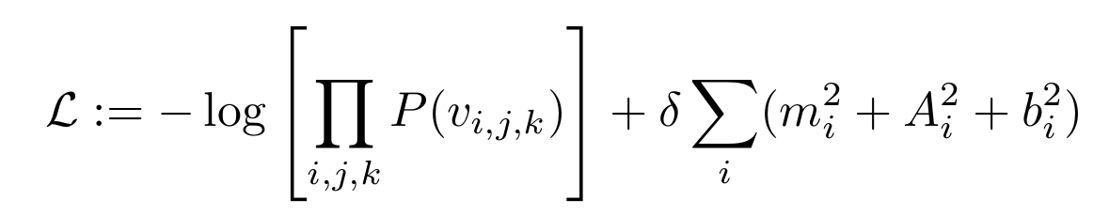
Question: can we account for sources of variability
Find model parameters using maximum likelihood analysis + small regularization
Probability of
measured values
Minimize over
unknown parameters
regularization

Slide 7
Question: can we account for sources of variability
Yields estimates of:
1) Biomarker # per PBMC lot
2) Binding affinity per reagent lot
3) Operator bias
4) Stochastic effects
Variation in each effect

Slide 8
Question: can we account for sources of variability
Uncertainty propagation of variations through
model estimates variation in CD-19 measurements
Allows us to isolate impact of each source of
variation on measurement process.

Slide 9
Open Questions
Limited analysis so far
27 data points
(Overly?) simple model
Linear uncertainty propagation
Analysis points to need for UQ. How can
we make it better reflect measurement process?
Can we better parse out &
quantify sources of uncertainty?

