Slide 1
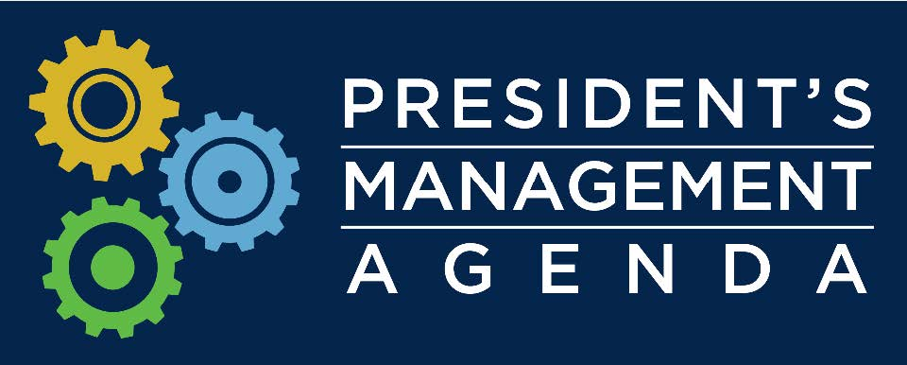


Unleashing American Innovation
Return on Investment (ROI) Initiative
to advance the Lab-to-Market Cross Agency Priority (CAP) Goal
of the President’s Management Agenda
MAY 17, 2018

Slide 2

Federal R&D Investment
The Federal government invests approximately $150 billion per year in R&D, with approximately:
  one-third invested at over 300 Federal laboratories across the country
  two-thirds invested at universities and industry R&D institutions
To produce economic gain and maintain a strong national security innovation base, the results of this investment must be put to productive use through:
  applied research and services to the public
  transfer to private companies to create new products and services

Slide 3

Federal Technology Transfer
Federal technology transfer policies and procedures, based on landmark 1980s legislation, continue to support U.S. innovation and have been widely emulated by other countries.
In an increasingly competitive environment, it is important to ask:
  Whether and how current laws, regulations, policies, and practices could more effectively promote transfer of federally developed technologies, knowledge, and capabilities to productive uses?

Slide 4
President’s Management Agenda
To advance the President’s Management Agenda to modernize government for the 21st century and its Lab-to-Market CAP Goal, NIST has launched an ambitious initiative in coordination with the White House Office of Science and Technology Policy to enable greater “Return on Investment” (ROI) from the Federal government’s $150 billion annual R&D investment.
New IP, licensing, products, processes, services and companies return value via economy growth and enhanced national security
Technology Transfer System
Federal R&D Investment
$150B/year

Slide 5
Lab-to-Market CAP Goal
Lab-to-Market is a cross agency priority (CAP) goal of the recently released President’s Management Agenda to modernize government for the 21st century.
  Improve Transfer of Federally-Funded Technologies from Lab-to-Market.
The Lab-to-Market CAP Goal is co-led by the Department of Commerce via NIST and the White House Office of Science & Technology Policy (OSTP).
NIST, in coordination with White House’s OSTP, will advance the President’s Management Agenda and its Lab-to-Market CAP Goal through the ROI Initiative.
The National Science and Technology Council Lab-to-Market Subcommittee will coordinate, review, and implement interagency priorities for this CAP Goal.

Slide 6


Mission
To promote U.S. innovation and industrial competitiveness by advancing measurement science, standards, and technology in ways that enhance economic security and improve our quality of life.
World-Leading Scientific and Engineering Research
Manufacturing Extension Centers
Advanced Manufacturing National Program Office

Slide 7
NIST and Tech Transfer
By statute, the Department of Commerce via NIST provides Federal leadership for promulgating and reporting on technology transfer policies, practices, regulations.
DOC/NIST focus: Advance Federal technology transfer to promote innovation and industrial competitiveness.
Interagency Workgroup for Technology Transfer (11 Federal agencies)
Interagency Workgroup for Bayh-Dole
Annual technology transfer reports to the President, Congress, and OMB
Co-Chair NSTC Science & Technology Enterprise Committee with NSF and DOE
Co-Lead NSTC Lab-to-Market Subcommittee with OSTP and DOE
“Host Agency” for Federal Laboratory Consortium for Technology Transfer

Slide 8
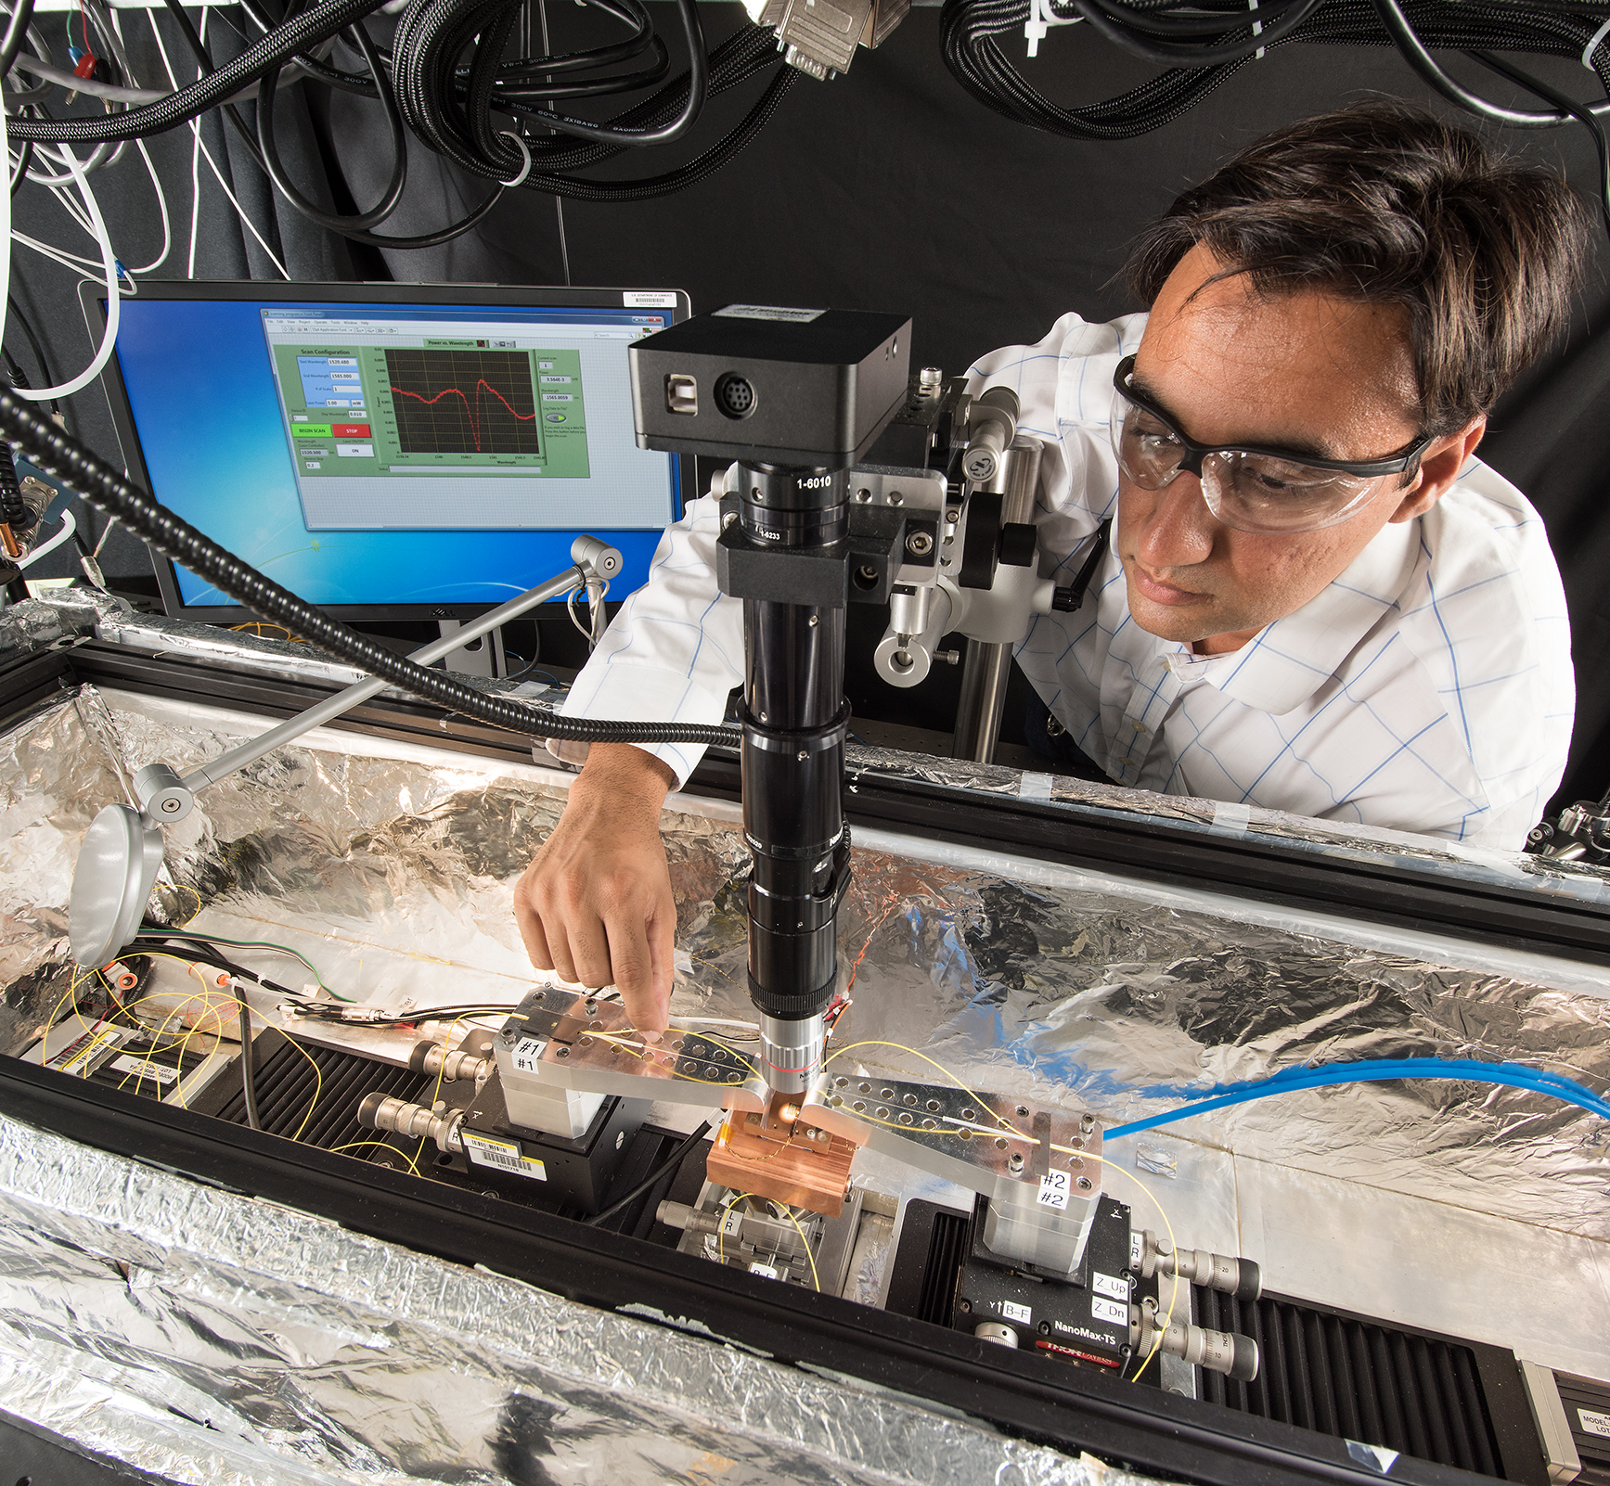
ROI Vision and Goal
VISION: Unleash the innovation power of America into our economy
GOAL: Maximize the transfer of federal investments in science and technology into value for America
meet current and future economic and national security needs in a rapidly shifting technology marketplace and enhance U.S. competitiveness globally
attract greater private sector investment to create innovative products, processes, services, as well as new businesses and industries

Slide 9

ROI Initiative Objective
Assess, streamline, and accelerate the transfer of technology from Lab-to-Market:
Identify critically needed improvements to Federal technology transfer policies, practices, and efforts
Seek broad input from Federal R&D, intellectual property and technology transfer stakeholders

Slide 10
ROI Assessment Areas
Core technology transfer principles and practices that should be protected, and those which should be adapted or changed.
Approaches to improve efficiency and reduce regulatory burdens for technology transfer to attract private sector investment in later-stage R&D, commercialization, and advanced manufacturing.
New partnering models and technology transfer mechanisms with the private sector, academia, other Federal agencies, state, and other public-sector entities to support technology development and maturation.
New approaches to reduce/eliminate barriers and enable accelerated commercialization in areas of strategic national importance.
Better metrics and methods to evaluate ROI outcomes and impacts from Federal R&D investment.
New approaches to motivate significantly increased technology transfer outcomes from the Federal sector, universities, and research organizations.

Slide 11
ROI Request for Information
What are the core Federal technology transfer principles and practices that should be protected, and those which should be adapted or changed?
What are the issues that pose systemic challenges to the effective transfer of technology, knowledge, and capabilities resulting from Federal R&D?
  Please consider those identified in the RFI as well as others that may have inhibited collaborations with Federal laboratories, access to other federally funded R&D, or commercialization of technologies resulting from Federal R&D.
What is the proposed solution for each issue that poses a systemic challenge to the effective transfer of technology, knowledge, and capabilities resulting from Federal R&D?
  Please consider the approaches identified in the RFI.
What are other ways to significantly improve transfer of technology, knowledge, and capabilities resulting from Federal R&D to benefit U.S. innovation and the economy?
  What changes would these proposed improvements require to Federal technology transfer practices, policies, regulations, and legislation?

Slide 12
ROI RFI Responses
Submit written responses by 5:00 pm Eastern Time on July 30, 2018 using either of the following methods:
Agency Website: https://www.nist.gov/tpo/roi-rfi-response.
  Follow the instructions for sending comments on the agency website.
E-mail: roi@nist.gov.
  Include “RFI Response: Federal Technology Transfer Authorities and Processes” in the subject line of the message.

Slide 13
ROI Public Meetings/Forums
Four public meetings have been announced as indicated below to gather additional stakeholder inputs:
  May 17, 2018, Silicon Valley USPTO Regional Office, San Jose, CA.
  May 21, 2018, Renaissance Denver Downtown City Center Hotel, Denver, CO.
  May 31, 2018, Hilton Chicago/Oak Lawn, Oak Lawn, IL.
  June 14, 2018 (simultaneous webcast), NIST Campus, Gaithersburg, MD.
All public meetings will be recorded and transcribed for internal NIST use only.

Slide 14
ROI Timeline and Milestones
February / March / April
April / May / June / July
August / September / October / November
President’s Management Agenda released with Lab-to-Market CAP Goal
Initial key stakeholder meetings to engage industry, university, and federal stakeholders
NIST website with ROI information and updates
Unleashing American Innovation Symposium Launch Event (April 19, 2018)
Request for Information (closes 7/30) published in Federal Register (May 1, 2018)
Public Forums (5/17, 5/21, 5/31, 6/14) announced in Federal Register (May 1, 2018)
Analysis of inputs/studies
Interagency review
Recommendations (best practices, policies, regulatory, legislative-if appropriate)
Initiate implementation of action plan

Slide 15

ROI Initiative Information
Federal Register and Press Release Announcement of RFI and Public Forums
Video Recording of Unleashing American Innovation Symposium
www.nist.gov/tpo/ROI

