Slide 1
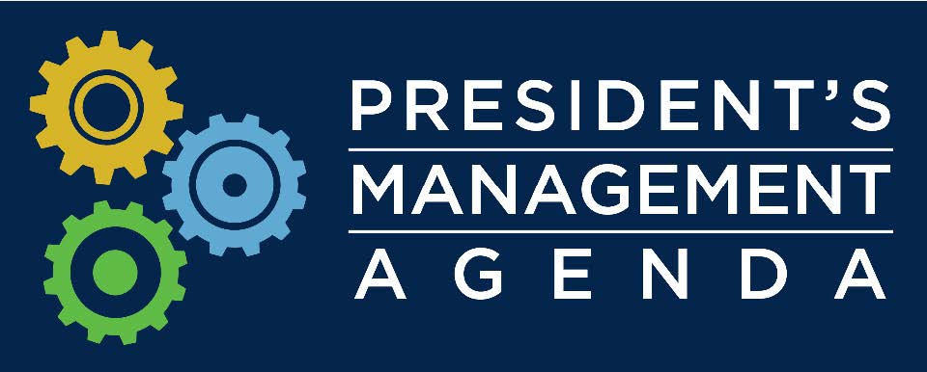
Unleashing American Innovation Return on Investment (ROI) Initiative Lab-to-Market Cross Agency Priority (CAP) Goal
Walter G. Copan, Ph.D.
Under Secretary of Commerce for Standards and Technology &
Director, National Institute of Standards and Technology (NIST)
ROI Public Forum at NIST
June 14, 2018

Slide 2
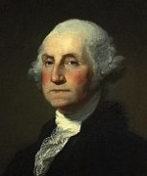
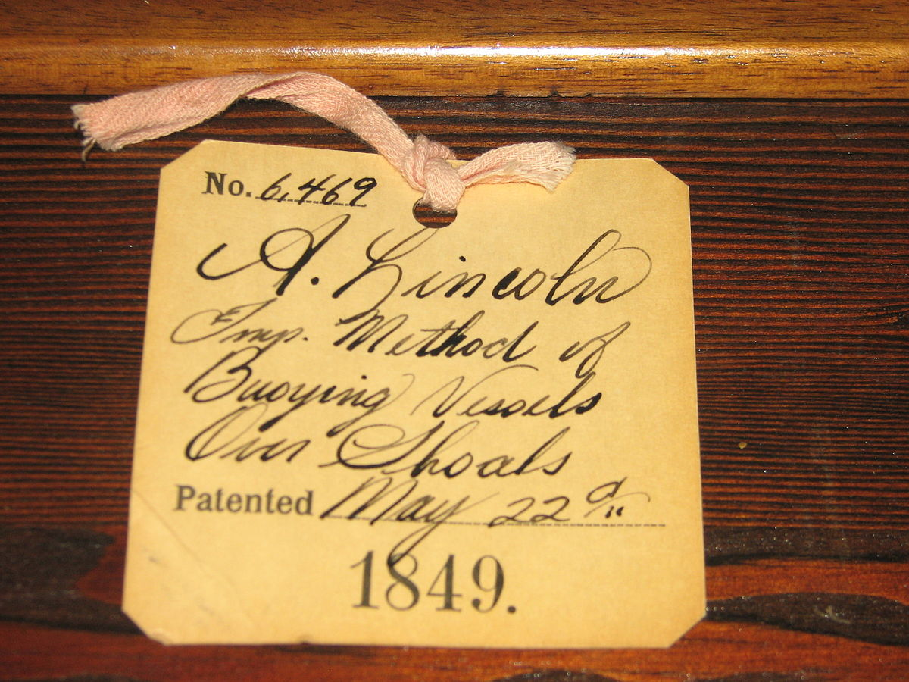
IP and Innovation
[The U.S. patent system] “adds the fuel of interest to the fire of genius in the discovery and production of new and useful things.”
Abraham Lincoln
… “I can not forbear intimating to you the expediency of giving effectual encouragement as well to the introduction of new and useful inventions from abroad as to the exertions of skill and genius in producing them at home”….
George Washington, State of the Union Address, January 8, 1790
U.S. Patent No. 6469

Slide 3
Federal R&D Investment
The Federal government invests approximately $150 billion per year in R&D:
~1/3 invested at over 300 Federal laboratories
~2/3 invested at universities and industry R&D institutions
To produce economic gain and maintain a strong national security innovation base, the results of this investment must be put to productive use through:
applied research and services to the public
transfer to private companies to create new products and services

Slide 4
Federal Technology Transfer
Federal technology transfer policies and procedures, based on landmark 1980s legislation, continue to support U.S. innovation and have been widely emulated by other countries.
In an increasingly competitive environment, it is important to ask:
Whether and how current laws, regulations, policies, and practices could more effectively promote transfer of federally developed technologies, knowledge, and capabilities to productive uses?

Slide 5
Mission
To promote U.S. innovation and industrial competitiveness by advancing measurement science, standards, and technology in ways that enhance economic security and improve our quality of life.
World-Leading Scientific and Engineering Research
Advanced Manufacturing National Programs
Technology Transfer and
U.S. Innovation

Slide 6
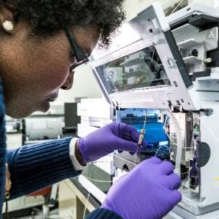
Programmatic Priorities
© Matt DeLorme
Advanced Manufacturing
Cybersecurity
Disaster Resilience
Engineering Biology
Internet of Things
Documentary Standards
Technology Transfer
Measurement Dissemination
Quantum Science
Artificial Intelligence
Notes:
NIST has a number of priorities -
Orange: national priority/programmatic areas
Green: unique NIST roles where we intend to extend influence
Blue: new technical capabilities that will be important in the next decades

Slide 7
NIST and Tech Transfer
Policy coordination and promulgation of technology transfer regulation
Lead for Interagency Workgroup for Technology Transfer (11 agencies) and Interagency Workgroup for Bayh-Dole
Annual reports for the President, the Congress, and OMB on technology transfer across federal agencies
Support Lab-to-Market NSTC Subcommittee
Host Agency for the Federal Laboratory Consortium for Technology Transfer
Credit: Peter Cutts
Unleashing American Innovation Symposium, April 19, 2018
NIST has a unique role in promoting and reporting on the overall strength of federal technology transfer efforts

Slide 8
Return on Investment (ROI) Initiative
Federal R&D Investment
$150B/year
As part of the President’s Management Agenda, the U.S. seeks to enable even greater return on the Federal government’s investment in R&D
Technology Transfer System
New IP, licensing, products, processes, services and companies return value via economic growth and enhanced national security
Notes:
Federal R&D investment (about $150 billion per year) is a major innovation driver for this Nation, creating jobs, technological leadership, and economic growth. For example, virtually every major drug and healthcare therapy on the U.S. market today can be traced to discoveries arising from Federal R&D investment. Most of these healthcare innovations comes from our research universities and hospitals, enabled by the Bayh-Dole Act for which NIST has responsibility.

Slide 9
Lab-to-Market CAP Goal
Lab-to-Market is a cross agency priority (CAP) goal of the recently released President’s Management Agenda to modernize government for the 21st century.
Improve Transfer of Federally-Funded Technologies from Lab-to-Market.
The Lab-to-Market CAP Goal is co-led by the Department of Commerce via NIST and the White House Office of Science & Technology Policy (OSTP).
NIST, in coordination with White House’s OSTP, will advance the President’s Management Agenda and its Lab-to-Market CAP Goal through the ROI Initiative.
The National Science and Technology Council Lab-to-Market Subcommittee will coordinate, review, and implement interagency priorities for this CAP Goal.

Slide 10
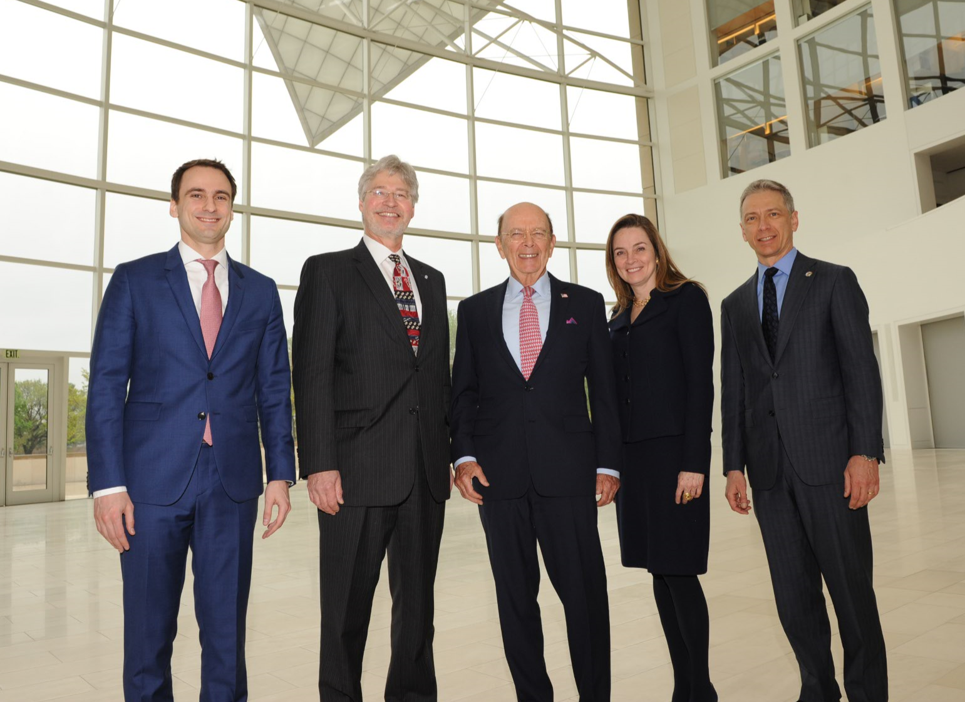
ROI Vision and Goal
VISION: Unleash the innovation power of America into our economy
GOAL: Maximize the transfer of federal investments in science and technology into value for America
meet current and future economic and national security needs in a rapidly shifting technology marketplace and enhance U.S. competitiveness globally
attract greater private sector investment to create innovative products, processes, services, as well as new businesses and industries
(L to R): Michael Kratsios (WH/OSTP), Walter Copan (U/S NIST), Wilbur Ross (Commerce Secretary), Margaret Weichert (Deputy Director OMB), Andrei Iancu (U/S USPTO)
Credit: Peter Cutts

Slide 11
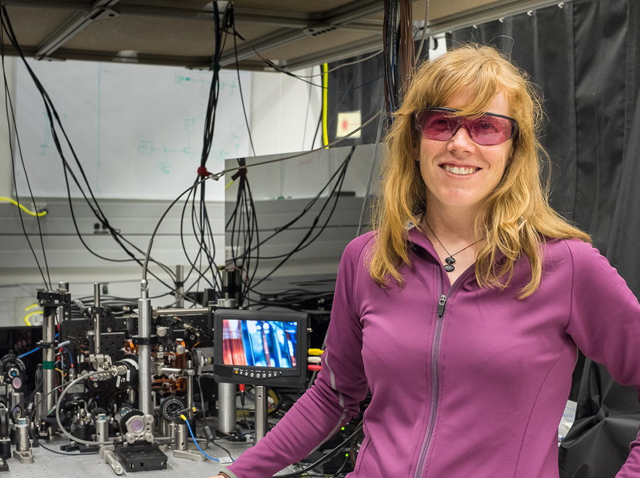
ROI Initiative Objective
Assess, streamline, and accelerate the transfer of technology from Lab-to-Market:
Identify critically needed improvements to Federal technology transfer policies, practices, and efforts
Seek broad input from Federal R&D, intellectual property and technology transfer stakeholders

Slide 12
ROI Initiative - Outreach
Unleashing American Innovation Symposium
April 19, Washington, DC
Request for Information
May 1 – July 30
ROI Public Meetings
May 17 – San Jose, CA
May 21 – Denver, CO
May 31 – Chicago, IL
June 14 – Gaithersburg, MD
All public meetings will be recorded and transcribed for internal NIST use only.
Notes:
NIST has used a variety of for a to gather input on tech transfer from stakeholders across the country, including a kick-off symposium (attended by 4 VCAT members), an RFI, and public meetings across the country

Slide 13
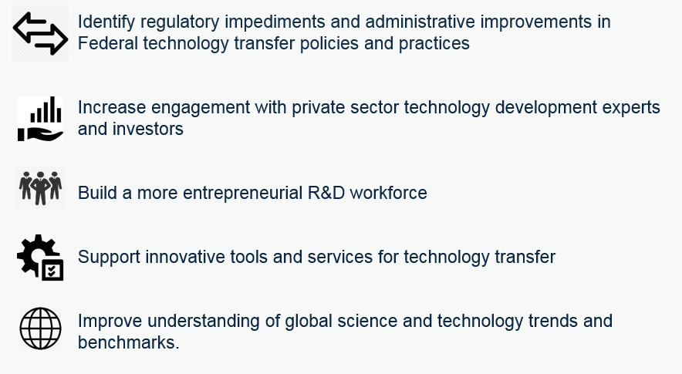
ROI Recommended Actions → CAP Goal Implementation
ROI recommended actions will support five CAP goal strategies:

Slide 14
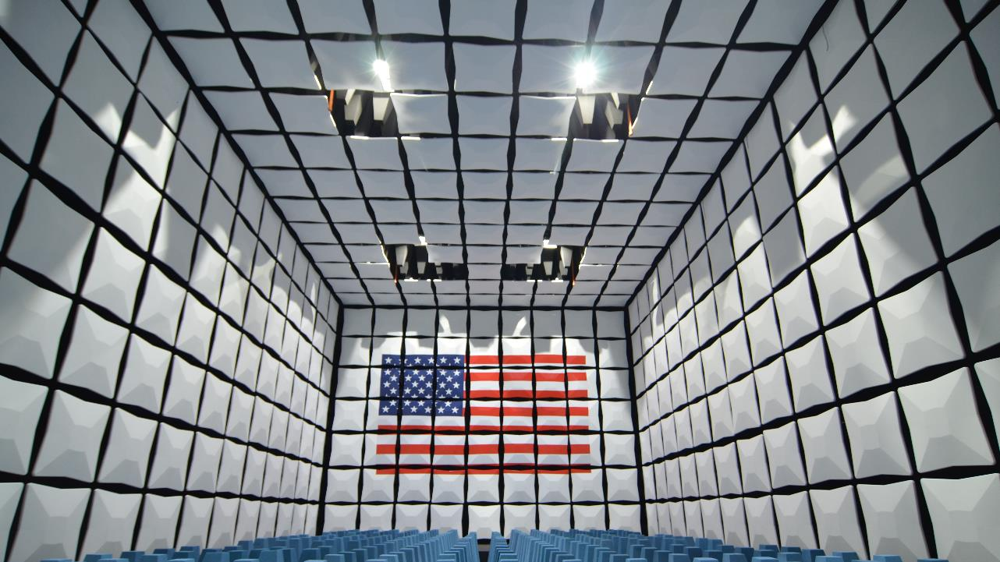
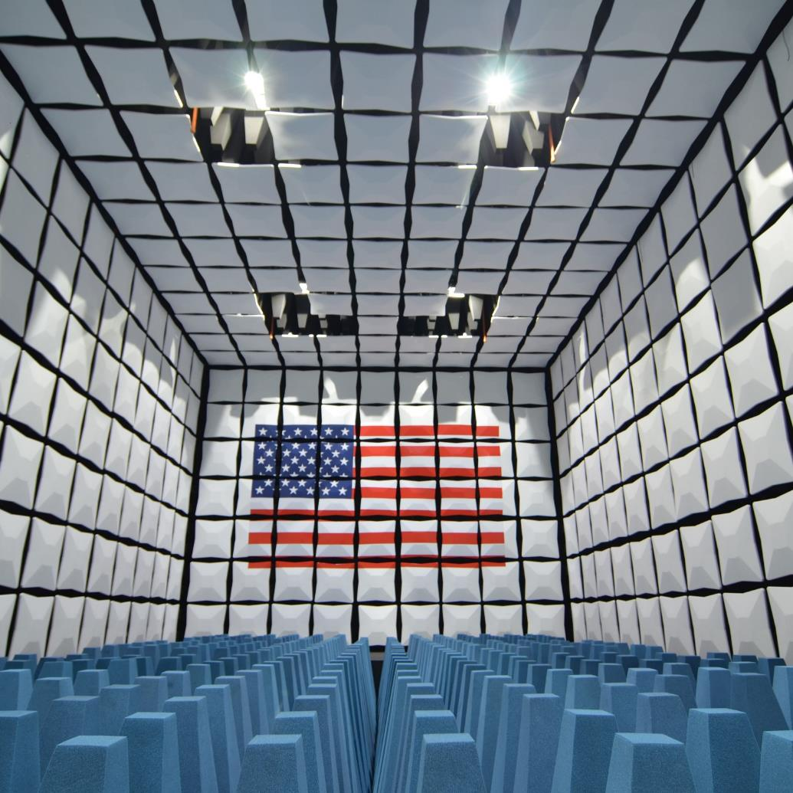
ROI Request for Information
What are the core Federal technology transfer principles and practices that should be protected, and those which should be adapted or changed?
What are the issues that pose systemic challenges to the effective transfer of technology, knowledge, and capabilities resulting from Federal R&D?
Please consider issues that may have inhibited collaborations with Federal laboratories, access to other federally funded R&D, or commercialization of technologies resulting from Federal R&D.
What is the proposed solution for each issue that poses a systemic challenge to the effective transfer of technology, knowledge, and capabilities resulting from Federal R&D?
What are other ways to significantly improve transfer of technology, knowledge, and capabilities resulting from Federal R&D to benefit U.S. innovation and the economy?
What changes would these proposed improvements require to Federal technology transfer practices, policies, regulations, and legislation?

Slide 15
Examples of Systemic Challenges
Difficulty negotiating IP terms and indemnification provisions
Inconsistent practices and interpretation of authorities across USG
Inability to copyright software and digital products developed by USG-operated labs
Challenges in protecting trade secrets when collaborating with Federal laboratories
Concern about march-in rights
Requiring Feds to leave government service to be entrepreneurs
Conflict of interest provisions that make it difficult for Feds to access resources needed to commercialize technology
©Robert Rathe
Notes:
This is an image of the NIST Center for Automotive Lightweighting (NCAL).This is a good example of successful public-private partnerships. Industry impact here: https://www.nist.gov/industry-impacts/automotive-lightweighting
Automotive companies are increasingly using lightweight materials to improve vehicle fuel economy. However, incorporating those materials into new vehicles is time-consuming and costly. NIST data and models are helping automakers understand and predict how materials behave in the harsh conditions inherent to manufacturing. NIST is partnering with U.S. automakers and base metal suppliers to develop the measurement methods, standards and analysis needed to more easily transition to lightweight materials. While many manufacturers have their own models for how materials can be formed and manipulated during the design process, the results of those models are only as good as the data they are based on. NIST is making the necessary fundamental measurements for automotive industry manufacturers to incorporate into their models.
The NCAL:
20+industry partners, including Chrysler, Ford, Novelis, GM, Auto/Steel Partnership and Alcoa
3-4 monthsdevelopment time saved by a major manufacturer by using NIST’s data—its new vehicle is 700 lbs. lighter and 50% more fuel efficient
$200 M/yr estimated cost savings to major U.S.-based automakers if NIST helps reduce their number of trial designs by half

Slide 16
ROI RFI Responses
Submit written responses by 5:00 pm Eastern Time on July 30, 2018 using either of the following methods:
Agency Website: https://www.nist.gov/tpo/roi-rfi-response.
Follow the instructions for sending comments on the agency website.
E-mail: roi@nist.gov.
Include “RFI Response: Federal Technology Transfer Authorities and Processes” in the subject line of the message.

Slide 17
ROI Initiative Information
Federal Register and Press Release Announcement of RFI and Public Forums
Video Recording of Unleashing American Innovation Symposium
www.nist.gov/tpo/ROI

Slide 18
Background Information

Slide 19
ROI Timeline and Milestones
February / March / April
April / May / June / July
August / September / October / November
President’s Management Agenda released with Lab-to-Market CAP Goal
Initial key stakeholder meetings to engage industry, university, and federal stakeholders
NIST website with ROI information and updates
Unleashing American Innovation Symposium Launch Event (April 19, 2018)
Request for Information (closes 7/30) published in Federal Register (May 1, 2018)
Public Forums (5/17, 5/21, 5/31, 6/14) announced in Federal Register (May 1, 2018)
Analysis of inputs/studies
Interagency review
Recommendations (best practices, policies, regulatory, legislative-if appropriate)
Initiate implementation of action plan

Slide 20
ROI Assessment Areas
Core technology transfer principles and practices that should be protected, and those which should be adapted or changed.
Approaches to improve efficiency and reduce regulatory burdens for technology transfer to attract private sector investment in later-stage R&D, commercialization, and advanced manufacturing.
New partnering models and technology transfer mechanisms with the private sector, academia, other Federal agencies, state, and other public-sector entities to support technology development and maturation.
New approaches to reduce/eliminate barriers and enable accelerated commercialization in areas of strategic national importance.
Better metrics and methods to evaluate ROI outcomes and impacts from Federal R&D investment.
New approaches to motivate significantly increased technology transfer outcomes from the Federal sector, universities, and research organizations.

