Slide 1
WELCOME
Informational Webinar – July 18, 2012
Federal Funding Opportunity: 2012-NIST-MEP-AZ-MD-RI-01
National Institute of Standards and Technology (NIST)
Manufacturing Extension Partnership (MEP)
Aimee Dobrzeniecki, Deputy Director, NIST MEP
Bill Kinser, Director, Center Operations, NIST MEP
Diane Henderson, Federal Program Officer, NIST MEP

Slide 2
Information Webinar and Communication Protocols
Webinar serves as a communication vehicle to provide an overview of the funding opportunity.
No questions will be taken as part of this webinar.
All questions should be presented in writing and submitted to Diane Henderson at NIST MEP, Diane.Henderson@nist.gov
  Provides for transparency and ensures all answers are documented.
  Assures questions and answers are handled consistently.
Questions and Answers will be posted regularly on the NIST MEP Public Site, www.nist.gov/mep

Slide 3
Information Webinar Agenda
Funding Opportunity Overview
Eligibility and Cost Share
Application/Proposal Submission
Application Package Details
Review Criteria
Selection Factors
Review and Selection Process
Award Administration Information
Reporting Requirements
NIST MEP Points of Contact

Slide 4
Funding Opportunity Overview (1)
Funding Opportunity Title: Manufacturing Extension Partnership (MEP) Centers for Arizona, Maryland and Rhode Island
Funding Opportunity Description: NIST invites proposals from eligible proposers for funding projects that provide manufacturing extension services to primarily small- and medium-sized manufacturers in the United States. Specifically, NIST seeks proposals for projects to establish MEP centers in Arizona, Maryland and Rhode Island.
  The objective of an MEP center is to provide manufacturing extension services that enhance productivity, innovative capacity, and technological performance, and strengthen the global competitiveness of primarily small- and medium-sized U.S.-based manufacturing firms in its service region.

Slide 5

Next Generation MEP Strategy
Increasing manufacturers’ capacity for innovation resulting in profitable sales growth is the overarching strategy for the MEP.
The approach is to provide a framework for manufacturers that:
  Reduces bottom line expenses through lean, quality, & other programs targeting plant efficiencies – which frees up capacity for business growth.
  Adds to top line sales through business growth services focused on the development of new sales, new markets, and new products.
Next Generation Strategies (NGS) – 5 key areas:
    Continuous Improvement
    Technology Acceleration
    Supply Chain
    Sustainability
    Workforce

Slide 6
MEP Program Evolution
Pre-Minimally Acceptable Impact Metrics
Minimally Acceptable Impact Metrics
Center Operations Reporting and Evaluation
Build a System
Optimize Performance and Accountability
Deliver Higher Value-Added Services
Deliver High Value
Focus on Strategic Management
Developing Leaders
Develop and Deploy Technology
Foster Innovation
Increase Economic Impact
Technology Based Economic Development
1988-1999
2000
2006
2008
2010

Slide 7
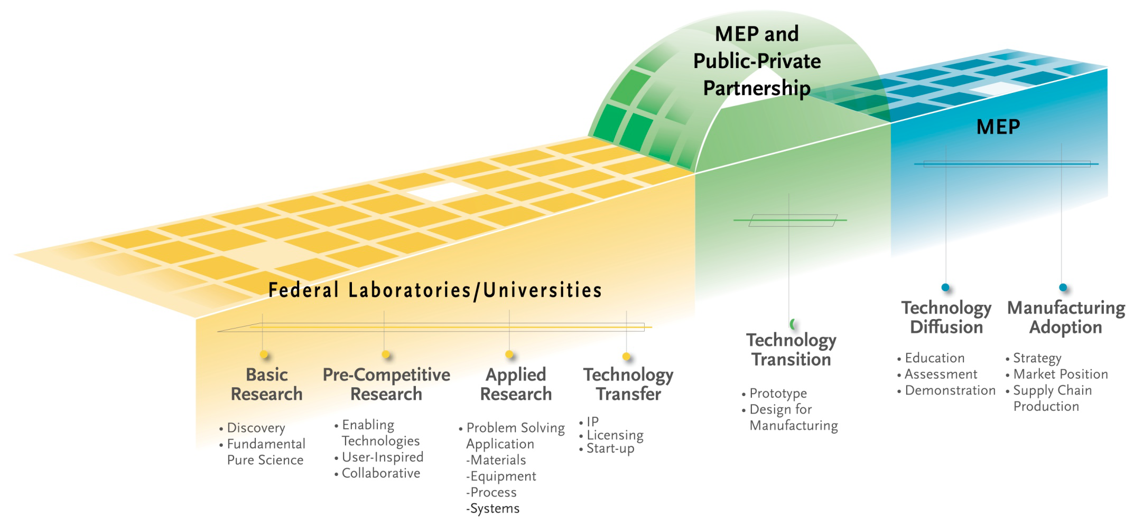
FY 2012 Focus:
Making the MEP Innovation System a Reality
  • Make the technology acceleration framework a reality
  • Engage at the CEO level to transform Firms
  • Partner with community leaders in regional innovation initiatives to encourage new business models/services/products, and to
commercialize technology

Slide 8
What does this mean for your center?
Developing an Innovation Plan that will then be translated into your Center’s future Annual Operating Plans
Integrating Services that Address Next Generation Strategies into Your Innovation Plan
Developing Sales and Executive Level Coaching Capabilities within your Center to Reach Decision Makers within Manufacturing Firms
Developing Transformation Plans for your Manufacturing Clients
  How to move a company from point “A” to “B” resulting in new business opportunities, for example:
    Opening new domestic or international markets
    Managing ownership changes
    Adopting environmentally sustainable practices

Slide 9
How the Plans Fit Together
Innovation Plan
Strategic Plan
1-Year Operating Plan
Innovation Plan is a hybrid of your strategic & operating plans
Focused on the transition to an innovation practice in your center
Temporary plan to encourage the transition to innovation services

Slide 10
Five Components of the Center Innovation Plan
Market Understanding
Information, perspectives, input and analysis done to identify the opportunities for the center in developing and adopting an Innovation Management System (includes client challenges from surveys, independent surveys, Board conversations, with client firms, etc.)
Business Model
Partnerships
Financial Viability
Performance Metrics
Metrics to be used by the center in understanding the success of implementing an Innovation Management System
(including anticipated milestones for implementation, outcome measures relating to CORE metrics and other performance measures)
Changes in the centers business model that will be necessary for success in implementing an Innovation Management System (such as use of broker approach, in-house, anticipated fee-for-service structure, new or modified products and services, staff deployment or other necessary key changes)
Changes in partnerships that will be necessary to successfully implement an Innovation Management System
(including key partners, partner types and roles or the role current partnerships are playing to support an Innovation Management System)
Anticipated financial requirements and outcomes in implementing an Innovation Management System
(such as investment, client fees, other revenue or working capital required over the next 2 – 5 years)

Slide 11
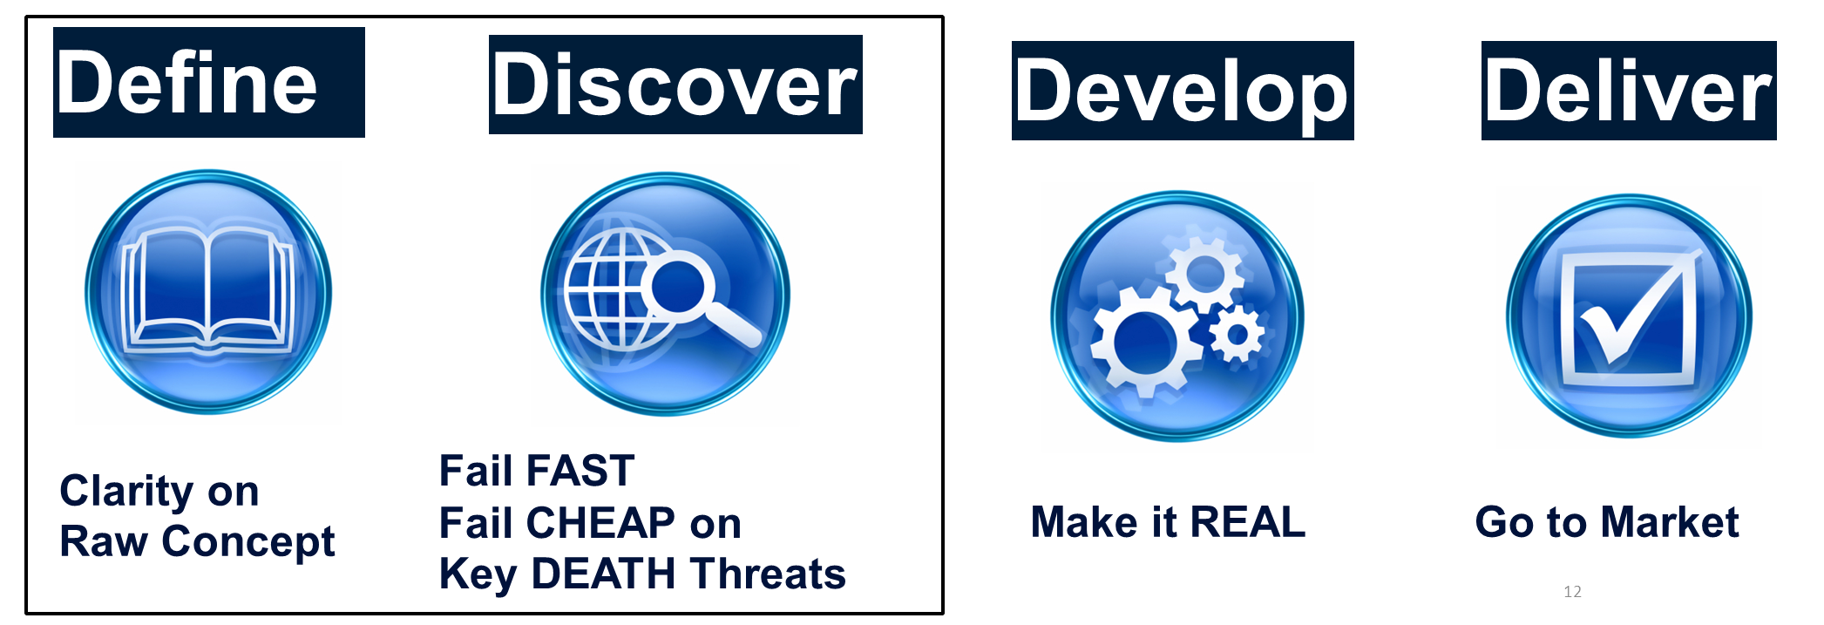
MEP Innovation Approach
Innovation Engineering Leadership Institute (IELI):
www.nist.gov/mep/innovation.cfm
Innovation Engineering Management System accelerates a company’s continuous flow of innovations – turning new ideas into cash.
  Major innovation projects impact sales and profits.
  Minor projects help transform the culture.
A four-stage process of Define, Discover, Develop and Deliver – a system that support with classic project management such as Compression Planning, Stage-Gate, Design for 6 Sigma or Hoshin Planning.

Slide 12
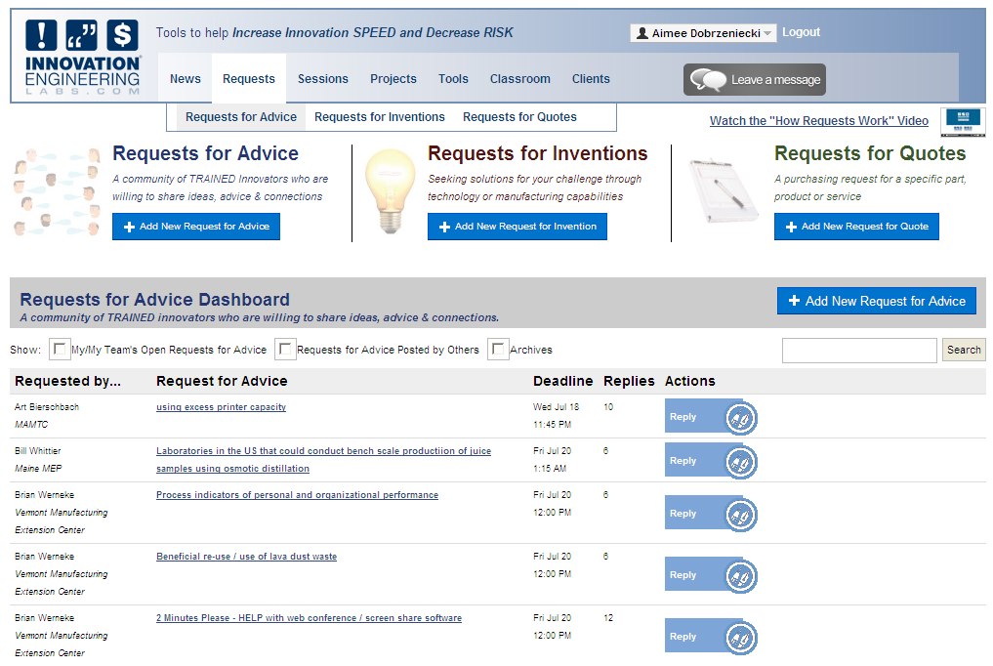
http://innovationengineeringlabs.com

Slide 13
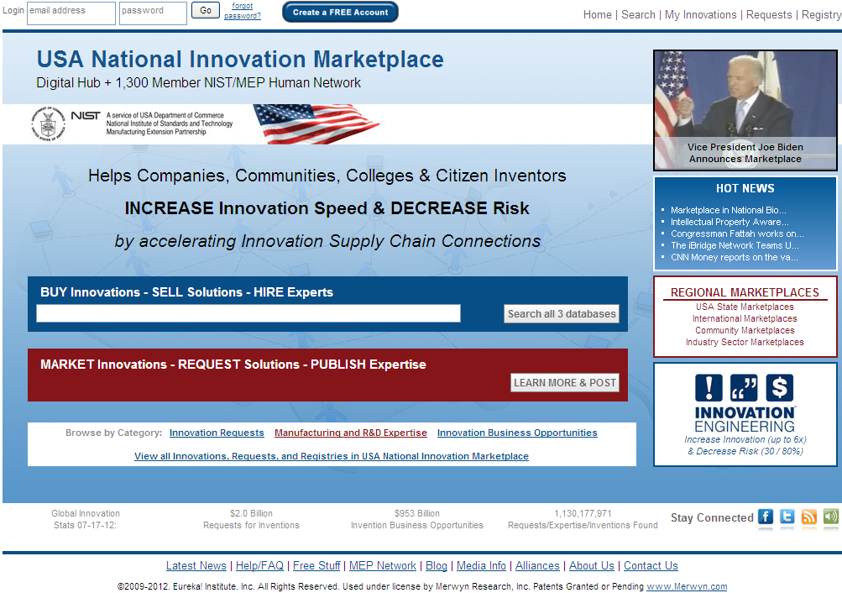

http://innovationsupplychain.com/

Slide 14

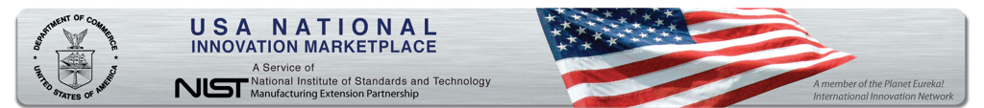

National Innovation Marketplace (NIM)
Connect manufacturers to requests for innovation
Translates emerging technologies into (1) business applications, (2) market opportunities, and (3) possible new products.
Uses open innovation approach which includes partnering, licensing, and co-developing innovations with partners outside of a company instead of the traditional, internal research and development.
Connects innovation research, technology experts with buying opportunities and manufacturers.
www.usainnovation.org

Slide 15
Funding Opportunity Overview (2)
Authority: The statutory authority for the MEP Program is 15 U.S.C. 278k, as implemented in 15 C.F.R. part 290.
Funding Instrument: Cooperative Agreement
  The funding instrument that will be used for each award is a cooperative agreement. The nature of NIST’s “substantial involvement” will generally be collaboration between MEP and the recipient organizations. This includes MEP collaboration with a recipient on its progress and approving changes in the statement of work.
  Reference: http://www.osec.doc.gov/oam/grants_management/policy/doc_grants_manual/default.htm

Slide 16
Funding Opportunity Overview (3)
Cost Share:
  Non-Federal cost sharing of at least 50 percent of the total project costs is required for the first year of operation.
  The proposer’s share of the MEP center expenses may include cash, services, and third party in-kind contributions, as described at 15 C.F.R. Sec. 14.23 or 24.24, as applicable, and the MEP program rule, 15 C.F.R. Sec. 290.4(c). (See FFO for further information)
Funding Available:
  NIST anticipates funding three (3) proposals: one (1) at the level of up to $1,000,000 for an MEP Center in the state of Arizona, one (1) proposal at the level of up to $1,000,000 for an MEP Center in the state of Maryland, and one (1) proposal at the level of up to $1,000,000 for an MEP Center in the state of Rhode Island.
Eligible Applicants: Existing MEP Centers
  The eligibility requirements given in this section will be used in lieu of those published in the MEP regulations found at 15 C.F.R. part 290, specifically 15 C.F.R. § 290.5(a)(1). Each award recipient must be a U.S.-based nonprofit institution or organization. For the purpose of this FFO, nonprofit organizations include, but are not limited to, universities and state and local governments. An eligible organization may work individually or include proposed subawards or contracts with others in a project proposal, effectively forming a team. Existing MEP centers are eligible.

Slide 17
Funding Opportunity Overview (4)
Period of Performance:
  The projects awarded under this FFO will have a budget and performance period of one (1) year.
  Each award may be renewed on an annual basis subject to the review requirements described in 15 C.F.R. 290.8.
  Renewal of each project shall be at the sole discretion of NIST and shall be based upon satisfactory performance, priority of the need for the service, existing legislative authority, and availability of funds.

Slide 18
Application/Proposal Submission
Dates:
  All applications must be received or postmarked on August 20, 2012 NLT 5:00 pm (EST).
  Late proposals will not be reviewed.
  No exceptions allowed.
Proposal Submission:
  Electronic submission: Applicants should follow application instructions
  provided at: www.grants.gov
  Paper submission: NIST requires an original and two (2) copies be sent to:
      National Institute of Standards and Technology
      Manufacturing Extension Partnership
      c/o Diane Henderson
      100 Bureau Drive, MS 4800
      Gaithersburg, MD 20899-4800

Slide 19
Application Package Details (1):
Complete applications/proposals must, at a minimum, include the following forms and documents and meet the following requirements identified in the FFO which are:
Required Forms*:
  SF-424 Application for Federal Assistance
  SF-424A Budget Information Non-Constructions
  SF-424B Assurances Non-construction
  CD-511 Certification Regarding Lobbying
  SF-LLL Disclosure of Lobbying Activities (if applicable)
  *Forms are available as part of the Grants.gov application kit
  Technical Proposal
    The Technical Proposal is a word-processed document of no more than twenty-five (25) pages responsive to the program description (see Section IV.2. of the FFO) and the evaluation criteria (see Section V.1. of the FFO). It should contain the following information:

Slide 20
Application Package Details (2):
Proposal Requirements:
In addition to the required forms the proposal must include:
  Executive Summary
    The executive summary should briefly describe the proposed project, consistent with the evaluation criteria (see Section IV.2. of the FFO).
  Project Narrative/Statement of Work
    A description of the proposed project, sufficient to permit evaluation of the proposal, in accordance with the evaluation criteria (see Section IV.2. of the FFO).
  Qualifications
    A description of the qualifications and proposed center operational or management activities of key personnel who will be assigned to work on the proposed project.

Slide 21
Application Package Details (3):
Statement of Work
    The statement of work should discuss the specific tasks to be carried out, including a schedule of measurable events and milestones.
Integration Plans
    Include plans for integration into the MEP national system and linkages to appropriate national resources.
Past Performance (for existing or previous MEP center proposers only)
    Proposals from existing or previous MEP centers or partners must provide specific information that addresses whether the proposer’s past performance with the program is indicative of expected performance under a possible new award and describing how and why performance is expected to be the same or different.
Budget Narrative
    There is no set format for the Budget Narrative; however, it should provide a detailed breakdown of each of the object class categories as reflected on the SF-424A. It should include:
    (a) All expenses for year one (1) of operation and identify all sources of funds to pay these expenses.
    (b) A budget outline for annual costs and sources of funds for potential years two (2) through five (5) at no more than $1,000,000 per year in NIST support for an MEP center in Arizona, no more than $1,000,000 per year in NIST support for an MEP center in Maryland and at no more than $1,000,000 per year in NIST support for an MEP center in Rhode Island.

Slide 22
Application Package Details (4):
Letters of Commitment for Non-Federal Cost Sharing
  Letters of commitment from all sources of the non-Federal cost sharing are required. Letters of commitment do not count toward the page limit.
  General “letters of support” are not required and will be counted toward the page limit for the Technical Proposal if included in the proposal.
Indirect Cost Rate Agreement
  If indirect costs are included in the proposed budget, provide a copy of the approved negotiated agreement if this rate was negotiated with a cognizant Federal audit agency. If the rate was not established by a cognizant Federal audit agency, provide a statement to this effect.

Slide 23
Application Package Details (5):
Proposal Format:
  The proposal must not exceed 25 typewritten pages (double-sided/counts as 2 pages) in length for the basic proposal document
      The proposal must be responsive to the criteria outlined in the FFO.
  The proposal must contain both technical and cost information.
  The proposal page count includes:
    Table of contents (if included), Technical Proposal with all required sections, resumes, figures, graphs, tables, images, and pictures.
  The proposal page count does not include:
    SF-424, Application for Federal Assistance; SF-424A, Budget Information – Non-Construction Programs; SF-424B, Assurances – Non-Construction Programs; SF-LLL, Disclosure of Lobbying Activities; CD-511, Certification Regarding Lobbying; Budget Narrative; and Indirect Cost Rate Agreement.

Slide 24
Review Criteria:
The proposals will be evaluated based on the evaluation criteria described below, which are assigned equal weighting:
  Identification of Target Firms in Proposed Region.
      Market Analysis
      Geographical Location
  Technology Resources
  Technology Delivery Mechanisms
      Linkages
      Program Leverage
  Management and Financial Plan
      Organizational Structure
      Program Management
      Internal Evaluation
      Plans for Financial Cost Share
      Budget
NOTE: Proposers may not submit replacement pages and/or missing documents once a proposal has been submitted. Any revisions must be made by submission of a new proposal that must be received by NIST by the submission deadline.

Slide 25
Selection Factors
The Selecting Official shall select proposals for award based upon the rank order of the proposals, and may select a proposal out of rank based on one or more of the following selection factors:
  Availability of Federal funds.
  The need to assure appropriate regional distribution.
  Whether the project duplicates other projects funded by DoC or by other Federal agencies.
  Proposer’s performance under current or previous Federal financial assistance awards.
Note: Proposals from existing or previous MEP centers or partners must contain specific information that addresses whether the proposer’s past performance with the program is indicative of expected performance under a possible new award and describing how and why performance is expected to be the same or different.

Slide 26
Review and Selection Process
Initial Administrative Review of Proposals
  An initial review of timely received proposals will be conducted to determine eligibility, completeness, and responsiveness to the FFO and the scope of the stated program objectives. Proposals determined to be ineligible, incomplete, and/or non-responsive may be eliminated from further review.
Full Review of Eligible, Complete, and Responsive Proposals
  Proposals that are determined to be eligible, complete, and responsive will proceed for full reviews in accordance with the review and selection processes below:
    Evaluation/Review and Ranking. NIST will appoint an evaluation panel, consisting of at least three technically qualified reviewers, to conduct independent and objective reviews and evaluations of each proposal based on the evaluation criteria (see Section V.1. of the FFO) and assign a numeric score for each proposal. If more than one non-Federal employee reviewer is used on the panel, the panel member reviewers may discuss the proposals with each other, but scores will be determined on an individual basis, not as a consensus. Based on the average of the panel member reviewers’ scores, a rank order will be prepared and provided to the Selecting Official for further consideration.

Slide 27
Review and Selection Process – 3 Phases
  Site Visits
    Site visits may be required to make full evaluation of a proposal that has been determined to be a finalist. If site visits are deemed necessary, all finalists will receive site visits conducted by the same evaluation panel reviewers referenced in the preceding paragraph.
  Ranking and Selection
    The Selecting Official, who is the Director of the NIST MEP Program, will then select funding recipients based upon the rank order and the selection factors (see Section V.2. of the FFO).

Slide 28
Award Administration Information
Anticipated Announcement and Award date
  Review, selection, and award processing is expected to be completed in September 2012.
  The earliest anticipated start date for awards made under this FFO is expected to be October 1, 2012.
Award Notices
  Each successful finalist will receive a cooperative agreement award document from the NIST Grants Officer
Employer/Taxpayer Identification Number (EIN/TIN), Dun and Bradstreet Data Universal Numbering System (DUNS), and Central Contractor Registration (CCR)
  All proposers for Federal financial assistance are required to obtain a universal identifier in the form of DUNS number and maintain a current registration in the CCR database.
Funding Availability and Limitation of Liability
  The funding periods and funding amounts reference in this notice and request for proposals are subject to the availability of funds and DOC and NIST priorities at the time of award

Slide 29
Award Administration Information (2)
Award Implementation
  Given the partnership nature of MEP Centers, and to clarify and support the project activities and budget, including cost sharing, NIST may ask recipients to provide copies of sub-tier agreements, including subawards and contracts over $100,000.
  In addition, to better understand and implement the national manufacturing extension network and partnership, NIST may ask recipients to provide an Operating Plan and Budget showing manufacturing extension service activity and costs in which the Center is engaged outside the Federal share and cost share for the project.

Slide 30
Reporting Requirements
In lieu of the reporting requirements described in sections A.01 Financial Reports and B.01 Performance (Technical) Reports of the DoC Financial Assistance Standard Terms and Conditions dated March 2008 (http://www.osec.doc.gov/oam/archive/docs/GRANTS/DOC%20STCsMAR08Rev.pdf), the following reporting requirements shall apply:
  SF-425 Federal Financial Report - Each award recipient will be required to submit an SF-425, Federal Financial Report in triplicate (an original and two (2) copies), on a quarterly basis for the periods ending March 31, June 30, September 30, and December 31 of each year. Reports will be due within 30 days after the end of the reporting period
  Performance (Technical ) Reports- Each award recipient will be required to submit a technical progress report in triplicate (an original and two (2) copies), on a quarterly basis for the periods ending March 31, June 30, September 30, and December 31 of each year. (Please refer to 15 C.F.R. § 14.51 for further information)
  Post client Project Follow-up - For demonstration activities, as applicable, the recipient shall provide client and project data in the specified format to the organization identified by NIST/MEP in order for post-project follow-up data to be obtained.

Slide 31
Reporting Requirements (2)
Automated Standardized Application for Payment System (ASAP)
  (For those awarded) In order to receive payments for services, recipients will be required to register to the Dept of Treasury. More information regarding ASAP can be found on-line at www.fms.treas.gov/asap/index.html.

Slide 32
NIST MEP Points of Contacts Regarding this Funding Opportunity
Subject Area | Point of Contact
Administrative, budget, cost-sharing, eligibility questions, and other programmatic questions. | Diane Henderson Manufacturing Extension Partnership NIST Phone: 301-975-5105 Fax: 301-963-6556 E-mail: diane.henderson@nist.gov
Grants.gov - Proposal submission | Christopher Hunton Grants & Agreements Management Division NIST Phone: 301–975–5718 Fax: 301–840-5976 E-mail: christopher.hunton@nist.gov
Grant rules and regulations | Jannet Cancino Grants & Agreements Management Division NIST Phone: 301-975-6544 Fax: 301-926-6458 E-mail: jannet.cancino@nist.gov

