Slide 1
NIST MEP Response to MEP Advisory Board Recommendations
MEP Advisory Board September 27, 2013

Slide 2
Board Recommendations
At the June 2013 meeting, the Board asked for an update on the following recommendations:
Recommendation that NIST MEP initiate a personnel exchange program with the MEP Centers so that Federal staff and MEP Center staff can deepen their understanding of their respective roles in this public private partnership and provide more effective services to U.S. manufacturers.
Recommendation that MEP strategic efforts in the area of workforce development be expanded by looking for collaborative efforts with other Federal Agencies that address specific workforce gaps of interest to SMEs.
Recommendation that MEP develop specific metrics for the Innovation Engineering program and that MEP continue its effort to more directly brand the Innovation Engineering program as an MEP activity while considering options to broaden the range of service providers under this program.

Slide 3
Recommendation that NIST MEP initiate a personnel exchange program with the MEP Centers so that Federal staff and MEP Center staff can deepen their understanding of their respective roles in this public private partnership and provide more effective services to U.S. manufacturers.

Slide 4
Employee Exchange Program
A personnel exchange program could be used for the professional development of staff at both the MEP centers and NIST MEP and offer specific benefits for the individual candidates and both organizations.
The benefits to NIST MEP include:
A broader understanding of the complexities of operating a MEP center
Stronger connections to a Center’s partner organizations and better understanding of center relationships with key stakeholders including state government leaders
Opportunities to better explore and understand the needs, challenges, and growth opportunities for U.S. manufacturers
The benefits for the MEP centers include:
An understanding of the role of NIST MEP in maintaining a networked system of centers
Stronger connections with NIST MEP and its various divisions, teams, and staff.
A greater appreciation for the complexities of operating within the federal government environment including MEP relationships with NIST, DOC, other federal agencies, the White House, and Congress.

Slide 5
Candidates for the Exchange Program
From NIST MEP: Employees that have been with the program for less than 3 years would be given the first opportunity.
From the MEP Centers: Participants in the Emerging Leaders 2.0 program (the MEP system leadership development program) would have the opportunity to participate in the exchange.

Slide 6
Sample Program focus:
For NIST MEP, a detail would include the opportunity to:
Participate in visits to manufacturers
Participate in project activity with a client
Develop an understanding of the Center partners and stakeholders
Attend Center Board meetings
Develop first-hand appreciation for the Center’s operating environment (reporting requirements, operating structure, business environment, etc.)

Slide 7
Sample Program focus:
For Center Staff, a detail would include the opportunity to:
Address a issue or challenge defined by NIST MEP
For example, how best to integrate a national initiative into a center business model
Address a Center specific challenge with application to the entire MEP system
For example, work with NIST MEP on opportunities to reduce administrative burden

Slide 8
Cost to NIST MEP
Using Philadelphia as a base, it would cost approximately $7200 for a NIST MEP staff person to complete a 30-day detail
NIST MEP would continue to pay all salary and benefits.
There would be no direct cost to the MEP center related to host a NIST MEP detailee.

Slide 9
Next Steps
NIST MEP will share the concept with a group of Centers that have been convened to offer advice and counsel on a number of reporting and administrative changes and their feedback will be incorporated.
The concept will be refined and specific topics will be identified.
The employee exchange opportunity will be shared with the MEP System during the January 2014 update meeting with plans to accept applicants as early as February / March 2014.

Slide 10
Recommendation that MEP strategic efforts in the area of workforce development be expanded by looking for collaborative efforts with other Federal Agencies that address specific workforce gaps of interest to SMEs.

Slide 11
MEP’s Strategic Approach to Workforce
MEP has been working proactively on several levels and through leveraged partnerships to accelerate the up-skilling and employment of the manufacturing workforce. Specifically, MEP works at three broad levels to encourage America’s manufacturers to enhance worker skills and to approach workforce issues more strategically:
Direct Client Engagements - MEP centers work directly with small manufacturers to help them with their competitiveness issues, including addressing workforce strategy and training needs.
State and Local Level - MEP centers are engaged with educational institutions, workforce boards, and other stakeholders and service providers to strengthen the manufacturing ecosystem that will support and address expressed manufacturers’ needs.
National Level - NIST MEP collaborates with trade associations, other federal agencies and other manufacturing allies to support and promote the growth of manufacturing.

Slide 12
Direct Client Engagements
MEP Centers continue to collaborate with local partners to deliver critical workforce related training and services to companies that include lean, quality, six sigma, environmental safety and health, etc.
To position organizations for the future and to strategically respond to growth opportunities, NIST MEP, in collaboration with MEP centers, is developing a talent management system - Strategic Management Acquisition and Retention of Talent (SMARTalent).
SMARTalent is a system to help manufacturers operationalize their workforce development strategies. As manufacturers focus on workforce planning and investment, this resource, in combination with the expertise of the local MEP center, can help most effectively operationalize investments to help manufacturers eliminate task redundancies and streamline processes.

Slide 13
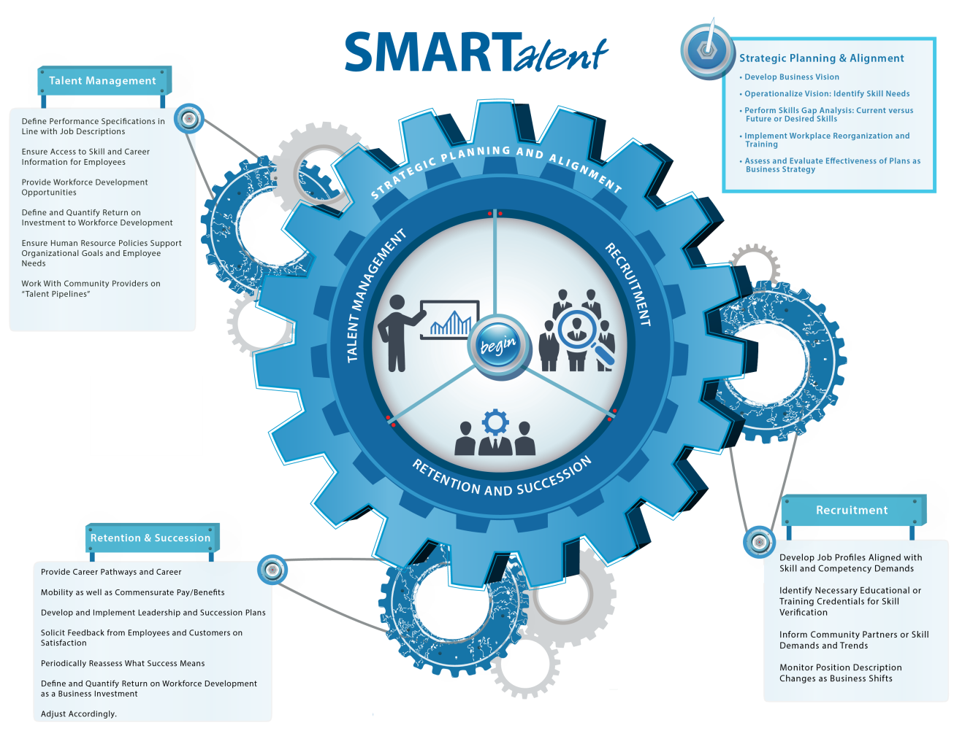
SMARTalent
SMARTalent helps CEOs understand their current practices and gaps; the modules manage and implement talent planning decisions as they align to business goals. SMARTalent is a knowledge management and process implementation tool.

Slide 14
State and Local Efforts
MEP centers engage with educational institutions, workforce boards, and other stakeholders to support the manufacturing ecosystem and address manufacturers’ needs.
Since 2012, nearly 150 community college/MEP partnerships have resulted in high-quality, job focused training and MEP centers have provided over 6,000 unique training opportunities.
In recent years, Centers have increasingly partnered with local workforce investment boards (WIBs), and play an integral role in lay-off aversion activities, which are intended to prevent job losses and plant closures.
Over the last two years, MEP centers have assessed over 200 at risk manufacturers and helped with cost savings, training, re-training and redeployment opportunities to ensure that the companies and the local economies do not lose revenue or skills.

Slide 15
Federal Partnerships and Related Collaborations
MEP has a number of Federal partnerships that support workforce activities. Three multi-agency federal funding partnerships that include manufacturing-specific training are:
Advanced Manufacturing Jobs and Innovation Accelerator Challenge (AMJIAC),
Building Construction Education Technology Program (BCTEP),
Energy, Economy and Environment (E3).
Federal Partners include EDA, Energy, USDA, Labor, EPA, and SBA.
~ 30 Centers currently participate in these opportunities and work directly with their local manufacturers, to deliver assessments and/or arrange the most suitable training in environmental, sustainability, and operational skills.
Skills for America’s Future
National Association of Manufacturers (NAM) skills certification system
MEP provides information and guidance to centers on the value and utility of skill certifications in manufacturing.
Notes:
In 2011, a major expansion was announced for Skills For America's Future, an industry-led partnership to improve industry partnerships with community colleges and help understand the skills needed for the 21st century. A big part of that is the NAM's skills certification system and MEP provides information and guidance to centers on the value and utility of skill certifications in manufacturing.
>

Slide 16
Local examples of how these are being deployed include:
Centers in New York, Pennsylvania and California are offering “building re-tuning” training, which finds quick, but inexpensive fixes to building energy costs.
Centers in Alabama, North Carolina, Ohio and twelve other states provide manufacturers with assessments, training and recommendations on how to reduce their environmental footprint and embrace sustainability as a business driver through the E3 program.
Nine Centers across the nation will spur job creation and economic growth through public and private partnerships, catalyze and leverage private capital, build an entrepreneurial ecosystem, and promote advanced manufacturing and cluster-based development through AMJIAC.

Slide 17
MEP WORKFORCE ACTIVITIES - FEDERAL AGENCIES SYNOPSIS

Slide 18
Recommendation that MEP develop specific metrics for the Innovation Engineering program and that MEP continue its effort to more directly brand the Innovation Engineering program as an MEP activity while considering options to broaden the range of service providers under this program.

Slide 19
Innovation Engineering
Innovation Engineering is a systematic approach to create a culture of innovation within an organization. The components of Innovation Engineering include:
Innovation Engineering Management System (IEMS) - The methodology used to increase the speed of innovation in a manufacturer, while reducing the risk of failure.
Innovation College - Provides MEP Center staff working with manufacturers the resources and tools to sustain an innovation culture within a manufacturing organization.
Innovation Engineering Black Belt - MEP Staff who complete all the Innovation College Program, as well as complete manufacturer specific projects, and finally
Innovation Engineering Labs – The portal for project management, tools management, and knowledge exchange.

Slide 20
Innovation Engineering (IE) Metrics
Challenges – Collection and Analysis
Available Data and Intelligence
Plans for Moving Forward
Program Evaluation and Management
Programmatic Need
Establish a Decision Framework Methodology
Codify and Align Contract Management with Program Evaluation
Next Steps

Slide 21
Challenges – Collection and Analysis
Survey
Survey focuses on “services received over the prior 12 months”
Multiple projects can be part of that survey
Client based survey rather than project based
Substance Codes do not focus on specific initiatives
Evolving Product and Service Mix

Slide 22
Available Data and Intelligence
709 unique, individual field staff participated in various programs and services including regular evolutions of the offerings including Eureka! Winning Ways, Jump Start, Innovation Engineering Leadership Institutes, and Innovation Black Belt Training
Represents more than half of the MEP field staff, which averages about 1,200 per year.
Black Belt Status
41 staff received their Innovation Black Belt
Includes 22 center staff who received their Innovation Black Belt as a result of the e-CAR award to ten centers to develop and implement the black belt certification.

Slide 23
Available Data and Intelligence, cont.
258 additional staff are currently enrolled in Black Belt training,
Anticipate 10% to 20% will become certified, resulting in additional 25 to 50 certified black belts across the system (in addition to the 41 current.)
CY 2010-2012 MEP sponsored 29 Innovation Engineering Leadership Institutes
~ 1,700 attendees
~ 416 (24%) were manufacturers.

Slide 24
Plans Moving Forward
Center Operations Reporting and Evaluation (“CORE”) Scorecard includes both quantitative data (client survey impact metrics) and qualitative assessment of center activities and approaches.
Innovation Engineering has been a part of our CORE Scorecard in the past with particular emphasis on center directors and staff becoming certified Black Belts in Innovation Engineering,
As of August 1, 2013 the qualitative metrics no longer reference any requirements in regards to Innovation Engineering or Black Belt certifications.
Reflected in the next available center Scorecard for Second Quarter 2013, available October 5, 2013.

Slide 25
Program Evaluation and Management
Programmatic Need
Establish a Decision Framework Methodology
Codify and Align Contract Management with Program Evaluation
Next Steps

Slide 26
Programmatic Need Establish a Decision Framework Methodology
Methodology to:
Effectively support strategic initiatives
Efficiently allocate resources
Transparently communicate decisions
DRAFT methodology under review

Slide 27
Programmatic Need
Codify and Align Contract Management with Program Evaluation
Document a Contract Management Procedure consistent with Acquisitions Management Division requirements and regulations – DRAFT
Integrate the Program Management Evaluation Process – DRAFT
Validating to current contract (RTI)

Slide 28
Next Steps
Contract and Program Evaluations
Complete NIM Evaluation – October 2013
Complete IE Evaluation – November 2013
Complete TS/TDMI Evaluation – November 2013
Fully Implement Contract and Performance Management Protocols – November 2013
Incorporate and align Decision Framework Methodology with Strategic Planning activity

Slide 29
Questions/Discussion

