Slide 1
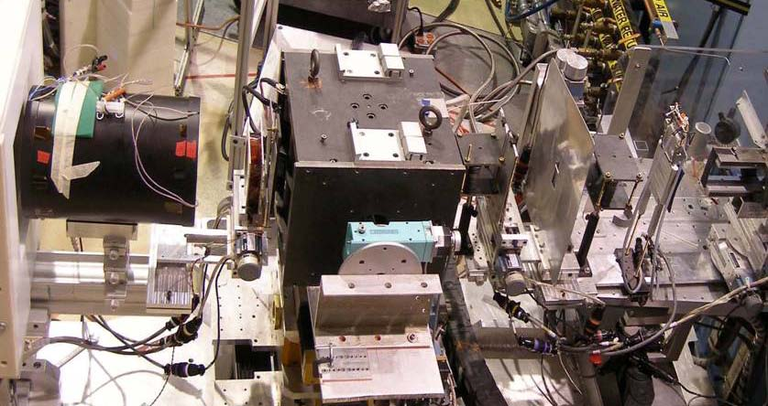
³He NSF polarization analysis for diffuse reflectometry
³He neutron spin filter
Four cross sections measured
No Q range blockage
³He neutron transmission 45% (for desired spin state)
Initial flipping ratio of 70
Supermirror efficiency above 0.98
Nearly perfect flipper efficiency
³He NMR based neutron spin flipping capability
Sample field up to 0.7 T
PSD
³He cell
SM polarizer
Spin
flipper
Sample
Magnetically
shielded solenoid
W.C. Chen et al, Rev. Sci. Instrum 75, 3256 (2004)
http://www.ncnr.nist.gov/equipment/he3nsf/index.html

