Slide 1
How Neutrons Are Produced: The NIST Research Reactor and Cold Neutron Sources
Robert Williams
NIST Center for Neutron Research
February 3, 2021
robert.williams@nist.gov

Slide 2
Outline:
Basics
NBSR History, Description
Cold Source Development
Conclusion
Informal History on the NCNR Web Site under About NCNR:
https://www.ncnr.nist.gov/NCNRHistory_Rush_Cappelletti.pdf

Slide 3
NIST Research Reactor History
Designed in the 1960’s and included a beam port for a cold neutron source.
NBSR First Critical, December 7, 1967.
10 MW until 1985, 20 MW since.
Cold Neutron Facility Development:
D₂O Cold Neutron Source installed, 1987.
First neutrons in the guide hall in 1990.
LH₂ Source installed September 1995.
Advanced LH₂ CNS, Unit 2, installed 2002.
NCNR Expansion Project – 5 more guides.
“Peewee” CNS installed 2012 in BT-9.

Slide 4
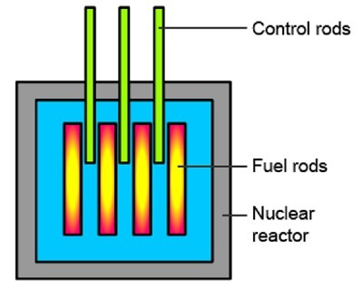
Thermal Reactor Components
Fissile fuel material, such as ²³⁵U, only 0.7% abundant, or ²³⁹Pu.
Moderator to slow neutrons (D₂O, H₂O, Graphite)
Control Elements (Cd, B)
Other Stuff:
Shielding
Coolant
Neutron Source
Neutron Detectors
Moderator
Biological Shield

Slide 5
NBSR Core Characteristics
HEU** Fuel: 93% ²³⁵U₃O₈ + Al
350 g ²³⁵U per Fuel Element
34 plates: 11 in x 2.5 in x .02 in
Heavy water coolant (D₂O)
30 Fuel Elements
Fuel cycle ~38 days @ 20 MW
Load 4 fresh elements, reposition the others
About 960 g ²³⁵U consumed per cycle
Split Core – No Fuel at Mid-plane
The BTs and CNS are at this elevation.
Thermal neutron “flux trap”.
BT fluxes ~ 1.5 x 10¹⁴ n/cm²-s
** Need to convert to LEU (U-10Mo) when fuel is qualified.

Slide 6
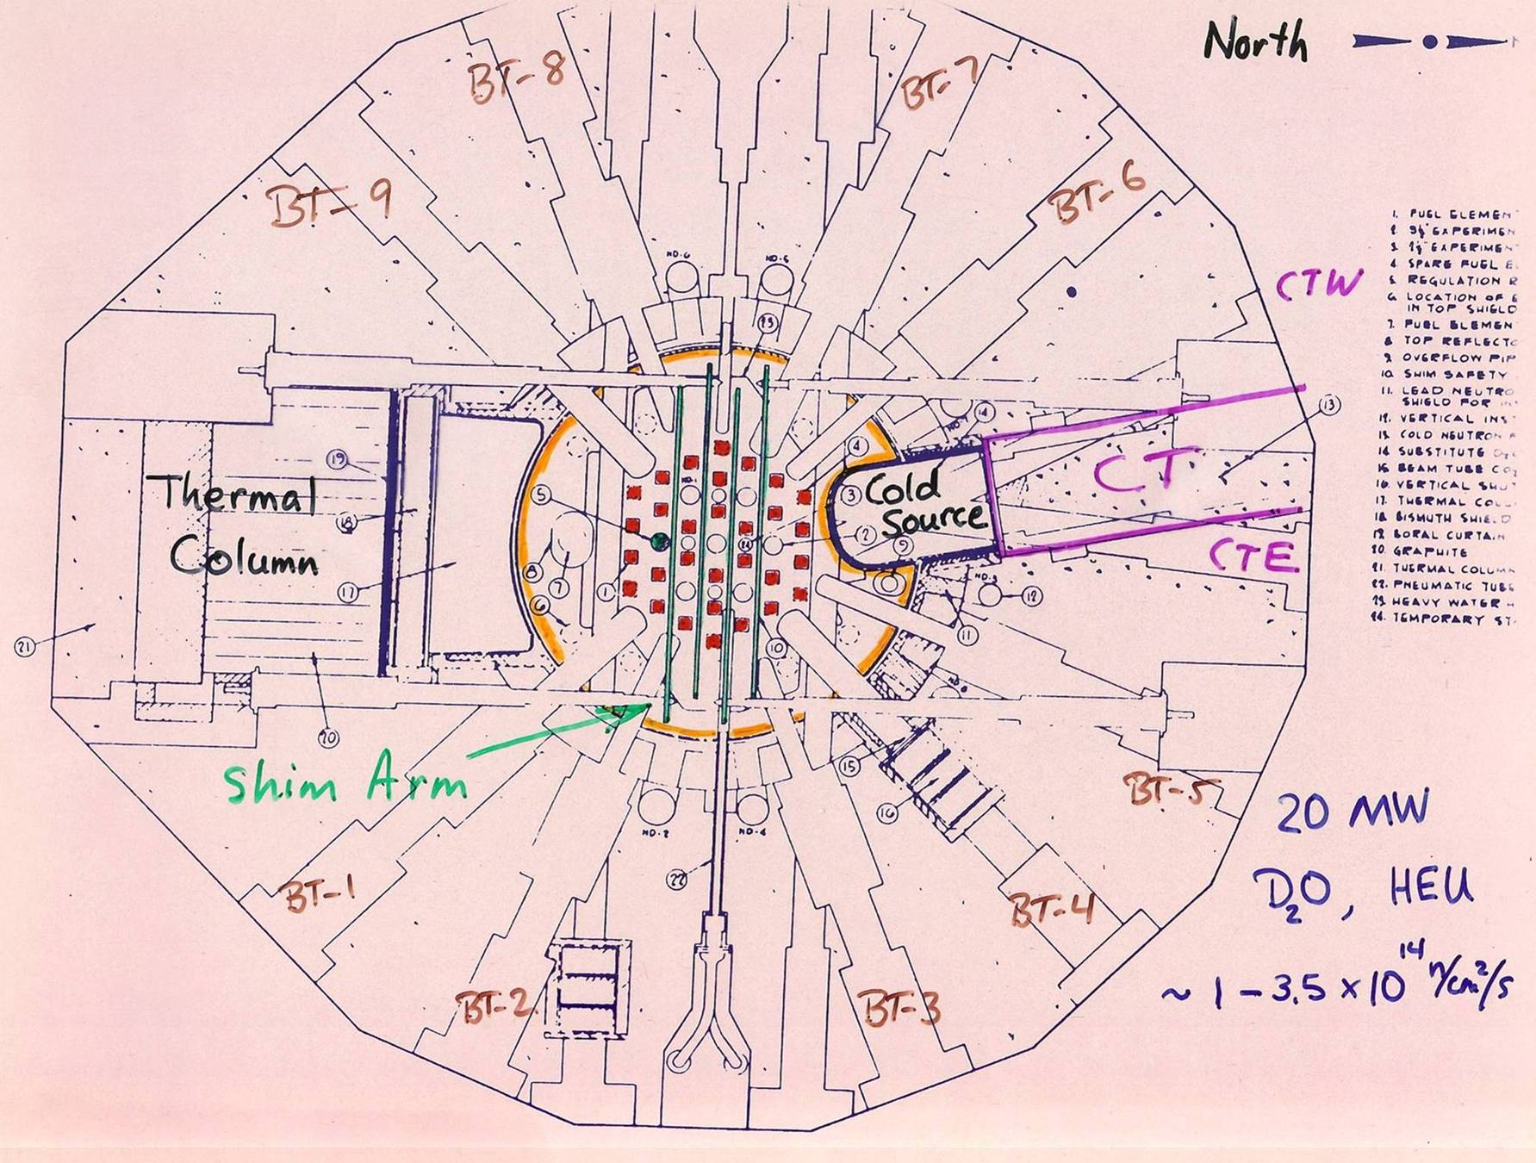

Slide 7
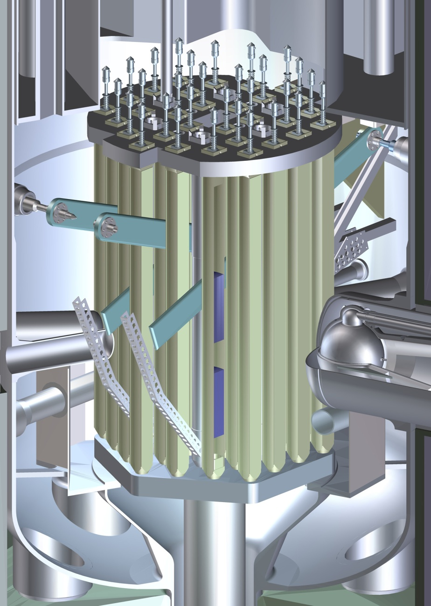
Cut-away View of the NBSR Core
Top Grid Plate
Cd Shim Safety Arms (4)
Fuel Elements (30)
Fuel Plates
Reactor Vessel
Radial Beam Tubes (9)
Liquid Hydrogen Cold Neutron Source
Split Core:
18-cm Unfueled Gap – Flux Trap
Bottom Grid Plate
D₂O Primary Inlet Plenums
Primary Outlet (2)
Thermal Shield

Slide 8
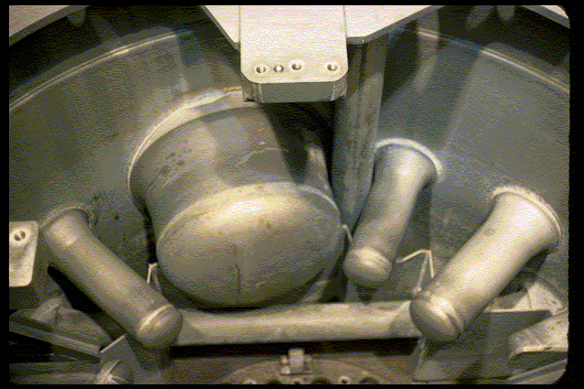
The NBSR was designed with a 55-cm diameter cryogenic beam port for a D₂O-ice CNS.
History:
D₂O Tank (1967)
D₂O Ice (1987) with gain 3-5
Unit 1 LH₂ (1995), gain ~ 6
Unit 2 LH₂ (2002), gain ~ 2
Reference: Kopetka et. al., NISTIR 7352

Slide 9
Production of Cold Neutrons
The neutrons born in fission have an average kinetic energy of about 2 Mega-electron volts, 2 MeV.
They are slowed to thermal energies (20 – 400 milli-eV) by scattering from the molecules of the heavy water (D₂O) moderator in the reactor. The D₂O is about 115 °F, or 320 Kelvin.
In thermal equilibrium, the neutron energy spectrum is determined solely by the temperature of the moderator (a Maxwell-Boltzmann distribution), analogous to the motion of atoms in an ideal gas.
To reach lower energies, therefore, we introduce a cold moderator, such as liquid hydrogen at 20 K.

Slide 10
The LH₂ CNS, Unit 1, installed in 1995, had a gain of 6 times the D₂O source
To fully illuminate the beam ports, the source had to have a very large area.
A 320-mm spherical annulus, 20 mm thick, with a 200-mm diameter exit hole was chosen:
Low heat load (850 W)
Ease of fabrication. Material: Al 6061-T6
Composed of concentric Al spheres (5 liters of LH₂)
Hydrogen vapor filled the inner sphere, which was open at the bottom.
Thermal-hydraulic tests with LH₂ conducted at NIST Boulder.

Slide 11
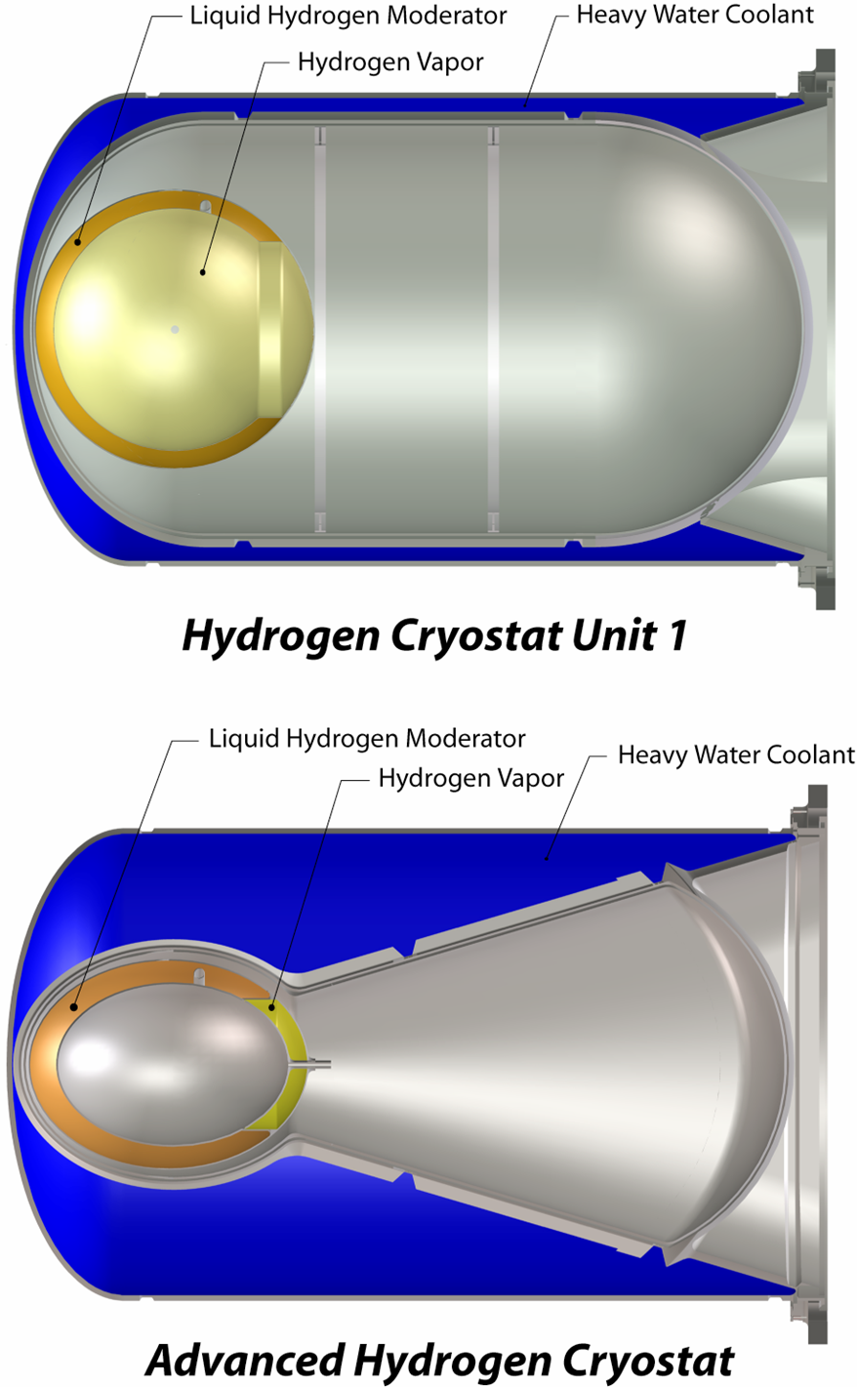
Unit 1 had too much empty space next to the reactor core.
Vapor in the inner sphere scattered cold neutrons from the beam.
Much more D₂O in Unit 2 results in a higher neutron flux in the CNS region and the adjacent fuel elements.
32 x 24 cm ellipsoid allowed more D₂O and a thicker LH₂ annulus.
Gain ~ 2 (2002)

Slide 12
The liquid hydrogen cold source is passively safe, simple to operate, and very reliable
A thermosiphon is the simplest way to supply the source with LH₂.
Cold helium gas cools the condenser below 20 K.
Hydrogen liquefies and flows by gravity to the moderator chamber.
Vapor rises to the condenser and a naturally circulating system is established.
The system is closed to minimize hydrogen gas handling.
All system components are surrounded by He containments.

Slide 13
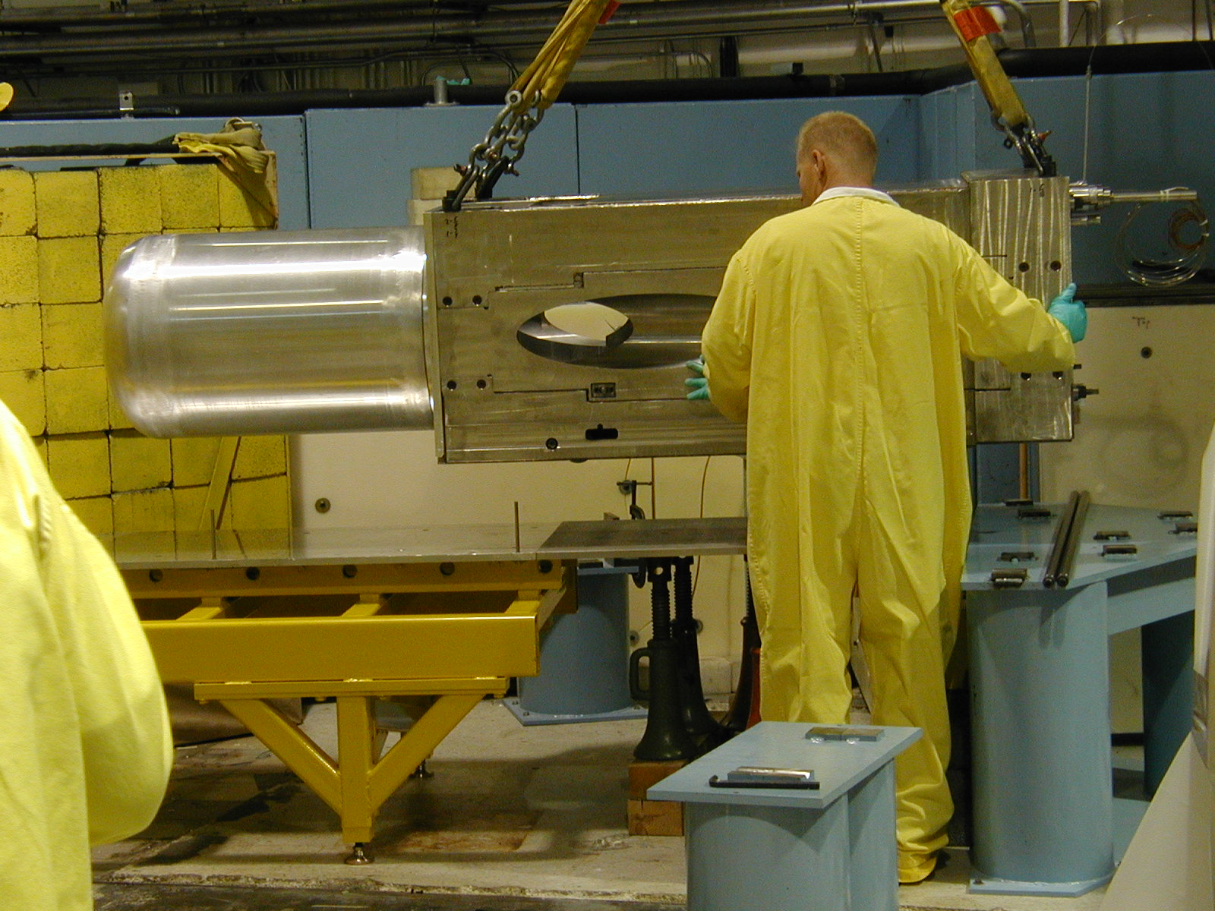
Insertion of Unit 2 Cold source – November 2001

Slide 14
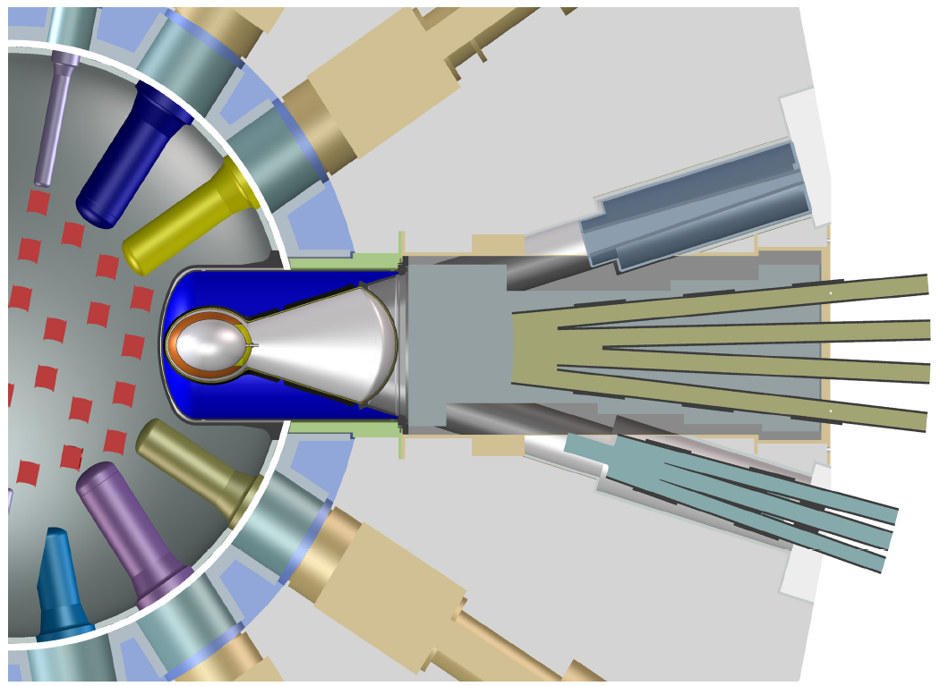
Existing LH₂ CNS, In-pile Guides as of April 2011
CTW Beam Port (now has inpile piece for new guides)
MACS
NG-1
NG-2
NG-3
NG-4
NG-5
CTE
NG-6
NG-7

Slide 15
A second LH₂ source was installed in BT-9 (2012) as part of the NCNR Expansion Initiative
5 new guides have been installed for the guide hall expansion.
MACS has moved to BT-9 and has its own small LH₂ source.
“Peewee” : 11-cm ID, and a 0.5-l volume.
It has a gain of about 1.7 over Unit 2.
MCNP code used to estimate performance and heat load.

Slide 16
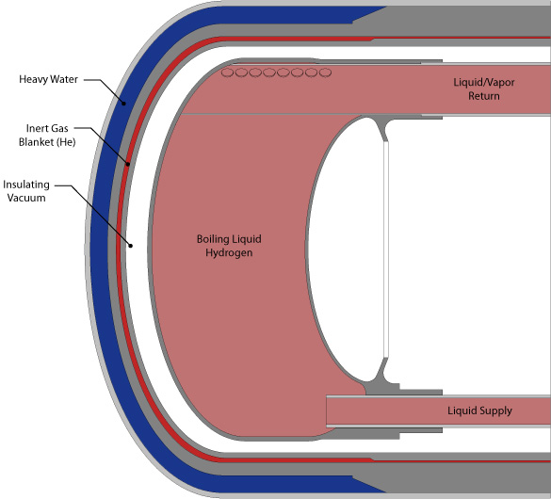
Side View of BT-9 Cold Source
Peewee:
14.6-cm OD water jacket
It has its own H₂ tank, but the condenser is cooled in parallel with Unit 2.
Piccolo “phase separator”
Operating successfully since April 2012.
Thermal-hydraulic tests of thermosiphon used R-134.
Reference: IGORR 2009

Slide 17
The plug provides shielding and supports the cryostat assembly.
A diverging beam of cold neutrons is provided for MACS.

Slide 18
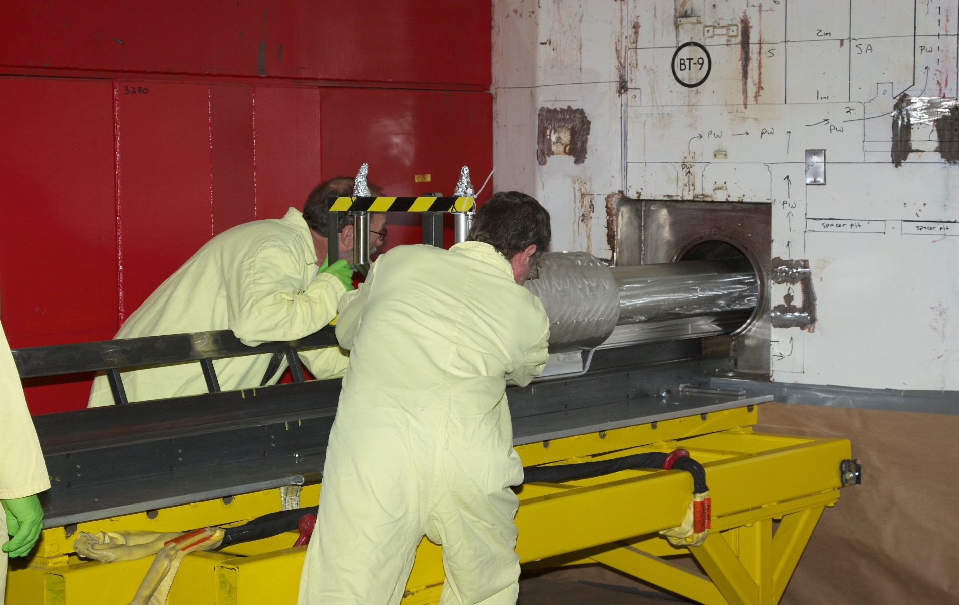
CNS Team installed Peewee in BT-9 in September 2011.

Slide 19
Conclusion
The LH₂ cold sources at NIST have made NCNR a world class cold neutron facility.
About 70% of experiments use cold neutrons.
LD₂ source planned for 2023(?), to replace Unit 2 (reference: IGORR 2016, Berlin).
Relicensed in 2009 for 20 more years!!
Plan to relicense again in 2029.
Studies have been initiated for a new reactor optimized for cold neutron production.

Slide 20
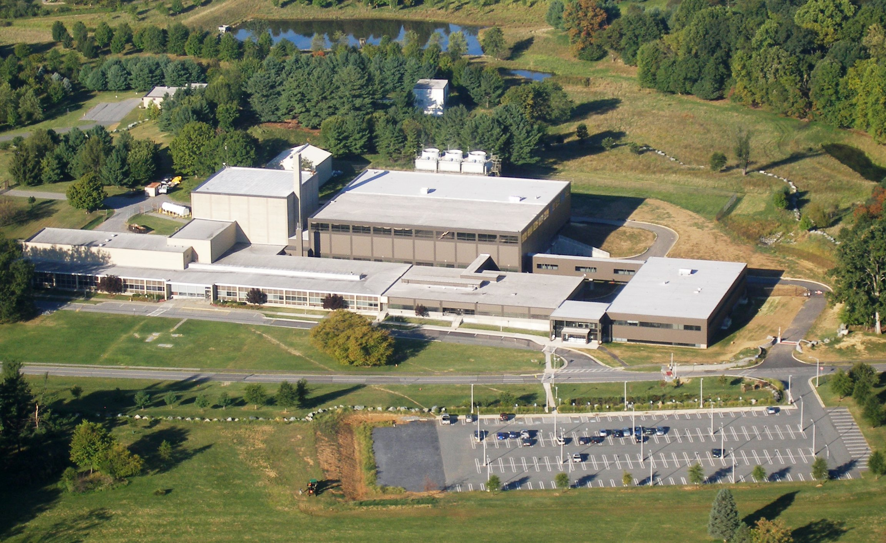
NCNR Expansion – Fall 2010
Guide Hall Addition
Technical Support Building
Original Building 1963-1967

Slide 21
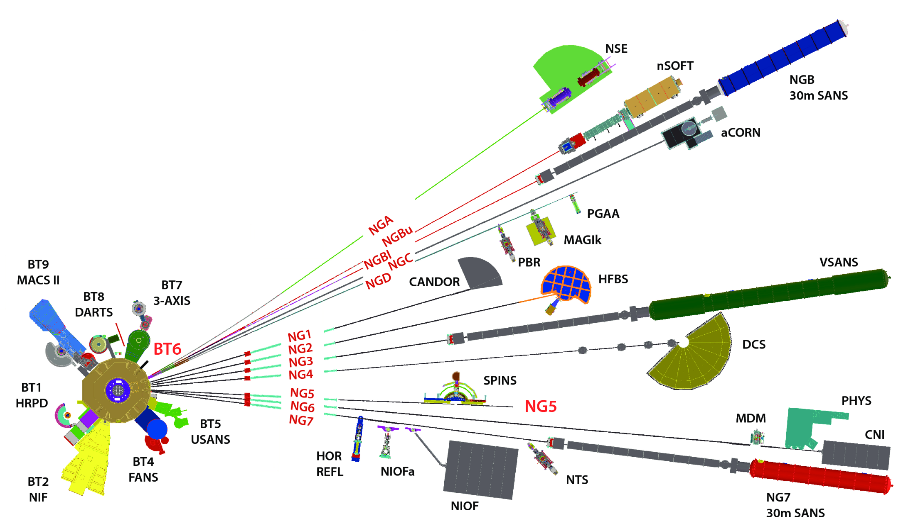

Slide 22
Xenon Poisoning

Slide 23
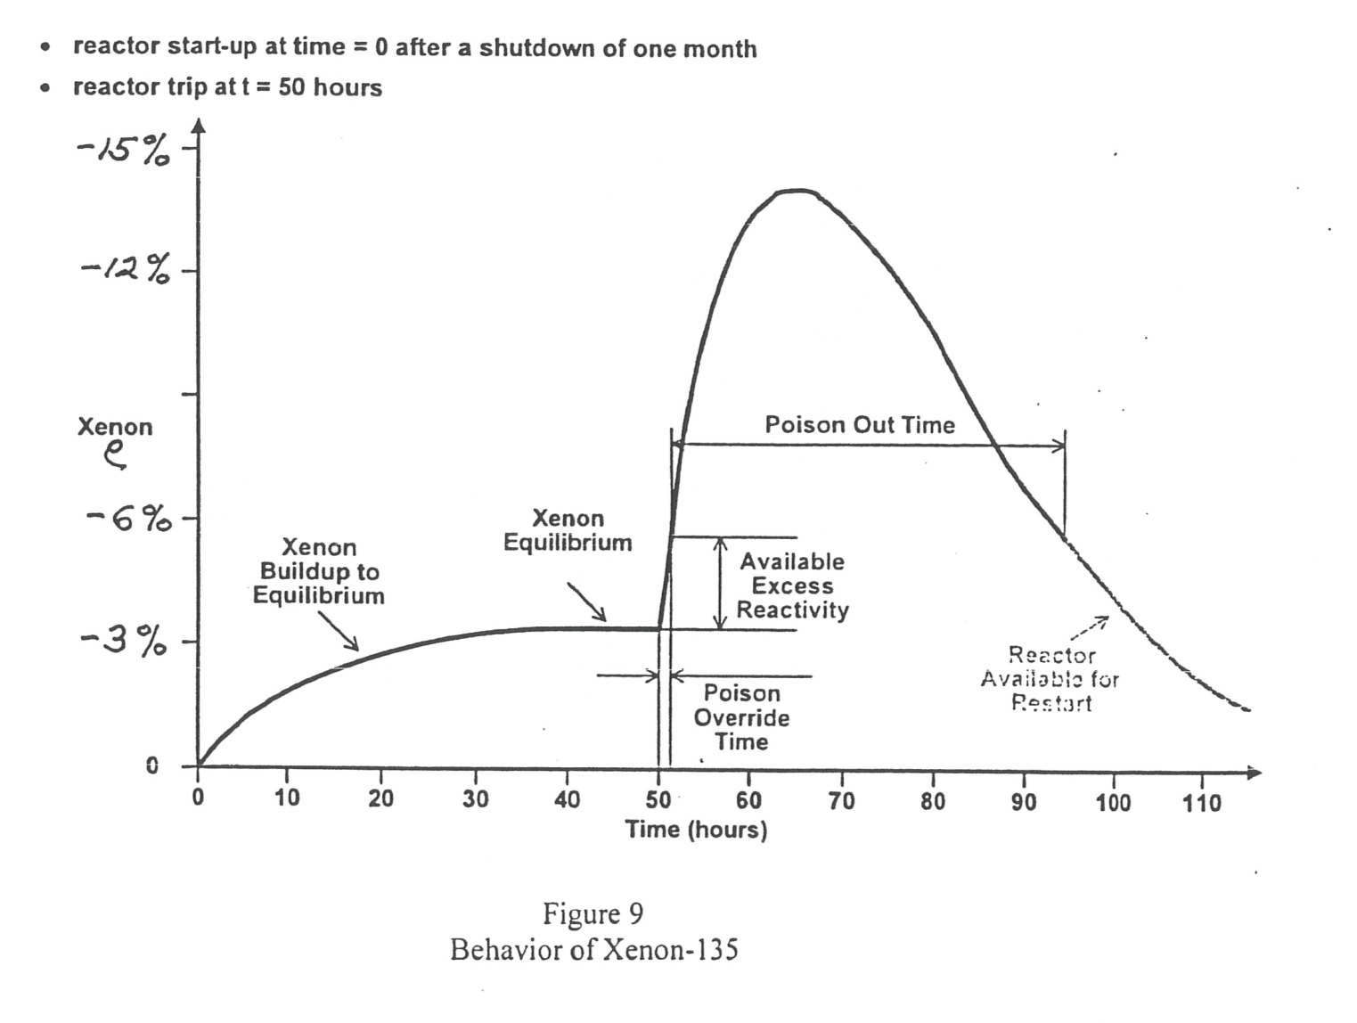
The buildup of ¹³⁵Xe can overwhelm the available excess reactivity and keep the NBSR shutdown 30 – 40 hours.
After an unplanned shutdown the operators are very busy:
- Find the cause, fix it
- Reduce cooling flow
- Commence restart
The Xe clock is ticking, so please refrain from calling the control room!

Slide 24
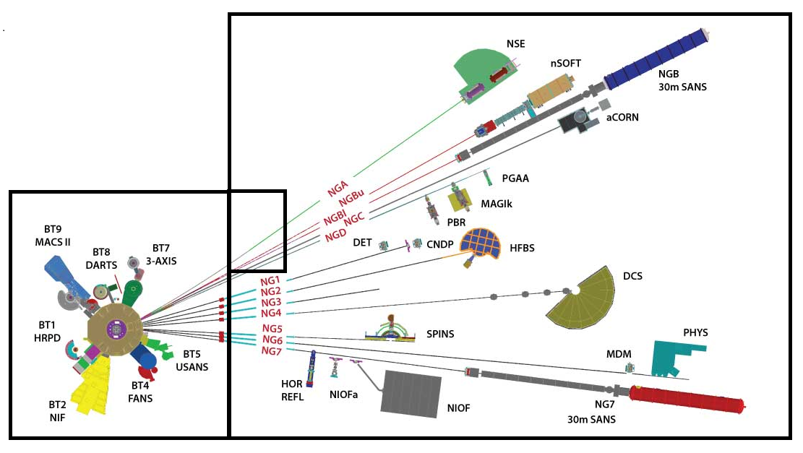
Existing Instrument Layout – Nov 2014
New Guide Hall

