Slide 1
RDA,
Data Type Registries (DTR),
& DEMONSTRATION PROJECT
CNRI (part of RDA DTR WG)
Larry Lannom, Giridhar Manipalli , Allison Powell
KSU (part of RDA MDII IG)
Laura Bartolo
NIST MML
Zachary Trautt, Sara Barron, John Henry Scott, Carelyn Campbell, Chandler Becker
NIST ITL
Alden Dima, Sharief Youssef, Sunil Bhaskarla
Dakota Consulting, Inc.
Antoine Fillinger, Usha Laham

Slide 2
Research Data Alliance https://rd-alliance.org/

Slide 3

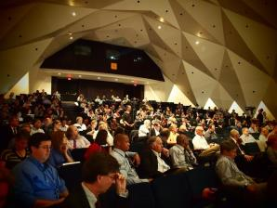
Research Data Alliance
Global community-driven
organization launched in
March 2013 to accelerate
data-driven innovation
RDA focus is on building the social, organizational and technical infrastructure to
  reduce barriers to data sharing and exchange
  accelerate the development of coordinated global data infrastructure

Slide 4
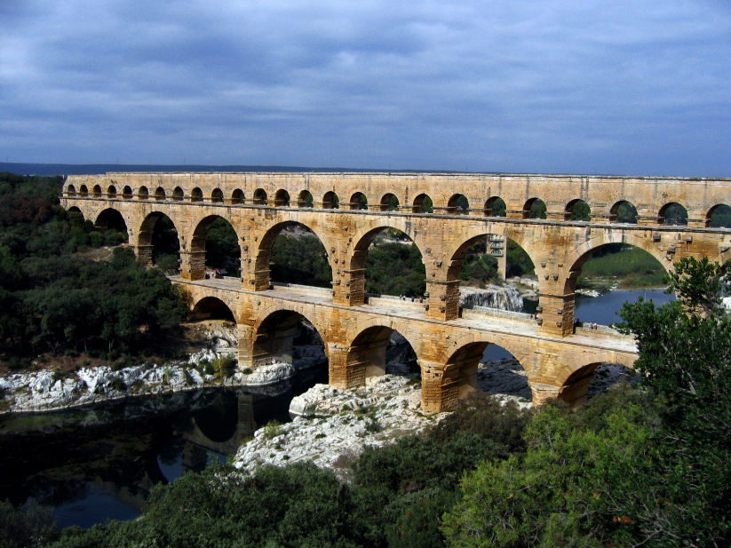
RDA Vision and Mission
Research Data Alliance Vision: Researchers and innovators openly share data across technologies, disciplines, and countries to address the grand challenges of society.
Research Data
Alliance Mission:
RDA builds the social
and technical bridges
that enable data sharing.

Slide 5
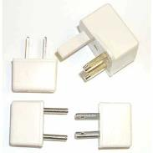

Goal of RDA Infrastructure: Support Data Sharing and Interoperability Across Cultures, Scales, Technologies
Common data types for data Interoperability
Persistent identifiers
Domain-focused portals
Harmonized standards
Data access and preservation policy and practice
Tools for data discoverability, …
Harmonized standards
Policy and Practice

Slide 6

RDA Community Today
Total RDA Community Members: 2778

Slide 7
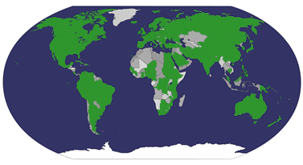
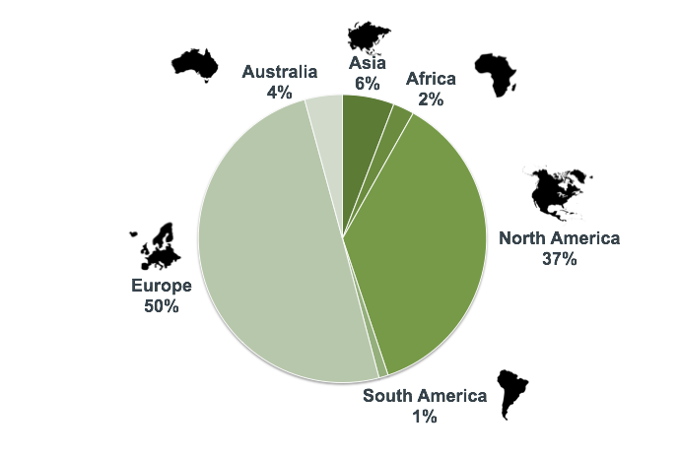
RDA Community Spans 95+ Countries

Slide 8
Going forward: Focus on impact
More Infrastructure
Continuing pipeline of infrastructure deliverables adopted and used to accelerate data sharing
Increasing coordination of infrastructure
Increasing cross-boundary collaborations between domains, sectors, organizations
International and regional programs focusing on workforce, outreach, expansion of infrastructure impact
New partners in the Organizational Assembly
Focused strategy to support development of industry infrastructure for data sharing
Effective Community
Synergistic Programs
Partnership with Industry
slide courtesy Fran Berman

Slide 9
How RDA is Organized
Interest Groups
domain coordination, idea generation, maintenance,
Working Groups
implementable, impactful outcomes
Technical Advisory Board
Socio-technical vision and strategy
Secretary-General and Secretariat
Administration and operations
Organizational Advisory Board and Organizational Assembly
Needs, adoption, business advice
RDA Membership
RDA Council
Organizational mission and strategy
RDA Foundation
Legal entity
Funder’s Forum
Public Sector Organizational and Community Support

Slide 10

RDA/US: Collaborate Globally,
Contribute Locally
RDA/US Goals:
Contribute to RDA “international” efforts and leadership
Bring US efforts to broader RDA community
Build the RDA community within
the US
Leverage and implement RDA deliverables in the US to amplify impact
Collaborate closely with other RDA “regions” on key programs and initiatives
NSF-supported RDA/US initiatives:
Outreach (RDA → RDA/US)
RDA Deliverables Amplification
Student / Early Career Engagement
RDA/US Steering Committee
Fran Berman, RPI
Larry Lannom, CNRI
Mark Parsons, RPI
Beth Plale, IU

Slide 11
RDA Interest Groups
  Agricultural Data Interoperability IG
  Active Data Management Plans*
  Big Data Analytics IG
  Biodiversity Data Integration IG
  Brokering IG
  Community Capability Model IG
  Data Fabric IG
  Data for Development
  Data Foundations and Terminology IG*
  Data in Context IG
  Development of cloud computing capacity and education in developing world research*
  Development of cloud computing capacity and education in developing world research
  Digital Practices in History and Ethnography IG
  Domain Repositories Interest Group
  Education and Training on handling of research data
  ELIXIR Bridging Force IG
  Engagement IG
  Federated Identity Management
  Geospatial IG*
  Libraries for Research Data
  Long tail of research data IG
  Marine Data Harmonization IG
  Metabolomics
  Metadata IG
  PID Interest Group
  Preservation e-Infrastructure IG
  Quality of Urban Life Interest Group
  RDA/CODATA Legal Interoperability IG
  RDA/CODATA Materials Data, Infrastructure & Interoperability IG
    RDA/WDS Certification of Digital Repositories IG
    RDA/WDS Publishing Data Cost Recovery for Data Centres
    RDA/WDS Publishing Data IG
    Reproducibility IG
    Research data needs of the Photon and Neutron Science community
    Research Data Provenance
    Service Management IG
    Structural Biology IG
    Toxicogenomics Interoperability IG
* in review

Slide 12
RDA Working Groups
  Brokering Governance
  Data Citation WG
  Data Description Registry Interoperability
  Data Foundation and Terminology WG
  Data Type Registries WG
  Metadata Standards Directory Working Group
  PID Information Types WG
  Practical Policy WG
  RDA/CODATA Summer Schools in Data Science and Cloud Computing in the Developing World
  RDA/WDS Publishing Data Bibliometrics WG
  RDA/WDS Publishing Data Services WG
  RDA/WDS Publishing Data Workflows WG
  Repository Audit and Certification DSA–WDS Partnership WG
  Repository Platforms for Research Data*
  The BioSharing Registry: connecting data policies, standards & databases in life sciences*
  Wheat Data Interoperability WG

Slide 13
Evolving focus for RDA “Deliverables”:
CREATE→ ADOPT→ USE
RDA Members come together as
Working Groups – 12-18 month efforts to build, adopt, and use specific pieces of infrastructure
Interest Groups – longer-lived discussion forums that spawn Working Groups as specific pieces of needed infrastructure are identified.
Working Group efforts focus on the development and use of data sharing infrastructure
Code, policy, infrastructure, standards, or best practices that are adopted and used by communities to enable data sharing
“Harvestable” efforts for which 12-18 months of work can eliminate a roadblock
Efforts that have substantive applicability to groups within the data community, but may not apply to everyone
Efforts for which working scientists and researchers can start today

Slide 14
Data Type Registries &
Demonstration Project

Slide 15
CNRI & RDA DTR WG
Problem: Implicit Assumptions in Data
Data sharing requires that data can be parsed, understood, and reused by people and applications other than those that created the data
How do we do this now?
  For documents – formats are enough, e.g., PDF, and then the document explains itself to humans
  This doesn’t work well with data – numbers are not self-explanatory
    What does the number 7 mean in cell B27?
Data producers may not have explicitly specified certain details in the data: measurement units, coordinate systems, variable names, etc.
Need a way to precisely characterize those assumptions such that they can be identified by humans and machines that were not closely involved in its creation

Slide 16
Goal of the DTR Effort: Explicate and Share Assumptions using Types and Type Registries
Evaluate and identify a few assumptions in data that can be codified and shared in order to…
Produce a functioning Registry system that can easily be evaluated by organizations before adoption
  Highly configurable for changing scope of captured and shared assumptions depending on the domain or organization
  Supports several Type record dissemination variations
Design for allowing federation between multiple Registry instances
The emphasis is not on
  Identifying every possible assumption and data characteristic applicable for all domains
  Technology

Slide 17
What is a Data Type?
A unique and resolvable identifier
  Which resolves to characterization of structures, conventions, semantics, and representations of data
  Serves as a shortcut for humans and machines to understand and process data
File formats and mime types have solved the ‘representation’ problem at a ‘unit’ level
Examples of problems we aim to solve with data types:
  It is a number in cell A3, but is it temperature? If so, in Celsius?
  It is a dataset consisting of location, temperature, and time, but what variable names should I look for?
  Is it all packaged as CSV or NetCDF? And as a single unit or a collection of units?
Type record structure will continue to evolve – not finished, but functioning

Slide 18
What is a Data Type Registry?
A low-level infrastructure with wide applicability to record and disseminate type records
  Not an immediate ROI application
Assigns unique and resolvable identifiers to type records
Enforces and validates common data model & expression for interoperation between multiple instances of Registries
API for machine consumption
UI for human use

Slide 19
Type Registry History
Handle Types – 0.Type/SomeType
  Good idea, limited applicability
  Profiles – ‘type’ the whole set of handle/type/value triples. No traction
Sloan Grant: 2012 -2014
  Generic Registry system using Type Registry as a use case
NSF Grant: 2013 -2014
  Included support for Type Registry
Research Data Alliance (RDA) Data Type Registries Working Group
  One of first two WGs approved at Plenary 1 – March 2013
  International representation, > 50 members
  Co-chairs Lannom (CNRI), Broeder (Max Planck Psycholinguistics Institute)
  Should result in an RDA Recommendation (2015?)
International DOI Foundation
  Proposed set of standard types for certain functions, e.g., resolve to license
  IDF-specific Type Registry

Slide 20
Current State
A prototype is at: http://typeregistry.org/
Implementation supports notions of primitives and derived types
Primitives are fundamental types that we expect humans and software to parse and understand
  Integer, floating point, boolean value, string, date, timestamp, etc.
Derived types depend on primitives to describe something complex
  Stream gauge, Lidar, Spatial bounding box, etc.
Registered types are assigned unique identifiers
Notes:
http://38.100.130.12/DOIProxyHelper/index.html
http://hecot1.doregistry.org:8081/registrar/

Slide 21
RDA DTR Infrastructure & MGI
Broad Aim:
  Integrate of RDA Data Type Registry + PID Concepts into Materials Genome Initiative’s Materials Innovation Infrastructure
Objectives:
  Work closely with NIST: Datasets, guidance, feedback
  Build Use Case
  Test Data Type Registry + PID Information Types

Slide 22
Demonstration Project
Meetings & Timeframe
CNRI, KSU, NIST MML, ITL & Dakota Consulting
3 planned F2F meetings:
2/4, NIST: lay out overall goals & contributions.
4/13, NIST: identify use case & datasets.
6/16, NIST: review phase 1 of demonstration project
9/22, RDA P6:present finalized demonstration project
CNRI & NIST ITL
Met at CNRI Reston, Virginia to discuss collaborations.
Use metadata registry component of DTR in NIST Materials Resource Registry.
Communication will happen via the REST API.
Will add support for OAI-PMH to harvest metadata from data providers periodically.

Slide 23

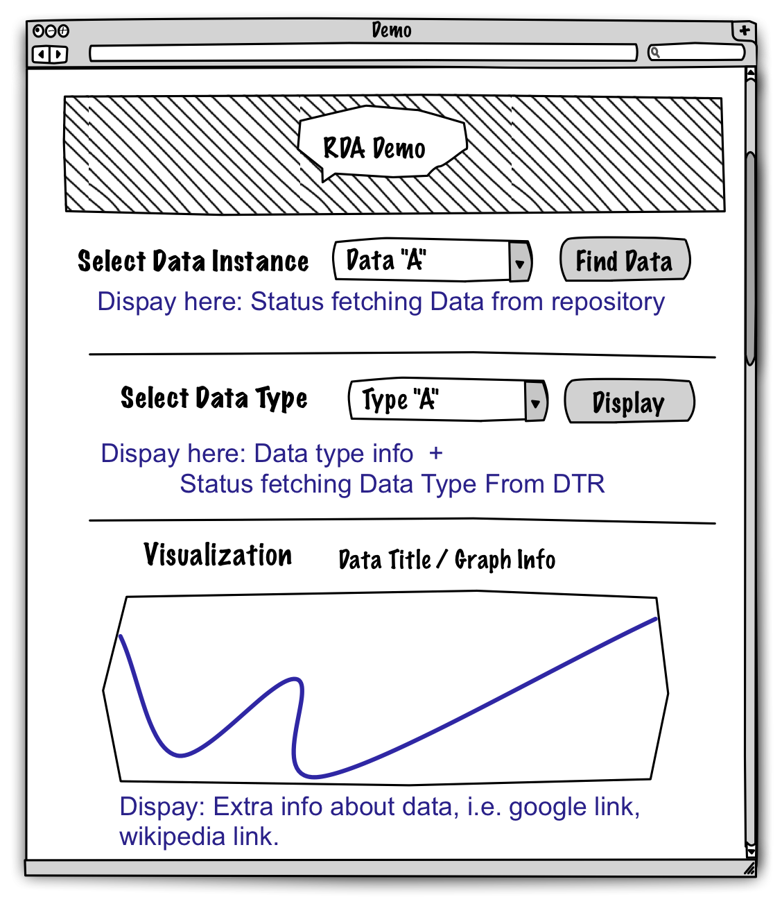
CNRI Meeting Use Case for RDA Demo
1. Search for Datasets using metadata
describing resources discoverable at
various repositories and registered at
NIST Registry
RDA Demo
2. Dataset results returned with PID &
protocol to fetch resource.
NIST Registry
3. Fetch Datasets
4. Datasets Returned
Repositories
5. Fetch Data Types
7. Visualize
6. Data Types returned
Data Type
Registry

Slide 24
User Interface Mockup
1 - User searches the NIST Materials Resource Registry for datasets of interest using metadata. User clicks “Find Data”.
2 - Application fetches the Data available and populates the list of “Select Data Instance”. Status information on fetching data from repositories are displayed.
3 - User select the specific data type instance for the dataset and click on the “Display” button.
4 - Application fetches the data type and displays a visual of the dataset with extra info. Status information on fetching data type from DTR are displayed.

Slide 25
Revised Use Case for RDA Demo
Discovery Visualization Tool (DVT) to query resource registry for looking for all data containing Al2O3
DVT to narrow the results by: is-a diffractogram datatype of any representation
This will result in 11 results conforming to 5 different representation datatypes (gss,dat,cpi,prn,xda)
DVT to query resource registry for a resource than can convert from representation type (gss,dat,cpi,prn,xda) to canonical 2D figure representation type.
DVT to render generated json representation

Slide 26
Revised Use Case for RDA Demo
7. Discovered 11 datasets, conforming to 5 data types. Unable to plot any. Searching for conversion resource.
1. Al₂O₃?
NIST Registry
2. Check Resource A and J
3. Fetch Datasets
4. Datasets Returned
Repositories
5. Fetch Data Types
6. Data Types returned
Data Type
Registry

Slide 27
Revised Use Case for RDA Demo
7. Discovered 11 datasets, conforming to 5 data types. Unable to plot any. Searching for conversion resource.
8. Conversion resources?:
11314.3/368d to 11314.3/74b5 and...
NIST Registry
9. Check Resource-M
10. Proprietary Format
11. Canonical Format
Resources
12. Visualize
Data Type
Registry

Slide 28
Thanks!
Questions?

