Slide 1

Quality Management Systems in Analytical Chemistry
Lane C. Sander, Ph.D.
Chemical Sciences Division
Material Measurement Laboratory
National Institute of Standards and Technology¹
¹Contribution of the National Institute of Standards and Technology. Not subject to copyright. This presentation reflects the views of the author and should not be construed as representing NIST’s views or policies.
This presentation is also available in a PowerPoint format with active links to relevant information.
Notes:
This presentation provides an introduction to some of the features and terminology used in quality management systems for the analytical laboratory. Each of the topics discussed shares the common features of achieving, maintaining, and improving measurement accuracy in chemical measurements. This presentation is not intended to be comprehensive, but it may serve as a primer for further study. Additional related information is provided in a separate tutorial on method validation. Finally, this presentation reflects the views of the author and should not be construed as representing NIST’s views or policies.

Slide 2

Frameworks for International Metrology
International Bureau of Weights and Measures (BIPM)
  Consultative Committee for Amount of Substance (CCQM)
  Joint Committee for Traceability in Laboratory Medicine (JCTLM)
  Joint Committee for Guides in Metrology (JCGM)
    Guide to the Expression of Uncertainty in Measurement (GUM)
    International Vocabulary of Metrology (VIM)
    The International System of Units (SI Brochure)
Reginal Metrology Organizations (RMOs)
  Inter-American Metrology System (SIM)
  European Association of National Metrology Institutes (EURAMET)
  Intra-Africa Metrology System (AFRIMETS)
  Asia Pacific Metrology Programme (APMP)
  Euro-Asian Cooperation of National Metrological Institutions (COOMET)
  Gulf Association for Metrology (GULFMET)
National Metrology Institutes
  Support of national measurement system
  Research
  Participation in key comparisons
  Measurement services (reference materials, calibrations)
  Calibration and Measurement Capabilities (CMCs) database
Image Credit: BIPM website
Notes:
It may be useful to begin by considering some of the ways that measurements are sanctioned by the international community. Numerous international, governmental, regulatory, commercial, and voluntary associations have come into being to advance measurement quality. The scope of these efforts is vast, but a few details can be provided that are germane to chemical measurements.
At the international level, the International Bureau of Weights and Measures (abbreviated BIPM) is an organization that acts through Member States on matters related to measurement science and measurement standards. The BIPM coordinates the world-wide measurement system, to ensure it provides comparable and internationally accepted measurement results. The BIPM is organized into several committees that advance specific tasks. Two committees relevant to the discussion of chemical measurements are the Consultative Committee for Amount of Substance: Metrology in Chemistry and Biology (CCQM), and the Joint Committee for Traceability in Laboratory Medicine (JCTLM). In addition, the Joint Committee for Guides in Metrology (JCGM) has published two guides pertinent to chemical measurements: the Guide to the Expression of Uncertainty in Measurement (GUM), and the International Vocabulary of Metrology (referred to as the VIM). Several additional documents are under development to supplement the GUM; these documents are available on the JCGM website as they are completed. The BIPM also provides the “SI Brochure”, a document that details the history and basis for the International System of Units (referred to as the SI).
At the regional level, associations of member states are recognized by the BIPM to perform activities suited to the needs of the region. Currently, six RMOs operate within the framework of the BIPM.
Finally, at the national level, National Metrology Institutes (abbreviated NMIs), carry out activities that support the measurement system of the country. Examples of such activities can include the performance of research in metrology, participation in international measurement key comparisons, and delivery of measurement services through production of reference materials and through calibrations. Recognition of an NMI’s measurement capabilities by the international community is made by participation in international measurement key comparisons, and inclusion of measurement claims in the calibration and measurement capabilities (CMCs) database maintained by the BIPM.

Slide 3
Quality Management Systems
Collection of structured activities to standardize processes
Goal: meet or exceed customer and regulatory requirements
Goal: continuous improvement of product quality
Quality management systems requirements
  ISO 9001 Focus on the design, development, and delivery of a general product or service
  Sector specific standards for quality management systems
Quality system components (typical)
  Organizational structure
  Roles and responsibilities
  Training
  Facilities and equipment
  Procedures
  Processes
  Record keeping
  Data management
  Customer satisfaction
  Quality analysis
Notes:
A quality management system, sometimes referred to as a quality system, is a collection of structured activities for management of quality within an organization. Quality systems include descriptions of the organizational structure, roles and responsibilities of personnel, processes, procedures, and resources required to implement quality management. The goal of quality management is to meet or exceed customer and regulatory requirements through the continuous improvement of product quality.
The International Standards Organization has developed perhaps the most widely recognized standard for quality management systems, ISO 9001. This standard is not itself a quality management system, but it provides requirements for the development of a quality management system. The focus of ISO 9001 is on the design, development, and delivery of a general product or service. Numerous other standards have been issued for specific sectors, such as ISO 17025 Testing and Calibration Laboratories. Additional discussion of documentary standards is provided later in this presentation.
Quality systems are developed individually by an organization to reflect the activities of the organization, their products, and their customers. Each quality system will differ, but a few broad categories of topics can be listed that are included in most quality manuals: organizational structure, roles and responsibilities of personnel, training, facilities and equipment, procedures, processes, and record keeping, data management, customer satisfaction, and quality analysis.

Slide 4
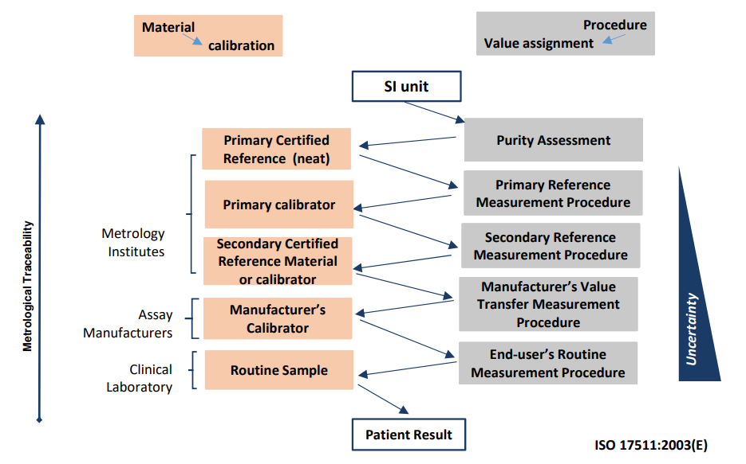
Standards
Documentary Standards
  Examples of Documentary Standards
    Test methods and sampling procedures
    Processes
    Services
    Specifications
    Classifications
    Definition of terms
  Performance Standards specify performance criteria for compliance
  Design Standards specify actual details for compliance
Reference Materials
  Primary Reference Standard¹
  Certified Reference Material (CRM)^{1,2}
  Standard Reference Material (SRM)²
  Primary Standard (PS)²
  Reference Material (RM)²
  NIST Traceable Reference Material (NTRM)²
¹ JCTLM
² NIST
Notes:
In the context of metrology, the term Standard can refer to a document that describes a way of doing something, or a physical, well characterized artifact used as a reference for measurements.
Documentary standards are usually developed through the consensus of experts, and they typically include technical specifications and precise criteria to delineate a procedure sufficiently to make it reproducible. Standards can be classified as performance standards or design standards. Performance standards specify criteria that must be met for compliance, whereas design Standards specify the actual details for compliance. As an example, a performance standard might require chromatographic separation at baseline resolution, with choice of the column left to the analyst, whereas a Design Standard might specify directly the column to be used.
Reference materials are physical artifact standards that are used as references for measurements. When used correctly, reference materials transfer knowledge through a measurement system to provide measurement traceability. A hierarchy of traceability defines the fitness of a reference material for a specific application. Each step in a traceability chain increases the uncertainty of the property value for the reference material. A few types of reference materials can be defined:
A Primary Reference Standard is defined by the JCTLM as a neat high purity certified standard with the highest metrological order, for use as a calibrator with direct traceability to the SI unit with associated uncertainty.
Certified Reference Materials (CRMs for short) are standards of the highest metrological order, and provide direct traceability to amount of substance units of the SI. Standard Reference Materials are NIST CRMs.
Recently NIST has issued the first in a new class of reference materials designated Primary Standard (PS), designed for calibration of nuclear magnetic resonance instrumentation. This designation appears to be similar to primary reference standards.
In addition to its generic meaning, the designation “Reference Material (abbreviated RM)” can also refer to a NIST material that does not meet the full requirements for certification as a certified reference material.
NIST Traceable Reference Materials (NTRMs) are commercially produced reference materials with well-defined traceability linkages to existing NIST standards. This traceability linkage is established in part by NIST analysis of at least 10% of a Gas Mixture NTRM® batch.

Slide 5
Voluntary Consensus Standards
International Organization for Standardization (ISO)
ASTM International
AOAC Int
  Originally (1884) Association of Official Agricultural Chemists
  Later, Association of Official Analytical Chemists
  Currently (2019) Association of Official Analytical Collaboration International
Clinical and Laboratory Standards Institute (CLSI) [formerly NCCLS]
  Secretariat of ISO Technical Committee 212 (ISO/TC 212)
  QMS01-A4 Quality Management System: A Model for Laboratory Services; Approved Guidelines
¹Certain commercial equipment, instruments, or materials are identified to specify adequately the experimental procedure. Such identification does not imply recommendation or endorsement by the National Institute of Standards and Technology, nor does it imply that the materials or equipment identified are the best available for the purpose.
Notes:
Numerous voluntary consensus standards organizations fill the needs of clinical, pharmaceutical, and manufacturing sectors. These standards are typically available through commercial channels. A partial list of such organizations can be provided:
The International Organization for Standardization (ISO) offers a variety of documentary standards for quality management, as well as standards for Environmental management, Health and safety, Energy, Food safety, and IT security.
The American Society for Testing and Materials (ASTM) produces over 12500 voluntary consensus technical standards that encompass a broad range of applications. Measurement sectors include metals, construction, fuels, paints and coatings, textiles, plastics and rubber, water and the environment, energy, medical devices, and general methods and products.
AOAC International is a voluntary consensus standards organization that dedicated to developing and validating standards related to food safety and human health and to produce trusted, reliable testing methods and products. As with other voluntary consensus standards organizations, AOAC International does not serve a regulatory role.
The clinical and Laboratory Standards Institute (CLSI) operates as a secretariat of the ISO Technical Committee 212 (ISO/TC 212), and is known formerly as the National Committee for Clinical Laboratory Standards (NCCLS). The CLSI continues this function and has developed guidance for implementing a Quality Management System (QMS) in clinical laboratory settings.
QMS01-A4 Quality Management System: A Model for Laboratory Services; Approved Guidelines

Slide 6
Regulatory Roles and Official Organizations
Government
  Food and Drug Administration (FDA)
    Good Laboratory Practice (GLP)
    Current Good Manufacturing Practice (cGMP)
    Laboratory Developed Tests (LDT)
  Department of Health and Human Services (HHS)
  Centers for Medicare & Medicaid Services (CMS)
    Clinical Laboratory Improvement Amendments (CLIA)
  Environmental Protection Agency (EPA)
“Official” Organizations
  AOAC International
    Official Methods of Analysis
    Proficiency Testing
  U.S. Pharmacopeia
    USP National Formulary (USP-NF)
    USP standards are legally recognized in the U.S, and are used internationally
    Method validation and verification
  American Society for Testing and Materials (ASTM)
Notes:
The terms “regulatory”, “official”, and “international”, as used in reference to standards or standards organizations is somewhat artificial, since considerable overlap exists between these designations. The clearest distinction is with regulatory authorities from governmental agencies.
In the US, three regulatory agencies that enforce aspects of laboratory compliance are the Food and Drug Administration (FDA), the Environmental Protection Agency (EPA), and Health and Human Services (HHS). The FDA enforces aspects of the Federal Food, Drug, and Cosmetic Act (referred to as FD&C Act or FFDCA), Health and Human Services certifies the operations of clinical laboratories under the authority of a broad reaching federal regulation known as the Clinical Laboratory Improvement Amendments (or CLIA for short), and the Environmental Protection Agency enforces a variety of environmental statutes, including the Clean Air Act, and the Clean Water Act. Quality Management Systems are frequently required by the statutes that are enforced by these agencies; examples include Good Laboratory Practices and Current Good Manufacturing Practices, enforced by the FDA. The FDA also regulates the manufacture of Laboratory Developed Tests as medical devices under the FFDCA.
So-called “Official” organizations are typically Voluntary Consensus Standards Organizations that offer documentary standards and are recognized by governmental agencies.
For example, AOAC International is a voluntary consensus standards organization, however, aspects of its mission support official and regulatory actions. AOAC International Official Methods of Analysis (OMA) are recognized in the U.S. Code of Federal Regulations and are legally defensible in courts worldwide. AOAC Int. also offers a Laboratory Proficiency Testing Programs that help laboratories demonstrate that they meet international standards for accuracy, reliability, and compliance.
The U.S. Pharmacopeia is not a regulatory body; however it works with governmental agencies, and USP standards are legally recognized in the US and are used internationally. A drug or drug ingredient listed in the USP-NF is considered “adulterated” if it does not conform to compendial standards for strength, quality or purity. The USP also offers guidance on validation of new analytical methods. Chapter <1225> of the USP National Formulary entitled “Validation of Compendial Procedures is devoted to analytical method validation. Additional guidance is provided in Chapter <1226> Verification of Compendial Methods; this chapter focuses on the implementation of compendial and standard methods. submitted for consideration.
The American Society for Testing and Materials (ASTM) and the International Organization for Standardization (ISO) produce voluntary consensus technical standards; these standards can be enforced if they are referenced by regulatory authorities.

Slide 7
International Organizations
International Organizations
  International Organization for Standardization (ISO)
  International Conference on Harmonization (ICH)
    Joint regulatory-industry initiative in the EU
    Validation of Analytical Procedures: Q2(R1)
  World Health Organization (WHO)
  Food and Agriculture Organization (FAO)
    Codex Alimentarius Commission (CAC)
Notes:
Different regulations are enforced in the United States and in the European Union, but the requirements for the use of technical standards are often similar.
Most of the Voluntary Consensus Standards Organizations operate with an international scope, and a few operate with a focus on the needs of the European Union.
The International Organization for Standardization (ISO) is a global network of national standards bodies. Each member country is represented by a single voting member body; member countries adopt and sell ISO International Standards nationally.
The International Conference on Harmonization of Technical Requirements for Pharmaceuticals for Human Use (abbreviated ICH) works with pharmaceutical industries and regulatory authorities in the European Union and world-wide to harmonize technical aspects of pharmaceutical products. In this role, the ICH provides guidance for the validation of methods used in pharmaceutical and clinical applications. The ICH has published a guide for validation of analytical methods for pharmaceutical drugs sometimes referred to by its designation “Q2(R1)”.
The World Health Organization is the directing and coordinating authority on international health within the United Nations system. In this capacity, WHO publishes numerous guides on laboratory quality, with a focus on human health.
The Food and Agriculture Organization is a specialized agency of the United Nations. Its mission is to end hunger and promote access to safe foods. To achieve this goal, the FAO Food Standards Program and the WHO established the Codex Alimentarius Commission. This commission established the Codex Alimentarius, a collection of standards, guidelines and codes of practice that protect consumer health and promote fair practices in food trade.

Slide 8
Good Laboratory Practice (GLP)
Food and Drug Administration: 21 CFR 58
  Nonclinical research laboratories
  Supports applications for products regulated by FDA
    Food, color additives, animal food additives, animal drugs, medical devices, biological products, and electronic products
WHO Good Laboratory Practice: handbook
Overview -- Requirements
  Personnel
  Facility
  Quality System
  Technical Operations
  Records
Notes:
Good Laboratory Practice is a quality management system that was first implemented in the US by the Food and Drug Administration in 1979. The GLP regulation 21 CFR 58 applies to nonclinical research laboratories that perform research or produce products that are regulated by the FDA. Examples of such products are food, color additives, animal food additives, animal drugs, medical devices, biological products, and miscellaneous electronic products.
The world Health Organization (WHO) has also published a comprehensive handbook on Good Laboratory Practice that offers similar guidance in a nonregulatory context.
A few general aspects of good laboratory practice can be listed. Specific requirements are listed in the code of federal regulations and the WHO Guide, and deal with:
Personnel
The laboratory facility
Compliance with a Quality System
Technical operations
Record keeping and reporting

Slide 9
Current Good Manufacturing Practice (cGMP)
Food and Drug Administration: 21 CFR 210; 21 CFR 211
  Pharmaceutical drug manufacturers
  Dietary Supplements manufacturers
  Supports manufacture of drugs, finished pharmaceuticals, and dietary supplements regulated by FDA
  Medical Devices 21 CFR 820
Overview -- Requirements
  Personnel
  Facility
  Quality System
  Technical Operations
  Records
  On-site Inspection
Notes:
Current Good Manufacturing Practices (or cGMP for short) is a quality management system provided for in the Code of Federal Regulations that is enforced by the Food and Drug Administration. The goal of cGMP is to ensure the quality of drugs products and medical devices. The cGMP regulations apply to manufacturers of drugs, finished pharmaceuticals, dietary supplements, and medical devices regulated by the FDA.
General principles are similar to the requirements for Good Laboratory Practice, and are listed. As with GLP, compliance with the cGMP requirements is evaluated through on-site inspection of the manufacturing facility.

Slide 10
Good Clinical Practice (GCP)
FDA enforcement of individual regulations
  Informed Consent
  Institutional Review Boards
  Financial Disclosure
  Investigational New Drug Applications
  Applications for New Drugs
  Bioavailability and Bioequivalence
  Medical Devices
  Privacy
ICH Guide for Good Clinical Practice E6(R1)
  Ethical and scientific quality standard
  Intended for EU, Japan, and USA to facilitate mutual acceptance of clinical data in these jurisdictions
Notes:
Unlike GLP and cGMP, Good Clinical Practice is not represented by a single statute in the Code of Federal Regulations. The FDA does enforce a series of individual regulations that combined can be considered to constitute Good Clinical Practice. These statutes cover aspects of Good Laboratory Practice, but also include topics more directly associated with clinical chemistry. A few of these topics can be summarized: Informed Consent, Institutional Review Boards, Financial Disclosure by Clinical Investigators, Investigational New Drug Applications, Applications for New Drugs, Bioavailability and Bioequivalence, Medical Devices, and Privacy.
A unified Guide for Good Clinical Practice E6(R1) has been produced by the International Conference on Harmonization. This highly detailed standard was produced for use in the EU, Japan, and USA to facilitate mutual acceptance of clinical data in these jurisdictions.

Slide 11
Laboratory Developed Tests (LDTs)
In vitro diagnostic test manufactured by and used within a single laboratory
Regulated by both FDA (under FFDCA) and HHS (under CLIA)
FDA
  Considered a medical device under FFDCA
  Analytical validity (method validation) and clinical validity are assessed
Centers for Medicare & Medicaid Services (CMS)
  Use of LDTs regulated by clinical laboratory testing aspects of CLIA.
  Laboratory performance specifications of LDTs established (method validation)
Notes:
Laboratory Developed Tests, are in vitro clinical tests manufactured and used within a single laboratory. These tests are treated differently than other clinical tests that are for general use and that are subject to full oversight by the Food and Drug Administration.
Laboratory developed tests are regulated by both the FDA under the authority of the Federal Food, Drug, and Cosmetic Act and by Health and Human Services under the Clinical Laboratory Improvement Amendments.
The FDA considers laboratory developed tests as medical devices, and can require both method validation and clinical validation of the test.
Under the Clinical Laboratory Improvement Amendments, The Centers for Medicare & Medicaid Services, Health and Human Services requires laboratory performance specifications be established for LDTs through method validation.

Slide 12
Proficiency Testing (PT)
  Laboratory performance is evaluated
  Participation can be required or voluntary
    Regulatory: laboratory certification and accreditation programs
    Voluntary: proficiency survey and quality assurance programs
  Proficiency testing providers
    Regulatory authorities approve the PT provider programs and services
    PT performance requirements are set by the regulatory authorities
Notes:
Laboratory proficiency testing is a quality assessment process by which participant laboratories test unknown samples for comparison with the results of a reference laboratory. The goal of proficiency testing is to evaluate laboratory performance, usually in a regulatory environment.
Proficiency Testing is frequently a requirement in laboratory certification and accreditation programs. When participation is voluntary, the program is sometimes termed a proficiency survey or interlaboratory study, and it is essentially equivalent to participation in a quality assurance program. The primary distinction is the consequences of performance. When performance metrics are not achieved in a regulatory PT exercise, negative consequences may result for the participating laboratory. With quality assurance programs, participating laboratories can self assess the adequacy of their performance, and if necessary, work to improve technical competence.
Usually, the regulatory authorities do not directly administer PT programs. Instead, PT is administered by independent providers, which are accepted by the regulatory authorities. Importantly, the regulatory authority sets the performance requirements for participants in the PT exercises.

Slide 13
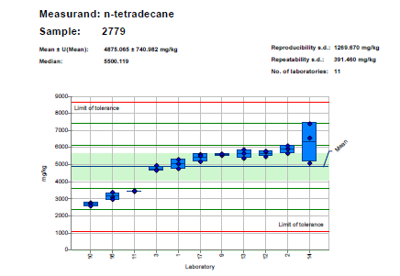
Quality Assurance Programs (QA)
Quality Assurance Programs
  Voluntary – self assessment
  Evidence of proficiency
  Requirement for funding
  Samples should represent relevant analytical challenges
Exercise/Study
  Exercise assigned values (consensus vs reference)
  Z-score (index of trueness or bias)
    Z = bias estimate / performance criterion
    Z = (x –X)/σ
  p-score (index of reproducibility)
    p = σ_{lab} / σ_{target}
Notes:
Quality Assurance Programs share many of the features of proficiency testing programs, except that participation is voluntary. In some cases, funding agencies may require participation in QA programs as a condition of funding, and participants may use their participation in a QA program as evidence of their proficiency to a regulatory agency. Because QA programs are nonregulatory, the organizers can tailor the program to the needs of the participants. For example, samples to be distributed should be relevant to the types of samples processed by participating laboratories, and they should represent similar analytical challenges to those encountered by the laboratories.
As with PT programs, samples are distributed to participants periodically for characterization; each individual study is referred to as an exercise. Exercise performance is based on comparisons with the exercise assigned values. The exercise assigned value can be a consensus of the results submitted by the participants, or it can be based on reference values assigned to the samples. In the latter case, the samples distributed can be reference materials or samples that have values assigned by a reference laboratory. After analyses are performed by the participants, results are submitted to the organizer, and results are reported with summary statistics for the exercise and with individual results for each participant.
Z-scores and P-scores can be calculated to represent trueness and precision metrics of the participant’s data. These indices assess the difference between the results of the laboratory and the exercise assigned values and can be used to compare performance on different analytes and on different materials.
An example of a QA report with summary statistics is shown in the figure. In this example, the results of each laboratory are presented as a mean and standard deviation with box plots. The central green band represents a 95% confidence interval about the mean; lines are drawn at 1, 2 and 3 standard deviations to represent Z-score intervals of 1, 2, and 3. In this plot, the laboratories are ordered as a function of their means, from low to high.

Slide 14
Conformity Assessment
Conformity Assessment Body (CAB)
Types of Conformity
  Voluntary
    Conformity with documentary standards
  Regulatory
    Compliance with technical statutes
Notes:
Conformity assessment is the methodology used to evaluate compliance with voluntary consensus standards or technical regulations.
Independent entities that assess such compliance are called a Conformity Assessment Bodies (CAB). Assessments are based on the requirements specified by the standard or regulation, but they typically include review of the organization’s quality system, site inspections (for laboratories or manufacturing facilities), assessment of personnel qualifications, and performance testing.
Two types on conformity can be distinguished: voluntary and regulatory. Conformity with voluntary consensus standards such as ISO 9001 are frequently business decisions that are made to increase productivity, and increase competitivity into markets that may demand certification to specific documentary standards. In contrast, compliance with regulations is a requirement for activities covered by the regulations. An example is compliance with the Clinical Laboratory Improvement Amendments that is required by laboratories that provide testing of human samples.

Slide 15
Accreditation and Certification
  Accreditation reflects the technical competence of a laboratory
    Proficiency Testing
    Quality Management
    Test Method Validation and Verification
  Certification is a documented assurance of conformity to specifications
    Documentary Standards
    Regulations
  Accreditation and certification both involve independent assessment
Notes:
Accreditation and certification are related but distinct aspects of laboratory quality performance.
Laboratory accreditation is a process for assessing the technical competence of a laboratory to perform specific types of testing and analyses. Technical competence is demonstrated through proficiency testing, adherence to a quality management system, and test method validation and verification.
Certification provides an assurance that a service or product conforms to specified requirements; certification is also referred to as conformity assessment. Certification always references the standards or regulations that are enforced by the organization. As an example of laboratory certification, after assessment by an appropriate authoritative body, the activities of an organization may be certified as compliant to a standard, such as ISO 17025. The organization may then claim they are ISO 17025 certified. It should be noted that ISO is not a certifying body, and it is not appropriate or meaningful to state that an organization is “ISO Certified”.
Both accreditation and certification involve an independent assessment of performance by a reputable authority. Accreditation is typically required by regulatory authorities as a condition of licensing.

Slide 16
Laboratory Accreditation Programs (LAPs)
Accreditation Providers
  Stature and legal status
  Business decision and/or legal requirement
American Association for Laboratory Accreditation (A2LA)
  ISO 15189 and CLIA for Clinical Testing Laboratories
  ISO/IEC 17020 for Inspection Bodies
  ISO/IEC 17025 for Testing/Calibration Laboratories
  ISO 17034 for Reference Material Producers
  ISO/IEC 17043 for Proficiency Testing Providers
  ISO/IEC 17065 for Product Certification Bodies
National Voluntary Laboratory Accreditation Program (NVLAP)
CLIA Accreditation Organizations
  AABB
  American Association for Laboratory Accreditation
  AAHHS/HFAP
  American Society for Histocompatibility and Immunogenetics
  COLA
  College of American Pathologists
  Joint Commission
Notes:
Organizations that provide laboratory accreditation offer specific Laboratory Accreditation Programs, depending on regulatory and commercial needs. Stature and legal status are factors that enter into the selection of an accreditation provider, and this choice can be a business decision as well as a legal requirement. Accreditation is a different approach to quality than the direct enforcement pathways of Good Laboratory Practice and Current Good Manufacturing Practice, but the goals are similar – namely, to promote accurate measurement results.
A few examples of Laboratory Accreditation Programs can be provided.
The American Association for Laboratory Accreditation (referred to now as A2LA) is a third party nonprofit accreditation body that assesses the competence of organizations to carry out specific tasks. The accreditation programs are based on a variety of international standards that depend on the tasks to be accredited. For example, accreditation for reference material producers might be based on conformity with ISO 17034, whereas accreditation of a conformity assessment body might be based on conformity with ISO 17020 Inspection Bodies. Other standards are provided in the list of types of accreditation.
NIST administers the National Voluntary Laboratory Accreditation Program (NVLAP) and provides specific LAPs based on public requests and needs. Accreditation is based on an evaluation of technical qualifications and competence to carry out specific calibrations or tests. The evaluation consists of an on-site assessment of conformity to technical standards, participation in proficiency testing, and technical evaluation.
Under the authority of the Clinical Laboratory Improvement Amendments, laboratories must be accredited to be licensed to perform and report the results of clinical testing. Currently, only seven organizations are authorized to carry out CLIA accreditation, shown in this list. After accreditation by one of these organizations, CMS issues CLIA Certification to license clinical testing operations.

Slide 17
Frameworks for International Accreditation Bodies
International Laboratory Accreditation Cooperation (ILAC)
Recognized Regional Cooperation Bodies
  Inter American Accreditation Cooperation (IAAC)
  European co-operation for Accreditation (EA)
  Asia Pacific Accreditation Cooperation Incorporated (APAC)
  Arab Accreditation Cooperation (ARAC)
  African Accreditation Cooperation (AFRAC)
USA Signatories to the ILAC-MRA
  AIHA Laboratory Accreditation Programs, LLC (AIHA-LAP, LLC)
  American Association for Laboratory Accreditation (A2LA)
  American Society of Crime Lab Directors/Laboratory Accreditation Board (ASCLD/LAB)
  ANSI National Accreditation Board (ANAB)
  International Accreditation Service, Inc (IAS)
  National Voluntary Laboratory Accreditation Program (NVLAP)
  Perry Johnson Laboratory Accreditation, Inc (PJLA)
Notes:
An international framework for accreditation bodies exists with the designation “International Laboratory Accreditation Cooperation (abbreviated as ILAC). The structure of this organization is markedly similarly to the BIPM, with recognition of international, regional, and national functional divisions. As with the BIPM, membership in the cooperation is through a Mutual Recognition Arrangement (ILAC-MRA).
Five regional cooperation bodies are recognized in this framework, representing the Americas, Europe, Asia-Pacific, Arab nations, and Africa.
Signatories to the (ILAC MRA) represent economies rather than nationalities, and multiple signatories per economy/nation are permitted. Seven accreditation bodies within the US are signatories of the ILAC-MRA; notably one of these accreditation bodies is the National Voluntary Laboratory Accreditation Program, administered by NIST.

Slide 18
Frameworks for International Accreditation Bodies
International Laboratory
Accreditation Cooperation (ILAC)
International Accreditation Forum (IAF)
Focus on laboratory competence
Focus on accreditation processes
Accreditation Bodies
Conformity Assessment Accreditation Bodies
Laboratory Accreditation
Accredits the Conformity Assessment Body
Judgement of competence
Assessment of quality system
Conformity (certification) to standards or regulations
Laboratory inspections
Proficiency testing
Conformity Assessment Bodies
Certifies conformity with standards or regulations
Products
Product Certification – demonstrates product is as intended
Notes:
In addition to the International Laboratory Accreditation Cooperation, the International Accreditation Forum provides similar functions for conformity assessment, but focuses on accreditation processes for management systems, products, services, and personnel rather than laboratory competence. The figure in this slide highlights the functions of each organization.
Membership in the International Laboratory Accreditation Cooperation is primarily accreditation bodies. These bodies provide laboratory accreditation by making a judgement of the competence of the laboratory to provide specific services. This assessment is based on the laboratory’s quality system, conformity to standards or regulation, laboratory inspections, and proficiency testing.
Membership in the International Accreditation Forum is also primarily accreditation bodies; however, here the focus is on the accreditation process itself, and on accreditation of the assessors.

Slide 19
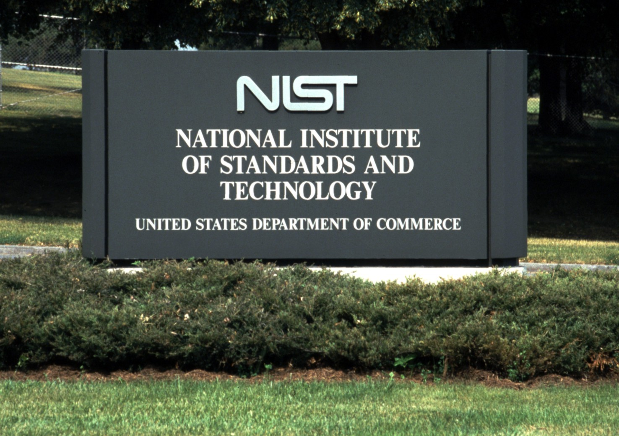

www.nist.gov
Notes:
To learn more about the National Institute of Standards and Technology, visit www.nist.gov

