Slide 1



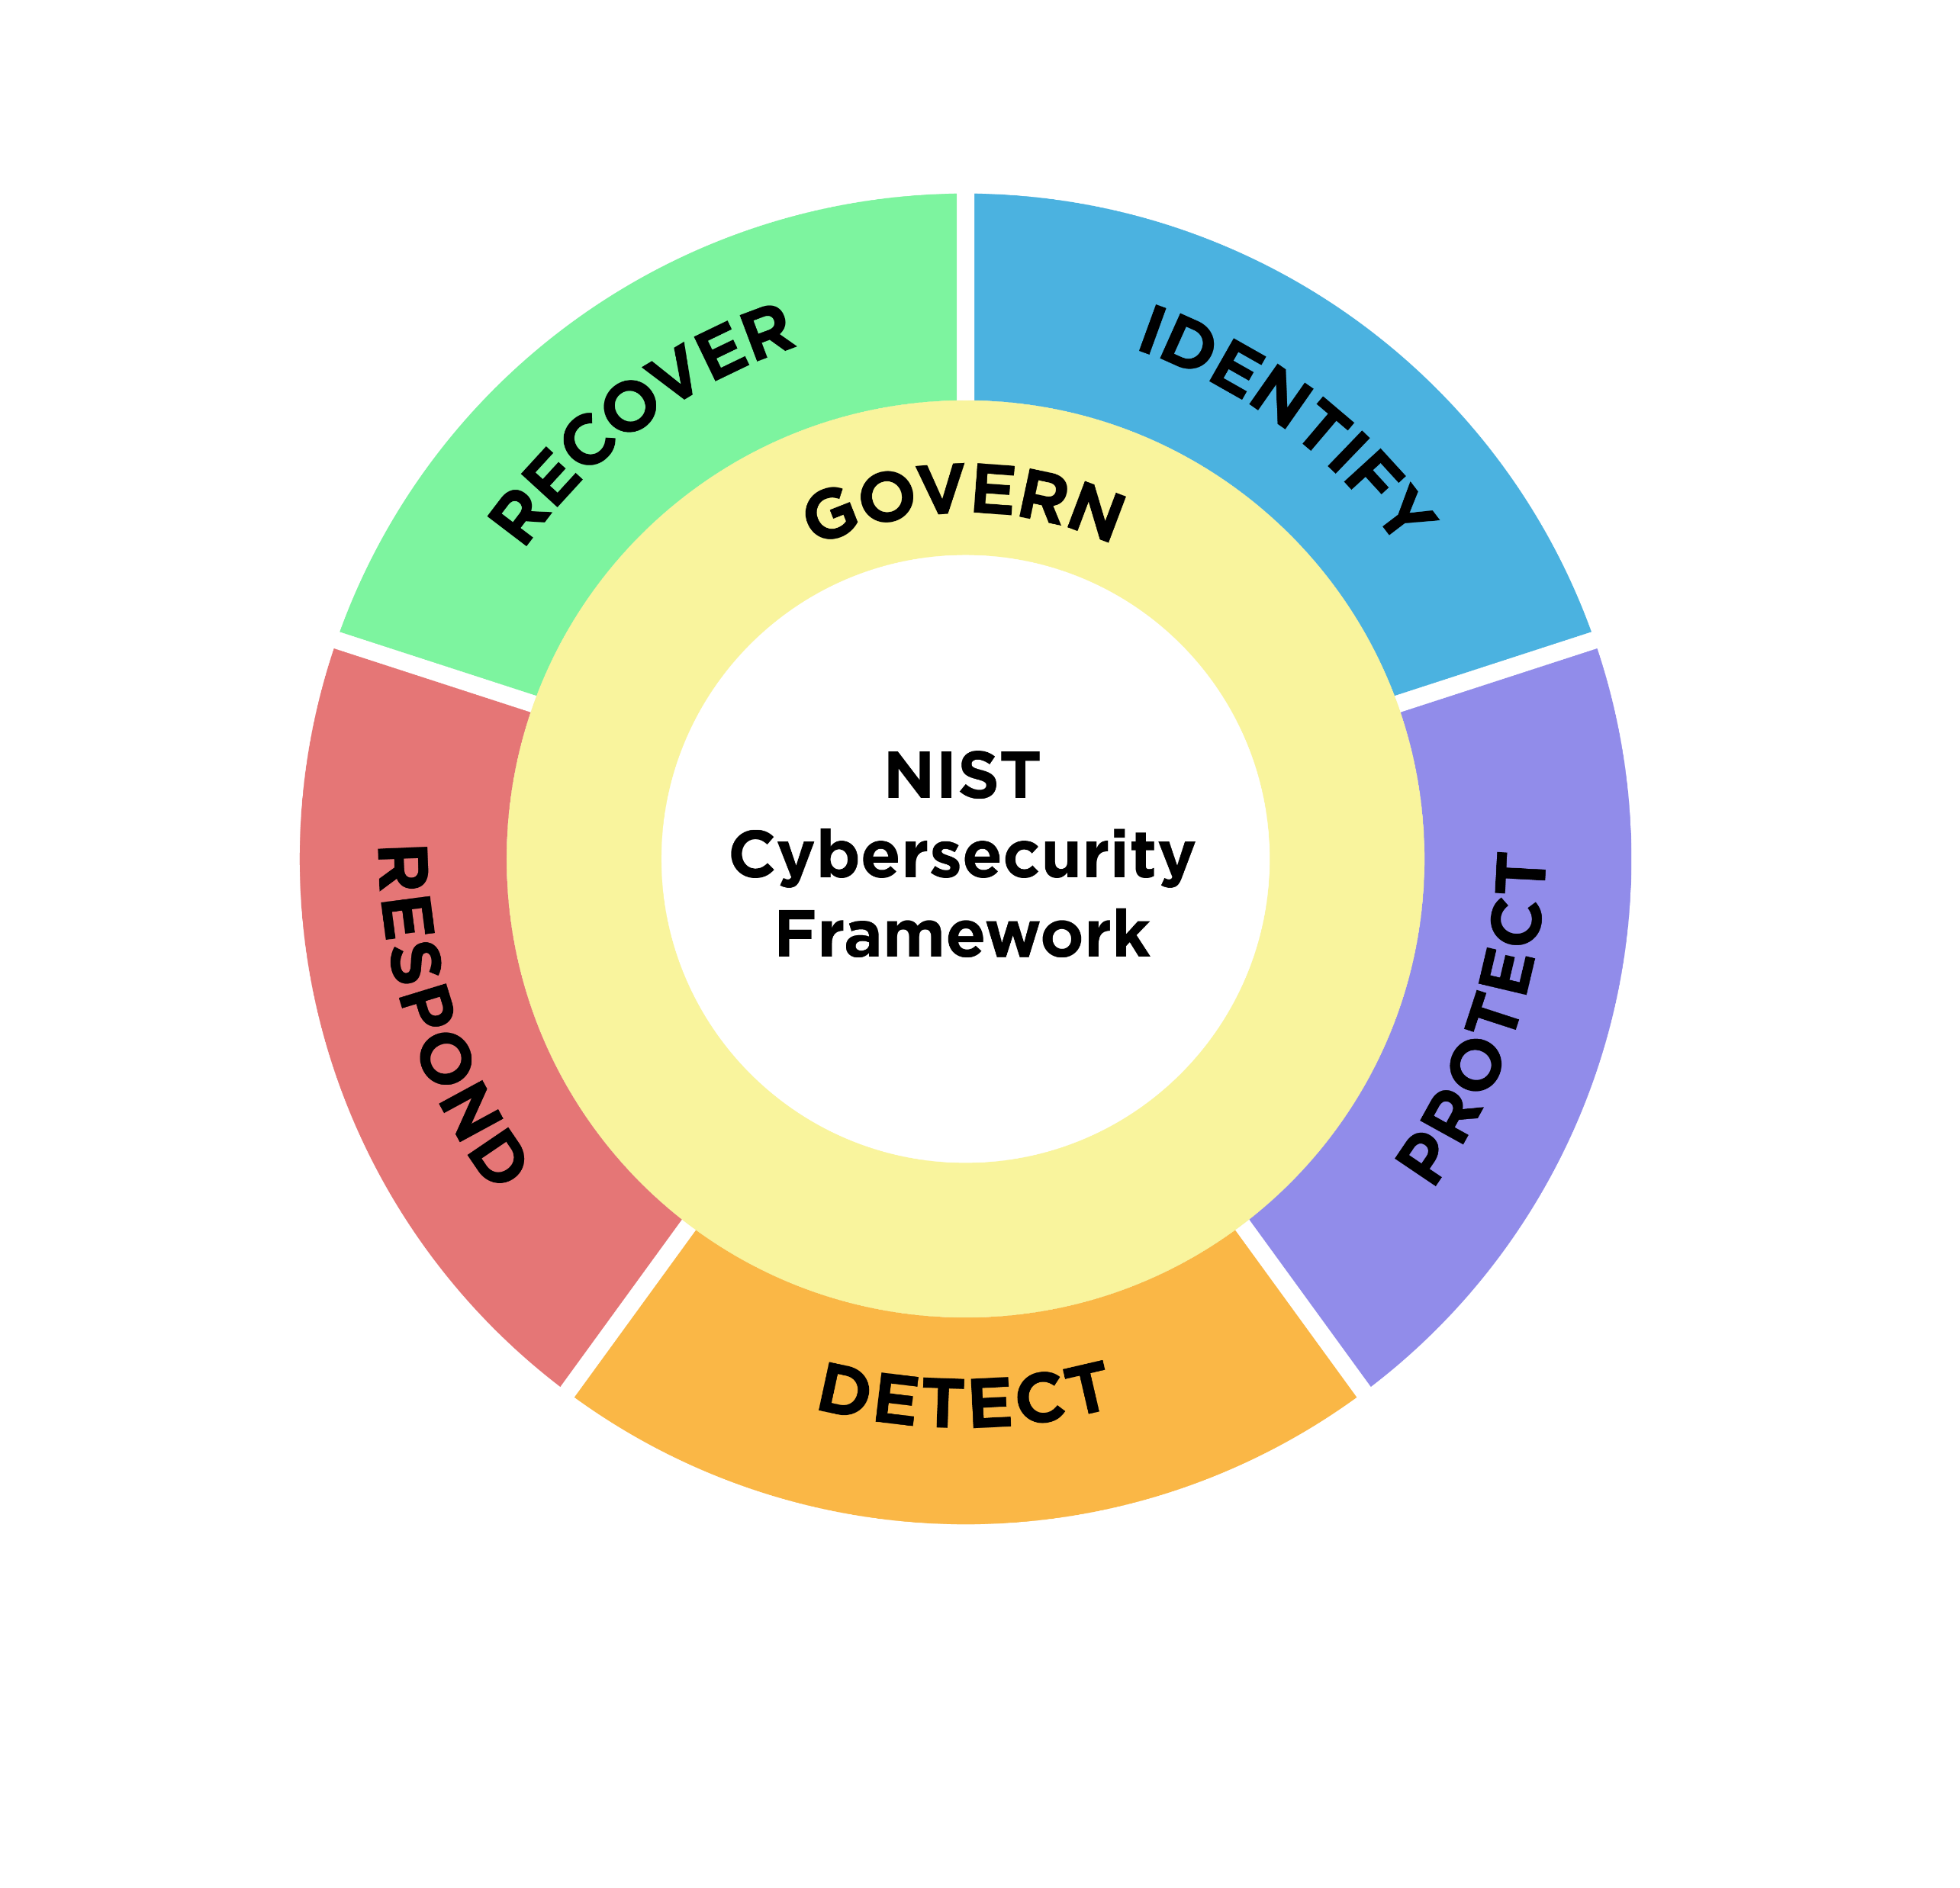
NIST Cybersecurity Framework 2.0
RESOURCE & OVERVIEW GUIDE
February 2024

Slide 2

NIST csf 2.0:
RESOURCE & OVERVIEW Guide
WHAT IS THE CSF…AND HOW TO USE IT?
The NIST Cybersecurity Framework (CSF) 2.0 can help an organization reduce their cybersecurity risks as they start or improve their cybersecurity program. The CSF outlines specific outcomes that an organization can achieve to address risk (and other NIST resources help explain specific actions that can be taken to achieve each outcome).
The CSF can be used by organizations to understand, assess, prioritize, and communicate cybersecurity risks; it is particularly useful for fostering internal and external communication across teams—as well as integrating with broader risk management strategies.
The CSF 2.0 is organized by six Functions – Govern, Identify, Protect, Detect, Respond, and Recover. Together, these Functions provide a comprehensive view for managing cybersecurity risk. This Resource & Overview Guide offers details about each Function to serve as potential starting points.
The CSF 2.0 is comprised of:
CSF Core - A taxonomy of high-level cybersecurity outcomes that can help any organization manage its cybersecurity risk.
CSF Profiles - A mechanism for describing an organization’s current or target cybersecurity posture in terms of the CSF Core’s outcomes.
CSF Tiers - Can be applied to CSF Profiles to characterize the rigor of an organization’s cybersecurity risk governance and management outcomes.
Organizations can use the CSF, along with NIST’s supplementary resources, to understand, assess, prioritize, and communicate cybersecurity risks.
EXPLORE MORE CSF 2.0 RESOURCES
Quickly find what you need, including:
A suite of NEW Quick Start Guides (actionable guidance on using the CSF and its online resources).
Informative References (point to sources of guidance for each outcome).
Implementation Examples (illustrate ways to achieve each outcome).
Community Profiles and Profile Templates
(help organizations put the CSF into practice and set priorities for managing cybersecurity risks).
Search tools (simplify and streamline as you look for specific information).
Concept papers (learn more about various CSF topics).
FAQs (see what others are asking and get answers to top questions).
See NIST’s online
resource repository

Slide 3

NIST csf 2.0:
RESOURCE & OVERVIEW Guide
NAVIGATING NIST's CSF 2.0 QUICK START GUIDES
QSG Type | Description | Explore
Small Business (SMB) | Provides SMBs, specifically those who have modest or no cybersecurity plans in place, with considerations to kick-start their cybersecurity risk management strategy
Creating and Using Profiles | Provides all organizations with considerations for creating and using spreadsheets called Profiles to implement the CSF 2.0.​
Using the Tiers | Explains how any organization can apply the CSF Tiers to Profiles to characterize the rigor of its cybersecurity risk governance and management outcomes.
Draft Cybersecurity Supply Chain Risk Management (C-SCRM) | Helps all organizations to become smart acquirers and suppliers of technology products and services by improving their C-SCRM processes.
See the QSG
See the QSG
See the QSG
See the QSG
…and more to follow in the future.
See the current full online QSG repository

Slide 4
NIST csf 2.0: RESOURCE & OVERVIEW Guide
GOVERN
The organization’s cybersecurity risk management
strategy, expectations, and policy are established, communicated, and monitored.
Identify
The organization’s current
cybersecurity
risk is understood.
Understand and assess specific cybersecurity needs. Determine your organization’s unique risks and needs. Discuss the current and predicted risk environment and the amount of risk your organization is willing to accept. Seek input and ideas from across the organization. Understand what has worked or not worked well in the past and discuss it openly.
Establish defined risk management policies. Policies should be approved by management and should be organization-wide, repeatable and recurring, and should align with the current cybersecurity threat environment, risks (which will change over time), and mission objectives. Embed policies in company culture to help drive and inspire the ability to make informed decisions.
Develop and communicate organizational cybersecurity practices. These must be straightforward and communicated regularly. They should reflect the application of risk management to changes in mission or business requirements, threats, and the overall technical landscape. Document practices and share them in an open and transparent way with room for feedback and the agility to change course.
Develop a tailored cybersecurity risk strategy. This should be based on your organization’s specific cybersecurity objectives, the current risk environment, and lessons learned from the past– and from others. The risk strategy should be managed, updated, and discussed at regular intervals.
Establish and monitor cybersecurity supply chain risk management. Establish strategy, policy, and roles and responsibilities for overseeing suppliers, customers, and partners. Incorporate requirements into contracts.
Continuous monitoring and checkpoints. Analyze risks at regular intervals and monitor them continuously (just as you would monitor financial risks). Empower and involve staff.
Identify critical business processes and assets. Consider which of your enterprise’s activities absolutely must continue to be viable. For example, this could be maintaining a website to retrieve payments, securely protecting customer/patient information, or ensuring that the information critical to your enterprise remains accessible and accurate.
Maintain hardware and software inventory. Know what computers and software your enterprise uses because these are frequently the entry points of malicious actors. This inventory could be as simple as a spreadsheet. Consider owned, leased, or employees’ personal devices and apps.
Document information flows. Consider what type of information your enterprise collects and uses (and where the data is located and how it is used), especially when contracts and external partners are engaged.
Identify threats, vulnerabilities, and risk to assets. Internal and external threats should be identified, assessed, and documented in risk registers– a repository of risk information, including data about risks over time. Ensure risk responses are identified, prioritized, and executed, and that results are monitored.
Lessons learned are used to identify improvements. When conducting day-to-day business operations, it is important to identify ways to further refine or enhance performance, including opportunities to better manage and reduce cybersecurity risks. This requires purposeful effort by your organization at all levels.

Slide 5
NIST CSF 2.0: RESOURCE & OVERVIEW GUIDE
PROTECT
Safeguards to manage the
organization’s cybersecurity
risk are used.
detect
Possible cybersecurity attacks
and compromises are
found and analyzed.
Manage access. Create unique accounts for employees and ensure users only have access to necessary resources. Authenticate users before they are granted access to information, computers, and applications. Manage and track physical access to facilities/devices.
Train users. Regularly train employees to ensure awareness of cybersecurity policies and procedures; explain how to recognize common attacks and report suspicious activity. Certain roles may require extra training.
Protect and monitor your devices. Consider using host-based firewalls and endpoint security products. Apply uniform configurations to devices and control changes to device configurations. Disable services or features that don't support mission functions. Configure systems and services to generate log records. Ensure devices are disposed of securely.
Protect sensitive data. Ensure sensitive stored or transmitted data is protected by encryption. Consider utilizing integrity checking so only approved changes are made to data. Securely delete and/or destroy data when no longer needed or required.
Manage and maintain software. Regularly update operating systems and applications; enable automatic updates. Replace end-of-life software with supported versions. Consider using software tools to scan devices for additional vulnerabilities and remediate them.
Conduct regular backups. Back up data at agreed-upon schedules or use built-in backup capabilities; software and cloud solutions can automate this process. Keep one frequently backed up set of data offline to protect it against ransomware. Test to ensure that backed up data can be successfully restored to systems.
Monitor networks, network services and physical environments to find potentially adverse events. Develop and test processes and procedures for detecting unauthorized entities and actions on the networks and in the physical environment (including personnel activity, technology usage, and external service provider activities and services).
Determine the estimated impact and scope of adverse events. If a cybersecurity event is detected, your enterprise should work quickly and thoroughly to understand the breadth and depth of the impact.
Analyze potentially adverse events. After determining the estimated impact, conduct a further analysis on the event to better understand associated activities. Awareness of these associated activities will help inform the response to the incident.
Provide information on adverse events to authorized staff and tools. Communicating information about the event with appropriate stakeholders will help keep you in good stead in terms of partners, oversight bodies, and others (potentially including investors)—and improve policies and processes.
Understand common indicators of a cybersecurity attack. To detect unauthorized access to your systems and data as soon as possible, understand common cybersecurity threats to your business, given your sector, mission, assets, etc.

Slide 6
NIST CSF 2.0: RESOURCE & OVERVIEW GUIDE
RESPOND
Actions regarding a detected
cybersecurity incident are taken.
RECOVER
Assets and operations affected by a cybersecurity incident are restored.
Execute an incident response plan once an incident is declared, in coordination with relevant third parties.
To properly execute an incident response plan, ensure everyone knows their responsibilities; this includes understanding any regulatory requirements, legal reporting requirements, or required information sharing.
Categorize and prioritize incidents and escalate or elevate as needed. Analyze what has been taking place, the root cause of the incident, and prioritize which incidents require attention first from your organization. Communicate this prioritization to your team and ensure everyone understands who information should be communicated to regarding a prioritized incident when it occurs.
Collect incident data and preserve its integrity and provenance. Collecting information in a safe manner
will help in your enterprise’s response to an incident. Ensure that data is still secure after the incident and its effects are mitigated to maintain your organization’s reputation and trust from stakeholders. Storing this information in a safe manner can also help inform updated and future response plans to be even more effective.
Notify internal and external stakeholders of any incidents and share incident information with them. Securely share information consistent with response plans and information-sharing agreements. Notify business partners and customers of incidents in accordance with contractual requirements.
Contain and eradicate incidents. Executing a developed and tested response plan will help your enterprise contain the effects of an incident and potentially eradicate it. Having effective coordination and communication with stakeholders can result in a more effective response and mitigation of the incident.
Communicate with internal and external stakeholders. Part of recovery depends upon effective communication. Carefully account for what, how, and when information will be shared with various stakeholders so that all interested parties receive the information they need, but no inappropriate information is shared. Communicate to your staff any lessons learned and revisions to processes, procedures, and technologies. This is a good time to train, or retrain, staff on cybersecurity best practices.
Double-check your work. It is important to ensure the integrity of backups and other recovery assets before returning to regular business operations.
Understand roles and responsibilities. Understand who, within and outside your business, has recovery responsibilities. Know who has access and authority to make decisions to carry out your response efforts on behalf of the business.
Assess what happened. Prepare an after-action report that documents the incident, the response, recovery actions taken, and lessons learned. Assess the integrity of your backed-up data and assets before putting them to use. Make sure you aren’t putting compromised assets back into use.

