Slide 1

Pressurized Fluid Extraction
Lane C. Sander, Ph.D.
Chemical Sciences Division
Material Measurement Laboratory
National Institute of Standards and Technology¹
¹Contribution of the National Institute of Standards and Technology. Not subject to copyright. Certain commercial equipment, instruments, or materials are identified to specify adequately the experimental procedure. Such identification does not imply recommendation or endorsement by the National Institute of Standards and Technology, nor does it imply that the materials or equipment identified are the best available for the purpose.
Notes:
Pressurized fluid extraction is one of several sample preparation methods that can be used to remove targeted analytes from a sample matrix into a solvent, to permit subsequent analysis. Instrumentation manufactured by Thermo/Dionex refers to this technique as Accelerated Solvent Extraction or simply ACE for short, and the two terms of often used interchangeably. This presentation will provide an introduction to the practice of pressurized fluid extractions, and will demonstrate the technique for a typical sample.

Slide 2
Overview
Principle of operation: samples are extracted using instrumentation that generates elevated solvent pressure and temperature.
Advantages
  Rapid extractions / high throughput (typically 15 min to 1 h)
  High extraction yields
  Reduced solvent requirements
  Automated operation
  Controlled environmental conditions (low potential for sample degradation)
Disadvantages
  Method development time consuming
  Complex instrumentation
Notes:
With pressurized fluid extraction, samples are extracted with solvent in a pressurized vessel somewhat reminiscent of a LC column. Environmental parameters can be controlled, and multiple re-extractions of a sample can be programed. The principle of operation is that samples are extracted using an instrument that generates elevated solvent pressure and temperature.
*Advantages are numerous. The primary advantage is that the technique is rapid, and this results in high sample throughput. Typically, an extraction takes 15 min to 1 h, depending on the number of cycles used.
High extraction yields usually result.
PFE requires less solvent that other extraction techniques such as soxhlet extraction, and this further reduces the time needed in subsequent sample concentration operations since less solvent must be evaporated.
The technique is automated, and this can help to improve reproducibility and measurement precision.
PFE permits precise control of environmental conditions. Gentle conditions can be set to reduce or eliminate sample degradation, such as might result from elevated temperature. Because the sample is enclosed, issues with exposure to light or oxygen are largely eliminated.
*A few disadvantages are also apparent. Method development can be time consuming to optimize. Also, because the instrumentation is complex, the potential for more down time exists compared with non-instrumental approaches such as liquid-liquid extraction.

Slide 3
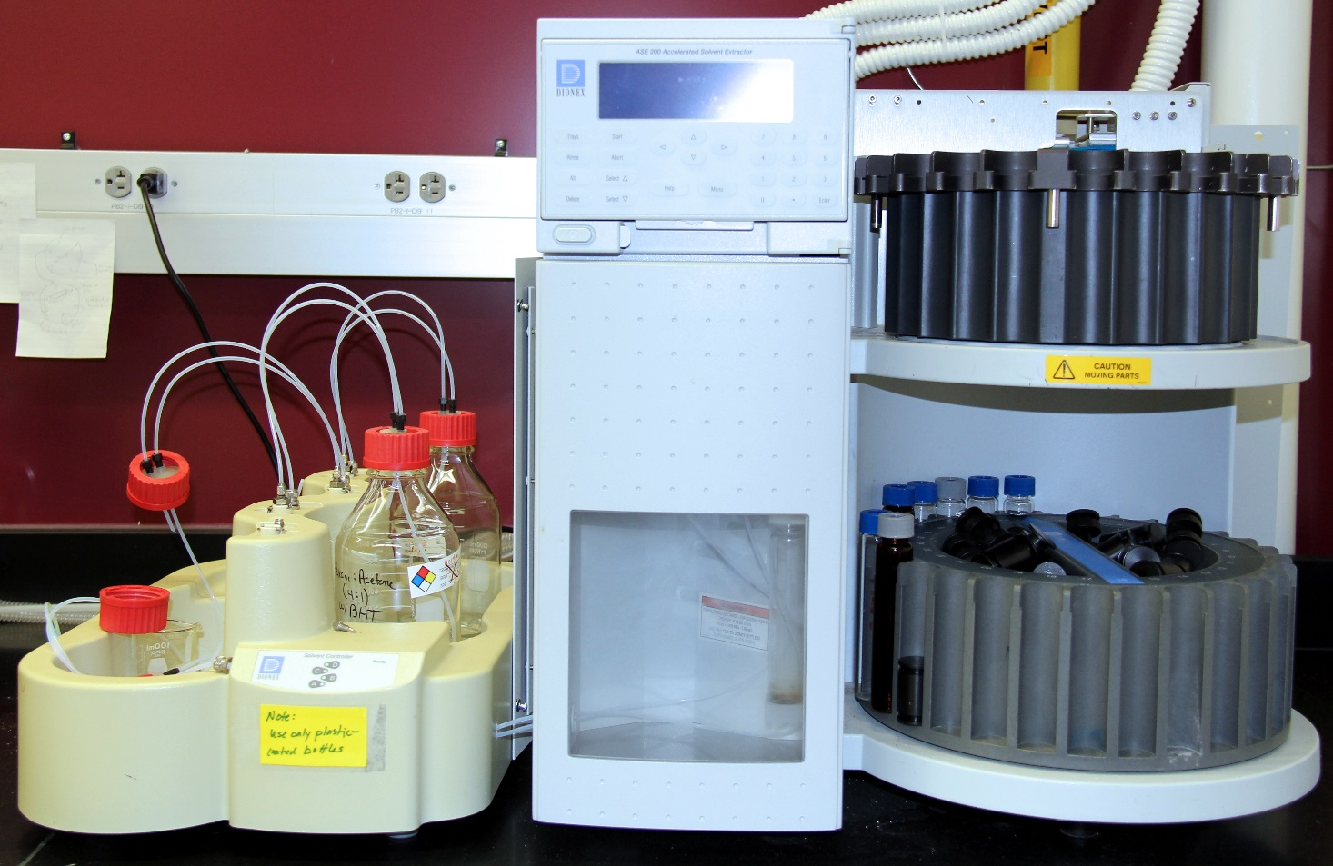
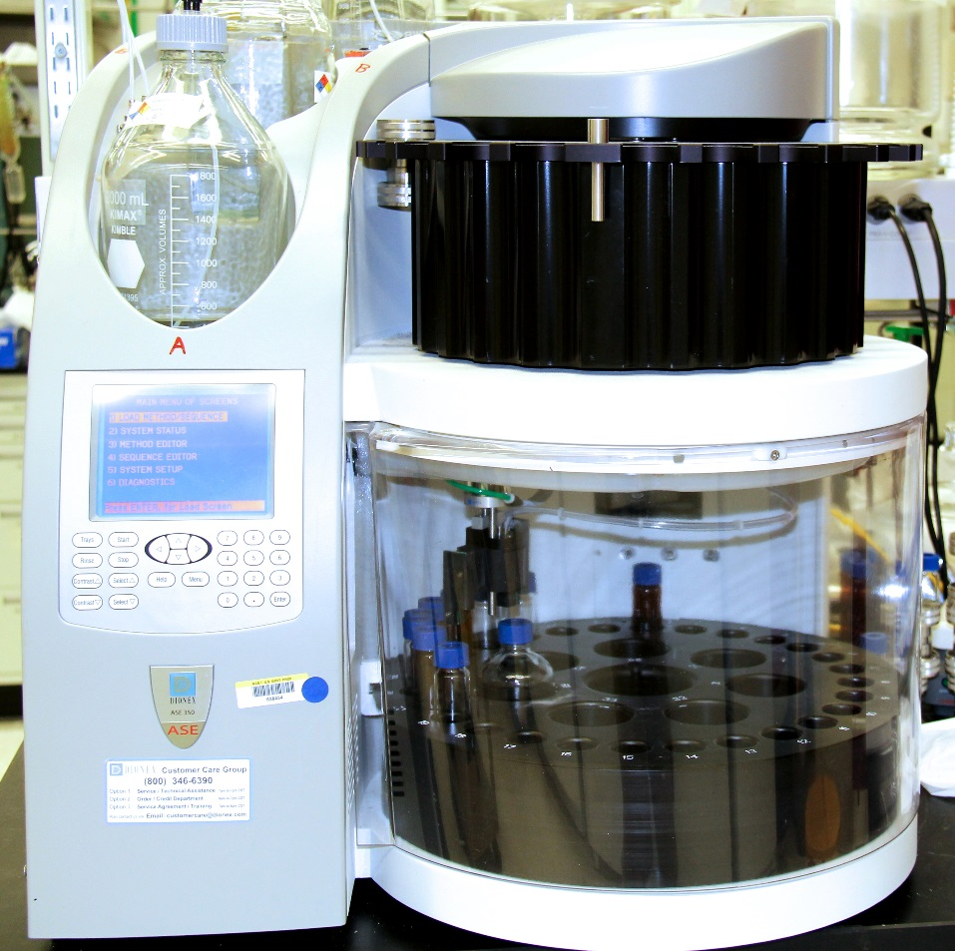
Apparatus
ACE 200
ACE 350
Notes:
These photographs show examples of two commercial instruments for pressurized fluid extraction. The principle of operation is the same for both instruments; however, more control over solvent composition is possible with recent ACE 350 instrumentation compared with the earlier ACE 200. Different sample cells must be used with the two instruments.

Slide 4
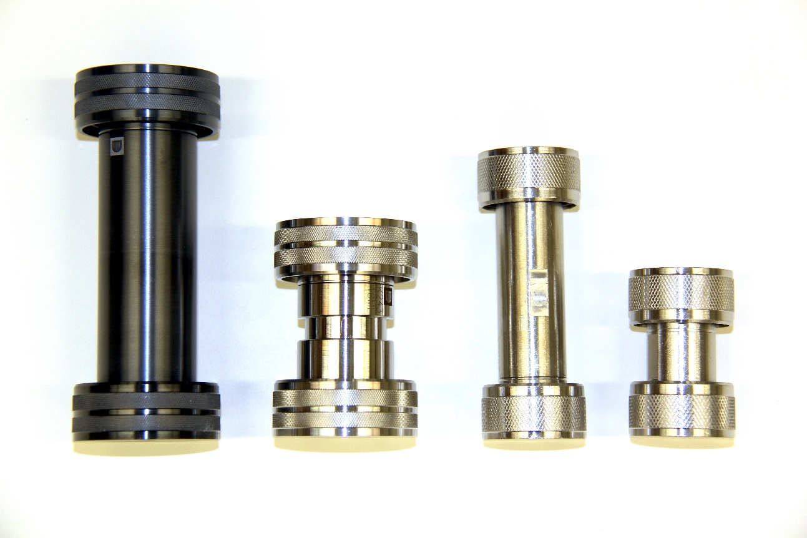
Apparatus: Cells
ACE 350 cells
ACE 200 cells
Notes:
This figure illustrates the basic configuration of PFE sample cells. Samples are placed in the cell body along with an inert granular matrix. The ends are sealed with endcaps, which are screwed onto the cell body at a finger tight level of tightness. Seals are made at polymer rings contained within each endcap assembly.
The black cell shown at the left is designed to be used with acid solutions, whereas conventional stainless steel cells are for use with aqueous and organic solvents. All cells are designed to withstand high pressure and high temperature conditions.

Slide 5
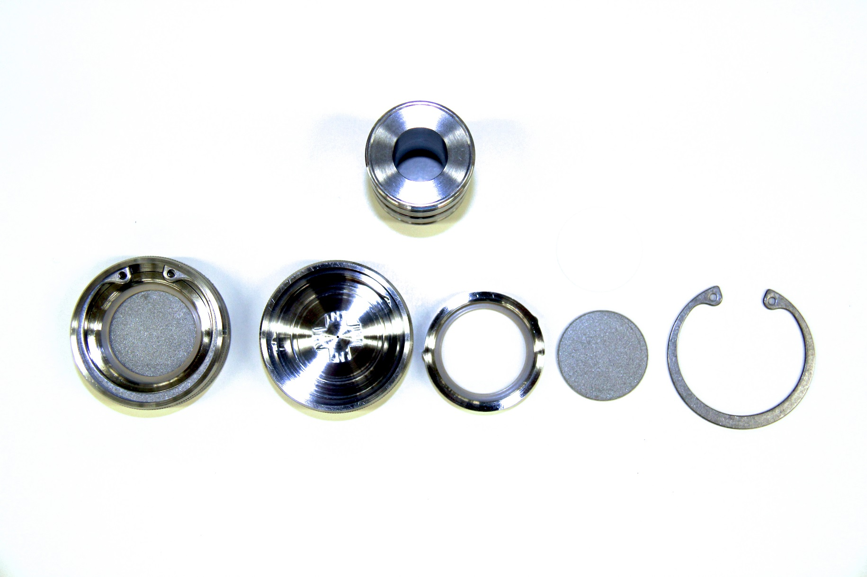
Apparatus: Cell Disassembly
Notes:
This photograph illustrates the components of a sample cell after disassembly. The endcaps are disassembled after each use for cleaning. To reassemble, the stainless steel frit is first placed in a recess in the top piece of the endcap. The ring seal is placed on top of the frit by aligning the two indexing tabs on the ring seal with the corresponding grooves in the endcap top piece. The assembly is retained by inserting the retaining clip into the groove in the endcap using ring clip pliers designed specifically for this purpose. Care must be taken when the clip is compressed to avoid sudden spring action and loss from slips.
A disposable cellulose or glass fiber filter is placed against the stainless steel frit before the cell is filled. It should be noted that the diameter of the filters used for specific cells may differ, depending on the configuration of the cell.

Slide 6
Method Development
Methods provide control over extraction conditions
Sequences describe how samples are processed
Adjustable Method Parameters
  Solvent
  Temperature
  Pressure
  Time
  Number of cycles
Adjustable Sequence Parameters
  Method
  Sample/extract location
  Wash cycle
Notes:
The development of a robust extraction method may require some effort, but the control provided by the instrumentation does permit optimization of individual process variables.
Methods provide control over extraction conditions, whereas sequences describe how samples are processed using specific methods.
Method parameters include choice of solvent, temperature, the pressure applied to the cell, the static time of the extraction, and the number of cycles used in extracting the sample.
Sequence parameters, on the other hand, control the method used for extracting the sample, the sample and extract tube locations, and the presence or absence of wash cycles.

Slide 7
Dispersant
Distributes sample
Prevents plug formation
Increases extraction efficiency
Types of Dispersants:
  Diatomaceous earth (Hydromatrix®)
  Sand
  Sodium Sulfate not recommended
Notes:
As with Soxhlet extraction, an inert material is used to distribute and dilute the sample and thus promote better contact with the extraction solvent. It is recommended that the PFE cell volume be filled, or nearly filled for operation.
The dispersant and sample are mixed within the PFE cell, and the combined matrix acts to prevent plug formation that might occur with sample alone. More importantly, the dispersant increases extraction recovery by diluting the sample to promote more efficient solvent interaction. The matrix may also help to prevent plugging of the frit and subsequent flow paths within the instrumentation.
*Hydromatrix is the usual dispersant employed with PFE. Prior to use, the dispersant should be cleaned to remove contaminants that might interfere with the analysis. This can be accomplished by rinsing with an organic solvent, or by soxhlet extraction, or by processing in a PFE cell. A blank sample can also be processed to indicate the presence or absence of such contaminants.
Processed sand can also be used as a dispersant, and this alternative may be indicated for certain classes of analytes that might be adsorbed by Hydromatrix. Sand is unlikely to be adsorptive due to its relatively low specific surface area.
It should be noted that unlike soxhlet extraction, sodium sulfate is not recommended for use as a dispersant with PFE, due to potential problems in blockage of the solvent flow pathways.

Slide 8
Steps in Sample Processing
Assemble the endcap components and attach one endcap to the cell body
Place a filter disk in contact with the end cap
Fill cell approx. half full with pre-cleaned Hydromatrix
Add sample to cell quantitatively
Mix sample and dispersant
Add internal standard solution to cell quantitatively
Fill remaining cell volume with Hydromatrix
Seal PFE cell with top endcap
Place PFE cell in upper carousel rack
Place receptacle tube in bottom carousel rack
Activate method or sequence
Notes:
Begin by assembling one of the cell endcaps to the cell body. Insert a cellulose or glass fiber filter into the cell body using a push rod designed for this purpose.
Fill the cell with pre-cleaned Hydromatrix to approximately half-full. A funnel is available from the manufacturer to aid in the addition of solids to the cell body.
Add the sample to the cell quantitatively. This can be accomplished by use of a separate weighing container. The mass of the sample is determined by difference of the weighing container before and after transfer to the cell. It should be noted that because the mass of a PFE cell is significant relative to the sample mass, the sample should not be weighed directly into the sample cell.
Once the sample is transferred to the cell, stir the contents to distribute the sample in the Hydromatrix.
Add the internal standard solution to the cell quantitatively. In most cases this is accomplished with a gas tight syringe, with weight by difference of the syringe before and after dispensing the solution.
Fill the remaining cell volume with Hydromatrix. The custom funnel is helpful for this purpose.
The next step is to seal the PFE cell with the top endcap. The instructions from the instrument manufacturer suggest that a cellulose or glass fiber filter should be added to the top endcap as well as the bottom endcap. This is a safety feature that eliminates the need to keep track of the top and bottom endcaps. If the orientation were reversed without the filter, solid material might plug the cell or fluid pathways in the instrument.
Place the PFE cell in the upper carousel rack, and place the receptacle tube in the lower carousel rack.
Finally, activate the method or sequence to begin extraction of the sample.

Slide 9
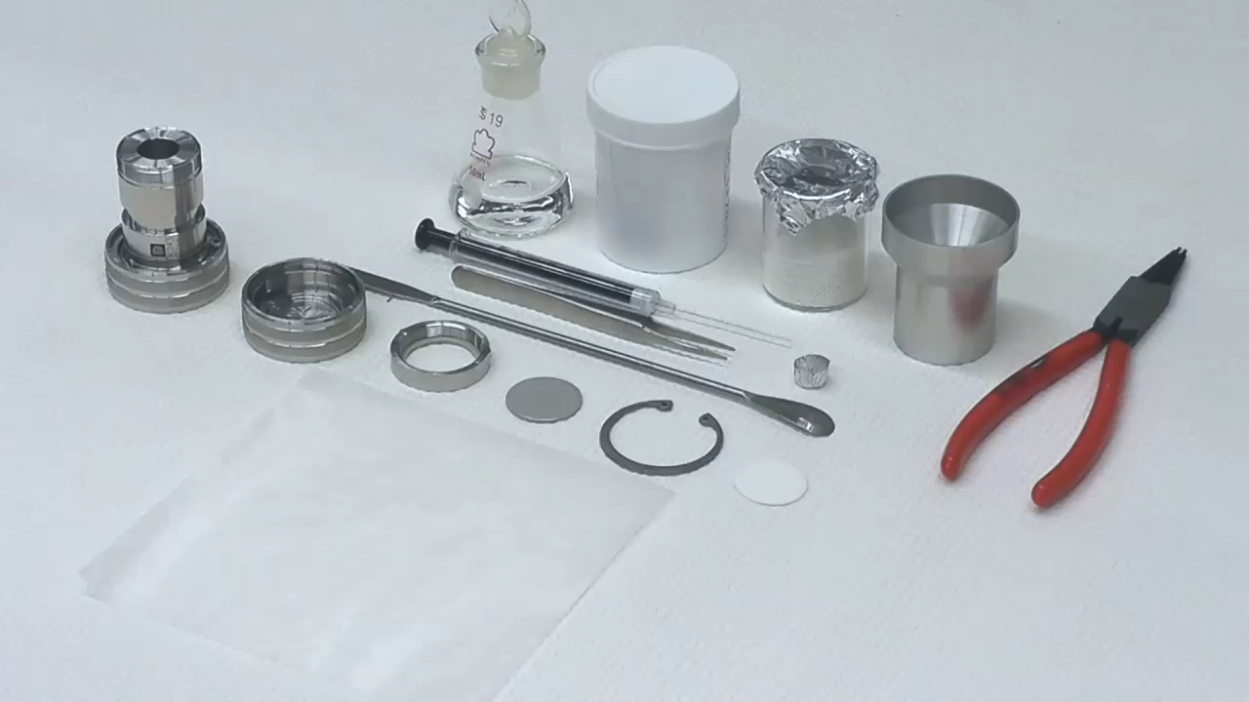
Notes:
The following video illustrates these steps for a typical sample. Begin by assembling all of the needed components on a clean work surface that can be discarded after the samples are prepared. Assemble the endcap by inserting the stainless steel frit and ring seal. Carefully compress the retaining ring with ring clip pliers and insert the clip into the groove in the endcap. Insert a cellulose or glass fiber filter against the stainless steel frit. Two filters can be used if particulate material is observed to collect in the extract or at the stainless steel frit. Next, attach the cell body onto the lower endcap assembly. It is useful to align the Dionex logo in the upper direction as a convention to indicate the top versus the bottom. A metal funnel is available to assist in filling the sample cell. Hydromatrix is the most commonly used dispersant. It is best to preclean and dry sufficient Hydromatrix prior to sample preparation. The Hydromatrix is simply rinsed with solvents or extracted by solvent extraction or even PFE. Fill the cell to a level about 1/3 or ½ of the volume of the cell, depending on sample size.
Next, weigh out an aliquot of the sample. A separate foil weighing container should be used to determine the mass before and after transfer to the cell. Because of the large mass of the cell, the sample mass should not be determined by difference using the sample cell. Using this approach, all of the sample transferred must be accounted for; that is, the transfer must be quantitative.
Mass determination is done by difference, as is usual.
After transferring the sample to the PFE cell, add a small quantity of hydromatrix, and distribute the sample and dispersant by stirring with a spatula.
The next step is to aliquot the internal standard solution onto the top of the sample / hydromatrix mixture. This is accomplished by a transfer using a gas tight syringe. The syringe is filled with the internal standard solution and weighed. Prior to this weighing step, the needle can be wiped with a tissue to remove solution on the needle.
An appropriate quantity of the solution is transferred to the top bed in the cell. Immediately after the transfer, the syringe is again weighed to determine the mass of the solution delivered.
Finally, the remaining space in the cell is filled, or nearly filled with dispersant, and the top endcap is attached and tightened. Before attaching the endcap, the area on the cell body that will contact the ring seal should be cleared of any dispersant. The level of tightness needed will become evident with experience, but the seal is usually achieved with much less force than the maximum that most individuals can apply. If a seal cannot be achieved, it is probably an indication that the polymer ring needs to be replaced.
To use the ACE instrument, the first step is to turn on the supply gas that operates the pneumatic actuators. Next, turn on the power and wait for the system to initialize. The menus are relatively intuitive. The system status screen shows the current run status when a sample cycle is activated. The system setup lists global parameters, such as units to display, rinse volume, and whether or not a sample should be aborted if a leak is detected.
To run a single sample, a method is required. A method must be defined using the method editor. Once defined, the method is selected. The sample cell is placed in the upper carrousel. A small sleeve in the upper carrousel is used by the instrument during wash cycles. A tube to receive the extract is placed in the lower carrousel at the corresponding position to the cell location. If a sequence is used, more flexibility is available to specify different sample cell and extract tube locations. Activate the method by pushing the start button. The lower carrousel will rotate so the system can detect the presence or absence of receptacle tubes. The upper portion of the tube should not be labeled since marks or labels may interfere with its detection.
The upper carrousel will go through a similar routine to detect the presence or absence of sample cells. The sample cell will be connected to the high pressure pumping system and moved into the oven. This action is normally not visible when system covers are in place. Once the sample cell and receptacle tubes are in place, the cell is pressurized with the extraction solvent and the program is run. At the completion of the extraction, and after the cell has been returned to the carrousel, the cell and receptacle tube containing the extract can be removed. If the trays appear to be locked in place, the tray button should be toggled to the unlock position, which is indicated by a lighted indicator on the left size of the botton. The extraction cell may be hot from the extraction cycle, so care should be taken when removing the cells.

Slide 10


www.nist.gov
Notes:
To learn more about the National Institute of Standards and Technology, visit www.nist.gov

