Slide 1


Precision Engineering of Biomolecular Function with… Measurements and Machine Learning
EBRC Meeting, April 26, 2021

Slide 2
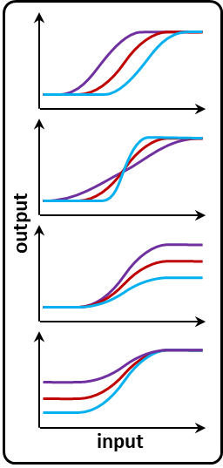
Goal:
Precision Engineering of Biological Function
Engineering biology needs to be quantitative
  Not just on/off, +/-, present/absent
Biological signal processing (sensors, gates, circuits)
  Requires precise matching
Engineering workflow for precision, made-to-specification genetic sensors
  Replace/supplement directed evolution
Notes:
The project I’m going to talk about today today stems from the need to engineer biology in a more quantitative way, particularly for biological sensing and signal processing.
Although there has been a lot of work on the engineering of living sensors for new types of molecules or other signals, it’s difficult to find any examples where the quantitative precision of sensor engineering is even considered.
Part of that might be cultural: biological interactions are often viewed as simply present vs. absent. Even within the engineering biology community, where we like to think more quantitatively, the most common analogy that we use to talk about sensors and information processing is digital logic: on vs. off.
But it’s also due to a lack of tools that can support precision sensor engineering.
So, our main goal with this project was to develop a workflow for quantitatively precise biological sensor engineering – something that can overcome the limitations of the directed evolution methods most of us are familiar with.

Slide 3
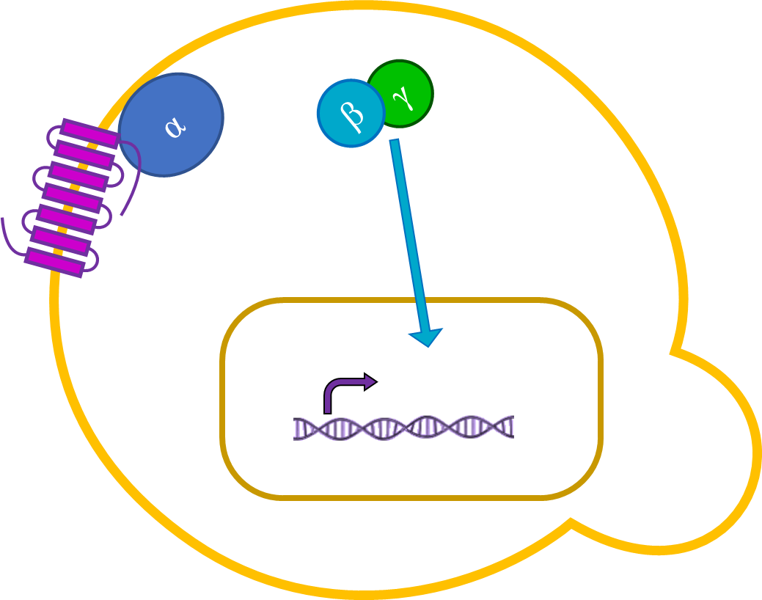
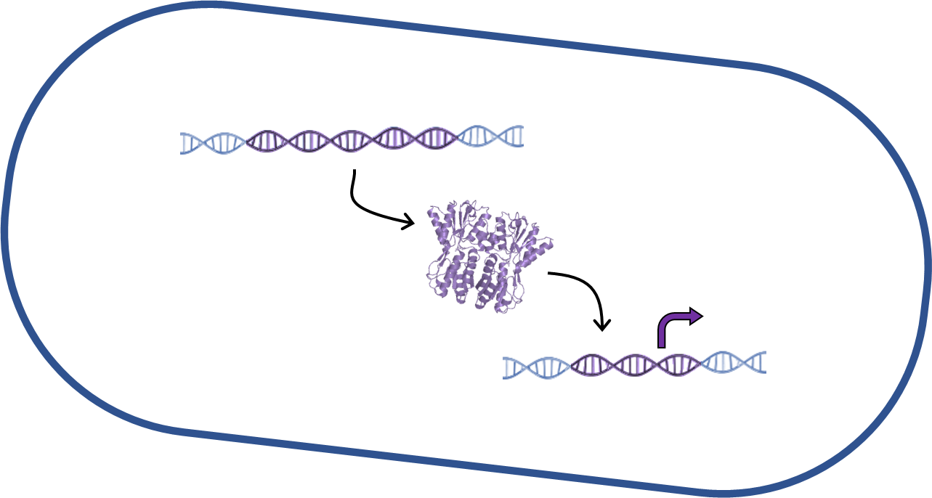
Engineering Biological Sense-Response:
Genetic Sensors
Function, encoded in DNA, that gives cells the ability to sense signals and respond by changing gene expression
  Bacterial allosteric transcription factors
    lac repressor, LacI
  GPCRs
Notes:
Our focus for the project are genetic sensors, which are functions encoded in DNA…

Slide 4
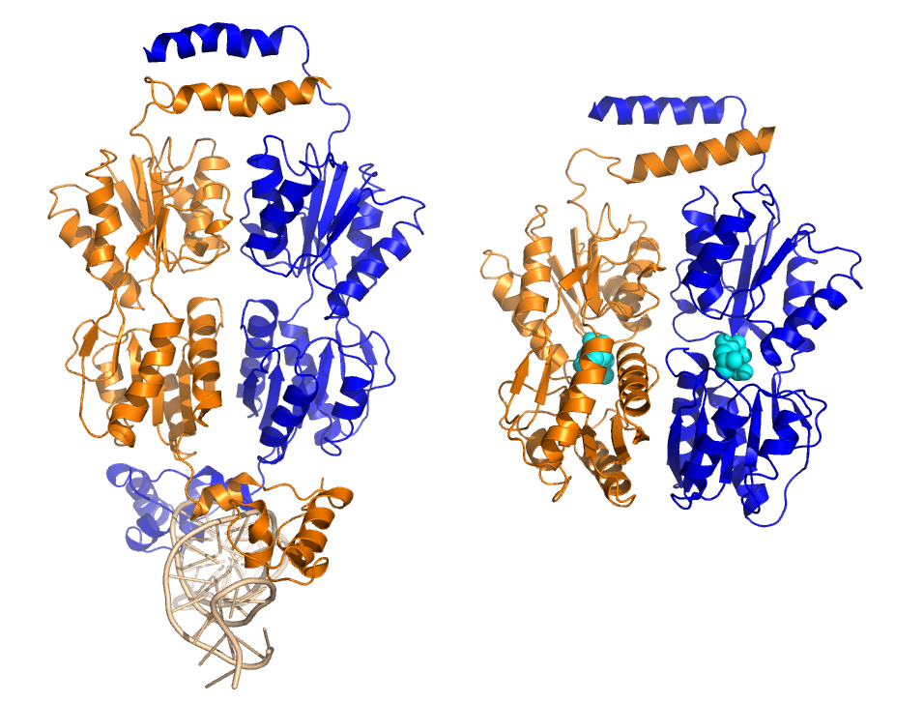
Engineering Genetic Sensors
DNA sequence (1080 bp)
  TCACTGCCCGCTTTCCAGTCGGGAAACCT…
↓
Protein sequence (360 amino acids)
  MKPVTLYDVAEYAGVSYQTVSRVVNQASH…
↓
Structure
↓
Function/phenotype
  Dose-response curve
Notes:
When we engineer genetic sensors…

Slide 5
Engineering Genetic Sensors
Dose-Response Curve
EC₅₀
G∞
G(c)
output (gene expression)
G₀
input (concentration)
log(c)

Slide 6
Engineering Genetic Sensors
Dose-Response Curve
EC₅₀
G∞
Can we engineer sensors with quantitatively specified EC₅₀, G₀, G∞?
G(c)
G₀
log(c)

Slide 7
Engineering Genetic Sensors
Dose-Response Curve
EC₅₀
G∞
Can we engineer sensors with qualitatively different dose-response?
G(c)
G₀
log(c)

Slide 8
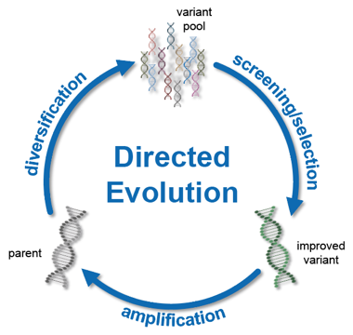
Engineering Genetic Sensors
Which DNA/amino acid sequence will give the dose-response curve that I need?
State of the art: Directed Evolution
  Large library of randomly modified sequences
  Darwinian selection to find the ‘best’ sequences
  Outcomes: identify a few improved sequences
  Precision is difficult
  Multi-objective and negative selections are
  difficult
    Necessary for sensors
variant
library
starting
variant
improved
variant
https://bsse.ethz.ch/bpl/research/directed-evolution.html

Slide 9

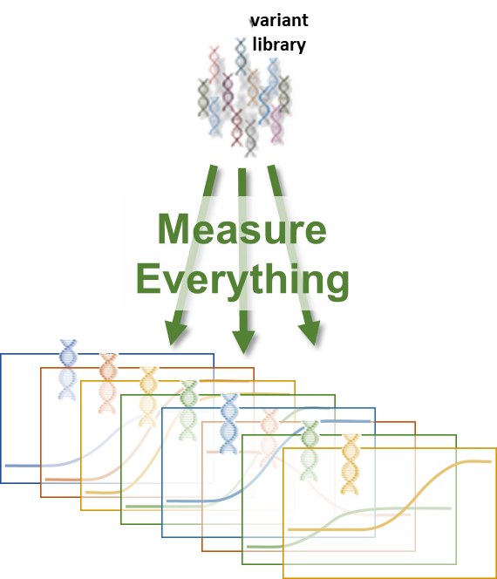
Engineering Genetic Sensors
Which DNA/amino acid sequence will give the dose-response curve that I need?
Our approach: Measure Everything
  Large library of randomly modified sequences
  Measure the DNA sequence and
  dose-response for all of them
  Outcomes:
    Choose sequences (in silico) that match requirements
    Learn sequence-function design rules
    Discover new, unexpected functions
  Precision is as good as measurement
  Multi-objective and negative selections are easy
starting
variant

Slide 10
What is “Everything”?
(and how do you measure it?)
Large library = 10⁵ to 10⁷ sequence variants
protein-coding sequence (1060 bp)
E. coli lac repressor, LacI

Slide 11
What is “Everything”?
(and how do you measure it?)
Large library = 10⁵ to 10⁷ sequence variants
barcode sequence
(54 bp)
protein-coding sequence (1060 bp)
DNA barcodes
  Attach short, random, DNA sequence to protein-coding sequence
  Barcode length ≈ 54 bp (4⁵⁴ ≈ 10³²)
Count barcodes with short-read (Illumina) sequencing
  4 lanes of Hi-Seq
  2 billion reads
10⁵
Decode barcodes with long-read (PacBio) sequencing
  Long-read sequencing of protein sequence + barcode
    Full plasmid sequence to avoid effects of off-target mutations
  Only need to do this once

Slide 12
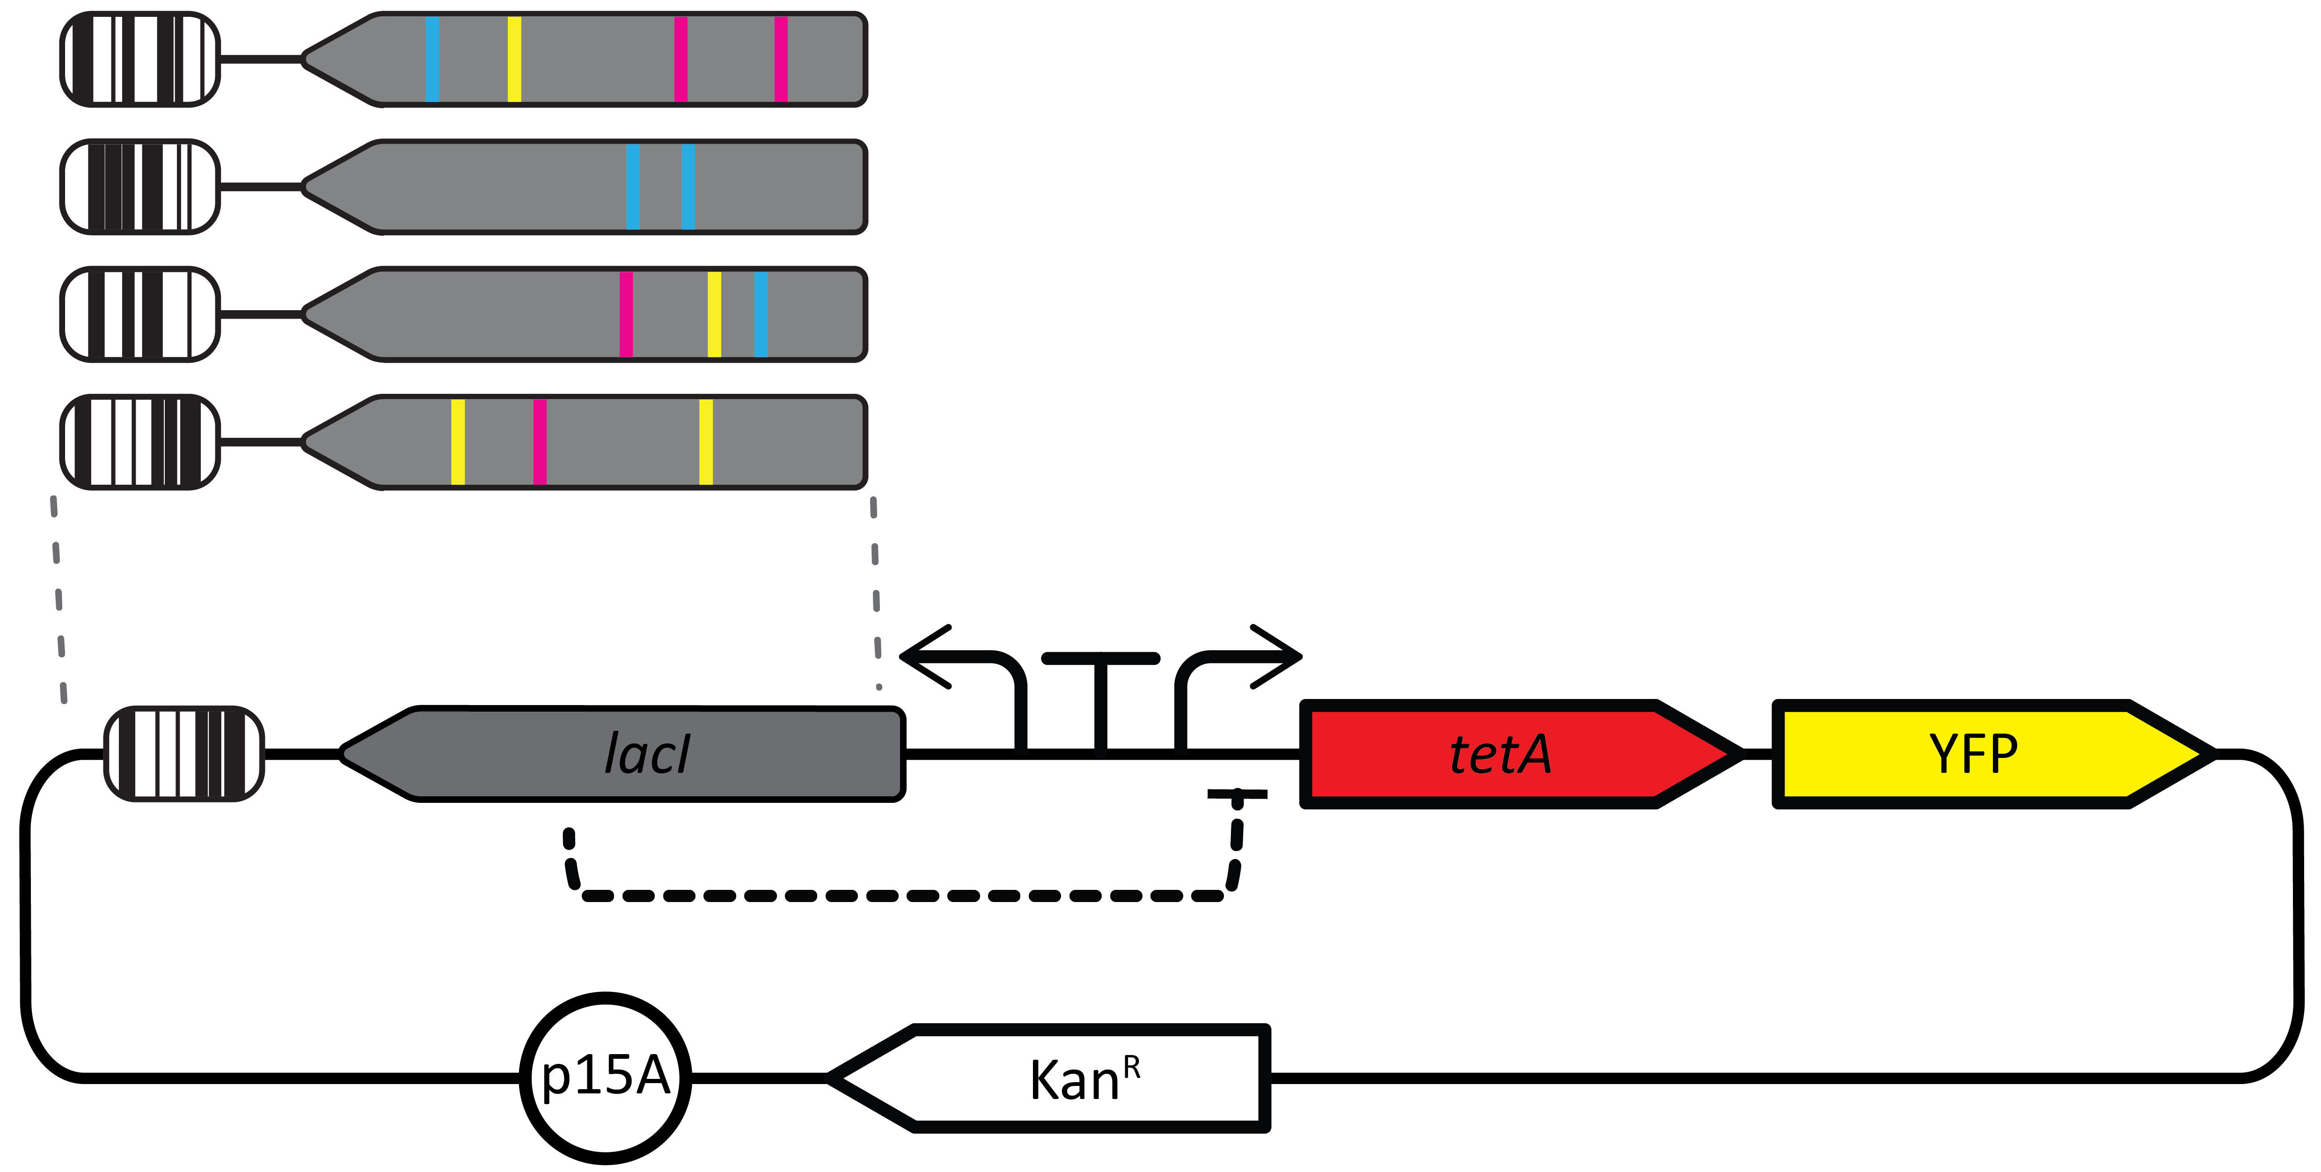
How to Measure 10⁵ Dose Response Curves by Counting DNA Barcodes?
Engineer sensor output to regulate expression of antibiotic resistance gene

Slide 13
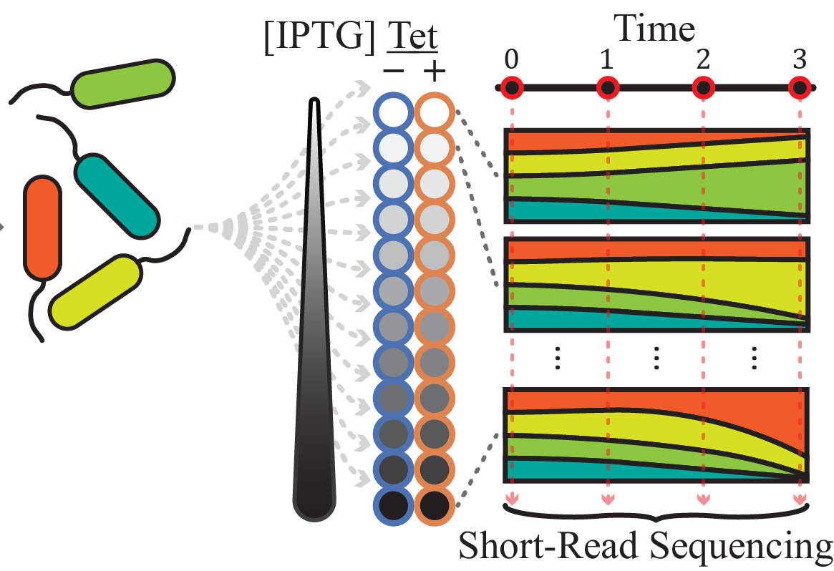
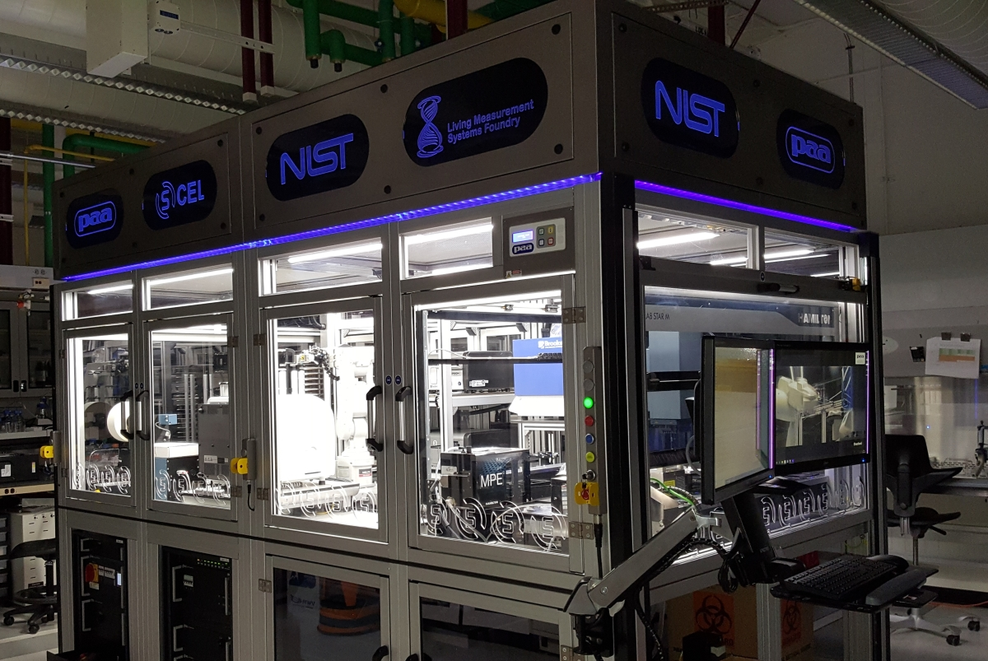
How to Measure 10⁵ Dose Response Curves by Counting DNA Barcodes?
Transform into E. coli
Grow library in 24 different conditions
  12 Input concentrations
  +/- Tetracycline
Maintained in exponential growth phase
  4 time points, 8 hours
NIST Living Measurement Systems Foundry
https://www.nist.gov/programs-projects/nist-living-measurement-systems-foundry

Slide 14
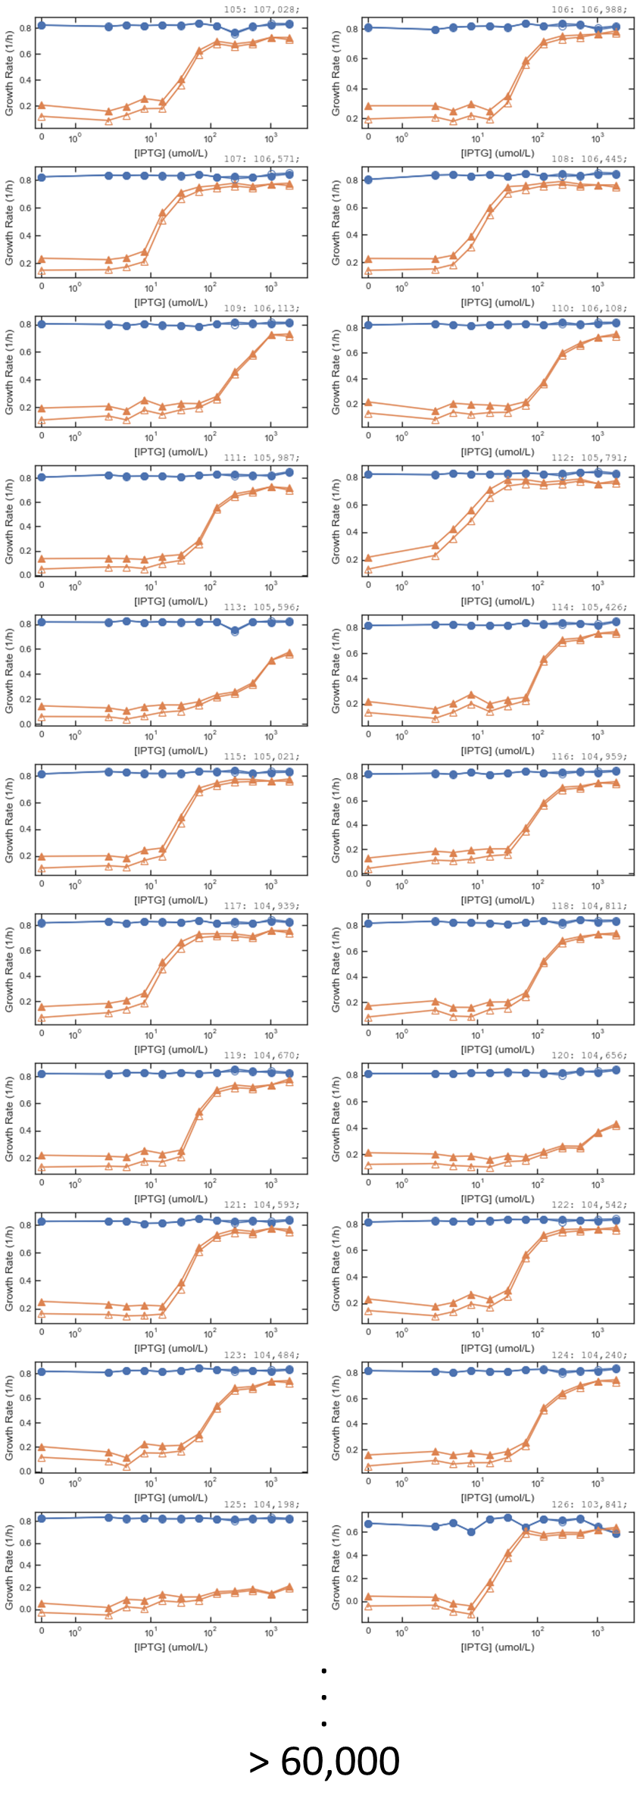
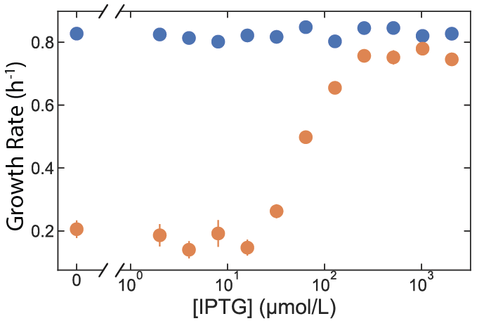
How to Measure 10⁵ Dose Response Curves by Counting DNA Barcodes?
Count barcodes in each sample at each time point
Change in barcode counts vs. time
Growth rate for cells with one LacI variant
without
antibiotic
with antibiotic
Input (concentration)

Slide 15
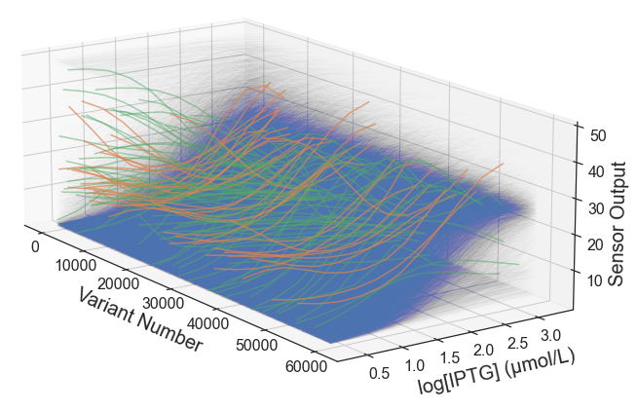
Results: > 60,000 Dose-Response Curves

Slide 16
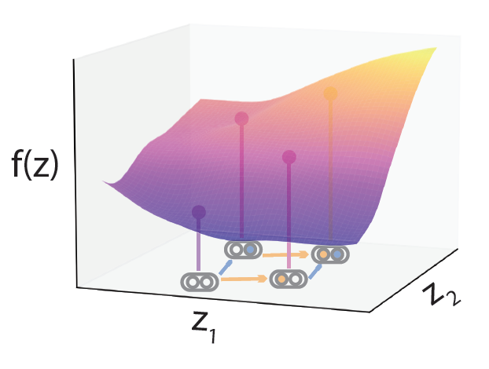
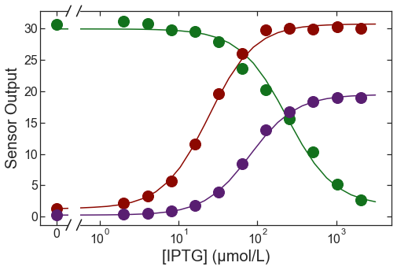
Two Routes to Precision Engineering
1. In Silico Selection
2. Forward Engineering
Identify DNA sequences from library with desired dose-response
Learn design rules
  Machine learning and biophysical models
Use them to predict new DNA sequences

Slide 17
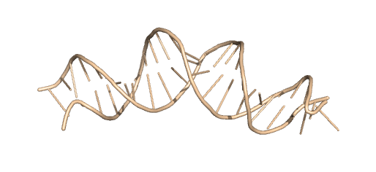
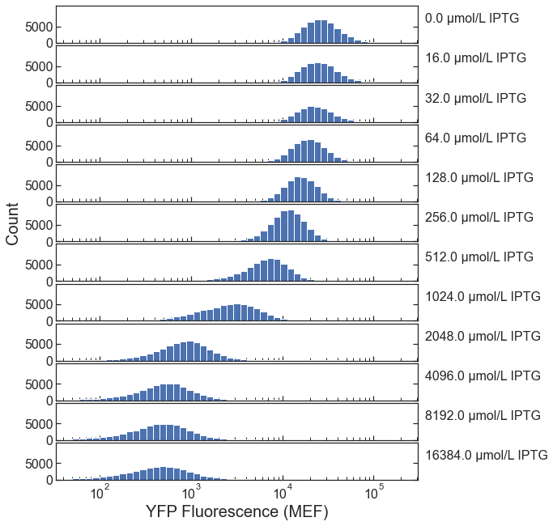
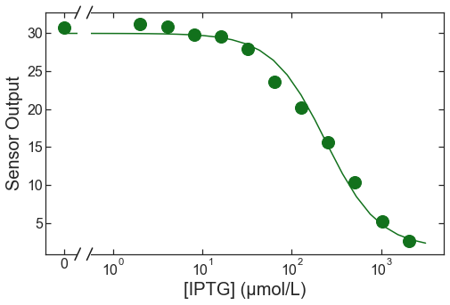
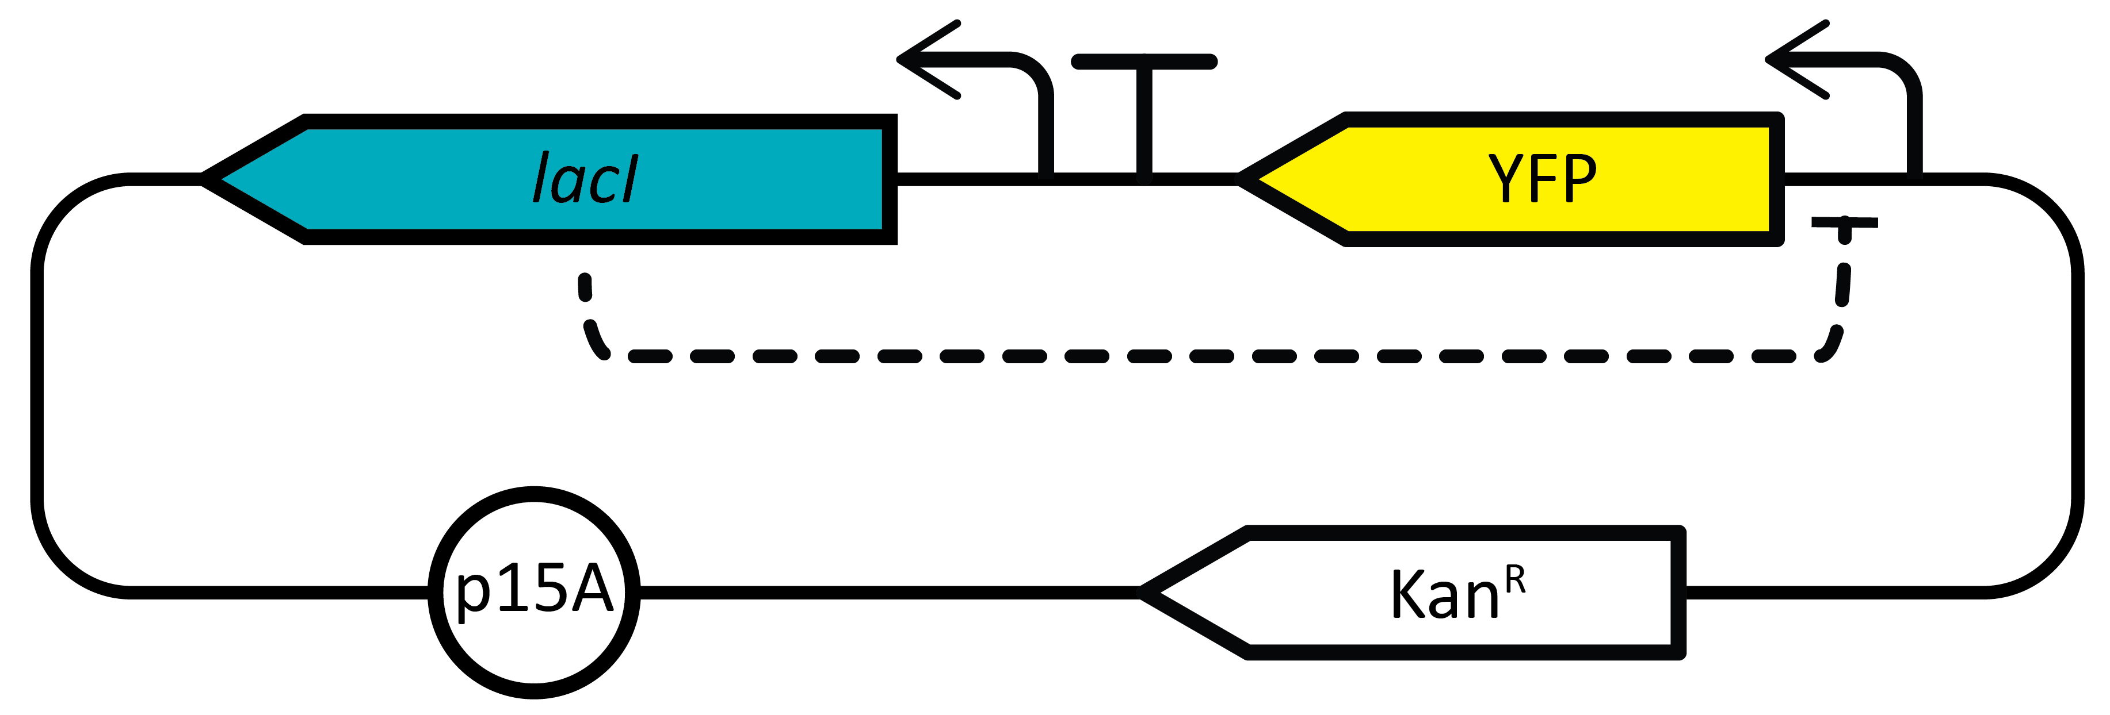
Two Routes to Precision Engineering
1. In Silico Selection
2. Forward Engineering
Identify DNA sequences from library with desired dose-response
Learn design rules
  Machine learning and biophysical models
Quantitative Verification:
(Re)Synthesize sensor gene
Insert into new plasmid
Measure dose-response with flow cytometry

Slide 18
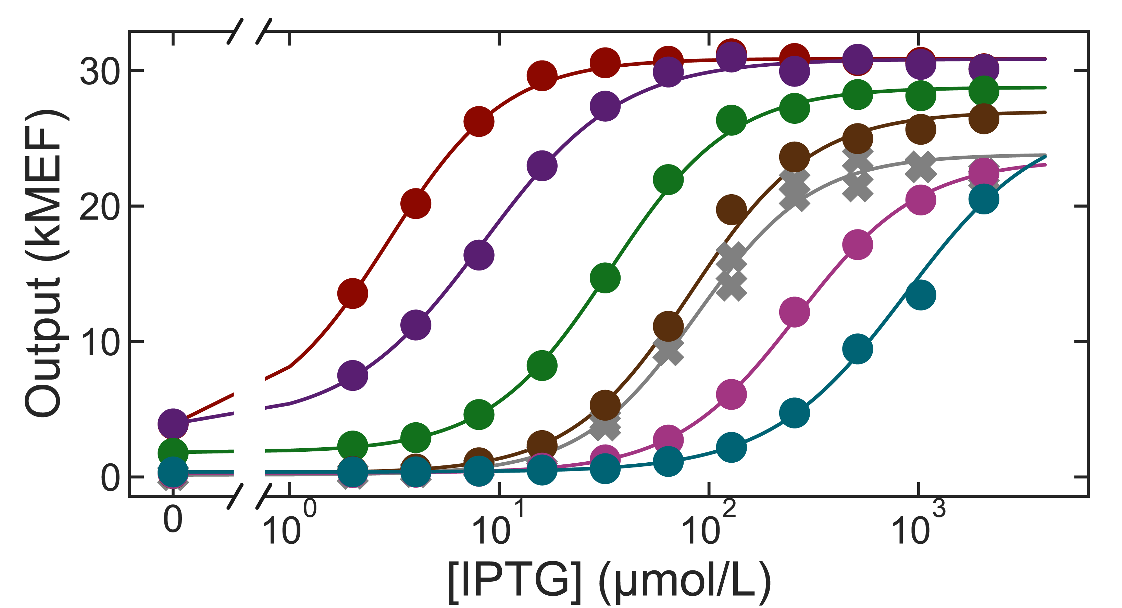
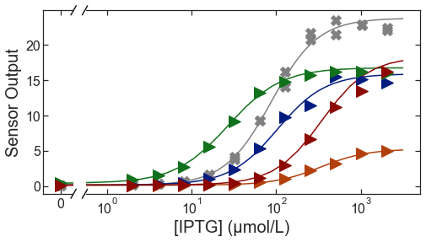
Precision Engineering 1: in silico selection, quantitative dose-response targets
Precision EC₅₀:
  1.25-fold accuracy
  3 orders of magnitude
Multi-objective:
  Select EC₅₀ and G∞ independently

Slide 19
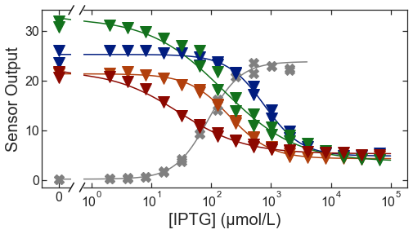
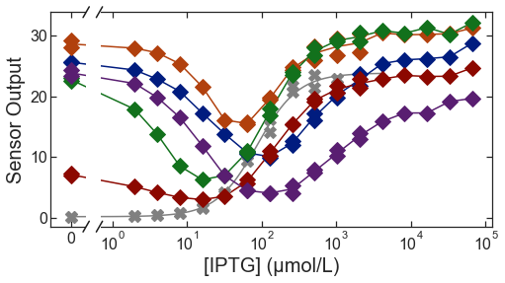
Precision Engineering 1: in silico selection, find rare dose-response phenotypes
Inverted dose-response
  >100 variants in library
  Genetically diverse
Band-stop dose-response
  Not seen before
  Not possible with other methods
  Genetically diverse

Slide 20
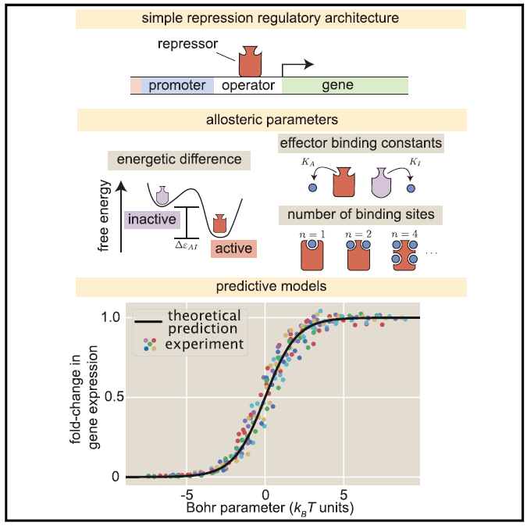
Precision Engineering 2:
Forward Engineering, learn and apply protein design rules
Data-driven ML models
  Dimensionality reduction
  Prediction
Biophysical models
  Interpretability (understanding)
  Extrapolation
Tonner et al., preprint coming soon to bioRxiv
Razo-Mejia et al., 2018, Cell Systems 6, 456–469

Slide 21
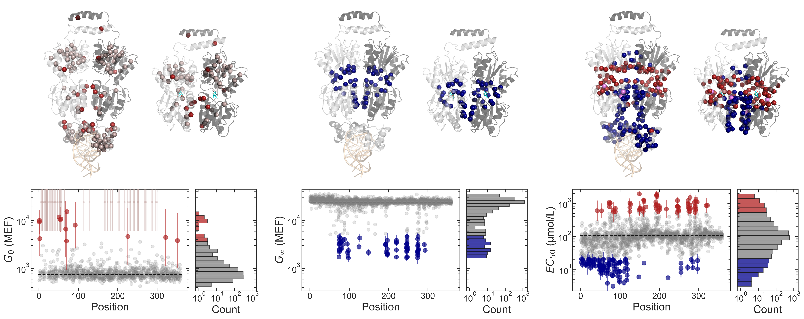
Precision Engineering 2:
Protein Design Rules
G₀
G∞
EC₅₀

Slide 22
Precision Engineering 2:
ML Prediction and Dimensionality Reduction
Mutations as vectors in low-dimensional space (z)
  Intuitive, interpretable
  Additive latent mutational effects
  Dimensionality learned from data
Measured phenotype (EC₅₀, G∞) as a non-parametric surface, f(z)
  Captures non-linearities and epistasis
Prediction accuracy as good as or better than neural network models
f(z)
z₂
z₁

Slide 23
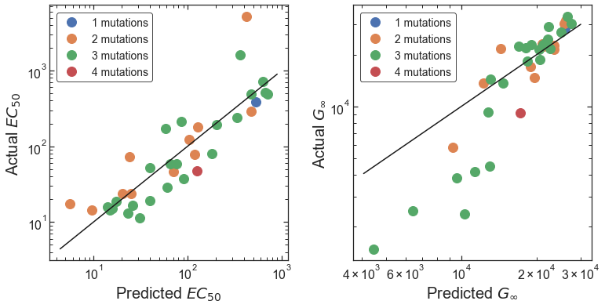
Precision Engineering 2:
ML Prediction and Dimensionality Reduction
Quantitively Predict Phenotypes for variants not in the library
  Combinations of multiple non-silent mutations
2.1-fold RMSE
1.6-fold RMSE
Bias in training data (barcode sequencing) vs. verification data (cytometry)

Slide 24
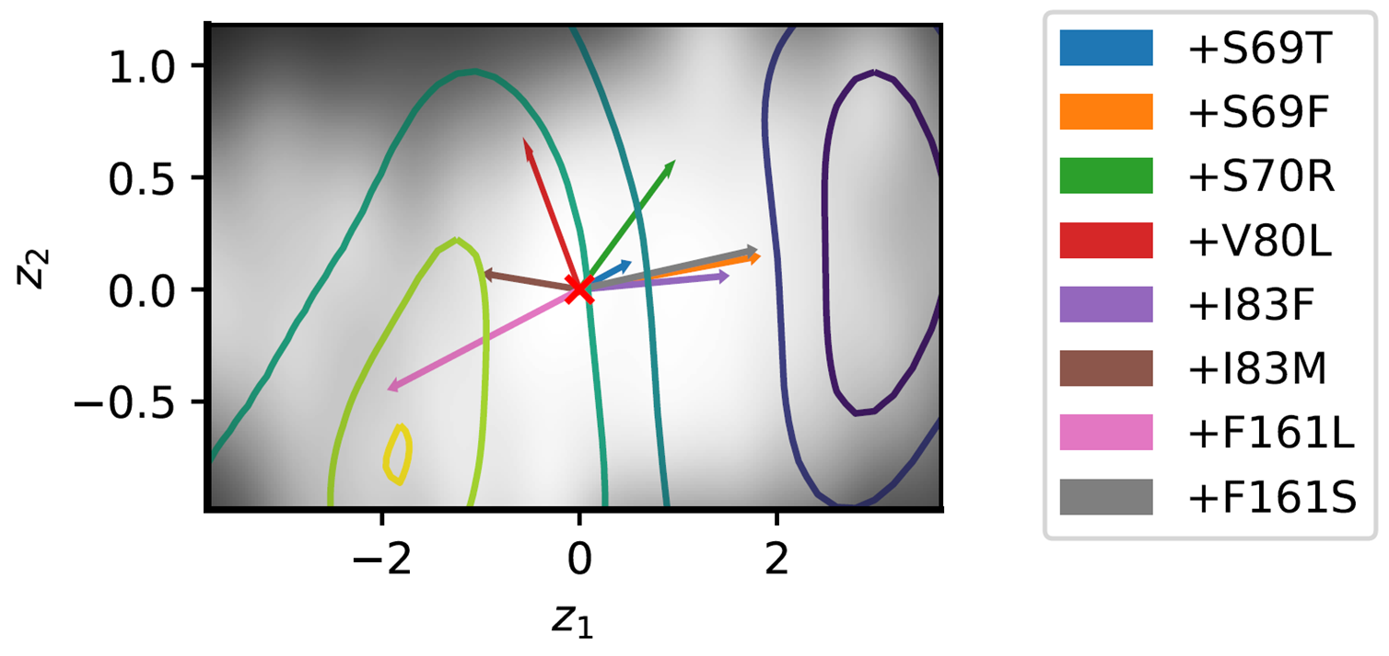
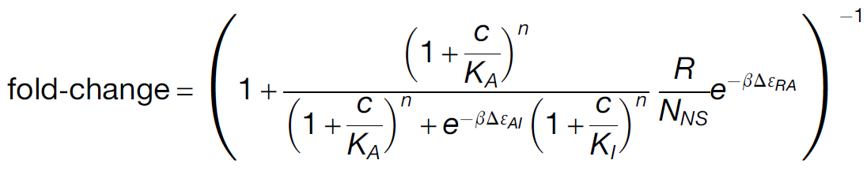

Precision Engineering 2:
Link ML Model to Protein Biophysics
Interpret ML result with biophysical model
  z₁: allosteric constant ($∆ε_{AI}$), DNA operator affinity ($∆ε_{RA}$)
  z₂: ligand binding affinity ($K_{A}$)
Contours: EC₅₀
Razo-Mejia et al., 2018, Cell Systems 6, 456–469

Slide 25
Precision Engineering 2:
Extrapolative Engineering: Better Inverted Sensors
Combine mutations to create new variants (not in the library)
  Goal: lower inverted sensor EC₅₀ and G∞
starting inverted sensors
mutation tool kit

Slide 26
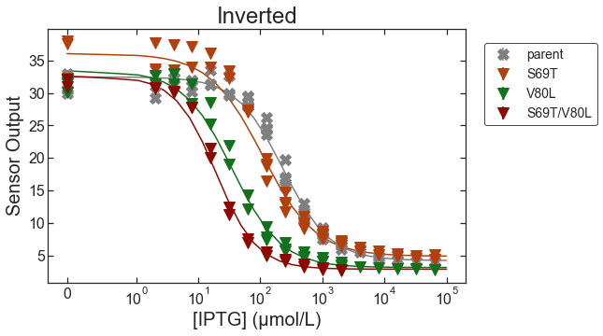
Precision Engineering 2:
Extrapolative Engineering: Better Inverted Sensors
Combine mutations to create variants not in the library
  Reduced EC₅₀ more than 10-fold
  Reduced G∞ 1.5-fold

Slide 27
Conclusion: Precision Engineering Biology
Quantitatively select sensor dose-response
Discover novel functions
  Band-stop transcription factors
Improved understanding
  Quantitative sequence-structure-function relationships
  Allostery enables sensing and evolution of sensing
Seeking new collaborators
  New types of sensors
  Sensor applications
  Other biomolecular functions
Postdoctoral positions available
Contact: david.ross@nist.gov,
elizabeth.strychalski@nist.gov

Slide 28

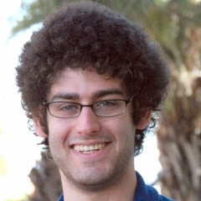
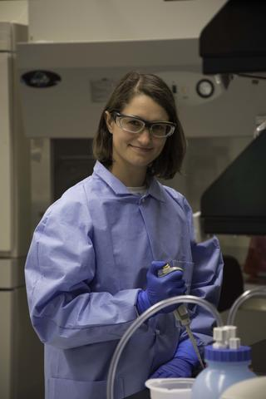
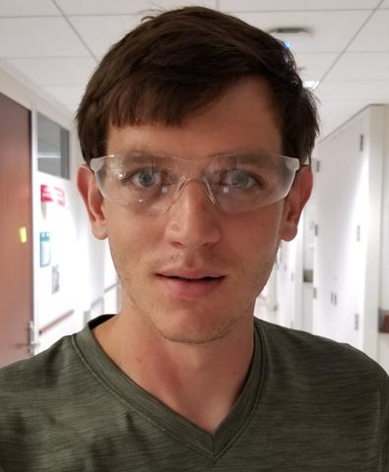
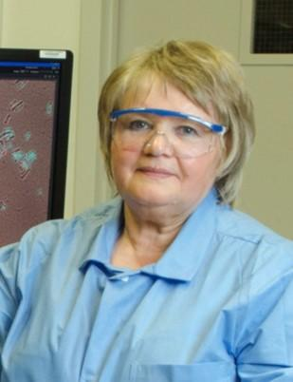

Thanks!
Drew Tack, Peter Tonner, Abe Pressman, Nate Olson, Sasha Levy (SLAC), Jane Romantseva, Nina Alperovich, Olga Vasilyeva
Elizabeth Strychalski, Jayan Rammohan, Ben Scott, Zvi Kelman, Gilad Kusne, Dan Samarov

Slide 29
Questions?

Slide 30
Backup slides
For potential questions

Slide 31
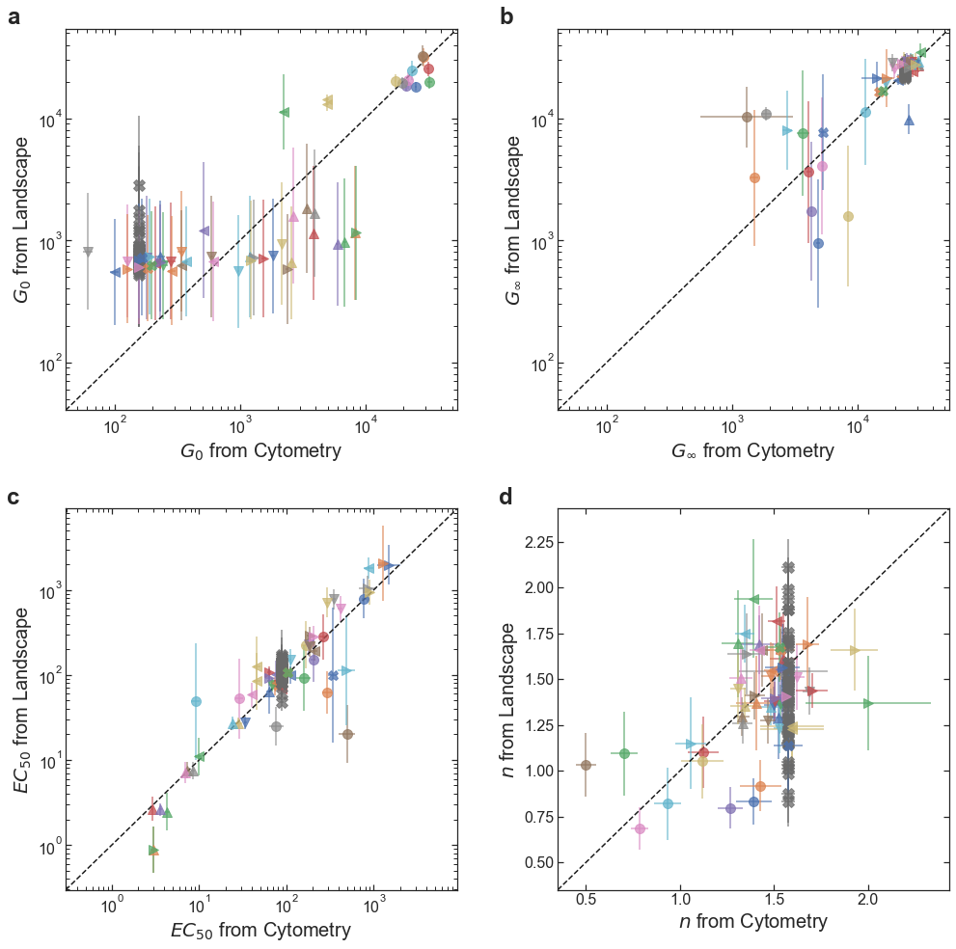
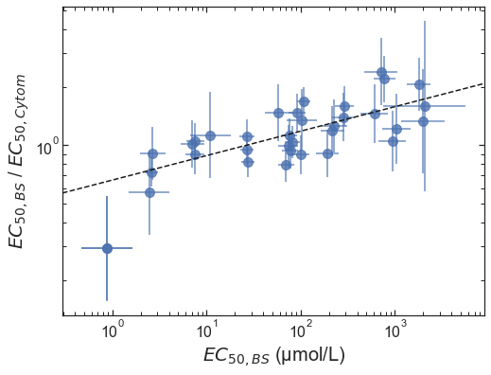
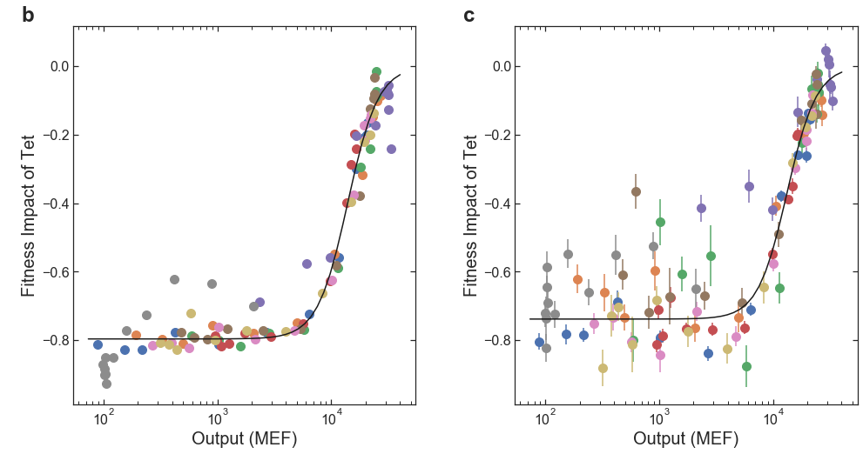
Accuracy of Library-Scale Measurement
G₀: 4-fold
G∞: 1.5-fold
EC₅₀: 1.8-fold
n: ± 0.28
EC₅₀: 1.25-fold, for normal variants, after systematic correction

Slide 32
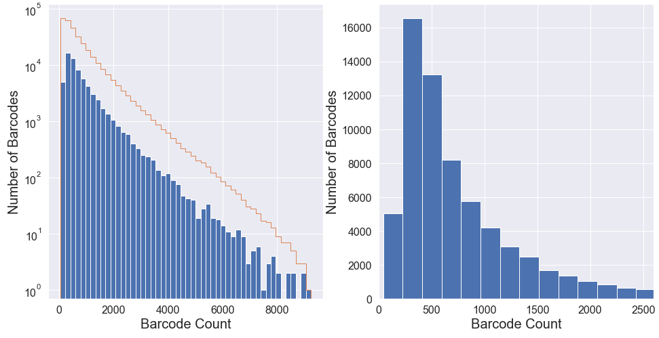
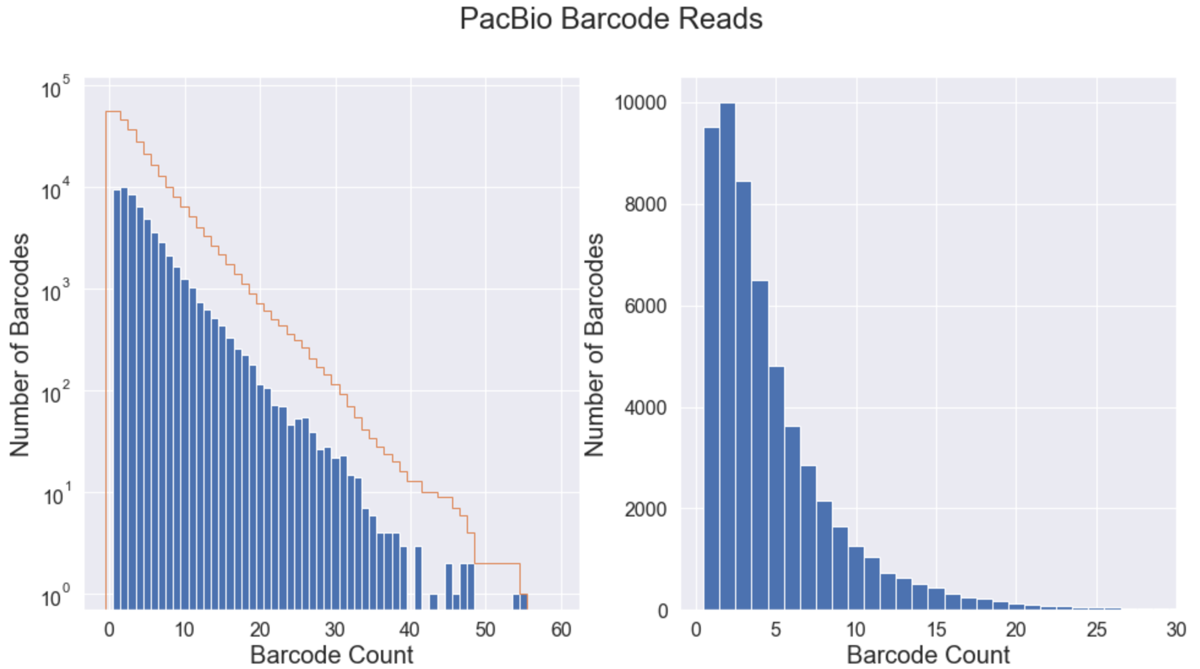
Library Variant Count Distribution
Hi-Seq
Pac Bio

Slide 33
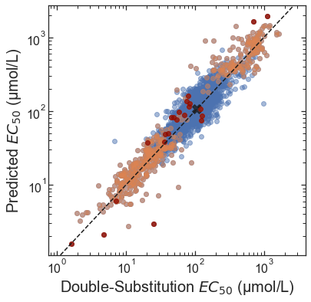
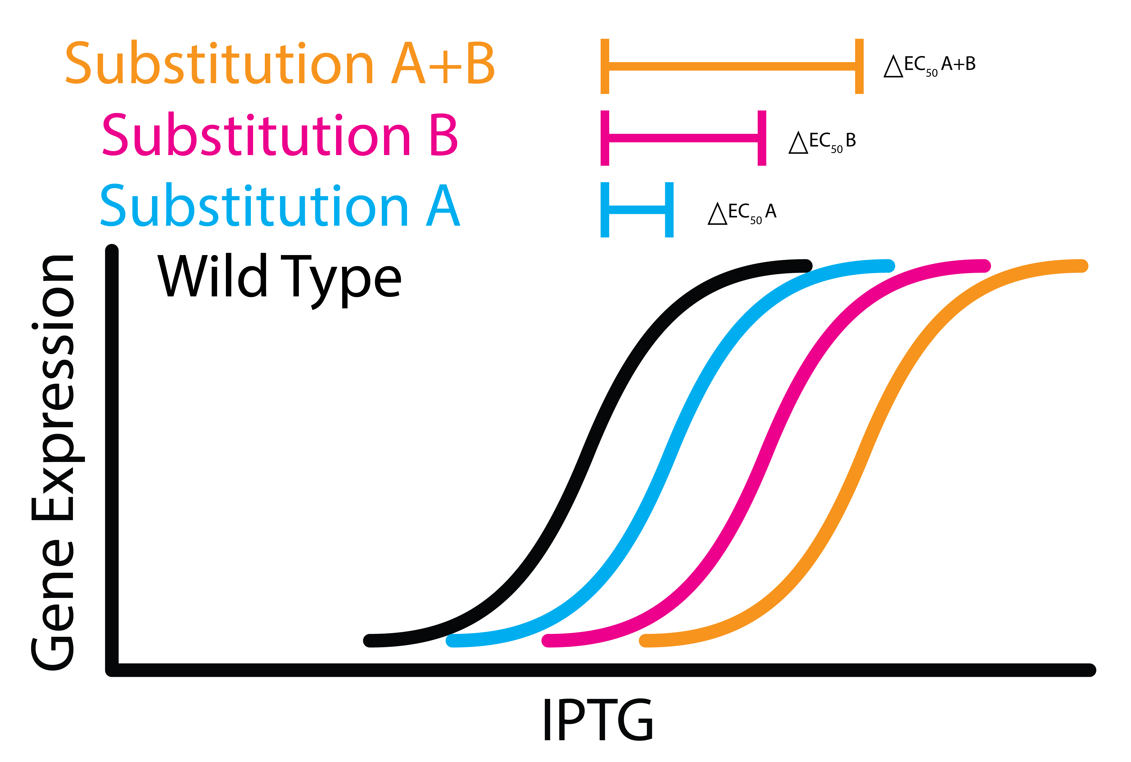
Design Rules for Sensor Protein Engineering
The effect of substitutions on EC₅₀ are log-additive
log(concentration)

Slide 34
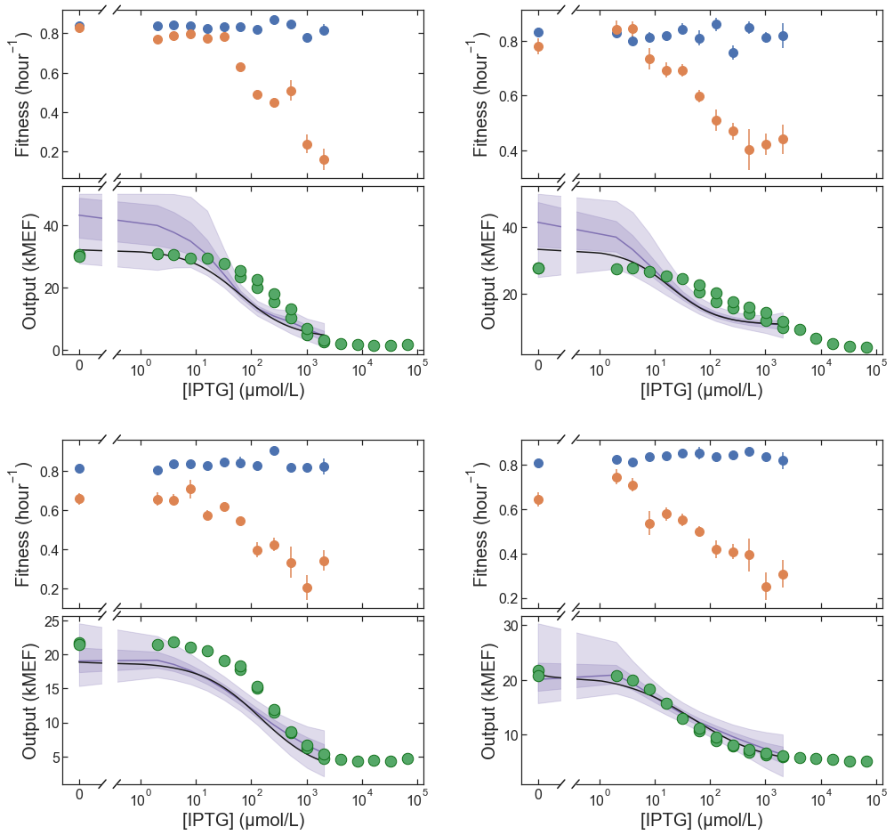
Unexpected Phenotypes
Inverted dose-response
Genetically diverse
Make up a decent portion of the library (0.35%)

Slide 35
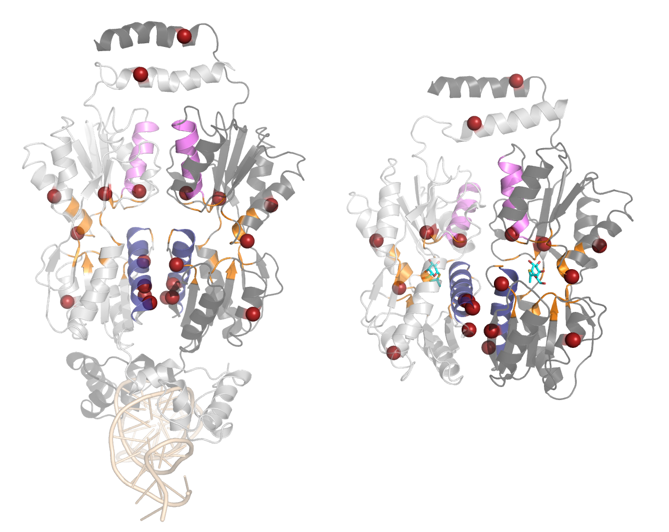
What Can Inverted Sensors Tell Us About the Biophysics of Allostery?
Inverted phenotype requires:
  Change in ligand binding affinity
  Change in allosteric constant
Inverted variants often have substitutions in:
  helix 5 (blue), helix 11 (violet), within 7 Å of binding pocket (orange)
However:
  21% have no substitutions within 10 Å of the binding pocket

Slide 36
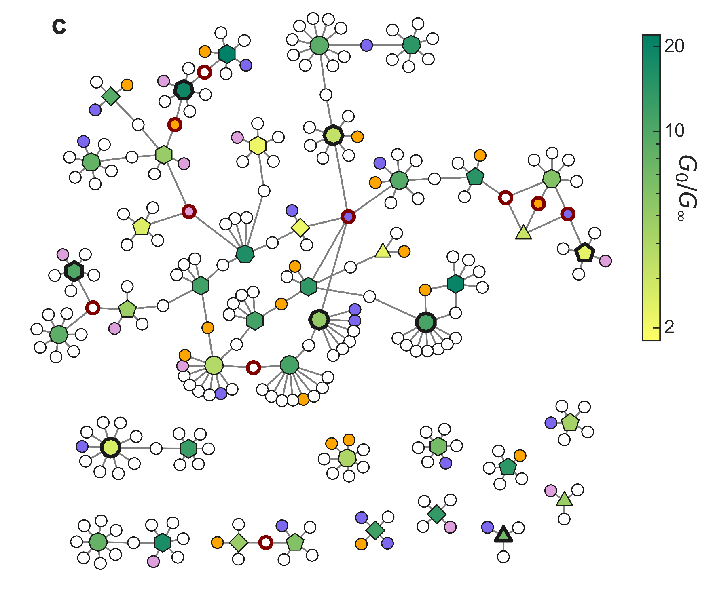
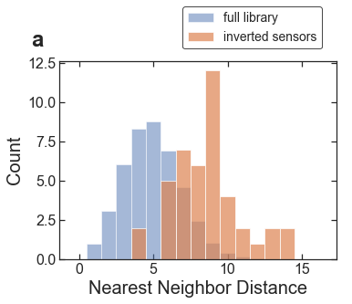
What Can Inverted Sensors Tell Us About Evolutionary Innovation?
Inverted variants are genetically diverse
Many different combinations of substitutions result in inverted phenotype
Inverted variants are genetically distant from each other

Slide 37
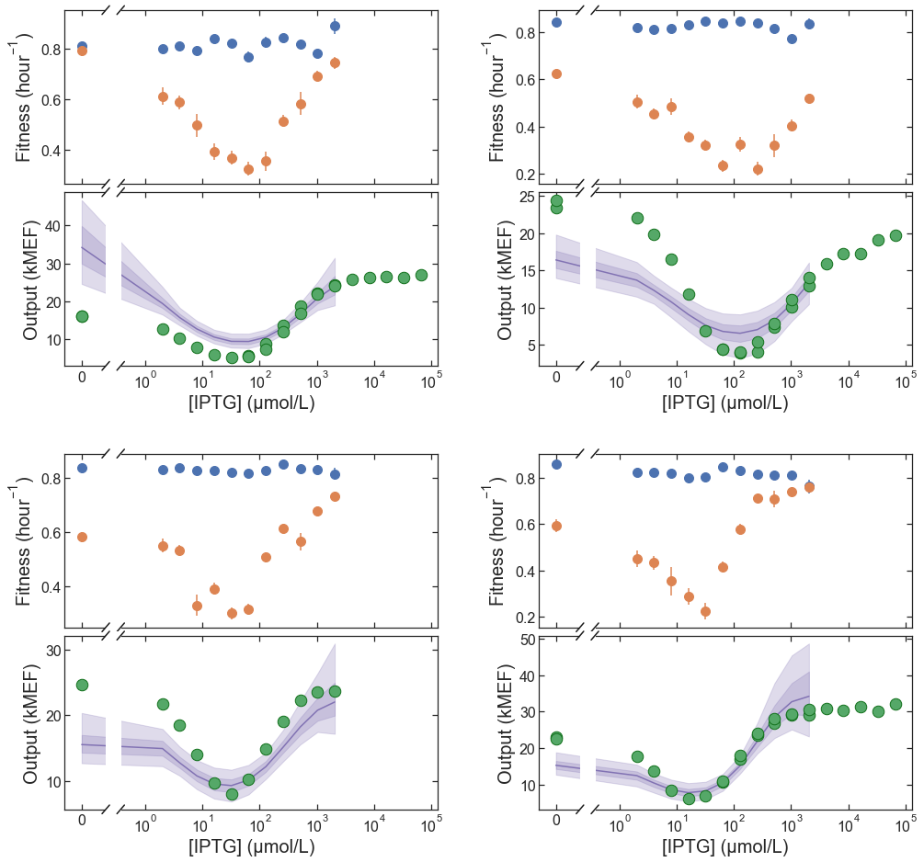
Novel Phenotypes
Band-stop dose-response
Genetically diverse
Make up a decent portion of the library (0.18%)

Slide 38
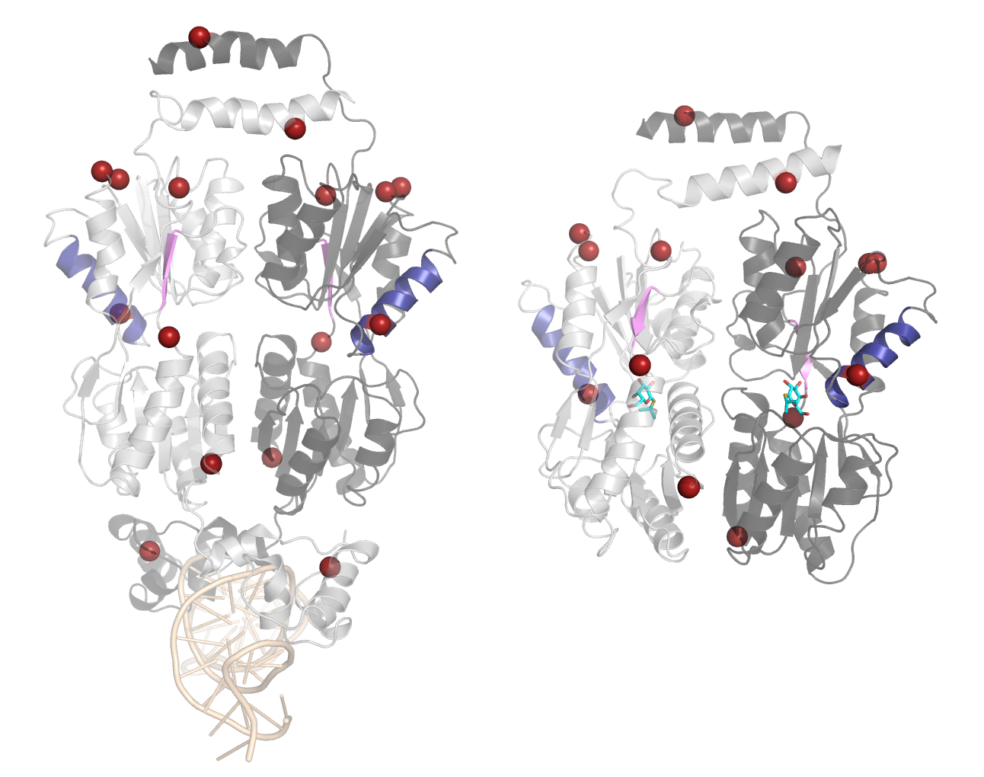
What Can Band-Stop Sensors Tell Us About the Biophysics of Allostery?
Surprise!
  Not compatible with current models(?)
  Similar to inverted sensors?
    Nope!
  Entropic rather than structural?
  Negative cooperativity?
Band-stop variants often have substitutions in:
  helix 9 (blue), strand J (violet)

Slide 39
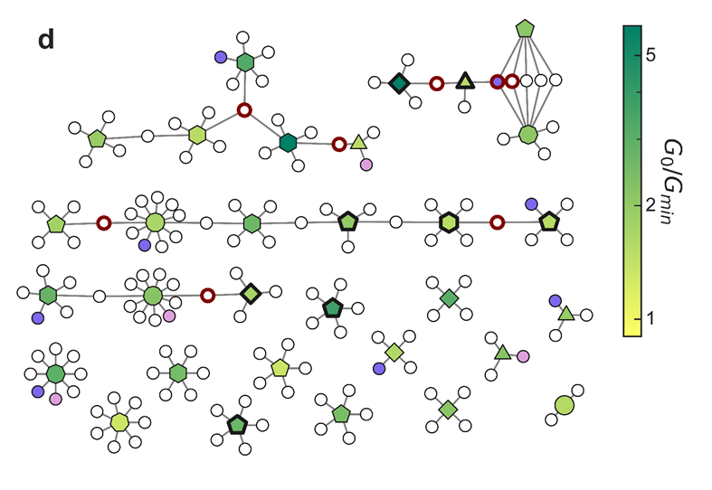
What Can Band-Stop Sensors Tell Us About Evolutionary Innovation?
Allosteric biomolecules have even more capacity for innovation than we might have thought
Not many substitutions required

Slide 40
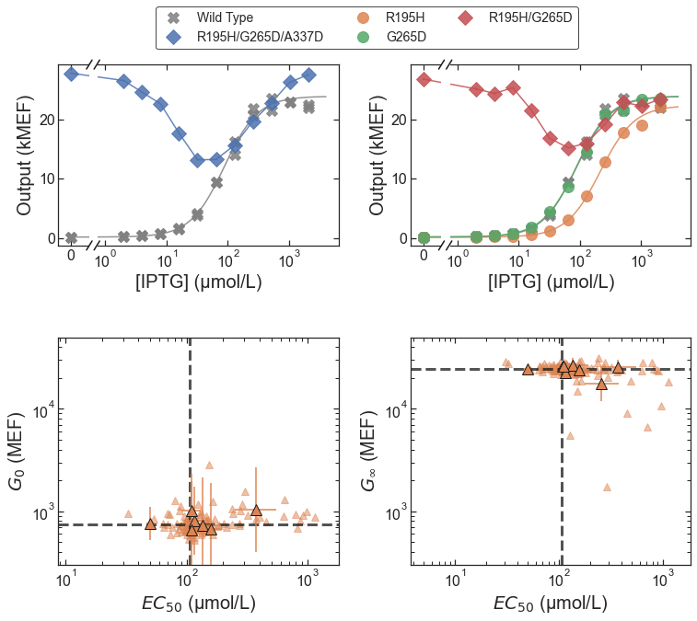
How Many Mutations Required for Band-Stop?
Answer: 2

Slide 41
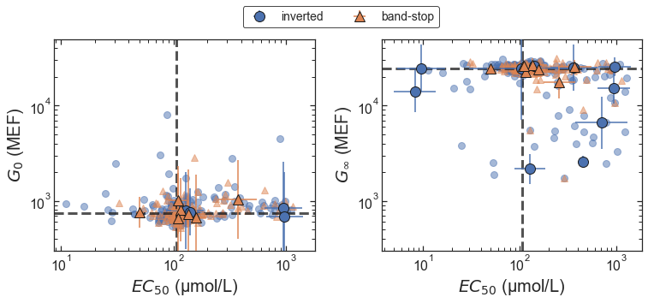
Band-Stop Emerges from Combination of Nearly Silent Substitutions

