Slide 1

A POLARIZED BEAM CAN DO A LOT OF THINGS
Brian Kirby, NCNR

Slide 2
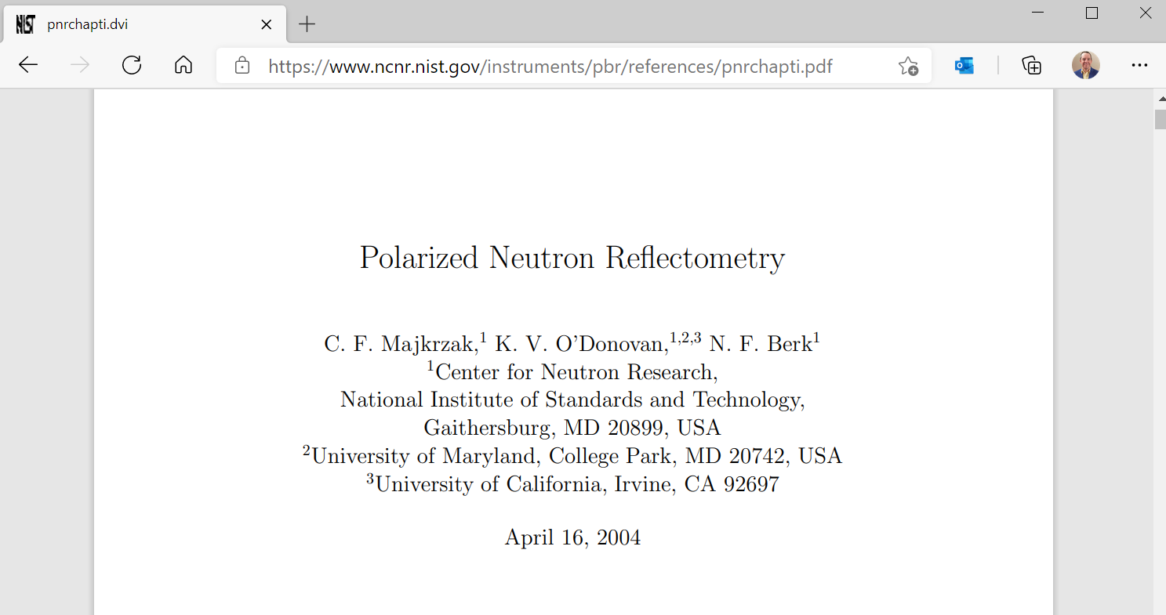
READ THIS
C. Majkrzak, K. O'Donovan, and N. Berk, in Neutron Scattering from Magnetic Materials (Elsevier, 2006), pp. 397–471.

Slide 3
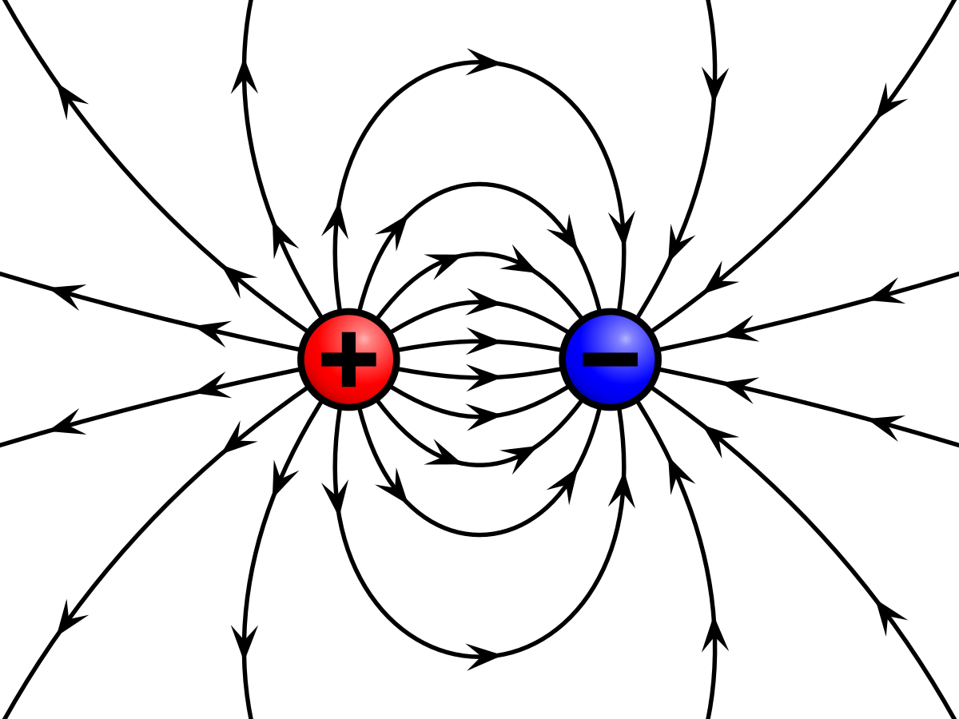
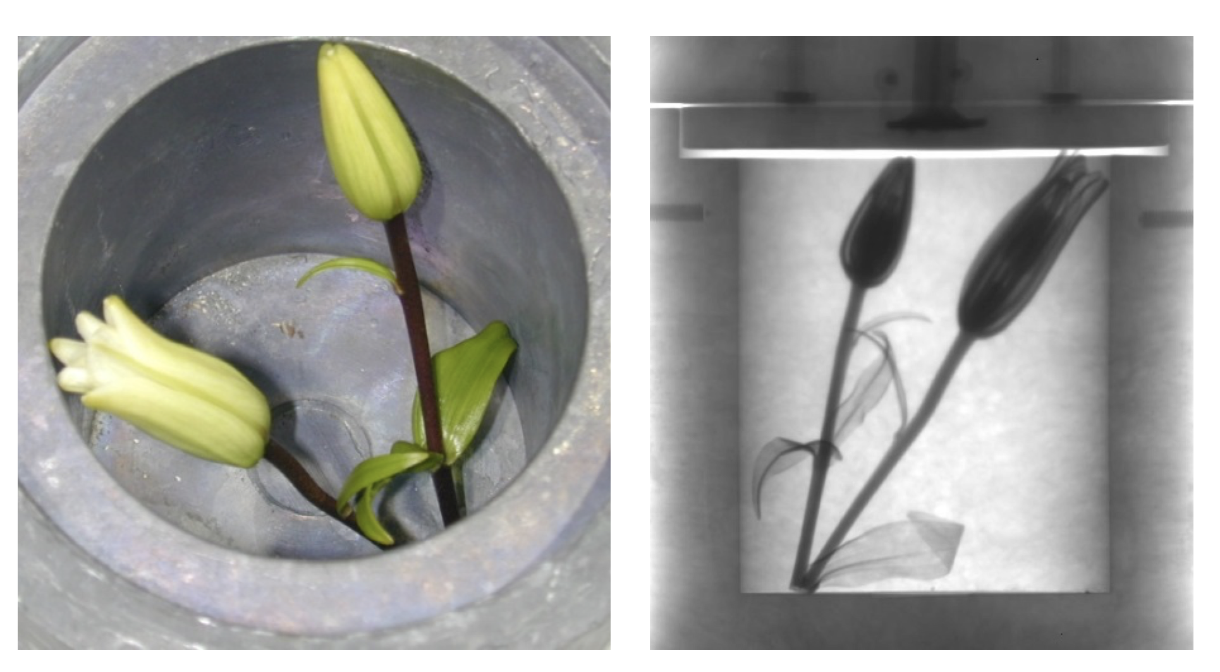
WHAT SCATTERS NEUTRONS?
Not This!

Slide 4

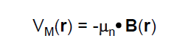
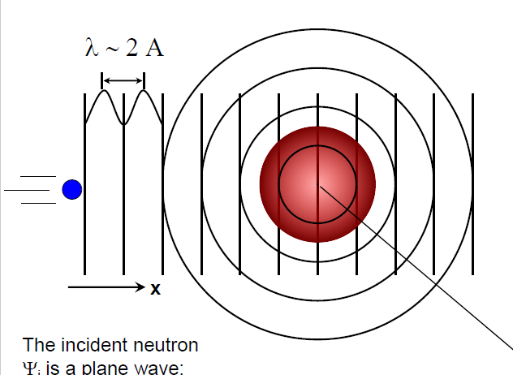
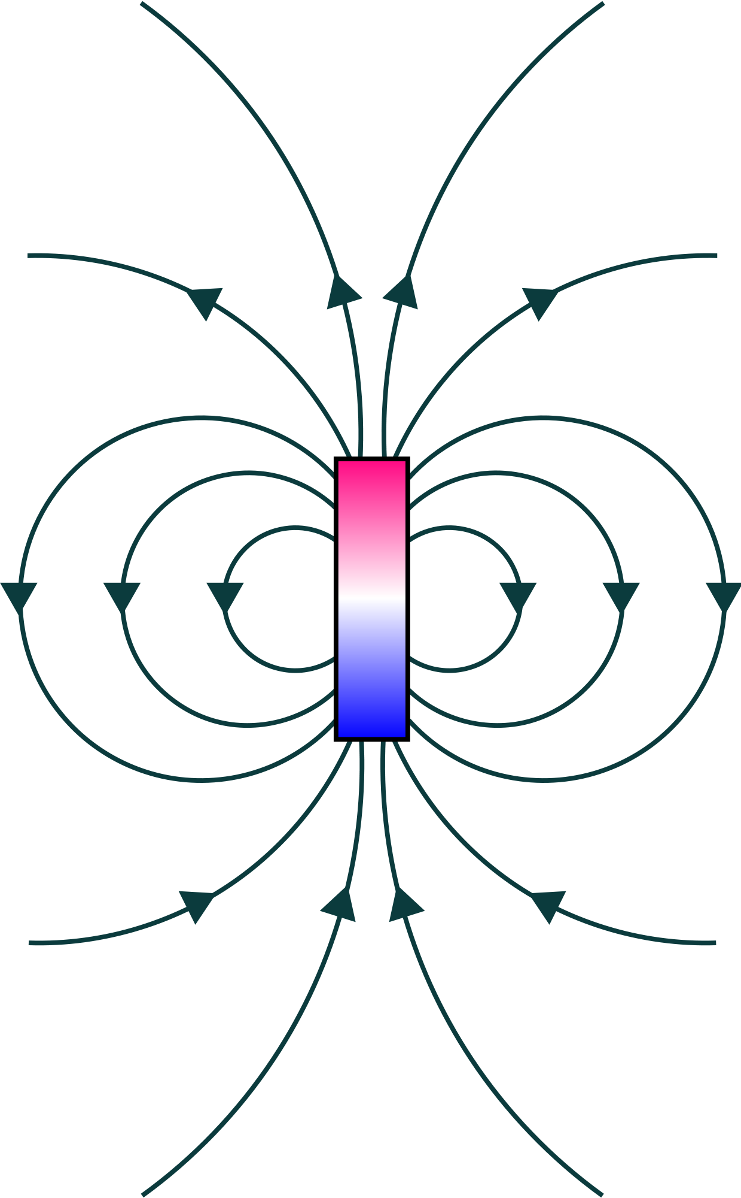
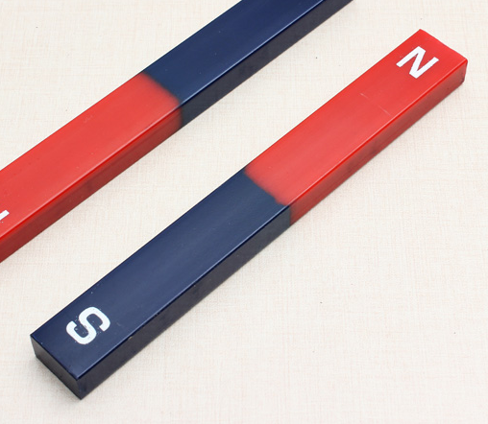
WHAT SCATTERS NEUTRONS?
nuclei:
magnetic fields:
Graphic courtesy Peter Gehring, NIST

Slide 5
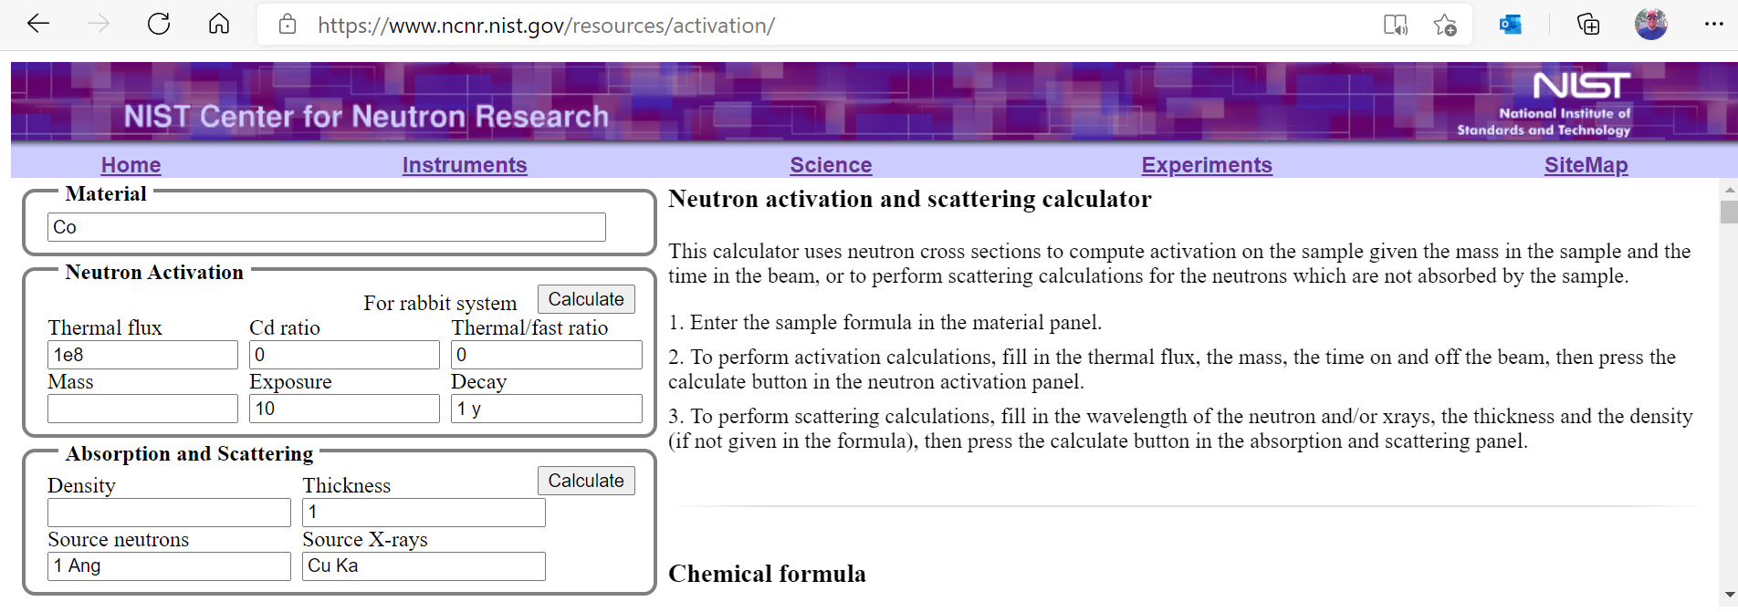
SCATTERING LENGTH DENSITY
Nuclear component

Slide 6
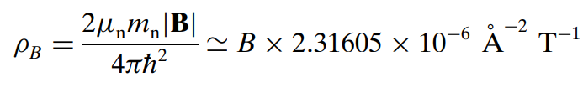
SCATTERING LENGTH DENSITY
Magnetic component
Just the magnetic field
B = µ₀(M + H)
H usually doesn’t contribute to the contrast
ρ_{M} = |M| x 2.91 x 10⁻⁶ Å⁻² cm³ emu⁻¹ = |M| x 2.91 x 10⁻⁶ Å⁻² kA-¹ m
Gaussian (emu/cc)
SI (kA/m)

Slide 7
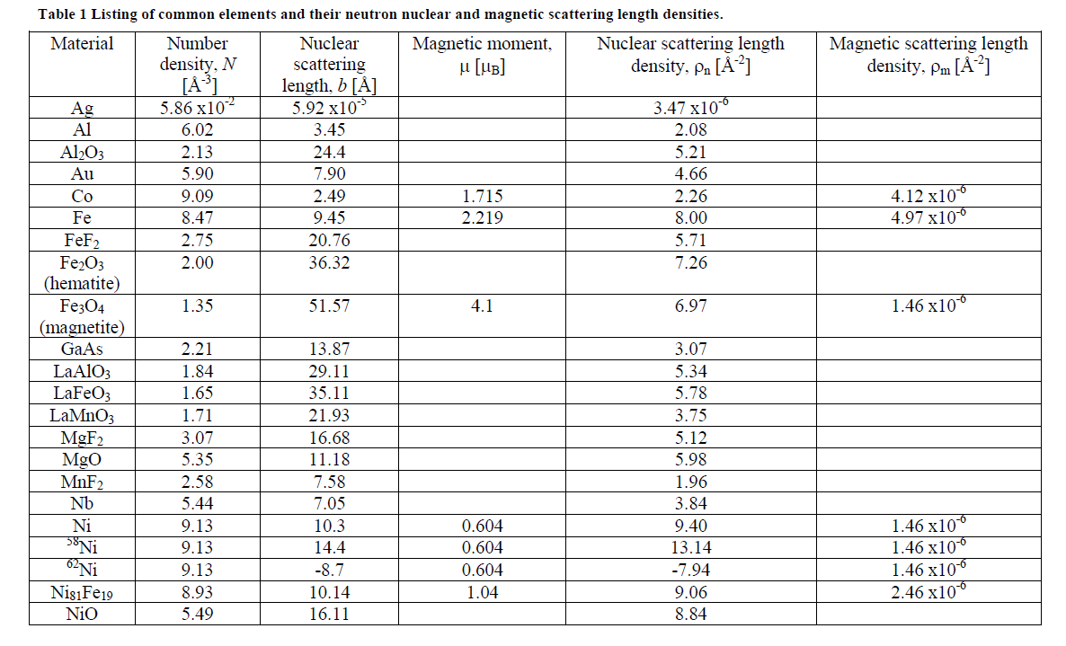
SCATTERING LENGTH DENSITY
M. R. Fitzsimmons and C. F. Majkrzak, in Modern Techniques for Characterizing Magnetic Materials, edited by Z. Zhu ( Kluwer, New York, 2005).
Nuclear & magnetic same order of magnitude!

Slide 8
POLARIZED NEUTRON BEAMS
Control orientation of neutron moment with respect to magnetic moments being probed
Separate nuclear and magnetic contributions to the scattering
Provides vector magnetic information
Unpolarized beams are affected by magnetic features

Slide 9
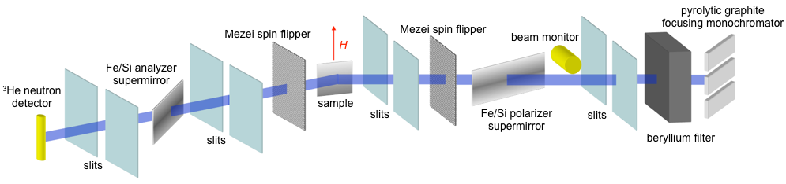
POLARIZED BEAM FOR A REFLECTOMETER

Slide 10
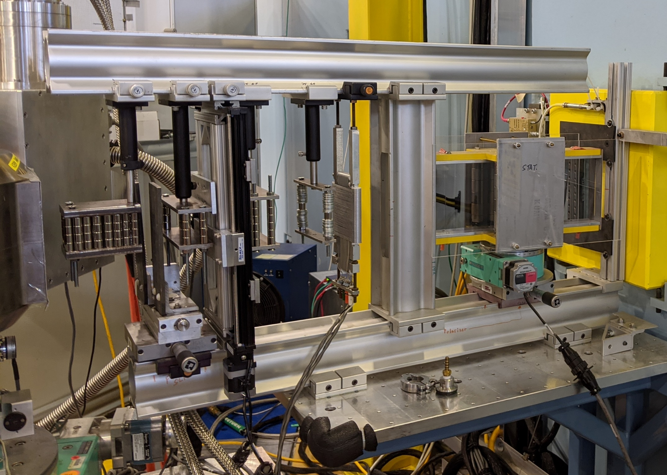
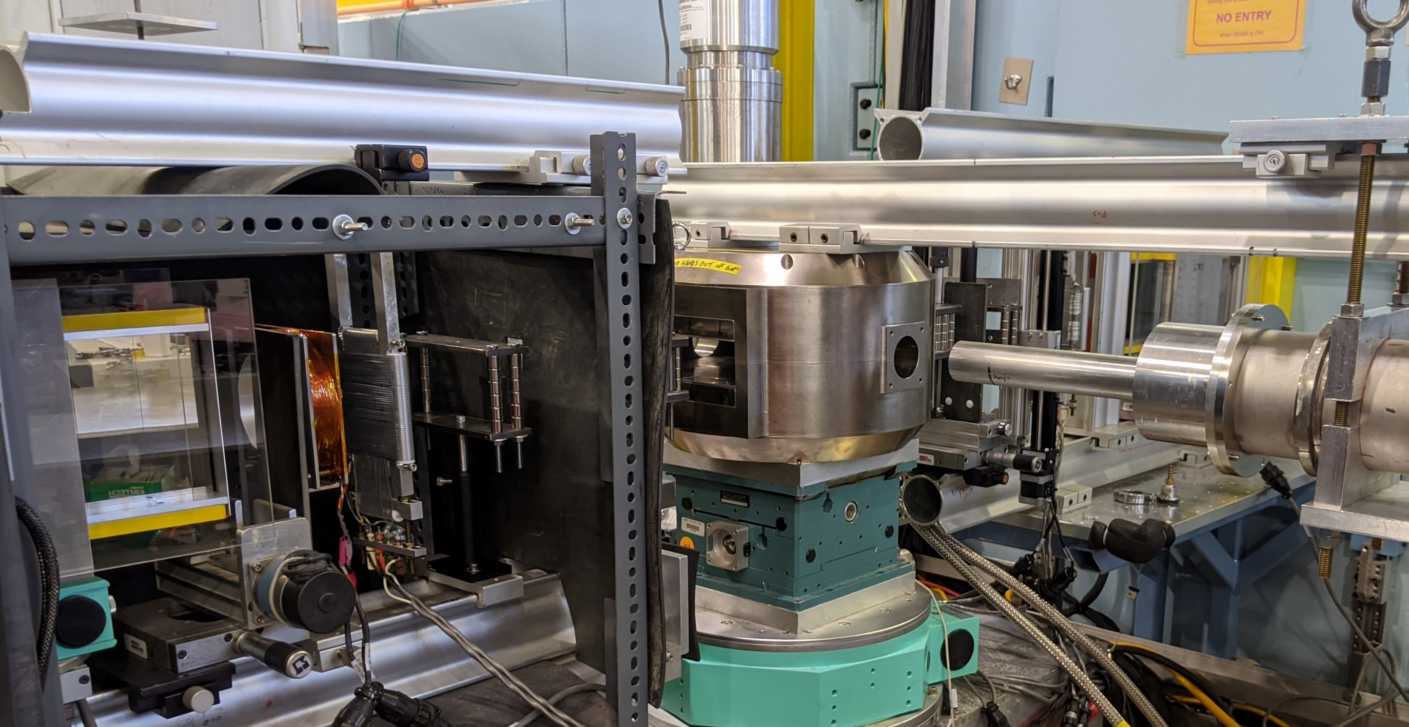
POLARIZED BEAM FOR A REFLECTOMETER
NO ZEROS!!!

Slide 11
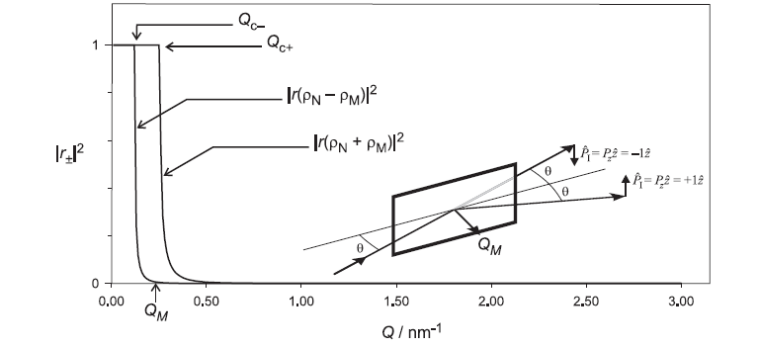
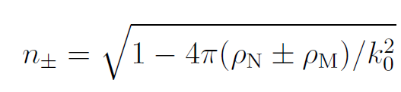
POLARIZED BEAM FOR A REFLECTOMETER
C. Majkrzak, K. O'Donovan, and N. Berk, in Neutron Scattering from Magnetic Materials (Elsevier, 2006), pp. 397–471.

Slide 12
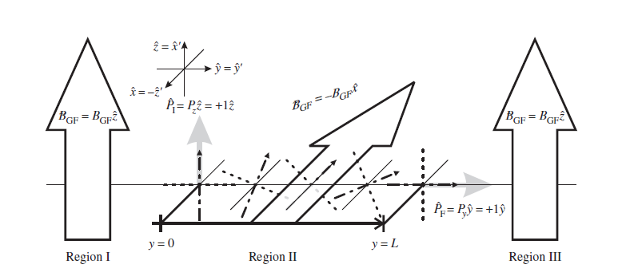
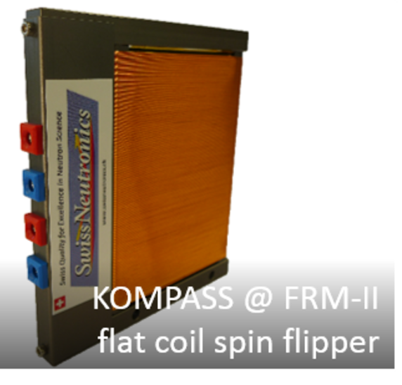
POLARIZED BEAM FOR A REFLECTOMETER
C. Majkrzak, K. O'Donovan, and N. Berk, in Neutron Scattering from Magnetic Materials (Elsevier, 2006), pp. 397–471.
swissneutronics.ch

Slide 13
POLARIZED BEAM FOR A REFLECTOMETER
Previous showed appropriate technology for a monochromatic reflectometer optimized for specular reflectivity, also be aware of:
Broadband polarizing cavities
3He polarizer / analyzer / flipper
RF flippers

Slide 14
PNR SELECTION RULES
Consider 4 types of scattering from the sample
R⁻⁻: Neutron moments antiparallel to H at sample, sample doesn’t flip neutrons
R⁺⁺: Neutron moments parallel to H at sample, sample doesn’t flip neutrons
R⁻⁺: Neutron moments antiparallel to H at sample, sample flips neutrons
R⁺⁻: Neutron moments parallel to H at sample, sample doesn’t flip neutrons

Slide 15
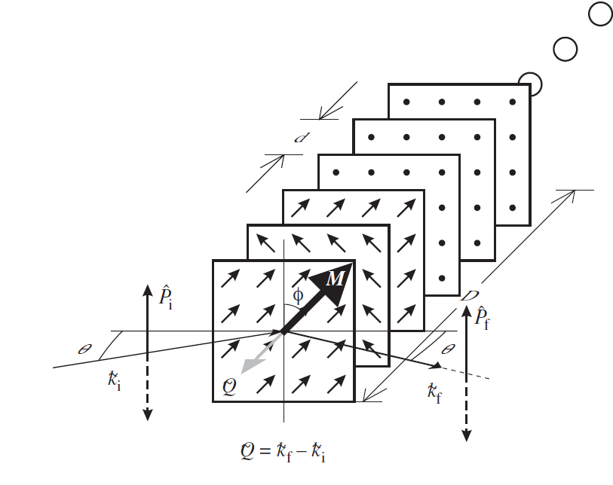
PNR SELECTION RULES
^
Z
H

Slide 16
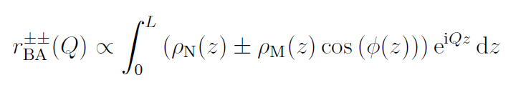
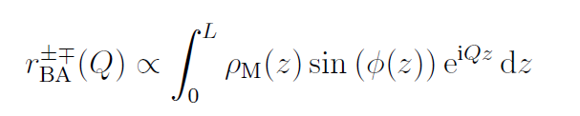
PNR SELECTION RULES
non spin-flip: in-plane M(z) || H
^
Z
spin-flip: in-plane M(z) ⊥ H
H
reflectivity, R = |r|²
Halperin Effect:
no magnetic scattering along Q
Model fit sld in terms of ρ_{N} , ρ_{M} , and φ

Slide 17
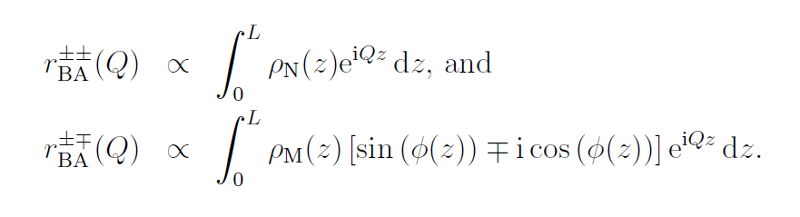
PNR SELECTION RULES
non spin-flip: just nuclear!
^
Z
spin-flip: in-plane M(z)
reflectivity, R = |r|²
H
Halperin Effect:
no magnetic scattering along Q
Model fit sld in terms of ρ_{N} , ρ_{M} , and φ

Slide 18
DEPTH PROFILE OF A COLINEAR MAGNET

Slide 19
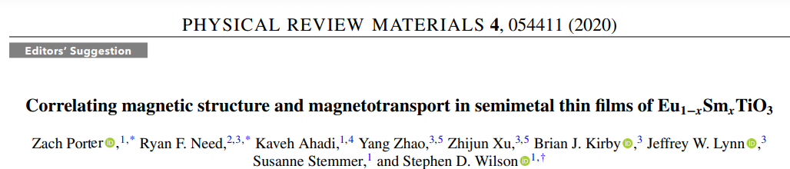

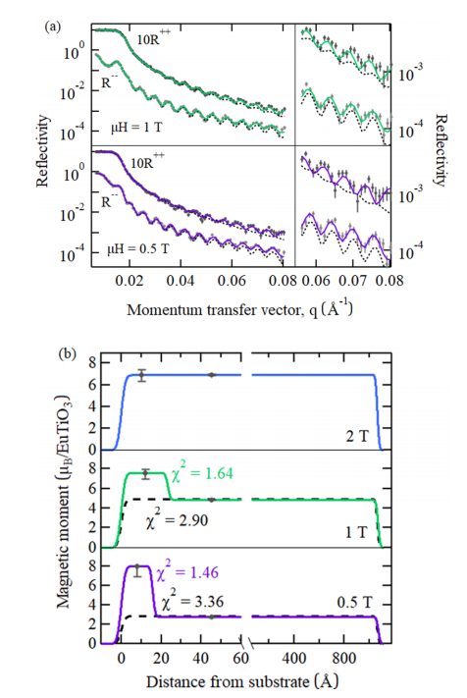

Slide 20
DEPTH PROFILE OF A NONCOLINEAR MAGNET

Slide 21
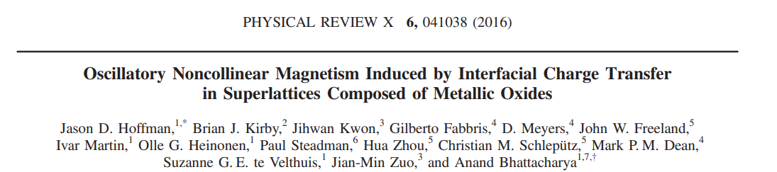
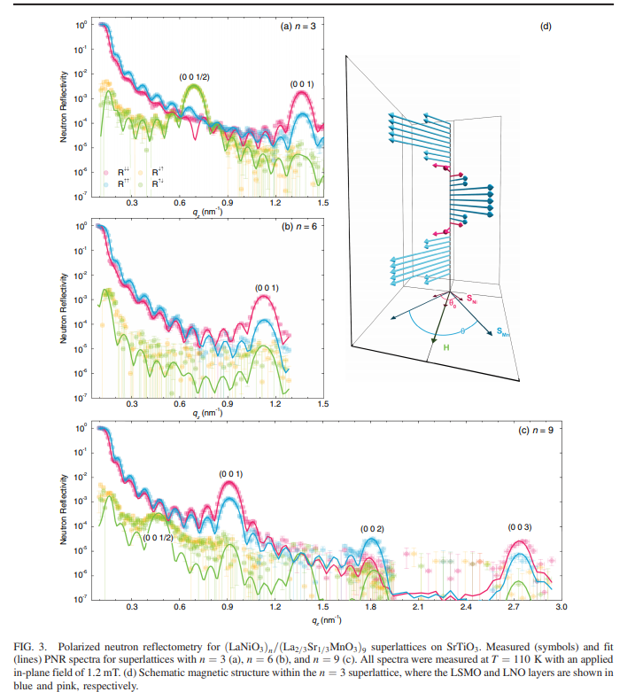

Slide 22
DEPTH PROFILE OF EXPELLED FIELD IN A SUPERCONDUCTOR

Slide 23
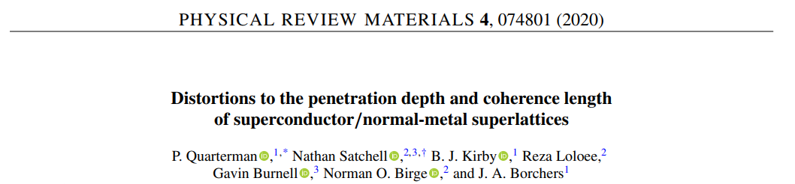
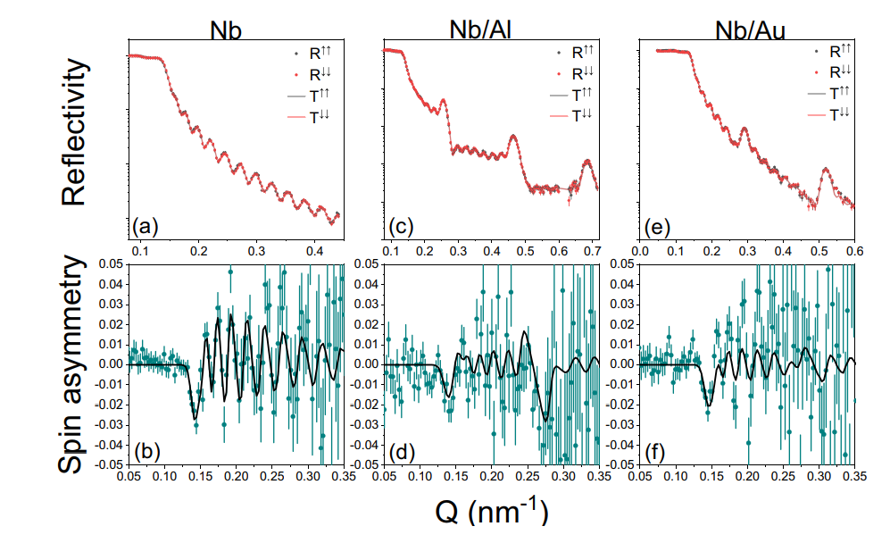
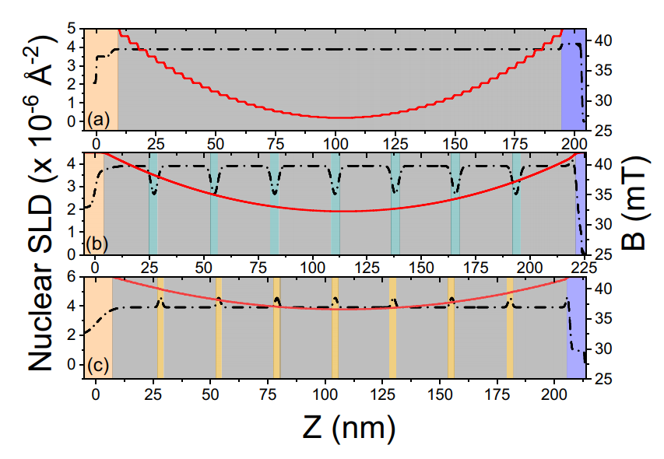

Slide 24
DEPTH PROFILE OF A NON-MAGNETIC SAMPLE WITH A MAGNETIC REFERENCE LAYER

Slide 25
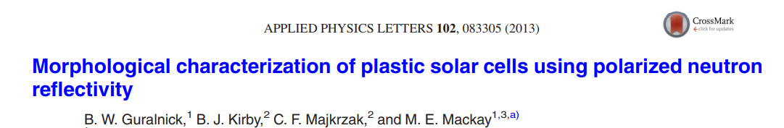
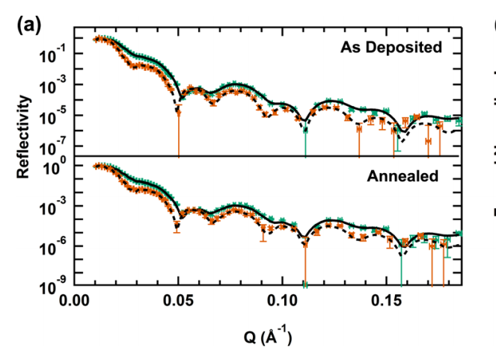
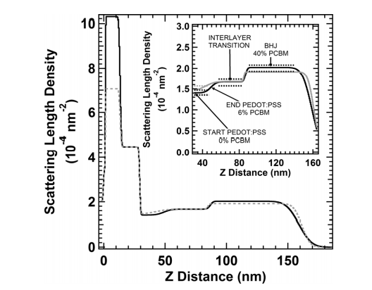

Slide 26
DEPTH PROFILE OF NUCLEAR POLARIZATION

Slide 27
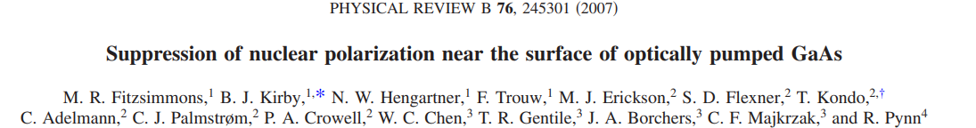
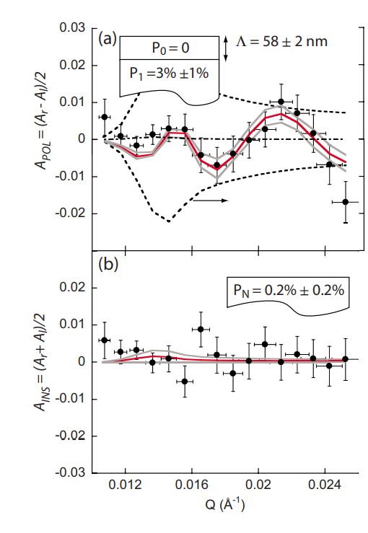

Nuclear scattering length is actually spin-dependent
Similar to magnetic scattering
For GaAs:

Slide 28
SUMMARY
For specular reflectometry
Polarization is used to separate magnetic and nuclear contributions to the scattering
Simultaneously model-fit R for different polarization states to determine nuclear & magnetic depth profile
Selection rules of thumb:
  Non spin-flip, R⁺⁺ & R⁻⁻, give you the nuclear profile and the component of the net in-plane magnetization profile parallel to H (but, see below…)
  Spin-flip, R⁺⁻ & R⁻⁺, give you the component of the net in-plane magnetization perpendicular to H
  Magnetic fields parallel to Q do not scatter neutrons – you can’t see perpendicular magnetic moments in films with specular PNR

