Slide 1
Introduction to Mass Spectrometry
Science Afternoon at NIST
February 4th, 2013

Slide 2
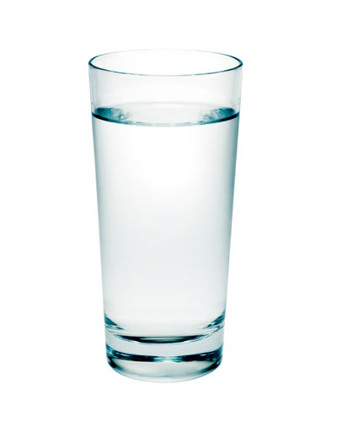
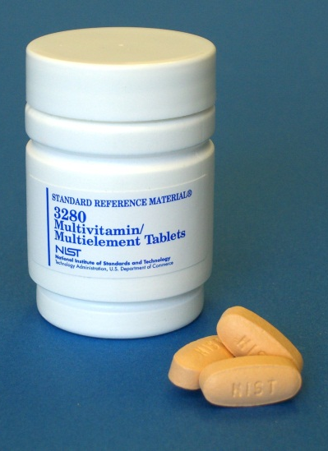
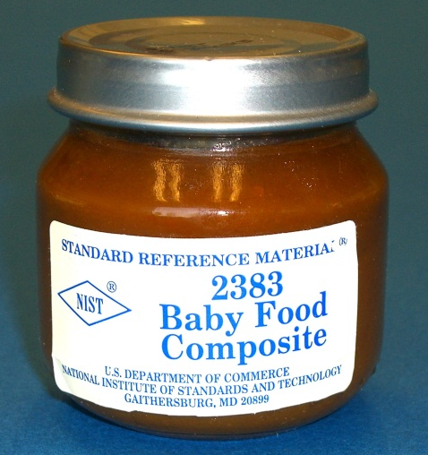
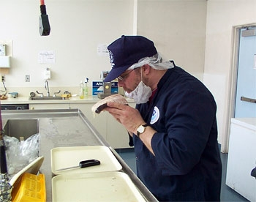
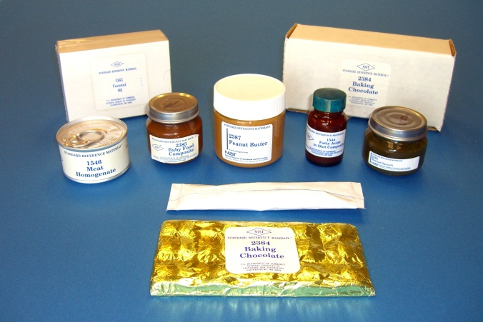
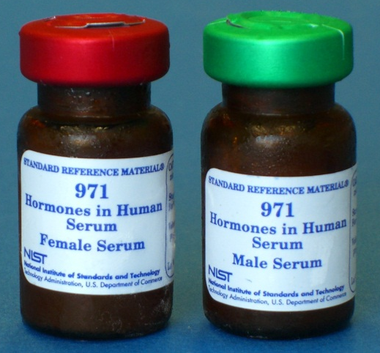
Questions Analytical (Bio)Chemists Ask
Environmental
  Is the water safe to drink?
  Deepwater Horizon Oil Spill: Where did the oil go? When will the seafood be safe to eat again?
Food
  Why kinds of vitamins are in baby food?
  Are there any toxic heavy metals in meat products?
Medicinal
  Are the vitamin levels on the label correct in a multivitamin?
  What are the hormone levels in a patient’s blood?
Images:
NIST Stock Photos (Lane Sander)
Images:
NIST Stock Photos (Lane Sander)
Images:
http://blog.chron.com/ultimateastros/files/2012/01/full-glass-of-water.jpg
http://ucanr.org/blogs/food/blogfiles/4826.jpg

Slide 3
Questions Analytical (Bio)Chemists Ask
Environmental
  Is the water safe to drink?
  Deepwater Horizon Oil Spill: Where did the oil go? When will the seafood be safe to eat again?
Food
  Why kinds of vitamins are in baby food?
  Are there any toxic heavy metals in meat products?
Medicinal
  Are the vitamin levels on the label correct in a multivitamin?
  What are the hormone levels in a patient’s blood?
All of these substances are complex mixtures!!! (like the M&M piles)
Scientists need to be able to separate and identify all of the chemicals in the mixtures

Slide 4
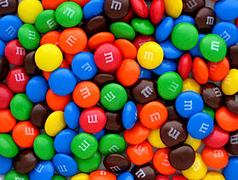
Finding Answers to the Questions
How can we detect and separate things?
  By color
Images:
http://en.wikipedia.org/wiki/File:Plain-M%26Ms-Pile.jpg

Slide 5
Finding Answers to the Questions
How can we detect and separate things?
  By color
  By size and shape
Images:
http://en.wikipedia.org/wiki/File:Plain-M%26Ms-Pile.jpg

Slide 6
Finding Answers to the Questions
How can we detect and separate things?
  By color
  By size and shape
  By smell
  By mass!
???
Images:
http://en.wikipedia.org/wiki/File:Plain-M%26Ms-Pile.jpg

Slide 7
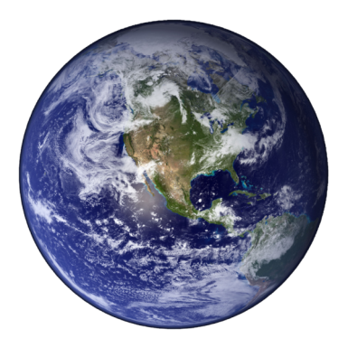
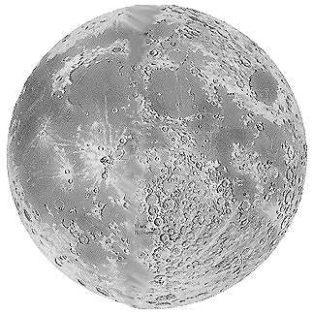
What is mass?
Mass is how much matter makes up something (how much ‘stuff’ is in it)
Weight is how much gravity is acting on something
On Earth, mass = weight
Do we have the same mass on the moon?
Do we have the same weight on the moon?
Images:
http://starchild.gsfc.nasa.gov/Images/StarChild/solar_system_level1/moon.gif
http://en.wikipedia.org/wiki/File:Earth_Western_Hemisphere_transparent_background.png

Slide 8
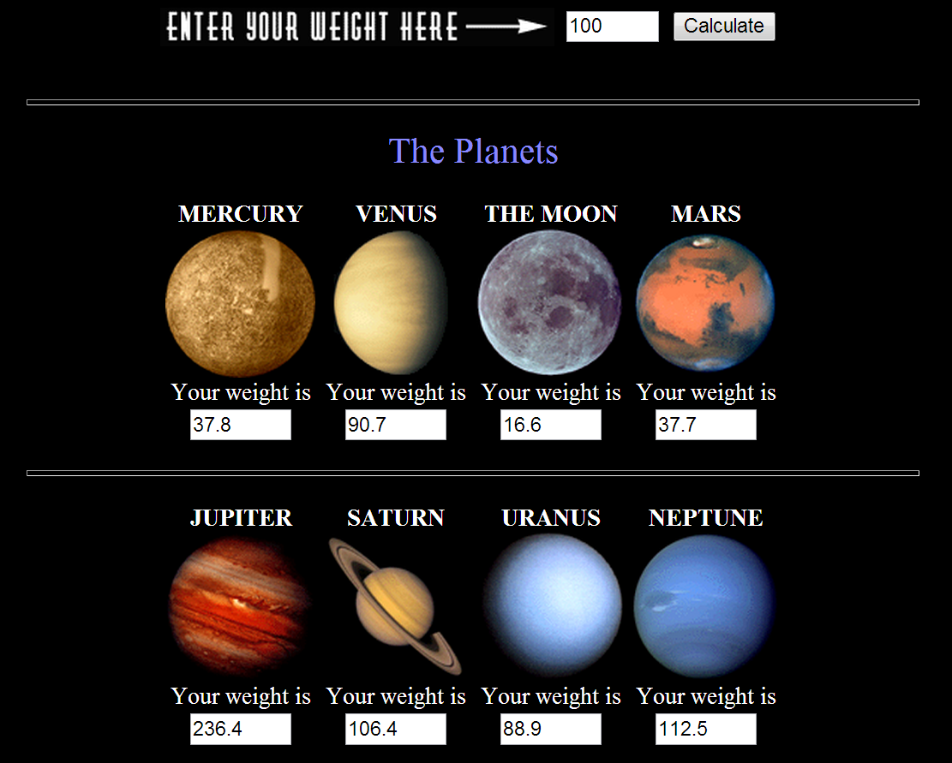
Ron Hipschman. “Your Weight on Other Worlds.” Exploratorium © 1997 (http://www.exploratorium.edu/ronh/weight/)

Slide 9
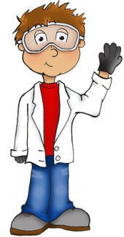
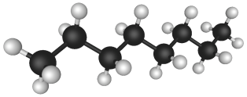
What is mass?
In science we use grams (g) to describe mass instead of pounds (lbs)
  2.2 lbs = 1000 g
For large objects (like people), we can determine its mass by using a balance
For very, very, very small objects (like molecules), a balance will not work so we have to use something else:
Mass Spectrometer!
2200.0000 g
0000.0000 g
Image: http://jakethecake.files.wordpress.com/2009/11/mini_u_scientist1.jpg
Image: http://en.wikipedia.org/wiki/File:Octane_molecule_3D_model.png

Slide 10
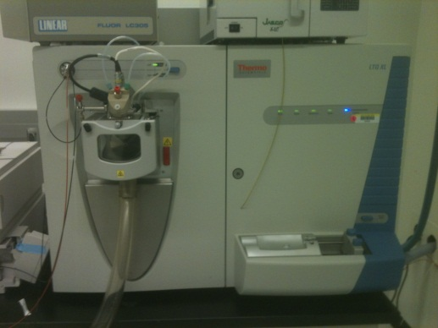
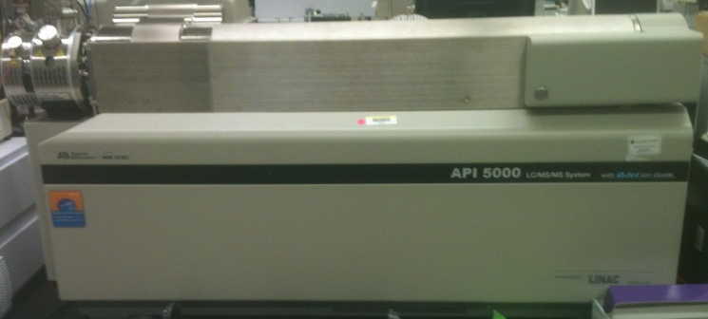
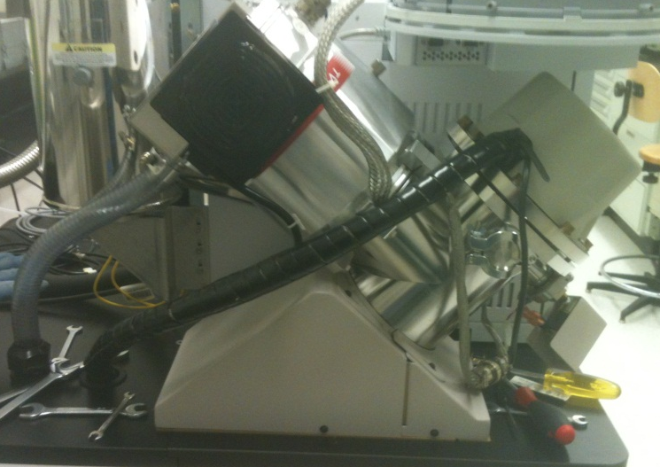
Mass Spectrometry (MS) Lingo
Mass Spectrometer vs. Mass Spectrometry
An MS is a type of detector, identifies chemicals by their mass (and counts them)
Many kinds of MS: magnetic sector, quadrupole, time of flight, ion trap, ion cyclotron resonance
  They all separate chemicals by mass, but in different ways (some are better than others)

Slide 11
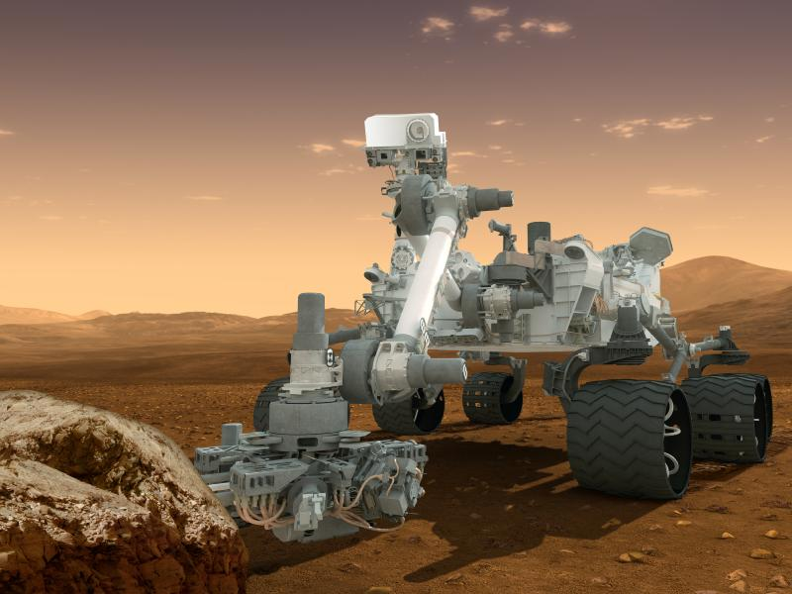
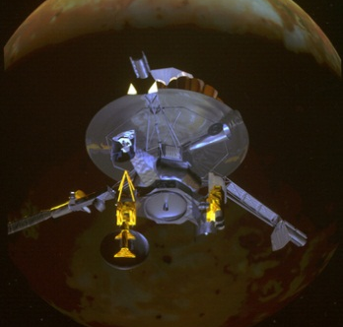
Mass Spectrometry outside of NIST
Media: Crime/Forensic Procedural Shows:
  Examples: CSI, NCIS, Bones
Airports
  Explosives detectors
Space probes
  Mars rover Curiosity
  Jupiter orbiter Galileo
Images: http://www.nasa.gov

Slide 12
How an MS works
Time of Flight: Separates chemicals by the time it takes to cross a distance
  Velocity is related to the chemical’s mass
Detector
Computer Output
Ion Path
Ion Source
mass

Slide 13
MS Simulation Activity
Detector
Computer Output
Ion Path
Ion Source
mass
Ion Source
Ion Path
Detector

Slide 14
MS Simulation Activity
Calibration
Standards
(known mass)
time (s)
Sample
(unknown mass)
Calculated Mass
mass (g)

