Slide 1
Healthcare Needs You:
From Heroism to Safe Design
Peter Pronovost, MD, PhD, FCCM
Johns Hopkins University

Slide 2
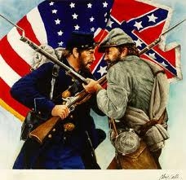
The Civil War is held as the as the deadliest war of our time
Casualties
620,000
155,000 / year for 4 years

Slide 3
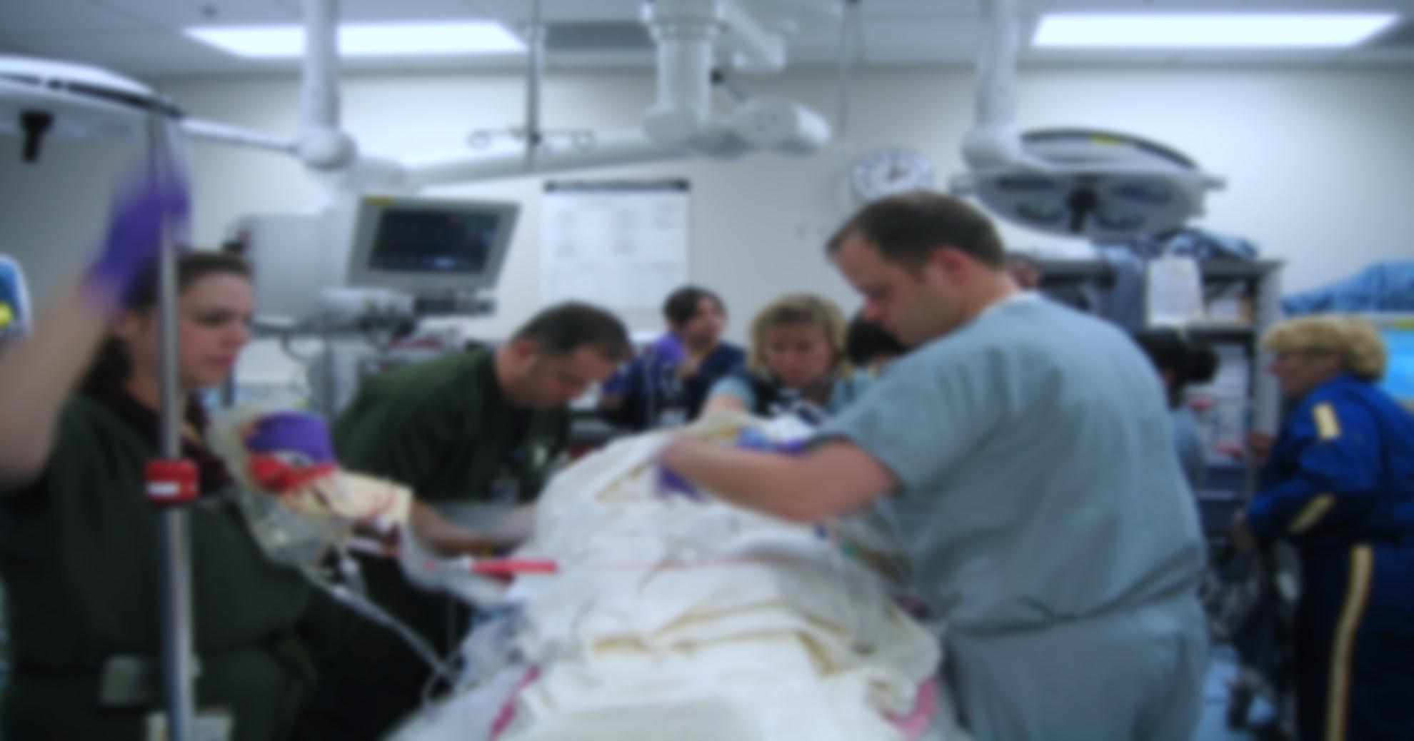
Medical error causes ~200,000 preventable deaths per year
Heart Disease
Cancer
Medical Error
Chronic Lower
Respiratory Disease
Stroke
Accidents

Slide 4
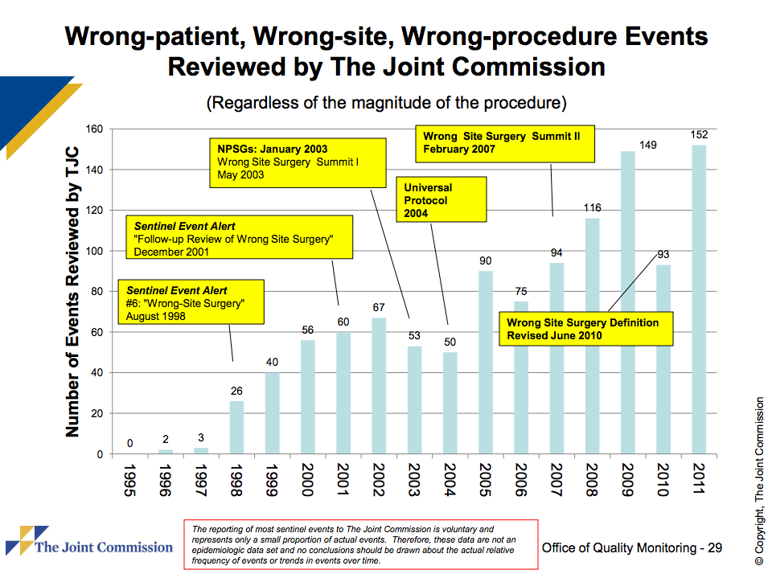

Slide 5
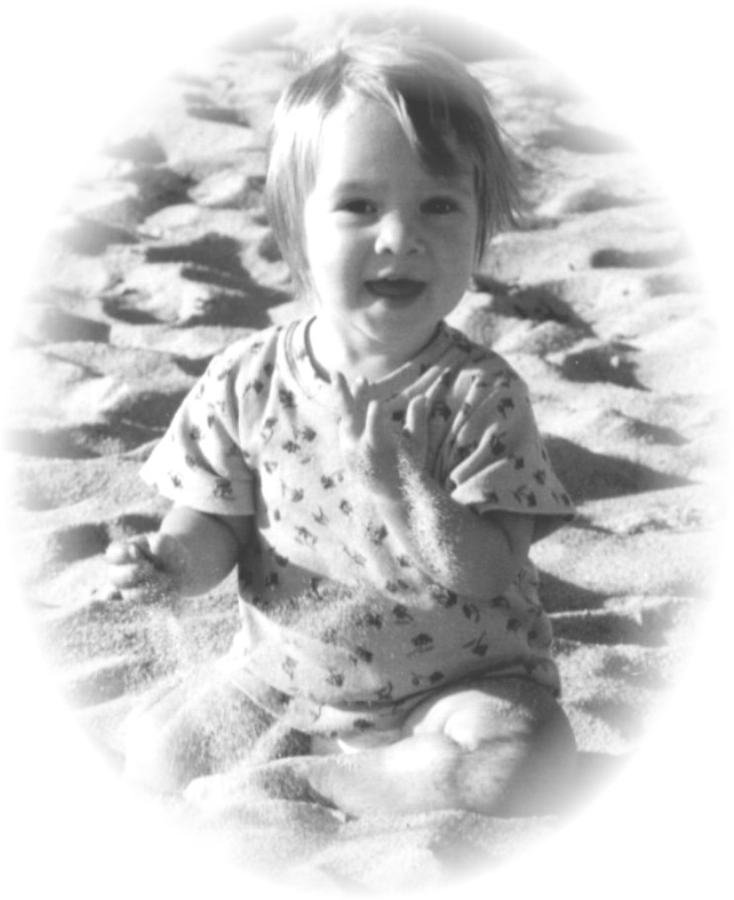

Slide 6
CLA-BSI Rate for All ICUS at JHH:
1998 - Q2 2012

Slide 7
CLA-BSI Rate for all Michigan ICUs 2004-2012 Pronovost NEJM 2006, Pronovost BMJ 2010

Slide 8
Impact of Statewide Quality Improvement Initiative on Hospital Mortality
Lipitz: BMJ 2011

Slide 9


Slide 10
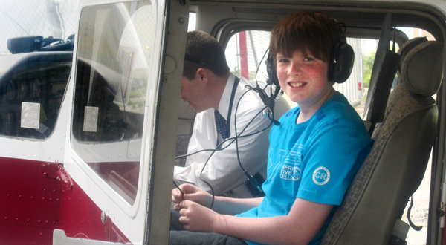
Rory Staunton
12 years old
“the most profound 12 year old I had ever met”
- Kevin Burgoyne, debate coach

Slide 11
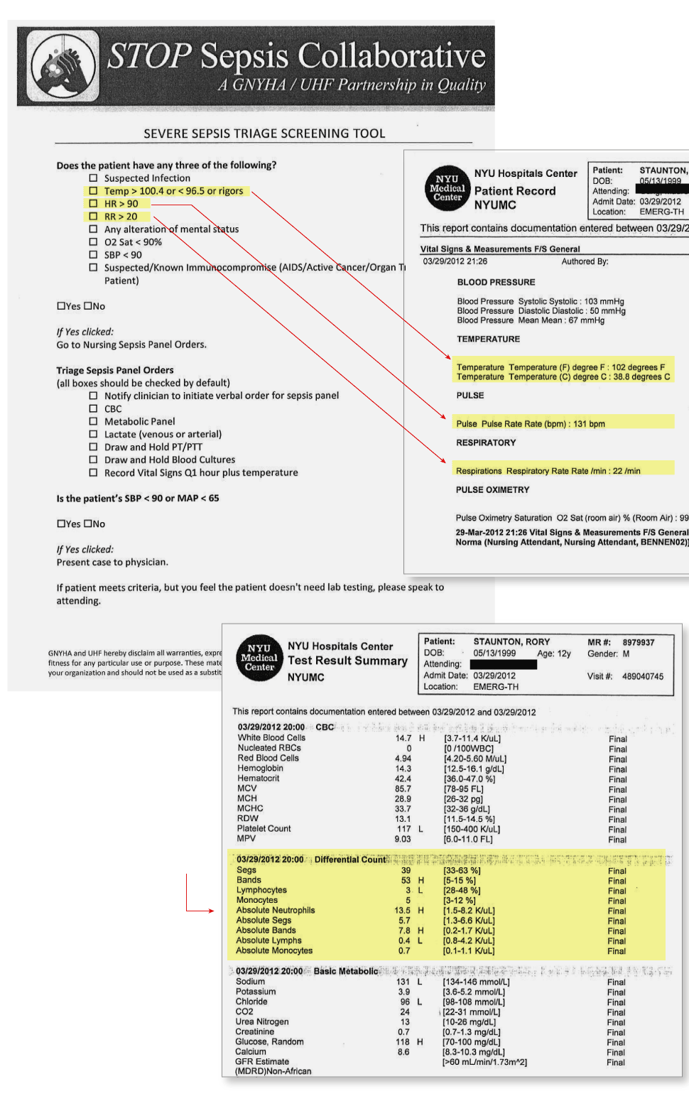

Slide 12
Harms to be eliminated – Associated Tasks
DVT-PE
Initial VTE risk stratification for all ICU patients
Computerized clinical decision support (CDS) tool to aid ordering of best-practice VTE prophylaxis
Ongoing risk re-stratification
Reminders when contraindications change to prompt addition of pharmacologic prophylaxis
Ultrasound screening of appropriate patients
Prevent missed prophylaxis doses
Optimal Mechanical Prophylaxis Use (Sequential Compression Device [SCD] and compression stockings [TEDS])
DELIRIUM
CAM ICU assessments
Automated screening
Modifiable factors
Non-pharmacologic interventions
Sedation management
Pain Scores
Family education
CLABSI
Hand washing
Chlorhexidine
Full Barrier Precautions
Avoid femoral site
Remove Unnecessary line
Use of checklist
Availability of cart
Harms
Delirium
Acquired Physical Impairment
Ventilator associated infections and harms
DVT-PE
CLABSI
Loss of Respect and Dignity
Failure to provide care consistent with patient goals
Acquired Physical Impairment
Early ambulation
Adjunctive physical therapy
Pharmacologic management
Prospective testing
Family engagement
Transition of care planning
Ventilator Harm
Daily sedation vacation (SAT)
Daily spontaneous breathing trials (SBT)
Automated ventilator management
Lung Protective Ventilation for ALI
Low Volume Ventilation if not ALI
VAP
Head of Bed Elevation (HOB) ( ≥ 30 degrees).
Spontaneous Awakening and Breathing Trials (SAT & SBT)
Oral Care
Oral Care with Chlorhexidine
Subglottic Suctioning ETTs
Loss of Respect and Dignity
Interpersonal communication
Scheduling
Education
Goals alignment
Access to care team
Inclusion
Continuity
Failure to provide care consistent with patient goals
Family meetings
Advanced directives
All teams meetings
Ethics engagement
Palliative Care

Slide 13
Harms to be eliminated – Associated Tasks
DELIRIUM
CAM ICU assessments
Automated screening
Modifiable factors
Non-pharmacologic interventions
Sedation management
Pain Scores
Family education
Acquired Physical Impairment
Early ambulation
Adjunctive physical therapy
Pharmacologic management
Prospective testing
Family engagement
Transition of care planning
VAP
Head of Bed Elevation (HOB) ( ≥ 30 degrees).
Spontaneous Awakening and Breathing Trials (SAT & SBT)
Oral Care
Oral Care with Chlorhexidine
Subglottic Suctioning ETTs
Harms
Delirium
Acquired Physical Impairment
Ventilator associated infections and harms
DVT-PE
CLABSI
Loss of Respect and Dignity
Failure to provide care consistent with patient goals
Failure to provide care consistent with patient goals
Family meetings
Advanced directives
All teams meetings
Ethics engagement
Palliative Care
Ventilator Harm
Daily sedation vacation (SAT)
Daily spontaneous breathing trials (SBT)
Automated ventilator management
Lung Protective Ventilation for ALI
Low Volume Ventilation if not ALI
DVT-PE
Initial VTE risk stratification for all ICU patients
Computerized clinical decision support (CDS) tool to aid ordering of best-practice VTE prophylaxis
Ongoing risk re-stratification
Reminders when contraindications change to prompt addition of pharmacologic prophylaxis
Ultrasound screening of appropriate patients
Prevent missed prophylaxis doses
Optimal Mechanical Prophylaxis Use (Sequential Compression Device [SCD] and compression stockings [TEDS])
Loss of Respect and Dignity
Interpersonal communication
Scheduling
Education
Goals alignment
Access to care team
Inclusion
Continuity
CLABSI
Hand washing
Chlorhexidine
Full Barrier Precautions
Avoid femoral site
Remove Unnecessary line
Use of checklist
Availability of cart

Slide 14
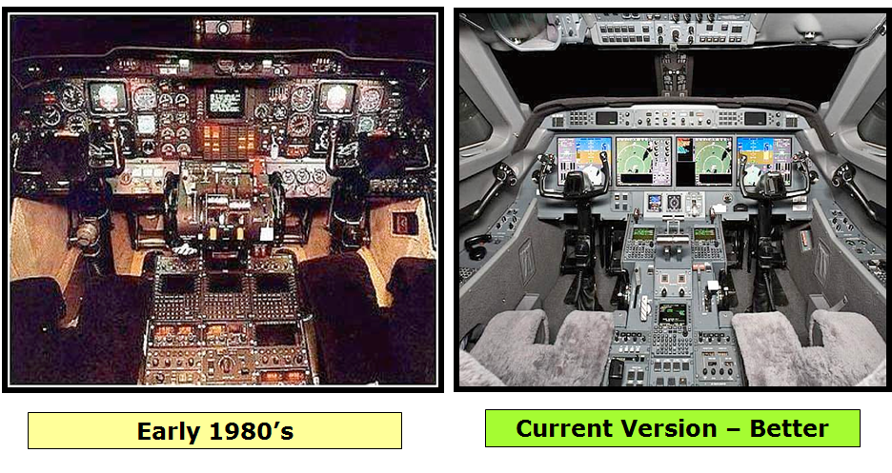
AIRPLANES

Slide 15
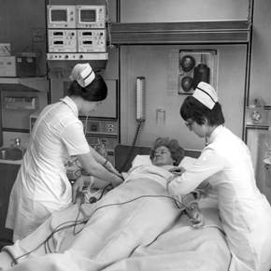
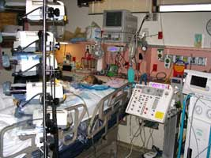
Hospitals in general, and especially ICUs
Current Version – Worse
Early 1980’s

Slide 16
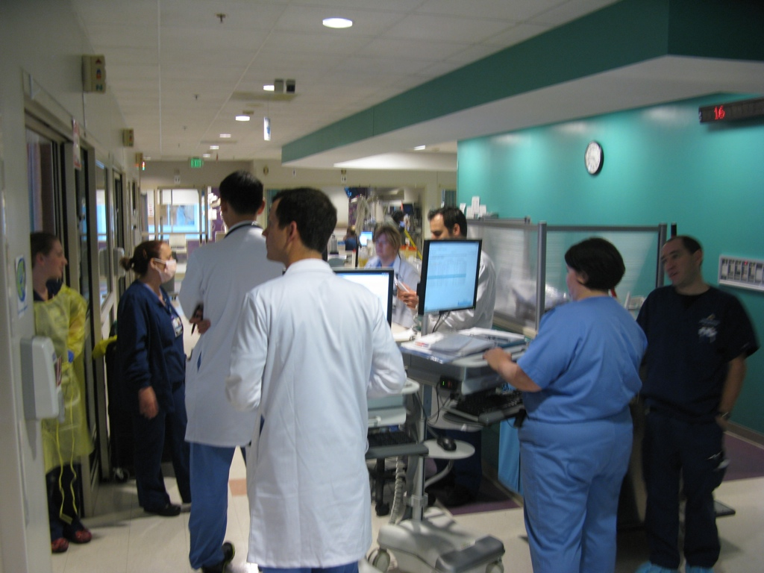
A Cluttered, Chaotic System

Slide 17
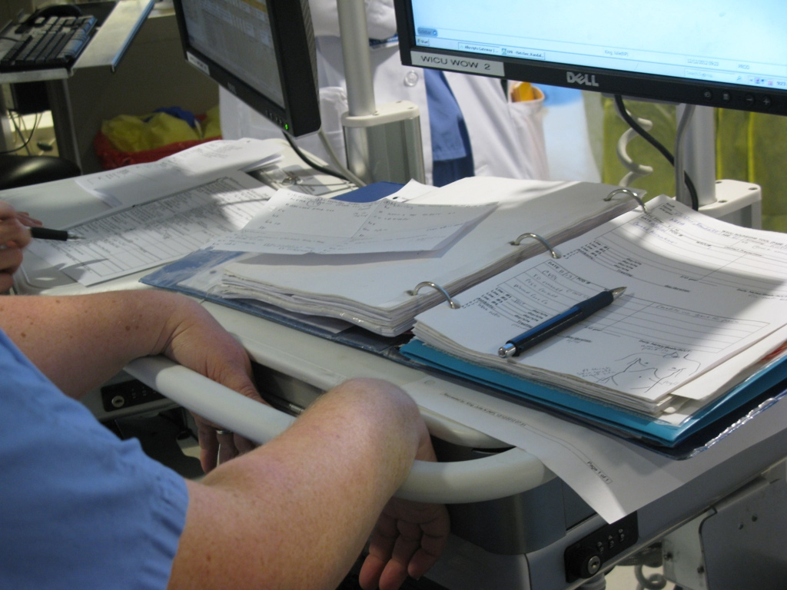
Based on Paper

Slide 18
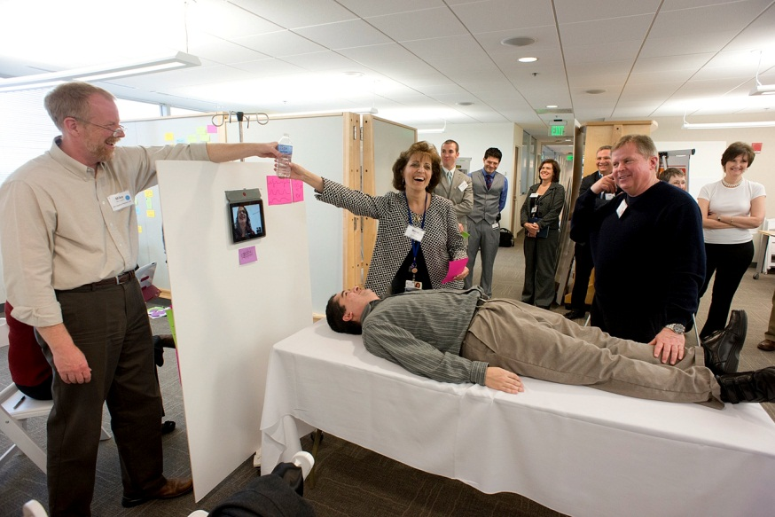
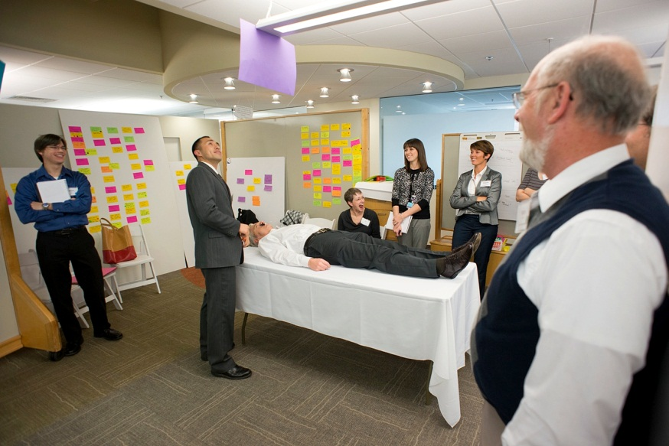
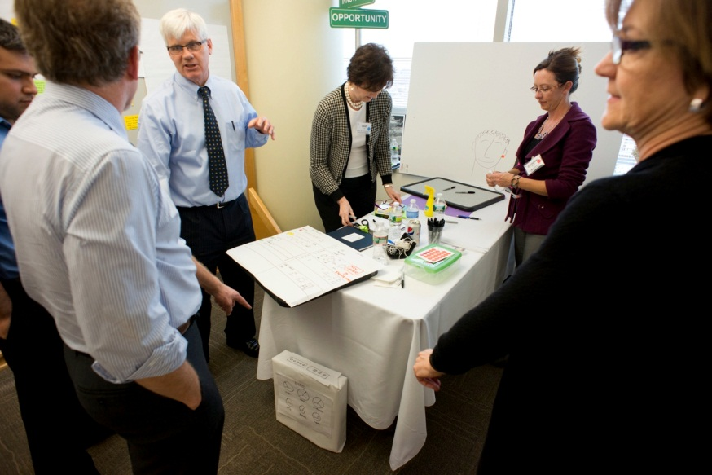
Innovation Engagement

Slide 19
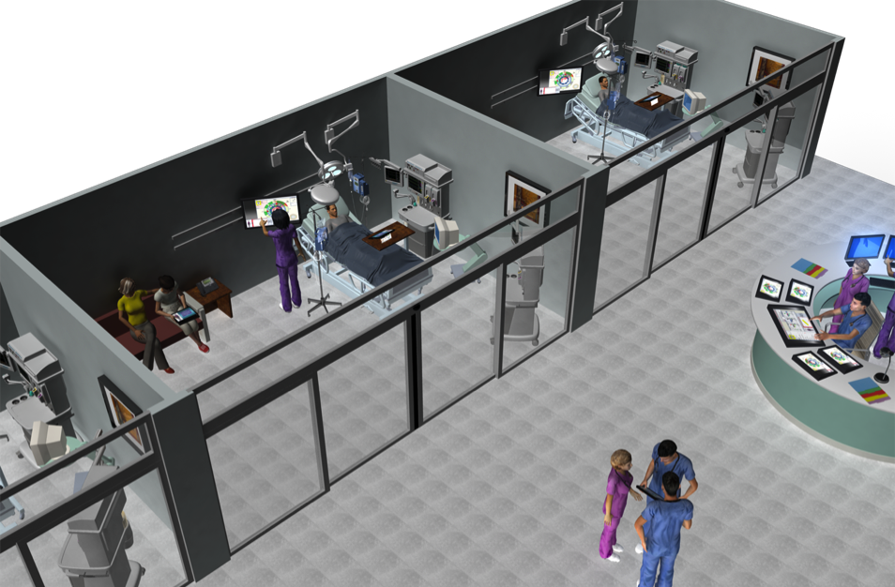
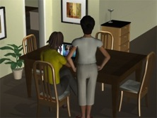
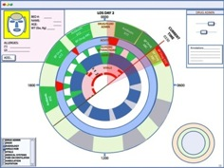
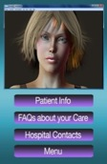
Concept of Operations
Operational View
©The Johns Hopkins University and the Johns Hopkins Health System Corp. 2012
Notes:
We believe, if we take a systems approach to care in the acute setting, we can capitalize on the advantages of interoperability and Open Systems to meet the goals of EMERGE.
We believe that if we gather information from clinical and non-clinical systems, clinicians, patients, and family members, we can put tools in the hands of those who require this information in a timely, complete, and accurate manner. We can provide a shared view of the situational awareness at the bedside, in central stations, and remote or mobile stakeholders. Putting tools in the hands of the patient and family can serve as a communication tool that augments direct human-to-human interaction to improve the care environment and clinical outcomes.

Slide 20
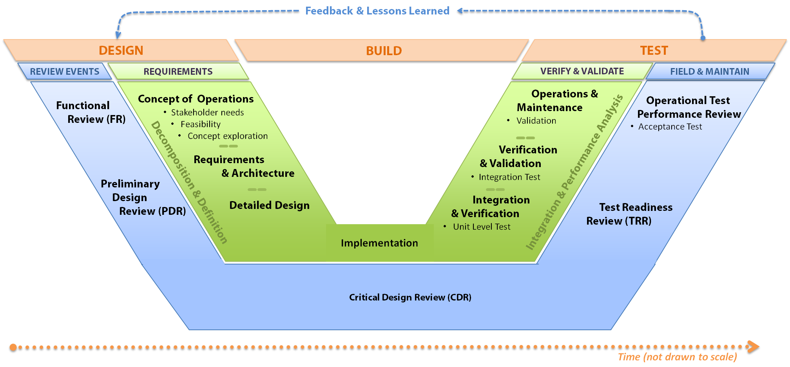
Development Approach
Stakeholder involvement early and often –
Trans-disciplinary development team -
Notes:
To develop such a system, we are following a Systems Engineering process, spanning DESIGN, BUILD, and TEST. We abide by the principles of stakeholder involvement throughout the development process – we have composed a team which is multi-disciplinary with expertise from patient/family engagement, clinical processes, care team engagement, learning and accountability, outcomes assessment, and engineering.
We are currently working on the left side of the V-model – heavily engaged in concept development and modeling in the form of prototypes and we are edging into design with some aspects of the system. The following slides represent currently ongoing activities
----------------------------
Background:
Systems Engineering (INCOSE)
An interdisciplinary approach and means to enable the realization of successful systems. It focuses on defining customer needs and required functionality early in the development cycle, documenting requirements, then proceeding with design synthesis and system validation while considering the complete problem:
Operations
Cost & Schedule
Performance
Training & Support
Test
Disposal
Manufacturing
Systems Engineering integrates all the disciplines and specialty groups into a team effort forming a structured development process that proceeds from concept to production to operation. Systems Engineering considers both the business and the technical needs of all customers with the goal of providing a quality product that meets the user needs.

Slide 21

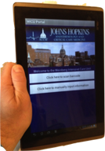
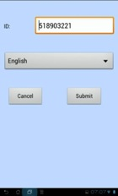
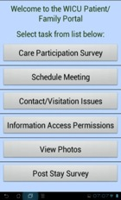
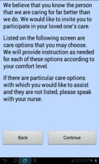
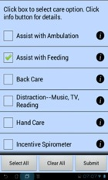
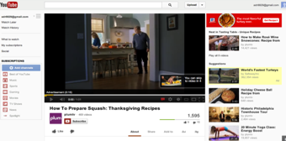



Patient/Family Tool
Care Participation Menu
Display defaults, set preferences
Home Screen
Select Option
Welcome
Screen
Select Options
Scan ID
Obtain
background
information if
requested
Notes:
This slide represents some ongoing work in the patient/family area. Here we illustrate how a family member can navigate some user friendly displays on a tablet to identify which care activities they wish to participate in. In terms of interoperability- it comes in several forms in this example:
Language set to preferred language based upon enrollment
EMERGE ID tied to patient record number
Questionnaire linked to video or written narrative to provide family member with more information regarding care activity
Links to scheduling system to present date/time periods when care activities will occur so family member can choose an activity they will be available to participate in
Upon selecting care activities, reminders will be sent to the family member to be sure they recall the date/time to participate and reminders are sent to the pertinent care team member to alert them to the family member’s participation.
And expanding on the concept of interoperability, for those people who have limited or no ability to move or control their hands, we are looking into eye and gesture control technologies to integrate into this system – this is interoperability in the form of human-computer interfaces tailored to the individuals condition and capabilities.
This questionnaire is one example of several similar surveys we plan to implement to gather patient and family member input as well as care team input to foster communication among all parties.

Slide 22

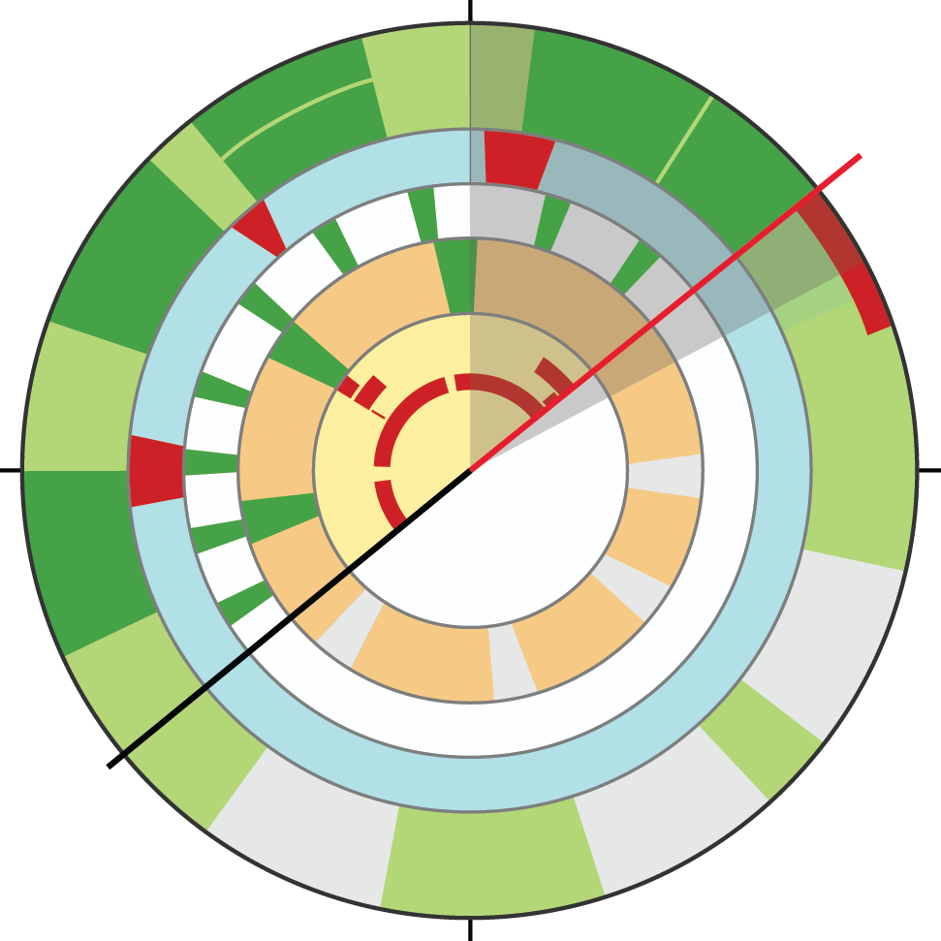
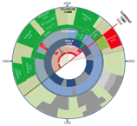
DAY 1
DAY 2
DAY 3
DAY 4
LOS DAY 4
DRUG ADMIN
Drug Administrations from the prior day
0000
Cursor slaved to start/end time on horizontal plot
drill down
BED #: _____
NAME: _____
AGE: _____
WT (lbs, Kg) _____
Antibiotic
XYZ
DRUG/FLUID
ADMIN
Antibiotic
XYZ
CURRENT
TIME
0330
Annotations:_______________________________________________________________________________________________
BP Drug ABC
ACVITITY
ALLERGIES:
_____________
(2) _____________
BP Drug
ABC
NURSING
INTERACTIONS
ADD…
BP Drug
XYZ
BP Drug XYZ
BP Drug
ABC
Near term task: start BP
Drug XYZ infusion
EXERCISE
BP Drug XYZ
Periods of exercise
BP
VITALS
HR
Sp0₂
Temp
BP Drug ABC continues
1800
0600
Activity monitor detects excessive movement
in the bed
Future exercise windows prescribed
Antibiotic
XYZ
Additional information for this patient
or Second Patient’s information
DRUG ADMIN
EMAR
RADIOLOGY
ANGLE HOB
VITALS
MEDICAL SYSTEMS
TIME ON VENTILATOR
AMBULATION
AGITATION
Periodic nursing interactions –
see horizontal plots for drill down re specifics
Future drug administrations planned for this patient
1200

Slide 23
Questions for Discussion
Will you partner with us to improve usability and eliminate paper
Will you commit to eliminating DVT by including risk prediction and decision support
Can we eliminate harm by sharing risk prediction, decision support tools and performance measures
Can we incorporate standard outcome measures
Will you make APIs to connect devices to reduce harm and improve productivity

