Slide 1
EHR Usability Framework and EUP
April 19, 2013
Notes:
1
Susan

Slide 2
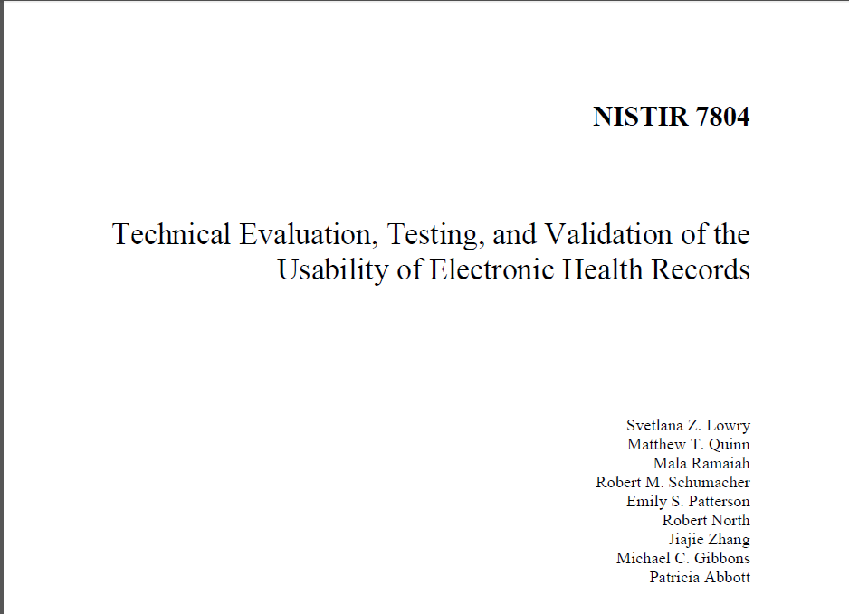
NIST EHR Usability Protocol (EUP)
- Lana Lowry, Mala Ramaiah, NIST - Bob North, Human Centered Technologies
- Bob Schumacher, User Centric - Jiajie Zhang, UT Houston
- Emily Patterson, OSU - Patricia Abbott, Johns Hopkins
- M. Chris Gibbons, Johns Hopkins - Reviewed by many of you (Thank you!)

Slide 3
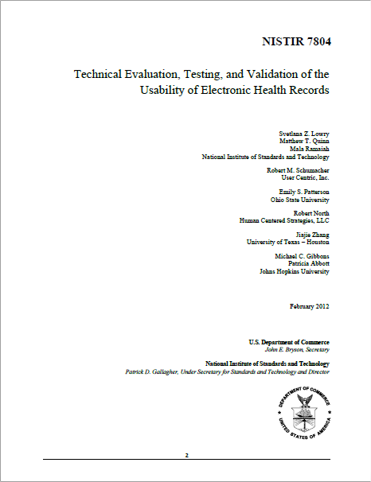
Objectives for the Usability Protocol
Apply existing established human factors methods in the technical evaluation (i.e., measurement) of EHR Usability
Focus on critical aspects of usability (related to patient safety)
Provide detailed systematic steps for conducting measurement usability validation studies
Provide a framework for reporting usability findings
Not a policy document or framework

Slide 4
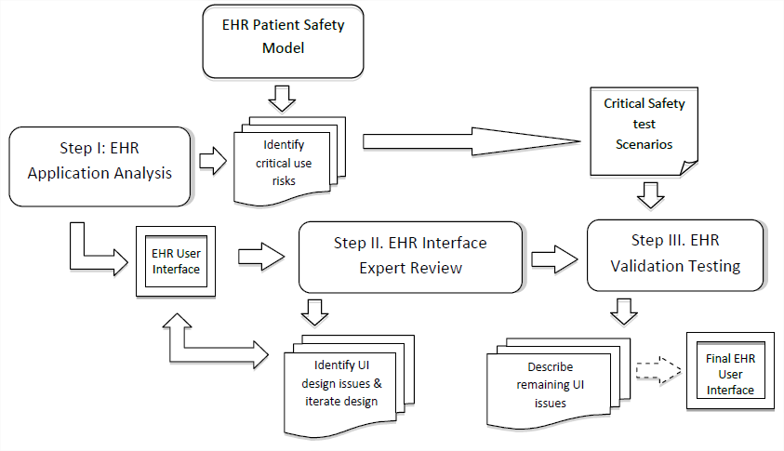
Three-Step User Centered Design Process

Slide 5
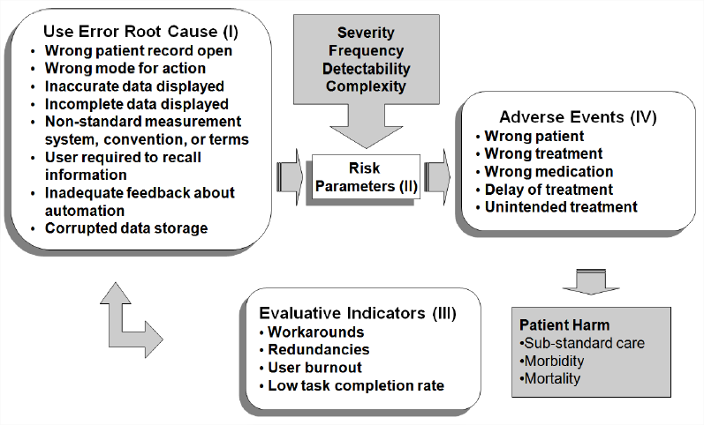
Model of Use-Related Risks of EHRs

Slide 6
Example: Wrong Patient Record Open
Imaging: Patient A
EHR: Patient A
EHR: Patient B

Slide 7
Example: Wrong Mode for Action
Direct Dose Mode (mcg/min)
Weight Dose Mode (mcg/kg/min)

Slide 8
Example: Incomplete Data Displayed
Lidocaine Hydrochlor

Slide 9
Example: Data not Readily Available
80 mg

Slide 10
Scenario: Ambulatory Care (Diabetic pt)
Task 1: Review active patient medications and medication history to identify if prescription refills are needed and ensure that discontinued medications do not need to be renewed
Task 2: Review patient labs to determine if
changes are needed for care plan
Task 3: Modify active medications
Task 4: Order new medications
Task 5: Update problem list
Task 6: Order a consult
Task 7: Document progress note

Slide 11
Factors to Approach Real-World Complexity
Increase dose of existing medication
Drug interaction warnings: false alarms
Taper dose for steroids
First dose now and subsequent doses tomorrow
Verbal order
Change form of medication (PO to IV)
Handoff
Interruptions
Follow-up documentation of prior work
Batch transfer of medications

Slide 12
Summary: Use it and Tell Us How it Went

Slide 13
Thank you!
Notes:
Susan

Slide 14
DISCUSSION
What are your best practices, your challenges, and your aspirations for how to make EHRs safer for patients and more usable for clinicians?
How can we enhance the user/clinician workflow, which enables clinicians to deliver quality health care for the benefit of all patients?

Slide 15
Discussion case: Order a CBC

Slide 16
Discussion Case: Review a Lab
Notes:
Working with some EHR products today is like playing the Game of Concentration. You look at one lab, you look at another lab, you look at another lab. You have to remember what ones are the same, different, changes, when it occurred in time, what you have already looked at, what is the definitive one that you are working with and what ones are related to each other. A photo organizer software has tags for particular photos or subsets where you can stack things in a pile. You can sort on what patients might need surgery, which ones are sicker, which ones have a dialated aorta. You can get a feel for what is there and how it’s organized on dimensions that matter to you by how the photo viewer is set up. You can look in detail at one photo while still viewing the context around it. It is not rigidly structured. Then let’s think about video games like Team Fortress 2. You are supported real-time in the tasks you are accomplishing, the interface is intuitive and you don’t require training, you can communicate easily with players in the context of the tasks you are trying to do, community contributors can create weapons and maps that others can use, you can have filters so that you can customize what you view for what you want to do individually. http://www.teamfortress.com/
In general, EHRs can do a better job with managing files from the perspective of a clinician in terms of what matters to them to deal with data overload. For example, card sorts can be done by physician on lab results on their system for what groupings are informative to them with their data. Also what if questions can be asked to decouple tasks and communications, such as requesting that a lab be ordered by someone else and shared with you (rather than the order turns into the display and there is no communication).

Slide 17
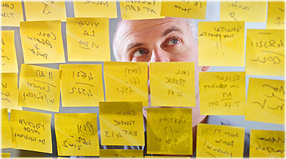
Discussion case: What is causing the patient’s symptoms?
Notes:
A normative workflow model to avoid diagnostic error (fixation bias too early on the wrong diagnosis) is a good history and physical, patient complaint elicitation, identifying 10 problems, deciding what the chief complaint is, orienting and questioning around the chief complaint, ordering tests, and developing in parallel a differential diagnosis of 3-10 possible rank ordered lists of diagnoses. Tests should be used to rule out some of them or distinguish between them. It is considered bad practice to identify the diagnosis in detail (like a ICD-9 code requires) up front. It is considered bad practice to diagnose only from tests. Understanding commonalities in what is needed to support this task can be done by “in situ” observations of multiple physicians doing this. In particular, observations can focus on the “Sticky notes” that are used to supplement EHR functionality that point to what opportunities exist to add/modify functionality to be more useful.

Slide 18
DISCUSSION
What are your best practices, your challenges, and your aspirations for how to make EHRs safer for patients and more usable for clinicians?
How can we enhance the user/clinician workflow, which enables clinicians to deliver quality health care for the benefit of all patients?

Slide 19
mail
fax
SD
Pdf/html
mail
fax
SD
Pdf/html
mail
fax
SD
Pdf/html
mail
fax
SD
Pdf/html
mail
fax
SD
Pdf/html
mail
fax
SD
Pdf/html
mail
fax
SD
Pdf/html
mail
fax
SD
Pdf/html
mail
fax
SD
Pdf/html
mail
fax
SD
Pdf/html
mail
fax
SD
Pdf/html
mail
fax
SD
Pdf/html
mail
fax
SD
Pdf/html
mail
fax
SD
Pdf/html
mail
fax
SD
Pdf/html
mail
fax
SD
Pdf/html
mail
fax
SD
Pdf/html
mail
fax
SD
Pdf/html

Slide 20
Discussion case: Which patient is sickest?
Notes:
When switching from paper to electronic charts, how do we keep the idea of a nurse marking the chart and handing it to the doctor in a way that allows the sickest child to be easily identified and remembered? Event communication and memory can be supported with EHRs to avoid errors of omission. Walkthrough interviews and focus groups with nurses and physicians are methods that could be used to understand this aspect of workflow.

