Slide 1
Overview of the IEEE-SA Process
Malia Zaman
Program Manager
Voting Equipment Electronic Data Interchange Committee
P1622 Working Group Meetings
Feb 8-9, 2011

Slide 2
In this Presentation we will cover:
Overview of the IEEE-SA Process
Project Approval Process
Development of Draft Standard
Sponsor Balloting Process
myBallot/myProject Access/Membership Services
Standards Board Approval Process
Resources

Slide 3

IEEE—A Global Organization
IEEE is a non-profit organization for
scientific and educational advancement
IEEE is made up of international technical professionals living around the world who are fostering
technological innovation and
excellence for the benefit of humanity

Slide 4




IEEE Standards Association
Oversees development of standards within IEEE
Global Membership
  Over 7 000 individual members
  Over 127 corporate members
  Approximately 20 000 participants
Broad Standards Portfolio
  Approximately 1 000 active standards
  Approximately 400 standards in development
Governed by volunteers
An independent organization
  Participants come together to develop
  standards with many constituents
Notes:
This is an overview of the Standards Associations

Slide 5
IEEE-SA Governance Structure
Board of Governors (BOG)
Legal & fiduciary, strategy, policy, finance,
Bus Dev, International,
Appeals, Awards
ISTO
Standards
Board (SASB)
Standards Process
SCC Oversight
Corporate Advisory
Group (CAG)
Corporate Program Strategy
Sponsor
Sponsors
Societies (Computer Society), Committee (EASC), Standards Coordinating Committees (SCC’s) ,CAG, etc.
Standards Working Groups/
Projects
Notes:
This Slides shows the IEEE-SA Governance Structure.

Slide 6
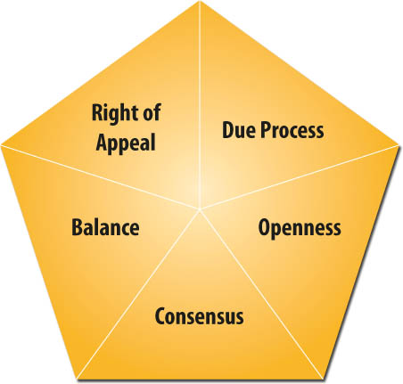
IEEE Standards Development
Five principles guide standards development
Ensuring integrity and wide acceptance for IEEE standards
IEEE standards reflect the standardization principles as
stated by the WTO
Notes:
IEEE follows the five principles to guide our standards development, which ensures integrity and wide acceptance for IEEE standards These 5 principles are as follows; due process, openness, consensus, balance, and right of appeal.
As you may know, these are the standardization principles that are stated by WTO (World Trade Organization).

Slide 7
Societies and Technical Sponsor Committees
C/SAB Standards Activities Board
C/SI Simulation Interoperability Stds Organization/Stds Activities Committee
C/SS Storage Systems
C/TT Test Technology
IEEE Consumer Electronics Society (CES)
CES/SC Standards Committee
IEEE Communications Society (COM)
COM/PC Personal Communications
COM/SIEPON Service Interoperability in Ethernet Passive Optical Networks
COM/TA&OS Transmission Access & Optical Systems
COM/TRANS Transmission Systems
IEEE Dielectrics and Electrical Insulation Society (DEI)
DEI/SC Standards Committee
IEEE Engineering in Medicine and Biology Society (EMB)
EMB/11073 11073 Committee
EMB/Stds Com Standards Committee
IEEE Electromagnetic Compatibility Society (EMC)
EMC/SDCom Standards Development Committee
IEEE Aerospace and Electronic Systems Society (AES)
AES/GA Gyro Accelerometer Panel
AES/RS Radar Systems Panel
AES/UWBRC Ultrawideband Radar Committee
IEEE Antennas and Propagation Society (APS)
APS/A Antennas
APS/P Propagation B
IEEE-SA Board of Governors (BOG)
BOG/CAG Corporate Advisory Group
IEEE Broadcast Technology Society (BTS)
BTS/AVTech Audio and Visual Techniques
BTS/RFTech RF Techniques
IEEE Computer Society (C)
C/DA Design Automation
C/EASC Environmental Assessment Standards Committee
C/FIPA Foundation for Intelligent Physical Agents
C/IA Information Assurance
C/LM Local and Metropolitan Area Networks
C/LT Learning Technology
C/MSC Microprocessor Standards Committee
C/PA Portable Applications
C/S2ESC Software & Systems Engineering Standards Committee
Notes:
7
IEEE has 44+ societies and over 86 sponsoring committees where standards are being developed and maintained. They are listed out in the next three slides. As you can see Voting Equipment Electronic Data Interchange Committee falls under the IEEE Computer Society highlighted in dark blue.

Slide 8
Societies and Technical Sponsor Committees - cont
IEEE Industry Applications Society (IAS)
IAS/CI Cement Industry
IAS/EM Electric Machines
IAS/ES Energy Systems
IAS/I&CPS Industrial & Commercial Power Systems
IAS/PCI Petroleum & Chemical Industry I
AS/PSE Power Systems Engineering
IAS/PSP Power Systems Protection
IAS/TBCC Technical Books Coordinating Committee
IEEE Instrumentation and Measurement Society (IM)
IM/AI TC8 - Automated Test Systems and Instrumentation
IM/ATLAS TC11 - SCC20 (ATLAS) Coordination
IM/Con TC5 - Connectors in Measurements
IM/DC-LF TC2 - DC-LF Measurement
IM/ET TC6 - Emerging Technologies in Measurements
IM/F&T TC3 - Frequency and Time
IM/HFM TC4 - High Frequency Measurement
IM/IM IEEE Instrumentation and Measurement Society
IM/MBM TC25 - Medical and Biological Measurements
IM/ST TC9 - Sensor Technology
IM/UM TC1 - Measurement Precision, Sensitivity and Noise
IM/WM&A TC10 - Waveform Generation Measurement and Analysis
IEEE Microwave Theory and Techniques Society (MTT)
MTT/SCC Standards Coordinating Committee
IEEE Nuclear and Plasma Sciences Society (NPS)
NPS/NI&D Nuclear Instruments and Detectors
IEEE Nanotechnology Council (NTC)
NTC/SC Standards Committee
IEEE Power & Energy Society (PE)
PE/ED&PG Energy Development & Power Generation
PE/EM Electric Machinery
PE/IC Insulated Conductors
PE/NPE Nuclear Power Engineering
PE/PSACE Power System Analysis, Computing, and Economics Committee
PE/PSC Power System Communications P
E/PSIM Power System Instrumentation and Measurements
Notes:
8

Slide 9
Societies and Technical Sponsor Committees - cont
IEEE Power & Energy Society (PE) Cont.
PE/PSR Power System Relaying
PE/PSACE Power System Analysis, Computing, and Economics Committee
PE/PSC Power System Communications
P E/PSIM Power System Instrumentation and Measurements
PE/PSR Power System Relaying
PE/SB Stationary Batteries Committee
PE/SPDHV Surge Protective Devices/High Voltage
PE/SPDLV Surge Protective Devices/Low Voltage
PE/SUB Substations
PE/SWG Switchgear
PE/T&D Transmission and Distribution
PE/TR Transformers
IEEE Power Electronics Society (PEL)
PEL/SC Standards Committee
IEEE Robotics and Automation Society (RAS)
RAS/SC Standing Committee for Standards
IEEE Reliability Society (RS)
RS/RS IEEE Reliability
IEEE-SASB Coordinating Committees (SASB)
SASB/SCC04 SCC04 - Electrical Insulation
SASB/SCC14 SCC14 - Quantities, Units, and Letter Symbols
SASB/SCC18 SCC18 - National Fire Protection Association Standards
SASB/SCC20 SCC20 - Test and Diagnosis for Electronic Systems
SASB/SCC21 SCC21 - Fuel Cells, Photovoltaics, Dispersed Generation, and Energy Storage
SASB/SCC22 SCC22 - Power Quality
SASB/SCC27 SCC27 - Time and Frequency SASB/SCC31 SCC31 - Automatic Meter Reading and Energy Management
SASB/SCC39 SCC39 - International Committee on Electromagnetic Safety
SASB/SCC40 SCC40 - Earth Observation
SASB/SCC41 SCC41 - Dynamic Spectrum
IEEE Ultrasonics, Ferroelectrics and Frequency
Control Society (UFFC)
Access Networks UFFC/UFFC IEEE Ultrasonics, Ferroelectrics and Frequency Control
IEEE Vehicular Technology Society (VT)
VT/ITS Intelligent Transportation Systems
VT/LT Land Transportation
VT/RT Rail Transit
Notes:
9

Slide 10
IEEE Sponsors – Role of the Sponsor
Organization within IEEE that assumes responsibility for a particular standards idea
Takes responsibility for the technical content of the document and provides oversight
Responsible for determining the scope and nature of the technical content
Not a financial sponsorship
IEEE already has a large number of Sponsors
  There are the various societies within the IEEE
  Within those societies, there are often many committees that are active in standards development
Notes:
The sponsor’s role is finding a home for a project within IEEE.

Slide 11
IEEE Standards Development: Process Flow
Idea!
Maximum of 4 years
Project Approval Process
Develop Draft Standard
IEEE-SA Standards Board Approval Process
Sponsor
Ballot
Publish Standard
Notes:
11
So let’s get started.
This chart illustrates the whole standards process in simplified form.

Slide 12
IEEE Standards Development: Getting Started
Idea!
Maximum of 4 years
Project Approval Process
Develop Draft Standard
Sponsor
Ballot
IEEE-SA Standards Board Approval Process
Publish Standard
The idea or concept needs to be well defined and accepted for standardization
The Standard is developed under the guidance of a sponsor
Notes:
12

Slide 13
IEEE Standards Development: Project Authorization
Idea!
Maximum of 4 years
Project Approval Process
IEEE-SA Standards Board Approval Process
Develop Draft Standard
Sponsor
Ballot
Publish Standard
A potential working group or study group gathers to work on the Project Authorization Request (PAR), up to six months before a PAR needs to be submitted.
With the support of the sponsor, submit a PAR to IEEE-SA Standards Board (SASB) for an approval to start the project.
PAR is reviewed by New Standards Committee (NesCom) and based on its recommendation, IEEE-SA Standards Board (SASB) approves/disapproves the project
Notes:
13
With the support of the Sponsor, a Project Authorization Request or what is referred as a PAR is submitted to get an authorization to work on the standard project in the IEEE-SA.
The approval of a PAR means that the work is authorized by the IEEE-SA Standards Board and this also means that IEEE extends the umbrella of indemnification (or protection) to its standards developers working under this PAR.
P1622 ‘s PAR was approved on: 17-Jun-2010 and Expires on:3 1 Dec-2014

Slide 14
IEEE Standards Development: Draft Development
Idea!
Maximum of 4 years
Project Approval Process
Develop Draft Standard
IEEE-SA Standards Board Approval Process
Sponsor
Ballot
Publish Standard
Working group (WG) is created/maintained under policies and procedures (P&P) of the sponsoring committee
WG officers are designated to start the development of the standard
Write the draft of the standard
Submit finalized draft for Mandatory Editorial Coordination (MEC) to ensure conformance with IEEE requirements.
Notes:
14
This is where we are currently: The draft standard is developed in a working group/sub-groups, which consists of both members and non-members of IEEE or IEEE-SA that are made up of developers interested in creating the standard. This means, it is open to anyone to participate in the development of a standard, which is consistent with the principle of openness. However, the working group is created and maintained under the policies and procedures (P&P) set forth by the sponsoring committee, which the working group follows including the Working Group P&Ps.

Slide 15
IEEE Standards Development: Sponsor Balloting
Idea!
Maximum of 4 years
Project Approval Process
Sponsor
Ballot
IEEE-SA Standards Board Approval Process
Develop Draft Standard
Publish Standard
A ballot group is formed using an electronic balloting system called myProject™ .
  No one interest group can be 50% or more.
  Composition of that balloting group cannot change when the ballot is initiated.
A sponsor ballot is initiated with the draft, to be reviewed, commented, and voted by the ballot group.
  Needs 75% return response rate from the ballot group, and
  Needs75% affirmative(approved) votes
Notes:
15
The sponsor ballot process is the means by which consensus is achieved on the proposed IEEE Standard. The goal of a ballot is to have 75% return response rate on a ballot. Otherwise the ballot fails. Once a 75% return response is achieved, WG needs to examine the approval rate, where it needs to have 75% affirmative votes.

Slide 16
IEEE Standards Development: Sponsor Balloting - cont
Idea!
Maximum of 4 years
Project Approval Process
Sponsor
Ballot
IEEE-SA Standards Board Approval Process
Develop Draft Standard
Publish Standard
WG reviews all the approved and disapproved votes with comments submitted by the ballot group.
Make a reasonable attempt to resolve all negative votes
  Add or revise materials as suggested
  Submit responses to the comments
Recalculate the revised draft standard and comments out to the ballot group .
Notes:
16
After the close of the ballot, all comments with approve and disapprove votes need to be examined by the Ballot Resolution Group or BRC and addressed or resolved. They may be resolved by either adding or revising materials suggested by the balloter or from the BRC itself.

Slide 17
Creating a Web Account and MyBallot/myProject Access/Membership Services
Accessing the myProject system requires an IEEE Web Account:
https://webapps1.ieee.org/WebAccount/Registration
MyBallot /MyProject Link:
  https://development.standards.ieee.org/my-site/home
  Membership Services:
  http://standards.ieee.org/membership/index.html
Notes:
Please note that just because you are part of the working group does not mean it will automatically make you part of the sponsor ballot, You will have to join the Sponsor ballot group. In order to access myProject/myBallot you will need to have a web account.
These are the links to help create a web account in order to get access to the myBallot/myProject site. In addition I have added the link to Membership Services as well. In order to Ballot on the Sponsor ballot one must at least be a IEEE-SA Member.

Slide 18
IEEE Standards Development: Approval Process to Publication
Idea!
Maximum of 4 years
IEEE-SA Standards Board Approval Process
Project Approval Process
Develop Draft Standard
Sponsor
Ballot
Publish Standard
Submit the final draft standard to Standard Review Committee (RevCom).
RevCom reviews the submitted documents and materials, and makes a recommendation to IEEE-SA Standards Board for an approval of the draft standard.
IEEE-SA Standards Board reviews the recommendation and approve the draft standard.
Publish Standard
Complimentary copies sent to the WG.
Notes:
18
The approval of the IEEE draft standard is achieved by submitting the document and supporting materials to Standard Review Committee (RevCom). RevCom determines whether or not the principles of consensus, due process, openness, and balance is maintained throughout the project development and makes recommendation to IEEE-SA Standards Board for an approval.

Slide 19
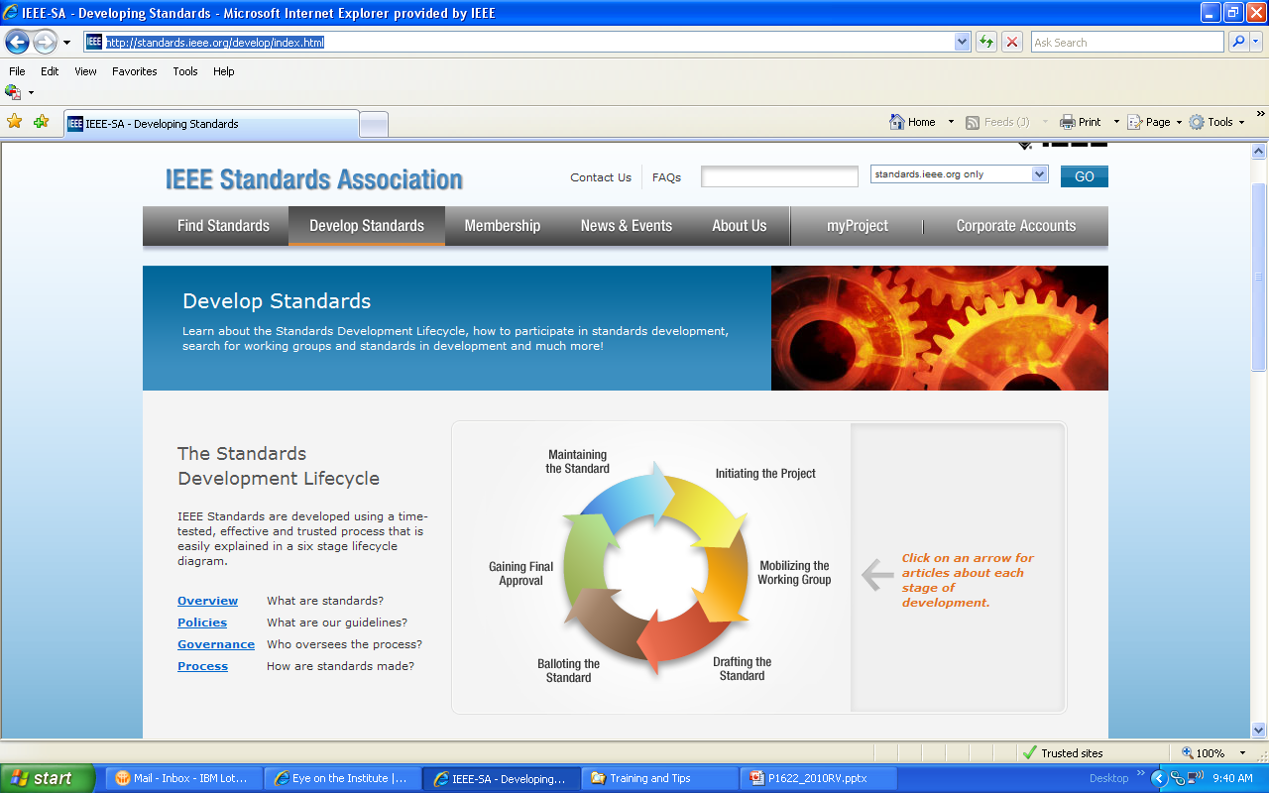
Resource Links
Additional Information:
http://standards.ieee.org/develop/index.html

Slide 20
Comments/Questions:

Slide 21
For more information…
Contact:
Malia Zaman
Program Manager
Technical Program Development
Phone: +1 732 562 3838
Email: m.zaman@ieee.org
Notes:
We thank you for joining us this morning. We hope the materials presented this evening was insightful, and resourceful. If you have any additional comments or questions, please do contact us.

