Slide 1
The Current Cybersecurity Threat Landscape
Bob Bastani
October 18, 2018

Slide 2
Bottom Line Up Front
A cyber attack will impact your facility, public health department, coalition, and government
You have a role in preventing and responding to cyber incidents
Emergency management must partner with IT Security professionals (CISOs, IT Managers) to successfully plan for, respond to, and recover from cyber incidents

Slide 3
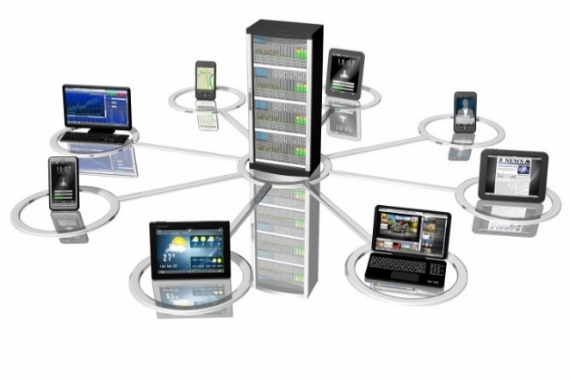
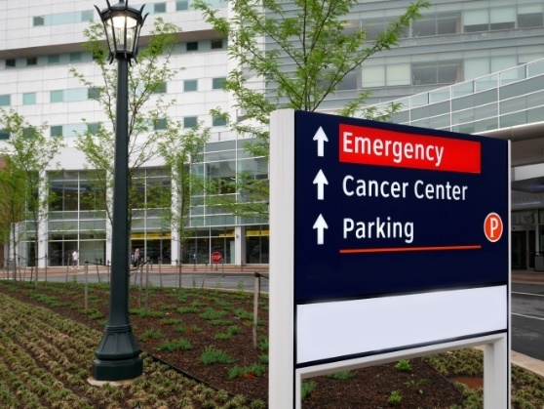
Critical Infrastructure
Systems and assets, whether physical or virtual, so vital to the United States that their incapacitation or destruction …would have a debilitating impact on security, economic security, public health or safety, or any combination of those matters.
§1016(e) of the USA Patriot Act of 2001 (42 U.S.C. §5195c(e))

Slide 4
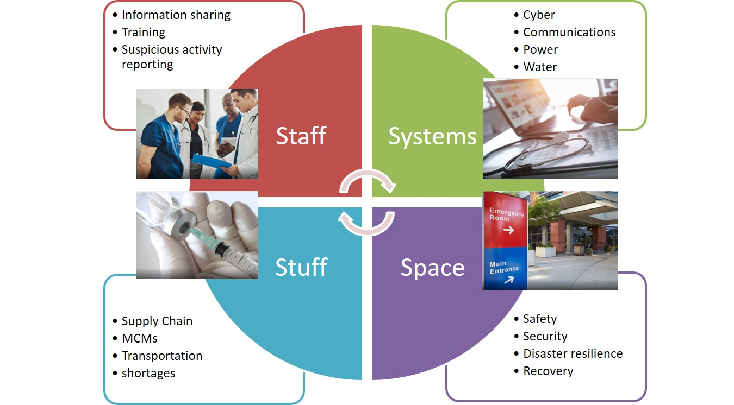
Healthcare and Public Health Critical Infrastructure
Security
Resilience

Slide 5
Compliance Security
Even if an organization does all of these things right, they are still at risk and need to proactively combat threats
  Proper documentation
  User training and awareness
  Software configuration and patch management
  Host computer security agents (Antivirus)
  Network security devices (Firewalls, Intrusion Detection Systems (IDS), Email and Web Proxies, etc.)
However…defense-in-depth is a key component for good security operations.
Notes:
I am not planning to go into the aspects of “compliance” for security, but that is not to say organization shouldn’t do these things.

Slide 6
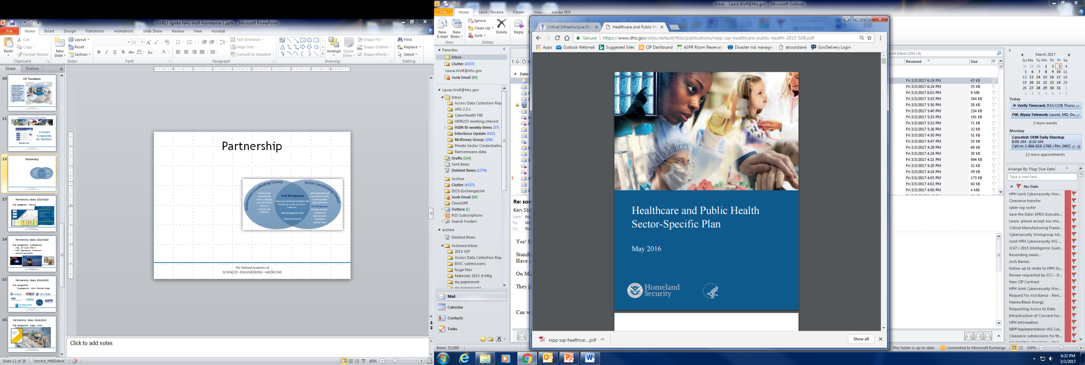
Healthcare and Public Health Sector
Critical Infrastructure Partnership
By providing a venue for public and private sector partners to collaborate, we
  Promote risk management activities;
  Share threat information;
  Socialize best practices; and
  Develop useful tools and policies;
  to mitigate impacts of disasters and enhance resilience of the entire health care system to minimize disruptions in care for all Americans

Slide 7
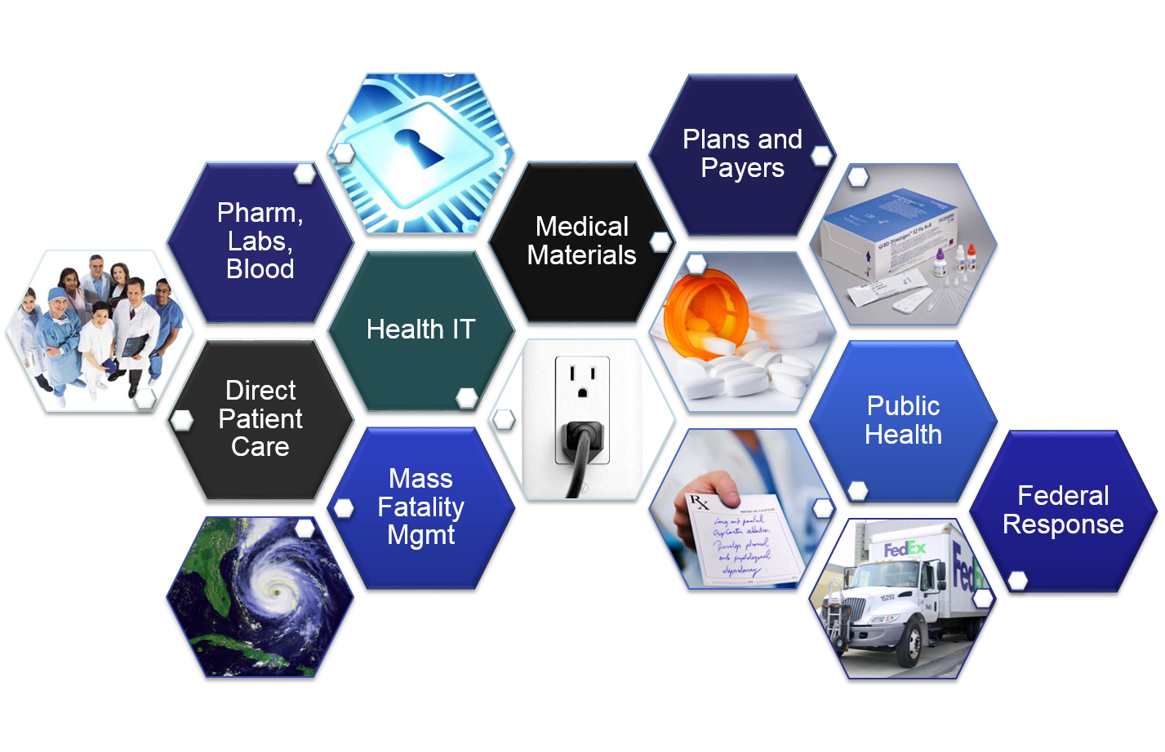
Healthcare and Public Health Subsectors

Slide 8
Healthcare is a Target
Advance Persistent Threat (APT) Actors
Target U.S. healthcare and other critical industries to steal Intellectual Property (IP), Personally Identifiable Information (PII), and Protected Health Information (PHI)
Cyber Criminals
Steal information to sell for a profit or benefit from insider stock trading, but recently more often to install ransomware
Hacktivists
Use hacking as a way to protest or call attention to a cause, often by causing a Denial of Service or by defacing a public-facing webpage
Notes:
Threat actors are highly motivated and there are many reasons an organizations data could be targeted. A few of the types of information being stolen are:
Patient Information
Proprietary Information
Business and Strategic Plans
Human Resources Documents
This year we have seen more than 10 significant Ransomware attacks within the Healthcare sector
Deliberately targeting because the operations are critical, money is available, and generally have modest cybersecurity operations.
This has included a large medical records firm, lab testing, several hospitals, and doctor’s offices.
These attacks have affected patient care.
We’ve observed payments to one threat actor group receiving > $300,000 the last weeks of July.
Hacktivists have caused disruptions to emergency response systems and caused negative reputational impacts.

Slide 9
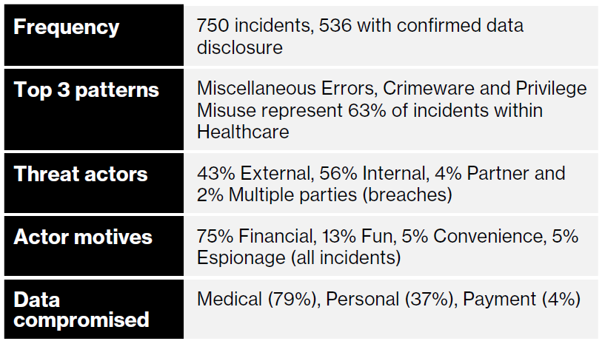
According to the 2018 Verizon Data Breach
Investigations Report (DBIR)
The Healthcare sector is rife with error and misuse. In fact, it is the only industry vertical that has more internal actors behind breaches than external. In addition to these problem areas, ransomware is endemic in the industry.
Ransomware accounts for 85% of all malware in Healthcare.
Notes:
Verizon's 2018 Data Breach Investigations Report (DBIR)
www.verizonenterprise.com/resources/reports/rp_DBIR_2018_Report_en_xg.pdf

Slide 10
The Cost of an Incident
Potentially Life-Threatening Impacts
Disruption of service: Patients may not get the timely care they need, if technology services are slowed or unavailable
Denial of service: Healthcare providers may be unable to provide care without access to digital health records.
Compromise of data integrity: Medical records could be altered
Breach of Intellectual Property (IP), Personally Identifiable Information (PII), or Protected Health Information (PHI)
Healthcare data breaches cost an average of $408 per record, according to the ”2018 Cost of a Data Breach Report” by IBM and the Ponemon Institute. That’s nearly twice as much as the runner-up (financial services at $206 per record), and nearly triple the average across all industries of $148 per record.
Loss of Reputation for the Organization
Notes:
2018 Cost of a Data Breach Report by IBM and the Ponemon Institute
https://www.ibm.com/security/data-breach
3.15M Records Exposed by 142 Healthcare Data Breaches in Q2 2018
In the second quarter of 2018, 3.15 million patient records were compromised in 142 healthcare data breaches, according to the Protenus Breach Barometer.
https://healthitsecurity.com/news/3.15m-records-exposed-by-142-healthcare-data-breaches-in-q2-2018
142 healthcare data breaches in Q2, 30% caused by repeat offenders
More than 3 million patient records were breached between April and June, highlighting an even bigger issue: Risk increases over time without proper education or reporting.
https://www.healthcareitnews.com/news/142-healthcare-data-breaches-q2-30-caused-repeat-offenders

Slide 11
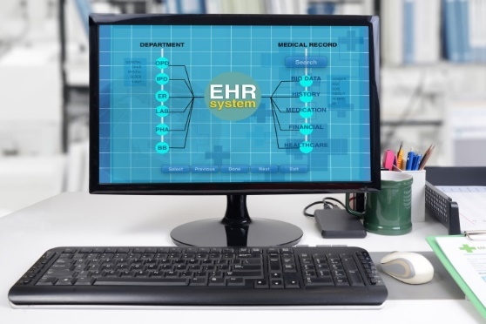
Evolving Cyber Threat to Healthcare Systems
Pre-2014
  Criminal intent, fraud
  PII >> PHI
  Content found on dark web
  Costly ~$2.2m per breach
  Industry cost $6b
Biggest impacts
  Cost
  Loss of reputation

Slide 12
Evolving Cyber Threat to Healthcare Systems
2014-2016
  Mega-breaches, >1m records
    Public health data
  Where is the data going?
    Not on dark web
  Ransomware
    Hollywood Presbyterian
    Medstar Washington
2017
  International ransomware impacts US healthcare

Slide 13
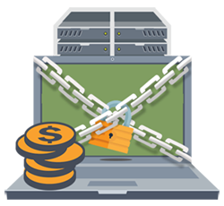
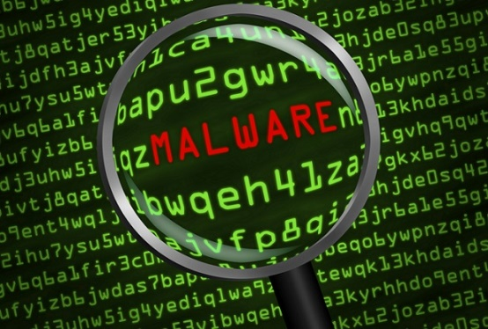
Types of Threats
Malware
Ransomware
Phishing
Malicious and careless insiders

Slide 14
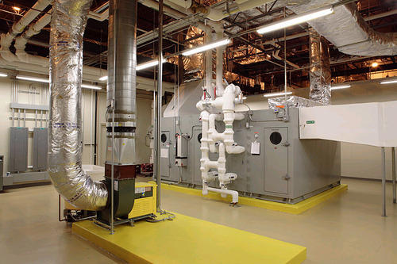
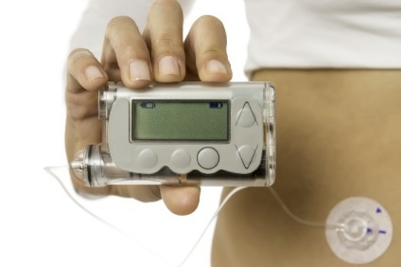
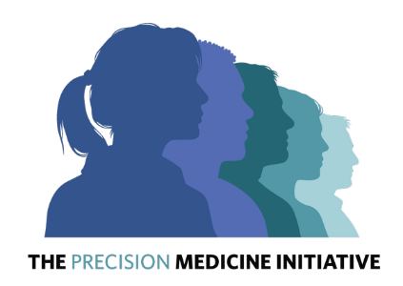
Evolving Healthcare Cybersecurity Threats
Insurance billing information
Electronic medical records
Intellectual Property
Facility Systems
Internet of Things (IoT)
Medical Devices
  Connected to the internet
  Connected to your body!
Supply Chain
Genetic information
Financial Concern
Patient Safety

Slide 15
Vulnerabilities at the Local Level
Lack of funding
Open culture/connection to others
Lack of prevention systems and firewalls
Lack of cyber incident response planning
Lack of backup systems and data protection
Lack of trained workforce on cyber issues
Mobile devices used for work purposes
Vulnerability of electronic health records and health systems
Security breaches of websites and information dissemination systems
Un-patched system and lack of antiviral protection
Poor cyber hygiene
Notes:
Cyber hygiene (e.g. not updating passwords, opening suspicious emails, sharing passwords, etc.)

Slide 16
Why Public Health and Healthcare are Attractive Targets
They collect a high volume of sensitive personal health information which they are required to protect
They collect patient financial information to process payments
Some use out-of-date software or inadequate computer security software
Disruption of their services will gain much public attention

Slide 17
Congressional and Administration Priority
Cybersecurity and Information Sharing Act of 2015
Presidential Executive Order on Strengthening the Cybersecurity of Federal Networks and Critical Infrastructure, May 11, 2017
“risks of cyber warfare … make the mission of ASPR more important and urgent. We must redouble our readiness efforts and improve capabilities for these and other threats.” Senate Confirmation Hearing for Dr. Bob Kadlec, August 1

Slide 18
HHS: Taking Cyber Seriously
HHS
Office of the Chief Information Officer
Office of the National Coordinator, HIT
Assistant Secretary for Preparedness and Response
Office of Civil Rights
Office of Emergency Management
CIP
Healthcare Cybersecurity and Communications Integration Center
HIPAA privacy and security
Health IT
Operations
TRACIE
FDA
Medical Device Cybersecurity

Slide 19
WannaCry 2017
Unknown actor deployed ransomware that encrypted files on computer systems and asks for $300 in Bitcoin for the key
In UK, 16 NHS systems were affected, including ~47 facilities, impacting patient care
“We can just about survive
without a stethoscope — once the
symbol of our craft — but without
our computer log-ins, modern
medicine grinds to a halt.”
DOI: 10.1056/NEJMp1706754
  Not specifically targeted, but vulnerable since 90% of computer systems run Windows XP
  Ambulances were re-routed
  Software for EMS communication with hospitals affected
In Spain, telecommunications were affected
FedEx impacted internationally
Variety of US facilities impacted, mainly hospital networks and imaging devices

Slide 20
WannaCry Impacts to
UK National Health Service
81 out of 236 trusts impacted
  37 impacted and locked out of systems
  44 pre-emptively disconnected systems
  Acute care facilities
  Emergency department
603 primary care practices affected
7,000 patient appointments were canceled
  Likely 20,000 follow-up appointments not made
200 urgent cancer treatments
1% of all imaging equipment went down
    Xrays, MRIs, CT scans
“It’s devastating to hear you have cancer in the first place and anything that delays you getting any treatment that could be life-saving is even more devastating. Everything depends on access to computer records so my treatment will be delayed. This makes me feel my survival chances have been reduced.”
https://www.theguardian.com/society/2017/may/14/nhs-cancer-patients-treatment-delays-cyber-attack

Slide 21
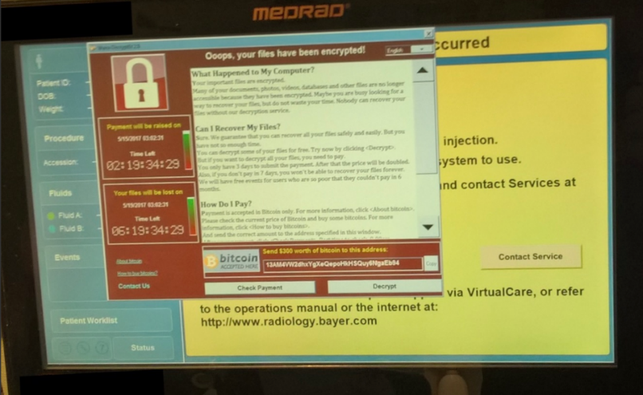
WannaCry Impacts
Patient Care
Patient Transportation
Imaging devices
Transmission of information
Access to records and results
Anticipatory shutdown of systems (email, prescription, etc)

Slide 22
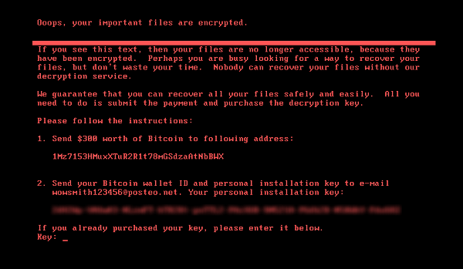
Petya/NotPetya 2017
What was believed to be a ransomware attack originating in Ukraine and quickly spread internationally
Used a similar exploit as WannaCry, however it spread within organizations even if they had patched
Few impacts to U.S. hospitals
Merck, Maersk, FedEx
  Financial impacts $300m to each

Slide 23
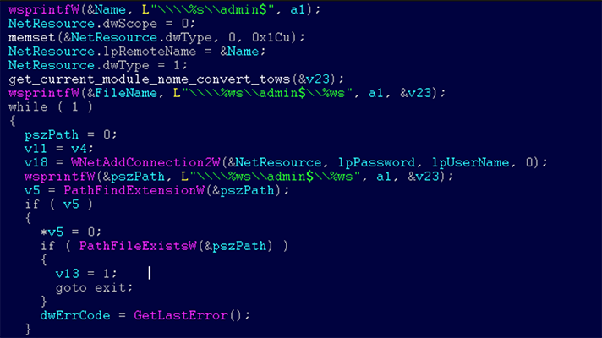
Petya was not really ransomware
Perceived to be ransomware
“Wiper” virus
Goal not to get paid, but to wipe out systems
Ransom did no good
“Keys” randomly generated

Slide 24
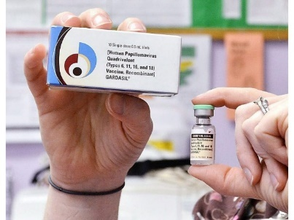
Impacts to Merck
Impacted production lines
Lost $135 million from lost sales and approximately $175 million in costs
In its third-quarter financial results, Merck reported that its sales were down by about $240 million after borrowing the GARDISIL vaccine from the U.S. Centers for Disease Control.

Slide 25
Lessons Learned: Merck
Vulnerability:
  Business with Ukraine
  Financial software: MeDocs
Response
  Disabled employee emails
  Communicated through text and phone tree
Impacts
  Wiper
  Loss in profits
  Not completely back to normal production– not making API in bulk

Slide 26
Contracts can help or hinder response
Nuance, a transcription services company was impacted for more than 6 weeks
  Do you vet vendors or contractors for their cybersecurity practices?
  Do you ask what their response plans are?
  Do you have exclusivity clauses in your contracts?
    How might that impact recovery from a long term event

Slide 27
Emergency Support Function 8 Role
ASPR leads national Public Health and Medical/ESF-8 response
What would be the role of ESF-8 in a major cyber attack?

Slide 28
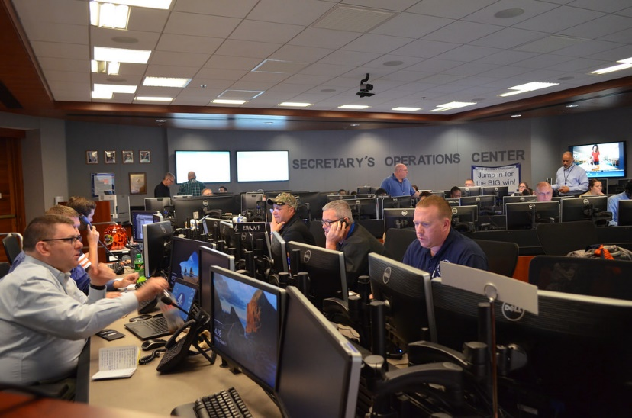
HHS Response
May 2017- HHS activated our Emergency Management Group to support internal response and private sector to WannaCry
  HHS Secretary’s Operations Center filled with ESF-8 staff and cybersecurity experts
  Frequent discussions of current and potential impacts
June 2017- Petya/notPetya response

Slide 29
Critical Infrastructure Protection Role in the Response
As EMG activated, we managed the Secretary’s priority to support private sector and public health
  Held daily sector-wide call
  Held daily call with key trade association partners
  Identified contacts at facilities that were reported as affected on our calls, in media, or by other agencies
  Coordinated messaging across sector
  Expanded contact lists for the event
  Partner reach expanded into the hundreds of thousands

Slide 30
Were WannaCry and Petya on your radar?
How did you learn about these events?
Was your coalition involved in response or communications?
What should the role of coalitions be in planning or response to cyber events?

Slide 31
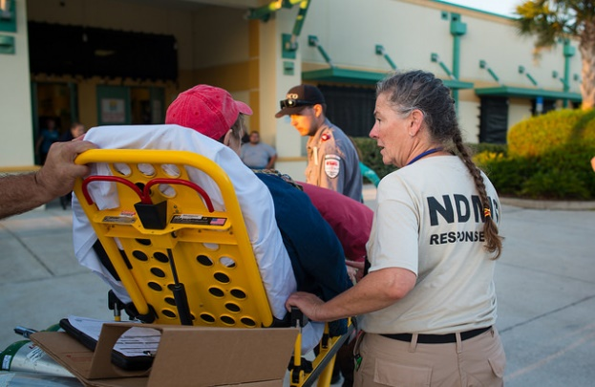
Worst case scenario
Zero-day vulnerability
  No patches
No warning
Impacts to power grid or transportations systems
Impacts to patient care across the country, all at once
  NHS turned away A&E (ED), radiology, and chemotherapy patients
Impacts to patient safety across the country, all at once

Slide 32
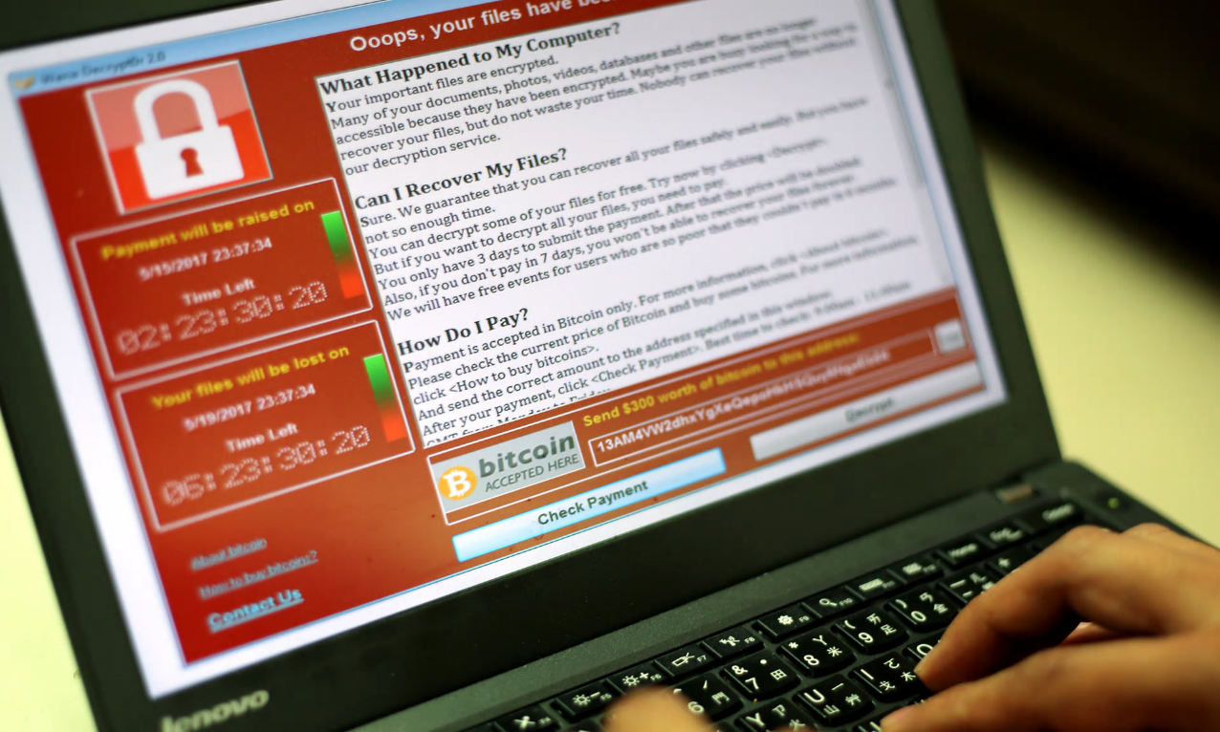
Are we better prepared today?

Slide 33
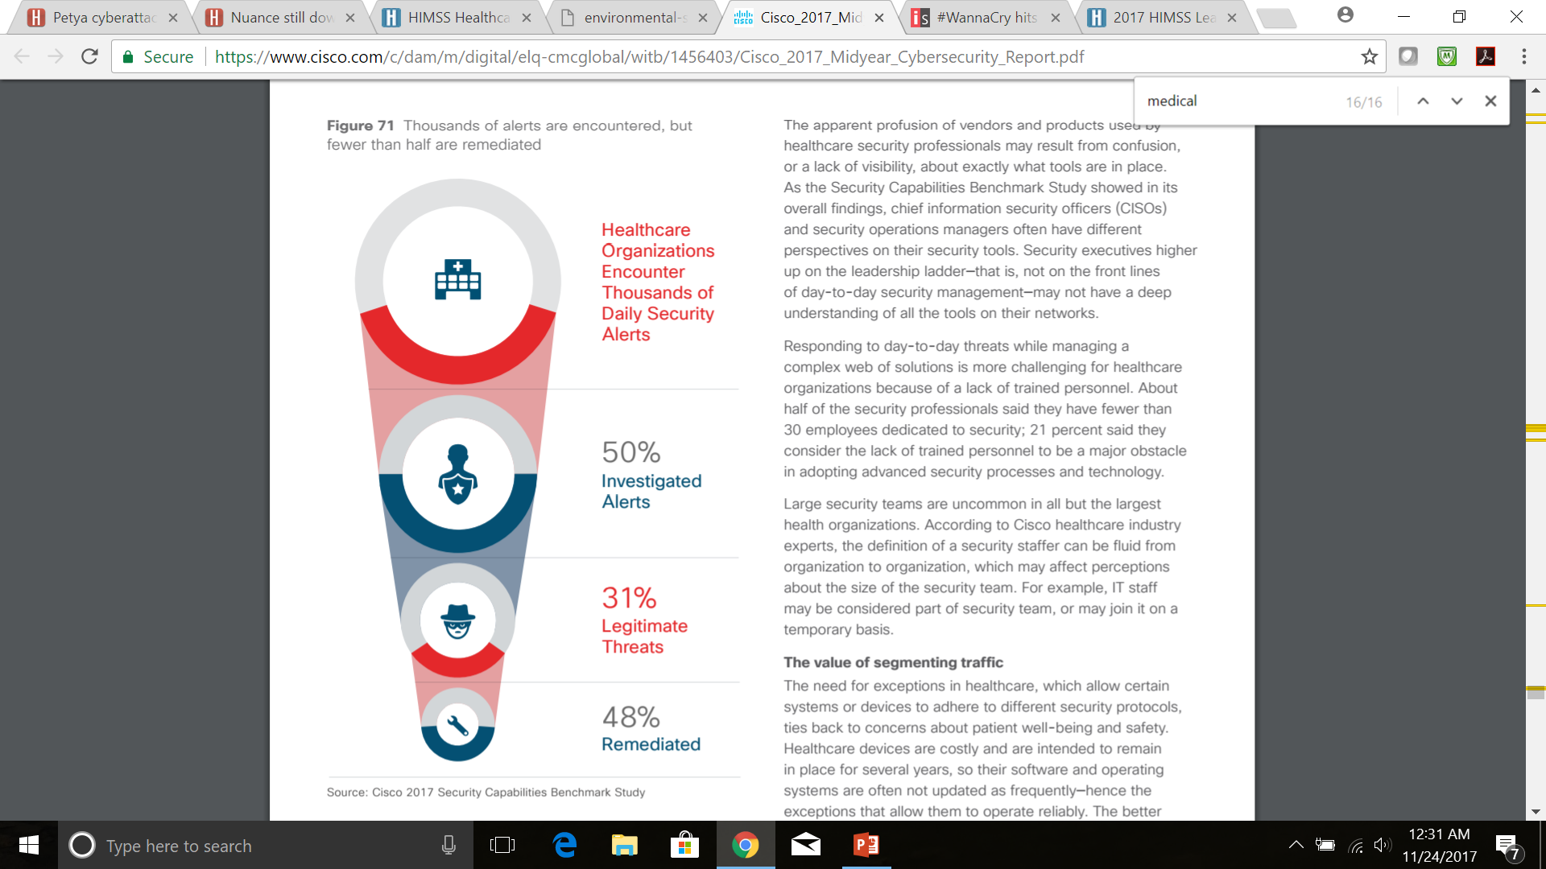
What is the threat to healthcare?
Over 40 percent of the healthcare organizations reported thousands of security alerts daily, and only 50 percent of those are investigated. Of the alerts that healthcare security teams investigate, 31 percent of those investigated are legitimate threats—but only 48 percent of those legitimate incidents are remediated.
Not enough personnel to adequately track threats and protect systems
Not enough bandwidth to quickly detect insults to systems

Slide 34
Information Systems Audit and Control Association (ISACA) survey
Survey of 450 CIOs found
50% implemented new security safeguards following the WannaCry ransomware attack
15% planned changes in response to Petya
76% said that their organizations were either highly or somewhat prepared to deal with the increased frequency of ransomware
23% are applying the latest security software patches within the first 24 hours of release. In some cases it can take over a month before the software is updated.
6% said they would pay ransom in future attacks

Slide 35


Key Myths
Large healthcare systems are the target of these attacks
  Any vulnerable system is at risk. Healthcare wasn’t targeted it was a victim
  Small and medium sized facilities are just as at risk
    Grozio Chirurgija clinic in Lithuania was specifically targeted
    Before and after photos and other info of patients, some nude, were held for ransom.
    300 bitcoin for the full database (currently over US$1m)
    Published the database of over 25,000 images
    Individual information has demanded around US$2000.
Paying ransom will provide you with a quick solution
  Business decision
  Profit not always the goal
    Petya/NotPetya- wiper
There will always be a patch

Slide 36
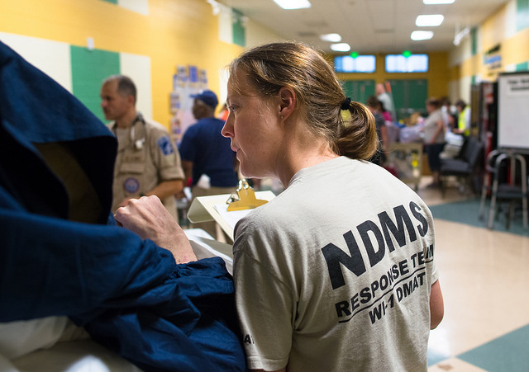
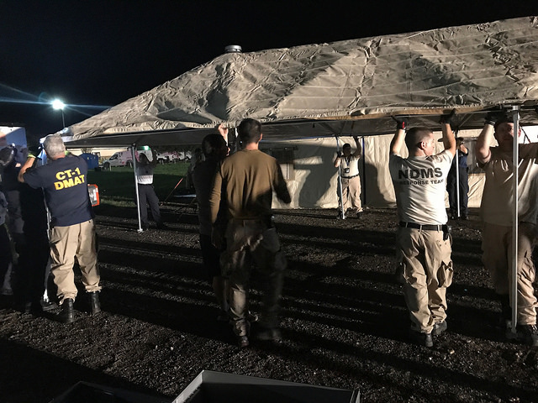
Planning for Impacts
How can you think through potential impacts
When do you use a cyber system
Backup procedures
Contracts
Who ya gonna call?

Slide 37
Recommendations for private sector
Implement of NIST Cybersecurity Framework and related standards at all levels of the healthcare system.
Encourage collaboration between IT and Emergency Management staff.
Incorporate cyber incidents into risk assessment, response plans and business continuity plans.
Engage in cybersecurity exercises. Be aware of cyber attacks conducted while other incident responses are underway.
Consider cyber posture of your contractors and suppliers
Recognize that negative patient outcomes could potentially have a cyber nexus
Notes:
Patch patch patch
Implement security patches or other mitigation measures as identified
Remain vigilant to the possibility of attacks
Train personnel to recognize attacks
Don’t pay ransom

Slide 38
Medical Device “hijacking” (MEDJACK)
TrapX researchers suggest that organizations take the following steps to reduce the likelihood, and impact, of a ransomware attack that targets medical devices and other critical OT technology:
  Understand what and how many medical assets in your environment are internet-connected
  Refresh contracts with suppliers, and make sure that they are meeting promises outlined in those contracts to update or replace software, devices, and systems
  Discuss this problem at the senior management and board levels to get their attention and commitment to the process
  Deploy technology tools that provide visibility into the network and automate threat detection and remediation

Slide 39
On-Going Efforts

Slide 40
On-going work
Activities to understand the level of preparedness across the sector to include public health and healthcare, including small- and medium-sized businesses
Improvements to response to cyber events
Improving communications to communicate
Making exercises more available

Slide 41
National Cyber Incident Response Plan
FBI- lead for law enforcement role
  State law enforcement may have a role- some states have robust programs
DHS- responsibility for asset response
  Helping facilities that were impacted
ODNI- responsible for intel support and plugging that into operation
HHS- Healthcare and Public Health Sector Coordination

Slide 42
Healthcare Industry
Cybersecurity Task Force
Under the Cybersecurity Act of 2015, the Task Force was directed to:
  Analyze how industries, other than the health care industry, have implemented strategies and safeguards for addressing cybersecurity threats within their respective industries;
  Analyze challenges and barriers private entities (excluding any State, tribal, or local government) in the health care industry face securing themselves against cyber attacks;
  Review challenges that covered entities and business associates face in securing networked medical devices and other software or systems that connect to an electronic health record;
  Provide the Secretary with information to disseminate to health care industry stakeholders of all sizes for purposes of improving their preparedness for, and response to, cybersecurity threats affecting the health care industry;
  Establish a plan for implementing title I of this division, so that the Federal Government and health care industry stakeholders may in real time, share actionable cyber threat indicators and defensive measures
  Report to the appropriate congressional committees on the findings and recommendations of the task force regarding carrying out subparagraphs (A) through (E).
Notes:
Report expected Mid-May

Slide 43
Joint HPH Cybersecurity Working Group
A forum for discussion of issues and development of needed resources to enhance cybersecurity among a wide variety of HPH Sector stakeholders including healthcare providers, information technology (IT) and information security professionals, pharmaceuticals, device manufacturers, health IT developers, etc.
CISA 405 d implementation
Incorporating cybersecurity into risk assessment

Slide 44
What you can do tomorrow
Talk to colleagues about your role in preventing and responding to cyber incidents
Ask questions of leadership: what is our cyber response plan and what is my role?
Meet your IT security staff (hire IT security staff!)
Encourage leadership to take cyber threats seriously!
Join us in our activities!
  cip@hhs.gov

Slide 45
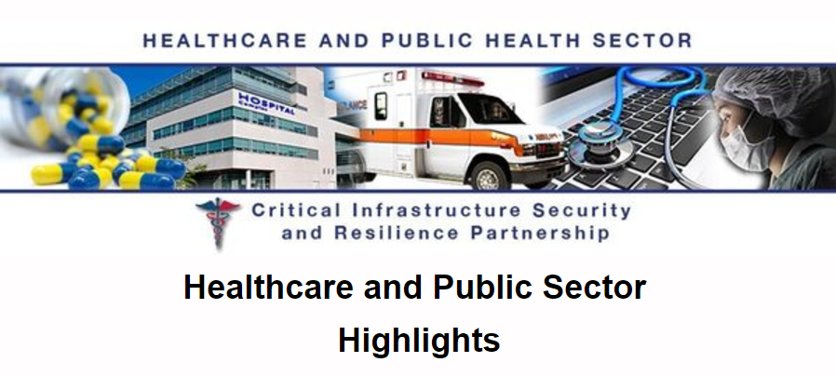
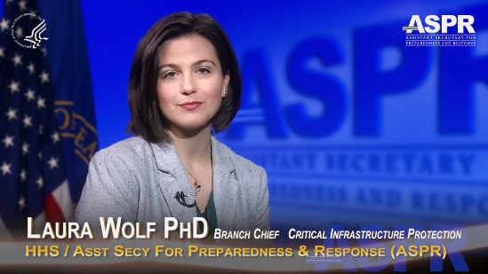
Partnership Engagement and Comms
Weekly Highlights Newsletter
Innovation Seminar Series
Bi-annual Public-Private Partnership Meetings
Response Coordination
Phe.gov/cip
cip@hhs.gov
Phe.gov (ASPR) twitter, facebook
ASPR blog posts
Response/incident communications
  Text messaging
Pilot: Podcast

Slide 46
If you are the victim of ransomware
HHS recommends the following steps:
Please contact your FBI Field Office Cyber Task Force www.fbi.gov/contact-us/field/field-offices immediately to report a ransomware event and request assistance. These professionals work with state and local law enforcement and other federal and international partners to pursue cyber criminals globally and to assist victims of cyber-crime.
Please report cyber incidents to the US-CERT www.us-cert.gov/ncas and FBI’s Internet Crime Complaint Center www.ic3.gov

