Slide 1
Office of Facilities & Property Management
Stephen Salber, Director

Slide 2
OFPM Mission / Vision
Our mission is to advance NIST’S mission success by planning, building, operating, maintaining and servicing facilities that provides a safe, secure, and sustainable environment.
Our vision is to be a model facilities services organization. Our customers will seek us out as a trusted partner that consistently delivers on its commitments in a proactive, responsive, safe, and cost-effective manner.

Slide 3
Our Organization
Approximately 360 Employees
Located at Gaithersburg, MD and Boulder, CO
Four Directorates -
Safety and Security
Design and Construction
Operations and Maintenance
Facility Services

Slide 4
A Sampling of Services We Provide
Fire Department, COOP, Emergency Response, Access Control
Regulatory and Environmental Compliance
Engineering Design
Cost Estimating
Construction Management
Grounds, HVAC, Electrical, Carpentry, Plumbing
Shipping, Receiving, Motor Pool, Mail, Printing and Duplicating, Storeroom Services
Custodial Services
Property Management
Reimbursable Services
Capital Asset Management

Slide 5
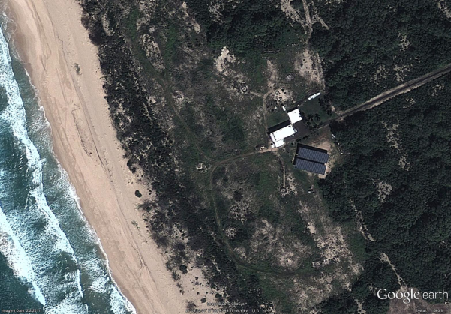
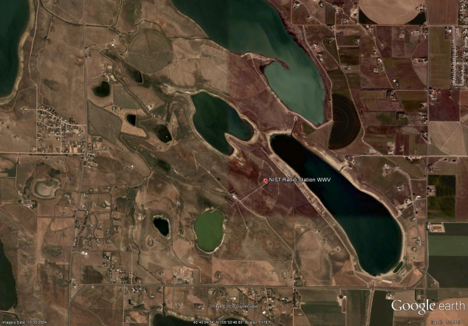
The Facilities We Support
Overall NIST has 4.3M GSF, on 1220 acres across its four sites
Mostly constructed in the 1950’s and 1960’s
Kauai, HI
Boulder, CO
Gaithersburg, MD
Ft. Collins, CO

Slide 6
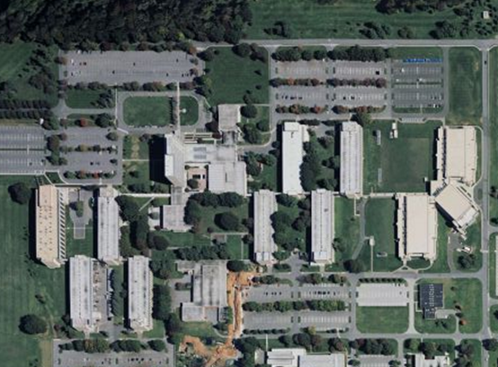
Gaithersburg Overview
Gaithersburg, MD
Site: 593 acres
Facilities: 54 Buildings and Structures
Footprint: 3.5 million Gross Square Feet
Space Type: Office, Lab and Support

Slide 7
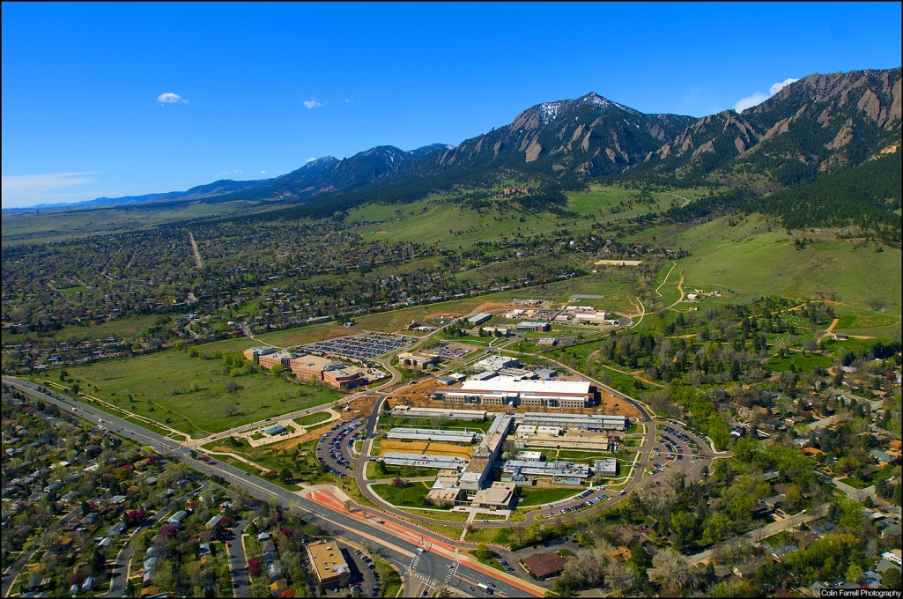
Boulder Overview
Boulder, CO
Site: 206 acres
Facilities: 28 Buildings and Structures
Footprint : 800,000 Gross Square Feet
Space Type: Office, Lab and Support

Slide 8
Field Site Overview
Ft. Collins, CO
Kauai, HI
Site: 390 Acres
Facilities: 5 Buildings and Structures
Footprint: 19,000 Gross Square Feet
Space Type: Office/Lab/Radio Broadcast
Site: 31 Acres
Facilities: 1 Building
Footprint: 6,000 Gross Square Feet
Space Type: Office/Lab/Radio Broadcast

Slide 9
Basic OFPM Budget Information
For Fiscal Year 2016
Working Capital: $34.0 M
Utilities and Other Uncontrollables: $35.2 M
Maintenance and Major Repairs: $59.0 M
New Construction: $60.0 M

Slide 10
Where We Need Your Expertise
Construction Management Services
New Construction Renovation of Existing Facilities (office, lab and common space)
Outside Utility Construction
Facility Assessments
Equipment Inspection and Certifications
Elevator and Crane Testing
Direct Digital Controls (HVAC)
Building Supplies and Materials
Office Supplies
Chemistry Supplies
Electronics
Plumbing Supplies
Safety Supplies
Rigging and Moving
Copier Maintenance
Carpet Installation
Asbestos Abatement
Architect & Engineer Services
Cafeteria Services
Painting
Paving/Sidewalk Construction and Maintenance
Roofing Repair and Replacement
Transportation Services

Slide 11
More about OFPM
The breakout session to follow in the Green Auditorium,
The OFPM Exhibit Table
or

