Slide 1
Visit to NIST by NSF Engineering Representatives
January 28, 2011
Dr. Shyam Sunder, Director
Engineering Laboratory
National Institute of Standards and Technology

Slide 2
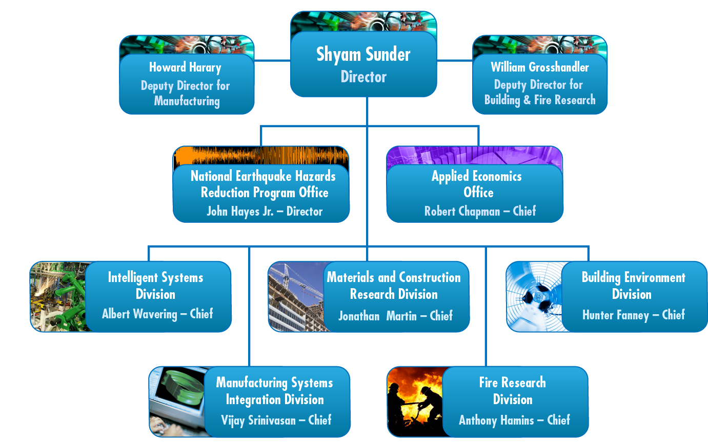
Engineering Laboratory Organization

Slide 3
Engineering Laboratory Mission
To promote U.S. innovation and industrial competitiveness in areas of critical national priority by anticipating and meeting the:
- measurement science and
- standards
needs for technology-intensive manufacturing and construction in ways that enhance economic prosperity and improve the quality of life.
Notes:
3

Slide 4
Engineering Laboratory Vision
To be the source for:
  - creating critical solution-enabling measurement science, and
  - critical technical contributions underpinning emerging standards, codes, and regulations
that are used by the U.S. manufacturing and construction industries to strengthen leadership in domestic and international markets.
EL is the primary federal laboratory serving the manufacturing and construction industries
Notes:
4

Slide 5
EL Core Competencies
Intelligent sensing, control, processes, and automation for
cyber-physical systems
Systems integration, engineering, and processes for
cyber-physical systems
Energy efficient and intelligent operation of buildings with healthy indoor environments
Sustainability, durability and service life prediction of building and infrastructure materials
Fire protection and fire dynamics within buildings and communities
Resilience and reliability of structures under multi-hazards

Slide 6

EL Strategic Goals
Measurement Science and Standards for:
Smart Manufacturing, Construction, and Cyber-Physical Systems
Sustainable and Energy-Efficient Manufacturing, Materials, and Infrastructure
Disaster-Resilient Buildings, Infrastructure, and Communities
Notes:
6

Slide 7
EL Strategic Goals
Smart Manufacturing, Construction, and Cyber-Physical Systems: To enable the next generation of innovative and competitive manufacturing, construction, and cyber-physical systems through advances in measurement science
Sustainable and Energy-Efficient Manufacturing, Materials, and Infrastructure: To enable sustainable and energy efficient manufacturing, materials, and infrastructure through advances in measurement science
Disaster-Resilient Buildings, Infrastructure, and Communities: To reduce the risk and enhance the resilience of buildings, infrastructure, and communities to natural and manmade hazards through advances in measurement science

Slide 8
EL Programs Aligned with EL Strategic Goals
Smart Manufacturing, Construction, and Cyber-Physical Systems
  Smart Manufacturing Processes and Equipment
  Next-Generation Robotics and Automation
  Smart Manufacturing and Construction Systems
  Systems Integration for Manufacturing Applications
Sustainable and Energy-Efficient Manufacturing, Materials, and Infrastructure
  Sustainable Manufacturing
  Sustainable, High-Performance Infrastructure Materials
  Net-Zero Energy, High-Performance Buildings
  Embedded Intelligence in Buildings
Disaster-Resilient Buildings, Infrastructure, and Communities
  Fire Risk Reduction in Communities
  Fire Risk Reduction in Buildings
  Earthquake Risk Reduction in Buildings and Infrastructure
  Structural Performance Under Multi-Hazards
Our programs are identified, developed, carried out, the results implemented, and consequences measured in partnership with key customer organizations.

Slide 9

Manufacturing Drivers
Increasing pace of
technological change
    Product and process innovation
    Shorter time-to-market
Growth of international trade and
distributed manufacturing
Continual push for higher quality, better performing customized products
Increasing productivity and reducing costs
Need to reduce environmental impacts
New safety and security challenges
Notes:
Quality & performance
Progression to tighter tolerances on critical features of manufactured workpieces
Increased complexity of workpiece shapes, e.g. 5 and 6 axis machines producing nontraditional surfaces
The miniaturization of machined features on workpieces

Slide 10
Manufacturing Matters
– the EL Role
Manufacturing is challenged by a changing world
and more aggressive and adept competition
Technology - to spur innovation and enhance
quality and productivity - is a critical factor for
the success of U.S. manufacturers
EL helps manufacturers to innovate and compete more effectively by providing measurements, performance metrics, test methods, and standards—critical elements of the manufacturing technology infrastructure

Slide 11
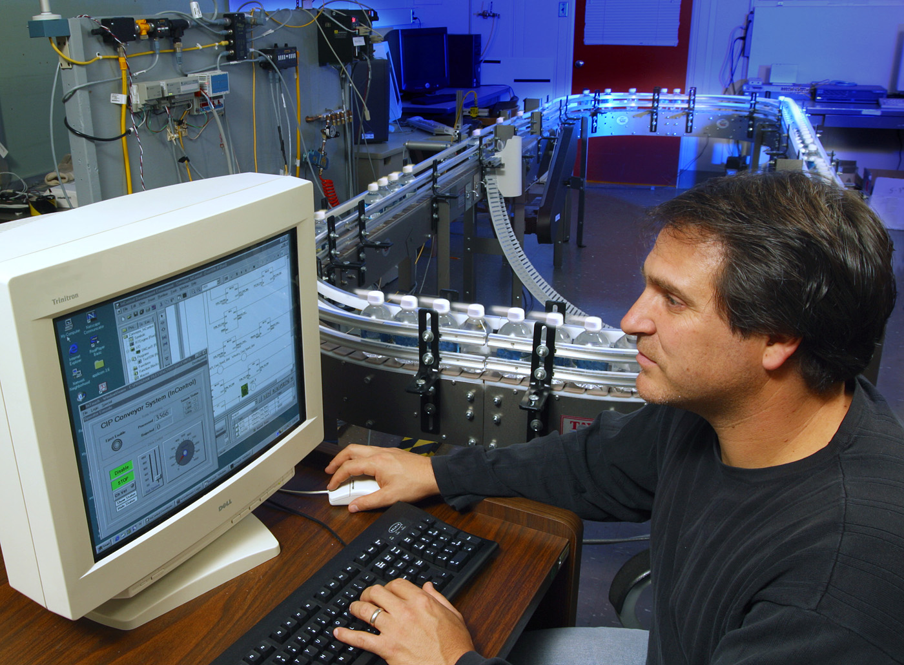
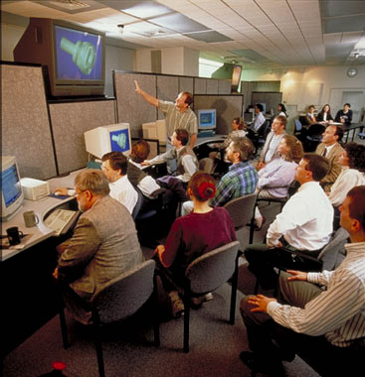
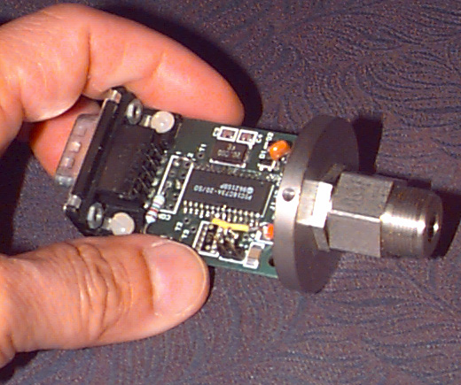
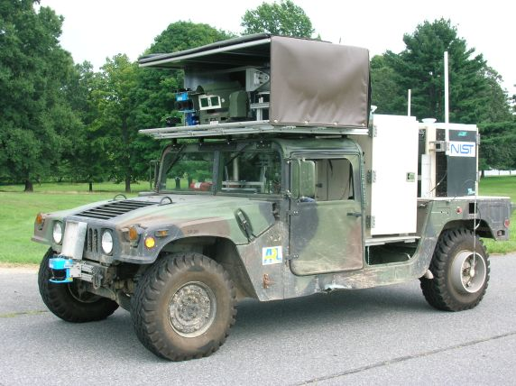
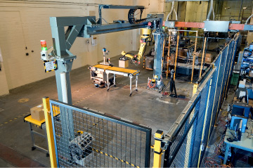
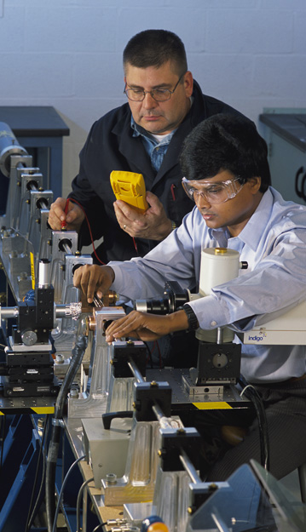
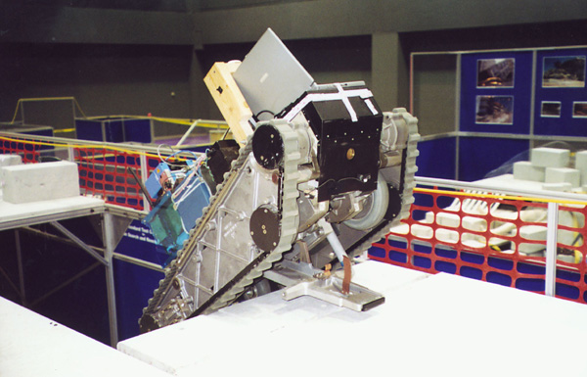
Manufacturing
Facilities
Industrial Control System
Networking and Security
Advanced Manufacturing
Systems and Networking
Smart and Wireless
Sensors Laboratory
Intelligent Mobility
Robotics in Manufacturing
and Safety
Reference Test Arenas for
Search and Bomb
Disposal Robots
Pulse-Heated Kolsky Bar Facility
Notes:
Another class of facility we employ are testbeds
Where developing standards can be tested in a neutral, well-defined environment
• Reference Test Arenas for Search and Bomb Disposal Robots
–The world-standard obstacle course for testing urban search and rescue, and now bomb disposal robots. Drives the development of mobile robot agility, sensing, navigation, and mapping capabilities.
•Advanced Manufacturing Systems and Networking Testbed
–A distributed, collaborative, environment for developing and testing manufacturing integration specifications
• Industrial Control System Networking and Security Testbed
– A neutral testing facility to evaluate the performance and security of industrial control systems and networks
• SCADA/Industrial Control System Security Guide to help industrial control system users understand security issues
• System-level IT security requirements document for control systems to help control system users know what security capabilities to ask for…and to help control system vendors know what to build into their products
• Antivirus performance testing guide to help control system users configure their antivirus software
•Intelligent Mobility Testbed
– Autonomous off-road and on-road vehicles and test course to promote innovation in intelligent vehicles and unmanned systems
• define, specify, measure, and evaluate intelligent vehicle system performance and capabilities
•Technology Readiness Level 6 experiments of Autonomous Mobility for Army
•Performance measures, Ref./Standards, technology, and tools for National Unmanned Systems
•A testbed that supports the evaluation and refinement of advanced technology needed for an autonomous mobility including route reconnaissance mission
•help build next-generation unmanned systems
•Demonstrated value and dramatic potential to save lives, improve performance and safety, provide new capabilities
B2B ･One report states that imperfect interoperability imposes $1B/year on members of the U.S. supply chain

Slide 12



Key Drivers for Change in Construction
Energy independence, environmental security, and sustainability
Renewal of Nation’s aging physical infrastructure
Demand for better quality, faster, and less costly construction
Competition due to globalization
and offshoring
Homeland security and disaster resilience

Slide 13


Key Barriers to Change in Construction
Declining industry level productivity; pockets of improvement and significant waste; marginal metrics
Industry fragmentation
Minimum first-cost mindset precludes lower-cost investment options based on life-cycle performance
Prescriptive standards and codes stifle innovation and competitiveness
Low profit margins and R&D investment

Slide 14








NIST Partnerships with the Construction and Building Industry
Board of Advisors
Breakthrough Strategy Committee
Benchmarking and Metrics Committee
Cost of Inadequate Interoperability Study
Workshops and Conferences
Research Teams
Capital Projects Technology Roadmap
Cost of Inadequate Interoperability Study
Automating Equipment Information Exchange
Intelligent and Automated Construction Job Site
Building Information Modeling
Workshops and Conferences
Building and Fire Codes and Standards
Technical Guidelines
Measurement Techniques
Performance Prediction Tools
Committees, Councils, and Boards
Workshops and Conferences
Collaborative Research
Publications
Working Groups
(Conceived by CII and NIST in 1999)

Slide 15





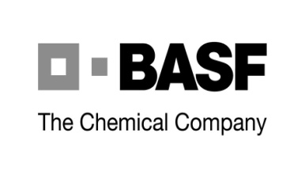




























Sampling of Industry Partners

Slide 16



































Representative EL Manufacturing Customers & Collaborators
Agilent
Notes:
Opportunities to collaborate in areas of mutual interest
WE OFFER THESE CUSTOMERS
The results of our research
Access to world-class expertise and facilities in our core competencies
Fee-for-service measurement services
Neutral venues and technical assistance for industry groups to develop tests and standards
Representation of U.S. Industry interests in National and International Standards Committees
While NIST has world-class researchers, we’re not an academic institution. We have many collaborators throughout industry, government and academia. However, our focus is on industry and we have industry partners across most all industrial sectors.
Almost everything we do—from planning and conducting our programs to evaluating its impact—is done in close cooperation with these folks—through industry roadmaps, trade groups, and workshops. This ensures that we deliver results that manufacturers need and use.

Slide 17




















Other Agency Partners

Slide 18
Success stories

Slide 19

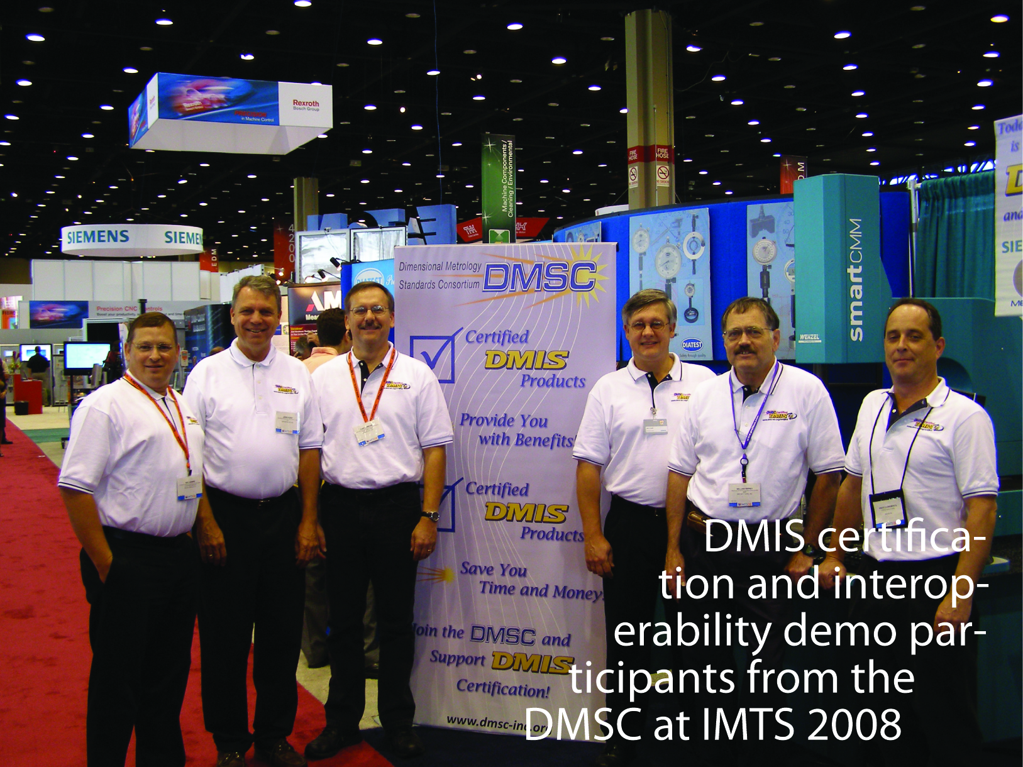
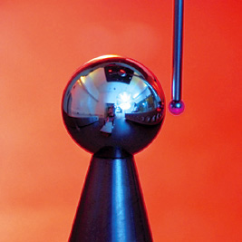
EL Makes Plug-and-Play a Reality
A new version of the DMIS standard, supporting new manufacturing technology,
makes it easier to integrate measurement systems with design and quality assurance
EL conformance tests ensure that new products from different vendors work well together
Dimensional Measurement Standards Consortium adopted NIST tests for certification of commercial products

Slide 20
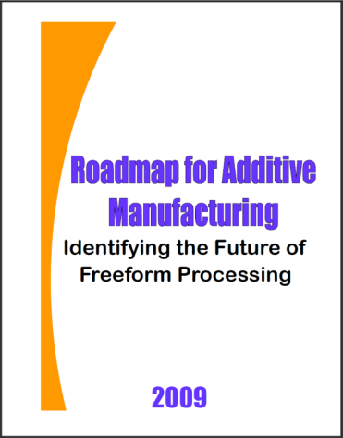
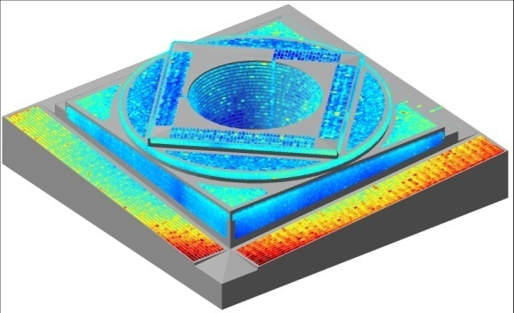
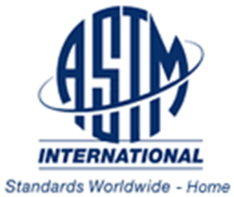
EL Confronts Challenges in Metal-Based Additive Manufacturing
Rapid art-to-part capability of fabricating
complex structures – revolutionary potential
Key barriers in the widespread adoption of metal-based additive processes
  part accuracy
  surface finish
  process certification
  data formats
  process speed
EL:
  Identified barriers and research needs
  Evaluated research on machine/process performance
  Helped form Standards Committee F42 on Additive Manufacturing Technologies (founded 2009)

Slide 21

New Security Guidance and Standards for Industrial
Control Systems
U.S. Manufacturers need safe, secure,
and reliable industrial control systems (ICS)
The NIST led SP 800-53 Recommended Security Controls for Federal Information Systems, Revision 3 standardizes the security controls for federally owned/operated ICS
  SP 800-53 the only, security standard that addresses both general IT systems and ICS
  Allows agencies to meet Federal IT security requirements in Industrial Control System environments
  SP800-53 has been downloaded over 1,250,000 times since initial release (February 2009)
Impacts private sector ICS security

Slide 22
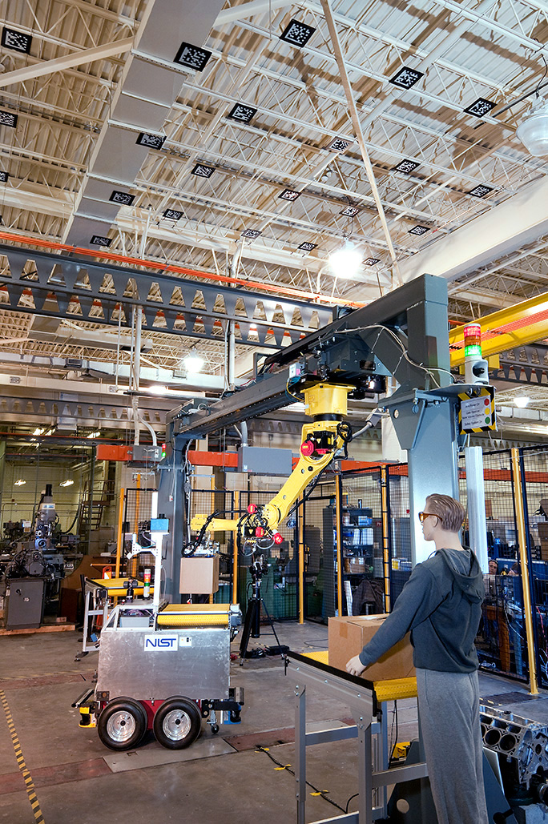
Robot Safety Standards: Facilitating Innovation and New Capabilities
Safety innovation identified by industry as as their most important robot standards issue
EL lead role in developing a Technical Specification for robot safety standard to allow safe human-robot collaboration (ISO 10218)
EL contributing new standard on safety requirements for non-medical and personal care robots and robotic devices (ISO 13482)
Notes:
EL leadership was instrumental in the adoption of new Robot safety standards that will promote the adoption of automated guided industrial vehicles in an industrial environment
Earlier versions of the safety standards required physical contact with the vehicle bumper to be actuated
EL conducted experiments and collected extensive data with new classes of non-contact (optical) sensors to build user and developer confidence in the viability and advantage of this new approach
As a result of this new standard, AGVs can be: shorter in length allowing tighter turning radii, have smart safety “slow” and “stop” zones, and move faster
Non-contact sensors also advance the material handling industry with safe and intelligent vehicle navigation

Slide 23

EL Tackles Automotive Industry’s Multi-million Dollar Logistics Problems
Current paper-based information exchange
systems causing serious logistics problems
  80% of OEMs don’t know when shipments
  leave a foreign port
  Both OEMs and suppliers carry excess inventory, as much as 30 days
  Air freight often used to expedite critical shipments
EL developed infrastructure for electronic logistics information system and tested it on international battery shipment to GM
Cost/Benefit Analysis showed potential
significant savings including
  Up to $10M in ongoing savings for each OEM
  Up to $50M reduction of working capital for each OEM
  An internal rate of return of 400% and a payback of 3 months

Slide 24
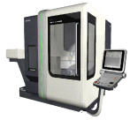
EL Simulation Enables Manufacturing Sustainability Analysis
Collecting, analyzing, and managing manufacturing sustainability related information is difficult
  Data comes from various sources and in different formats
  Lack of analysis tools
  Lack of standardized sustainability metrics
EL developed a sustainability simulation model provided proof of concept on an actual Boeing work cell, integrating a machine tool data source with EL simulation model via MTConnect data standard
Modest opportunities for energy savings, however, the simulation revealed a resource bottleneck in the operation
Simulation provides a low-risk way to explore effects of changes
without impacting daily operations
Machine
Data
HTTP/
Filter
Formatted
Discrete
Simulation
XML
XML
Data
Event
Output
&
Simulation
Agent
Client
Translator
(e.g., ED)
Analysis

Slide 25
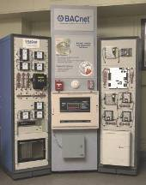

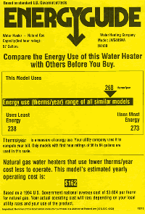
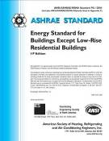
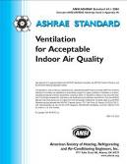
Success Stories
Building Automation and Control – enabling energy savings, reduced operating costs, and improved occupant comfort and safety via BACnet standard for integration of building automation and control systems adopted by ISO, CEN, and over 30 countries
Energy Efficiency of Appliances – enabling energy savings, reduced operating costs, and consumer awareness via standard DOE testing and rating procedures for HVAC, water heaters, and appliances
Indoor Air Quality – enabling indoor air quality by providing minimum threshold standards for ventilation while ensuring efficient use of energy resources in buildings nationwide
Renewable Energy – enabling use of solar equipment through test method and rating procedure development that forms the basis of industry (Solar Rating and Certification Corporation) certification programs
Sustainability Assessment – enabling science-based selection of cost-effective, environmentally preferable building products through incorporation in major U.S. “green building” rating systems

Slide 26
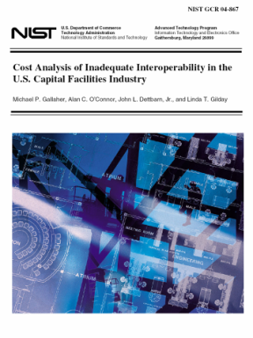
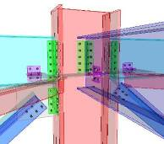
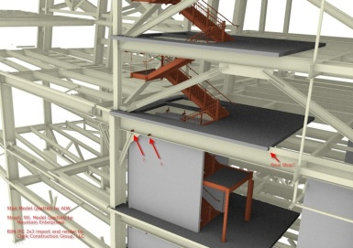
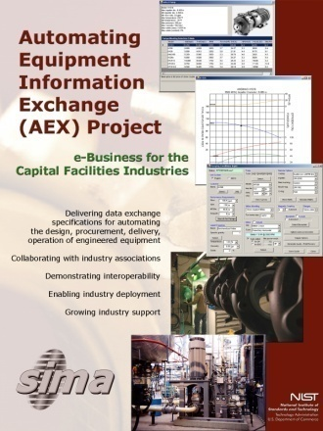
Success Stories
Interoperability in the U.S. Construction Industry – catalyzed industry to action on addressing interoperability through an authoritative analysis of costs to industry and the country
Assembly of Manufactured Parts for Construction – enabling improved engineering productivity through international data exchange standards
Engineering and Fabrication of Equipment and Components Used in Constructed Facilities – enabling improved engineering and fabrication productivity through emerging industry standards
Engineering and Construction of Buildings – enabling improved engineering and construction productivity through emerging test suites, guidelines, and industry standards

Slide 27


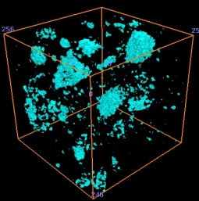

Success Stories
Development of the NIST Sphere – first weathering apparatus in which essentially all experimental and systematic errors have been eliminated from laboratory experiments.
Derivation and validation of scientifically-based models for linking field and laboratory experimental results and predicting field performance of polymers – first demonstration that models derived from laboratory results can be used in predicting field performance of a polymeric material.
Doubling the Service Life of Concrete: Concrete microstructure models and electrical/diffusive transport algorithms accurately predict the dependence of transport properties on pore structure leading to insight that ionic diffusion rates through concrete could be remarkably reduced by affecting the fluid-filled pore space, rather than the solid matrix.
Discovery of universal mechanism of nanocomposite flammability reduction – nanoparticles act as heat shields radiating incident radiation away from the polymer.

Slide 28
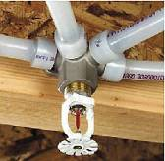


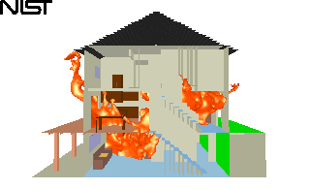
Success Stories
Smoke Alarm Standards – enabling a 50 percent reduction in U.S. fire death rate from the mid-1970’s via smoke alarm standards
Mattress Flammability and Cigarette Ignition – enabling reduction in smoking related fires and unsafe mattresses through widely adopted standard test methods for reduced-ignition-propensity cigarettes and mattress flammability
Fire Fighter Protective Equipment – enabling safer and more effective fire fighting through performance metrics and standards for thermal imagers and personal alert safety systems and positive-pressure ventilation techniques for fire fighting
Automatic Fire Sprinkler Standards – enabling reductions in loss of life and property due to fire by developing the only installation and design standard for residential sprinkler systems
Fire Dynamics Models – enabling transformation from prescriptive to performance standards through tools to predict the spread of fire, smoke, and toxic products
Heat and Visible Smoke Release Measurements – enabling fundamental heat release rate measurements worldwide via improved standard test method

Slide 29

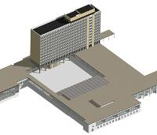
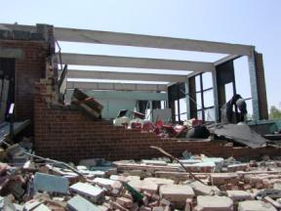
Success Stories
Fire Resistance of Concrete Construction – enabling use of high-strength concrete in building construction
Innovative Connection for Precast Concrete Buildings – enabling use of precast concrete construction in high seismic regions through significant cost savings
Enhanced Fujita Tornado Intensity Scale – nationwide adoption of new scale which more realistically relates observed damage to wind speeds

Slide 30
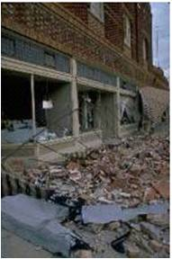

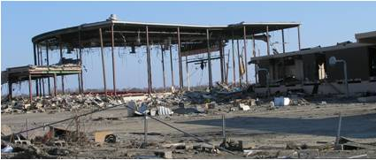
Success Stories
Lead Agency for the National Earthquake Hazard Reduction Program (NEHRP) – the Federal government’s coordinated long-term nationwide program to reduce risks to life and property in the U.S. from earthquakes
Federal Building and Fire Safety Investigation of the World Trade Center Disaster – enabling enhanced safety of buildings, occupants, and emergency responders through scientific advances in predicting the performance of complex building systems and in understanding evacuation and emergency response procedures during extreme events
Reconnaissance of Physical Structures Following Hurricanes Katrina and Rita – enabling enhanced safety of major buildings, physical infrastructure, and residential structures through adoption and enforcement of model building codes and standards and risk-based storm surge maps to reduce losses due to catastrophic hurricanes

Slide 31
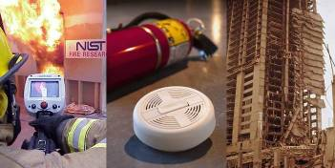
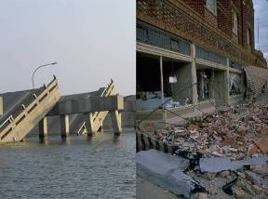
Improving the Quality of Life…
Construction Strategies to Avoid Progressive Collapse – enabling owners, engineers and building officials to prevent collapse through risk-informed planning and design of structures
Smoke Detector Nuisance Alarm Tests – enabling design of next-generation “smart” units to accurately distinguish unwanted fire conditions from nuisance conditions
Building and Fire Safety
Earthquake and Hurricane Safety Research
Enhanced Fujita Tornado Intensity Scale – nationwide adoption of new scale which more realistically relates observed damage to wind speeds
Lead Agency for the National Earthquake Hazards Reduction Program (NEHRP) - the Federal government's coordinated long-term nationwide program to reduce risks to life and property in the U.S. from earthquakes

Slide 32
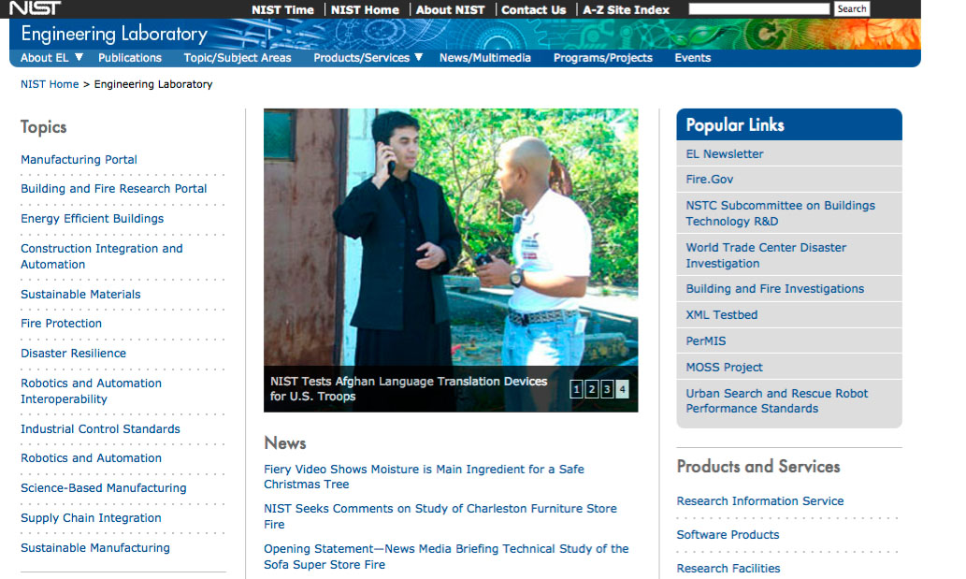
Contact
Info
Shyam Sunder
Director
301 975 5900
sivaraj.shyam-sunder@nist.gov
The NIST Engineering Laboratory
100 Bureau Drive Stop 8600
Gaithersburg, MD 20899-8600
www.nist.gov/el

Slide 33
NIST level and Back-up slides

Slide 34

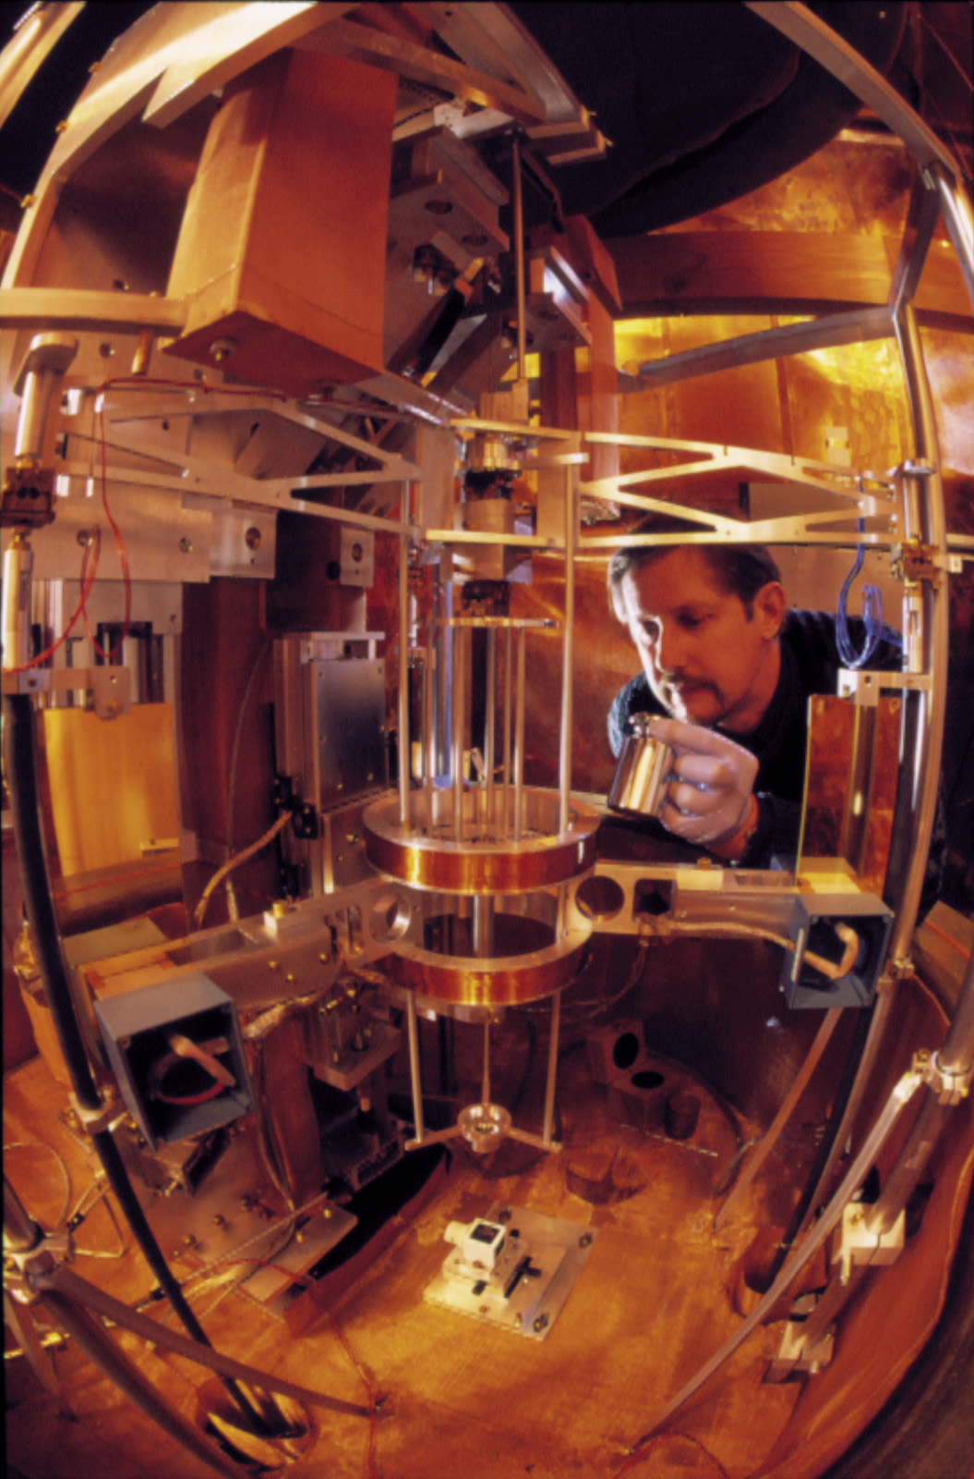
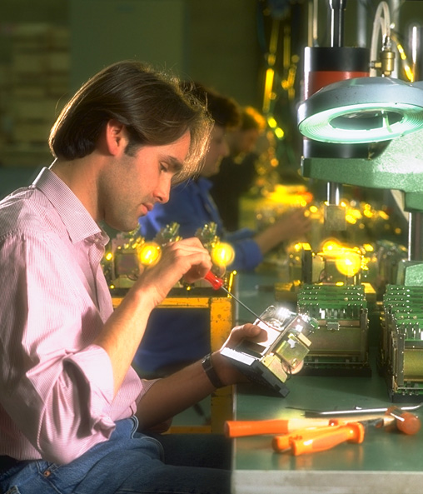

National Institute of
Standards and Technology
Develop and promote measurement, standards, and technology to enhance productivity, facilitate trade, and improve the quality of life.
NIST carries out its mission through a
portfolio of four programs:
Laboratories
Technology Innovation Program
Manufacturing Extension Partnership
Baldrige National
Quality

Slide 35

NIST Laboratories

Slide 36
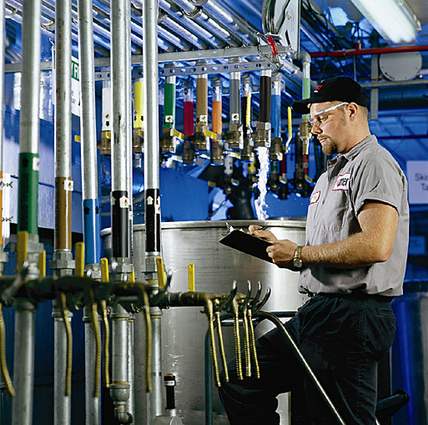

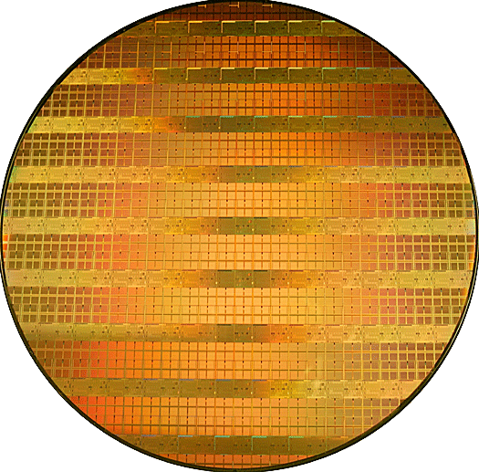
NIST Extramural Programs
Hollings Manufacturing Extension Partnership
  Nationwide network of resources helping smaller manufacturers compete globally
Baldrige National Quality Program
  Promoting and recognizing performance excellence via information and Presidential awards in manufacturing, service, small business, education, health care, and the nonprofit sector
Technology Innovation Program
  Supports development of cutting edge technologies by the private sector and
  universities to address critical national
  needs and key societal challenges
Courtesy Stoner Inc.
Courtesy Steuben
Courtesy Intel Inc.

Slide 37
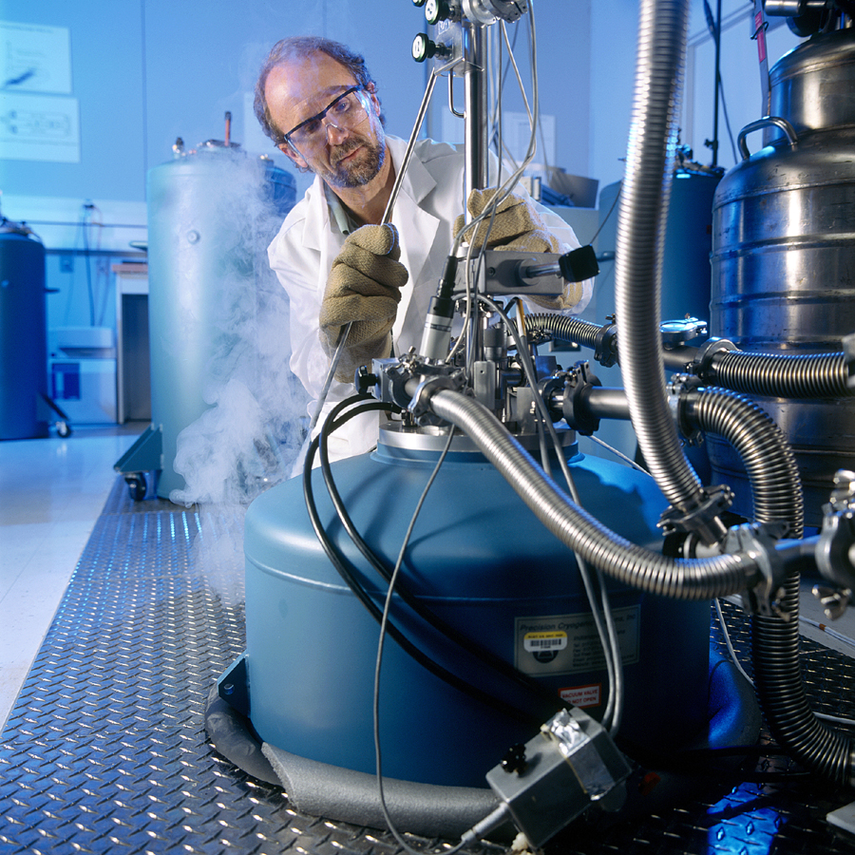

NIST Products and Services
Measurement Research
  2,000 publications per year
Standard Reference Data
  100 different types
  6,000 units sold per year
  25 million data downloads per year
Standard Reference Materials
  1,300 products available
  32,000 units sold per year
Calibration Tests
  18,000 tests per year
Laboratory Accreditation
  800 accreditations of testing and
  calibrations laboratories per year
© Robert Rathe

Slide 38
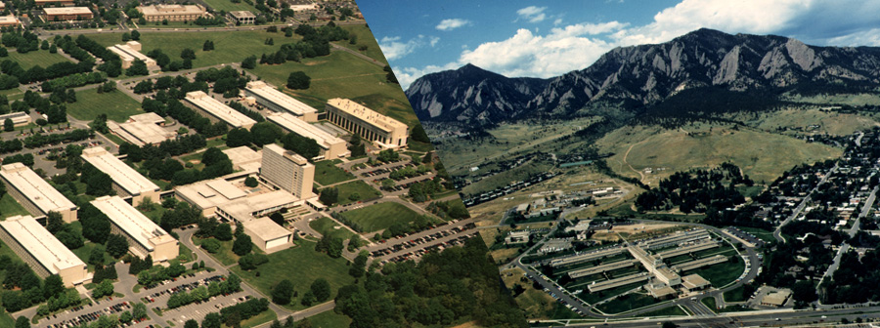
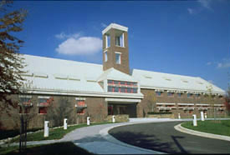


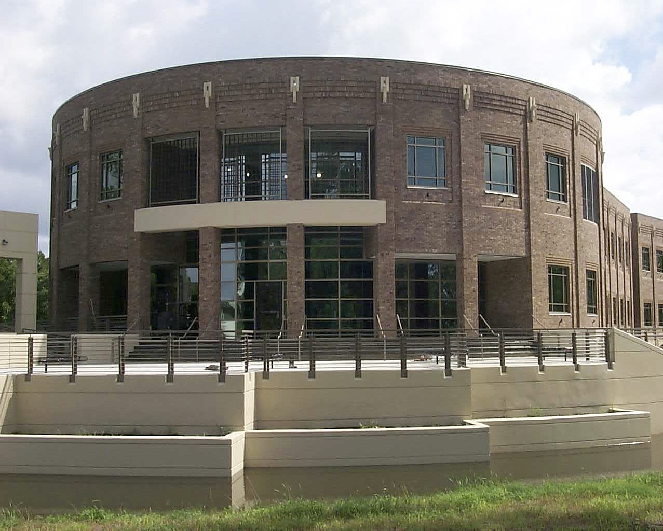
NIST Gaithersburg
NIST Boulder
Center for Advanced
Research in Biotechnology
JILA
Joint Quantum
Institute
Hollings Marine
Laboratory

