Slide 1
Communication-Avoiding Algorithms for Linear Algebra and Beyond
Jim Demmel
EECS & Math Departments
UC Berkeley
Notes:
1 hour including questions

Slide 2
Why avoid communication? (1/3)
Algorithms have two costs (measured in time or energy):
Arithmetic (FLOPS)
Communication: moving data between
  levels of a memory hierarchy (sequential case)
  processors over a network (parallel case).
CPU
Cache
CPU
DRAM
CPU
DRAM
DRAM
CPU
DRAM
CPU
DRAM

Slide 3
Why avoid communication? (2/3)
Running time of an algorithm is sum of 3 terms:
  # flops * time_per_flop
  # words moved / bandwidth
  # messages * latency
communication
Time_per_flop << 1/ bandwidth << latency
  Gaps growing exponentially with time [FOSC]
Avoid communication to save time
Annual improvements
Time_per_flop |  | Bandwidth | Latency
 | Network | 26% | 15%
 | DRAM | 23% | 5%
59%
Goal : reorganize algorithms to avoid communication
  Between all memory hierarchy levels
    L1 L2 DRAM network, etc
  Very large speedups possible
  Energy savings too!
Notes:
2008 DARPA Exascale report has similar prediction:
Gap between DRAM access time and flops will increase
100x over coming decade to balance power usage between
processors, DRAM
2011 NRC Report: “The Future of Computing Performance: Game Over or Next Level?”
Millett and Fuller

Slide 4
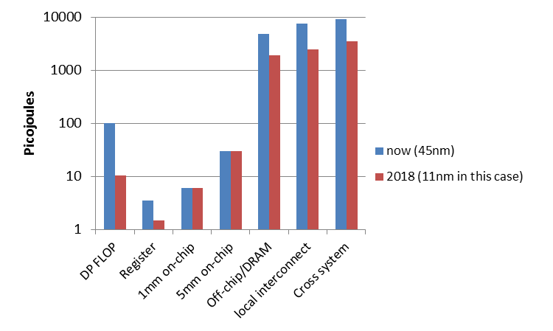
Why Minimize Communication? (3/3)
Source: John Shalf, LBL

Slide 5
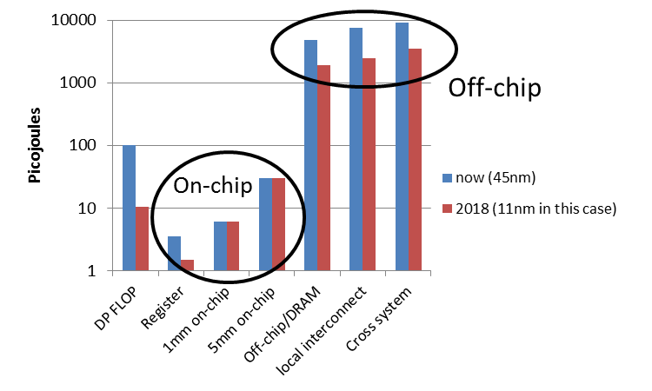
Why Minimize Communication? (3/3)
Minimize communication to save energy
Source: John Shalf, LBL

Slide 6
Goals
Redesign algorithms to avoid communication
  Between all memory hierarchy levels
    L1 L2 DRAM network, etc
Attain lower bounds if possible
  Current algorithms often far from lower bounds
  Large speedups and energy savings possible
Notes:
2008 DARPA Exascale report has similar prediction:
Gap between DRAM access time and flops will increase
100x over coming decade to balance power usage between
processors, DRAM

Slide 7
Sample Speedups
Up to 12x faster for 2.5D matmul on 64K core IBM BG/P
Up to 3x faster for tensor contractions on 2K core Cray XE/6
Up to 6.2x faster for APSP on 24K core Cray CE6
Up to 2.1x faster for 2.5D LU on 64K core IBM BG/P
Up to 11.8x faster for direct N-body on 32K core IBM BG/P
Up to 13x faster for TSQR on Tesla C2050 Fermi NVIDIA GPU
Up to 6.7x faster for symeig (band A) on 10 core Intel Westmere
Up to 2x faster for 2.5D Strassen on 38K core Cray XT4
Up to 4.2x faster for MiniGMG benchmark bottom solver, using CA-BiCGStab (2.5x for overall solve)
  2.5x / 1.5x for combustion simulation code

Slide 8
President Obama cites Communication-Avoiding Algorithms in the FY 2012 Department of Energy Budget Request to Congress:
“New Algorithm Improves Performance and Accuracy on Extreme-Scale Computing Systems. On modern computer architectures, communication between processors takes longer than the performance of a floating point arithmetic operation by a given processor. ASCR researchers have developed a new method, derived from commonly used linear algebra methods, to minimize communications between processors and the memory hierarchy, by reformulating the communication patterns specified within the algorithm. This method has been implemented in the TRILINOS framework, a highly-regarded suite of software, which provides functionality for researchers around the world to solve large scale, complex multi-physics problems.”
FY 2010 Congressional Budget, Volume 4, FY2010 Accomplishments, Advanced Scientific Computing Research (ASCR), pages 65-67.
CA-GMRES (Hoemmen, Mohiyuddin, Yelick, JD)
“Tall-Skinny” QR (Grigori, Hoemmen, Langou, JD)

Slide 9
Outline
Survey state of the art of CA (Comm-Avoiding) algorithms
  Review previous Matmul algorithms
  CA O(n³) 2.5D Matmul and LU
  TSQR: Tall-Skinny QR
  CA Strassen Matmul
Beyond linear algebra
  Extending lower bounds to any algorithm with arrays
  Communication-optimal N-body algorithm
CA-Krylov methods
Related Topics

Slide 10
Outline
Survey state of the art of CA (Comm-Avoiding) algorithms
  Review previous Matmul algorithms
  CA O(n³) 2.5D Matmul and LU
  TSQR: Tall-Skinny QR
  CA Strassen Matmul
Beyond linear algebra
  Extending lower bounds to any algorithm with arrays
  Communication-optimal N-body algorithm
CA-Krylov methods
Related Topics

Slide 11
Summary of CA Linear Algebra
“Direct” Linear Algebra
  Lower bounds on communication for linear algebra problems like Ax=b, least squares, Ax = λx, SVD, etc
  Mostly not attained by algorithms in standard libraries
  New algorithms that attain these lower bounds
    Being added to libraries: Sca/LAPACK, PLASMA, MAGMA
    Large speed-ups possible
  Autotuning to find optimal implementation
Ditto for “Iterative” Linear Algebra

Slide 12
Lower bound for all “n³-like” linear algebra
  Let M = “fast” memory size (per processor)
  #words_moved (per processor) = Ω(#flops (per processor) / M^{1/2} )
  #messages_sent (per processor) = Ω(#flops (per processor) / M^{3/2} )
  Parallel case: assume either load or memory balanced
Holds for
  Matmul, BLAS, LU, QR, eig, SVD, tensor contractions, …
  Some whole programs (sequences of these operations, no matter how individual ops are interleaved, eg A^{k})
  Dense and sparse matrices (where #flops << n³ )
  Sequential and parallel algorithms
  Some graph-theoretic algorithms (eg Floyd-Warshall)

Slide 13
Lower bound for all “n³-like” linear algebra
  Let M = “fast” memory size (per processor)
  #words_moved (per processor) = Ω(#flops (per processor) / M^{1/2} )
  #messages_sent ≥ #words_moved / largest_message_size
  Parallel case: assume either load or memory balanced
Holds for
  Matmul, BLAS, LU, QR, eig, SVD, tensor contractions, …
  Some whole programs (sequences of these operations, no matter how individual ops are interleaved, eg A^{k})
  Dense and sparse matrices (where #flops << n³ )
  Sequential and parallel algorithms
  Some graph-theoretic algorithms (eg Floyd-Warshall)
Notes:
APSP talk Tuesday, session 12, Edgar Solomonik, Aydin Buluc

Slide 14
Lower bound for all “n³-like” linear algebra
  Let M = “fast” memory size (per processor)
  #words_moved (per processor) = Ω(#flops (per processor) / M^{1/2} )
  #messages_sent (per processor) = Ω(#flops (per processor) / M^{3/2} )
  Parallel case: assume either load or memory balanced
Holds for
  Matmul, BLAS, LU, QR, eig, SVD, tensor contractions, …
  Some whole programs (sequences of these operations, no matter how individual ops are interleaved, eg A^{k})
  Dense and sparse matrices (where #flops << n³ )
  Sequential and parallel algorithms
  Some graph-theoretic algorithms (eg Floyd-Warshall)
SIAM SIAG/Linear Algebra Prize, 2012
Ballard, D., Holtz, Schwartz

Slide 15
Can we attain these lower bounds?
Do conventional dense algorithms as implemented in LAPACK and ScaLAPACK attain these bounds?
  Often not
If not, are there other algorithms that do?
  Yes, for much of dense linear algebra, APSP
  New algorithms, with new numerical properties, new ways to encode answers, new data structures
  Not just loop transformations (need those too!)
Only a few sparse algorithms so far
  Ex: Matmul of “random” sparse matrices
  Ex: Sparse Cholesky of matrices with “large” separators
Lots of work in progress
Notes:
Dense linear algebra: Mention Floyd-Warshall APSP
Sparse: depends on George, Rose, Tarjan
Eg if graph of matrix is n x n mesh, so all separators of size Omega(n)

Slide 16
Outline
Survey state of the art of CA (Comm-Avoiding) algorithms
  Review previous Matmul algorithms
  CA O(n³) 2.5D Matmul and LU
  TSQR: Tall-Skinny QR
  CA Strassen Matmul
Beyond linear algebra
  Extending lower bounds to any algorithm with arrays
  Communication-optimal N-body algorithm
CA-Krylov methods
Related Topics

Slide 17
Naïve Matrix Multiply
{implements C = C + A*B}
for i = 1 to n
for j = 1 to n
for k = 1 to n
C(i,j) = C(i,j) + A(i,k) * B(k,j)
C(i,j)
C(i,j)
A(i,:)
=
+
*
B(:,j)

Slide 18
Naïve Matrix Multiply
{implements C = C + A*B}
for i = 1 to n
{read row i of A into fast memory}
for j = 1 to n
{read C(i,j) into fast memory}
{read column j of B into fast memory}
for k = 1 to n
C(i,j) = C(i,j) + A(i,k) * B(k,j)
{write C(i,j) back to slow memory}
C(i,j)
C(i,j)
A(i,:)
=
+
*
B(:,j)

Slide 19
Naïve Matrix Multiply
{implements C = C + A*B}
for i = 1 to n
{read row i of A into fast memory} … n² reads altogether
for j = 1 to n
{read C(i,j) into fast memory} … n² reads altogether
{read column j of B into fast memory} … n³ reads altogether
for k = 1 to n
C(i,j) = C(i,j) + A(i,k) * B(k,j)
{write C(i,j) back to slow memory} … n² writes altogether
C(i,j)
C(i,j)
A(i,:)
=
+
*
B(:,j)
n³ + 3n² reads/writes altogether – dominates 2n³ arithmetic

Slide 20
Blocked (Tiled) Matrix Multiply
Consider A,B,C to be n/b-by-n/b matrices of b-by-b subblocks where b is called the block size; assume 3 b-by-b blocks fit in fast memory
for i = 1 to n/b
for j = 1 to n/b
{read block C(i,j) into fast memory}
for k = 1 to n/b
{read block A(i,k) into fast memory}
{read block B(k,j) into fast memory}
C(i,j) = C(i,j) + A(i,k) * B(k,j) {do a matrix multiply on blocks}
{write block C(i,j) back to slow memory}
C(i,j)
C(i,j)
A(i,k)
b-by-b
block
=
+
*
B(k,j)

Slide 21
Blocked (Tiled) Matrix Multiply
Consider A,B,C to be n/b-by-n/b matrices of b-by-b subblocks where b is called the block size; assume 3 b-by-b blocks fit in fast memory
for i = 1 to n/b
for j = 1 to n/b
{read block C(i,j) into fast memory} … b² × (n/b)² = n² reads
for k = 1 to n/b
{read block A(i,k) into fast memory} … b² × (n/b)³ = n³/b reads
{read block B(k,j) into fast memory} … b² × (n/b)³ = n³/b reads
C(i,j) = C(i,j) + A(i,k) * B(k,j) {do a matrix multiply on blocks}
{write block C(i,j) back to slow memory} … b² × (n/b)² = n² writes
C(i,j)
C(i,j)
A(i,k)
b-by-b
block
=
+
*
B(k,j)
2n³/b + 2n² reads/writes << 2n³ arithmetic - Faster!

Slide 22
Does blocked matmul attain lower bound?
Recall: if 3 b-by-b blocks fit in fast memory of size M, then #reads/writes = 2n³/b + 2n²
Make b as large as possible: 3b² ≤ M, so #reads/writes ≥ 3^{1/2}n³/M^{1/2} + 2n²
Attains lower bound = Ω (#flops / M^{1/2} )
But what if we don’t know M?
Or if there are multiple levels of fast memory?
Can use “Cache Oblivious” algorithm

Slide 23
Recursive Matrix Multiplication (RMM) (1/2)
For simplicity: square matrices with n = 2^{m}
C = = A · B = · ·
=
True when each A_{ij} etc 1x1 or n/2 x n/2
C₁₁ C₁₂ C₂₁ C₂₂
A₁₁ A₁₂ A₂₁ A₂₂
B₁₁ B₁₂ B₂₁ B₂₂
A₁₁·B₁₁ + A₁₂·B₂₁ A₁₁·B₁₂ + A₁₂·B₂₂ A₂₁·B₁₁ + A₂₂·B₂₁ A₂₁·B₁₂ + A₂₂·B₂₂
func C = RMM (A, B, n)
if n = 1, C = A * B, else
{ C₁₁ = RMM (A₁₁ , B₁₁ , n/2) + RMM (A₁₂ , B₂₁ , n/2)
C₁₂ = RMM (A₁₁ , B₁₂ , n/2) + RMM (A₁₂ , B₂₂ , n/2)
C₂₁ = RMM (A₂₁ , B₁₁ , n/2) + RMM (A₂₂ , B₂₁ , n/2)
C₂₂ = RMM (A₂₁ , B₁₂ , n/2) + RMM (A₂₂ , B₂₂ , n/2) }
return

Slide 24
Recursive Matrix Multiplication (RMM) (2/2)
func C = RMM (A, B, n)
if n=1, C = A * B, else
{ C₁₁ = RMM (A₁₁ , B₁₁ , n/2) + RMM (A₁₂ , B₂₁ , n/2)
C₁₂ = RMM (A₁₁ , B₁₂ , n/2) + RMM (A₁₂ , B₂₂ , n/2)
C₂₁ = RMM (A₂₁ , B₁₁ , n/2) + RMM (A₂₂ , B₂₁ , n/2)
C₂₂ = RMM (A₂₁ , B₁₂ , n/2) + RMM (A₂₂ , B₂₂ , n/2) }
return
For big speedups, see SC12 poster on “Beating MKL and ScaLAPACK at Rectangular Matmul” 11/13 at 5:15-7pm
A(n) = # arithmetic operations in RMM( . , . , n)
= 8 · A(n/2) + 4(n/2)² if n > 1, else 1
= 2n³ … same operations as usual, in different order
W(n) = # words moved between fast, slow memory by RMM( . , . , n)
= 8 · W(n/2) + 12(n/2)² if 3n² > M , else 3n²
= O( n³ / M^{1/2} + n² ) … same as blocked matmul
“Cache oblivious”, works for memory hierarchies, but not panacea
Notes:
Big speedups for very rectangular matrices
Speedups are for very rectangular matrices, not square

Slide 25
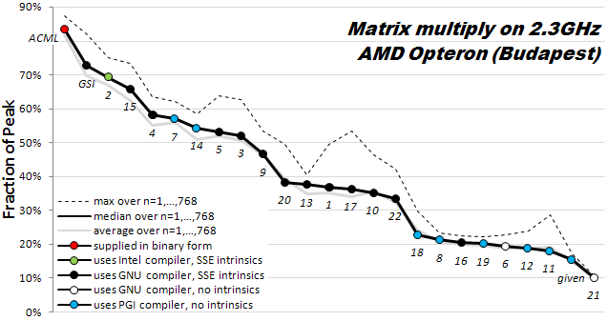
How hard is hand-tuning matmul, anyway?
Results of 22 student teams trying to tune matrix-multiply, in CS267 Spr09
Students given “blocked” code to start with (7x faster than naïve)
  Still hard to get close to vendor tuned performance (ACML) (another 6x)
For more discussion, see www.cs.berkeley.edu/~volkov/cs267.sp09/hw1/results/

Slide 26
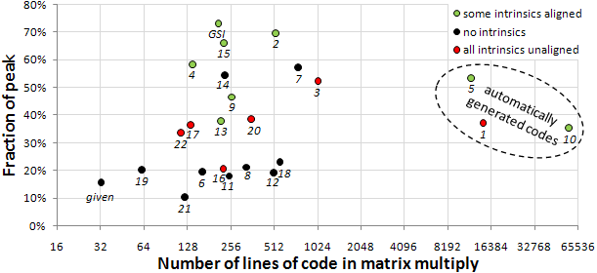
How hard is hand-tuning matmul, anyway?

Slide 27
SUMMA– n x n matmul on P^{1/2} x P^{1/2} grid
(nearly) optimal using minimum memory M=O(n²/P)
Using more than the minimum memory
What if matrix small enough to fit c>1 copies, so M = cn²/P ?
  #words_moved = Ω( #flops / M^{1/2} ) = Ω( n² / ( c^{1/2} P^{1/2} ))
  #messages = Ω( #flops / M^{3/2} ) = Ω( P^{1/2} /c^{3/2})
Can we attain new lower bound?
k
j
B(k,j)
k
*
=
Brow
i
C(i,j)
For k=0 to n-1 … or n/b-1 where b is the block size
… = # cols in A(i,k) and # rows in B(k,j)
for all i = 1 to p_{r} … in parallel
owner of A(i,k) broadcasts it to whole processor row
for all j = 1 to p_{c} … in parallel
owner of B(k,j) broadcasts it to whole processor column
Receive A(i,k) into Acol
Receive B(k,j) into Brow
C_myproc = C_myproc + Acol * Brow
A(i,k)
Acol
For k=0 to n/b-1 … b = block size = #cols in A(i,k) = #rows in B(k,j)
for all i = 1 to P^{1/2}
owner of A(i,k) broadcasts it to whole processor row (using binary tree)
for all j = 1 to P^{1/2}
owner of B(k,j) broadcasts it to whole processor column (using bin. tree)
Receive A(i,k) into Acol
Receive B(k,j) into Brow
C_myproc = C_myproc + Acol * Brow

Slide 28
Summary of dense parallel algorithms attaining communication lower bounds
Assume nxn matrices on P processors
Minimum Memory per processor = M = O(n² / P)
Recall lower bounds:
  #words_moved = Ω( (n³/ P) / M^{1/2} ) = Ω( n² / P^{1/2} )
  #messages = Ω( (n³/ P) / M^{3/2} ) = Ω( P^{1/2} )
Does ScaLAPACK attain these bounds?
  For #words_moved: mostly, except nonsym. Eigenproblem
  For #messages: asymptotically worse, except Cholesky
New algorithms attain all bounds, up to polylog(P) factors
  Cholesky, LU, QR, Sym. and Nonsym eigenproblems, SVD
Can we do Better?
Notes:
ScaLAPACK assumes best block size chosen
Many references, blue are ours
LU: uses tournament pivoting, different stability, speedup up to 29X predicted on exascale
QR uses TSQR, speedup up to 8x on Intel Clovertown, 13x on Tesla, up on cloud
Symeig uses variant of SBR, speedup up to 30x on AMD Magny-Cours, vs ACML 4.4
n=12000, b=500, 6 threads
Nonsymeig, uses randomization in two ways

Slide 29
Can we do better?
Aren’t we already optimal?
Why assume M = O(n²/p), i.e. minimal?
  Lower bound still true if more memory
  Can we attain it?
Special case: “3D Matmul”
  Uses M = O(n²/p^{2/3} )
  Dekel, Nassimi, Sahni [81], Bernsten [89], Agarwal, Chandra, Snir [90], Johnson [93], Agarwal, Balle, Gustavson, Joshi, Palkar [95]
Not always p^{1/3} times as much memory available…
Notes:
Uses P^(1/3) as much memory as minimal

Slide 30
Can we do better?
Aren’t we already optimal?
Why assume M = O(n²/p), i.e. minimal?
  Lower bound still true if more memory
  Can we attain it?
Special case: “3D Matmul”
  Uses M = O(n²/p^{2/3} )
  Dekel, Nassimi, Sahni [81], Bernsten [89], Agarwal, Chandra, Snir [90], Johnson [93], Agarwal, Balle, Gustavson, Joshi, Palkar [95]
  Processors arranged in p^{1/3} x p^{1/3} x p^{1/3} grid
  Processor (i,j,k) performs C(i,j) = C(i,j) + A(i,k)*B(k,j), where each submatrix is n/p^{1/3} x n/p^{1/3}
Not always that much memory available…
Notes:
Uses P^(1/6) as much memory as minimal

Slide 31
Outline
Survey state of the art of CA (Comm-Avoiding) algorithms
  Review previous Matmul algorithms
  CA O(n³) 2.5D Matmul and LU
  TSQR: Tall-Skinny QR
  CA Strassen Matmul
Beyond linear algebra
  Extending lower bounds to any algorithm with arrays
  Communication-optimal N-body algorithm
CA-Krylov methods
Related Topics

Slide 32
2.5D Matrix Multiplication
Assume can fit cn²/P data per processor, c > 1
Processors form (P/c)^{1/2} x (P/c)^{1/2} x c grid
(P/c)^{1/2}
(P/c)^{1/2}
Example: P = 32, c = 2
c

Slide 33
2.5D Matrix Multiplication
Assume can fit cn²/P data per processor, c > 1
Processors form (P/c)^{1/2} x (P/c)^{1/2} x c grid
j
i
Initially P(i,j,0) owns A(i,j) and B(i,j)
each of size n(c/P)^{1/2} x n(c/P)^{1/2}
k
(1) P(i,j,0) broadcasts A(i,j) and B(i,j) to P(i,j,k)
(2) Processors at level k perform 1/c-th of SUMMA, i.e. 1/c-th of Σ_{m} A(i,m)*B(m,j)
(3) Sum-reduce partial sums Σ_{m} A(i,m)*B(m,j) along k-axis so P(i,j,0) owns C(i,j)

Slide 34
2.5D Matmul on BG/P, 16K nodes / 64K cores

Slide 35
2.5D Matmul on BG/P, 16K nodes / 64K cores
c = 16 copies
2.7x faster
12x faster
Distinguished Paper Award, EuroPar’11 (Solomonik, D.)
SC’11 paper by Solomonik, Bhatele, D.
Notes:
SC’11 paper about need to fully utilize 3D torus network on BG/P to get this to work

Slide 36
2.5D Matmul on BG/P, 16K nodes / 64K cores
c = 16 copies
2.7x faster
Ideas adopted by Nervana, “deep learning” startup,
acquired by Intel in August 2016
12x faster
Distinguished Paper Award, EuroPar’11 (Solomonik, D.)
SC’11 paper by Solomonik, Bhatele, D.
Notes:
SC’11 paper about need to fully utilize 3D torus network on BG/P to get this to work
"Neural nets are based on similar computations, and some
of these ideas were adopted by a recent startup, Nervana
Systems, for which I am an adviser, and which was recently
acquired by Intel."

Slide 37
Perfect Strong Scaling – in Time and Energy
Every time you add a processor, you should use its memory M too
Start with minimal number of procs: PM = 3n²
Increase P by a factor of c ➔ total memory increases by a factor of c
Notation for timing model:
  γ_{T} , β_{T} , α_{T} = secs per flop, per word_moved, per message of size m
T(cP) = n³/(cP) [ γ_{T}+ β_{T}/M^{1/2} + α_{T}/(mM^{1/2}) ]
= T(P)/c
Notation for energy model:
  γ_{E} , β_{E} , α_{E} = joules for same operations
  δ_{E} = joules per word of memory used per sec
  ε_{E} = joules per sec for leakage, etc.
E(cP) = cP { n³/(cP) [ γ_{E}+ β_{E}/M^{1/2} + α_{E}/(mM^{1/2}) ] + δ_{E}MT(cP) + ε_{E}T(cP) }
= E(P)
Extends to N-body, Strassen, …
Can prove lower bounds on needed network (eg 3D torus for matmul)
Notes:
Can use these formulas to ask:
How to choose p and M to minimize energy needed for computation?
Given max allowed runtime T, how much energy do I need to achieve it?
Given max allowed energy E, what is the minimum runtime T I can attain?
Given target energy efficiency (Gflops/W), what architectural parameters
are needed to achieve it?
Talk by Andrew Gearhart, Session 14, today May 22

Slide 38
Perfect Strong Scaling – in Time and Energy (2/2)
T(cP) = n³/(cP) [ γ_{T}+ β_{T}/M^{1/2} + α_{T}/(mM^{1/2}) ] = T(P)/c
E(cP) = cP { n³/(cP) [ γ_{E}+ β_{E}/M^{1/2} + α_{E}/(mM^{1/2}) ] + δ_{E}MT(cP) + ε_{E}T(cP) } = E(P)
Perfect scaling extends to N-body, Strassen, …
We can use these models to answer many questions, including:
What is the minimum energy required for a computation?
Given a maximum allowed runtime T , what is the minimum energy E needed to achieve it?
Given a maximum energy budget E , what is the minimum runtime T that we can attain?
The ratio P = E/T gives us the average power required to run the algorithm. Can we minimize the average power consumed?
Given an algorithm, problem size, number of processors and target energy efficiency (GFLOPS/W), can we determine a set of architectural parameters to describe a conforming computer architecture?

Slide 39
2.5D vs 2D LU
With and Without Pivoting
Thm: Perfect Strong Scaling impossible, because
Latency*Bandwidth = Ω(n²)

Slide 40
Outline
Survey state of the art of CA (Comm-Avoiding) algorithms
  Review previous Matmul algorithms
  CA O(n³) 2.5D Matmul and LU
  TSQR: Tall-Skinny QR
  CA Strassen Matmul
Beyond linear algebra
  Extending lower bounds to any algorithm with arrays
  Communication-optimal N-body algorithm
CA-Krylov methods
Related Topics

Slide 41
TSQR: QR of a Tall, Skinny matrix
W₀
W₁
W₂
W₃
Q₀₀ R₀₀
Q₁₀ R₁₀
Q₂₀ R₂₀
Q₃₀ R₃₀
Q₀₀
Q₁₀
Q₂₀
Q₃₀
R₀₀
R₁₀
R₂₀
R₃₀
W =
=
=
.
R₀₀
R₁₀
R₂₀
R₃₀
Q₀₁ R₀₁
Q₁₁ R₁₁
Q₀₁
Q₁₁
R₀₁
R₁₁
=
=
.
R₀₁
R₁₁
=
Q₀₂ R₀₂

Slide 42
TSQR: QR of a Tall, Skinny matrix
W₀
W₁
W₂
W₃
Q₀₀ R₀₀
Q₁₀ R₁₀
Q₂₀ R₂₀
Q₃₀ R₃₀
Q₀₀
Q₁₀
Q₂₀
Q₃₀
R₀₀
R₁₀
R₂₀
R₃₀
W =
=
=
.
R₀₀
R₁₀
R₂₀
R₃₀
Q₀₁ R₀₁
Q₁₁ R₁₁
Q₀₁
Q₁₁
R₀₁
R₁₁
=
=
.
R₀₁
R₁₁
=
Q₀₂ R₀₂
Output = { Q₀₀, Q₁₀, Q₂₀, Q₃₀, Q₀₁, Q₁₁, Q₀₂, R₀₂ }

Slide 43
TSQR: An Architecture-Dependent Algorithm
W₀
W₁
W₂
W₃
R₀₀
R₁₀
R₂₀
R₃₀
R₀₁
Parallel:
W =
R₀₂
R₁₁
W₀
W₁
W₂
W₃
R₀₀
Sequential:
R₀₁
W =
R₀₂
R₀₃
W₀
W₁
W₂
W₃
R₀₀
R₀₁
Dual Core:
R₀₁
W =
R₀₂
R₁₁
R₀₃
R₁₁
Multicore / Multisocket / Multirack / Multisite / Out-of-core: ?
Can choose reduction tree dynamically
Notes:
Oldest reference for idea of tree: Golub/Plemmons/Sameh 1988,
But didn’t avoid communication

Slide 44
TSQR Performance Results
Parallel
  Intel Clovertown
    Up to 8x speedup (8 core, dual socket, 10M x 10)
  Pentium III cluster, Dolphin Interconnect, MPICH
    Up to 6.7x speedup (16 procs, 100K x 200)
  BlueGene/L
    Up to 4x speedup (32 procs, 1M x 50)
  Tesla C 2050 / Fermi
    Up to 13x (110,592 x 100)
  Grid – 4x on 4 cities vs 1 city (Dongarra, Langou et al)
  Cloud – 1.6x slower than just accessing data twice (Gleich and Benson)
Sequential
  “Infinite speedup” for out-of-core on PowerPC laptop
    As little as 2x slowdown vs (predicted) infinite DRAM
    LAPACK with virtual memory never finished
SVD costs about the same
Joint work with Grigori, Hoemmen, Langou, Anderson, Ballard, Keutzer, others
Data from Grey Ballard, Mark Hoemmen, Laura Grigori, Julien Langou, Jack Dongarra, Michael Anderson
Notes:
Transition: TSQR -> CAQR
Cloud: Hadoop and Python based Dumbo MapReduce interface on 40-core mapreduce cluster at Stanford

Slide 45
TSQR Performance Results
Parallel
  Intel Clovertown
    Up to 8x speedup (8 core, dual socket, 10M x 10)
  Pentium III cluster, Dolphin Interconnect, MPICH
    Up to 6.7x speedup (16 procs, 100K x 200)
  BlueGene/L
    Up to 4x speedup (32 procs, 1M x 50)
  Tesla C 2050 / Fermi
    Up to 13x (110,592 x 100)
  Grid – 4x on 4 cities vs 1 city (Dongarra, Langou et al)
  Cloud – 1.6x slower than just accessing data twice (Gleich and Benson)
Sequential
  “Infinite speedup” for out-of-core on PowerPC laptop
    As little as 2x slowdown vs (predicted) infinite DRAM
    LAPACK with virtual memory never finished
SVD costs about the same
Joint work with Grigori, Hoemmen, Langou, Anderson, Ballard, Keutzer, others
SIAG on Supercomputing Best Paper Prize, 2016
Data from Grey Ballard, Mark Hoemmen, Laura Grigori, Julien Langou, Jack Dongarra, Michael Anderson
Notes:
Transition: TSQR -> CAQR
Cloud: Hadoop and Python based Dumbo MapReduce interface on 40-core mapreduce cluster at Stanford

Slide 46
Outline
Survey state of the art of CA (Comm-Avoiding) algorithms
  Review previous Matmul algorithms
  CA O(n³) 2.5D Matmul
  TSQR: Tall-Skinny QR
  CA O(n³) 2.5D LU
  CA Strassen Matmul
Beyond linear algebra
  Extending lower bounds to any algorithm with arrays
  Communication-optimal N-body algorithm
CA-Krylov methods

Slide 47
Back to LU: Using similar idea for TSLU as TSQR:
Use reduction tree, to do “Tournament Pivoting”
W₁
W₂
W₃
W₄
P₁·L₁·U₁
P₂·L₂·U₂
P₃·L₃·U₃
P₄·L₄·U₄
Choose b pivot rows of W₁, call them W₁’
Choose b pivot rows of W₂, call them W₂’
Choose b pivot rows of W₃, call them W₃’
Choose b pivot rows of W₄, call them W₄’
W^{nxb} =
=
W₁’
W₂’
W₃’
W₄’
P₁₂·L₁₂·U₁₂
P₃₄·L₃₄·U₃₄
Choose b pivot rows, call them W₁₂’
Choose b pivot rows, call them W₃₄’
=
W₁₂’
W₃₄’
= P₁₂₃₄·L₁₂₃₄·U₁₂₃₄
Choose b pivot rows
Go back to W and use these b pivot rows
  Move them to top, do LU without pivoting
  Extra work, but lower order term
Thm: As numerically stable as Partial Pivoting on a larger matrix

Slide 48
Exascale Machine Parameters
Source: DOE Exascale Workshop
2^20 ≈ 1,000,000 nodes
1024 cores/node (a billion cores!)
100 GB/sec interconnect bandwidth
400 GB/sec DRAM bandwidth
1 microsec interconnect latency
50 nanosec memory latency
32 Petabytes of memory
1/2 GB total L1 on a node

Slide 49
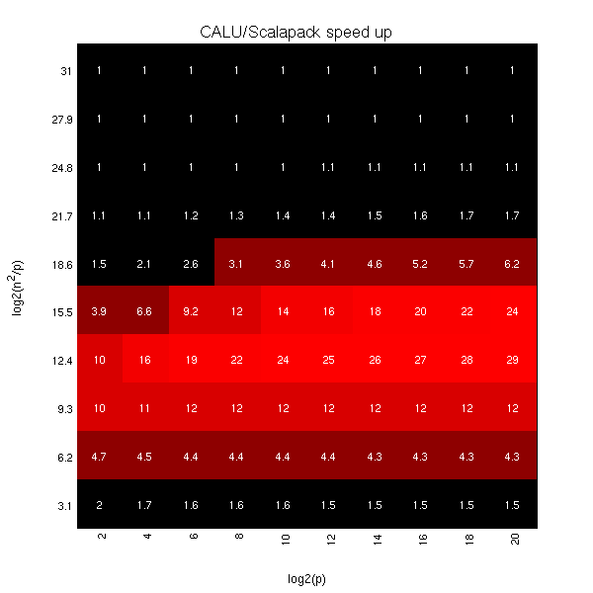
Exascale predicted speedups for Gaussian Elimination:
2D CA-LU vs ScaLAPACK-LU
log₂ (n²/p) =
log₂ (memory_per_proc)
log₂ (p)
Notes:
Vertical axis log2(n^2/p) is memory per processor
Horizontal axis log2(p) is processor count

Slide 50
Ongoing Work
Lots more work on
  Algorithms:
    BLAS, LDL^{T}, QR with pivoting, other pivoting schemes, eigenproblems, …
    Sparse matrices, structured matrices
    All-pairs-shortest-path, …
    Both 2D (c=1) and 2.5D (c>1)
    But only bandwidth may decrease with c>1, not latency (eg LU)
  Platforms:
    Multicore, cluster, GPU, cloud, heterogeneous, low-energy, …
  Software:
    Integration into Sca/LAPACK, PLASMA, MAGMA,…
Integration into applications
  CTF (with ANL): symmetric tensor contractions
Notes:
Rectangular matmul, talk yesterday by David Eliahu, Session 6
LDLT – best paper talk by Ichitiaro Yamazaki, May 23,tomorrow Thursday, plenary session (IPDPS’13)
APSP – talk yesterday by Edgar Solomonik, session 12
CTF – talk by Edgar Solomonik, today Session 17
Qbox code – Francois Gygi @ UC Davis, also LLNL, first principle molecular dynamics,
uses Density Functional Theory to solve Kohn Sham equations, won Gordon Bell Prize in 2006
CTF – Cyclops Tensor Framework,
faster symmetric tensor contractions for “coupled cluster” electronic structure calculations

Slide 51
Outline
Survey state of the art of CA (Comm-Avoiding) algorithms
  Review previous Matmul algorithms
  CA O(n³) 2.5D Matmul and LU
  TSQR: Tall-Skinny QR
  CA Strassen Matmul
Beyond linear algebra
  Extending lower bounds to any algorithm with arrays
  Communication-optimal N-body algorithm
CA-Krylov methods
Related Topics

Slide 52
Communication Lower Bounds for Strassen-like matmul algorithms
Classical
O(n³) matmul:
#words_moved =
Ω (M(n/M^{1/2})³/P)
Strassen’s
O(n^{lg7}) matmul:
#words_moved =
Ω (M(n/M^{1/2})^{lg7}/P)
Strassen-like
O(n^{ω}) matmul:
#words_moved =
Ω (M(n/M^{1/2})^{ω}/P)
Proof: graph expansion (different from classical matmul)
  Strassen-like: DAG must be “regular” [and connected]
Extends up to M = n² / p^{2/ω}
Best Paper Prize (SPAA’11), Ballard, D., Holtz, Schwartz,
also in JACM
Is the lower bound attainable?
Notes:
Jacob Scott removes some assumptions in original proof
Bilardi and De Stephani remove more assumptions (allow recomputation)

Slide 53
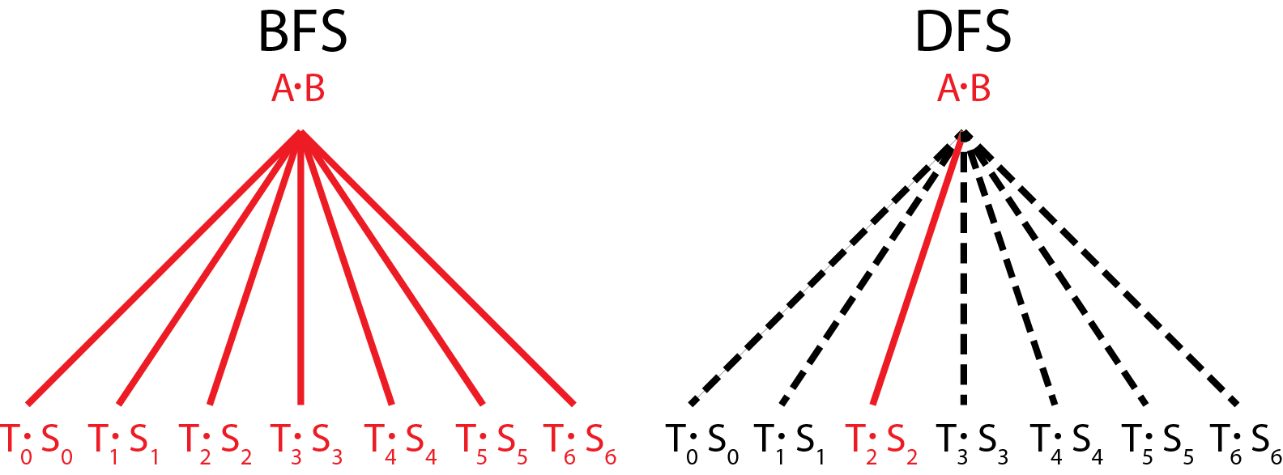
vs.
Communication Avoiding Parallel Strassen (CAPS)
Runs all 7 multiplies in parallel
Each on P/7 processors
Needs 7/4 as much memory
Runs all 7 multiplies sequentially
Each on all P processors
Needs 1/4 as much memory
CAPS
If EnoughMemory and P ≥ 7
then BFS step
else DFS step
end if
Best way to interleave
BFS and DFS is a
tuning parameter
Notes:
Say what BFS and DFS are

Slide 54
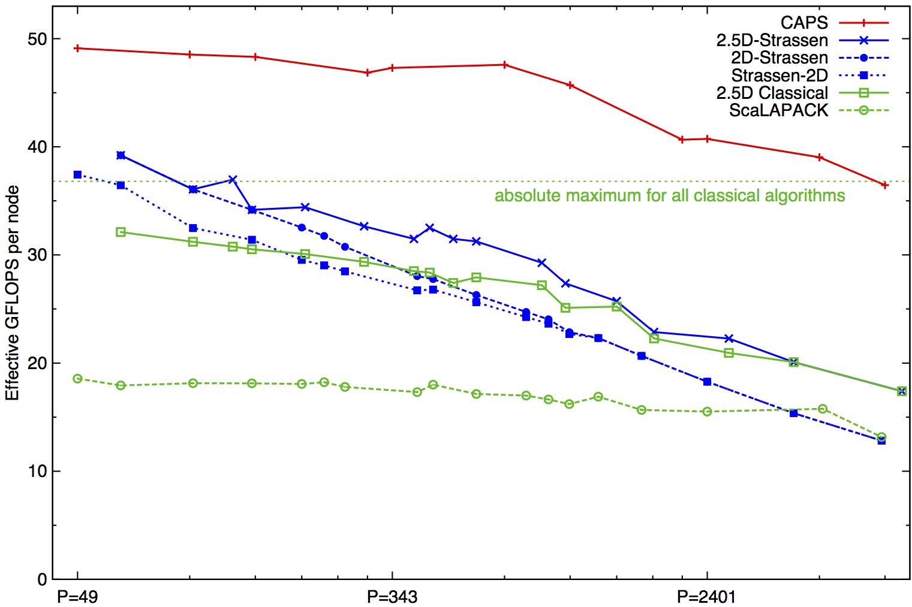
Performance Benchmarking, Strong Scaling Plot
Franklin (Cray XT4) n = 94080
Invited to appear as Research Highlight in CACM
Speedups: 24%-184%
(over previous Strassen-based algorithms)
Notes:
2n^3/time 184% is at 7203 ours 7056 theirs (per node).
Strong scaling range up to about p=1000
Top on this plot: p = 7200, recent data up to 20K
2(.5)D-Strassen means 2(.5)D-outer, and Strassen-inner, on the small local matrices
Strassen-2D means x DFS Strassen steps, followed by 2D classical for the 7^x subproblems

Slide 55
Outline
Survey state of the art of CA (Comm-Avoiding) algorithms
  Review previous Matmul algorithms
  CA O(n³) 2.5D Matmul and LU
  TSQR: Tall-Skinny QR
  CA Strassen Matmul
Beyond linear algebra
  Extending lower bounds to any algorithm with arrays
  Communication-optimal N-body algorithm
CA-Krylov methods
Related Topics

Slide 56
Recall optimal sequential Matmul
Naïve code
for i=1:n, for j=1:n, for k=1:n, C(i,j)+=A(i,k)*B(k,j)
“Blocked” code
for i1 = 1:b:n, for j1 = 1:b:n, for k1 = 1:b:n
for i2 = 0:b-1, for j2 = 0:b-1, for k2 = 0:b-1
i=i1+i2, j = j1+j2, k = k1+k2
C(i,j)+=A(i,k)*B(k,j)
Thm: Picking b = M^{1/2} attains lower bound:
#words_moved = Ω(n³/M^{1/2})
Where does 1/2 come from?
b x b matmul

Slide 57
New Thm applied to Matmul
for i=1:n, for j=1:n, for k=1:n, C(i,j) += A(i,k)*B(k,j)
Record array indices in matrix Δ
Solve LP for x = [xi,xj,xk]^{T}: max 1^{T}x s.t. Δ x ≤ 1
  Result: x = [1/2, 1/2, 1/2]^{T}, 1^{T}x = 3/2 = s_{HBL}
Thm: #words_moved = Ω(n³/M^{SHBL-1})= Ω(n³/M^{1/2})
Attained by block sizes M^{xi},M^{xj},M^{xk} = M^{1/2},M^{1/2},M^{1/2}
 | i | j | k
 | 1 | 0 | 1 | A
Δ = | 0 | 1 | 1 | B
 | 1 | 1 | 0 | C

Slide 58
New Thm applied to Direct N-Body
for i=1:n, for j=1:n, F(i) += force( P(i) , P(j) )
Record array indices in matrix Δ
Solve LP for x = [xi,xj]^{T}: max 1^{T}x s.t. Δ x ≤ 1
  Result: x = [1,1], 1^{T}x = 2 = s_{HBL}
Thm: #words_moved = Ω(n²/M^{SHBL-1})= Ω(n²/M¹)
Attained by block sizes M^{xi},M^{xj} = M¹,M¹
 | i | j
 | 1 | 0 | F
Δ = | 1 | 0 | P(i)
 | 0 | 1 | P(j)

Slide 59
New Thm applied to Random Code
for i1=1:n, for i2=1:n, … , for i6=1:n
A1(i1,i3,i6) += func1(A2(i1,i2,i4),A3(i2,i3,i5),A4(i3,i4,i6))
A5(i2,i6) += func2(A6(i1,i4,i5),A3(i3,i4,i6))
Record array indices
in matrix Δ
Solve LP for x = [x1,…,x6]^{T}: max 1^{T}x s.t. Δ x ≤ 1
  Result: x = [2/7,3/7,1/7,2/7,3/7,4/7], 1^{T}x = 15/7 = s_{HBL}
Thm: #words_moved = Ω(n⁶/M^{SHBL-1})= Ω(n⁶/M^{8/7})
Attained by block sizes M^{2/7},M^{3/7},M^{1/7},M^{2/7},M^{3/7},M^{4/7}
 | i1 | i2 | i3 | i4 | i5 | i6
 | 1 | 0 | 1 | 0 | 0 | 1 | A1
 | 1 | 1 | 0 | 1 | 0 | 0 | A2
Δ = | 0 | 1 | 1 | 0 | 1 | 0 | A3
 | 0 | 0 | 1 | 1 | 0 | 1 | A3,A4
 | 0 | 0 | 1 | 1 | 0 | 1 | A5
 | 1 | 0 | 0 | 1 | 1 | 0 | A6

Slide 60
Where do lower and matching upper bounds on communication come from? (1/3)
Originally for C = A*B by Irony/Tiskin/Toledo (2004)
Proof idea
  Suppose we can bound #useful_operations ≤ G doable with data in fast memory of size M
  So to do F = #total_operations, need to fill fast memory F/G times, and so #words_moved ≥ MF/G
Hard part: finding G
Attaining lower bound
  Need to “block” all operations to perform ~G operations on every chunk of M words of data

Slide 61
Proof of communication lower bound (2/3)
k
C = A * B
(Irony/Tiskin/Toledo
2004)
“C face”
Cube representing
C(1,1) += A(1,3)·B(3,1)
C(2,3)
C(1,1)
B(3,1)
A(1,3)
A(1,2)
B(2,1)
j
B(1,3)
B(1,1)
A(2,1)
A(1,1)
“B face”
i
If we have at most M “A squares”, M “B squares”, and M “C squares”, how many cubes G can we have?
“A face”

Slide 62
Proof of communication lower bound (3/3)
k
x
“C shadow”
y
z
y
j
z
x
“B shadow”
“A shadow”
#words_moved = Ω(M(n³/P)/M^{3/2}) = Ω(n³/(PM^{1/2}))
i
(i,k) is in “A shadow” if (i,j,k) in 3D set
(j,k) is in “B shadow” if (i,j,k) in 3D set
(i,j) is in “C shadow” if (i,j,k) in 3D set
Thm (Loomis & Whitney, 1949)
G = # cubes in 3D set = Volume of 3D set
≤ (area(A shadow) · area(B shadow) ·
area(C shadow)) ^{1/2}
≤ M ^{3/2}
G = # cubes in black box with
side lengths x, y and z
= Volume of black box
= x·y·z
= ( xz · zy · yx)^{1/2}
= (#A□s · #B□s · #C□s )^{1/2}
≤ M ^{3/2}
Notes:
This is the original matmul proof:
But it has nothing to do with doing mul/add in the inner loop,
Or A, B and C being disjoint matrices, or with them being dense

Slide 63
Approach to generalizing lower bounds
Matmul
for i=1:n, for j=1:n, for k=1:n,
C(i,j)+=A(i,k)*B(k,j)
=> for (i,j,k) in S = subset of Z³
Access locations indexed by (i,j), (i,k), (k,j)
General case
for i1=1:n, for i2 = i1:m, … for ik = i3:i4
C(i1+2*i3-i7) = func(A(i2+3*i4,i1,i2,i1+i2,…),B(pnt(3*i4)),…)
D(something else) = func(something else), …
=> for (i1,i2,…,ik) in S = subset of Z^{k}
Access locations indexed by group homomorphisms, eg
φ_{C} (i1,i2,…,ik) = (i1+2*i3-i7)
φ_{A} (i1,i2,…,ik) = (i2+3*i4,i1,i2,i1+i2,…), …
Goal: Communication lower bounds, optimal algorithms for any program that looks like this

Slide 64
Approach to generalizing lower bounds
Matmul
for i=1:n, for j=1:n, for k=1:n,
C(i,j)+=A(i,k)*B(k,j)
=> for (i,j,k) in S = subset of Z³
Access locations indexed by (i,j), (i,k), (k,j)
General case
for i1=1:n, for i2 = i1:m, … for ik = i3:i4
C(i1+2*i3-i7) = func(A(i2+3*i4,i1,i2,i1+i2,…),B(pnt(3*i4)),…)
D(something else) = func(something else), …
=> for (i1,i2,…,ik) in S = subset of Z^{k}
Access locations indexed by group homomorphisms, eg
φ_{C} (i1,i2,…,ik) = (i1+2*i3-i7)
φ_{A} (i1,i2,…,ik) = (i2+3*i4,i1,i2,i1+i2,…), …
Can we bound #loop_iterations (= |S|)
given bounds on #points in its images, i.e. bounds on |φ_{C} (S)|, |φ_{A} (S)|, … ?

Slide 65
General Communication Bound
Given subset of loop iterations, how much data do we need?
  Given S subset of Z^{k}, group homomorphisms φ₁, φ₂, …, bound |S| in terms of |φ₁(S)|, |φ₂(S)|, … , |φ_{m}(S)|
Def: Hölder-Brascamp-Lieb LP (HBL-LP) for s₁,…,s_{m}:
for all subgroups H < Z^{k}, rank(H) ≤ Σ_{j} s_{j}*rank(φ_{j}(H))
Thm (Christ/Tao/Carbery/Bennett): Given s₁,…,s_{m}
|S| ≤ Π_{j} |φ_{j}(S)|^{sj}
Thm: Given a program with array refs given by φ_{j}, choose s_{j} to minimize s_{HBL} = Σ_{j} s_{j} subject to HBL-LP. Then
#words_moved = Ω (#iterations/M^{sHBL-1})
Notes:
Note: there are infinitely many subgroups H, but only finitely many possible constraints
Michael Christ (UCB), Terry Tao (UCLA), Anthony Carbery (Edinburgh), Jonathan Bennett (Birmingham),
Published in Geometric Functional Analysis, 2008

Slide 66
General Communication Bound
Given S subset of Z^{k}, group homomorphisms φ₁, φ₂, …, bound |S| in terms of |φ₁(S)|, |φ₂(S)|, … , |φ_{m}(S)|
Def: Hölder-Brascamp-Lieb LP (HBL-LP) for s₁,…,s_{m}:
for all subgroups H < Z^{k}, rank(H) ≤ Σ_{j} s_{j}*rank(φ_{j}(H))
Thm (Christ/Tao/Carbery/Bennett): Given s₁,…,s_{m}
|S| ≤ Π_{j} |φ_{j}(S)|^{sj}
Thm: Given a program with array refs given by φ_{j}, choose s_{j} to minimize s_{HBL} = Σ_{j} s_{j} subject to HBL-LP. Then
#words_moved = Ω (#iterations/M^{sHBL-1})
Notes:
Note: there are infinitely many subgroups H, but only finitely many possible constraints
Michael Christ (UCB), Terry Tao (UCLA), Anthony Carbery (Edinburgh), Jonathan Bennett (Birmingham),
Published in Geometric Functional Analysis, 2008

Slide 67
Is this bound attainable?
But first: Can we write it down?
Thm: (bad news) HBL-LP reduces to Hilbert’s 10th problem over Q (conjectured to be undecidable)
Thm: (good news) Another LP with same solution is decidable
Depends on loop dependencies
  Best case: none, or reductions (like matmul)
Thm: In many cases, solution x of Dual HBL-LP gives optimal tiling
  Ex: For Matmul, x = [1/2, 1/2, 1/2] so optimal tiling is M^{1/2} x M^{1/2} x M^{1/2}
Notes:
Note: real “relaxation” is Tarski decidable.

Slide 68
New Thm applied to Direct N-Body
for i=1:n, for j=1:n, F(i) += force( P(i) , P(j) )
Record array indices in matrix Δ
Solve LP for x = [xi,xj]^{T}: max 1^{T}x s.t. Δ x ≤ 1
  Result: x = [1,1], 1^{T}x = 2 = s_{HBL}
Thm: #words_moved = Ω(n²/M^{SHBL-1})= Ω(n²/M¹)
Attained by block sizes M^{xi},M^{xj} = M¹,M¹
 | i | j
 | 1 | 0 | F
Δ = | 1 | 0 | P(i)
 | 0 | 1 | P(j)

Slide 69
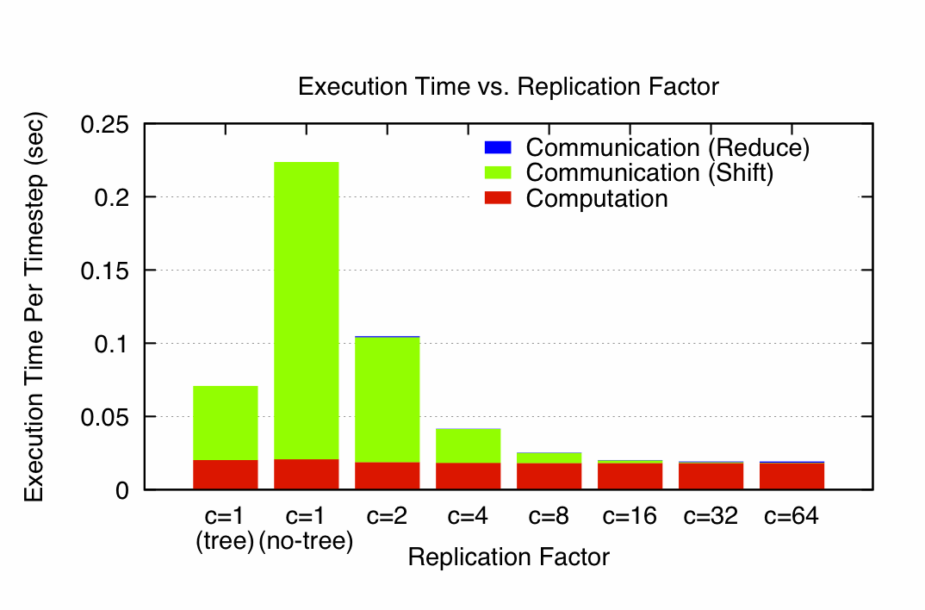
N-Body Speedups on IBM-BG/P (Intrepid)
8K cores, 32K particles
K. Yelick, E. Georganas, M. Driscoll, P. Koanantakool, E. Solomonik
11.8x speedup
Notes:
Talk by M. Driscoll, tomorrow, May 23, session 21
Intrepid: 163,480 core IBM BG/P at Argonne NL (ALCF)
Each node is one quad-core in a 3D torus
C=1(tree) uses special HW collective network, (no tree) just used regular network

Slide 70
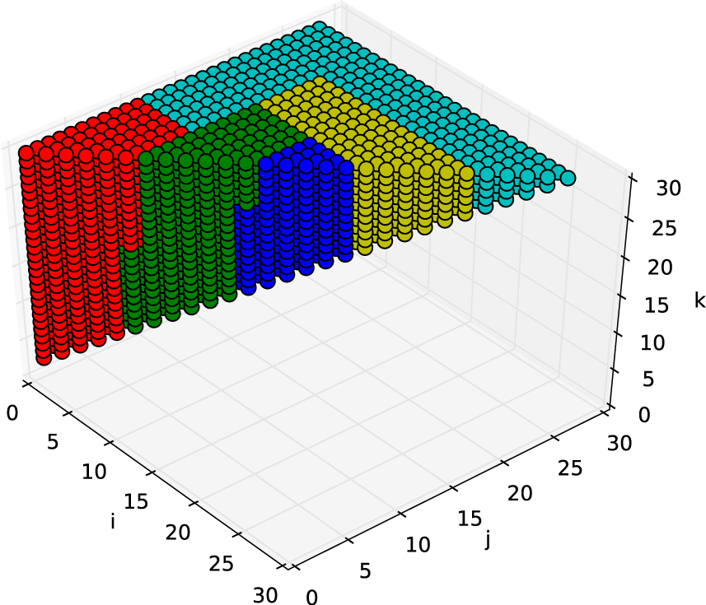
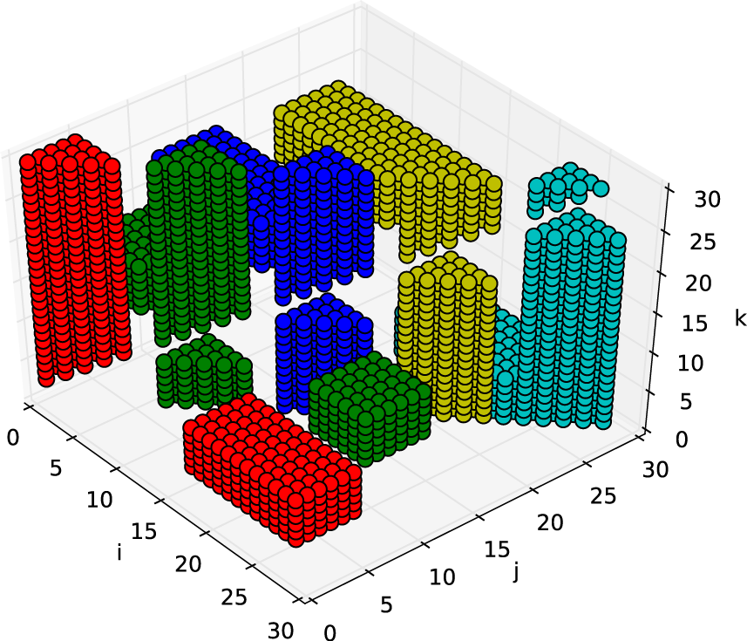
Variable Loop Bounds are More Complicated
Redundancy in n-body calculation f(i,j), f(j,i)
k-way n-body problems (“k-body”) has even more
Can achieve both communication and computation (symmetry exploiting) optimal
Penporn Koanantakool and K. Yelick

Slide 71

Some Applications
Gravity, Turbulence, Molecular Dynamics, Plasma Simulation, …
Electron-Beam Lithography Device Simulation
Hair ...
  www.fxguide.com/featured/brave-new-hair/
  graphics.pixar.com/library/CurlyHairA/paper.pdf
Notes:
Gravity – astrophysical simulation (even if BH or FMM, direct method for nearby particles)(GB Prize 1992)
Vortex particular simulation of turbulence (GB 2009)
Molecular dynamics common in chemistry, biology
Plasmas in astrophysics
Electron-beam lithography: EE colleagues in Cory Hall
use it to simulation new ways of building chips
Hair, in graphics (Pixar) – use n-body now
(former CS267 GSI worked on improving their algorithm,
will appear in an upcoming movie, not FMM yet, mostly
nearest neighbor)
Princess Merida in Brave (Disney)
Email from Michael Driscoll (4/1/14)
Most everything about the simulator is public, except the code. It's described in detail in this paper:
http://graphics.pixar.com/library/CurlyHairA/paper.pdf
It was developed for Brave, and it's been used on most productions since. Merida, the protagonist in Brave, has about 44.5K hair-points, with about 40-200 points/hair (Table 2 in the paper). The number of point-point interactions changes over time but I'd guess there can be thousands or tens-of-thousands total, per timestep.

Slide 72
Is this bound attainable (1/2)?
But first: Can we write it down?
Thm: (bad news) HBL-LP reduces to Hilbert’s 10th problem over Q (conjectured to be undecidable)
Thm: (good news) Another LP with same solution is decidable (but expensive, so far)
Thm: (better news) Easy to write down LP explicitly in many cases of interest (eg all φ_{j} = {subset of indices})
Thm: (good news) Easy to approximate, i.e. get upper or lower bounds on s_{HBL}
    If you miss a constraint, the lower bound may be too large (i.e. s_{HBL} too small) but still worth trying to attain
    Tarski-decidable to get superset of constraints (may get s_{HBL} too large)
Notes:
Note: real “relaxation” is Tarski decidable.

Slide 73
Is this bound attainable (2/2)?
Depends on loop dependencies
Best case: none, or reductions (matmul)
Thm: When all φ_{j} = {subset of indices}, dual of HBL-LP gives optimal tile sizes:
HBL-LP: minimize 1^{T}*s s.t. s^{T}*Δ ≥ 1^{T}
Dual-HBL-LP: maximize 1^{T}*x s.t. Δ*x ≤ 1
Then for sequential algorithm, tile i_{j} by M^{xj}
Ex: Matmul: s = [ 1/2 , 1/2 , 1/2 ]^{T} = x
Extends to unimodular transforms of indices

Slide 74
Ongoing Work
Implement/improve algorithms to generate for lower bounds, optimal algorithms
Have yet to find a case where we cannot attain lower bound – can we prove this?
  Checking the proof…
Extend “perfect scaling” results for time and energy by using extra memory
  “n.5D algorithms”
Incorporate into compilers
Notes:
Qbox code – Francois Gygi @ UC Davis, also LLNL, first principle molecular dynamics,
uses Density Functional Theory to solve Kohn Sham equations, won Gordon Bell Prize in 2006
CTF – Cyclops Tensor Framework,
faster symmetric tensor contractions for “coupled cluster” electronic structure calculations

Slide 75
Ongoing Work
Accelerate decision procedure for lower bounds
  Ex: At most 3 arrays, or 4 loop nests
Have yet to find a case where we cannot attain lower bound – can we prove this?
Extend “perfect scaling” results for time and energy by using extra memory
  “n.5D algorithms”
Incorporate into compilers
Notes:
Qbox code – Francois Gygi @ UC Davis, also LLNL, first principle molecular dynamics,
uses Density Functional Theory to solve Kohn Sham equations, won Gordon Bell Prize in 2006
CTF – Cyclops Tensor Framework,
faster symmetric tensor contractions for “coupled cluster” electronic structure calculations

Slide 76
Outline
Survey state of the art of CA (Comm-Avoiding) algorithms
  Review previous Matmul algorithms
  CA O(n³) 2.5D Matmul and LU
  TSQR: Tall-Skinny QR
  CA Strassen Matmul
Beyond linear algebra
  Extending lower bounds to any algorithm with arrays
  Communication-optimal N-body algorithm
CA-Krylov methods
Related Topics

Slide 77
Avoiding Communication in Iterative Linear Algebra
k-steps of iterative solver for sparse Ax=b or Ax=λx
  Does k SpMVs with A and starting vector
  Many such “Krylov Subspace Methods”
    Conjugate Gradients (CG), GMRES, Lanczos, Arnoldi, …
Goal: minimize communication
  Assume matrix “well-partitioned”
  Serial implementation
    Conventional: O(k) moves of data from slow to fast memory
    New: O(1) moves of data – optimal
  Parallel implementation on p processors
    Conventional: O(k log p) messages (k SpMV calls, dot prods)
    New: O(log p) messages - optimal
Lots of speed up possible (modeled and measured)
  Price: some redundant computation
  Challenges: Poor partitioning, Preconditioning, Num. Stability
77
Notes:
Well – partitioned = modest surface-to-volume ratio
See bebop.cs.berkeley.edu
CG: [van Rosendale, 83], [Chronopoulos and Gear, 89]
GMRES: [Walker, 88], [Joubert and Carey, 92], [Bai et al., 94]

Slide 78
Communication Avoiding Kernels:
The Matrix Powers Kernel : [Ax, A²x, …, A^{k}x]
Replace k iterations of y = A⋅x with [Ax, A²x, …, A^{k}x]
Example: A tridiagonal, n=32, k=3
Works for any “well-partitioned” A
A³·x
A²·x
A·x
x
1 2 3 4 …
… 32
Notes:
C. J. Pfeifer, Data flow and storage allocation for the PDQ-5 program
on the Philco-2000, Comm. ACM 6, No. 7 (1963), 365366.
Referred to in paper by Leiserson/Rao/Toledo/ in 1993 paper on blocking covers

Slide 79
Communication Avoiding Kernels:
The Matrix Powers Kernel : [Ax, A²x, …, A^{k}x]
Replace k iterations of y = A⋅x with [Ax, A²x, …, A^{k}x]
Example: A tridiagonal, n=32, k=3
A³·x
A²·x
A·x
x
1 2 3 4 …
… 32

Slide 80
Communication Avoiding Kernels:
The Matrix Powers Kernel : [Ax, A²x, …, A^{k}x]
Replace k iterations of y = A⋅x with [Ax, A²x, …, A^{k}x]
Example: A tridiagonal, n=32, k=3
A³·x
A²·x
A·x
x
1 2 3 4 …
… 32

Slide 81
Communication Avoiding Kernels:
The Matrix Powers Kernel : [Ax, A²x, …, A^{k}x]
Replace k iterations of y = A⋅x with [Ax, A²x, …, A^{k}x]
Example: A tridiagonal, n=32, k=3
A³·x
A²·x
A·x
x
1 2 3 4 …
… 32

Slide 82
Communication Avoiding Kernels:
The Matrix Powers Kernel : [Ax, A²x, …, A^{k}x]
Replace k iterations of y = A⋅x with [Ax, A²x, …, A^{k}x]
Example: A tridiagonal, n=32, k=3
A³·x
A²·x
A·x
x
1 2 3 4 …
… 32

Slide 83
Communication Avoiding Kernels:
The Matrix Powers Kernel : [Ax, A²x, …, A^{k}x]
Replace k iterations of y = A⋅x with [Ax, A²x, …, A^{k}x]
Example: A tridiagonal, n=32, k=3
A³·x
A²·x
A·x
x
1 2 3 4 …
… 32

Slide 84
Communication Avoiding Kernels:
The Matrix Powers Kernel : [Ax, A²x, …, A^{k}x]
Replace k iterations of y = A⋅x with [Ax, A²x, …, A^{k}x]
Sequential Algorithm
Example: A tridiagonal, n=32, k=3
Step 1
A³·x
A²·x
A·x
x
1 2 3 4 …
… 32

Slide 85
Communication Avoiding Kernels:
The Matrix Powers Kernel : [Ax, A²x, …, A^{k}x]
Replace k iterations of y = A⋅x with [Ax, A²x, …, A^{k}x]
Sequential Algorithm
Example: A tridiagonal, n=32, k=3
Step 1
Step 2
A³·x
A²·x
A·x
x
1 2 3 4 …
… 32

Slide 86
Communication Avoiding Kernels:
The Matrix Powers Kernel : [Ax, A²x, …, A^{k}x]
Replace k iterations of y = A⋅x with [Ax, A²x, …, A^{k}x]
Sequential Algorithm
Example: A tridiagonal, n=32, k=3
Step 1
Step 2
Step 3
A³·x
A²·x
A·x
x
1 2 3 4 …
… 32

Slide 87
Communication Avoiding Kernels:
The Matrix Powers Kernel : [Ax, A²x, …, A^{k}x]
Replace k iterations of y = A⋅x with [Ax, A²x, …, A^{k}x]
Sequential Algorithm
Example: A tridiagonal, n=32, k=3
Step 1
Step 2
Step 3
Step 4
A³·x
A²·x
A·x
x
1 2 3 4 …
… 32

Slide 88
Communication Avoiding Kernels:
The Matrix Powers Kernel : [Ax, A²x, …, A^{k}x]
Replace k iterations of y = A⋅x with [Ax, A²x, …, A^{k}x]
Parallel Algorithm
Example: A tridiagonal, n=32, k=3
Each processor communicates once with neighbors
Proc 1
Proc 2
Proc 3
Proc 4
A³·x
A²·x
A·x
x
1 2 3 4 …
… 32

Slide 89
Communication Avoiding Kernels:
The Matrix Powers Kernel : [Ax, A²x, …, A^{k}x]
Replace k iterations of y = A⋅x with [Ax, A²x, …, A^{k}x]
Parallel Algorithm
Example: A tridiagonal, n=32, k=3
Each processor works on (overlapping) trapezoid
Proc 1
Proc 2
Proc 3
Proc 4
A³·x
A²·x
A·x
x
1 2 3 4 …
… 32

Slide 90
The Matrix Powers Kernel : [Ax, A²x, …, A^{k}x] on a general matrix (nearest k neighbors on a graph)
Simple block-row partitioning ➔
(hyper)graph partitioning
Top-to-bottom processing ➔
Traveling Salesman Problem
Same idea for general sparse matrices: k-wide neighboring region

Slide 91
Minimizing Communication of GMRES to solve Ax=b
GMRES: find x in span{b,Ab,…,A^{k}b} minimizing || Ax-b ||₂
Standard GMRES
for i=1 to k
w = A · v(i-1) … SpMV
MGS(w, v(0),…,v(i-1))
update v(i), H
endfor
solve LSQ problem with H
Communication-avoiding GMRES
W = [ v, Av, A²v, … , A^{k}v ]
[Q,R] = TSQR(W)
… “Tall Skinny QR”
build H from R
solve LSQ problem with H
Sequential case: #words moved decreases by a factor of k
Parallel case: #messages decreases by a factor of k
Oops – W from power method, precision lost!
91

Slide 92
Matrix Powers Kernel + TSQR in GMRES

Slide 93
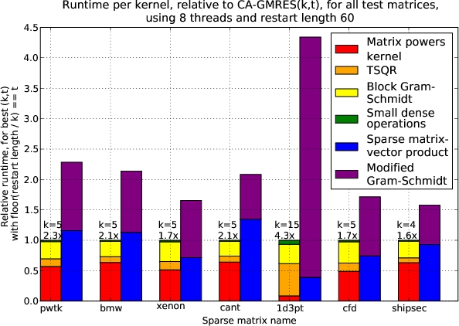
Speed ups of GMRES on 8-core Intel Clovertown
Requires Co-tuning Kernels
[MHDY09]
93

Slide 94
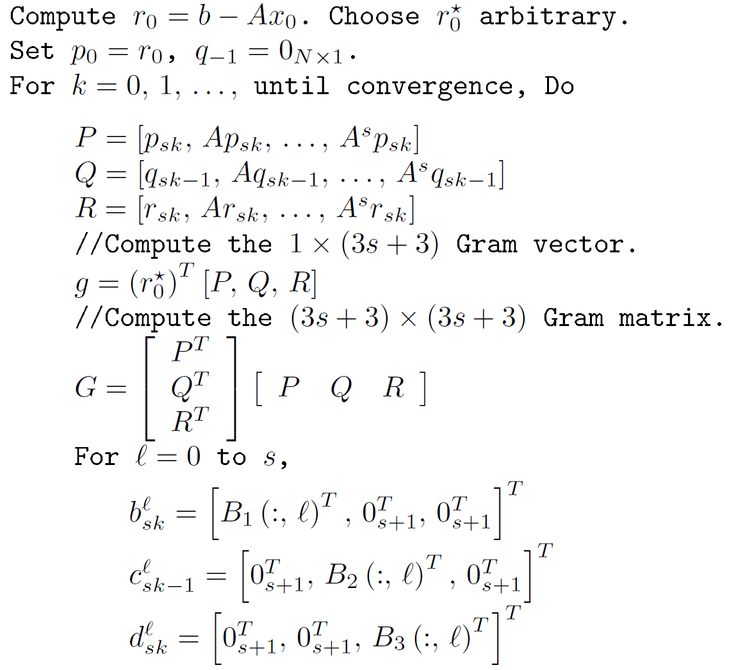
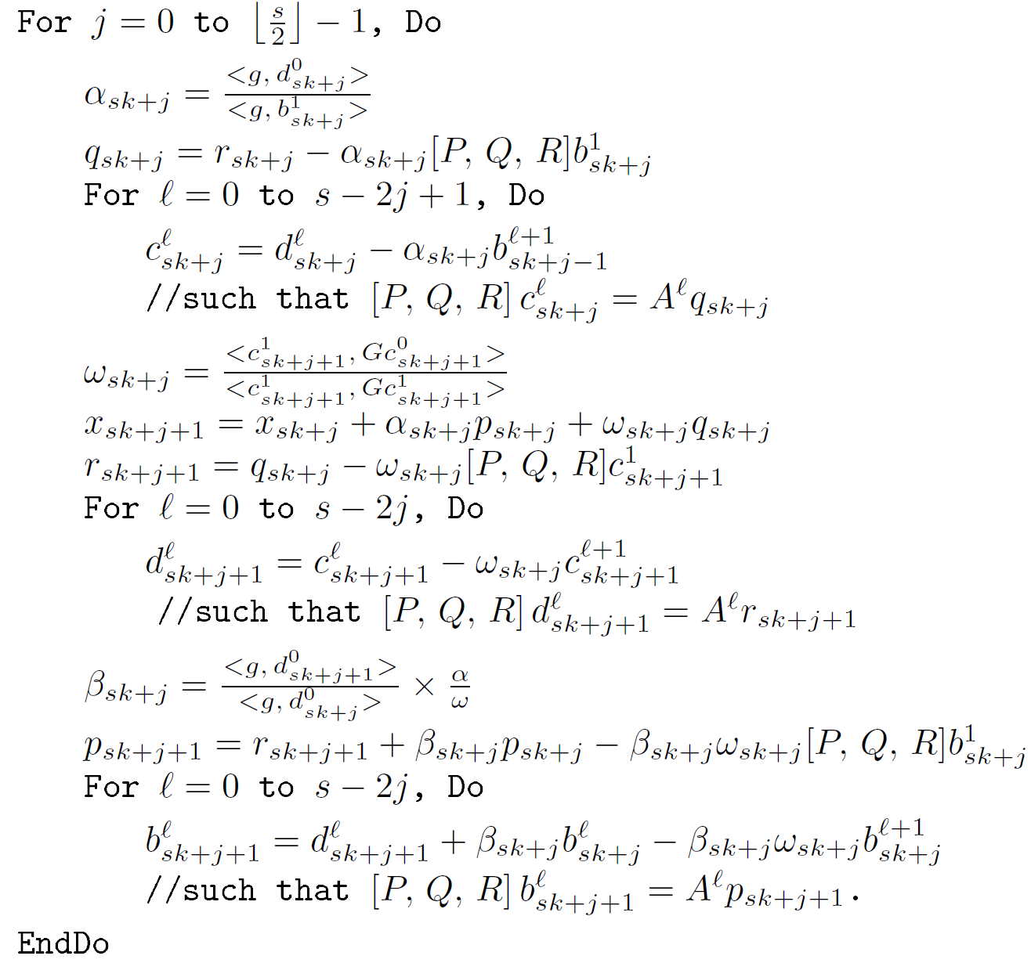
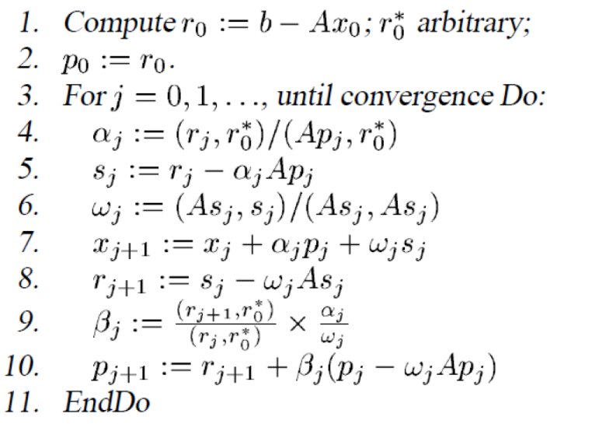

CA-BiCGStab

Slide 95
Notes:
For Matrix pde900, U Florida collection, 2D Model problem, Nx=30, Ny=30, non-normal.
Cond ~ 120

Slide 96
With Residual Replacement (RR)
a la Van der Vorst and Ye
 | Naive | Monomial | Newton | Chebyshev
Replacement Its. | 74 (1) | [7, 15, 24, 31, …, 92, 97, 103] (17) | [67, 98] (2) | 68 (1)

Slide 97
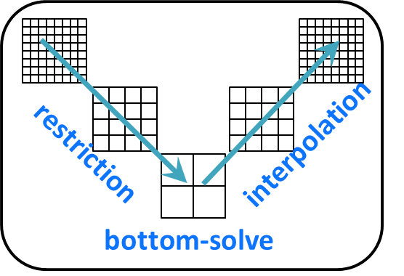
Speedups for GMG w/CA-KSM Bottom Solve
Compared BICGSTAB vs. CA-BICGSTAB with s = 4 (monomial basis)
Hopper at NERSC (Cray XE6), weak scaling: Up to 4096 MPI processes (1 per chip, 24,576 cores total)
Speedups for miniGMG benchmark (HPGMG benchmark predecessor)
  4.2x in bottom solve, 2.5x overall GMG solve
Implemented as a solver option in BoxLib and CHOMBO AMR frameworks
Speedups for two BoxLib applications:
  3D LMC (a low-mach number combustion code)
    2.5x in bottom solve, 1.5x overall GMG solve
  3D Nyx (an N-body and gas dynamics code)
    2x in bottom solve, 1.15x overall GMG solve
Notes:
CA-BICGSTAB improves aggregate performance - degrees of freedom solved per second close to linear

Slide 98
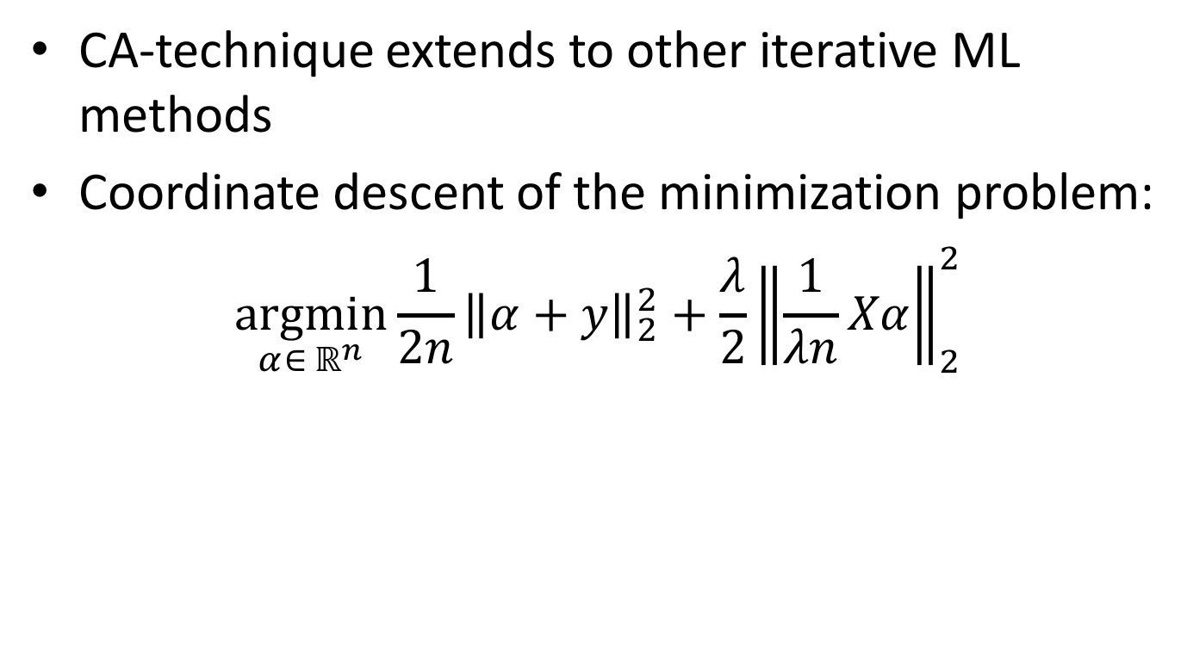
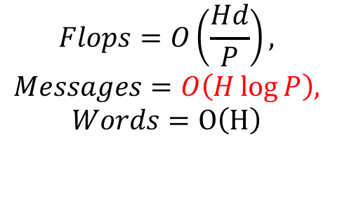
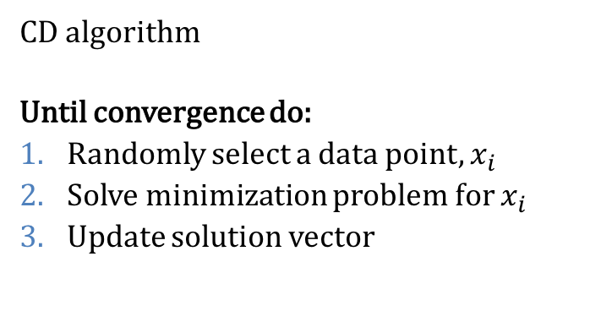
Communication-Avoiding
Machine Learning
Dot products and axpys
Notes:
d = # of features
n = # of samples (data points)
H = # of iterations
P = # of processor
Flops cost: parallel dot product on each iteration
Msgs cost: all-reduce each iteration
Words cost: assuming minimum spanning tree + pipelining
Algorithm costs assuming dense (i.e. upper bound for sparse). In general, flops is different for sparse case. Words same since dot product, Msgs same since all procs need dot product.
Least squares with L2 problem.
Showing dual problem which has comparable or better convergence guarantees compared to SGD (Shalev-Shwartz and Zhang JMLR’13)
Results extend to primal problem (i.e. CA-SGD).
Similar coordinate-wise update for primal problem (leads to SGD… our CA results also apply)

Slide 99
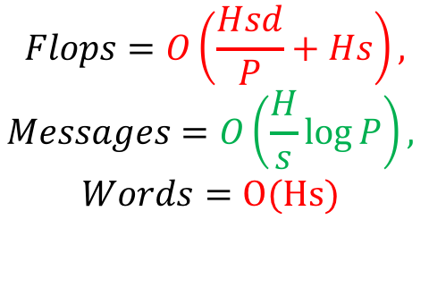
Communication-Avoiding
Coordinate Descent
CA-CD algorithm
Until convergence do:
Randomly select s data points
Compute Gram matrix
Solve minimization problem for all data points
Update solution vector
GEMM,
dot products,
and axpys
We expect 1st flops term to dominate
MPI: choose s that balances cost
Spark: choose large s to minimize rounds
Parallel implementations in progress
Numerically stable for (very) large s
Notes:
Re-organization splits into outer and inner iterations.
H/s outer iterations (communication)
s inner iterations (no communication)
Flops cost: Parallel Gram matrix computation O(s^2d/P) and local updates O(s^2) each outer iteration, so O(Hsd/P + Hs)
Msgs cost: all-reduce each outer iteration, so O(H/s log P)
Words cost: Communicate s x s Gram each outer iteration, so O(Hs)
Algorithm costs assuming dense (i.e. upper bound for sparse). In general, flops cost is different for sparse case (words, if Gram is sparse).
Flops increases by s if 1st term dominates (d/P > 1)
If d/P < 1 then reduce processors (since 1D-row layout with P procs not possible)
Or use 1D-column layout (different comm cost due to all-to-all needed to parallelize Gram computation)
Or use SGD (CA applies with same costs as above but d replaced by n in flops)
Bandwidth is under-utilized, so increase ok.
Technique applies for SGD, block generalizations (of both) and other kernel functions (i.e. Kernel Ridge Regression).
Numerically stable for a9a dataset (pre-processed version of Adult Census Income from ‘94 Census database)
more info on pre-processing, etc. on LIBSVM
123 x 32561 sparse matrix, NNZ = 11%
sigma_min of XX^T = 4.9e-06, sigma_max = 2.0e+05
lambda = 1e-4
Spark scheduling more expensive than flops (see Spark and MPI comparison paper on Arxiv).
CA for non-linear challenging and interesting

Slide 100
Summary of Iterative Linear Algebra
New lower bounds, optimal algorithms, big speedups in theory and practice
Lots of other progress, open problems
  Many different algorithms reorganized
    More underway, more to be done
  Need to recognize stable variants more easily
  Preconditioning
    Hierarchically Semiseparable Matrices
  Autotuning and synthesis
    Different kinds of “sparse matrices”

Slide 101
Outline
Survey state of the art of CA (Comm-Avoiding) algorithms
  Review previous Matmul algorithms
  CA O(n³) 2.5D Matmul and LU
  TSQR: Tall-Skinny QR
  CA Strassen Matmul
Beyond linear algebra
  Extending lower bounds to any algorithm with arrays
  Communication-optimal N-body algorithm
CA-Krylov methods
Related Topics
  Write-Avoiding Algorithms
  Reproducilibity

Slide 102
Write-Avoiding Algorithms
What if writes are more expensive than reads?
  Nonvolatile Memory (Flash, PCM, …)
  Saving intermediates to disk in cloud (eg Spark)
  Extra coherency traffic in shared memory
Can we design “write-avoiding (WA)” algorithms?
  Goal: find and attain better lower bound for writes
  Thm: For classical matmul, possible to do asymptotically fewer writes than reads to given layer of memory hierarchy
  Thm: Cache-oblivious algorithms cannot be write-avoiding
  Thm: Strassen and FFT cannot be write-avoiding
Notes:
PCM = Phase Change Memory

Slide 103
Measured L3-DRAM traffic on
Intel Nehalem Xeon-7560
Optimal #DRAM reads = O(n³/M^{1/2})
Optimal #DRAM writes = n²
Cache-Oblivious Matmul
#DRAM reads close to optimal
#DRAM writes much larger
Write-Avoiding Matmul
Total L3 misses close to optimal
Total DRAM writes much larger
Notes:
To measure the number of writes to slow memory, we measure the evictions of modified
cache lines from L3 cache as these are obligatory write-backs to the DRAM. We use the C-box
event LLC VICTIMS.M [30] for this. We also measure the number of exclusive lines evicted from L3
using the event LLC VICTIMS.E. We measure the number of reads from the DRAM into L3 cache
necessitated by L3 cache misses with the performance event LLC S FILLS.E

Slide 104
Measured L3-DRAM traffic on
Intel Nehalem Xeon-7560
Optimal #DRAM reads = O(n³/M^{1/2})
Optimal #DRAM writes = n²
Intel MKL Matmul
#DRAM reads >2x optimal
#DRAM writes much larger
Write-Avoiding Matmul
Total L3 misses close to optimal
Total DRAM writes much larger
Notes:
To measure the number of writes to slow memory, we measure the evictions of modified
cache lines from L3 cache as these are obligatory write-backs to the DRAM. We use the C-box
event LLC VICTIMS.M [30] for this. We also measure the number of exclusive lines evicted from L3
using the event LLC VICTIMS.E. We measure the number of reads from the DRAM into L3 cache
necessitated by L3 cache misses with the performance event LLC S FILLS.E

Slide 105
Reproducibility
Want bit-wise identical results from different runs of the same program on the same machine, possibly with different available resources
  Needed for testing, debugging, correctness.
  Requested by users (e.g. FEM, climate modeling, …)
Hard just for summation, since floating point arithmetic is not associative because of roundoff
  (1e-16 + 1) – 1 ≠ 1e-16 + (1 – 1)

Slide 106
Reproducible Floating Point Computation
Get bit-wise identical answer when you type a.out again
NA-Digest submission on 8 Sep 2010
  From Kai Diethelm, at GNS-MBH
  Sought reproducible parallel sparse linear equation solver, demanded by customers (construction engineers), otherwise they don’t believe results
  Willing to sacrifice 40% - 50% of performance for it
Email to ~110 Berkeley CSE faculty, asking about it
  Most: “What?! How will I debug without reproducibility?”
  Few: “I know better, and do careful error analysis”
  S. Govindjee: needs it for fracture simulations
  S. Russell: needs it for nuclear blast detection
Notes:
GNS = Gesellschaft fuer Numerische Simulation

Slide 107
Intel MKL non-reproducibility
Vector size: 1e6. Data aligned to 16-byte boundaries. For each input vector:
Dot products are computed using 1, 2, 3 or 4 threads
Absolute error = maximum – minimum
Relative error = Absolute error / maximum absolute value
Sign not
reproducible
Absolute Error for Random Vectors
Relative Error for Orthogonal vectors
Same magnitude opposite signs
Intel MKL 11.2 with CBWR: reproducible only for fixed number of threads
and using the same instruction set (SSE2/AVX)
Notes:
CBWR = Conditional bitwise-reproducibility

Slide 108
Goals/Approaches for Reproducible Sum
Goals
  Same answer, independent of layout, #processors, order of summands
  Good performance (scales well)
  Portable (assume IEEE 754 only)
  User can choose accuracy
Approaches
  Guarantee fixed reduction tree (not 2. or 3.)
  Use (very) high precision to get exact answer (not 2.)
  Our approach (Nguyen, Ahrens, D.)
    Oversimplified:
      Compute A = maximum absolute value (reproducible)
      Round all summands to one ulp in A
      Compute sum; rounding causes them to act like fixed point numbers
    Possible with one pass over data, one reduction operation, using just a 6 word “reproducible accumulator”

Slide 109
Performance results on 1024 proc Cray XC30
1.2x to 3.2x slowdown vs fastest code, for n=1M

Slide 110
Reproducible Software and Hardware
Software for Reproducible BLAS 1 available at bebop.cs.berkeley.edu/reproblas
  BLAS2, 3 under development
Used Chisel (hardware design language) to design one new instruction that would make reproducible summation as fast (and more accurate) than standard summation
Industrial interest

Slide 111
Reproducible Software and Hardware
Software for Reproducible BLAS available at bebop.cs.berkeley.edu/reproblas
IEEE 754 Floating Point Standards Committee considering adding new instruction that would accelerate this
BLAS Standard Committee also considering adding these
Industrial interest

Slide 112
For more details
Bebop.cs.berkeley.edu
  155 page survey in Acta Numerica
CS267 – Berkeley’s Parallel Computing Course
  Live broadcast in Spring 2016
    www.cs.berkeley.edu/~demmel
    All slides, video available
  Available as SPOC from XSEDE
    www.xsede.org
    Free supercomputer accounts to do homework
    Free autograding of homework

Slide 113
Collaborators and Supporters
James Demmel, Kathy Yelick, Michael Anderson, Grey Ballard, Erin Carson, Aditya Devarakonda, Michael Driscoll, David Eliahu, Andrew Gearhart, Evangelos Georganas, Nicholas Knight, Penporn Koanantakool, Ben Lipshitz, Oded Schwartz, Edgar Solomonik, Omer Spillinger
Austin Benson, Maryam Dehnavi, Mark Hoemmen, Shoaib Kamil, Marghoob Mohiyuddin
Abhinav Bhatele, Aydin Buluc, Michael Christ, Ioana Dumitriu, Armando Fox, David Gleich, Ming Gu, Jeff Hammond, Mike Heroux, Olga Holtz, Kurt Keutzer, Julien Langou, Devin Matthews, Tom Scanlon, Michelle Strout, Sam Williams, Hua Xiang
Jack Dongarra, Dulceneia Becker, Ichitaro Yamazaki
Sivan Toledo, Alex Druinsky, Inon Peled
Laura Grigori, Sebastien Cayrols, Simplice Donfack, Mathias Jacquelin, Amal Khabou, Sophie Moufawad, Mikolaj Szydlarski
Members of FASTMath, ParLab, ASPIRE, BEBOP, CACHE, EASI, MAGMA, PLASMA
Thanks to DOE, NSF, UC Discovery, INRIA, Intel, Microsoft, Mathworks, National Instruments, NEC, Nokia, NVIDIA, Samsung, Oracle
bebop.cs.berkeley.edu
Notes:
Underlined named visited other site, Mathias and Sophie in Summer 2012
New INRIA Postdoc: Soleiman Yousef

Slide 114
Summary
Time to redesign all linear algebra, n-body, …
algorithms and software
(and compilers)
Don’t Communic…

