Slide 1
How to collect data with a neutron reflectometer
useful
^
David Hoogerheide
NIST Center for Neutron Research
CHRNS Virtual Neutron School
February 2021

Slide 2
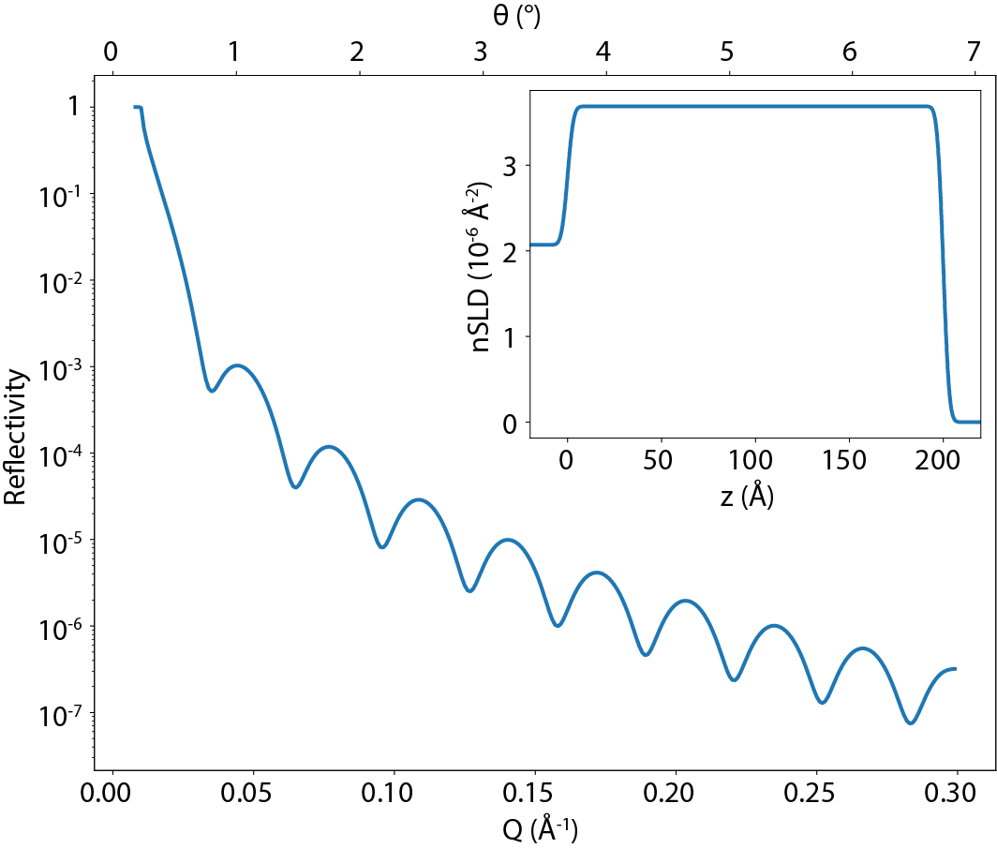
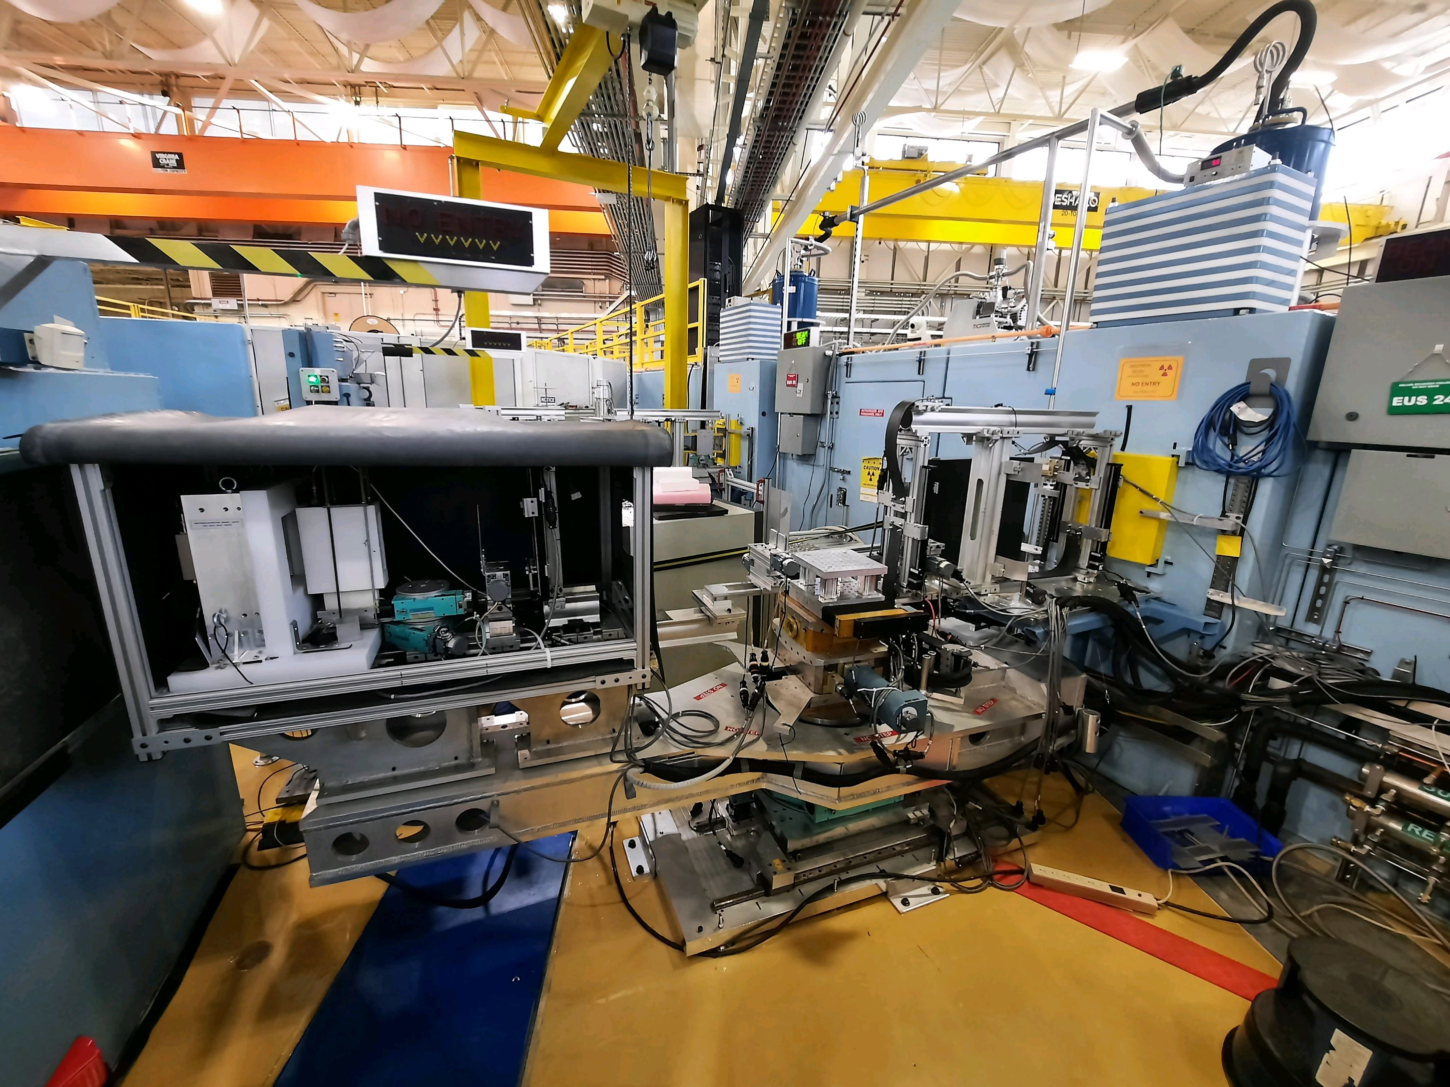
The goal…
…and the tool
SiO₂
Si
Real space model
air
J. Dura / NIST
Neutron reflectivity pattern

Slide 3
The basic idea
Interpretation of reflectivity data is model-based. It is best to know in advance what are the competing models*; then you can prepare your sample and measure your data to maximize your chances of discriminating among the various real-space models.
* this might involve a continuum of structures

Slide 4
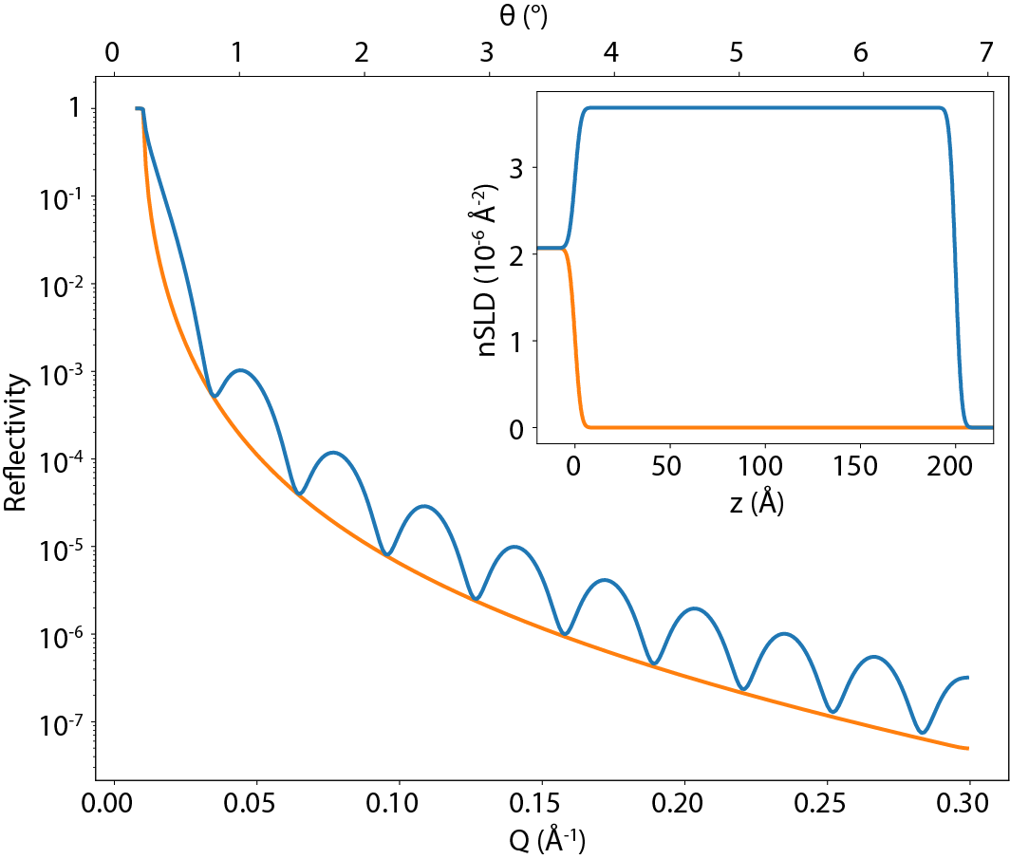
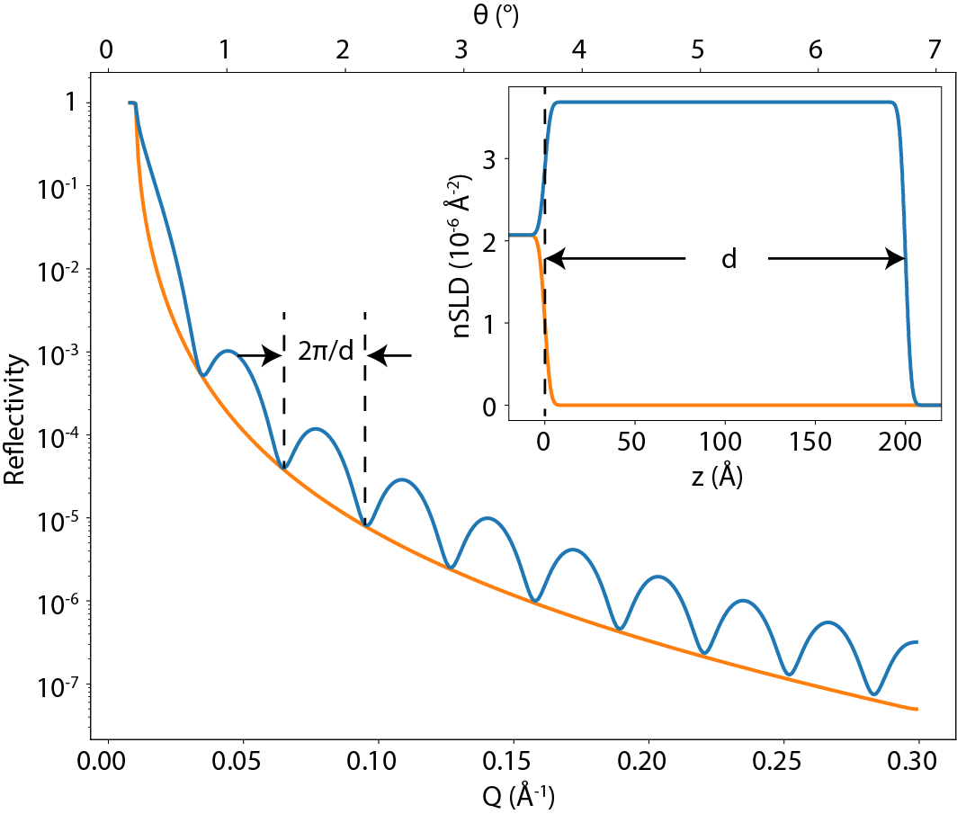
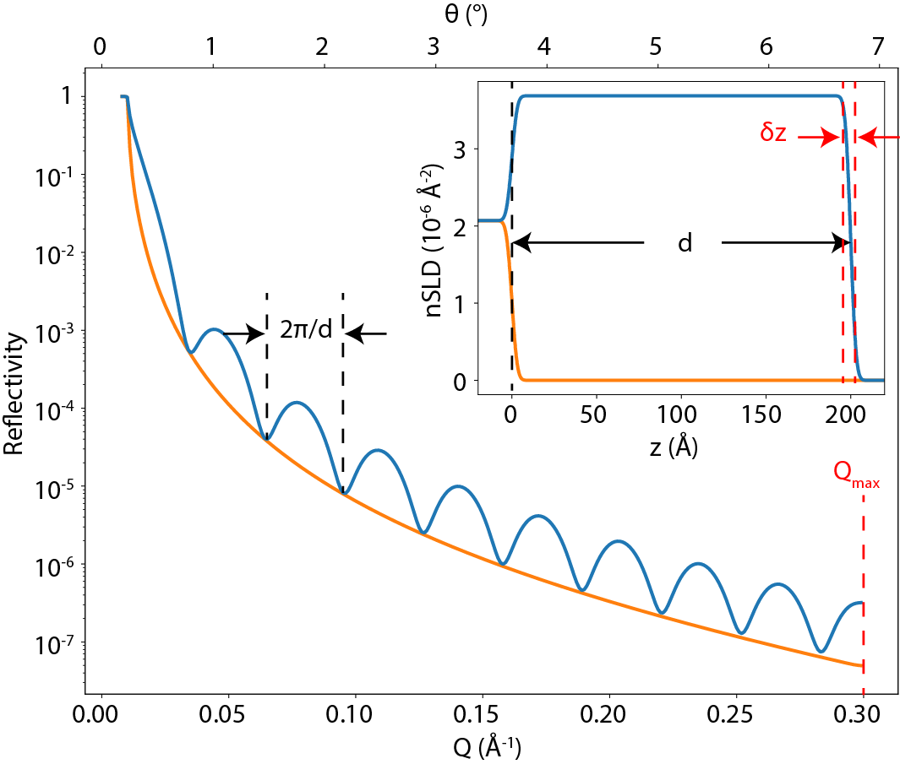
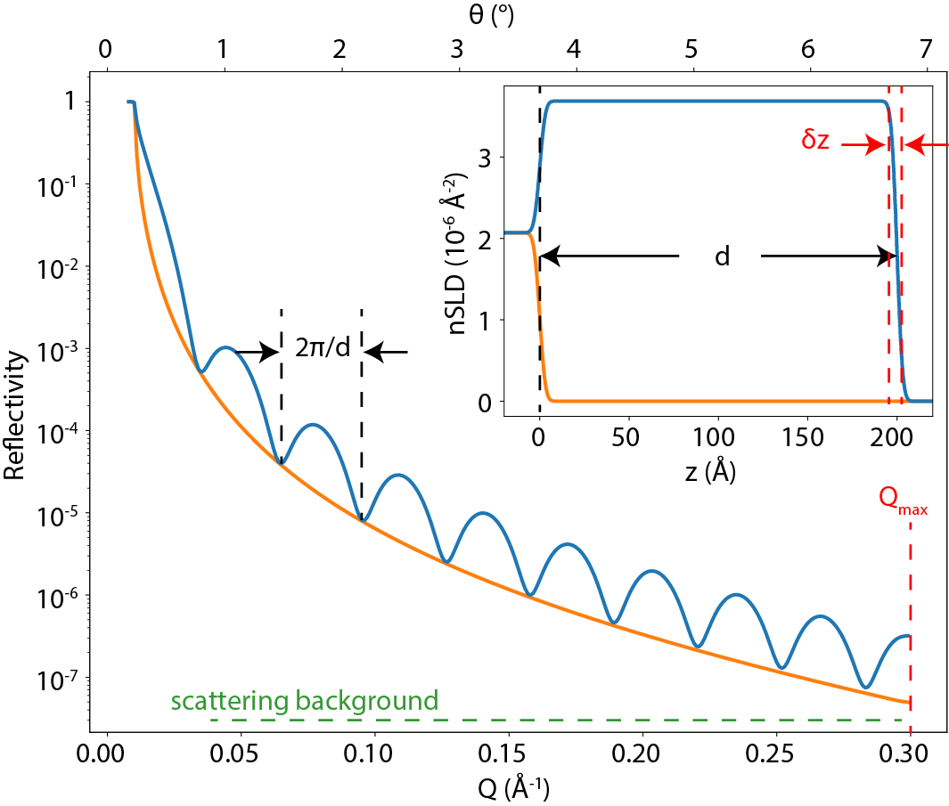
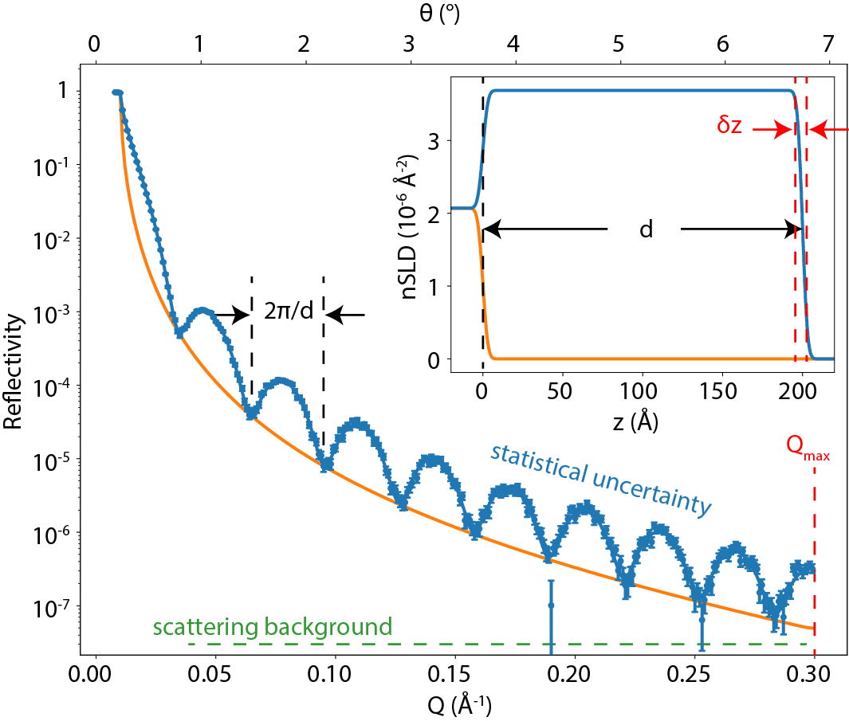
Elements of a reflectivity curve
oscillation period ⬄ film thickness
maximum Q ⬄ real space resolution
Scattering background ⬄ max Q
Statistics ⬄ parameter uncertainty

Slide 5
Experimental considerations
Sample
Film contrast with substrate
Film thickness
Film roughness
Film uniformity
Environment
Sample size
Instrument
Pre-sample collimation (angular resolution)
Post-sample collimation (background)
Data collection
Maximum Q
Number of Q steps
Counting time

Slide 6
Effect of film contrast
When nSLDs match, there is no longer any contrast
Sample design matters!
Recommended contrast: $ΔnSLD>1×{10}^{−6} Å^{−2}$
It’s always worth calculating your expected SLD profile and neutron reflectivity pattern ahead of time

Slide 7
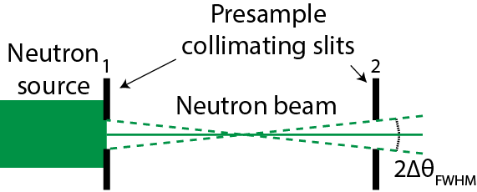
Effect of film thickness: thick films
Thick films require a tight point spacing
Angular resolution of the measurement starts to matter
Tradeoff with intensity

Slide 8
Effect of film thickness: thin films
Resolution of the measurement is determined by maximum Q value
High Q measurement takes a long time; reflectivity is very small.
Changes in layer thickness are much more easily detected

Slide 9
Effect of film thickness: surface roughness
Roughness causes reflectivity to drop off faster
Limits effective Q_{max} and hence real space resolution
Can also cause artifacts (or offspecular signal!) above about 10 Å rms
It is worth optimizing sample quality for low roughness

Slide 10
Effect of background
Background limits maximum Q
Comes mainly from interaction of the main beam with the sample and its environment
Background + roughness limits Q range of the measurement

Slide 11
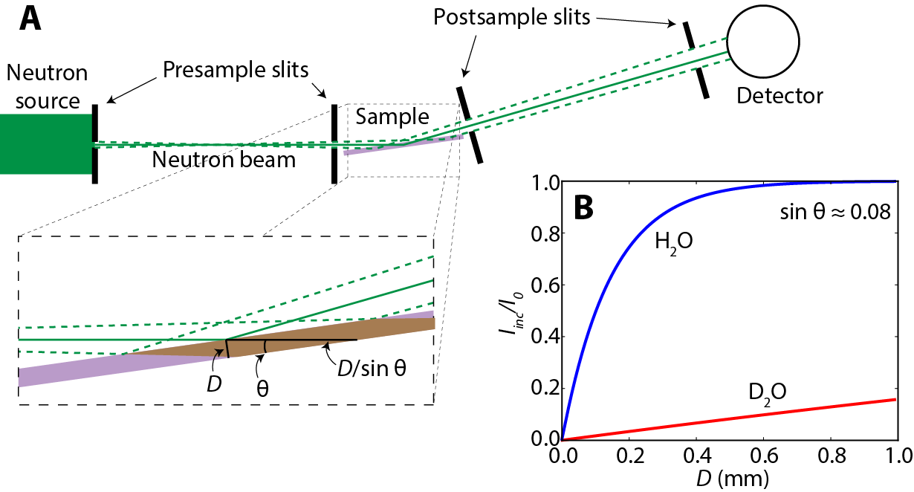
How to reduce background
Tight post-sample collimation
Use the right materials for substrate and sample environment: avoid hydrogen (plastic)

Slide 12
How to measure background
Move detector or sample so $θ_{i}≠θ_{f}$ (offspecular condition)
Interpolate to estimate background under the specular signal (discussed further in data reduction module)
Gains no more than a factor of 10 in reflectivity

Slide 13
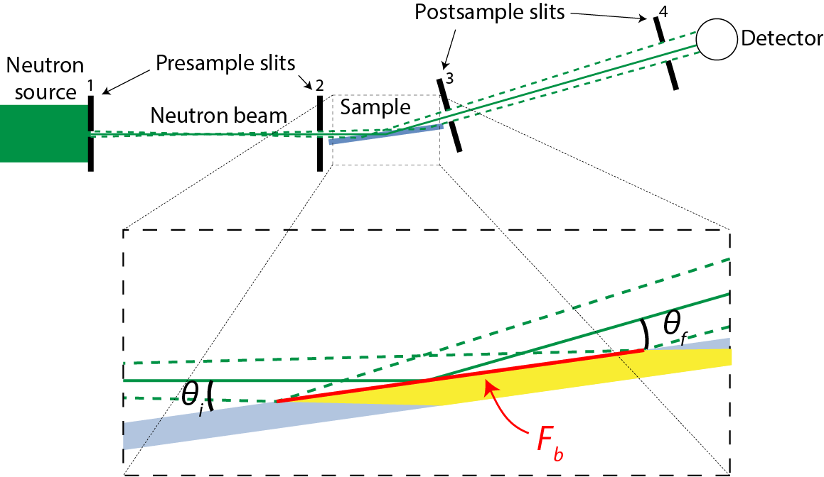
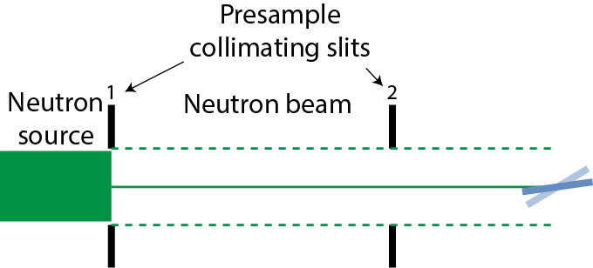
Effect of sample size
Large samples
constant footprint
intensity changes with angle
Small samples
constant beam size
beam footprint changes with angle

Slide 14
Mounting the sample
What sample environment do I need?
Do I have the physical hardware/sample mounts to put the sample on the sample table
Talk to your friendly local instrument scientist!

Slide 15
How to align a reflectometry sample
Eyeball it!
Rough alignment
Close collimation so detector can handle the direct beam
Move to a direct beam geometry (sample and detector angles 0)
Find the sample by scanning sample translation
Scan sample rotation
Iterate a couple of times
Fine alignment
Move to a reflection geometry (sample angle to $θ$, detector angle to $2θ$).
Iterate among sample rotation, translation, and tilt. The intensity will be peaked around the optimal values.

Slide 16
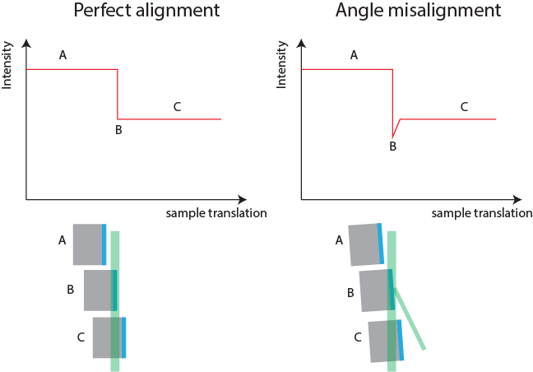
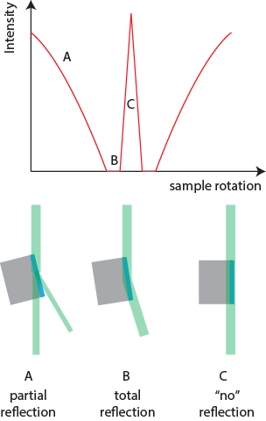
Direct beam alignment
Sample translation
Sample rotation

Slide 17
Sample alignment video game
From Brian Maranville: https://www.ncnr.nist.gov/instruments/magik/d3-science-v4/demos/reflectometer_alignment_sim_three.html
Move the sample rotation and translation to direct the beam into the detector.
In practice, after a rough alignment, this is done by:
Positioning the detector at an angle $2θ$
Optimizing the sample rotation and translation to maximize the count rate in the detector. This is done, along with a sample tilt, in an iterative fashion
Define the sample rotation angle to be $θ$ at this position.

Slide 18
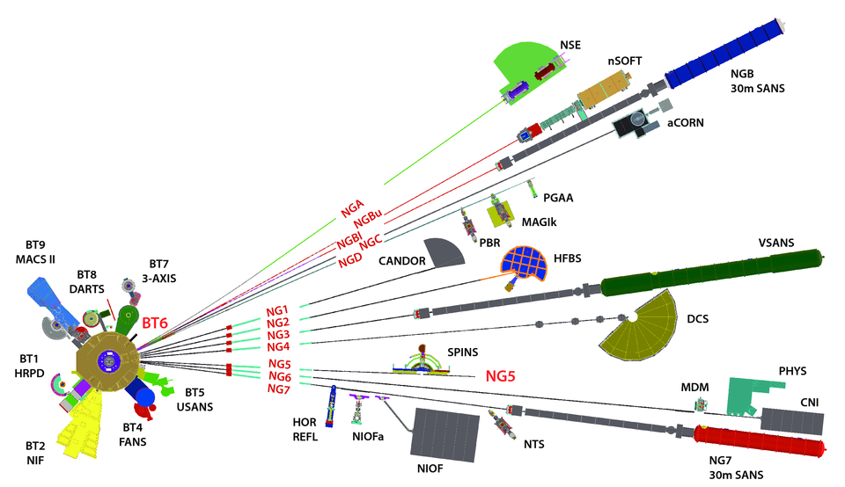
Reflectometry suite @ NCNR

Slide 19
Monochromatic reflectometers
← MAGIK
Neutron source is a graphite monochromator
Very good (≈ 1%) wavelength resolution
Relatively low flux (uses only about 1% of the neutrons in the guide)

Slide 20
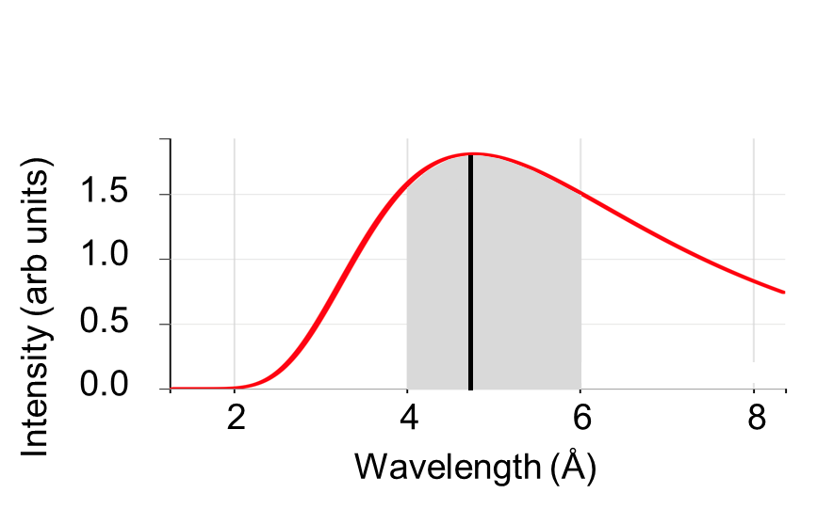
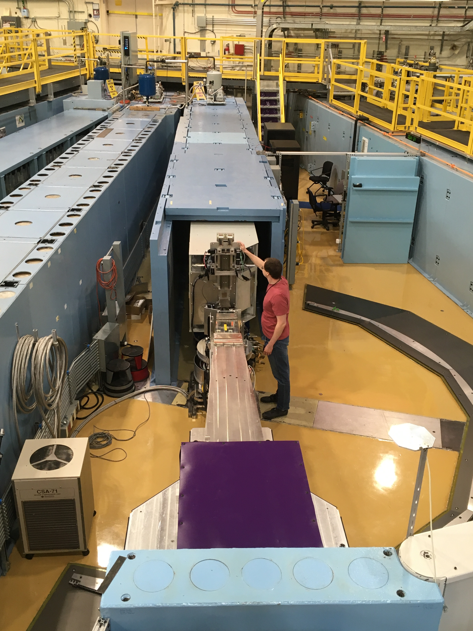
CANDOR polychromatic reflectometer
NIST/Dan Neumann

Slide 21
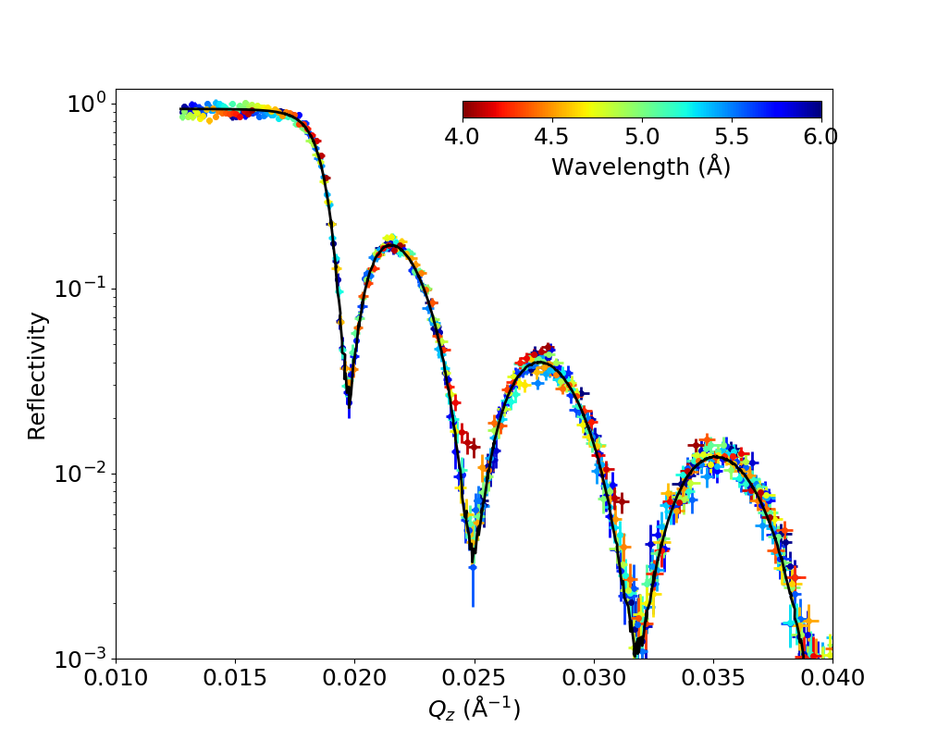
CANDOR polychromatic reflectometer
NIST/Dan Neumann
Current speed improvement: 20x

Slide 22
Questions?
Contact me:
David Hoogerheide
david.hoogerheide@nist.gov
https://www.nist.gov/ncnr/neutron-instruments/reflectometry
Or any of your other friendly instrument scientists!

