Slide 1
Data Management in FactSage
Sergei A. Decterov
École Polytechnique de Montréal

Slide 2
Repository of Thermodynamic and Phase Equilibria Data
  Should there be one Repository or several Repositories for different types of systems?
    Organics
    Alloys
    Sulfides
    Oxides
  Viable Repository
    Sufficiently large
    Constantly updated: large amount of data are added
  Format of Repository
    Mandatory fields
    Recommended fields
    Possibility to enter data in free format
    It should be easy for authors to add data

Slide 3
Bibliographic Database
  ID number for each reference
    Never changes
  Reference
    Chemical Abstracts standard
  Affiliations
    It is essential to know the lab for data evaluation
  E-mail
    For making inquiries
  Link to the article
    Abstract
    Is it possible to have a PDF copy?
  References and links to related articles
    Description of the experimental method
    Studies of the same system by the same group

Slide 4
Bibliographic Database
  Who cited this article?
    Science Citation Index accessed through the Web of Science
    Scopus from Elsevier
    Google Scholar
    Microsoft Academic
  Blog
    Inquiries sent to the authors and their replies
    Discussion of data quality
    Should not be anonymous?
  Notes and Editorial notes
    Brief summary of the data made by any user
    Editorial notes made by database managers
  Importance

Slide 5
Studied Chemical System
  Elements in alphabetical order
    For all studied systems and subsystems
  Search capabilities
    Search for a particular system
    Search for a particular system with subsystems
  System components
    For example CaO-Al₂O₃-SiO₂
  Phases
    bcc, fcc for alloys
    Major minerals for oxides (feldspar, olivine, pyroxene, etc.)

Slide 6
Keywords
    Calorimetry Calorimitric measurements
    CpHT Cp at high temperature (>298 K)
    CpLT Cp at low temperature (<298 K)
    H-H298 Heat content H(T)-H(298)
    Hm Enthalpy of mixing
    Hf Enthalpy of formation
    Trans Enthalpy and Temperature of Fusion/Transformations
    EMF EMF measurements
    Gf Gibbs energy of formation
    Act Partial Gibbs energy and/or Activities
    TD Thermodynamic properties
    Entropy Entropy
    Isopiestic Isopiestic measurements
    PO2 Partial Pressure of Oxygen
    Pgas Partial Pressures (other than oxygen)
    Ptot Total Vapour Pressure

Slide 7
Keywords
    PD Phase Diagram
    PE Phase Equilibria
    Liquidus Liquidus equilibria
    Solidus Solidus equilibria
    SubSol Subsolidus equilibria
    SlbLim Solubility Limit
    InvPnt Invariant Points
    MisGap Miscibility Gap
    Distrib Distributions of minor elements among several phases
    Fe2/Fe3 Fe2+/Fe3+ ratios
    Str Crystal Structure Data
    LatPar Lattice Parameters
    CD Cation Distribution
    NonSt Nonstoichiometry, defects (vacancies, etc.)
    Ordering Order-disorder transformations; Short-range ordering
    Spectr Spectroscopic data

Slide 8
Keywords
    Magn Magnetic properties (Tcurie, Tneel, magnetic moment, etc.)
    SurfTen Surface Tension
    Th-Cond Thermal Conductivity
    Visc Viscosity
    Diff Diffusion
    Kin Kinetic data
    Vol Molar Volume or Density
    dV/dP Compressibilities, Bulk Modulus
    dV/dT Thermal Expancivities
    High-P High Pressure data
    Model Modeling
    Opt Optimization
    Rev Review
    Estim Estimation of Thermodynamic Properties
    Exp Experimental methods
    Appl Applications of computational thermodynamics

Slide 9
Phase Identification
  Known structure with atomic coordinates
    Space Group and Wyckoff Sequence
      Inorganic Crystal Structure Database from FIZ Karlsruhe (Leibniz Institute for Information Infrastructure)
      Depends in some space groups on the choice of origin
    We need to know what phases have related structures
      Modeling of several phases as one solution
    May not tell the whole story
  Information on crystal structure is incomplete
    What to store?
    How to search?

Slide 10
Na₂O-Al₂O₃-SiO₂ system
SiO₂
Solid solutions
Albite, NaAlSi₃O₈, end-member of multicomponent feldspar
Jadeite, NaAlSi₂O₆, end-member of multicomponent pyroxene
NaAlSiO₄–based nepheline and carnegieite solid solutions
NaAlO₂–based solid solutions
Na₂O
Al₂O₃

Slide 11
Na₂O-Al₂O₃-SiO₂ system
S
N
A

Slide 12
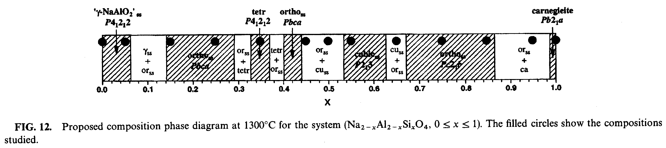
Solid Solutions in the NaAlO₂-NaAlSiO₄ region

Slide 13
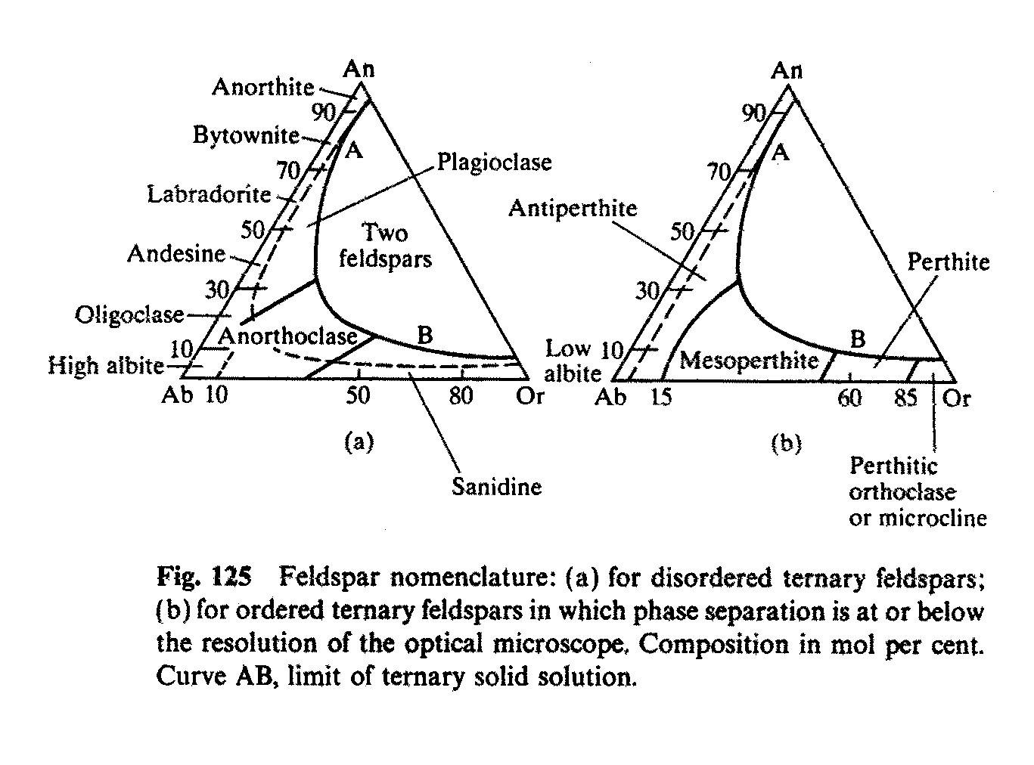
Feldspar
Composes ~60% of the Earth’s crust
One of the most and best studied silicate solid solutions.
The phase transitions are among the most complex
CaAl₂Si₂O₈
Anorthite
NaAlSi₃O₈
Albite
KAlSi₃O₈
Orthoclase

Slide 14
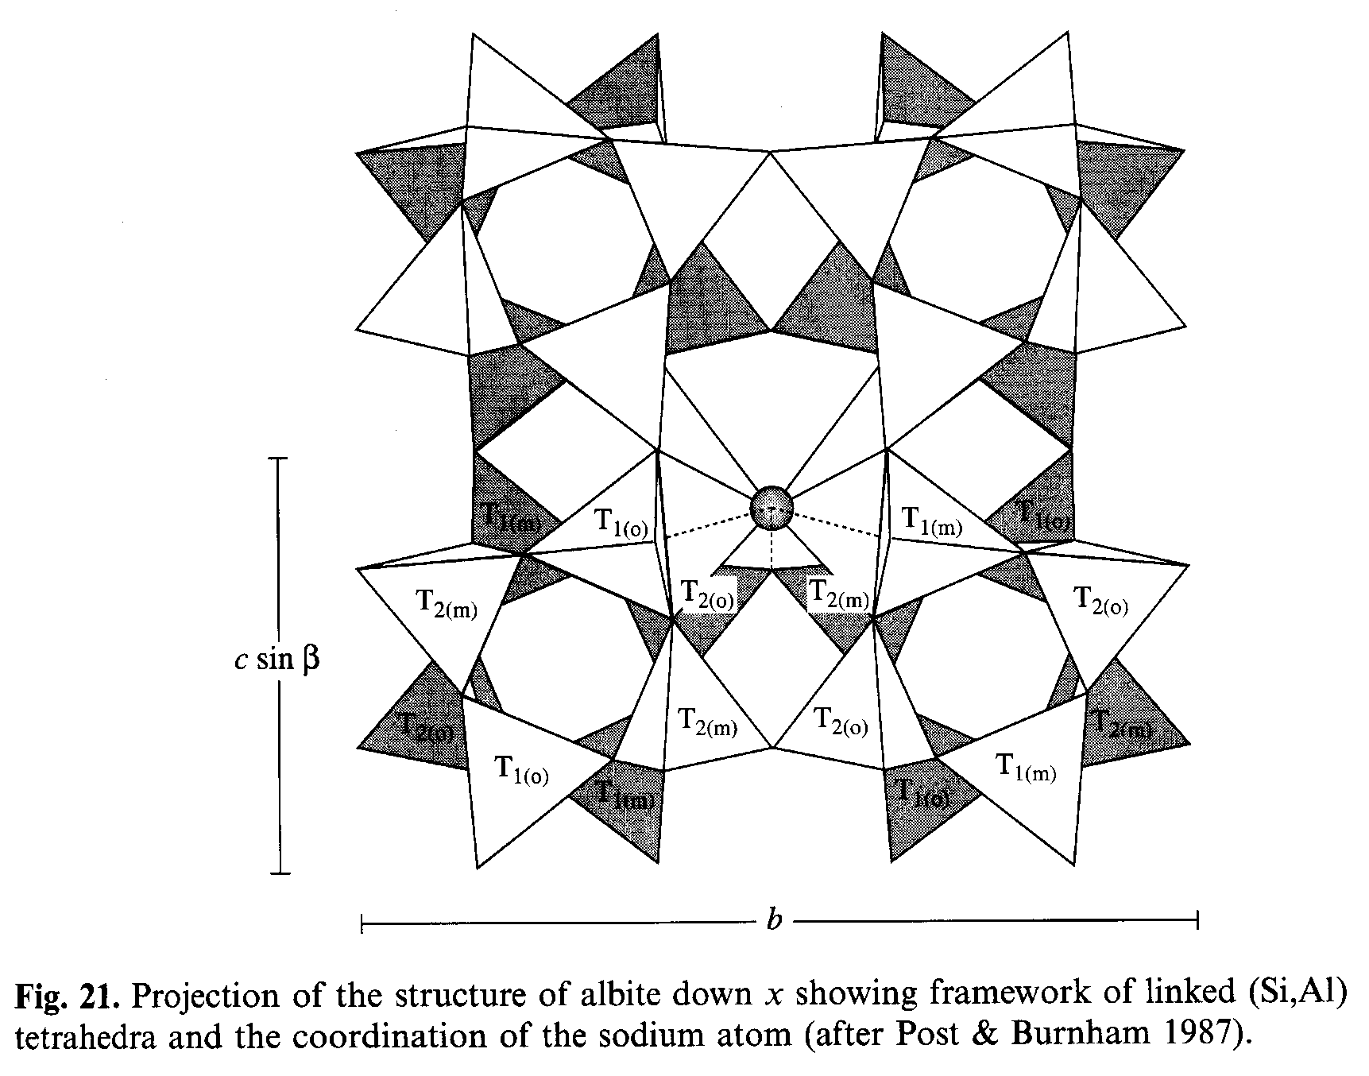
Feldspar Structure
Framework silicate

Slide 15
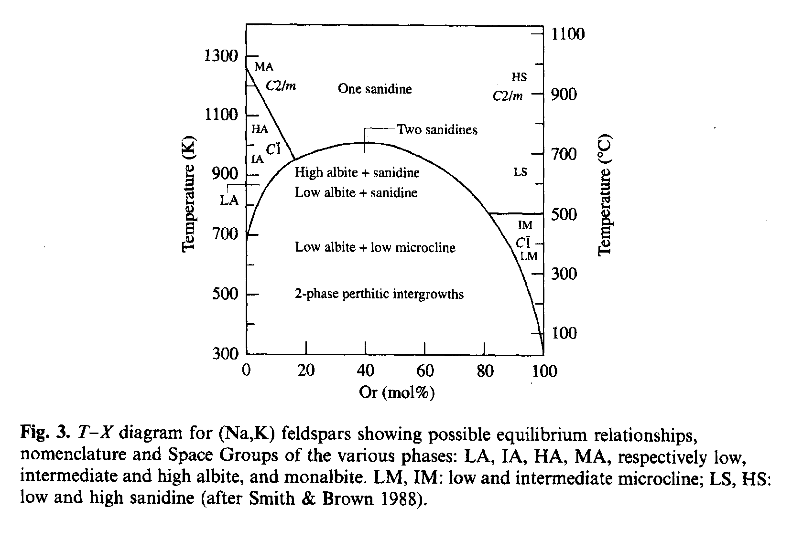
Alkali Feldspar
What are the phases?
NaAlSi₃O₈
Albite
KAlSi₃O₈
Orthoclase

Slide 16
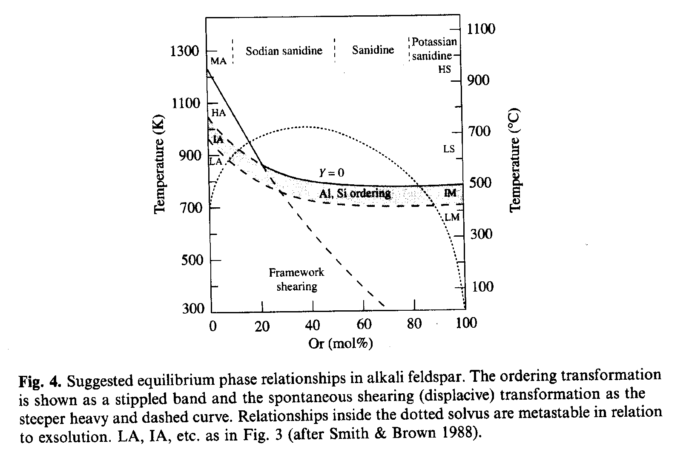
Alkali Feldspar
Most feldspar minerals and samples are metastable:
Equilibrium long-range ordering is not reached
C2/m
C2/m
CĪ
CĪ
NaAlSi₃O₈
Albite
KAlSi₃O₈
Orthoclase

Slide 17
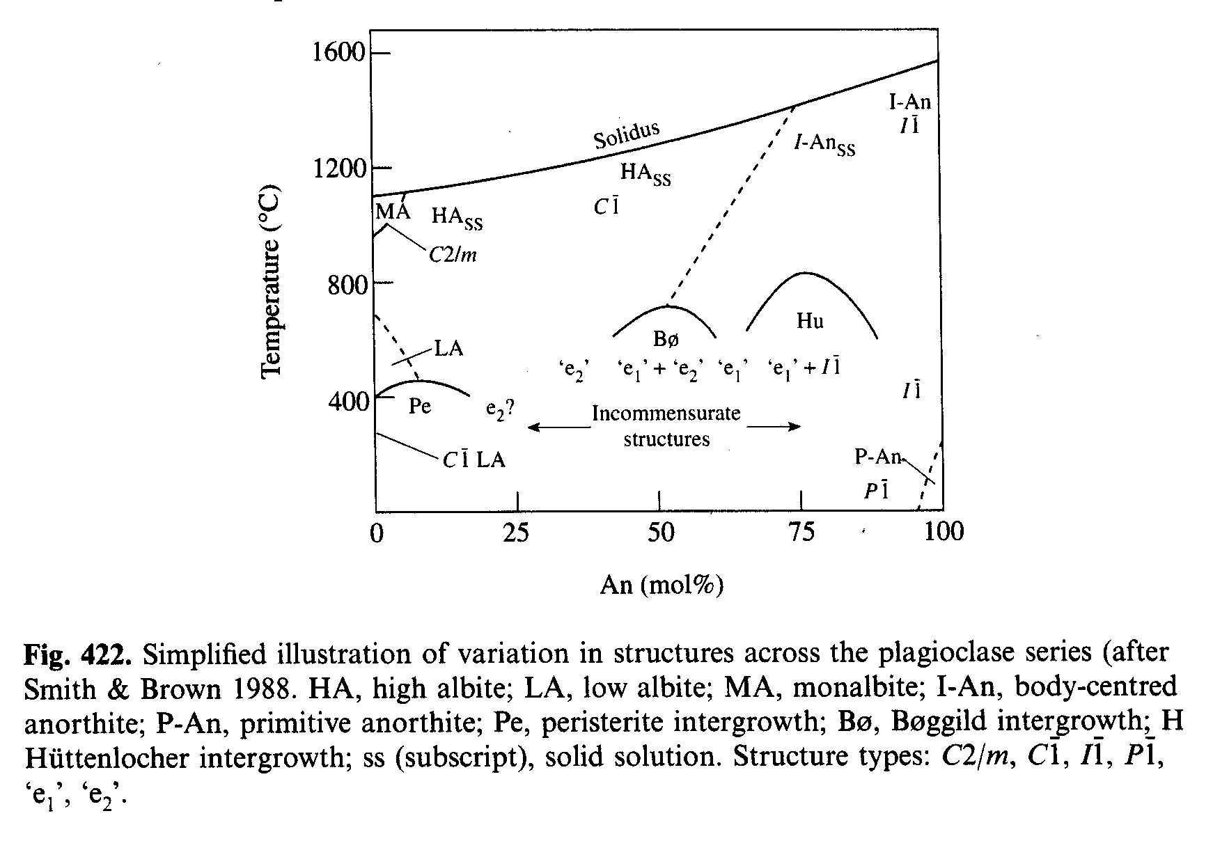
Plagioclase Feldspar
NaAlSi₃O₈
Albite
CaAl₂Si₂O₈
Anorthite

Slide 18
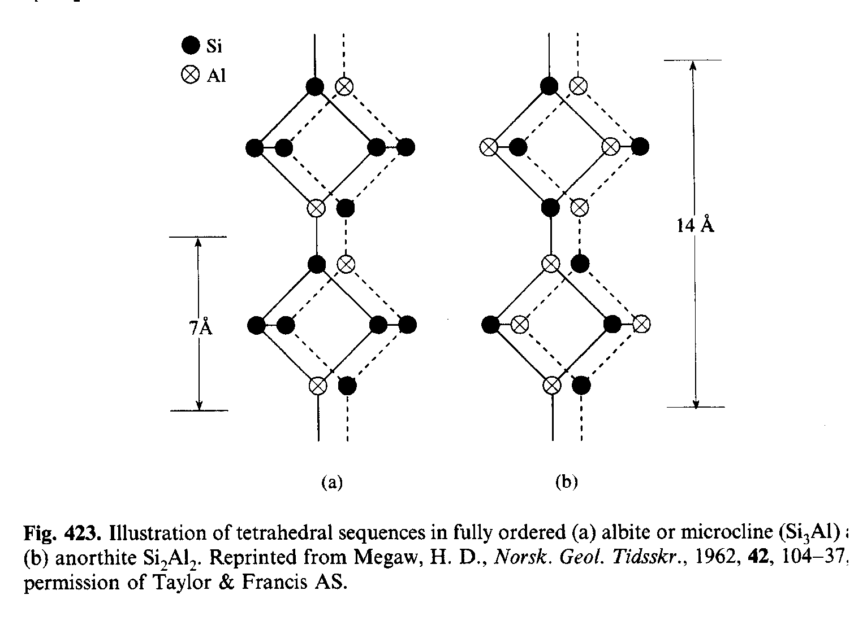
Plagioclase Feldspar
C1 -> I1 phase transition
  Probably 2nd order
  Different tetrahedral sequences of Al and Si in albite and anorthite

Slide 19
Feldspar
Al-Si ordering is very slow.
  Most experimental measurements are made on metastable samples (not under equilibrium conditions)
  Normally, disordered phases form first
What database do we need?
  Thermodynamic properties of equilibrium (ordered) feldspars?
  Thermodynamic properties of metastable (more disordered) feldspars that initially form in phase equilibrium measurements?
How can we identify the studied phase?
  Crystal structure
  Thermal history of samples

Slide 20
Information to Store in the Database
Characterization of Samples
  Analysis (before and after the experiment)
  Thermal history
  Crucibles
  Atmosphere
Unambiguous characterization of the data
  Store primary experimental data (e.g. EMF rather than recalculated thermodynamic properties)
  Units (e.g. pressure in bar or atm)
  Activities, ΔH_{f} with respect to what phases (and at what T )?
  Data used to calculate the reported values
  1st principles and MD data represent what particular measurable thermodynamic properties and at what conditions?

Slide 21
B₂O₃-SiO₂

Slide 22
B₂O₃-SiO₂ system

Slide 23
B₂O₃-SiO₂ system

Slide 24
B₂O₃-SiO₂ system

Slide 25
B₂O₃-SiO₂ system

Slide 26
B₂O₃-SiO₂ system

Slide 27
Functionality
It must be easy to enter data
  Copy and paste the whole table
  Plenty of space for headings
  Impossible to devise a universal set of fields to fill
Graphs
  Any column of a table versus any other column
  Data from different data sets plotted on the same graph
Tables that can be copied and paste into Excel
  The whole table, not one number at a time

Slide 28
Conclusions
Very few mandatory fields
  Search for a particular system
  Type of data
Recommended fields
  Not really for search, but to remind what is important
Enter data in free format
  Copy and paste Excel tables

