Slide 1
Privacy Risk Assessments: A Prerequisite to Privacy Risk Management

Slide 2
Trustworthy Systems: Foundational to a Digital Society
What makes systems trustworthy?
Multiple attributes of trustworthiness include security, safety, reliability, etc.
Privacy must be considered one of the attributes
How can we know if systems are trustworthy?
Repeatable and measurable approaches help provide a sufficient base of evidence
Privacy needs a body of guidance for repeatable and measurable approaches similar to other attributes of trustworthiness

Slide 3
Friction in Our Digital World
45% of online households reported that privacy or security concerns stopped them from:*
Conducting financial transactions;
Buying goods or services;
Posting on social networks; or
Expressing opinions on controversial or political issues via the Internet.
*July 2015 data collected for NTIA at https://www.ntia.doc.gov/blog/2016/first-look-internet-use-2015

Slide 4
Primary Federal Driver
OMB July 2016 update to Circular A-130 clarified that:
Agencies’ obligations with respect to managing privacy risk and information resources extends beyond compliance with privacy laws, regulations, and policies
Agencies must apply the NIST Risk Management Framework in their privacy programs

Slide 5
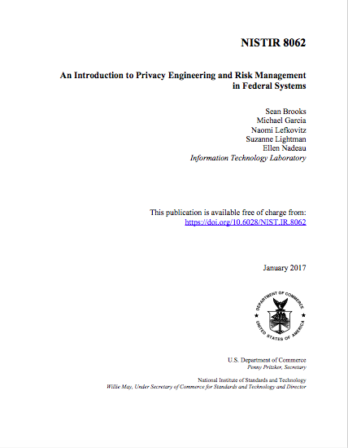
NISTIR 8062
An Introduction to Privacy Engineering and
Risk Management in Federal Systems

Slide 6
NIST Risk Management Framework
Starting Point
FIPS 199/SP 800-60
CATEGORIZE Information System
SP 800-137/SP 800-53A
FIPS 200/SP 800-53
MONITOR
Security State
SELECT Security Controls
Security Life Cycle
SP 800-30
SP 800-37
SP 800-39
SP 800-37
Many SPs
AUTHORIZE Information System
IMPLEMENT Security Controls
SP 800-53A
ASSESS
Security Controls

Slide 7
What is privacy risk?

Slide 8
Risk Analysis
Risk is a function of:
Likelihood of occurrence of adverse event
Impact from the occurrence

Slide 9
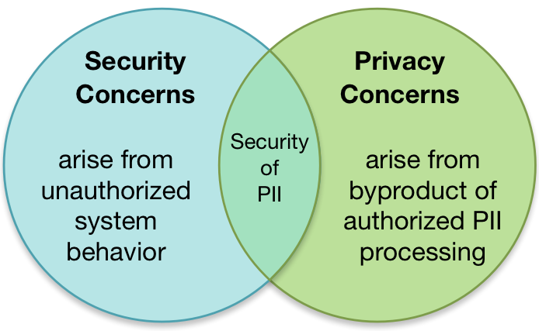
Information Security and Privacy: Boundaries and Overlap

Slide 10
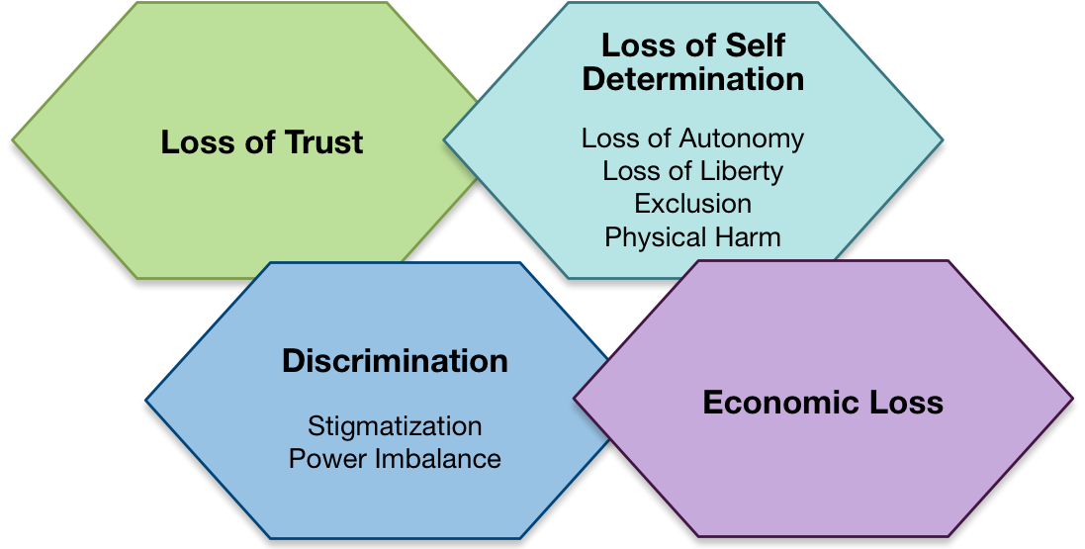
Processing PII Can Create Problems for Individuals

Slide 11
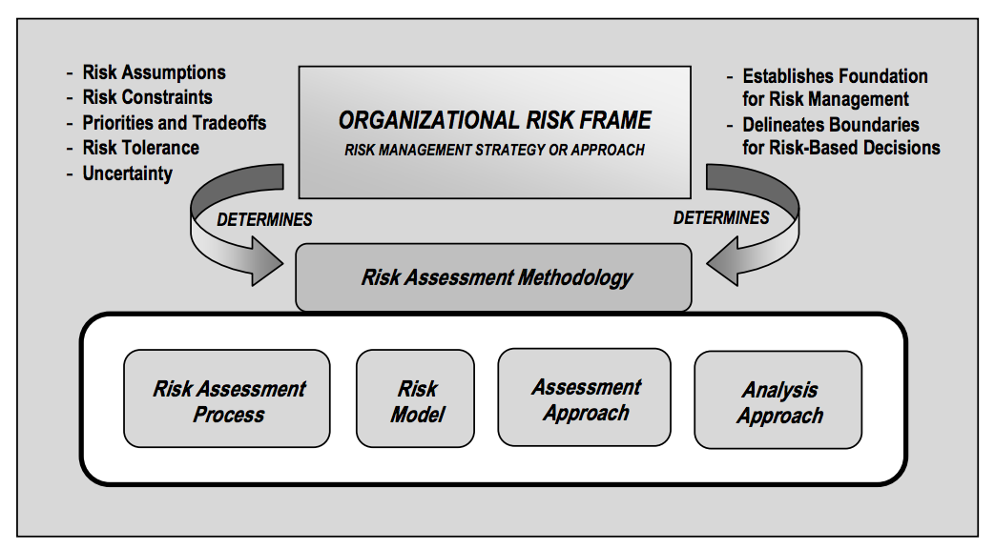
Risk Assessment Components
NIST Special Publication 800-30

Slide 12
Risk Model
Risk models define the risk factors to be assessed and the relationships among those factors.
Risk factors are inputs to determining levels of risk.

Slide 13
Security Risk Model
Risk factors:
Likelihood |Vulnerability | Threat | Impact

Slide 14
NIST Working Model for System Privacy Risk
Privacy Risk Factors: Likelihood |Problematic Data Action |Impact
Likelihood is a contextual analysis that a data action is likely to create a problem for a representative set of individuals
Impact is an analysis of the costs should the problem occur
Note: Contextual analysis is based on the data action performed by the system, the PII being processed, and a set of contextual considerations

Slide 15
Discussion for the Breakouts
How can organizations effectively do risk assessments for privacy?
Does a risk model for privacy differ from other risk models?
What should be the factors for analysis?
Notes:
If you are on the webcast or would like to supplement any discussion points you make today, we will be posting the questions to the website for those who would like to provide us with written feedback.

Slide 16
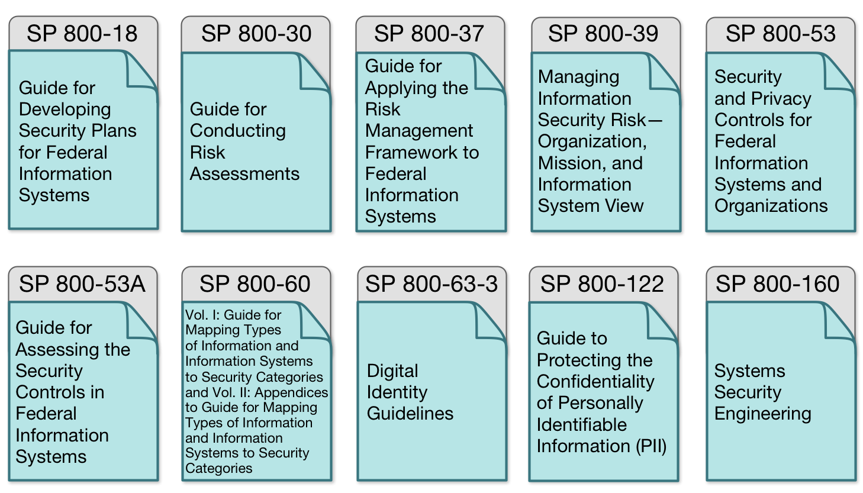
Guidance Roadmap

Slide 17
What Should NIST Do Next?
Which (if any) security-focused RMF documents require privacy parallels or additions?
What other tools are needed for organizations to effectively do privacy risk management?
What should be the prioritization?

Slide 18
NIST Privacy Risk Assessment Methodology (PRAM)
Frame Org Privacy Governance
Assess System Design
Assess Privacy Risk
Select Privacy Controls
Monitor Change
Frame Business Objectives
Notes:
Introduce Jenn

