Slide 1

Developing Diffusion Experiments for Space: Possibilities
patton.downey@nasa.gov
256-544-6432
Presenter: James Patton Downey
NASA Marshall Space Flight Center

Slide 2
Research Directions
Measurement of thermophysical properties that are not possible to make on earth has consistently received high priority endorsement in external reviews of the NASA microgravity program.
These thermophyiscal property measurements have included various types of diffusion measurements that are enabled by reduction of buoyancy driven convection that occurs in earth based experiments.
A NASA Research Announcement in Materials and Fluids is planned in the latter half of this calendar year and proposals for diffusion related studies would be welcomed.
The announcement will be made on the website
http://nspires.nasaprs.com/external/

Slide 3
Example Spaceflight Diffusion Experiments
Shear Cells where the fluid bodies are allowed to mix then separated;
Experiments mainly conducted by Gunter Frohberg and colleagues.
Radiotracers used by Dr. Banish of the University of Alabama in Huntsville for determining Indium self-diffusion from data obtained in situ and by Dr. Unakawa of Howard for Zn (post-flight analysis)
Thermal diffusion experiments on organic liquids proposed by Dr. Banish.
Oxygen diffusion in melts using Yttria Stablized Zirconia based Electro-Chemistry proposed by Dr. Tim Anderson of Florida (now at Massachusetts)
Diffusion and Thermodiffusion Coefficients Measurements in organic ternary mixtures (DCMIX) is an ongoing ESA team effort
Soret Coefficients of organics in aquesous solutions – Van Vaerenberg & Legros
Soret studies of AgI/KI molten salt by Bert and Dupey-Philon
Suzuki, et. al. plan Soret studies using interferometry; team is sponsored by JAXA
Soret Coefficients in Crude Oil (SCCO) is an ongoing team sponsored by ESA

Slide 4
Hardware Available for Use
Microgravity Science Glovebox (MSG) – Used for chemical containment
Coarsening of Solid/Liquid Mixtures (CSLM) hardware – Heats small discs (12x6mm) up to 185C and provides for a quick quench using water.
Pore Formation and Mobility Investigation (PFMI) hardware – Directionally solidifies transparent organic materials from near ambient to 120C
Solidification Using a Baffle in Sealed Ampoules (SUBSA) hardware – A one zone heater capable of 850C max
Materials Science Research Rack – Two directional solidification furnaces are available, the Large Gradient Furnace and the Solidification with Quench furnace
EXPRESS Racks – For small to mid-sized, near ambient and largely automated payloads.
DIXI – A proposed German facility in which in situ x-ray images of samples can provide inter-diffusion data of heavy elements in light (Li, Al, Mg)
Proposers may also propose to build their own experimental flight hardware (Should only be done for simple hardware concepts)

Slide 5
MSG-Payload Interfaces/Resources
General illumination
  1000 lux @ 200mm above WV floor
Video
  4 color Hitachi HV-C20 cameras
  2 Sony DSRV10 Digital Recorders
  2 Sony GV-A500 Analog 8mm Recorders
Data handling connections
  T61P Laptop Computer
  Two RS422-to-MSG for investigations
  One MIL-BUS-1553B-to-MSG for communication via MLC
  Ethernet LAN 2
Filtration
  12 HEPA/charcoal/catalyst WV filters (Replaceable on orbit)
1 HEPA/charcoal/catalyst Airlock filter
  Replaceable on orbit
Up to Two Levels of Containment
  Physical barrier of MSG structures, gloves, etc.
  Negative pressure generated by MSG fans.
Other resources available
  Gaseous Nitrogen
  Vacuum (VRS & VES)
Work Volume (WV) - Volume
  0.255 m³ = 255 liters
Work Volume - Dimensions
  906mm wide x 637mm high
  500mm deep (at the floor)
  385mm deep (at the top)
Maximum size of single piece of equipment in WV (via side access ports)
  406mm diameter
Maximum size of single piece of equipment in WV (via the airlock)
  254 x 343 x 299 mm
Payload Attachment
  M6 threaded fasteners in floor, ceiling, & sides
Power available to investigation
  +28V DC at useable 7 amps
  +12V DC at useable 2 amps
  -12V DC at useable 2 amps
  +5V DC at useable 4 amps
  +120V DC at useable 8.3 amps
Maximum heat dissipation
  1000W Total
    800W from coldplate
    200W from air flow

Slide 6
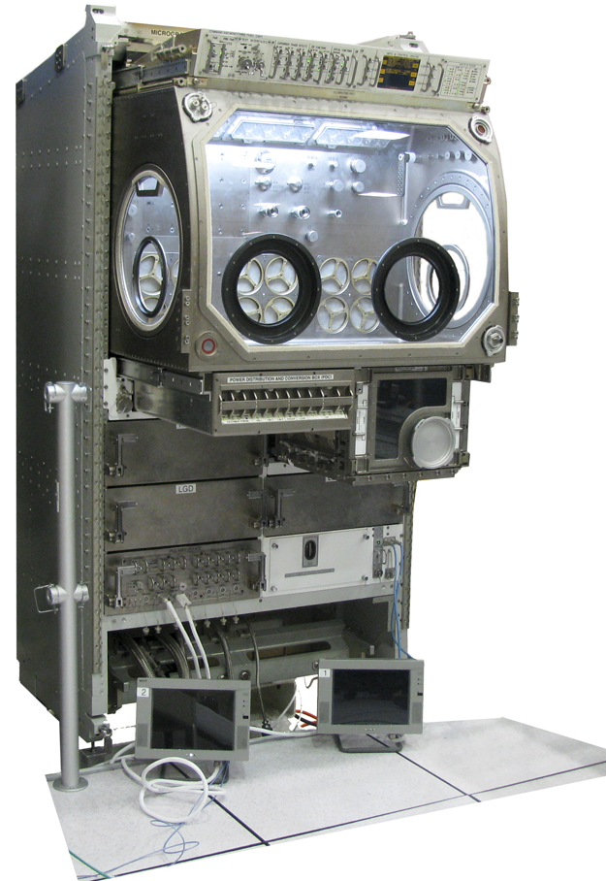
MSG Facility Hardware Overview
Removable Side Ports
16” diameter on both Left and Right sides for setting up hardware in Work Volume
Front Window Glove Ports
Four 6” diameter glove ports can be fitted with any of three different sized gloves or blanks
Glove Ports
Four identical glove ports are located on the left and right side loading ports and the front window
Core Facility
Retractable Core Facility includes the Work Volume, Airlock, Power Distribution & Switching Box, and the Command and Monitoring Panel
Airlock
Provides a “Pass Through” for hardware to enter the Work Volume without breaking Containment. The lid of the Air Lock opens up into the floor of the Work Volume
DC Power Switching
And Circuit Breakers
Airlock Glove Port with Blank
A Single 4” diameter glove port can also be fitted with any of three different sized gloves or a blank
Stowage Drawers
Video System Drawer
Stowage Drawers
Engineering Unit Located at MSFC

Slide 7
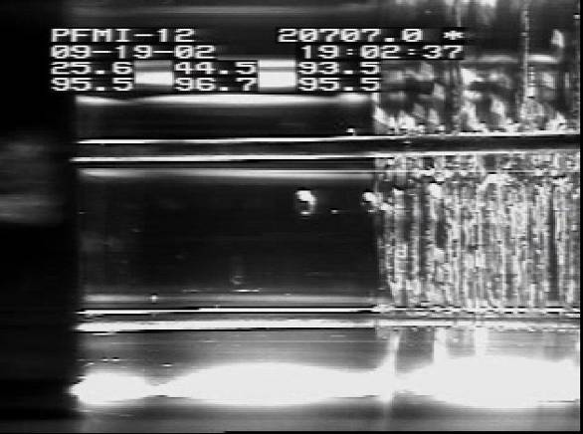
Pore Formation Mobility Investigation (PFMI)
Programmatic Advantages:
PFMI Hardware used in previous ISS experiments
Utilizes Transparent Materials, Succinonitrile-H₂O
Experiments Implemented in the ISS Glovebox.
Some Astronaut Intervention.
Many Sample Cartridges, can be Reused
Development Approach:
The PFMI unit, as is, has a working temperature range from ~0° to 120°C and utilizes Transparent Samples. Has Temperature Gradient and/or Isothermal Capability. Directional Solidification or Static Sample Processing
Upgrade/Modify Video Camera System
Evaluate other Transparent Model Systems
On Orbit Video Snapshot Showing Two Bubbles leaving the Interface and Moving up the Imposed Temperature Gradient by Thermocapillary Flow. “Housekeeping” Data superimposed at the Top.
Additional Metal Analogue Studies:
Columnar to Equiaxed Dendrite Transition Experiments
Particle Pushing / Distributions in Castings
Eutectic/Monotectic/Peritectic Studies
Additional Dendrite Studies, e.g., Low Volume Fractions
Sample Cartridge used in the PFMI Experiments
PFMI Microgravity Investigations:
Pore Mobility Studies
Dendrite Growth Studies
Thermocapillary Flow Studies
Planar Interface Breakdown Studies
“Gaserite” Studies
Particle Movement at Interfaces
Disruption of Dendrite Growth Fronts
Potential Applications to Other Systems / Disciplines
Crystal Growth Studies, Nucleation and/or Dissolution, Interactions
Organic Crystal Growth Studies
Biomaterials, e.g., Scaffolding Experiments
Cementation Reaction Studies.

Slide 8
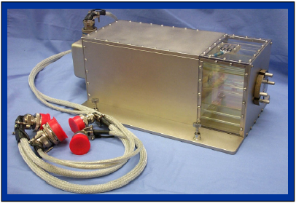
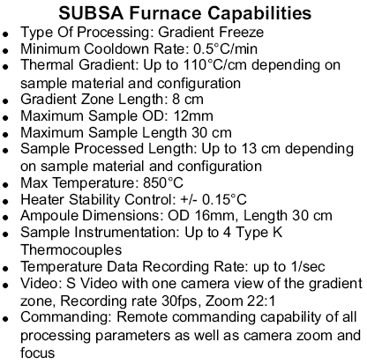
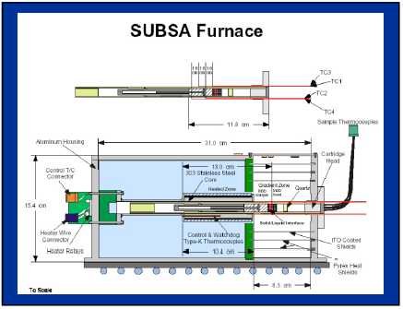
SUBSA Furnace Capabilities
June 19, 2002

Slide 9
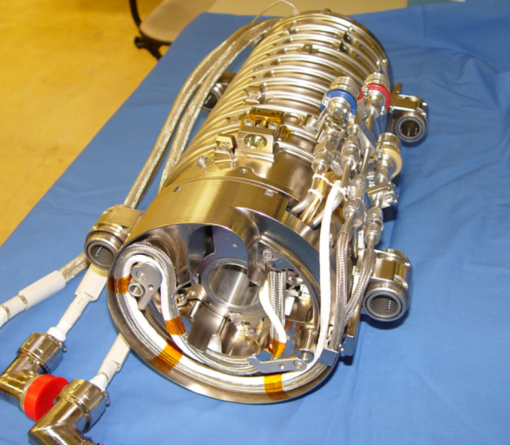
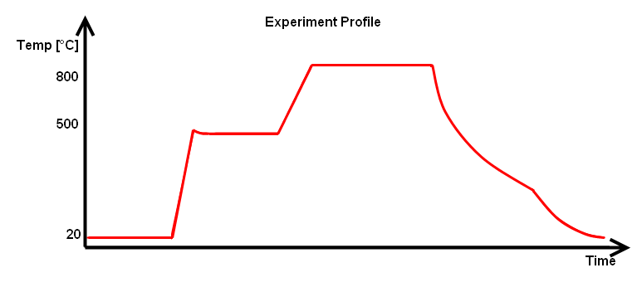
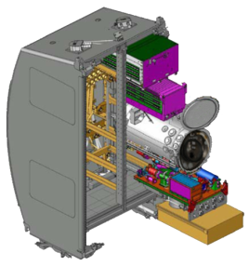

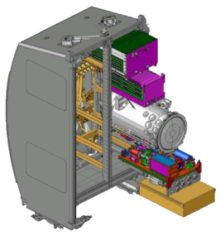


Solidification with Quench Furnace
Temperature gradients of 50 - 100 K/cm
3 thermocouples per heater zone
4 heater zones (up to 1400°C)
Exchangeable adiabatic zone
Cooling zone (60°C – 90°C)
Sample Cartridge Assembly Extraction
Sample Cartridge Assembly Installation
Evacuation
Heat-up
Processing
Cooldown
  Temperature gradients of 50-100 K/cm
  3 thermocouples per heater zone
  4 heater zones
  Exchangeable adiabatic zone
  Cooling zone (60°C – 90°C)
crew sleep
© DLR

Slide 10
Large Gradient Furnace (LGF)
LGF is a Bridgman furnace that supports directional solidification of metals and growth of semiconductors at gradients in a typical range < 40 K/cm.
LGF consists of a "cold" and a "hot" cavity separated by an 50mm adiabatic zone (booster heater and "heat extraction zone" to maximize thermal gradient if needed)
Vacuum operation
Maximum furnace displacement 150 mm
Temperature of each heated zone can be controlled with 2 redundant WRe-thermocouples located inside the diffusers
Carbon reinforced carbon diffusers provide for enhanced circumferential temperature uniformity
maximum zone temperature: 1400 °C at the level of the diffusers.
Rotating magnetic field (see below)

Slide 11
Diagnostics and Stimuli for MSRR Experiments
Temperature monitoring for 12 thermocouples (inside SCA)
Independent heating and temperature control of an internal reservoir (in order to control the vapor pressure of volatile elements in compound semiconductors [GaAs, CdTe]).
Direct Current (DC) or Rotating Magnetic Field (RMF) with maximum field strength at "hot" side of adiabatic zone
  magnetic flux density: ~ 4.1 mT at 100 Hz,~ 1.5 mT at 400 Hz
Current Pulses:
  max. current 100 A [40 V], max. voltage 80 V [50 A],
  pulse duration 100 msec - 4 sec
Stepper motor interface (e.g. shear cell actuation for diffusion experiments)
Ultrasound diagnostics for determination of the solid/liquid interface position (transducer package to be provided as part of the sample).
Further diagnostics / stimuli can be added as "Experiment Dedicated Electronics" (to be individually developed).

Slide 12
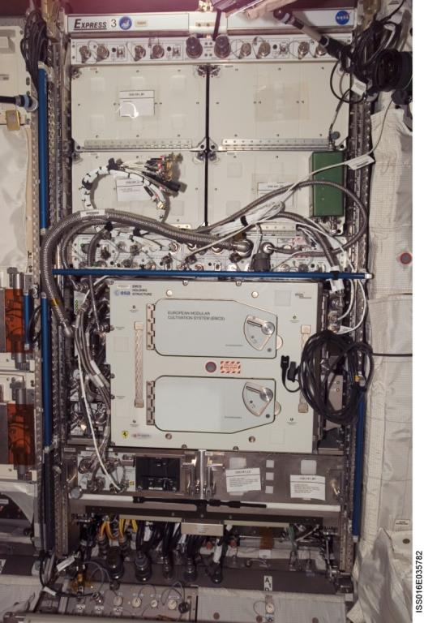
EXPRESS Rack
EXpedite the PRocessing of Experiments to Space Station (EXPRESS) rack is a multi-use facility which provides standard interfaces and resources for Middeck Locker-type and International Subrack Interface Standard (ISIS)Payloads
  28Vdc power
  Ethernet, RS422 , Analog, Discrete
  Air and Water (2 locations per rack) Cooling
  NTSC Video
  Vacuum Exhaust (1 location per rack)
  Nitrogen Supply (1 location per rack)
Eight flight racks
Trainer Racks at JSC and MSFC to support crew and ground training
Functional Checkout Unit (FCU) to support payload testing at MSFC
EXPRESS Rack 3 with European Modular Cultivation System operating in Columbus Module

Slide 13
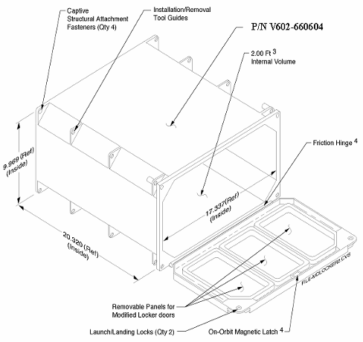
EXPRESS Locker Interface
Payloads can either be locker “inserts” or locker “replacements”.
Features
4 rear captive fastener
attachments
Friction hinge
Dual door locks
Installation tool
guides on 4 corners
Weight – 13 lbs empty
Volume – 2 ft³
ISS Locker Details
Notes:
17

Slide 14
Effective Gravity Level
The International Space Station (ISS) provides a laboratory platform where the effective acceleration between the ISS laboratory and the experiment container boundaries is less than one millionth of the gravity on the surface of the earth.
Hence the term microgravity
The fact that it is not effectively zero g is the atmospheric drag on the ISS and the distance of the experiment from the ISS center of mass
  This is the so-called gravity gradient effect, da = (GMe/R³)dR, where a in the acceleration vector, G is the gravitational constant, Me is the mass of the earth, and R is the vector to the center of the earth.

Slide 15
Obtaining Diffusion Controlled Conditions
Microgravity investigators typically want conditions in which the transport of mass and/or heat is dominated by diffusion, D, rather than convective flow, u, over some length scale of interest, L, i.e. uL/D<<1. The term on the left is known as the Peclet number
Convective velocity in directional solidification is on the order of g(Δρ/ρ)L²/ν, where g is a steady acceleration perpendicular to the density gradient, Δρ/ρ is the relative density difference arising due to thermal or solutal non-uniformities, and ν is the kinematic viscosity
g(Δρ/ρ)L²/ν may be used as an estimate for the convective velocity, u, in the Peclet number above.
Making the substitution above shows that investigators desire g(Δρ/ρ)L³/νD<<1. The term on the left is known as the Rayleigh number
When D is the diffusion coefficient for mass it is known as the solutal Rayleigh number
When D is the thermal diffusion coefficient it is known as the thermal Rayleigh number
Both Rayleigh numbers may be relevant to an experimenter.

Slide 16
Vibrational Disturbances
Oscillatory accelerations occurring at low frequencies affect convection in a quasi-static manner; the velocity of the fluid is roughly in phase with the acceleration
At high frequencies there is little fluid motion since the viscosity of the fluid prevents much motion in the timescale of the period of the oscillation
A transition occurs gradually in the neighborhood of ωL²=D where ω is the radial frequency of the acceleration
  This transition occurs when the distribution of mass (or heat) no longer responds in a quasi-static manner
An effective Diffusion constant occurring due to an oscillatory acceleration can be written as Deff=(D²+ (ωL²) ²) ^{½}
Another transition occurs when ωL²=v; an effective value for kinematic viscosity occurring due to an oscillatory acceleration can be written as veff=(v²+ (ωL²) ² ) ^{½}
See the review by Monti, et.al. in Fluid Sciences and Materials Science in Space, edited by H.U. Walter, published by Springer, Berlin (1987).

Slide 17
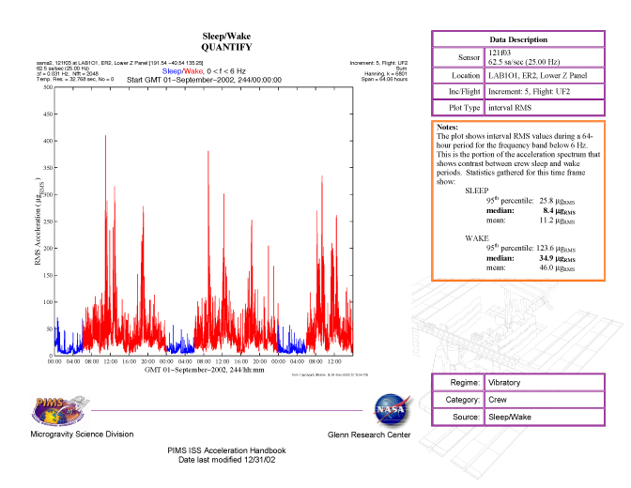
Sleep /Wake Root Mean Square Acceleration

Slide 18
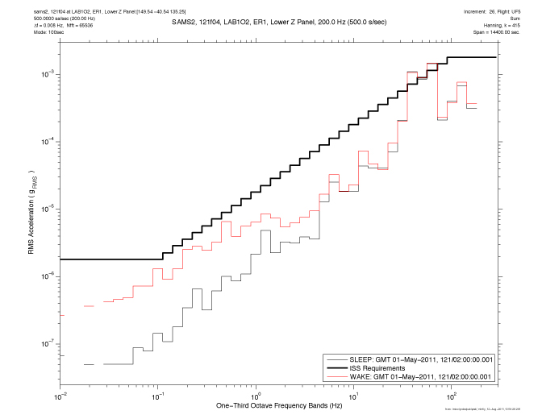
Root Mean Square Example

Slide 19
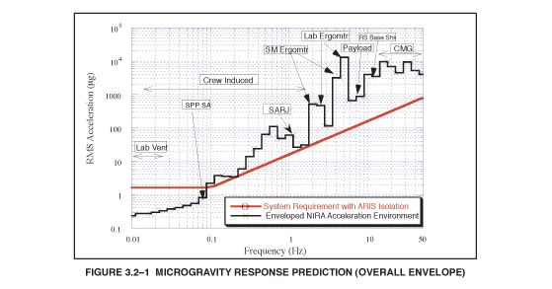
Worst-Case RMS from SSP 57006

Slide 20
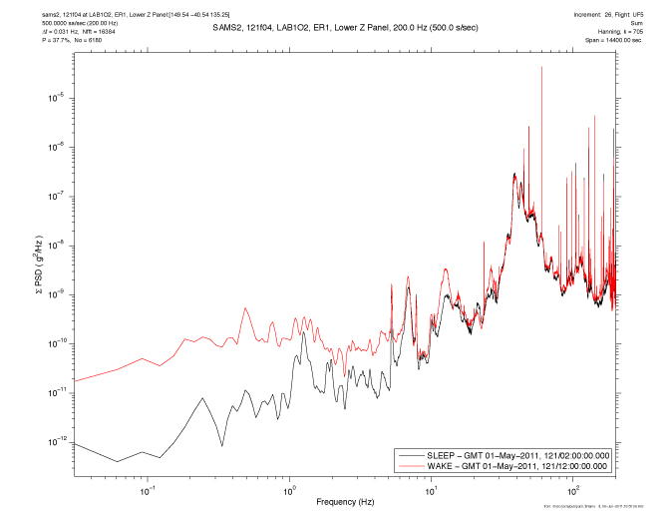
Power Spectral Density Example

Slide 21
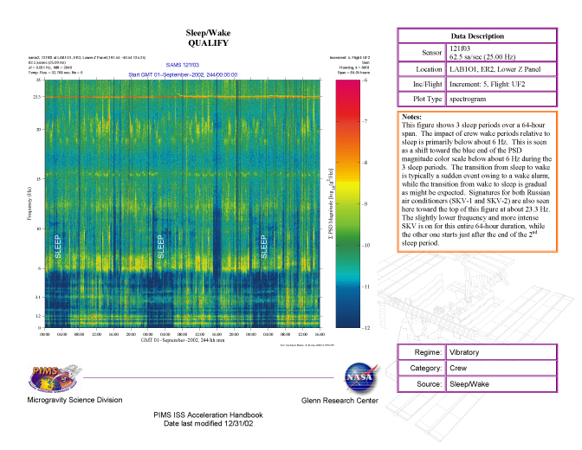
Power Spectral Density, Frequency, & Time Example

Slide 22
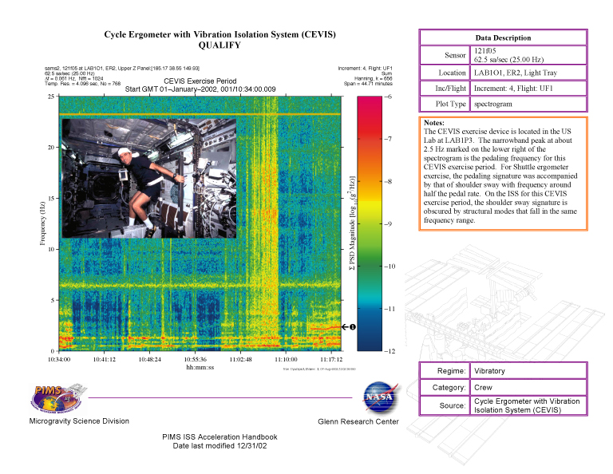
Pims hb_vib_cevis_rev 2002

Slide 23
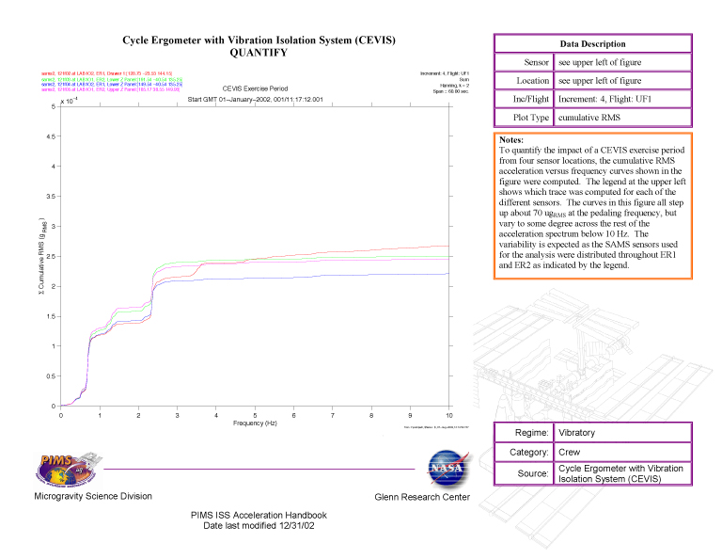
Pims hb_vib_cevis_rev 2002

