Slide 2

NIST Flow Cytometry Standard Consortium https://www.nist.gov/programs-projects/nist-flow-cytometry-standards-consortium
A public-private partnership to address the measurements and standards needed to increase confidence and comparability of flow cytometry data in research and commercial products
MISSION: Convene stakeholders in the pre-competitive space to accelerate the adoption of quantitative flow cytometry in biomanufacturing of cell and gene therapies.

Slide 3
Consortium Goals
Consortium Aims
Develop reference standards including reference materials, reference data, reference methods, and measurement service for assigning the Equivalent Number of Reference Fluorophores (ERF) to calibration microspheres and assessing the associated uncertainties and utilities.
Develop candidate reference standards including biological reference materials, reference data, reference methods
Design interlaboratory studies based on candidate reference materials to support the development of best practices, standard methods, and documentary standards
Consortium Anticipated Impact
Develop standards and measurement assurance tools to enhance flow cytometry measurement confidence
Generate data from interlaboratory studies to support development of best practices and standard methods
Improve flow cytometry measurement capabilities

Slide 4


























Consortium Members
CBER
CDRH
Bruce H Davis MD

Slide 5
Consortium Timelines

Slide 6
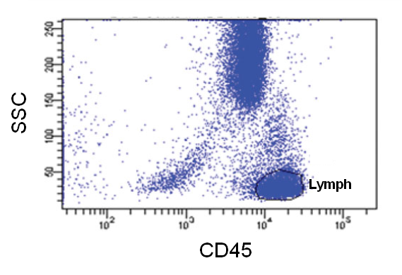
Consortium Progress
Working Groups
WG1: Develop reference standards including reference materials, reference data, reference methods, and measurement service for assigning the Equivalent Number of Reference Fluorophores (ERF) to calibration microspheres and assessing the associated uncertainties and utilities, and drive cytometer standardization
WG2: Design and conduct interlaboratory studies for the development of reference standards, control materials, and best practice protocols to achieve assay standardization and reference data generation
WG3: Build infrastructure and capability for flow cytometry data repository and multi-modal simultaneous data analysis
Standardized assay expressed in ERF
across cytometer platforms

Slide 7
SOP Basics
WG1 ILS – ERF Assigned Beads
Paul DeRose, PhD – Biosystems and Biomaterials Division
National Institute of Standards and Technology (NIST)

Slide 8
Overall Goals of WG1 First Study
  NIST-assigned ERF bead calibrations
  ERF assignment of an unknown biological sample
  Determine levels of variability between bead sets, instruments and labs

Slide 9
Materials
  ERF-assigned Hard-Dyed beads
      Daily QC – 1 intensity (Beckman)
      Ultra Rainbow – 5 intensities (Spherotech)
      Performance Tracking – 3 intensities (Thermo Fisher)
  2. ERF-assigned Fluorophore Specific
      15 Fluorophores (BD FC beads)
      Will know availability date soon
  3. Unknown samples
      Lyophilized PBMCs – BioLegend (pre-labelled)
      Will match as many of the BD beads as possible

Slide 10
List of Flow Cytometers and Material Quantities
51 Instruments – 1mL Bead Suspension per Instrument
33 PMT Instruments
7 APD Instruments
6 CCD Instrument
2 SiPM
3 Spectral Instruments
20 well plate format
Lyophilized PBMCs with Different Labels – Supply in well plate, reconstitute with supplied buffer

Slide 11
SOP
Purpose and Scope
Materials
Procedures for Data Collection
Preliminary Data Analysis by Participant
Send FCS Data, Analysis and Meta-Data to NIST

Slide 12
Reporting Spreadsheet
Institution and Contact person
Cytometer Manufacturer & Model:
Fluorescent label/bead | File Name (sample, instrument, organization, S/N ID - 4-digits) | Fluorescence Channel nominal (EX/EM/Dl - nm) | Fluorescence Channel actual (EX/EM/Dl - nm) | MFI | Date/Time Collected | Date/Time Prepared
DQC (BCLS) | DQC Aria TFS 1897 | 375/450/45
DQC (BCLS) | DQC Aria TFS 1897 | 375/525/40
DQC (BCLS) | DQC Aria TFS 1897 | 375/675/30
DQC (BCLS) | DQC Aria TFS 1897 | 405/450/45

Slide 13
WG2 ILS – Development of Standardized Assays and Associated Reference Materials
Lili Wang
Biosystems and Biomaterials Division
National Institute of Standards and Technology (NIST)

Slide 14
Assay Survey Results
Priority Assays Standardized across Instrument Platforms
(Kite, BMS, MSKCC, NCI, AZ, Sanofi, Mana Therapeutics)
Cell subsets/lineage phenotypes (minimal CD markers and antibody clones), e.g., naïve, central memory, effector, etc.
Potency assay defining intended function, e.g., cell killing, proliferation, cytokine production
Cell count and health, e.g., viability, exhaustion, apoptosis
Assay for expression analysis, e.g., CAR expression, tumor antigens
Benchmark assay for impurities of cell therapy product

Slide 15
Scope of WG2 Interlaboratory Study on Cell Count and Health
  Design a cell count and health assay (TBMNK assay with a viability dye and an apoptosis marker, an 8-color assay)
  Fix assay variables including cell sample, assay panel, instrument and assay control materials
  Develop an assay SOP and implement the SOP enabling result comparability across different cytometer platforms
  Study Outputs: assay SOP, standard panel, assay and instrument control materials, and reference data

Slide 16
Assay for Cell Count and Health:
CD45, CD3, CD19, CD14, CD56/CD16, CD4, CD8, Annexin, and Aqua
Cell sample
Antibody clone
Cell counting
Data acquisition & analysis
Fixed Clones &
Binding Affinities
From BioLegend
Volumetric
Cryopreserved PBMCs
Reagent
Titration
Non-volumetric:
Counting Ref:
BD (TruCount)
WG3
Standardized assay
Calibration & Standardization:
BD (FC beads with ERF values)
Spherotech (8-peak beads)
1) Lyophilized PBMCs
(NIBSC)
2) Synthetic cells
(Slingshot)
Different Controls:
lyophilized PBMC (NIBSC)
Comp beads (TF BCLS)
Flow Cytometer Platform
Non-viable cell control
Compensation
Assay SOP

Slide 17
WG2 Instrument Spreadsheet
https://docs.google.com/spreadsheets/d/1WaatI_5_c23EURGN9h3iAT-v-rTFd-z_gPB8GjSHg_U/edit#gid=1488220511

Slide 18
Cytometer Characterization & Qualification

Slide 19
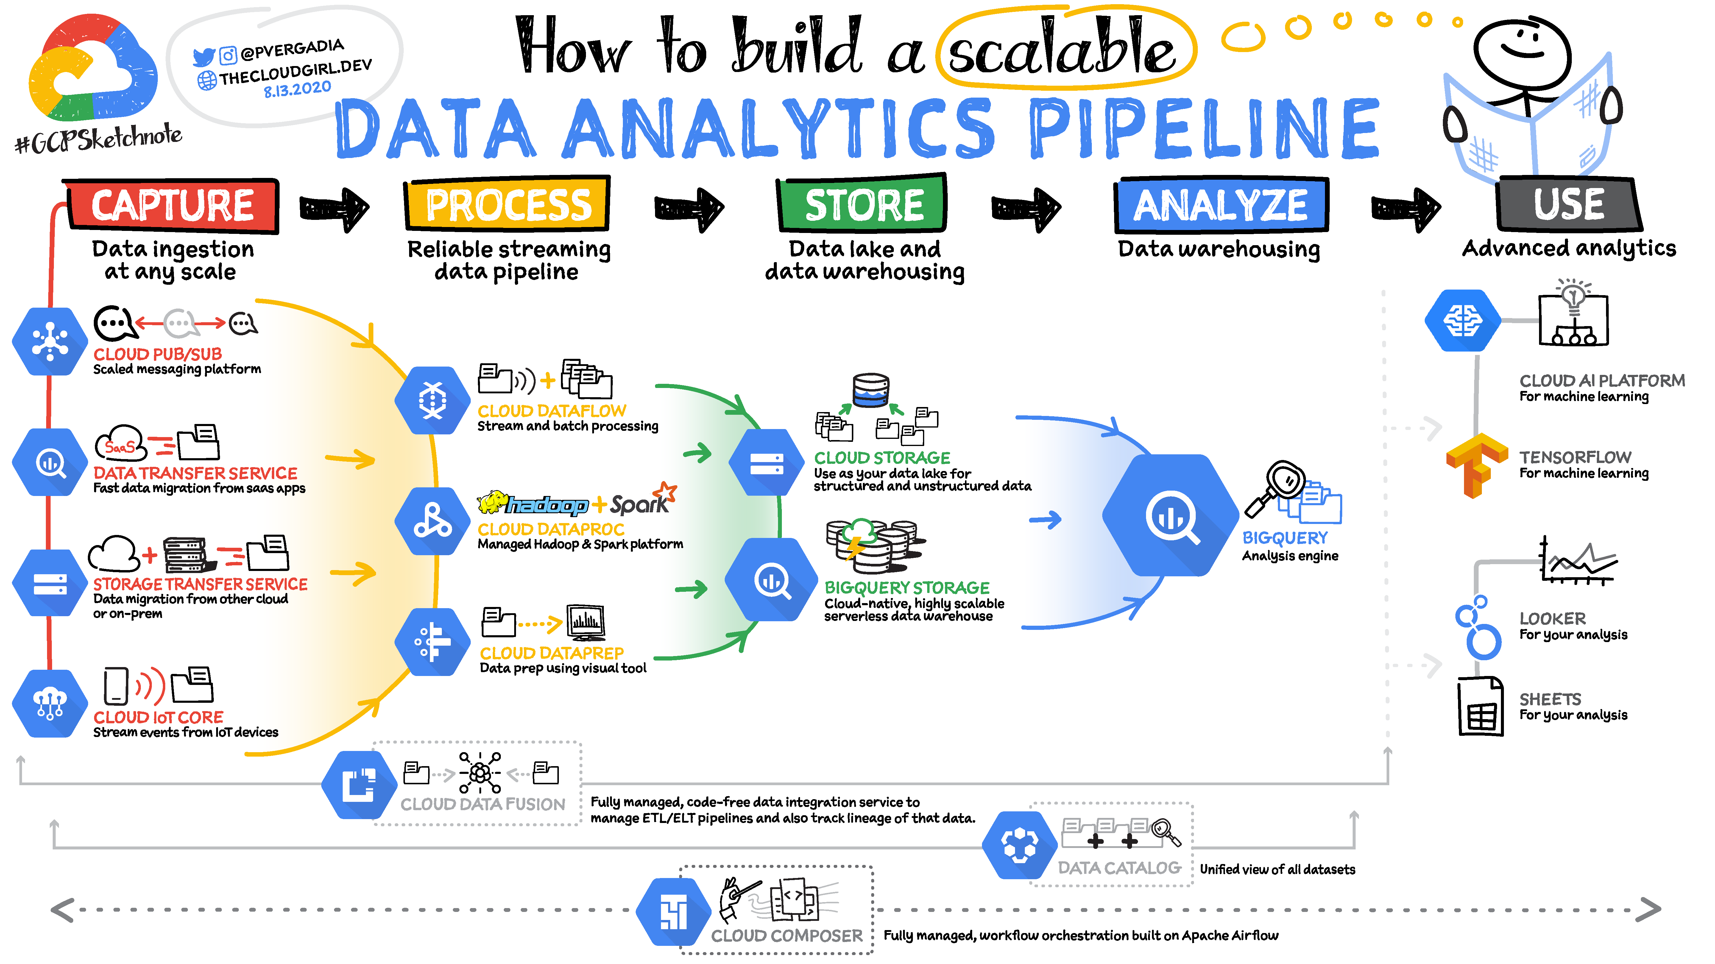
Developing the Data Repository and Data Analysis Pipeline (WG3)
John Elliott, NIST
Flow cytometry consortium
WG3 Kick Off Meeting
Nov 18, 2021
Where does the WG1 WG2 data go?

Slide 20
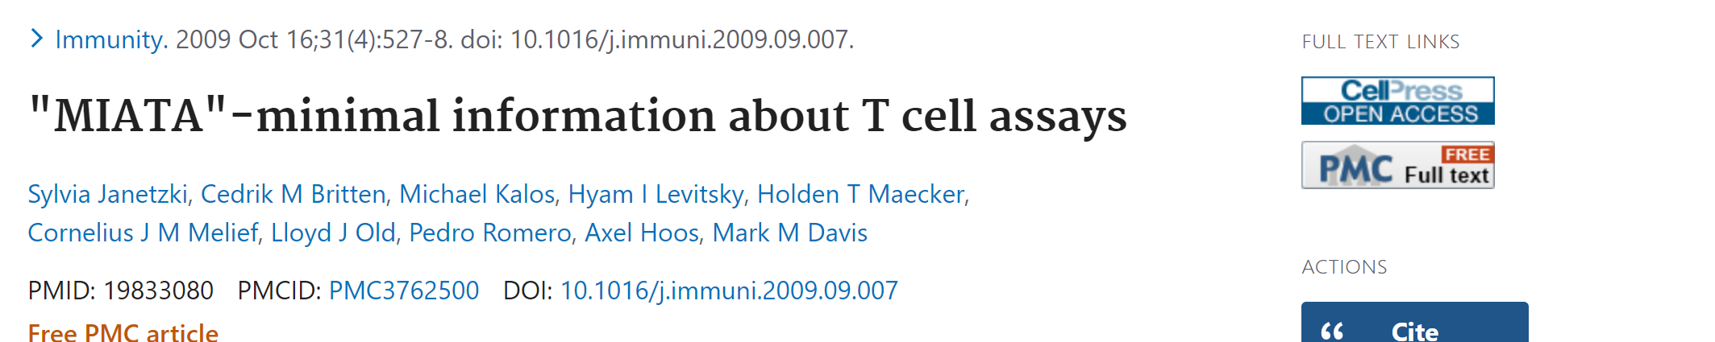
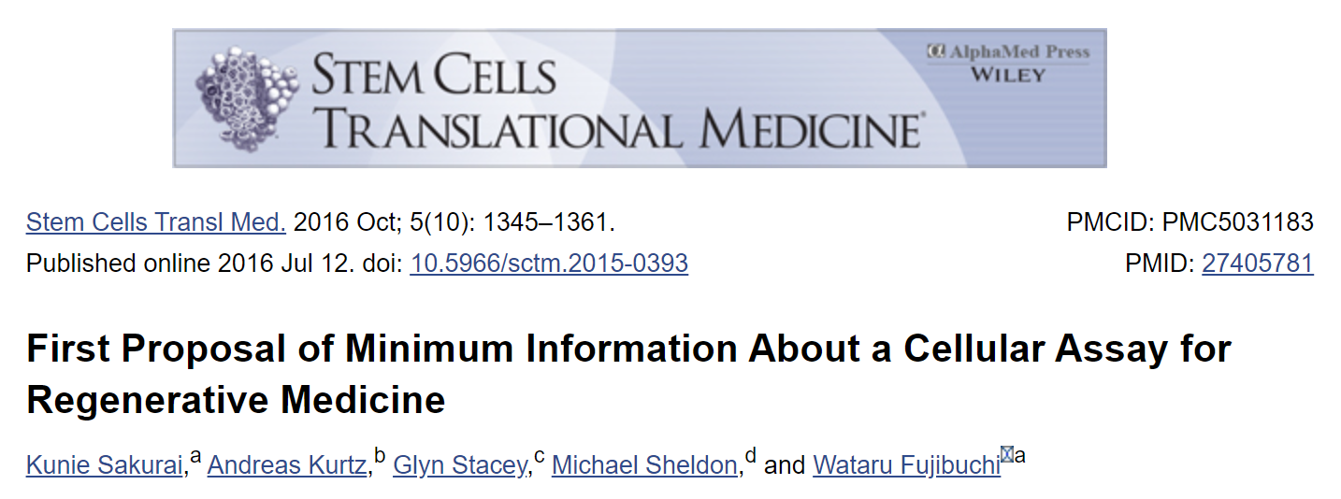
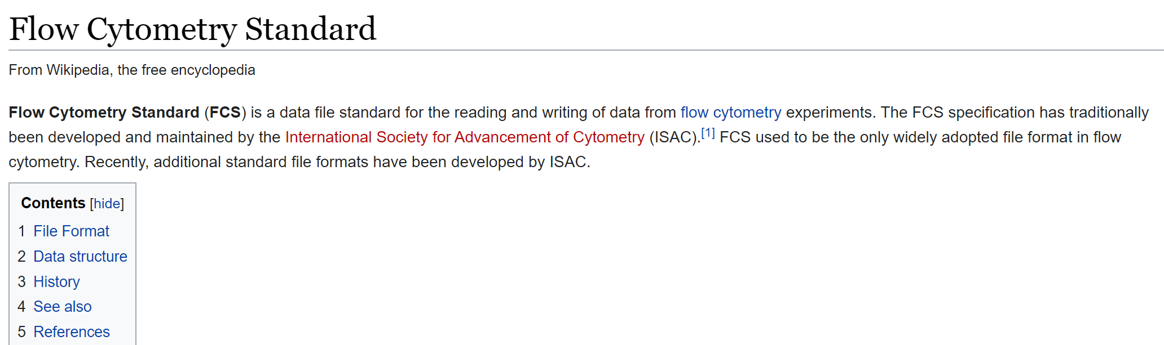
Data standards for flow cytometry-
WG3 Kick Off meeting:
What is needed for goals of the flow cytometry consortium?
What are best practices and what is available?
Where, who, how is the data repository and analysis pipeline built?
Provide data for WG1 and WG2 to make important decisions about filenames

Slide 21

Tentative workflow for consortium projects?
Data
Description
Type
WG3-Data Repository and Analysis Pipeline
Support Stats
User/lab
Who, when
Text
Derivative data
Instrument
num
Access
FCC Members
NIST?
settings
WG1-references
Analysis Pipeline
RM/beads
what
FCS num
protocol
how
mix
Data Extractor
(module 1/vendor 1)
WG2-interlab study
Reports
User/lab
Who, when
Text
Data repository
Cell Classifier
module 2/vendor 2
Full design
Test material
what
FCS num
Cell RM
what
FCS num
Extractor/Classifier
(parallel/vendor 3)
protocol
how
mix
Lab 1
User/lab
High quality protocol
…
…
…
Sources of variability
recommendations
protocol changes
Lab 2-x
Retesting

Slide 22
Needs of data repository (near term)?
Reliable Storage
Member access
Flow and metadata file transfer (one way?)
Linkages between data collected and experiment details (replicate, run, beads)
Physical location of data, maintenance, backup, type, compatibility with NIST
Others?

Slide 23

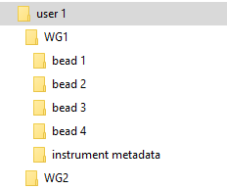
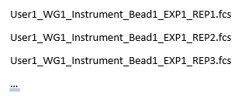
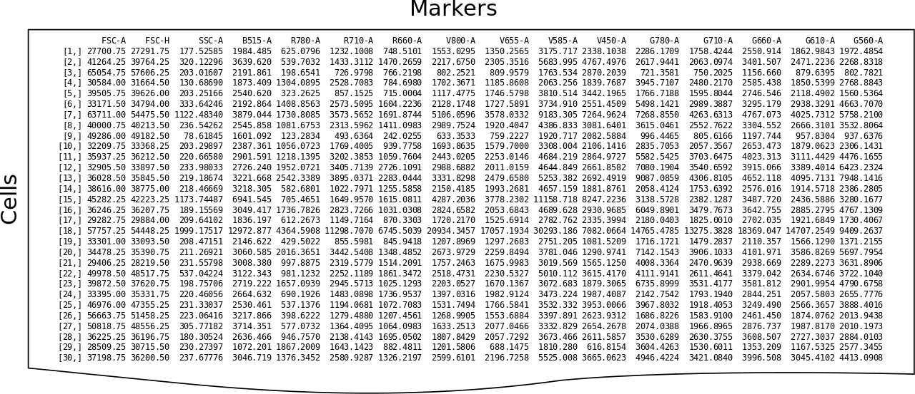
Possible starting point (NIST compatible)
NIST Google Drive
(for each member)
Directory structure
User 1
Filename structure
FCS 3.0 data (?)
Based on NIST Genome Editing Consortium Data Repository

Slide 24

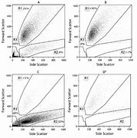

Possible starting point (All Access/dissemination)
Member google cloud drives
NIST cloud drive (all access)
Derived data
Statistics tools
User 1
Raw, Derived data
Curation
Raw, Derived data
User 2
Derived data
gating analysis tools
User 3
Raw, Derived data
User 4
Curation of interlab datsets (i.e. fix filenames, linkage to metadata)
Based on NIST Genome Editing Consortium Data Repository
Backups (NIST)

Slide 25

WG3-Data Repository and Analysis Pipeline
Discussion-
  Leverage experience of members
  Ensure compatibility with analysis and statistics pipelines
  Consensus on a standardized filename scheme, directory structure, etc.
  Ensure linkages between metadata and raw flow cytometry data
  Understand the requirement of memory space for simultaneous multi-model analyses
  Explore additional capabilities (ML & AI) beyond conventional analysis results from ILS

