Slide 1
NIST HL7 v2 Immunization Test Suite Overview AIRA HL7 Immunization User Group
February 2022
Robert Snelick, NIST

Slide 2
NIST Immunization Test Suite
Performs Conformance Testing
Does the system implement the requirements as stated in the specification?
Specification
Validates HL7 v2 Messages
Based on requirements from the IZ HL7 v2.5.1 Implementation Guide
All Profiles, VXU, ACK, QBP, RSP
Supports scenario base testing
Supports functional testing
Multiple way to access validation
Conformance
Implementation

Slide 3
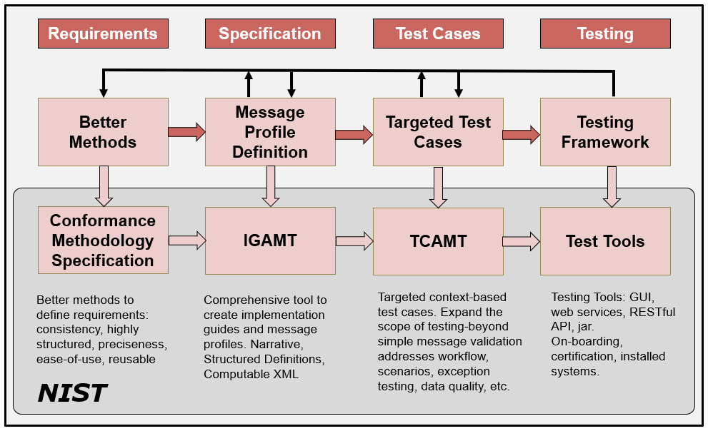
HL7 v2 Development Phases/Cycle
2/9/2022
Notes:
Profiling: Refinements of the standard via constraints and extension.
NOTE: Can implement to the same profiled standard (which is often the goal when the same expectations are the same for sender and receiver).
NOTE 2: A derived specification is a profile, but documentation of an interface is also considered a “derived specification”.

Slide 4
NIST Testing Tools Features
HL7 v2 Message Validation
Easy to Read and Understand Errors
On-line Requirements—Traceable
Vocabulary (Required Coded Data)
Valid Example Messages
Reports (XML, PDF, WORD)
Transport Support
Multistep Scenario Testing
Context-free and Context-based Testing
Inspection Testing
Functional Requirements Testing

Slide 5
How to use the Validation Tool
Web Application
Cut/Paste
Load File
Transport (SOAP, MLLP-TCP/IP)
REST API
Web Service
Validation JAR
Source Code
Free, in the public domain

Slide 6
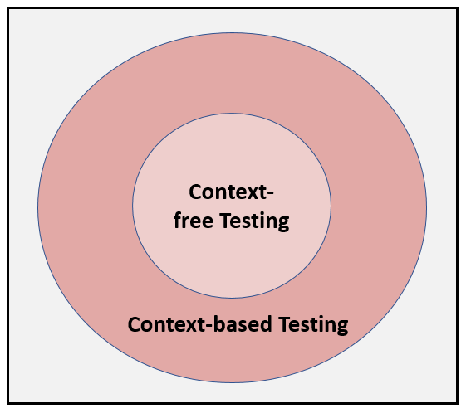
Context-free & based Testing
Expands test scope
Targeted
Test
Cases
Black-box functional requirements testing
Data
Driven
Test Plans
Scenarios

Slide 7
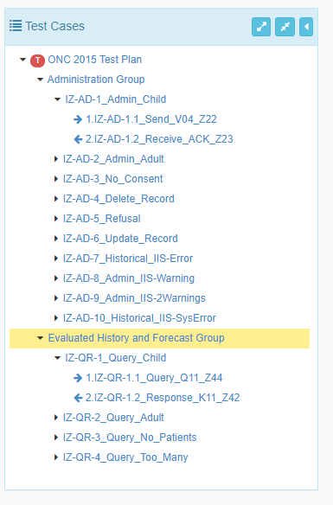
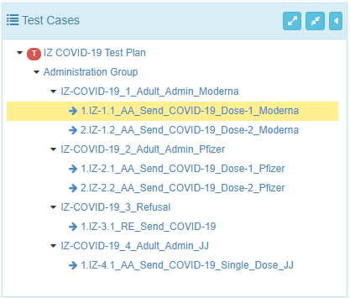
Immunization Test Plans
ONC EHR Certification
COIVD-19 Immunization Reporting

Slide 8
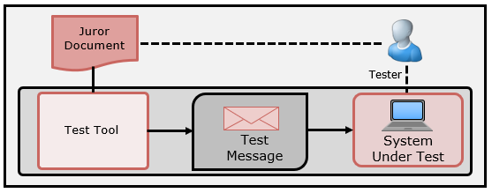
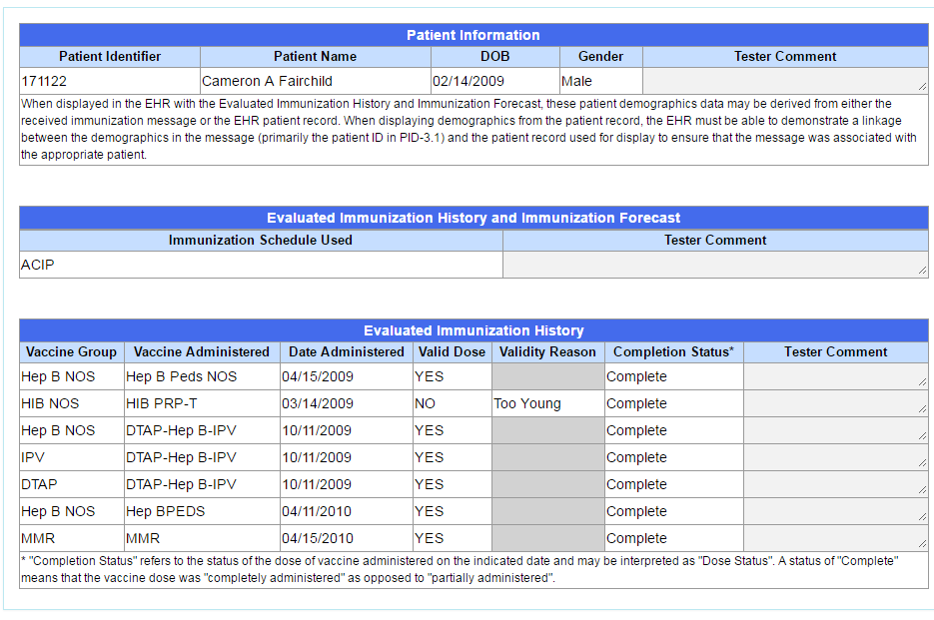
Inspection Testing
Receiver-oriented Testing
Use of an inspection (Juror) Document
Can be used for Incorporation and Display Testing
Test Tool provides the stimulus
Can have levels of storage requirements

Slide 9
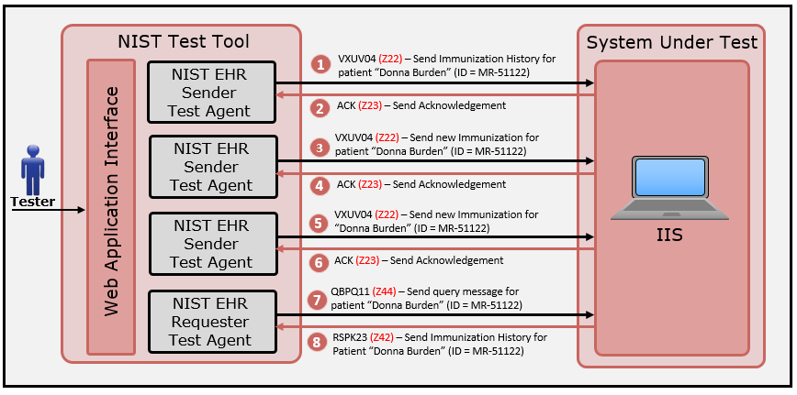
Testing Functional Requirements
Create scenarios to invoke a capability of the SUT
Use context-based testing to validate expected content in the response message

Slide 10
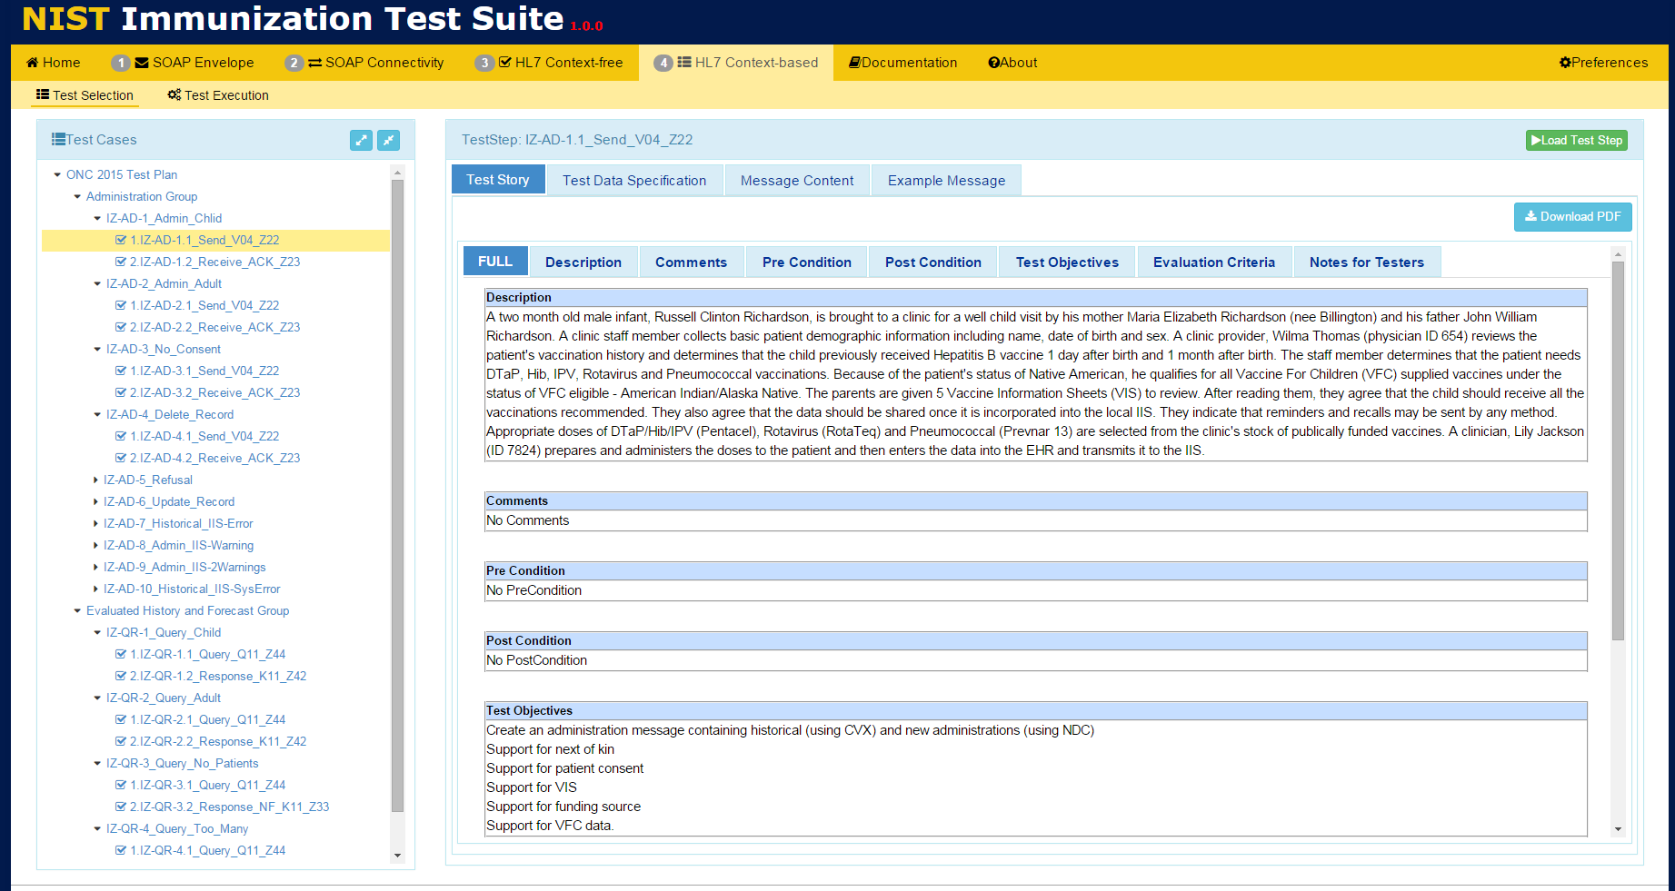
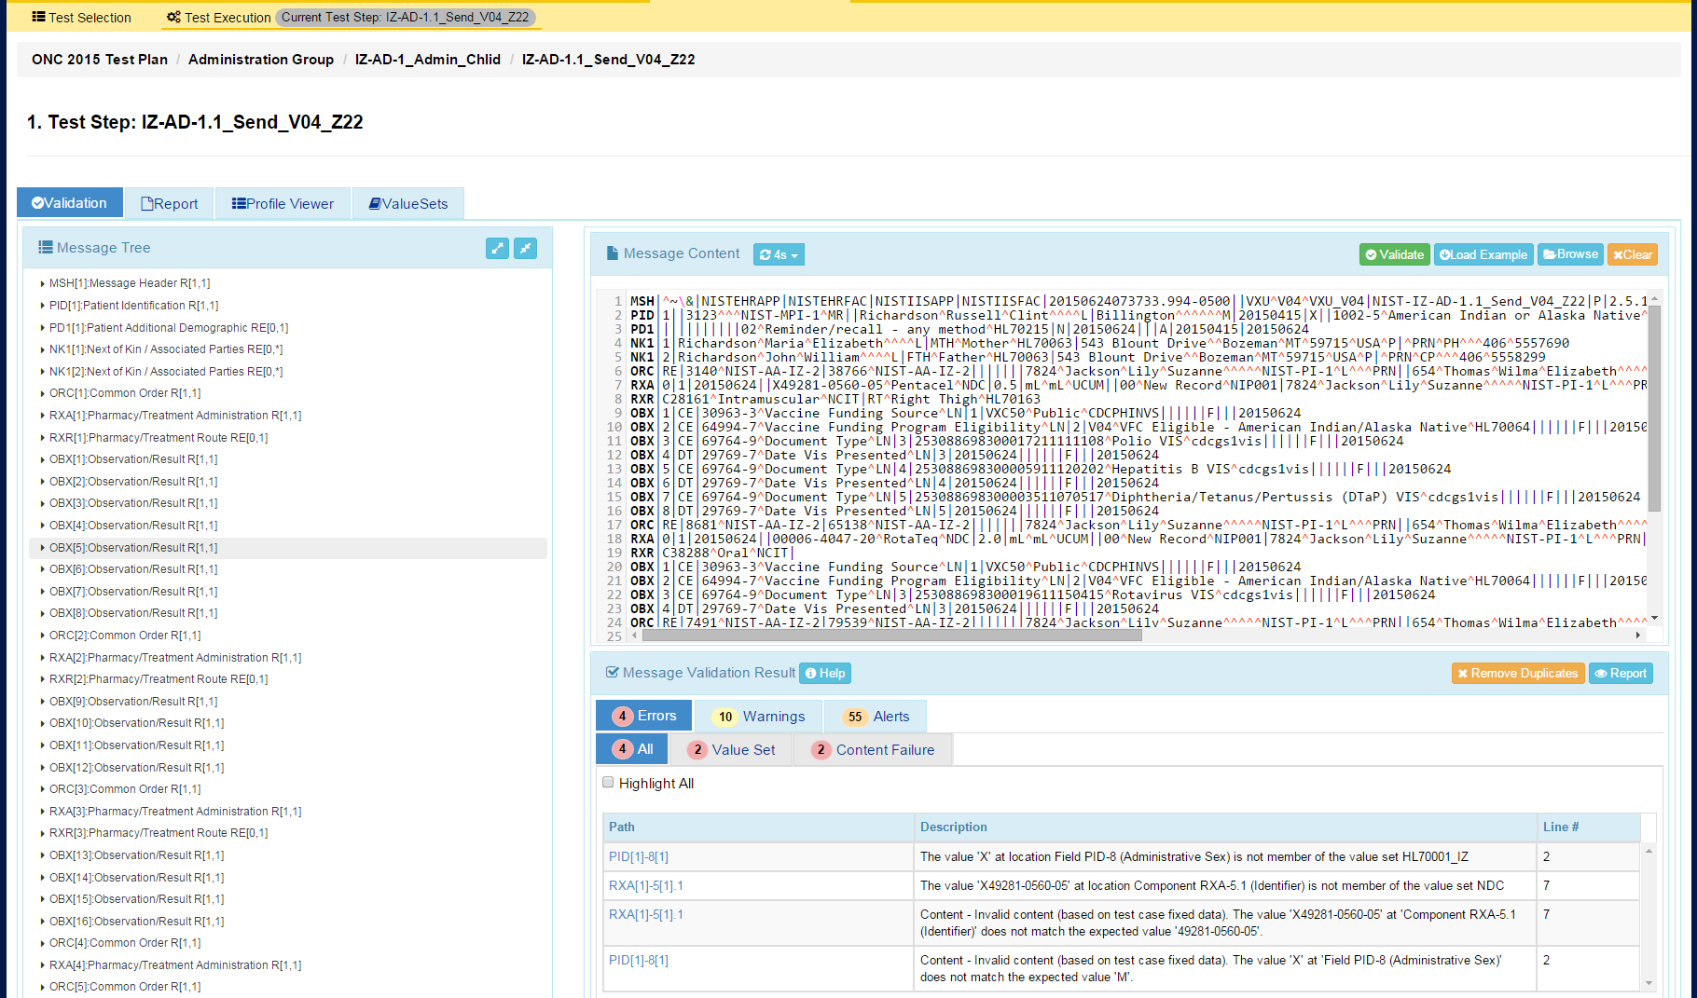
Conformance Testing DEMO
Context-based testing in the NIST HL7 v2.5.1 Immunization Test Suite
Test Data Message Content
Test Step Scenario
Test Plan with Test Cases & Test Steps
Load Test Step
Input HL7 v2 test message for validation
View Validation Report
DEMO
Immunization Test Suite
View validation results
Access this test tool at:
https://hl7v2-iz-r1.5-testing.nist.gov

Slide 11
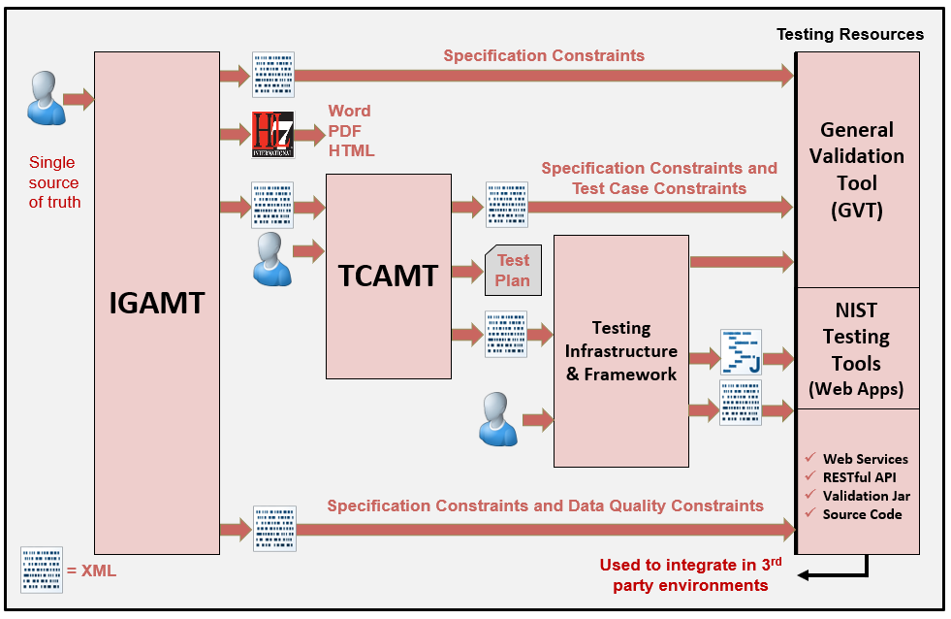
NIST HL7 v2 Platform

Slide 12
Example Uses
Healthcare Industry Vendor Product Testing
Assessment and Certification Programs
CMS/ONC EHR Meaningful Use
HIMSS
IHE
AIRA
On-Boarding
State Registries (Many Registries and Domains)
Association of Public Health Laboratories (APHL)
IIS to IIS Gateway

Slide 13
Thank You
Contact: robert.snelick@nist.gov
https://hl7v2tools.nist.gov

Slide 14
Extra Slides

Slide 15
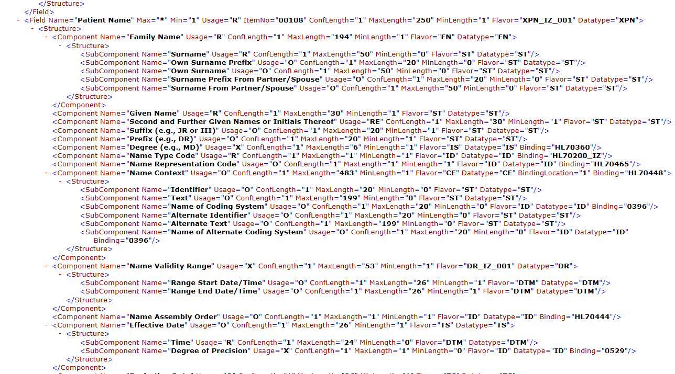
HL7 v2 Profile XML Format
Notes:
NIST HL7 v2 XML format. To be submitted to HL7 to standardize. The NIST format adds additional conformance constructs.

Slide 16
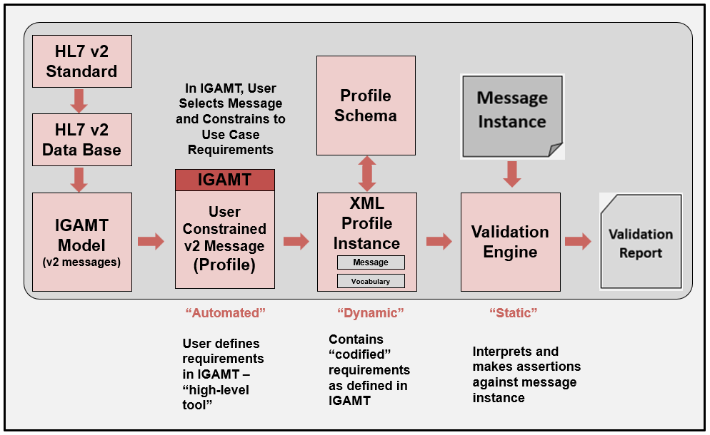
Validation Process

Slide 17
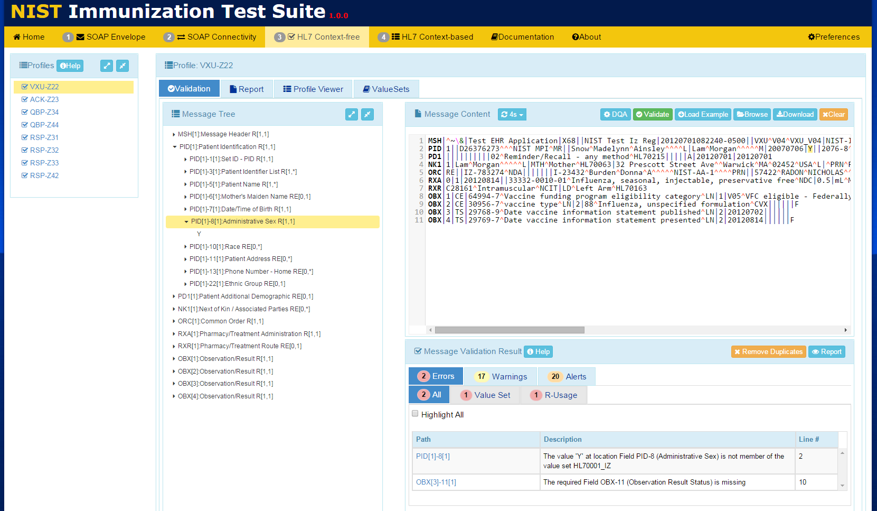
Context-free Validation

Slide 18
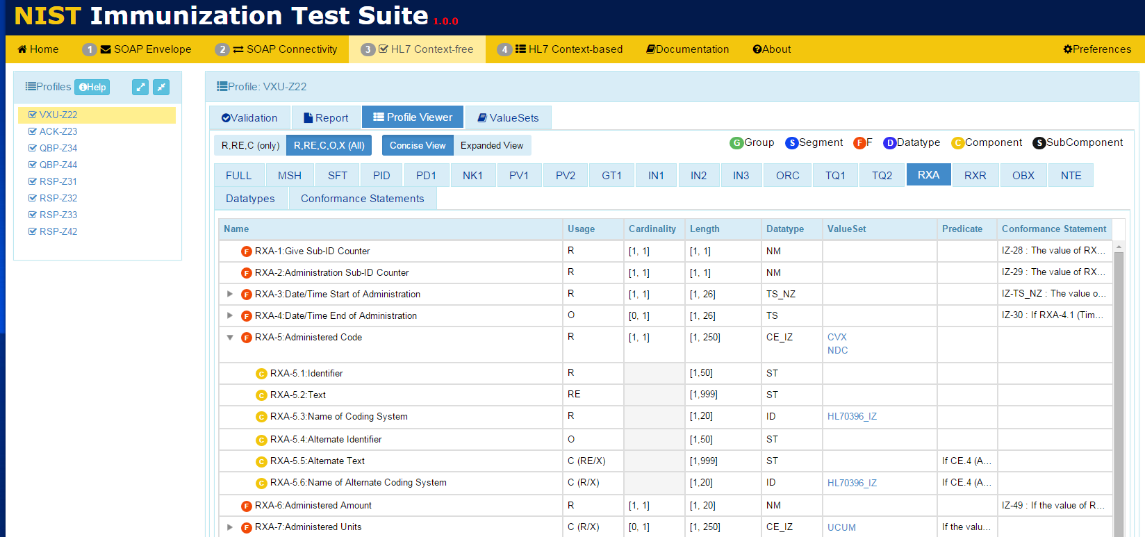
View Messaging Requirements

Slide 19
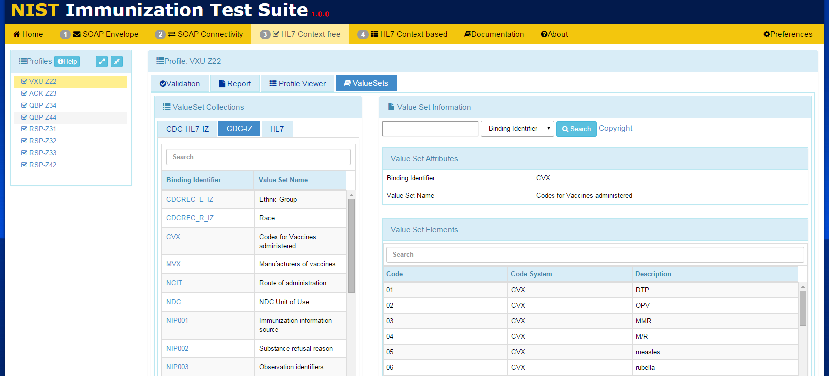
View Vocabulary Requirements

Slide 20
Context-based Validation

