Slide 1
NIST Healthcare Testing Infrastructure Overview Interoperability by way of Standards, Conformance, and Testing Tools
June 2021
Robert Snelick, NIST
End-to-end Testing Platform
Part 3 of 3

Slide 2
Video Series
Part 1
NIST HL7 v2 Testing Infrastructure Overview
Part 2
NIST Conformance Testing Tools
Focus on Immunization Test Suite
Part 3
NIST Development and Testing Platform
Supplement
Background: HL7 v2, Conformance, Interoperability

Slide 3
Overview
What are we Doing
Improving Healthcare Data Exchange Interoperability
Improve Healthcare Data Quality
Who are the Users
Healthcare Information Technology Vendors
Public Health (CDC, APHL, AIRA, etc.)
Certification and Testing Organization
Standards Development Organization
Impact
Improved Quality of Care (better data/better care)
Cost

Slide 4
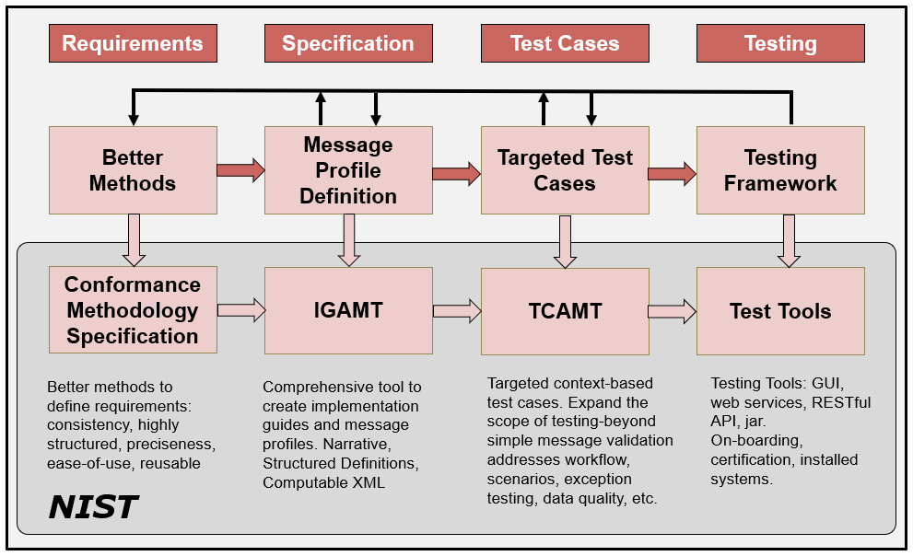
HL7 v2 Development Phases/Cycle
6/1/2021
Notes:
Profiling: Refinements of the standard via constraints and extension.
NOTE: Can implement to the same profiled standard (which is often the goal when the same expectations are the same for sender and receiver).
NOTE 2: A derived specification is a profile, but documentation of an interface is also considered a “derived specification”.

Slide 5
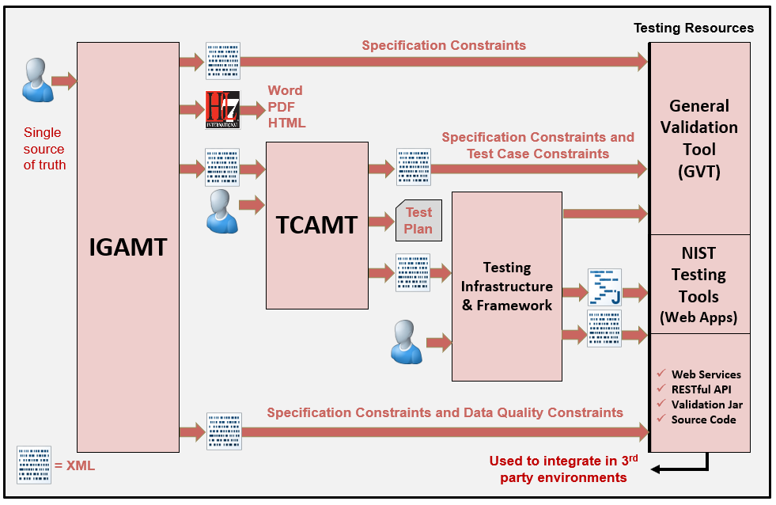
NIST HL7 v2 Platform

Slide 6
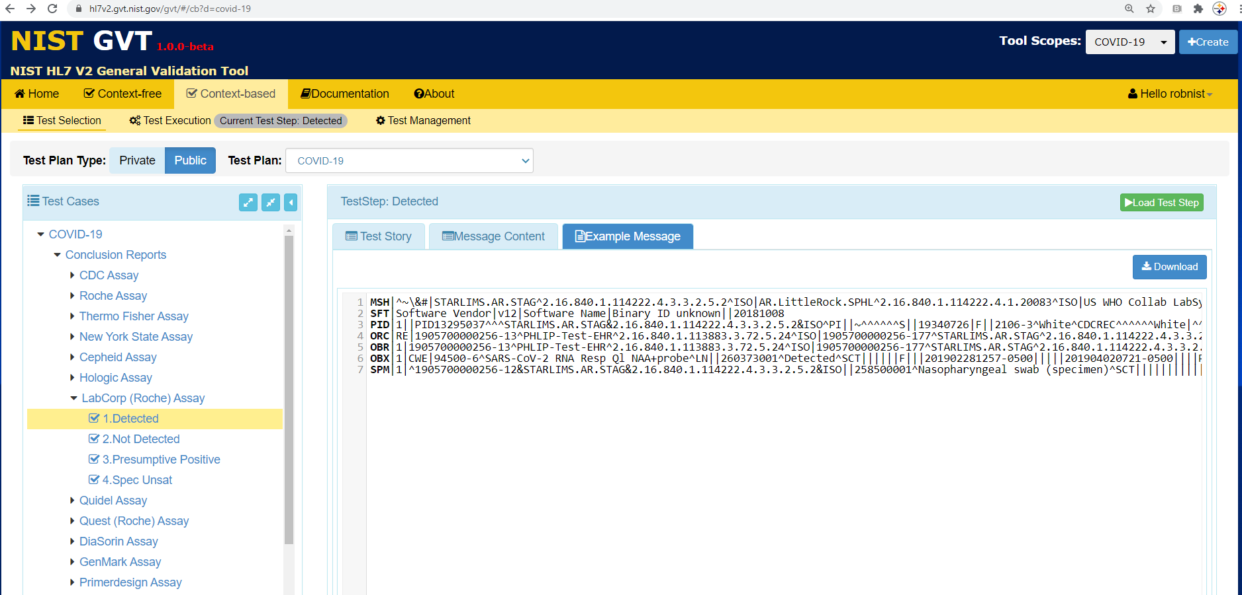
GVT – User Created Tools
Platform for User Created Tools
Automatically Generated
User Space on The Platform
Test Plans
Public/Private
Test Cases

Slide 7
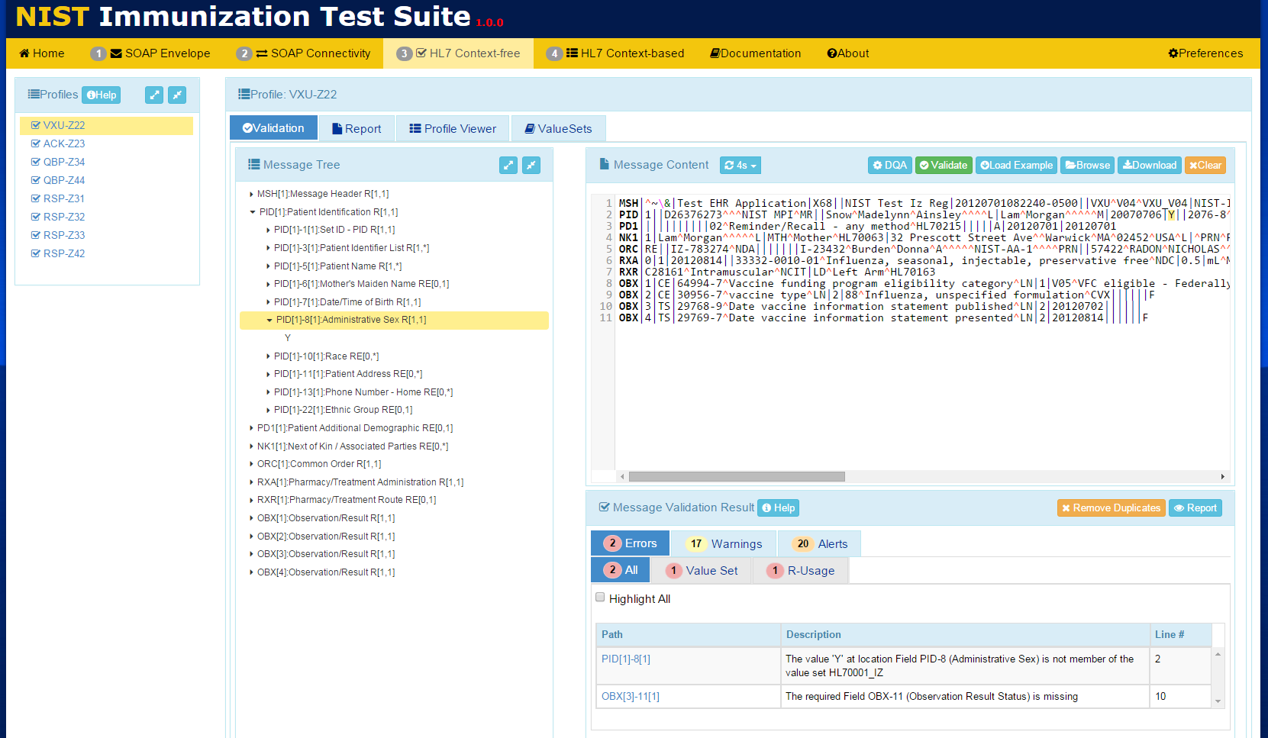
Conformance Testing

Slide 8
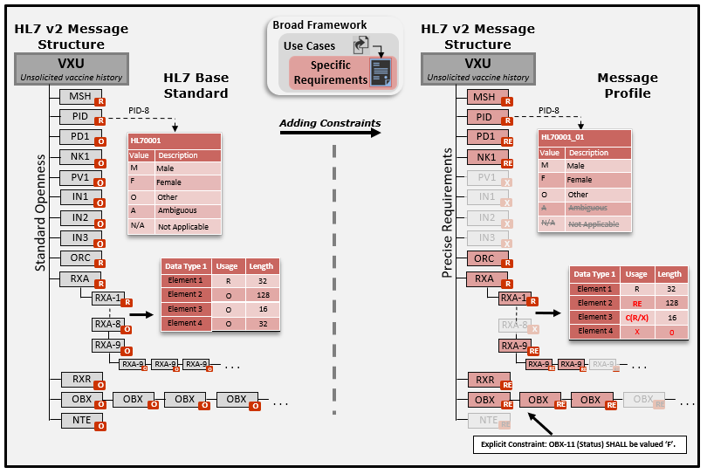
Creating Specifications
Notes:
Applicable to any standard product family.

Slide 9
Creating Specifications
IGAMT: Implementation Guide Authoring and Management Tool
Base on Strong Conformance Model
Embedded Data Model
Consistent Specifications
Computable Specifications
Component Reuse
Extensive Publication Capabilities
Easy to Use Web Based Application
Allows Domain Experts to create Conformance Testing Tools
Reduces Maintenance Nightmare
Notes:
Applicable to any standard product family.

Slide 10
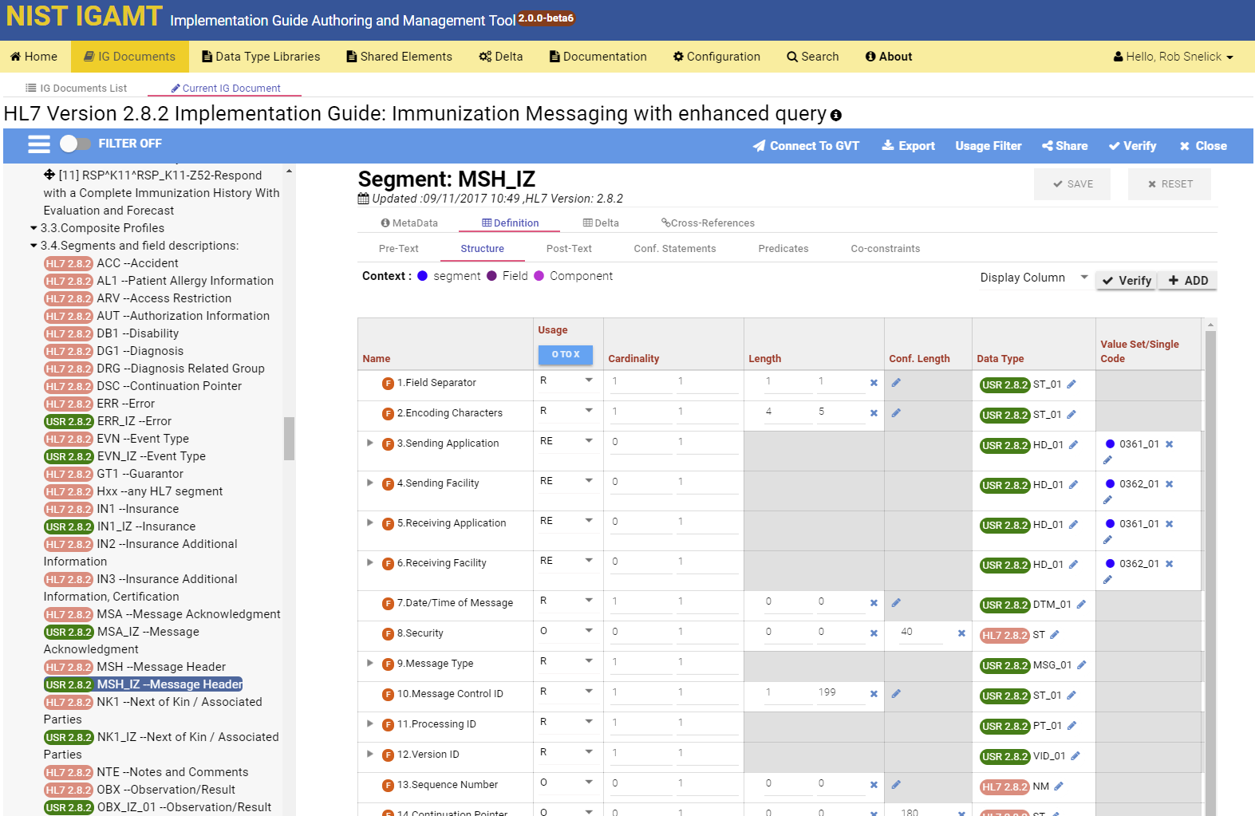
Creating a Specification in IGAMT
DEMO: IGAMT and GVT

Slide 11
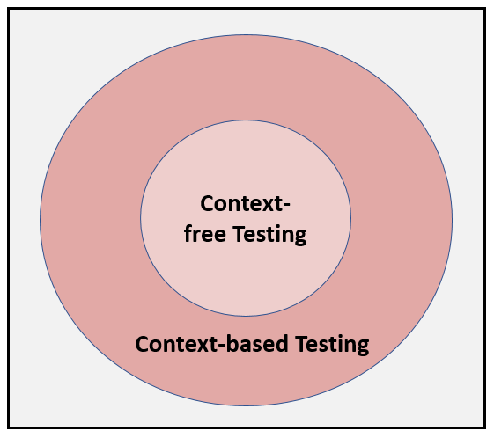
Context-free & based Testing
Context-based has expanded test scope
Scenarios
Targeted Test Cases
Data Driven
Black-box functional requirements testing

Slide 12
Testing Workflow (Sender)
Targeted Test Cases
1
Select Test Case
2
Tool Provides Test Story and Test Data Sheet
3
Test Data Entered into the EHR System
NIST Test Tool(Acting as an IIS)
Validation Report
EHRs
4
EHR Creates Message and Submits to NIST Validation Tool
5
Tool Provides Validation Report

Slide 13
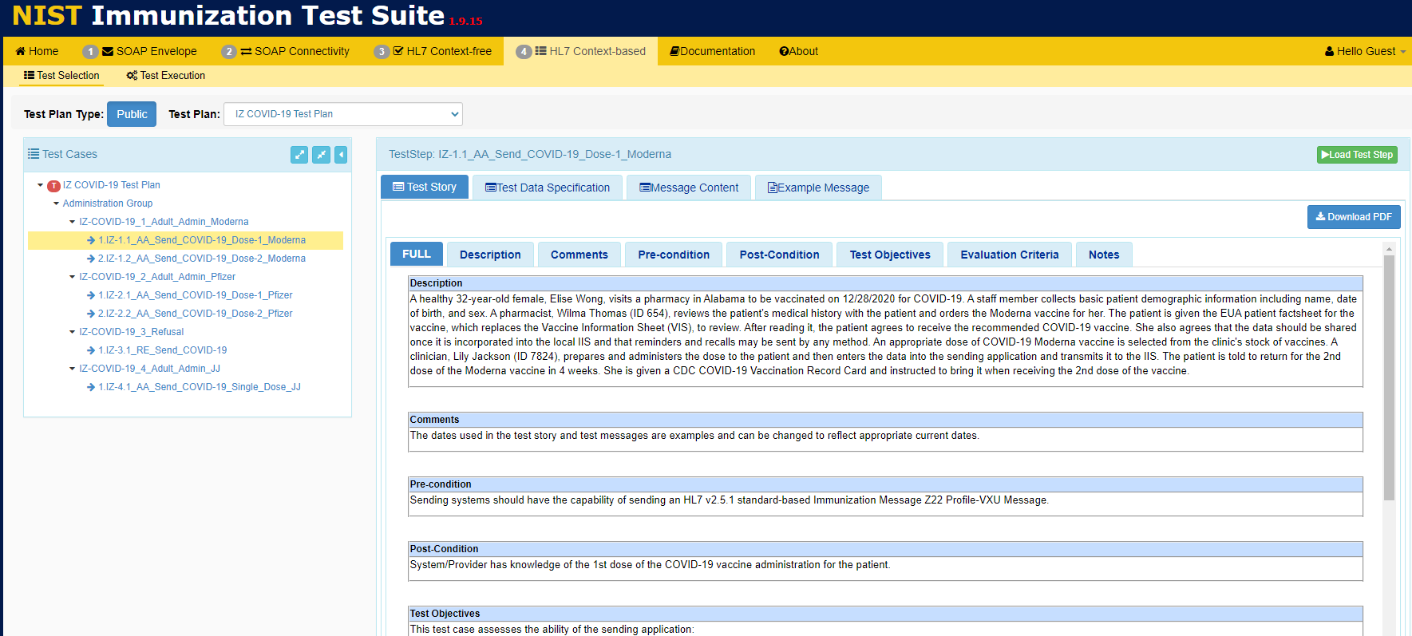
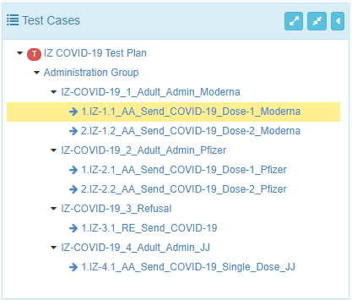
Test Case and Data Driven Testing
DEMO: TCAMT

Slide 14
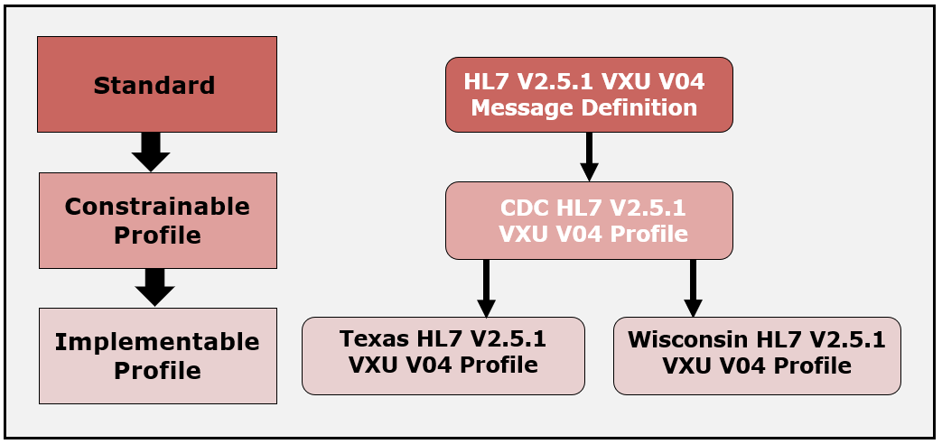
Supporting Local Requirements
6/1/2021

Slide 15
Summary
Integrated End-to-end Platform
We have changed the paradigm
We don’t build conformance test tools; we build the tools that builds them
Empowered Domain Experts and SDOs
NIST GVT is a host for user created tools

Slide 16
Summary: Towards Interoperability
Use Cases
Trading Partner A
Trading Partner B
Reduced Negotiations &
Translations
Requirements
Requirements
Standards
Profiling
Implementation
Testing
Need quality data exchange standards
Provide the mechanisms and education to create well-defined standards
Be precise, and demand it from SDOs
Profile, Modularize, and Reuse
Use existing tools (profiling and testing)
Non-conformance should not prevent useful exchange of data
Plan for testing, and test (at all layers)
Notes:
Implementers/Specifiers can decide how far to go—profiling mechanisms should provide capabilities for a precise specification.
THERE ARE NO SHORT CUTS—YOU HAVE TO DO IT ONE WAY OR THE OTHER!
These tools help us manage and leverage/reuse existing models.
Think about now Trading Partner C with the same needs.
Improves Patient Safety
Better Data Sharing
Saves Time and Money
Reasonable confidence that the product meets the conformance requirements stated in the standard
Closer to achieving interoperability
Don’t expect “out-of-the-box” interoperability
Local adaptation and testing is necessary
Most likely each integration will still require translation
Reasonable scope
Based on what standards are part of the certification
E.g., if no usability standards, don’t set unrealistic expectations

Slide 17
Acronyms
HL7 – Health Level 7 (Standards Dev. Org)
CDC – Centers for Disease Control and Prevention
AIRA – American Immunization Registry Association
IIS – Immunization Information System
APHL – Association of Public Health Laboratory
IHE – Integrating the Healthcare Enterprises
ONC – Office of the National Coordinator (HHS)
MU – Meaningful Use (CMS EHR Certification)
IGAMT – Implementation Guide Authoring and Management Tool (NIST Tool)
TCAMT – Test Case Authoring and Management Tool (NIST Tool)
GVT – General Validation Tool

Slide 18
Thank You
Contact: robert.snelick@nist.gov
https://hl7v2tools.nist.gov

