Slide 1
NIST Healthcare Testing Infrastructure Overview
Interoperability by way of Standards, Conformance, and Testing Tools
June 2021
Robert Snelick, NIST
Conformance Testing Tools
Part 2 of 3

Slide 2
Video Series
Part 1
  NIST HL7 v2 Testing Infrastructure Overview
Part 2
  NIST Conformance Testing Tools
  Focus on Immunization Test Suite
Part 3
  NIST Development and Testing Platform
Supplement
  Background: HL7 v2, Conformance, Interoperability

Slide 3
Heart of what NIST Does
Conformance Testing
Does the system implement the requirements as stated in the specification?
Purpose: Enables stakeholders to measure HIT conformance to accepted data exchange standards for achieving complete and accurate communication of patient information
Specification
Conformance
Implementation

Slide 4
Impact
Improved Healthcare Data
Better Data, Better Quality of Care
Better Standards
EHR Certification
  Laboratory Reporting Systems
  Immunization Reporting
Registries Assessment
  Immunization Information Systems
Real World Data
  E.g., State of California Immunizations (millions/month)

Slide 5
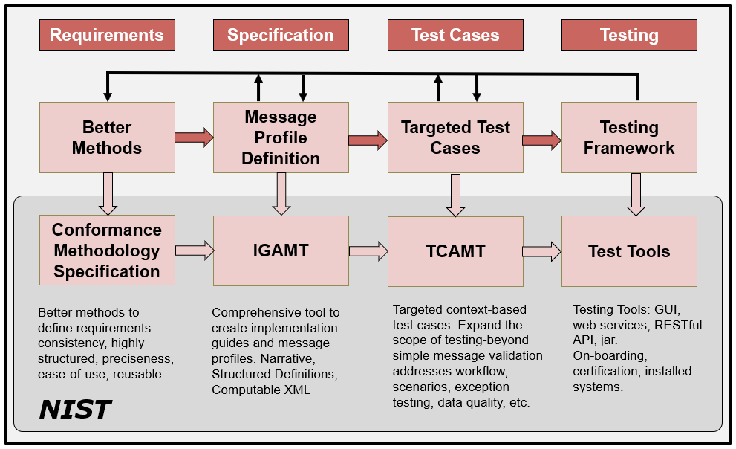
HL7 v2 Development Phases/Cycle
Specific Tool Instances
6/1/2021
Notes:
Profiling: Refinements of the standard via constraints and extension.
NOTE: Can implement to the same profiled standard (which is often the goal when the same expectations are the same for sender and receiver).
NOTE 2: A derived specification is a profile, but documentation of an interface is also considered a “derived specification”.

Slide 6
HL7 and HL7 v2
Health Level 7—SDO
HL7 v2
  Healthcare Data Exchange Messaging Standard
  Most widely used healthcare standard
  E.g., Most lab reporting and immunization records
  Nearly all Public Health systems use HL7 v2
Reportable Result
3a
Order
Laboratory System
EHR
3b
Public Health
1
2
LIS
Result
Reportable Result

Slide 7
Example HL7 v2 COVID-19 Message
MSH|^~\&|COVID-19NISTAPP|COVID-19NISTFAC|COVID-19IISAPP|COVID-19IISFAC|20201228084727.655-0500||VXU^V04…
PID|1||89778^^^NIST-MPI-1^FI||Wong^Elise^^^^^L|Xhang^^^^^^M|19880417|F||2028-9^Asian^CDCREC~2131-1^Other Race^CDCREC|89 West 21st Ave^^Birmingham^AL^35203^USA^P||^PRN^PH^^^406^5554019~^NET^^Elise.Wong@isp.com|||||||||2186-5^Not Hispanic or Latino^CDCREC||N|1|||||N
ORC|RE|5237^NIST-AA-IZ-1|31309^NIST-AA-IZ-1|||||||7824^Jackson^Lily^Suzanne^^^^^NIST-PI-1^L^^^PRN||654^Thomas^Wilma^Elizabeth^^^^^NIST-PI-1^L^^^RPH|||||NISTEHRFAC^NISTEHRFacility^HL70362
RXA|0|1|20201228||80777-0273-99^Moderna COVID-19 Vaccine^NDC^207^COVID-19, mRNA, LNP-S, PF, 100 mcg/ 0.5 mL dose^CVX|0.5|mL^mL^UCUM||00^New Record^NIP001|7824^Jackson^Lily^Suzanne^^^^^NIST-PI-1^L^^^RPH|^^^NIST-Clinic-1||||025L20A|20210205|MOD^Moderna US, Inc.^MVX|||CP|A
RXR|C28161^Intramuscular^NCIT|RD^Right Deltoid^HL70163
OBX|1|CE|30963-3^Vaccine Funding Source^LN|1|VXC50^Public^CDCPHINVS||||||F|||20201228
OBX|2|CE|64994-7^Vaccine Funding Program Eligibility^LN|2|V01^Not VFC Eligible^HL70064||||||F|||20201228|||VXC40^per immunization^CDCPHINVS
OBX|3|CE|69764-9^Document Type^LN|3|253088698300034911201201^COVID-19 Moderna Vaccine EUA Recipient-Caregiver Fact Sheet^cdcgs1vis||||||F|||20201201
OBX|4|DT|29769-7^Date Vis Presented^LN|3|20201228||||||F|||20201228
OBX|5|ST|30973-2^dose number in series^LN|4|1||||||F|||20201228
OBX|6|CE|59783-1^Status in immunization series^LN|4|N^No^HL70136||||||F|||20201228
Wong^Elise^^^^^L
Patient Data
80777-0273-99^Moderna COVID-19 Vaccine^NDC
Vaccine Data
30973-2^dose number in series^LN|4|1
Observations

Slide 8
NIST Testing Tools Features
HL7 v2 Message Validation
Easy to Read and Understand Errors
On-line Requirements—Traceable
Vocabulary (Required Coded Data)
Valid Example Messages
Reports (XML, PDF, WORD)
Transport Support
Multistep Scenario Testing
Context-free and Context-based Testing
Inspection Testing
Functional Requirements Testing

Slide 9
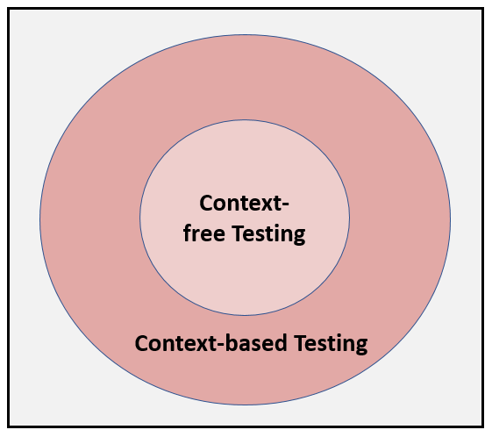
Context-free & based Testing
Expands test scope
Targeted
Test
Cases
Black-box functional requirements testing
Data
Driven
Test Plans
Scenarios

Slide 10
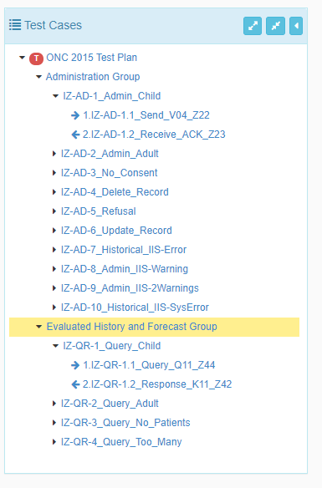
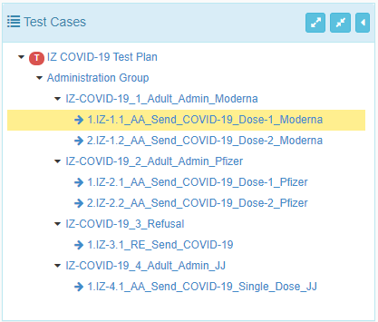
Immunization Test Plans
ONC EHR Certification
COIVD-19 Immunization Reporting

Slide 11
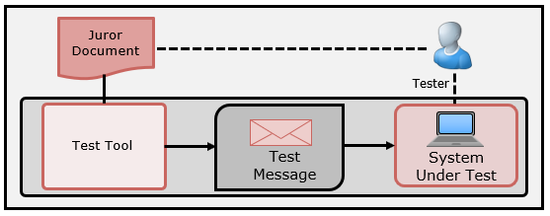
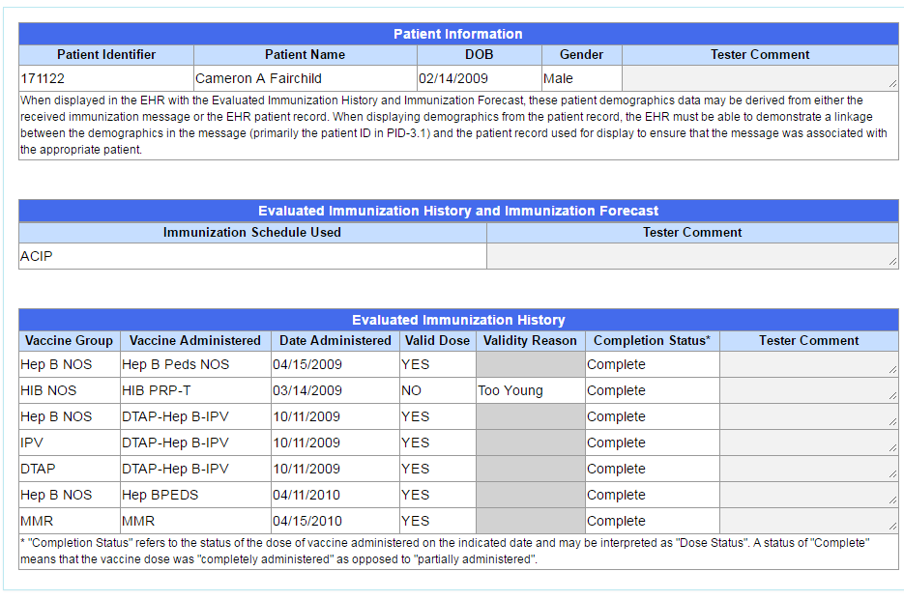
Inspection Testing
Receiver-oriented Testing
Use of an inspection (Juror) Document
Can be used for Incorporation and Display Testing
Test Tool provides the stimulus
Can have levels of storage requirements

Slide 12
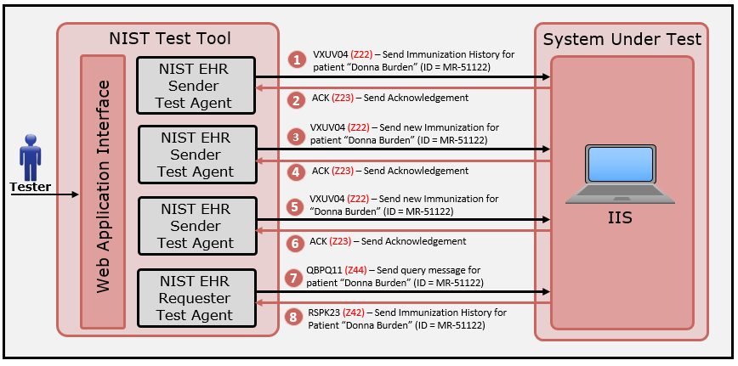
Testing Functional Requirements
Create scenarios to invoke a capability of the SUT
Use context-based testing to validate expected content in the response message

Slide 13
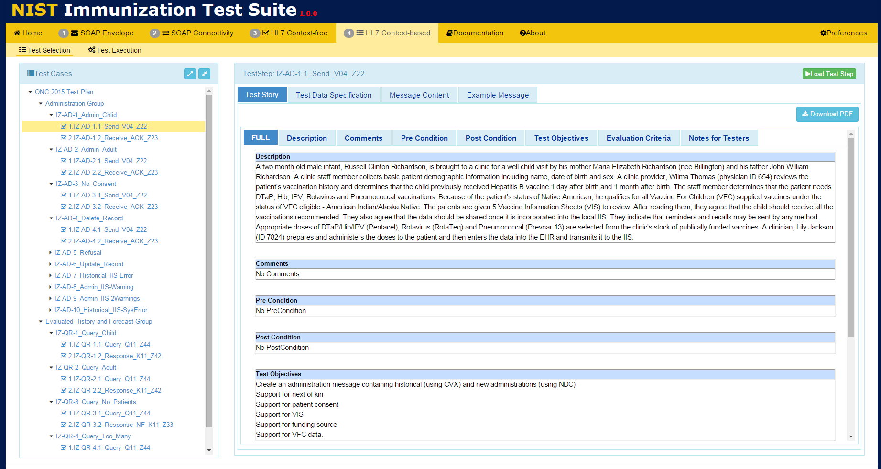
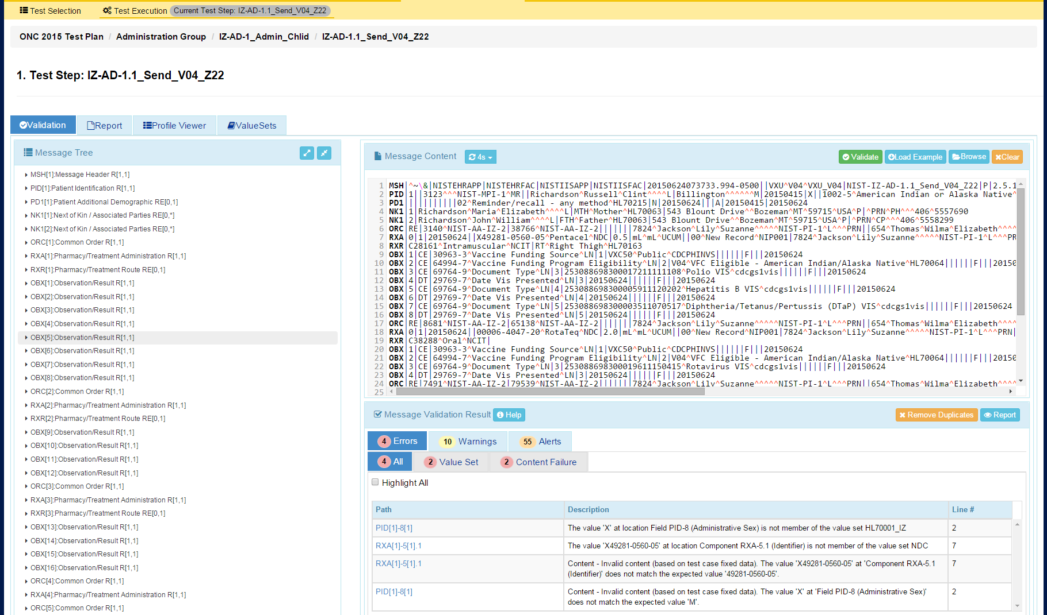
Conformance Testing DEMO
Context-based testing in the NIST HL7 v2.5.1 Immunization Test Suite
Test Data Message Content
Test Step Scenario
Test Plan with Test Cases & Test Steps
Load Test Step
Input HL7 v2 test message for validation
View Validation Report
DEMO
Immunization Test Suite
View validation results
Access this test tool at:
https://hl7v2-iz-r1.5-testing.nist.gov

Slide 14
Example Uses
Healthcare Industry Vendor Product Testing
Assessment and Certification Programs
  CMS/ONC EHR Meaningful Use
  HIMSS
  IHE
  AIRA
On-Boarding
  State Registries (Many Registries and Domains)
  Association of Public Health Laboratories (APHL)
  IIS to IIS Gateway

Slide 15
NIST Tool Instances
Immunization
Laboratory
  Results
  Orders
  Reportable
  Electronic Directory of Service (eDOS)
Syndromic Surveillance
Vital Records
  Birth
  Death
PIX/PDQ (Patient Identification and Demographics)
Patient Care Devices (PCD)
User Created Tools (via NIST Platform)

Slide 16
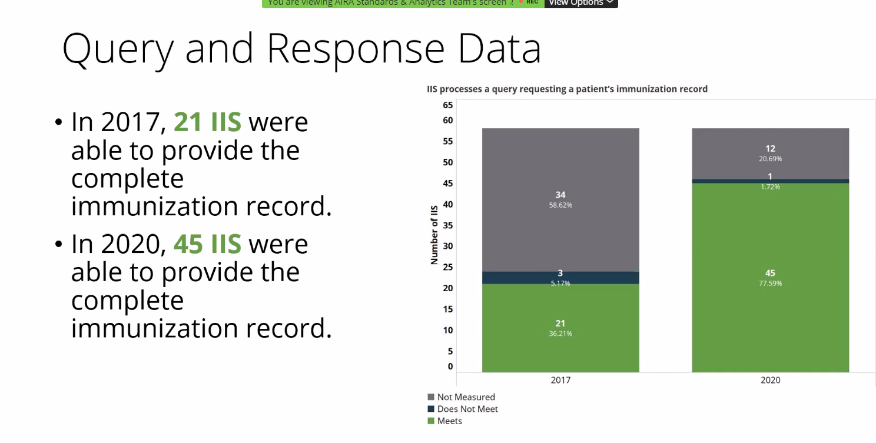
Real Success – AIRA Assessment
Measures of Immunization Query and Response Messages
Measures will get more rigorous over time
Source: American Immunization Registry Association, May 2021
Notes:
Implementers/Specifiers can decide how far to go—profiling mechanisms should provide capabilities for a precise specification.
THERE ARE NO SHORT CUTS—YOU HAVE TO DO IT ONE WAY OR THE OTHER!
These tools help us manage and leverage/reuse existing models.
Think about now Trading Partner C with the same needs.
Improves Patient Safety
Better Data Sharing
Saves Time and Money
Reasonable confidence that the product meets the conformance requirements stated in the standard
Closer to achieving interoperability
Don’t expect “out-of-the-box” interoperability
Local adaptation and testing is necessary
Most likely each integration will still require translation
Reasonable scope
Based on what standards are part of the certification
E.g., if no usability standards, don’t set unrealistic expectations

Slide 17
Acronyms – For Reference
HL7 – Health Level 7 (Standards Dev. Org)
CDC – Centers for Disease Control and Prevention
AIRA – American Immunization Registry Association
IIS – Immunization Information System
APHL – Association of Public Health Laboratory
IHE – Integrating the Healthcare Enterprises
ONC – Office of the National Coordinator (HHS)
MU – Meaningful Use (CMS EHR Certification)
IGAMT – Implementation Guide Authoring and Management Tool (NIST Tool)
TCAMT – Test Case Authoring and Management Tool (NIST Tool)
GVT – General Validation Tool

Slide 18
Thank You
Contact: robert.snelick@nist.gov
https://hl7v2tools.nist.gov

