Slide 1
NIST Healthcare Testing Infrastructure Overview
Interoperability by way of Standards, Conformance, and Testing Tools
June 2021
Robert Snelick, NIST
Background: HL7 v2, Conformance, Interoperability
Supplemental Video

Slide 2
Video Series
Part 1
  NIST HL7 v2 Testing Infrastructure Overview
Part 2
  NIST Conformance Testing Tools
  Focus on Immunization Test Suite
Part 3
  NIST Development and Testing Platform
Supplement
  Background: HL7 v2, Conformance, Interoperability

Slide 3
Heart of what NIST Does
Conformance Testing
Does the system implement the requirements as stated in the specification?
But relies on:
Requirements Specifications
Computable Formats
Test Cases
Test Data

Slide 4
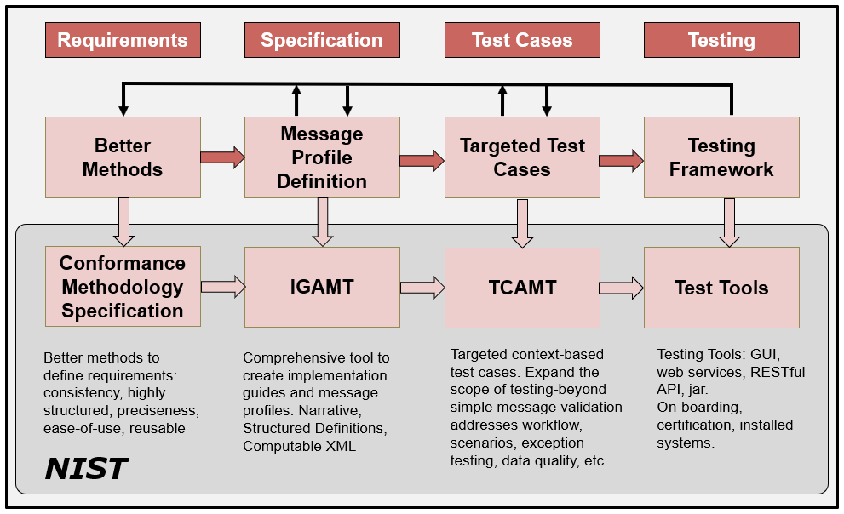
HL7 v2 Development Phases/Cycle
Notes:
Applicable to any standard product family.

Slide 5
Standards
HL7 – Health Level 7
  Messaging
    HL7 v2 ← “workhorse”
  Documents
    HL7 v3-CDA (Clinical Document Architecture)
  APIs
    FHIR (Fast Healthcare Interoperability Resources) ← “new”
IHE – Integrating Healthcare Enterprises
  Use Cases
  Integration Profiles
  Solutions
HL7 Implementation Guides
  Use Cases

Slide 6
HL7 v2 Message Structure
HL7 Message
Segment
Groups
Fields
Groups
Segment
Components
Data Types
Sub-Components

Slide 7
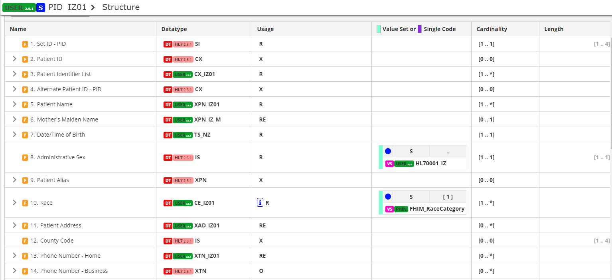
HL7 v2 Segment
Notes:
Applicable to any standard product family.

Slide 8
HL7 v2 Messages
Laboratory System
EHR
HL7 v2 Message
MSH|^~\&|COVID-19NISTAPP|COVID-19NISTFAC|COVID-19IISAPP|COVID-19IISFAC|20201228084727.655-0500||VXU^V04…
PID|1||89778^^^NIST-MPI-1^FI||Wong^Elise^^^^^L|Xhang^^^^^^M|19880417|F||2028-9^Asian^CDCREC~2131-1^Other Race^CDCREC|89 West 21st Ave^^Birmingham^AL^35203^USA^P||^PRN^PH^^^406^5554019~^NET^^Elise.Wong@isp.com|||||||||2186-5^Not Hispanic or Latino^CDCREC||N|1|||||N
ORC|RE|5237^NIST-AA-IZ-1|31309^NIST-AA-IZ-1|||||||7824^Jackson^Lily^Suzanne^^^^^NIST-PI-1^L^^^PRN||654^Thomas^Wilma^Elizabeth^^^^^NIST-PI-1^L^^^RPH|||||NISTEHRFAC^NISTEHRFacility^HL70362
RXA|0|1|20201228||80777-0273-99^Moderna COVID-19 Vaccine^NDC^207^COVID-19, mRNA, LNP-S, PF, 100 mcg/ 0.5 mL dose^CVX|0.5|mL^mL^UCUM||00^New Record^NIP001|7824^Jackson^Lily^Suzanne^^^^^NIST-PI-1^L^^^RPH|^^^NIST-Clinic-1||||025L20A|20210205|MOD^Moderna US, Inc.^MVX|||CP|A
…

Slide 9
Fundamental Concepts

Slide 10
Fundamental Terms
Conformance
Interoperability
Compliance
Compatibility
Alert: Not everyone will agree on these definitions
Alert: Some use these terms interchangeably
Alert: Terms are overloaded in use

Slide 11
Conformance
Defined as the fulfillment of a product, process, or service of specified requirements [1,2].
The concept of conformance is essential to any standard for providing an objective measure of how closely implementations satisfy the requirements defined in the standard [1,2].
Specification
Does the system implement the requirements as stated in the specification?
Conformance
Implementation
[1] ISO Reference - ISO/IEC 17000 Conformity assessment - Vocabulary and general principles, first edition 2004-11-02.
[2] Glossary of Conformance Terminology, Interoperability and Conformance Technical Committee, OASIS. http://www.oasis-open.org/committees/ioc/glossary.htm
Notes:
Conformance is determined based on a claim of conformance to a particular specification (which can be a national implementation guide or a local specification).

Slide 12
Interoperability
“is the ability of two or more systems or components to exchange information and to use the information that has been exchanged.” [1]
Two Key Parts:
  1) information must be exchanged, which refers to the technical/functional/syntactical characteristic;
  2) but the more important part is the correct semantic interpretation allowing for use of the exchanged information [2].
Implementation
Implementation
Interoperability
Can two interconnected systems exchange data and use that data to perform a business function as both intended?
[1] [IEEE-1990] Institute of Electrical and Electronics Engineers. IEEE Standard Computer Dictionary: A Compilation of IEEE Standard Computer Glossaries. New York, NY: 1990.
[2] Benson T. Principles of Health Interoperability HL7 and SNOMED. Health Informatics Series, Springer-Verlag, London Limited 2010.

Slide 13
Compliance
Is the degree to which a derived specification adheres to the requirements defined in the foundational specification (standard)
In other words, are the rules for adding constraints or extending the specification faithfully followed
Specification
Does a derived specification apply constraints to a base specification in accordance to the constraint model?
Compliance
Derived Specification
Notes:
That is, is the derived specification a proper set of requirements on the base specification (If an element is Required in the base, a derived specification can’t change it to Optional and be considered compliant).
Compliance is often a term used in place of conformance—hard to argue that it is wrong, conformance is the better term for describing if systems implement requirements and we will put a stake in the ground and use these terms as defined here. We will use ISO’s definition of conformance.
In order to determine conformance of a system, complete documentation is necessary. This however is often not the case. Compliance of the complete documentation of the interface can be assessed with the higher level profile. Missing documentation hinders conformance and compliance assessment.

Slide 14
Compatibility
Declares whether two specifications define sets of requirements that are harmonized with each other, allowing systems that implement them to work together, i.e., interoperate
Compatibility is a prerequisite for interoperability
Specification
Compatibility
Specification
Do the specifications define a set of harmonized requirements?
Notes:
Compatibility is a concept that is determined from the receiver perspective. The receiver is the “party” that needs to perform a certain function with the data received. If data is not available to perform a function then the sending/receiving pair is non-compatible. Compatibility is a pre-requisite for interoperability. More on this topic later in this tutorial.

Slide 15
Relationships
Specification
Compliance
Derived
Specification
Compatibility
Derived
Specification
Conformance
Implementation
Implementation
Interoperability
Source: F. Oemig, R. Snelick [2016]
6/1/2021
Notes:
Key Terms (white boxes) as they related to specifications and implementations (rose boxes).
Specification is the standard that contain the requirements. Specifications can be profiled (i.e., constrained further) to meet the needs of a refined use case. The result is a derived specification.
Specifications are implemented.

Slide 16
How is Profiling Related?
We must profile in a consistent manner using “rich” conformance constructs.
Profiling
Profiling
Specification
Compliance
Derived
Specification
Compatibility
Derived
Specification
Conformance
Implementation
Implementation
Interoperability
Source: F. Oemig, R. Snelick [2016]
6/1/2021
Notes:
Profiling: Refinements of the standard via constraints and extension.
NOTE: Can implement to the same profiled standard (which is often the goal when the same expectations are the same for sender and receiver).
NOTE 2: A derived specification is a profile, but documentation of an interface is also considered a “derived specification”.

Slide 17
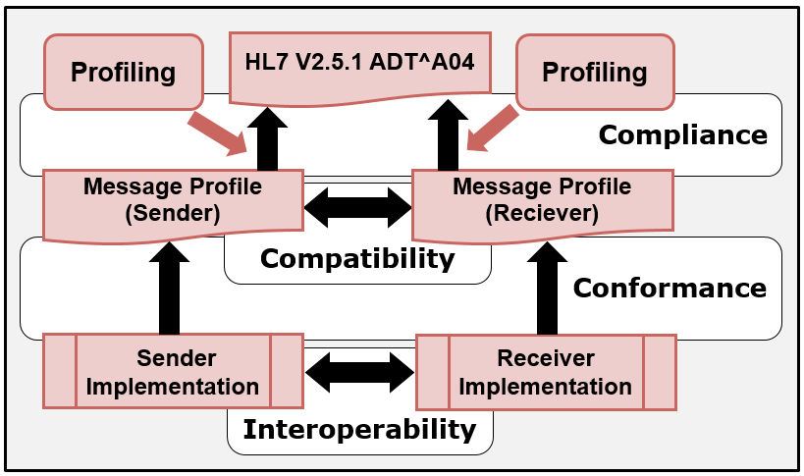
In the Context of HL7 v2
6/1/2021
Notes:
Profiling: Refinements of the standard via constraints and extension.
NOTE: Can implement to the same profiled standard (which is often the goal when the same expectations are the same for sender and receiver).
NOTE 2: A derived specification is a profile, but documentation of an interface is also considered a “derived specification”.

Slide 18
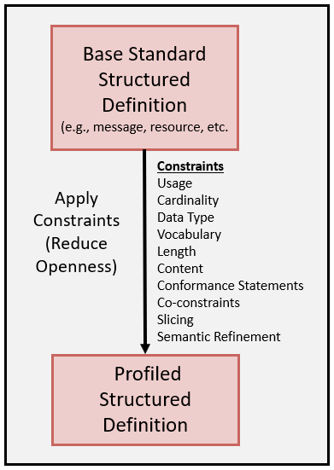
Profiling Overview
The base standard is a framework that contains many templates (starting point) that is intended to be constrained for a specific use and context.
Allows implementers to document an agreed-upon subset of the standard, and thus arrive at a common interpretation
Conformance Constructs provides the mechanisms to constraint in a consistent manner
6/1/2021

Slide 19
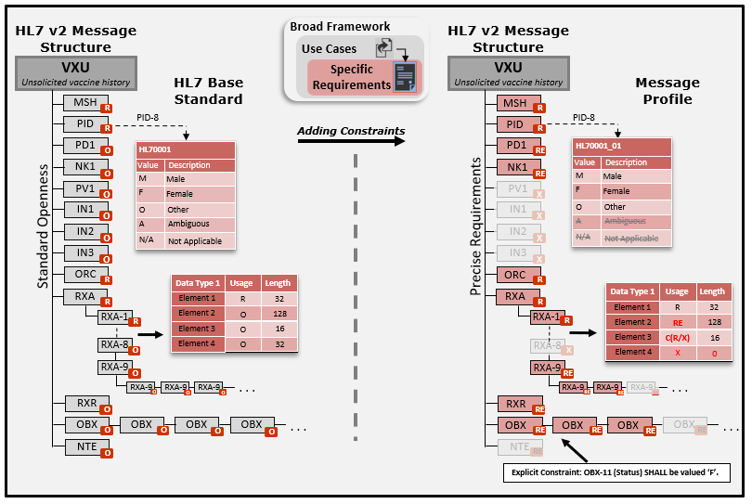
Creating Specifications
Notes:
Applicable to any standard product family.

Slide 20
Creating Specifications
Base Standard (Framework)
}
+
Profiling
Use Case (Requirements)
Use Case Specific Specification
+
Constraints
Notes:
Applicable to any standard product family.

Slide 21
Layers of Interoperability
Organizational Interoperability
Standardized process (workflow) elements using business process modeling tools
Can we accomplish the clinical task? What we want!
Semantic Interoperability
Standardized meaning (model elements) and terms/vocabulary for data interpretation, e.g., LOINC, ICD-10CM
Common information model—an understanding
Syntactic Interoperability
Standardized data exchange formats, e.g., HL7 v2, CDA, XML
Domain independent data exchange—processing of the data at these level is agnostic to the meaning of the data
Structural Interoperability
Simple EDI, envelopes
Technical Interoperability
Signals using standard protocols for technically secure data transfer, e.g., TCP/IP
Standards
Standards provide the foundation for each layer
What’s important about the data exchange is how it is used in the clinical setting to affect care, change and automate processing workflow.
Interoperability Levels: Blobel B. Introduction into Advanced eHealth – The Personal Health Challenge (Adapted).
6/1/2021
Notes:
This is a common diagram (others are equally valid). The grouping of the interoperability layers will vary depending on perspective. The lower levels are taken more or less for granted.
Standards are necessary at each layer—the higher we go up the more complex we get; thus the harder it is to achieve “automated” interoperability.

Slide 22
Process for Creating
Specifications

Slide 23


Old Process
1
6
Test Systems
Creates Specification in WORD
SMEs
Certification
Testers Read and try to best Interpret Requirements
2
One or more Ballots
4
Given to Testers
Validation Tools
3
Publication
5
Create Validation Tools
What if the tester gets it wrong?
Independent: Standards, Test Tool Development, Testing
What if requirements are under specified or ambiguous?
Who is the arbitrator?

Slide 24
Old Process
Disconnect Among SMEs/Testers/Certifiers
Review of Implementation Guides
  Written with “loose” language
  Consultation with Subject Matter Experts
  “Self-determining/Arbitrary” Decisions (in lieu of ballot)
  200 pages with 50 pages of addendum/clarification
Tester Interpretation can become source of truth
  Not Good!
Hand-crafted Assertions
Labor intensive and maintenance nightmare

Slide 25
NIST HL7 v2 Tooling Platform
1
Conformance
Methods
Provide the constructs to defined requirements
Tools Generated Automatically
6
Specification Builder
(IGAMT)
XML
Validation Tools
2
3
SMEs
XML
Test Case Builder
(TCAMT)
XML+
5
3
Export
4
Build Targeted Test Cases
Web Applications
Web Services
RESTful APIs
Validation Jar
Source Code
HTML
WORD
PDF
XML
= Machine-Computable

Slide 26
Validation
Conformance Testing is dependent on Foundational Layers!

Slide 27
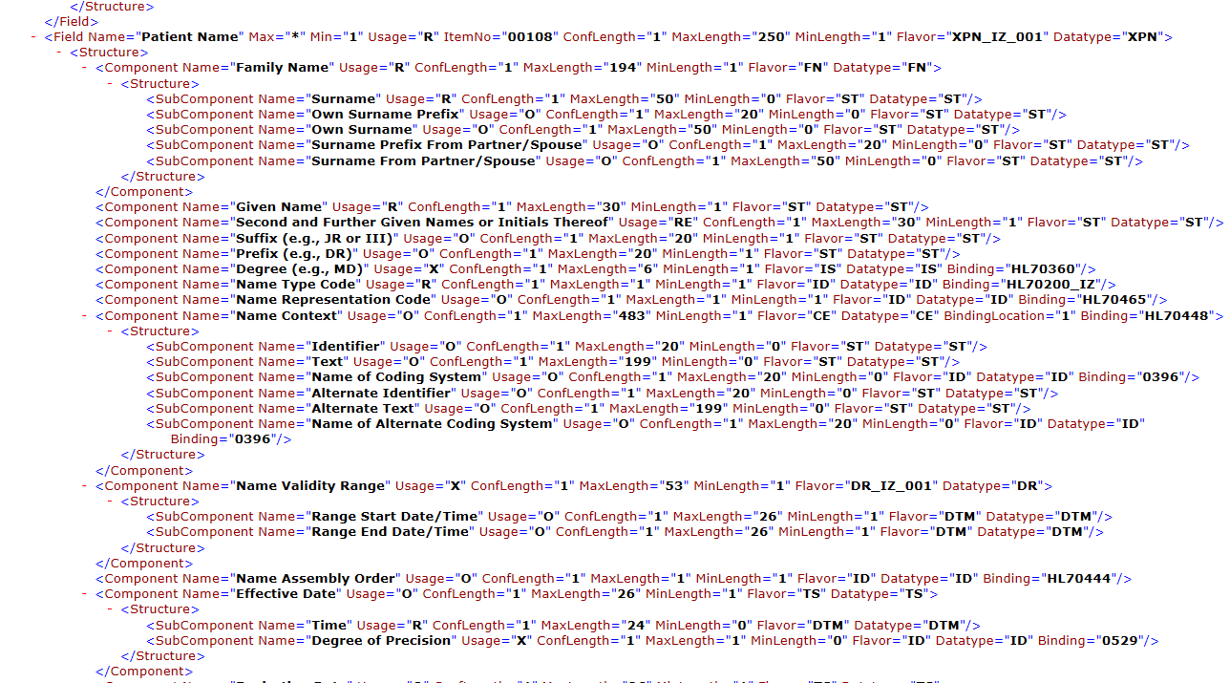
HL7 v2 Profile XML Format
Notes:
NIST HL7 v2 XML format. To be submitted to HL7 to standardize. The NIST format adds additional conformance constructs.

Slide 28
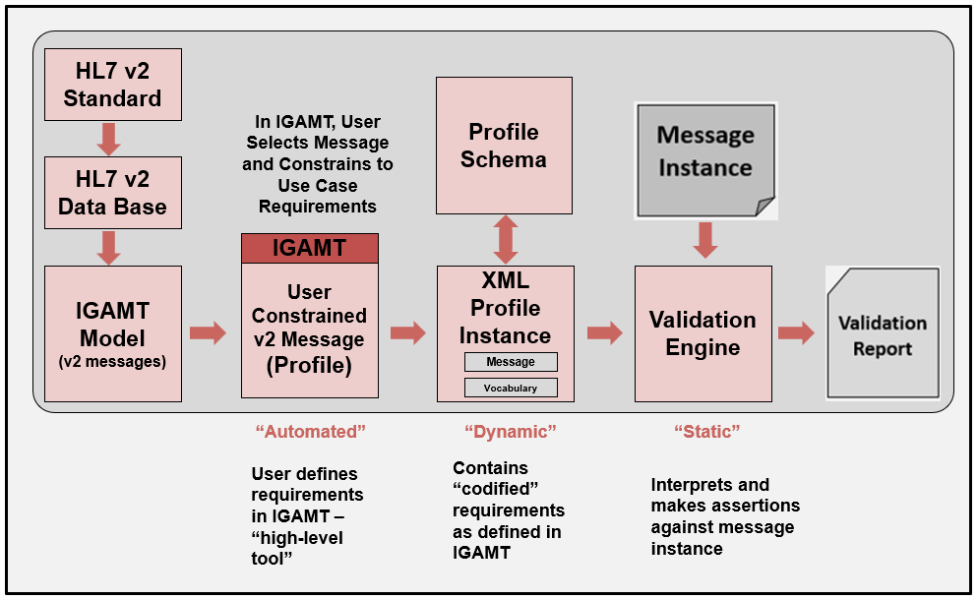
Validation Process

Slide 29
Standards and Testing
Conformance Testing is dependent on Foundational Layers!

Slide 30
Lessons Learned: Standards
Ambiguous
Inadequate investment
Not specific enough for use cases
Lack of verification (Implementations and Testing)
Not written to a desired state
Complex
Evolving
Timeliness
Not complete
Too many
Impact
Standards Investment
Surprising how little SDOs know about what constitutes a well-written standard
Subject Matter Experts don’t know how to write good standards
Lack of mechanisms to do so
Lack of tools to help in the process
Notes:
Ambiguous—a factor is that standards are written natural languages
Evolving—new versions, like, IHE for some every year. Some terminologies constantly changed.
Because they are consensus based, often will be written to a current—inadequate state, not to a desired state—I’ve actually standard include multiple solutions because of competing vendors products implemented a capability differently.
HL7 v2 IGs, but different
Ambiguous
Not the responsibility of testers to fill in the gaps—testers can and should request clarification, SDO needs to respond
Is FHIR heading in same direction?
The use of APIs and RESTful services in FHIR is a powerful paradigm, but it does not and cant not mask the inherent complexity in healthcare data exchange. We must still pay attention to how we specify requirements in FHIR, we can’t make the same mistakes we have made in the past, or we will only make incremental change instead of transformative change.
Under specified
Multiple solutions
Conflation of requirements (requirement scoping)
Document current state—not desired state
Not specific enough—e.g., code system binding
Too specific
Poor documentation and typos
Lack of a consistency
Incomplete Use Cases
Absence of harmonized requirement specification methodology
Insufficient requirement specification mechanisms
Lack of reference and pilot implementations
Lack of testing
Improper scoping

Slide 31
Lessons Learned: Realities of Testing
Bound to the quality of the standards
Tolerance for comprehensiveness
Time
Budgets
Inadequate Investments
What to Test?
  Boundless instances
  Adequate test coverage
  What are the priorities?
Test Cases
  Realistic
  Data
  Value in provide use examples
Impact
Testing Investment
Often not done
Done Inadequately
Based on poor standards
Notes:
Computability

Slide 32
Summary

Slide 33
How does Interoperability come to be?
Standards
Requirement Specification
Conformance
Compliance
Compatibility
Information Models
Semantic Understanding
Vocabulary Standards
Use Cases
Profiling
Implementation
Success Metrics
Computable Standard Formats
Specification Tools
Conformance Testing
Real Life Scenarios
Directed Test Cases
Test Data Sets
Conformance Test Tools
Testing Frameworks
Data Quality
Functional Requirements
Interoperability Testing
Life Cycle

Slide 34

How do we achieve Interoperability?
Standards must be created and adopted
Not just standards, but well-defined standards (they must be understandable)
Standards must be specific (profiled for use)
Standards should/must be represented in a computable format
Implementations must be tested for conformance
Systems must be tested for interoperability
Notes:
Creating well-defined standard is one of the main purposes of this tutorial (and what a well-defined standard means).
Conformance provides the principles for understanding and the foundation for testable requirements.
Normative standards should not be published unless reference/pilot implementations are created and conformance test tools available.

Slide 35
Summary: Towards Interoperability
Use Cases
Trading Partner A
Trading Partner B
Reduced Negotiations &
Translations
Requirements
Requirements
Standards
Profiling
Implementation
Testing
Need quality data exchange standards
Provide the mechanisms and education to create well-defined standards
Be precise, and demand it from SDOs
Profile, Modularize, and Reuse
Use existing tools (profiling and testing)
Non-conformance should not prevent useful exchange of data
Plan for testing, and test (at all layers)
Notes:
Implementers/Specifiers can decide how far to go—profiling mechanisms should provide capabilities for a precise specification.
THERE ARE NO SHORT CUTS—YOU HAVE TO DO IT ONE WAY OR THE OTHER!
These tools help us manage and leverage/reuse existing models.
Think about now Trading Partner C with the same needs.
Improves Patient Safety
Better Data Sharing
Saves Time and Money
Reasonable confidence that the product meets the conformance requirements stated in the standard
Closer to achieving interoperability
Don’t expect “out-of-the-box” interoperability
Local adaptation and testing is necessary
Most likely each integration will still require translation
Reasonable scope
Based on what standards are part of the certification
E.g., if no usability standards, don’t set unrealistic expectations

Slide 36
Thank You
Questions
Contact: robert.snelick@nist.gov
https://hl7v2tools.nist.gov

