Slide 1
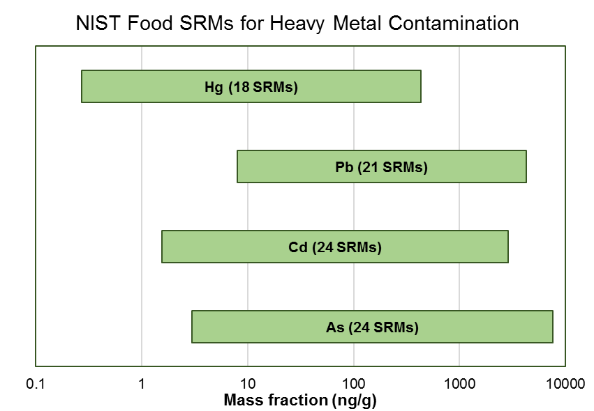
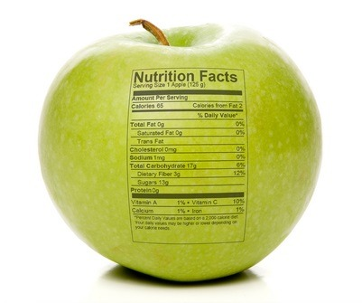
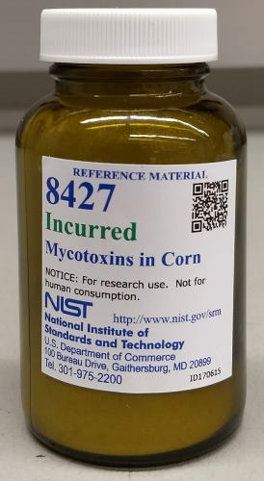
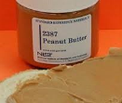
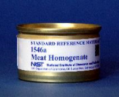
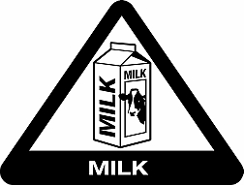
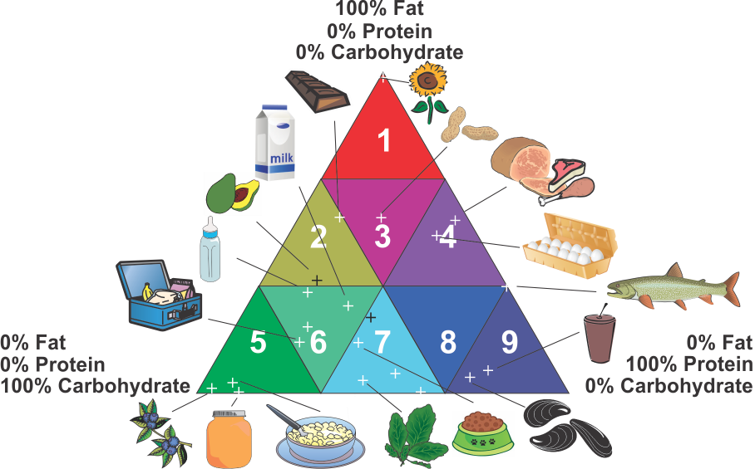
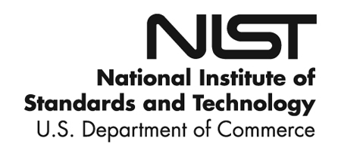
NIST has developed and currently maintains an extensive Measurement Service Program in Food Nutrition & Safety…
NIST’s efforts have been focused on nutritional content:
in assisting the food industry in compliance with labeling regulations imposed by the US Food and Drug Administration
NIST’s efforts for food safety have been historically limited to toxic elements,
with our newer areas in mycotoxins and allergens
… but, what’s next?

Slide 2
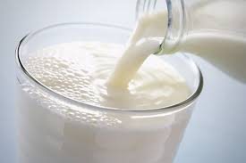




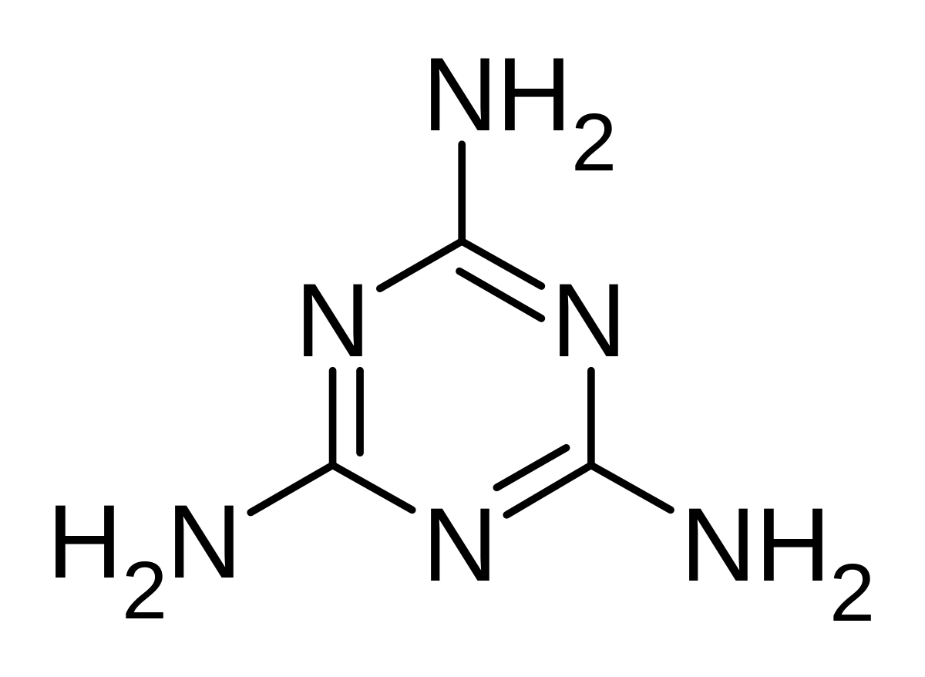
Upcoming NIST Food Safety Workshop
April 16-18, 2019 in Gaithersburg, MD USA
Questions or Interest? foodsafety@nist.gov
Protein Food Allergens
Chemical Residues & Contaminants
Authenticity, Fraud, & Adulteration
Microbiological Contaminants
Workshop Goals
Gather industry feedback on current measurement science needs for food safety
Engage stakeholders and seek partnerships or collaborations in development of new materials, methods, or programs
Focus Areas

Slide 3
Focus of Food Safety Workshop
Industry
Academia &
Researchers
Food Manufacturers
Testing Laboratories
US FDA
USDA
Method Developers
Instrument Manufacturers
Regulators
RM Producers
Metrology Institutes
Commercial Sector
75%
10%
10%
5%

