Slide 1




Cloud Assessments
Industry Day
SaaS Email Working Group Meeting
John Connor, IT Security Specialist, OISM, NIST
February, 2016
Background Photo - JILA strontium atomic clock (a joint institute of NIST and the University of Colorado Boulder)

Slide 2
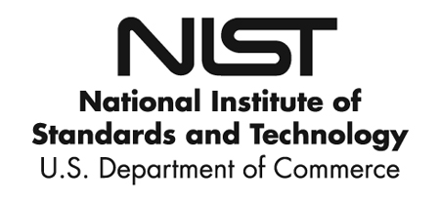
OISM
“Certain commercial vendors are identified in this presentation for example purposes. Such identification is not intended to imply recommendation or endorsement by the National Institute of Standards and Technology, nor is it intended to imply that the vendors identified are necessarily the best available for any given purpose.”
This presentation was created by NIST’s Office of the Chief Information Officer for informational purposes only and is not an official NIST publication.
Industry Day

Slide 3

OISM
IN THE NEWS - 2015
LastPass saw potentially millions of passwords accessed
CVS, Walgreens, others hit by credit card breach
Carphone Warehouse, phone store - 90,000 customers had encrypted credit card data stolen.
Anthem lost more than 80 million customer records - including SSN’s
UCLA Health hacked - 4.5 million records, including SSN’s, and medical data
IRS data breach led to hackers taking tax returns
Ashley-Madison - “The last truly secure space on the Internet”
Sony hasn't recovered from the hack yet
Hacked toymaker leaked gigabytes’ worth of kids’ headshots and chat logs
OPM data breach effects 12.5 million people
1 to look at in more detail…
Industry Day

Slide 4
OISM
Hacking Team (July 2015)
Hacking Team, an Italian company that makes surveillance software used by governments to police the Internet was hacked.
All company information exposed.
Christian Pozzi, senior system and security engineer for the company:
The leaked security engineer's list of passwords:
UserName : Neo
Password : Passw0rd
UserName : c.pozzi
Password : P4ssword
Information from various public news reports.
Industry Day

Slide 5

OISM
Requirements:
  ‘‘The head of each agency shall be responsible for providing information security protections commensurate with the risk and magnitude of the harm resulting from unauthorized access, use, disclosure, disruption, modification, or destruction of
    ‘‘(i) information collected or maintained by or on behalf of the agency; and
    ‘‘(ii) information systems used or operated by an agency or by a contractor of an agency or other organization on behalf of an agency
Federal Information Security Management Act of 2002 (FISMA) section 3544. Federal agency responsibilities
See OMB Memo M-14-04 November 18, 2013
- Excellent FAQ on all aspects of FISMA, including cloud
Industry Day

Slide 6


OISM
What does this have to do with “The Cloud” ?
(ii) information systems used or operated by an
agency or by a contractor of an agency or other
organization on behalf of an agency
OMB Memo M-14-04 November 18, 2013
#25, 26, 27 & 48 specifically on 3rd part and cloud vendors
See NIST SP-135 for definition of “cloud”
Any vendor who stores, accesses, CAN access, touches, manipulates etc… Government data MUST be fully assessed against all applicable controls.
Industry Day

Slide 7
OISM
Risk Based Decisions:
  Security plans, security assessment reports, and plans of action and milestones for common controls are used by authorizing officials within the organization to make risk-based decisions in the security authorization process for their information systems.
  When security controls are provided to an organization by an external provider (e.g., through contracts, interagency agreements, lines of business arrangements, licensing agreements, and/or supply chain arrangements), the organization ensures that the information needed for authorizing officials to make risk-based decisions, is made available by the provider.
NIST Special Publication 800-37
FISMA is Risk Based – Authorizing Officials weigh residual risks vs the risk to the Agency of exposure. Not pass/fail
Industry Day

Slide 8

OISM
How NIST assesses a “Cloud” Service Provider (CSP)
(applies to any 3rd party vendor)
Involves 2 parts:
Assessment of the CSP
  Could involve multiple assessments
    CSP will often use subcontractors
      For example a SaaS CSP may use Amazon Web Services to host the data or
      May use Iron Mountain to store backups. Those providers must be assessed.
  Could leverage other assessments
    Assessment could be conducted by the agency, leverage another agencies assessment, partially leverage non-FISMA assessments, leverage FedRAMP assessment.
Assessment of agency specific controls
  There will ALWAYS be an agency specific implementation part
Industry Day

Slide 9

OISM
Log Files
Physical
Backups
Backups
Hosting
A cloud vendor may be using other vendors…
Who may be using other vendors…
Who may be using…
Vendor
File Shares
Code
Scanning
Password
Safe
Federal Computer Security Managers’ Forum

Slide 10

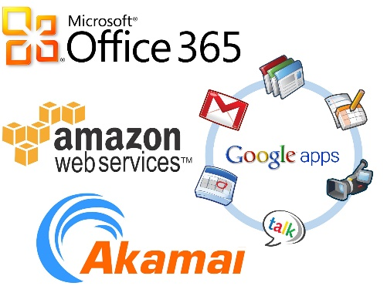
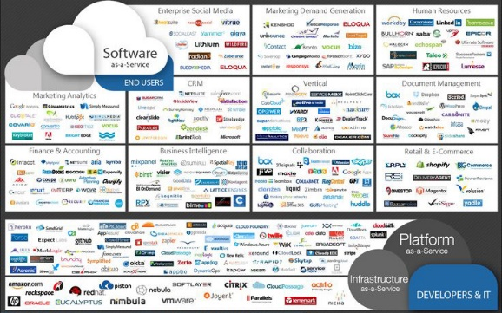
OISM
Different types of cloud assessments (example use cases)
Social Media
Publically available, low criticality levels
Confidentially not an issue, availability not a direct issue, integrity a concern
Unauthorized modification of system information could be expected to have an adverse effect…
Scope out of testing CSP, test agency specific implementation, document mitigations
Still requires an assessment!
Enterprise Level (SaaS, PaaS, IaaS)
Enterprise level, often moderate* criticality levels
Full testing of CSP required
Full testing of agency specific implementation
Leverage FedRAMP, PCI, SAS 70/SSAE 16, HIPPA
Everything in between…
Could have low impact levels, but not public and require login
Could be a CSP that leveraged another PaaS and has limited access
Must follow FISMA process to determine impact
Finding balance of testing – ‘Commensurate with the risk’
Industry Day

Slide 11

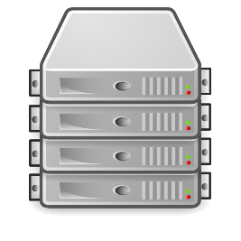
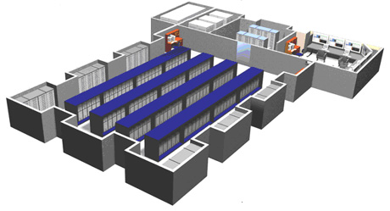


OISM
Software as a Service (SaaS)
Typical Small Business
Cloud Vendor layout
Hosted In Data Center
Accesses SaaS
Government User
SaaS Vendor Corporate
HQ accesses servers
for administration or SaaS for help desk
SaaS Vendor
telecommuters
may access through
HQ or directly.
Things to realize:
Even if data center is secure the vendor is responsible for configuring the servers.
If the vendor can access Gov’t data from HQ or admin telecommuters, all controls are in play for them.
Industry Day

Slide 12
OISM
Leveraging other assessments
SSAE 16 (formerly SAS-70) (Statement on Standards for Attestation Engagements)
PCI (Payment Card Industry)
HIPPA (Health Insurance Portability and Accountability Act)
Sarbanes–Oxley
others… (will get into FedRAMP shortly)
Do not encompass all FISMA (800-53)/FedRAMP controls
Will not meet all requirements
Some are pass/fail – no explanation of mitigating controls
For instance PCI only requires a 7 character password
8.2.3 Passwords/phrases must meet the following:
Require a minimum length of at least seven characters.
Contain both numeric and alphabetic characters.
Payment Card Industry (PCI) Data Security Standard
Requirements and Security Assessment Procedures
Version 3.0 November 2013
Risk Based Decision
Industry Day

Slide 13

OISM
Cloud Service Providers (CSP)
Chicken and the egg problem for the vendors
Resources necessary for compliance
Fairness to small businesses
Need to protect taxpayer data
Industry Day

Slide 14

OISM
Some other Challenges
Incident response
How will the vendor notify if a possible breach or incident has occurred? How with they interface with an agencies incident response team? Will they share logs (could be difficult if a shred tenant)?
Background Investigations
All personnel who have access to Government data are required to have background investigations conducted by a Federal Government entity.
OPM requirements (IPv6, PIV, TIC, 508)
OPM Cloud First mandate vs. other OPM mandates. Many cloud vendors may not be able to currently meet all Federal Government technical requirements.
Continuous Monitoring
Most likely do not have ‘feeds’ from vendor. What continuous monitoring is in place?
Industry Day

Slide 15

OISM
Leveraged by
multiple agencies
One assessment
http://www.fedramp.gov
OMB Authorizing Memo December 8, 2011: https://cio.gov/wp-content/uploads/2012/09/fedrampmemo.pdf
Contact: info@fedramp.gov
FedRAMP does not issue ATO
ONLY an agency can issue an ATO
JAB board provides ‘provisional’ authorization only
All cloud projects must meet FedRAMP (not just FISMA) requirements
(as of June 6, 2014, which has passed)
Industry Day

Slide 16
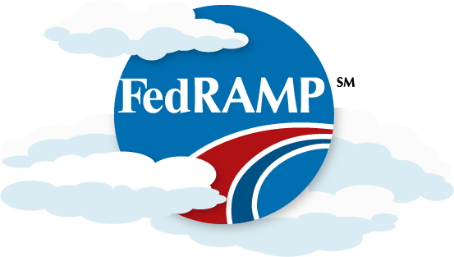
OISM
FedRAMP is an extension of FISMA.
Additional SP 800-53 controls
  1 additional low control (independence)
  46 additional moderate controls
  High baseline available
Specific FedRAMP templates
Uses validated Third Party Assessor (3PAO) for assessment.
Challenge with FedRAMP will be Continuous Monitoring
Ultimately up to the authorizing agency to ensure proper continuous monitoring
Industry Day

Slide 17

OISM
Thank You
For further information:
NIST CSC Publications (FIPS and SP’s: http://csrc.nist.gov/publications/
  Specifically:
  800-37: http://nvlpubs.nist.gov/nistpubs/SpecialPublications/NIST.SP.800-37r1.pdf
  800-53: http://nvlpubs.nist.gov/nistpubs/SpecialPublications/NIST.SP.800-53r4.pdf
FedRAMP: https://www.fedramp.gov/
Background Image: Deer at the NIST campus in Gaithersburg, MD
Industry Day

