Slide 1
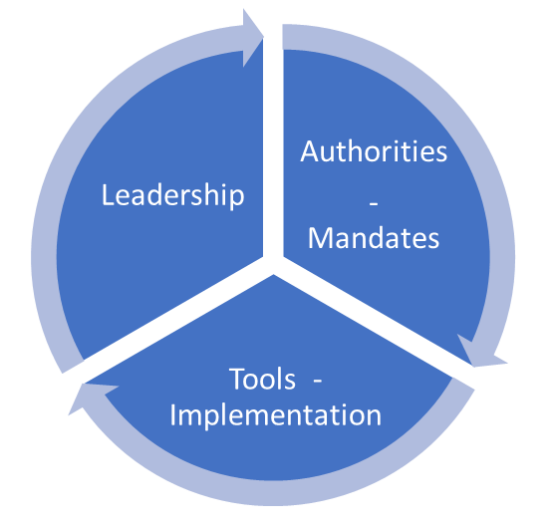
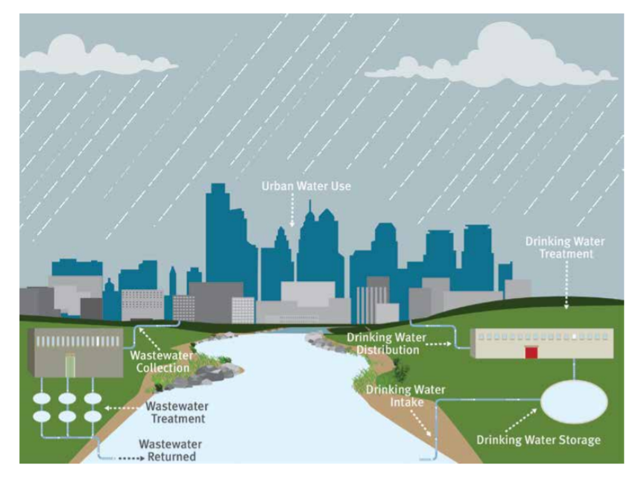
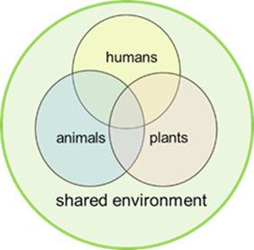

Enduring Capability
for Wastewater-based Epidemiology
through a One Health Lens
SWWR Workshop June 18,2021
Tonya Nichols, PhD USEPA

Slide 2



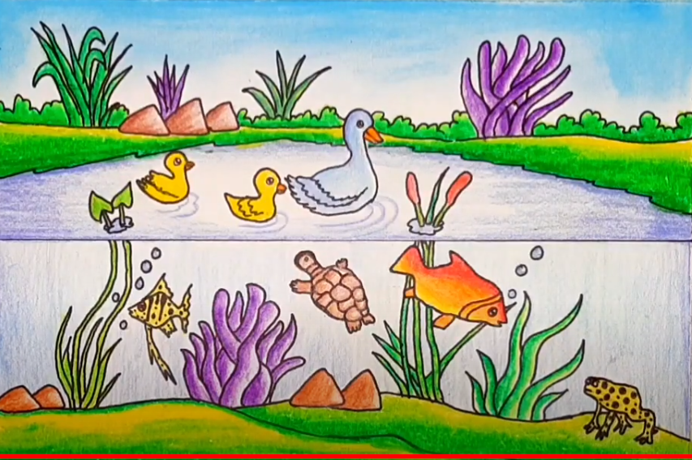

Slide 3
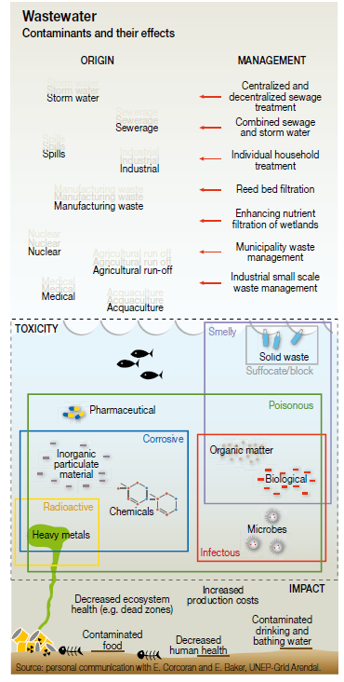
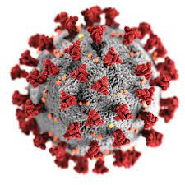
AMR
SARS-CoV-2
Modified from:

Slide 4

Finding SARS-COV-2
In Wastewater
++other contaminants++
…before contaminants become a
One Health emergency

Slide 5
Enduring Capability
for Wastewater-based Epidemiology
Authorities / Mandates
Tools / Implementation
Leadership
WBE implications ?
Clean Water Act
One Health Act (introduced 2021)
National Biodefense Strategy
Health Security Strategy
Global Health Security Strategy
Multiple Executive Orders addressing Public Health Preparedness and Prevention

Slide 6
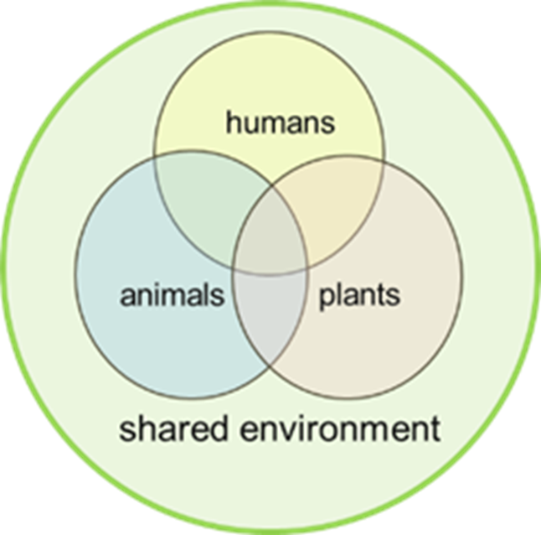
Wastewater-based Epidemiology through a One Health Lens
June 18, 2021
Tonya Nichols, PhD
USEPA

