Slide 1
Title of Presentation
Speaker Name
Speaker Email Address
Notes:
Updated January 7, 2021
Graphic Credit: NICE

Slide 2
NICE Mission
NICE MISSION
To energize, promote, and coordinate a robust community working together to advance an integrated ecosystem of cybersecurity education, training, and workforce development.
Notes:
The National Initiative for Cybersecurity Education (or NICE), is led by the National Institute of Standards and Technology (NIST) in the U.S. Department of Commerce, is a partnership between government, academia, and the private sector focused on cybersecurity education, training, and workforce development. However, NICE is a community effort between government, industry, and academia to energize, promote, and coordinate a robust community working together to advance an integrated ecosystem of cybersecurity education, training, and workforce development.
Visit the NICE website at www.nist.gov/nice.
Photo Credit: shutterstock/Bakhtiar Zein

Slide 3
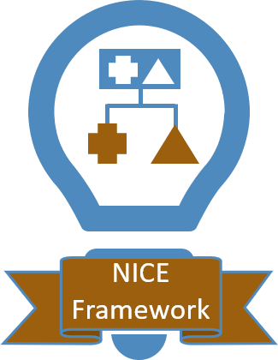
NICE Goals
NICE GOALS
Notes:
In the NICE Strategic Plan, released November 2020, there are five goals, each with many objectives.
The first goal focuses on promoting the discovery of cybersecurity careers and multiple pathways.
The second goal focuses on transforming learning to build and sustain a diverse and skilled workforce.
The third goal focuses on modernizing the talent management process to address cybersecurity skills gaps.
The fourth goal focuses on expanding use of the NICE Framework (more on this in a minute).
The fifth goal focuses on driving research on effective practices for cybersecurity workforce development.
View the NICE Strategic Plan at: www.nist.gov/itl/applied-cybersecurity/nice/about/strategic-plan
Graphic Credit: NICE

Slide 4
Goal: NICE Framework
Expand Use of the Workforce Framework for Cybersecurity (NICE Framework)
Document and Disseminate Successful Uses
Align NICE Framework with Other Cybersecurity and Privacy Guidance
Establish a Process for Reviews and Updates
Explore Tools to for Access and Interoperability
Identify Work Subject to Automation
Expand International Outreach
Notes:
As mentioned, one of the five NICE Strategic Plan goals focuses on expanding the use of the Workforce Framework for Cybersecurity (or NICE Framework).
Primary objectives of this goal include:
Document and widely disseminate methods, resources, and tools shown to successfully expand use of the NICE Framework
Align the NICE Framework to the NIST Cybersecurity Framework, NIST Privacy Framework, and other cybersecurity, privacy, and risk management publications
Establish processes for regularly reviewing, improving, and updating the NICE Framework
Explore development of new tools or integration of NICE Framework data into existing tools to increase access and facilitate interoperability
Identify and highlight components of the NICE Framework (Tasks, Knowledge, and Skill Statements) that could be potentially performed via automated techniques
Expand international outreach to promote the NICE Framework and document approaches being used in other countries
Graphic Credit: NICE

Slide 5
Why a Workforce Framework?
Why a Workforce Framework?
A consistent framework model…
EMPLOYERS
Enables the establishment of regular processes – from hiring to training and assessment – for multiple roles in an organization.
Shares clear information about cybersecurity work to help students interested in this career field, people looking for a new job or to change job roles, and workers who are looking to demonstrate or increase their competencies.
Provides direct information about what a workforce needs to know, helping in the development of certificates, badging, and other verification techniques to consistently describe learner capabilities
LEARNERS
EDUCATION, TRAINING, & CREDENTIAL PROVIDERS
Notes:
A workforce framework for cybersecurity provides a common, consistent model and point of reference for various audiences to uses in various applications. A standard lexicon will promote a stronger ecosystem by:
Enabling a regular process for the talent lifecycle – from hiring to training and assessment.
Illustrates a clear picture about what cybersecurity work is – so students and job seekers (or career changers) can decide what area of cybersecurity they want to work in.
Provides direct information about what current and future workers need to know – so that teachers can create materials that will meet the needs.
These three key areas translate to (next slide) who the NICE Framework is for.
Photo Credit Blue office: https://commons.wikimedia.org/wiki/File:Kit_Out_My_Office%27s_%27HD_Colour%27_(blue_photo_2)_office_furniture.png
Photo Credit Learners: https://www.flickr.com/photos/unu-wider/44832221595
Photo Credit Class: https://www.pickpik.com/classroom-computers-education-class-education-technology-learning-155611

Slide 6
Who is the NICE Framework for?
EMPLOYERS
Public and Private Sectors
LEARNERS
Students
EDUCATION, TRAINING, AND CREDENTIAL PROVIDERS
Job-Seekers
Employees
Human Resources
Hiring Managers
Other SME’s
Learning Pathways
Credentials
Notes:
The NICE Framework can be used broadly.
It can be used by employers who are looking to gauge their workforce needs. Human Resources can use it to assess their current workforce. Hiring Managers can use it to determine what gaps exist on their cybersecurity teams and hire new talent appropriately.
Or it can be used by learners -- including students, job-seekers, and employees.
Finally, it can be leveraged by educators and training providers who will provide learning pathways for learners, teach them, and provide them with credentials to enter or grow in their cybersecurity career.
The NICE Framework provides for all these audiences a common language around cybersecurity work by defining work roles, tasks, knowledge and skill statements, and competencies.
Photo Credit Blue office: https://commons.wikimedia.org/wiki/File:Kit_Out_My_Office%27s_%27HD_Colour%27_(blue_photo_2)_office_furniture.png
Photo Credit Learners: https://www.flickr.com/photos/unu-wider/44832221595
Photo Credit Class: https://www.pickpik.com/classroom-computers-education-class-education-technology-learning-155611

Slide 7
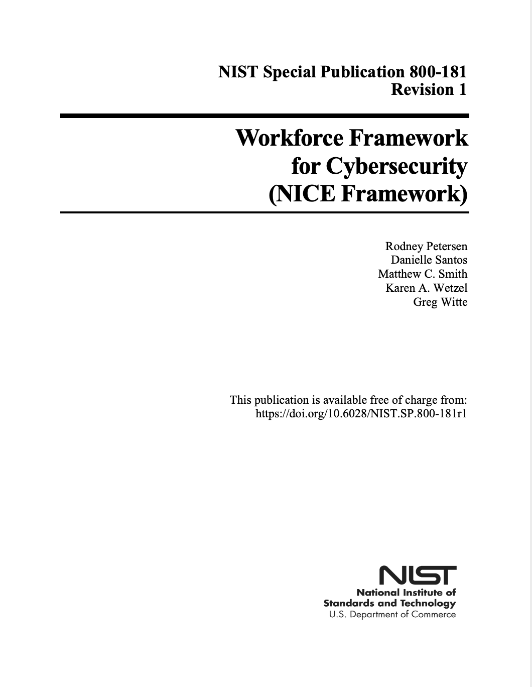
What is the NICE Framework?
What is the NICE Framework?
NIST Special Publication 800-181r1
Title: Workforce Framework for Cybersecurity (NICE Framework)
Scope: Security of Cyberspace (Cybersecurity)
Focus: Cybersecurity Work
nist.gov/nice/framework
Notes:
The Workforce Framework for Cybersecurity (NICE Framework), is a fundamental reference for describing and sharing information about cybersecurity work. The NICE Framework considers the “Cybersecurity Workforce” to include not only those whose primary focus is on cybersecurity but also those who need specific cybersecurity-related knowledge and skills to properly manage cybersecurity-related risks to the enterprise.
While we recognize that cyberspace includes many elements of traditional IT or ICT, we are specifically focusing on the security of those systems and processes.
The NICE Framework supports four key attributes – agility, flexibility, interoperability, and modularity.
Please note that the NICE Framework was recently updated (November 2020). In this revision the artifacts that support the NICE Framework - supplemental content such as lists of Work Roles and Tasks, that were previously were appendices - have been removed from the publication itself to support these attributes. These materials have been removed to be able to be maintained on a more frequent basis.

Slide 8
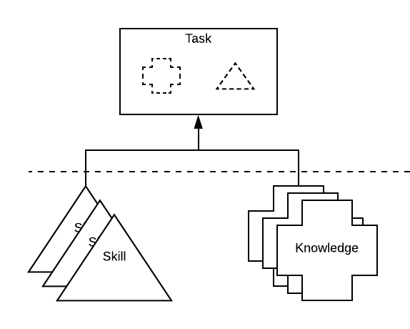
Building Blocks
Building Blocks: Tasks, Knowledge, and Skills (TKS)
Describes the Work
Describes the Learner
Notes:
At its core, the NICE Framework provides a set of building blocks for describing the tasks, knowledge, and skills (TKS) that are needed to perform cybersecurity work performed by individuals and teams.
Ability statements from the previous version have been refactored in the 2020 revision for simplicity into Skill statements. These refactored statements, along with existing Skill statements and which Knowledge statements, focus on the action of the learner.
Tasks, which are comprised of Skill and Knowledge (K&S) statements, describe the work to be done.

Slide 9
Application and Uses
TEAMS
COMPE- TENCIES
WORK ROLES
Notes:
The NICE Framework shares ways of using and applying the building blocks in a variety of ways to support organizations’ unique contexts. The ones that we identify in particular are work roles, teams, and competencies.
Work Roles are a way of describing a grouping of work for which someone is responsible or accountable and are composed of Tasks that constitute the work to be done. Work roles are not synonymous with job titles or occupations.
Teams are commonly used to bring together individuals with complementary skills and experience, and can be defined through either work roles or competencies. (next slide)
Photo Credit Hands: https://www.lifeofpix.com/photo/diverse-people-stacking-hands-together-3/
Photo Credit Tools:
Rob Kemme from Netherlands, CC BY-SA 2.0 <https://creativecommons.org/licenses/by-sa/2.0>, via Wikimedia Commons
https://commons.wikimedia.org/wiki/File:Old_tools_collection_(27204177988).jpg
Photo Credit Mountain: https://pixabay.com/photos/person-mountain-top-achieve-1245959/

Slide 10
Competencies
Competencies
COMPETENCIES that learners possess, acquire, develop
NICE Framework
Education, Training Providers, Employers
Employers
Competency: A mechanism for organizations to assess learners. Competencies consist of a name, description of the Competency, and group of associated TKS (Task, Knowledge, Skill) statements.
Competencies are
Defined via an employer-driven approach
Learner-focused
Observable and measurable
define
identify
assess
Notes:
The NICE Framework Competencies offer an opportunity to increase alignment and coordination between employers, learners, and education and training providers, where NICE Framework “defines competencies,” employers “identify competencies,” and academic institutions assess them (i.e., “evidence” of competencies).
Competencies offer a higher-level perspective on cybersecurity work, allowing organizations to group together various TKS statements into an overarching category that defines a broad need. They are flexible, allowing the inclusion or removal of specific TKS statements in response to shifting needs in a changing cybersecurity ecosystem. Importantly, they are
Defined via an employer- driven approach
Learner-focused
Observable and measurable
The NICE Framework sees Competencies as an employer-drive mechanism for an employer or educator to assess a learner’s overall ability to achieve the competency. So, instead of specifying the work to be done (tasks) or what is needed to do the work (K&S), it’s about assessing a learner’s overall ability to do that work (the combination of TKS statements that it encompasses).

Slide 11
More Information
For More Information
Visit Us Online
Email Us
Join the NICE Framework Users Group
Engage on Social Media
#NICEFramework
#NICEatNIST
Notes:
(Note to presenter: Hyperlinks aren’t clickable on this slide when viewing in edit mode. However, if you are in presentation mode or if you PDF the file, they will work.)
Visit the NICE Framework Resource Center online or email NICE for more information.
You may also join the NICE Framework Users Group which is a forum for users (employers, learners, and education and training and credential providers) who are interested in sharing and learning through questions, insights, or mutual support how to apply and use the NICE Framework and its associated components in various settings.
NICE Framework Resource Center: www.NIST.gov/NICE/Framework
Email : NICEFramework@nist.gov
NICE Framework Users Group: https://www.nist.gov/itl/applied-cybersecurity/nice/about/community-coordinating-council/nice-framework-users
Twitter: https://twitter.com/NISTcyber

