Slide 1
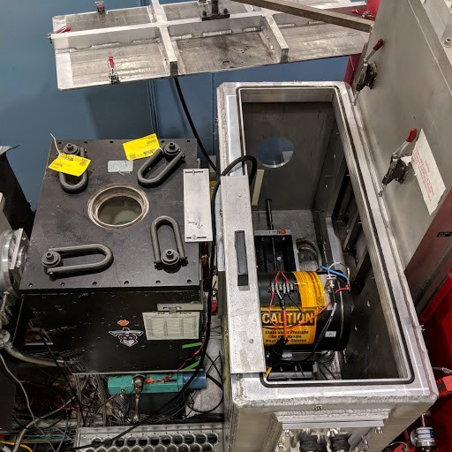
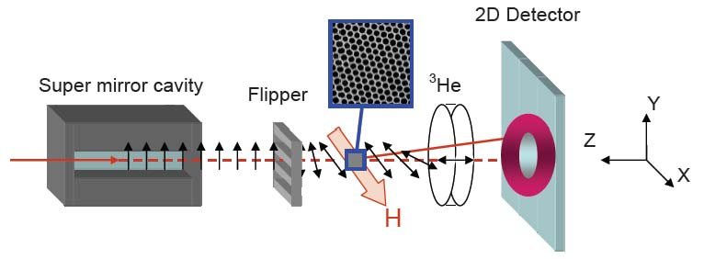
³He NSF based polarization analysis on SANS
³He neutron spin filter
Four cross sections measured
Wavelength: 0.43 nm to 0.84 nm
Q range coverage up to 1.4 nm⁻¹
³He neutron transmission 45% (for desired spin state)
Initial flipping ratio up to 20
Supermirror efficiency 0.87 - 0.94
Flipper efficiency above 0.98
³He NMR based neutron spin flipping capability.
Sample field up to 1.3 T
Detector
Sample
³He analyzer
neutrons
Sample
W.C. Chen et al, Physica B 404, 2663 (2009); K.L. Krycka et al, Physica B 404, 2561 (2009)
http://www.ncnr.nist.gov/equipment/he3nsf/index.html

