Slide 1
OCR/NIST HIPAA Security Conference – October 18 & 19
Safeguarding Health Information: Building Assurance through HIPAA Security
Heather Nelson, VP & CIO
University of Chicago Medicine
October 19, 2018

Slide 2

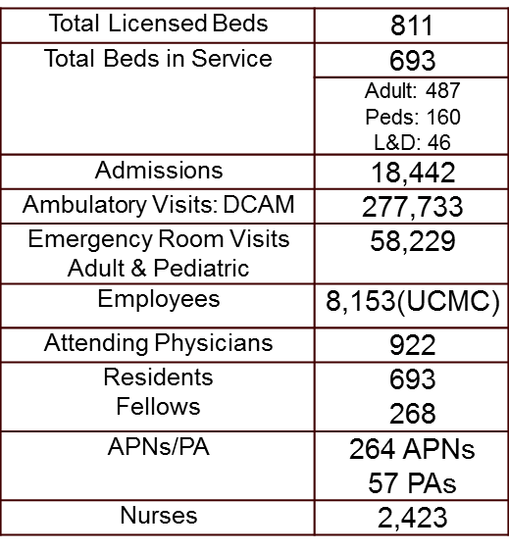
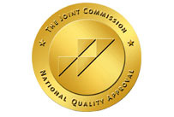


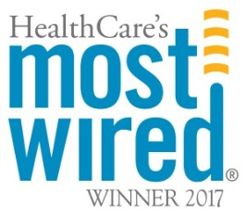


University of Chicago Medicine: At a Glance
The University of Chicago Medical Center
  Center for Care and Discovery
  Bernard Mitchell Hospital
  Comer Children's Hospital
  Duchossois Center for Advanced Medicine
  Orland Park Center for Advanced Care
  South Loop Center for Advanced Care
  Ingalls Memorial (Harvey, IL)

Slide 3
Technology Silo’ed Infrastructure, Remember the 2000s?
Remember when?
You could keep your data inside your network?
When there were no smartphones and data leakage to mobile devices?
There was barely any social media?
The “cloud” was just another term for “external hosting”?
Medical devices didn’t run on Windows or Linux?
New technology meant bringing in systems “inside of your four-walls”?
You “kinda knew” where your data were?

Slide 4
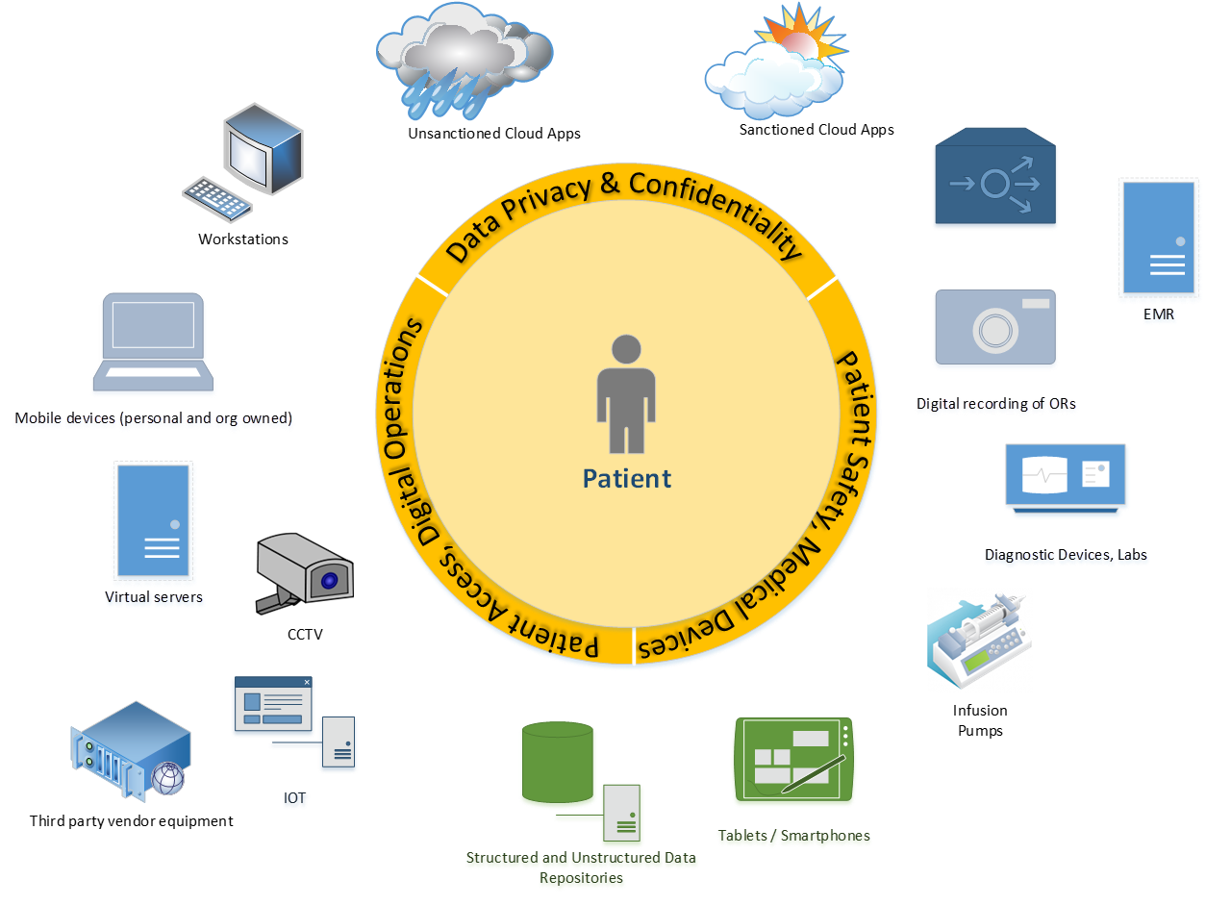

Modern Digital Age, Patient Centric
Well, those times are gone

Slide 5
Modern Age, Cyber Threat Model
Threat actors are the individuals, or groups of individuals, who take actions to induce harm. These actions may be deliberate, or they may be accidental. If the actions are successful, however, the result is some form of harm to the organization, or its patients.
The below matrix illustrates the actors, their motivations, and the primary and most likely manner in which harm can be actualized.
Notes:
Threats have modernized. Whereas before the general concern was related to data use misuse, such as malicious or unintentional which was done by a smaller group of threat actors, now more sophisticated actors have entered the picture. Organized crime, terrorism and nation state actors have different motivations. They aren’t necessarily as driven by financial fraud (though certainly organized crime might be), as much as they are about causing more malicious harm (shutting down the health system, harming a patient, conducting political or economic espionage). These are also threats that must be considered and mitigated.

Slide 6
Modern Age, Cyber Risks
We care for the whole patient, including their well-being and their privacy
Disruptions to the digital ecosystem affect the ability to treat the patient
Attacks to connected medical devices could affect the health of the patient
Patient Safety - Attacks against devices connected to patients, leading to:
Financial harm
Reputational Harm
Embarrassment
Digital Resiliency - Attacks against the digital ecosystem that disrupts operations, leading to:
Inability to treat patients (downtime and hospital diversion)
Reputational embarrassment
Potential regional emergency response issues
Physical Harm
Misdiagnosis
Unnecessary testing
Patient Privacy - Inappropriate disclosure of data, leading to:

Slide 7
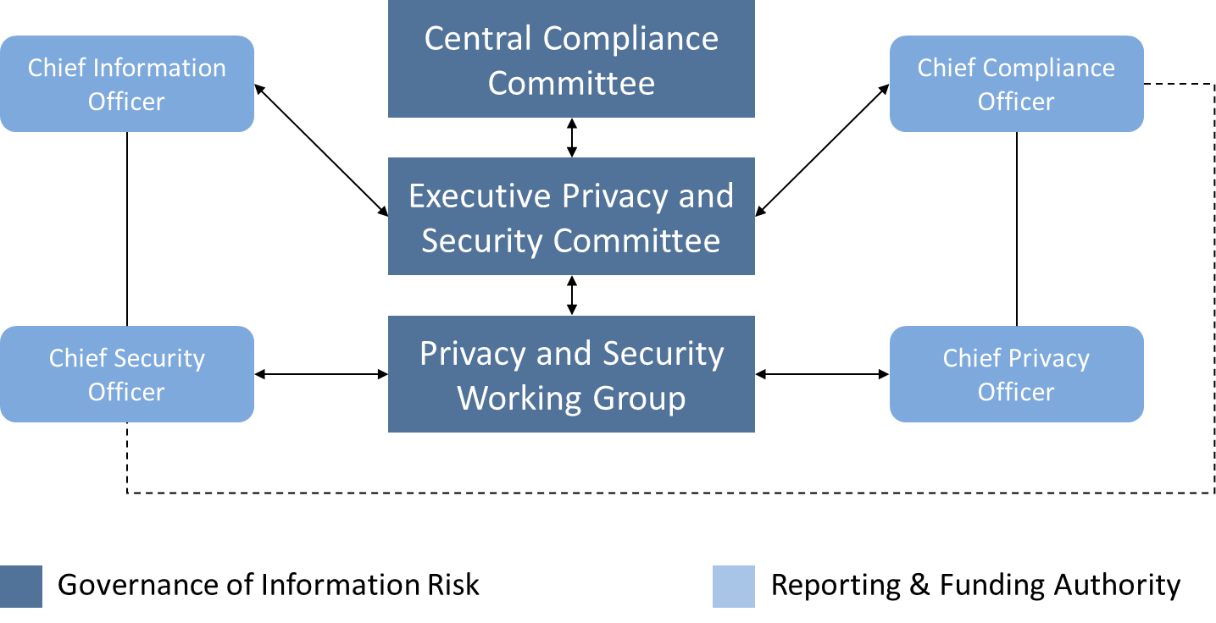
Managing Risks, Governance Needed
(A Model, not THE Model)
Credit: HIMMS 2018, How to be an Effective Cybersecurity Leader
Notes:
Many models exist. The important notes here are to engage your business stakeholders. Ensure that risks are being discussed at all levels of the organization. Ensure that proper funding is secured to manage the risks that are important.

Slide 8
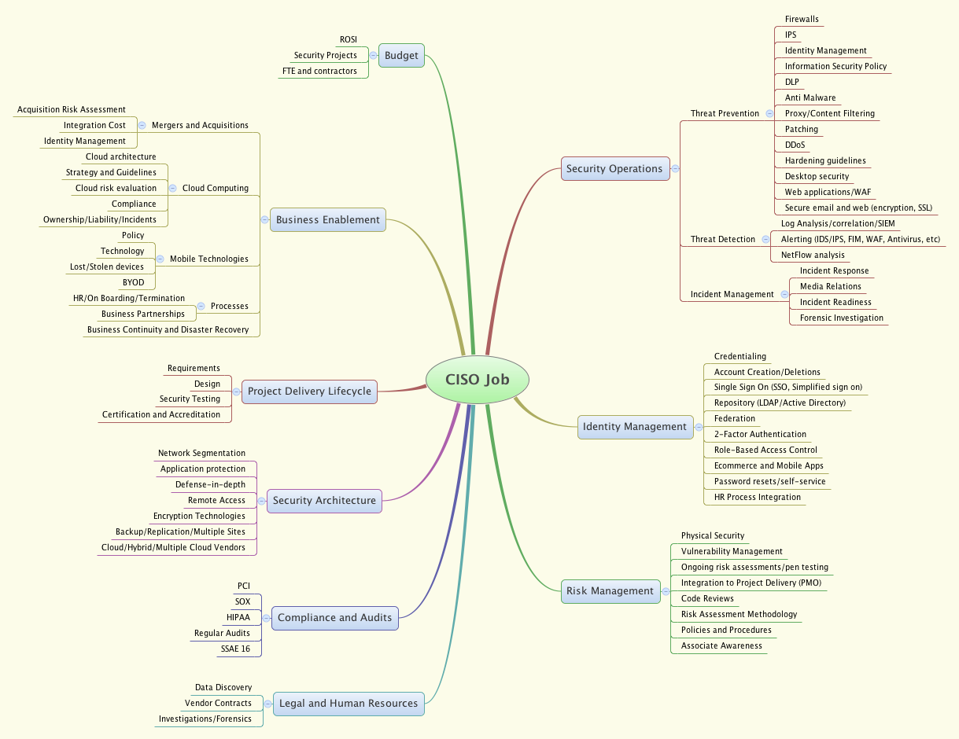
In the Minds Eye of the CISO
A lot runs through the mind of the CISO
They must be business experts, in addition to IT experts
Adopting the proper framework is crucial
Credit: http://rafeeqrehman.com/wp-content/uploads/2012/08/CISO-ResponsibilityMatrix-02.png

Slide 9
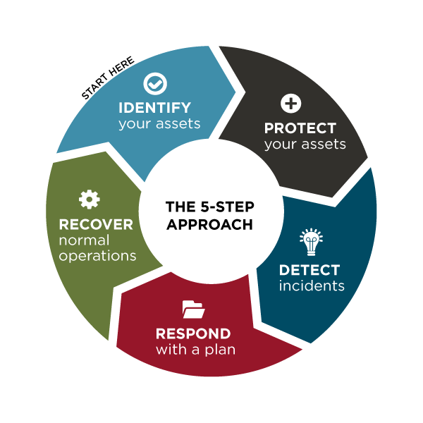
NIST Cybersecurity Framework!
A well organized framework, paid for by your tax dollars
Aligns the varied control frameworks (800-53, COBIT, ISO, etc)
Can be mapped back to the risks you manage, and ultimately be a core component of your risk analysis process
Simple, easy to use, outcomes driven
Many tools exist to adopt
Plus video tutorials on the
NIST website!

Slide 10
That’s nice for strategy, but I want to jump right in
Cybersecurity must be considered as important a risk as patient safety, for it can actually affect patient safety!
Setting strategy, securing resources, acquiring new technology and changing culture is very difficult and requires lots of buy-in.
Want to set strategy, but also make practical improvement?
Consider leveraging the soon to be released CSA 405d Cybersecurity Practices Guidance planned for December 2018

Slide 11
Cybersecurity Act of 2015 (CSA)
CSA Section 405
Improving Cybersecurity in the Health Care Industry
Section 405(b): Health care industry preparedness report
Section 405(c): Health Care Industry Cybersecurity Task Force
Section 405(d): Aligning Health Care Industry Security Approaches
Source: HHS/OCIO, Cleared 405d Materials

Slide 12
CSA 405(d): Legislative Language
Authority: Cybersecurity Act of 2015 (CSA), Section 405(d), Aligning Health Care Industry Security Approaches
The Secretary shall establish, through a collaborative process with the Secretary of Homeland Security, health care industry stakeholders, the Director of the National Institute of Standards and Technology, and any Federal entity or non-Federal entity the Secretary determines appropriate, a common set of voluntary, consensus-based, and industry-led guidelines, best practices, methodologies, procedures, and processes that--
(A) Serve as a resource for cost-effectively reducing cybersecurity risks for a range of health care organizations;
(B) Support voluntary adoption and implementation efforts to improve safeguards to address cybersecurity threats;
(C) Are consistent with—
  (i) The standards, guidelines, best practices, methodologies, procedures, and processes developed under section 2(c)(15) of the National Institute of Standards and Technology Act (15 U.S.C. 272(c)(15));
  (ii) The security and privacy regulations promulgated under section 264(c) of the Health Insurance Portability and Accountability Act of 1996 (42 U.S.C. 1320d-2 note); and
  (iii) The provisions of the Health Information Technology for Economic and Clinical Health Act (title XIII of division A, and title IV of division B, of Public Law 111-5), and the amendments made by such Act; and
(D) Are updated on a regular basis and applicable to a range of health care organizations.
Source: HHS/OCIO, Cleared 405d Materials

Slide 13
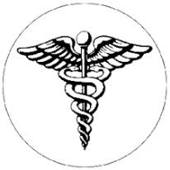

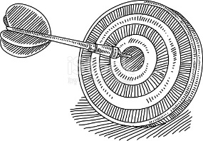

Industry-Led Activity to Improve Cybersecurity in the Healthcare and Public Health (HPH) Sector
WHAT IS THE 405(d) EFFORT?
WHO IS PARTICIPATING?
An industry-led process to develop consensus-based guidelines, practices, and methodologies to strengthen the HPH-sector’s cybersecurity posture against cyber threats.
The 405(d) Task Group is convened by HHS and comprised of over 150 information security officers, medical professionals, privacy experts, and industry leaders.
HOW WILL 405(d) ADDRESS HPH CYBERSECURITY NEEDS?
WHY IS HHS CONVENING THIS EFFORT?
With a targeted set of applicable & voluntary guidance that seeks to cost-effectively reduce the cybersecurity risks of healthcare organizations.
To strengthen the cybersecurity posture of the HPH Sector, Congress mandated the effort in the Cybersecurity Act of 2015 (CSA), Section 405(d).
Source: HHS/OCIO, Cleared 405d Materials

Slide 14
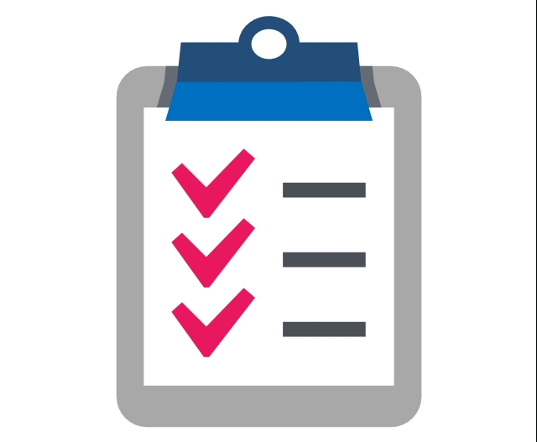
Document - Content Overview (1/2)
After significant analysis of the current cybersecurity issues facing the HPH Sector, the Task Group agreed on the development of three documents—a main document and two technical volumes:
  The main document examines cybersecurity threats and vulnerabilities that affect the healthcare industry. It explores five (5) current threats and presents ten (10) practices to mitigate those threats.
  Technical Volume 1 discusses these ten cybersecurity practices for small healthcare organizations.
  Technical Volume 2 discusses these ten cybersecurity practices for medium and large healthcare organizations.
The 5 current threats identified in healthcare:
Email Phishing Attacks
Ransomware Attacks
Loss or Theft of Equipment or Data
Internal, Accidental, or Intentional Data Loss
Attacks Against Connected Medical Devices that May Affect Patient Safety
Source: HHS/OCIO, Cleared 405d Materials

Slide 15
Document - Content Overview (2/2)
The document identifies ten (10) practices, which are tailored to small, medium, and large organizations and discussed in further detail in the technical volumes:
1
Email Protection Systems
2
Endpoint Protection Systems
3
Access Management
4
Data Protection and Loss Prevention
5
Asset Management
6
Network Management
7
Vulnerability Management
8
Incident Response
9
Medical Device Security
10
Cybersecurity Policies
Source: HHS/OCIO, Cleared 405d Materials

Slide 16
Thank You
Heather Nelson, VP & CIO
Heather.Nelson@uchospitals.edu

