Slide 1
NIST Industry Day
February 10, 2016
Paul Brand
NIST Center for Neutron Research (NCNR)

Slide 2
Outline
NCNR and its Mission
Opportunities for Small Businesses
Examples of past and present practice

Slide 3
NIST Laboratory Structure
Associate Director for Laboratory Programs
NIST Center for Neutron Research (NCNR)
Center for Nanoscale Science and Technology
Materials Measurement Laboratory
Communications Technology Laboratory
Physical Measurement Laboratory
Engineering Laboratory
Information Technology Laboratory
Notes:
The vast majority of NIST Calibrations, SRMs and SRD will be provided by two Metrology Laboratories (PML and MML)
Among other advantages, the new reorganization will provide:
the opportunity and expectation to better focus, balance and intertwine our research program with our measurement services delivery program
the empowerment along with the responsibility to more efficiency and effectively delivery these services
an unambiguous accountability chain –with the buck stopping with the OU Director !!!

Slide 4
Elements of NCNR Mission
Neutron Beam Research
State of the Art
Cost Effective
Safe
User Facility
Predictable and Available

Slide 5
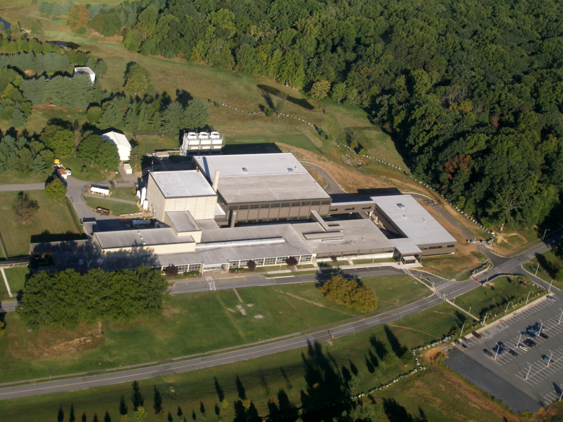
NCNR
Neutron Source
(Reactor)
Guide Hall
Offices/Labs

Slide 6
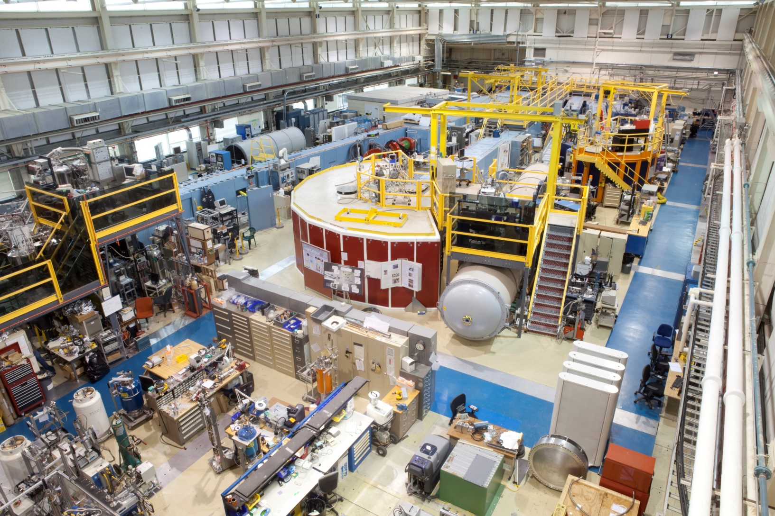
Neutron Guide Hall

Slide 7
Opportunities for Small Businesses
Basic Ordering Agreements (BOA)
  Fabrication
  Machining
Indefinite Delivery Indefinite Quantity (IDIQ)
  Engineering Services
    Design/Testing
    Manufacturing/Installation Oversight
  Welding Services
Scientific/Technical Equipment

Slide 8
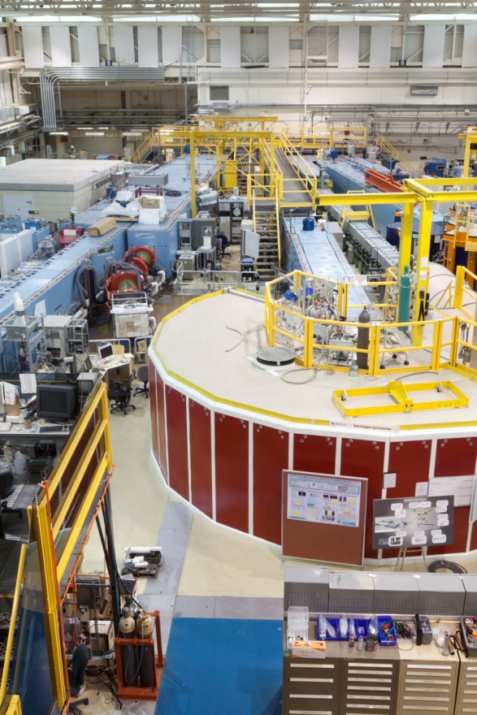
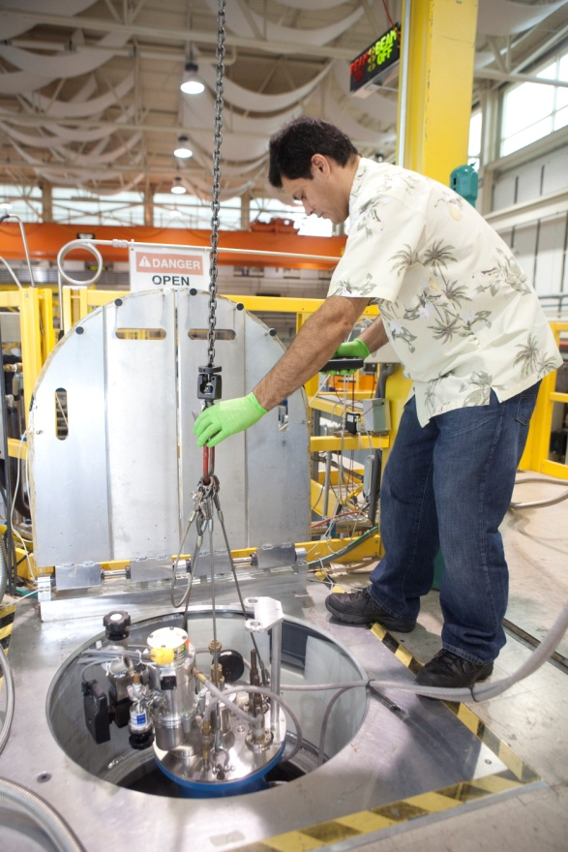
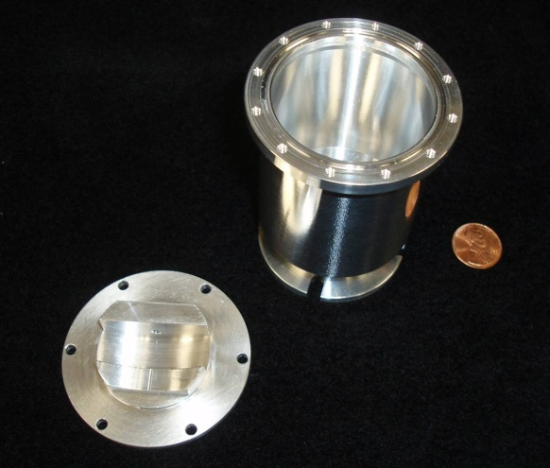
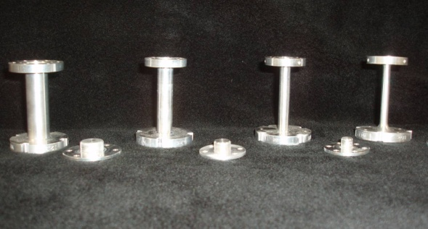
Scientific Instruments
Fabrication and Manufacturing of Parts

Slide 9
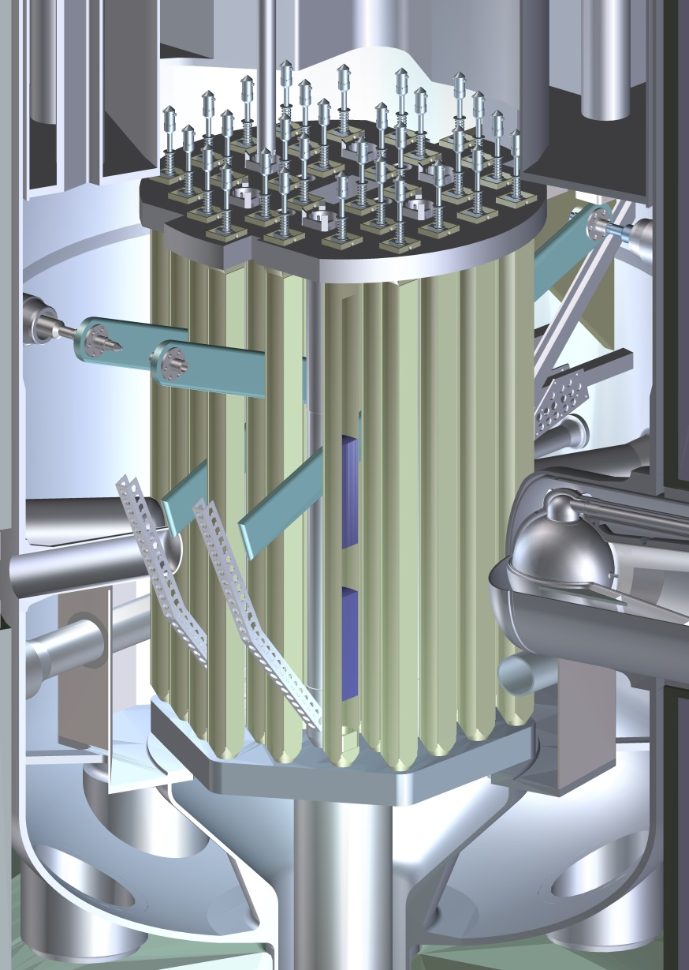
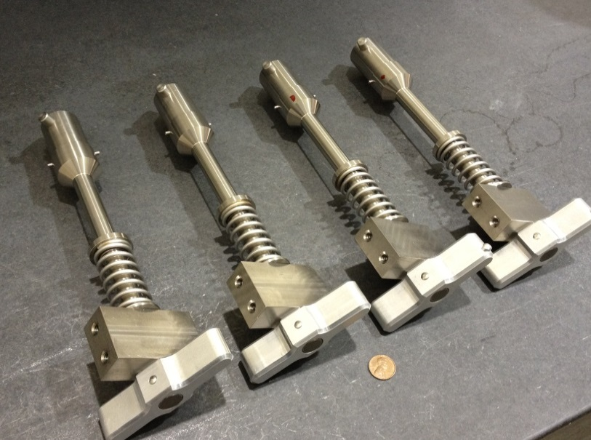
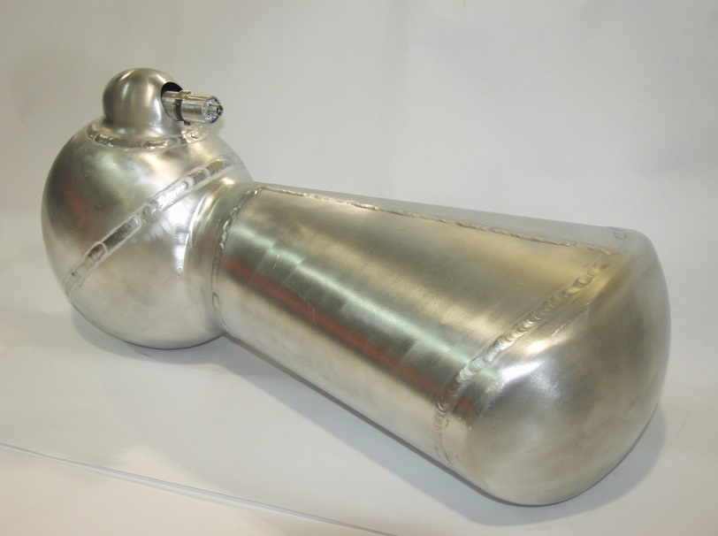
Reactor Parts

Slide 10

Conclusion (same as in 2012)
NIST (STILL) WANTS
YOU

