Slide 1
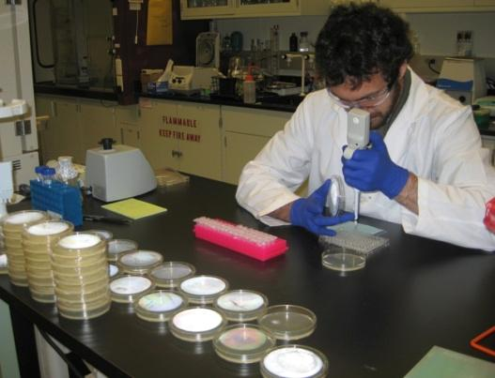
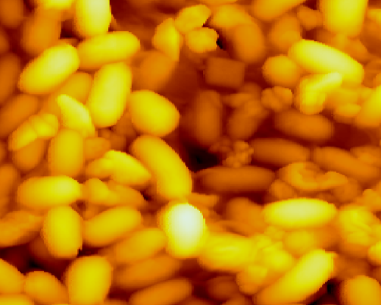
Jayne B. Morrow, PhD
Assistant Vice President for
Research and Economic Development
Montana State University former Executive Director,
National Science and Technology Council

Slide 2
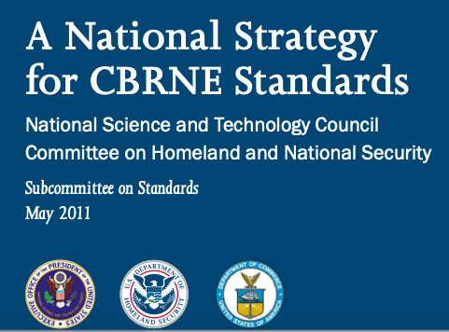

Slide 3

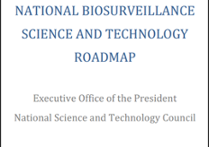
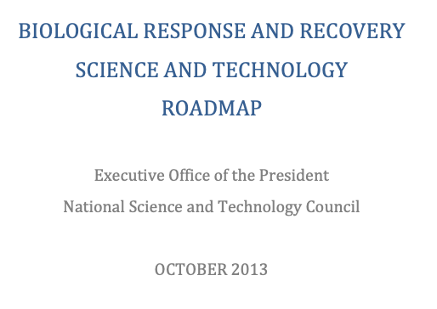

Slide 4
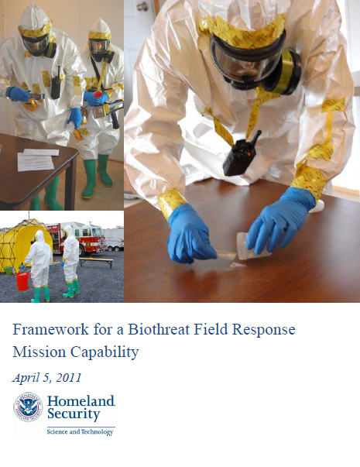




Framework for a Biothreat Field Response Mission Capability
Develop guidance to first responders for the biological assessment of suspicious powders
Interagency effort involving DHS, CDC, FBI, and EPA
Defines Critical Elements of a Mission Capability (a.k.a., an Actionable Assay – the Onion)
Outlines the accomplishments and remaining gaps
Material Measurement Laboratory
https://www.rkb.us/
4

Slide 5
Framework for a Biothreat Field Response Mission Capability
An assay, method, or detector must be operated by a trained and proficient user and integrated into a response plan
ConOps¹
Training
Proficiency Testing⁴
Sampling & Sample Handling²
Assay
  Performance Specifications³
  Testing and Certification³
ASTM E2270-17 Standard Guide for Operational Guidelines for Initial Response to a Suspected Biothreat Agent
ASTM E2458-17 Standard Practices for Bulk Sample Collection and Swab Sample Collection of Visible Powders Suspected of Being Biothreat Agents from Nonporous Surfaces
AOAC International SMPRs
NIST RM 8230: Lyophilized Saccharomyces cerevisiae NE095

Slide 6
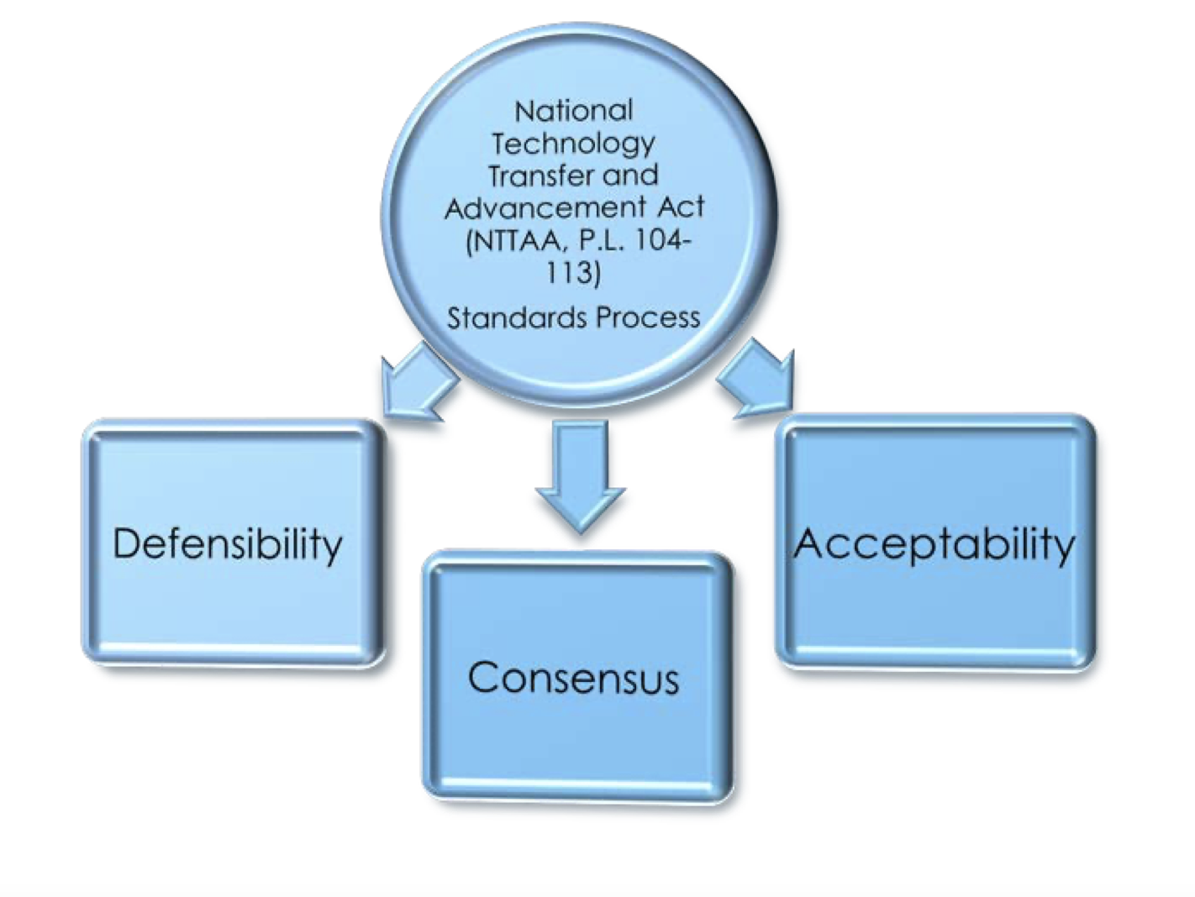
Federal Government Efforts to Work with Standards Development Organizations
ASTM, AOAC International
and other non-SDO consensus forming communities (Interagency Board, IAB)

Slide 7
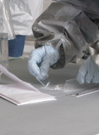
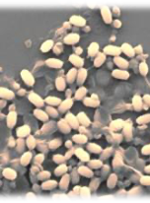
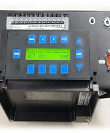
Response to Biothreats
NIST and DHS worked with interagency partners to develop standards and guidance for a biological response mission capability for local, state and federal agencies

Slide 8
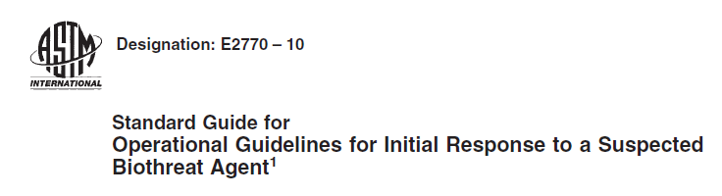
ASTM E2770 Operational Guidance
Standard Guide - provides operational guidelines for initial response to a suspected biothreat agent
Fundamentals for response planning to assure proper involvement, communication and coordination between key players in a jurisdiction
Minimum training and PPE requirements for field personnel
Guidance for risk assessment process to determine if visible powder should be deemed a biological threat
Guidance for threat evaluation process in conjunction with law enforcement representatives (including FBI) for determination of threat credibility

Slide 9
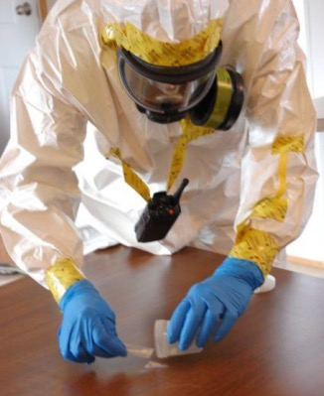
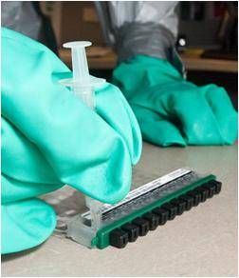
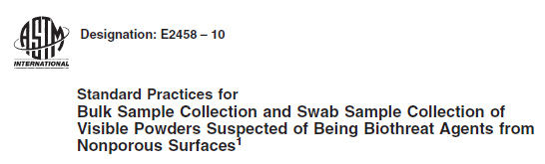
ASTM E2458 Collection of Suspicious Powders
Method A – Bulk Sample Collection Method for Laboratory Analysis
Method for collection of bulk of visible suspicious
powder on nonporous surface
Ensures sufficient sample is available to Laboratory Response
Network (LRN) reference laboratory for confirmatory analysis
Method B – Swab Sample Collection for On-Site Analysis
AFTER Method A applied, residual powder can be collected from surfaces
Sample can be used for on-site biological assessments
using field detection devices

Slide 10
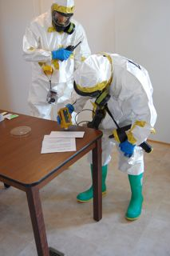
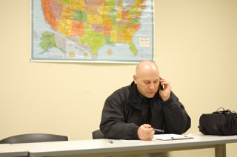
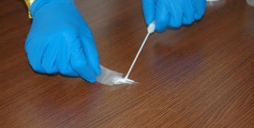
Process Coordination - ASTM Standards E2770 and E2458
2
Communication of results to Law Enforcement and Public Health
3
Decision to collection with ASTM E2458
1
Initial sample screen, minimizing consumption
10
10

Slide 11
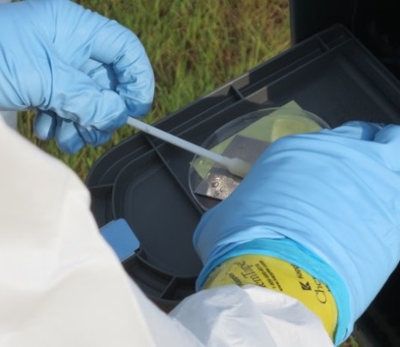
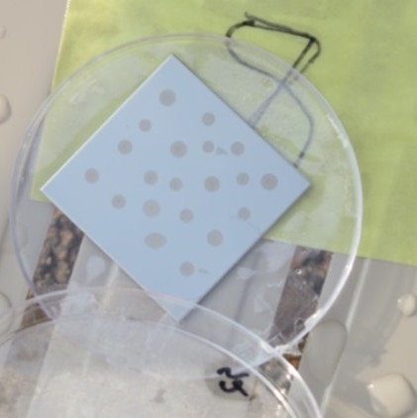
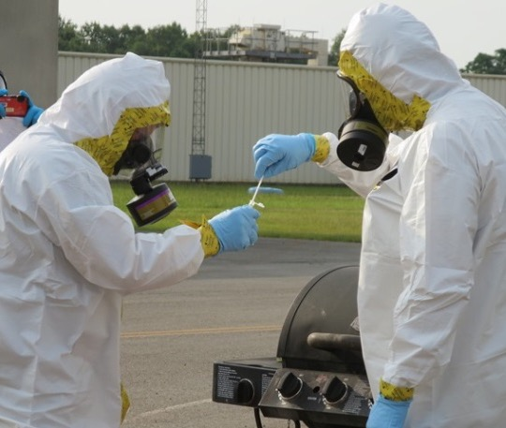
Operation Vigilant Sample IV
July 14-16, 2015
Led by Capt. Bryon Marsh, 4th CST
Joint exercise with 4th and 48th CSTs, FL and GA PHLs, EPA, BioWatch, local first responders
NIST obtained EPA approval to use a modified yeast strain, Saccharomyces cerevisiae NE095
Protocol
Yeast deposited onto stainless steel coupons and dried overnight
Coupons were sampled using protocol adapted from surface sampling procedures for B. anthracis spores (CDC, 2012)
Yeast detected successfully by mobile and public health labs using qPCR

