Slide 1
Regulatory Perspectives on Reference Materials for Measuring Potency of Gene Therapy Products
Anurag Sharma, Ph.D.
Chief, Gene Therapy Branch 2
Division of Gene Therapy 1
Office of Gene Therapy
Office of Therapeutic Products, FDA CBER
September 5, 2025

Slide 2
OUTLINE
Overview of Cell and Gene Therapy Products
Potency Assurance 2023 Draft Guidance
Potency Assay Design
Establishing and Bridging Reference Materials

Slide 3
Diversity of products regulated by CBER’s Office of Therapeutic Products
Gene therapies (GT)
  Ex vivo genetically modified cells
  Non-viral vectors (e.g., plasmids)
  Replication-deficient viral vectors (e.g., adenovirus, adeno-associated virus, lentivirus)
  Replication-competent viral vectors (e.g., measles, adenovirus, vaccinia)
  Microbial vectors (e.g., Listeria, Salmonella)
Stem cells/stem cell-derived
  Adult (e.g., hematopoietic, neural, cardiac, adipose, mesenchymal)
  Perinatal (e.g., placental, umbilical cord blood)
  Fetal (e.g., neural)
  Embryonic
  Induced pluripotent stem cells (iPSCs)
Products for xenotransplantation
Functionally mature/differentiated cells (e.g., retinal pigment epithelial cells, pancreatic islets, chondrocytes, keratinocytes)
Combination products
  Engineered tissues/organs
Therapeutic vaccines and other antigen-specific active immunotherapies
Blood- and Plasma-derived products
  Coagulation factors
  Fibrin sealants
  Fibrinogen
  Thrombin
  Plasminogen
  Immune globulins
  Anti-toxins
  Venom antisera for scorpions, snakes, and spiders
Devices
Tissues

Slide 4
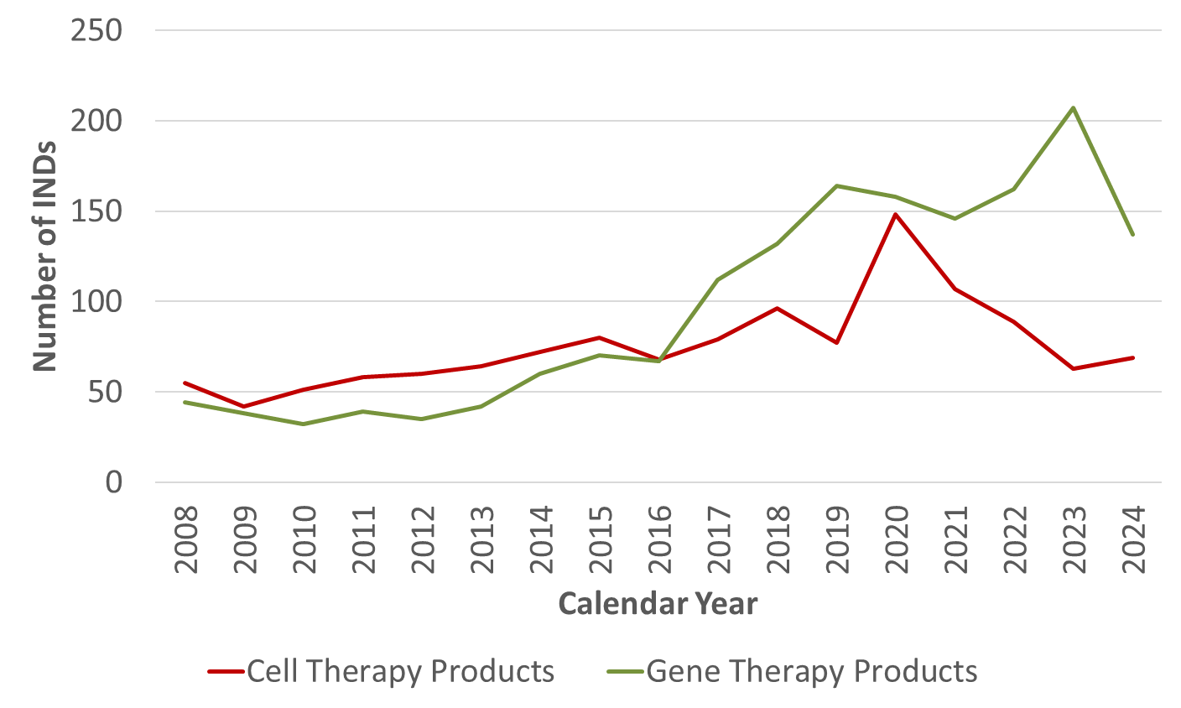
Cell and gene therapies: new INDs per year
Excluding expanded access

Slide 5
FDA-approved cellular and gene therapy products
Full list:
  List of FDA Approved Cellular and Gene Therapy Products
Examples:
  Luxturna – AAV vector
  Imlygic – oncolytic HSV
  Adstiladrin – adenovirus vector
  Vyjuvec – HSV vector
  Kymriah – CAR T cell
  Zynteglo – hematopoietic stem cell gene therapy
  Casgevy – genome-edited hematopoietic stem cell gene therapy
  Hemacord – hematopoietic progenitor cells from cord blood
  Stratagraft – allogeneic cultured keratinocytes and fibroblasts in bovine collagen
  Lantidra – allogeneic pancreatic islets
  Amtagvi – tumor-derived autologous T cell immunotherapy

Slide 6
Potency assurance
2023 draft guidance

Slide 7
New potency assurance draft guidance
Update our 2011 guidance: Potency Tests for Cellular and Gene Therapy Products
  Provide more options without imposing new burdens
  Scope covers all cellular and gene therapies, including genome-editing products and tissue-engineered medical products
Covers all aspects of potency, not just potency assays
Incorporates quality risk management approach and ICH terminology
  From Q8, Q9, Q10 and Q14
Gives industry and regulators a science-based and risk-based framework for discussing potency
  Additional advice on communicating with CBER about potency
Continues to allow progressive implementation of potency assays during clinical development
This draft guidance document is for comment purposes only
You can use an alternative approach if it satisfies the requirements of the applicable statutes and regulations

Slide 8
What is a potency assurance strategy?
“A comprehensive approach to help ensure that every lot of a product will have the potency necessary to achieve the intended therapeutic effect.”

Slide 9
From the first paragraph of the guidance
A potency assurance strategy is a multifaceted approach that reduces risks to the potency of a product through manufacturing process design, manufacturing process control, material control, in-process testing, and potency lot release assays. The goal of a potency assurance strategy is to ensure that every lot of a product released will have the specific ability or capacity to achieve the intended therapeutic effect.
Risk assessment and risk reduction
Identify what might go wrong during manufacturing to harm potency – assess likelihood and severity of the risks
If risk is high, reduce risk by improving the manufacturing process and/or the controls
Manufacturing process design
The manufacturing process should be designed
to consistently produce a potent product
Control strategy
Potency release assays are just the final check – they are not the entire control strategy
Product lots should have the ability or capacity to be therapeutic

Slide 10
Potency assurance
Lot Release Testing for
Potency-Related CQAs
Manufacturing Process Design
Material Controls
Potency
Critical Process Parameters
In-Process Testing
Routine Reassessment of Potency Assurance Strategy

Slide 11
Potency assays and acceptance criteria
Potency release assays and their acceptance criteria are essential elements of a potency assurance strategy
May include physicochemical assays or bioassays
Should have suitable precision, accuracy, specificity, and robustness
Should quantitate a potency-related CQA that is at risk
Potency assurance strategies should typically include multiple release assays, including at least one bioassay that measures a relevant biological activity of the product

Slide 12
Potency assay design

Slide 13
Characteristics of a good potency assay
The assay should make a meaningful contribution to potency assurance by reducing risks to product potency
  Quantitate a potency-related critical quality attribute that is at risk
Can be a physicochemical or biological assay
  But typically, each product will need at least one bioassay to measure potency
The assay should have adequate performance characteristics, especially intermediate precision
  Imprecise assays may not be fit for purpose:
    Potent lots may be rejected
    Sub-potent lots may fail to be rejected
  USP <1047>: High-precision assays are more effective tools in monitoring product quality

Slide 14
Improving precision of potency assays
Choose assays that tend to be less variable
  ELISA instead of western blot
Improve assay precision, when possible
  Improve repeatability by adding additional replicates or dilutions
    e.g., more wells or more closely-spaced dilutions in a TCID₅₀ assay
  Add a reference material (RM) for normalization: relative potency assay
    During an individual run, the test article and RM experience the same variations, which cancels out some of the variation
Or, perform the assay multiple times, and report the mean result

Slide 15
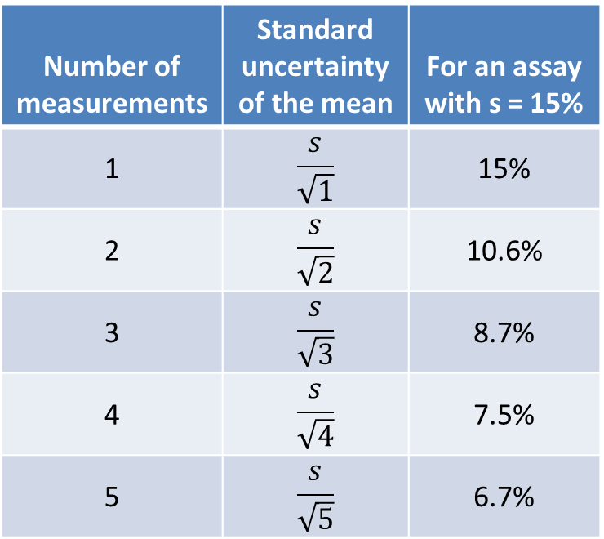
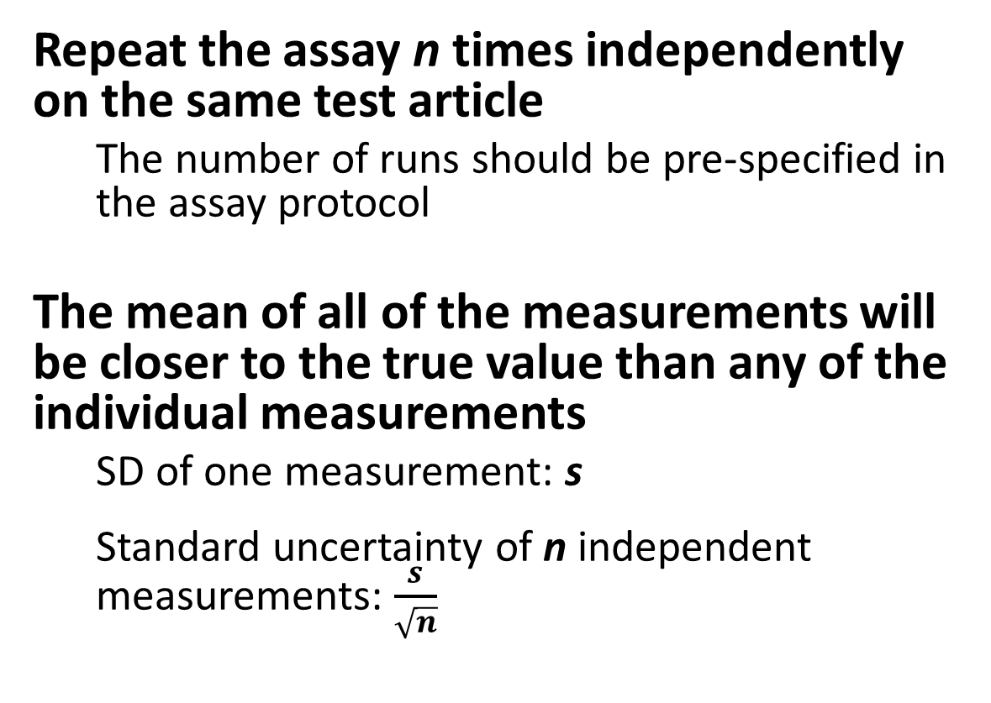
You can always improve measurement precision by running the assay multiple times independently
Repeat the assay n times independently on the same test article
  The number of runs should be pre-specified in the assay protocol
The mean of all of the measurements will be closer to the true value than any of the individual measurements
  SD of one measurement: s
  Standard uncertainty of n independent measurements: $\frac{s}{\sqrt{n}}$
Number of measurements | Standard uncertainty of the mean | For an assay with s = 15%
1 | $$\frac{s}{\sqrt{1}}$$ | 15%
2 | $$\frac{s}{\sqrt{2}}$$ | 10.6%
3 | $$\frac{s}{\sqrt{3}}$$ | 8.7%
4 | $$\frac{s}{\sqrt{4}}$$ | 7.5%
5 | $$\frac{s}{\sqrt{5}}$$ | 6.7%

Slide 16
Reference materials and control materials
Reference material (RM)
  A well-characterized lot of the product, used as a reference for a relative potency assay
  Assigned an arbitrary value, such as 100%
  Measure potency of the test article relative to the RM in the same assay run
Control material (CM)
  An additional lot of the product, separate from the RM
    Both relative and non-relative potency assays can use CMs
  Establish potency value of CM with high confidence by measuring potency multiple times, relative to the RM
    Assign the CM an expected potency range (e.g., prediction interval: 88 – 114%)
      Use this range of expected CM potency as a system suitability criterion in each assay run

Slide 17
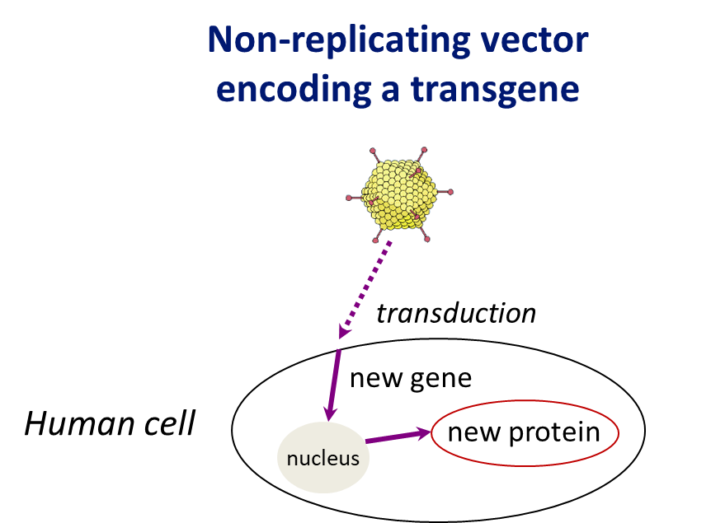
Potency assays for viral gene therapy vectors
A typical potency assay for a vector will measure the amount and/or activity of the transgene protein
  Production of the new protein depends on the ability of the vector to transduce cells
An assay on the transgene protein confirms multiple aspects of the vector’s mechanism of action
  The ability to deliver nucleic acids to cells
  The activity of the nucleic acids

Slide 18
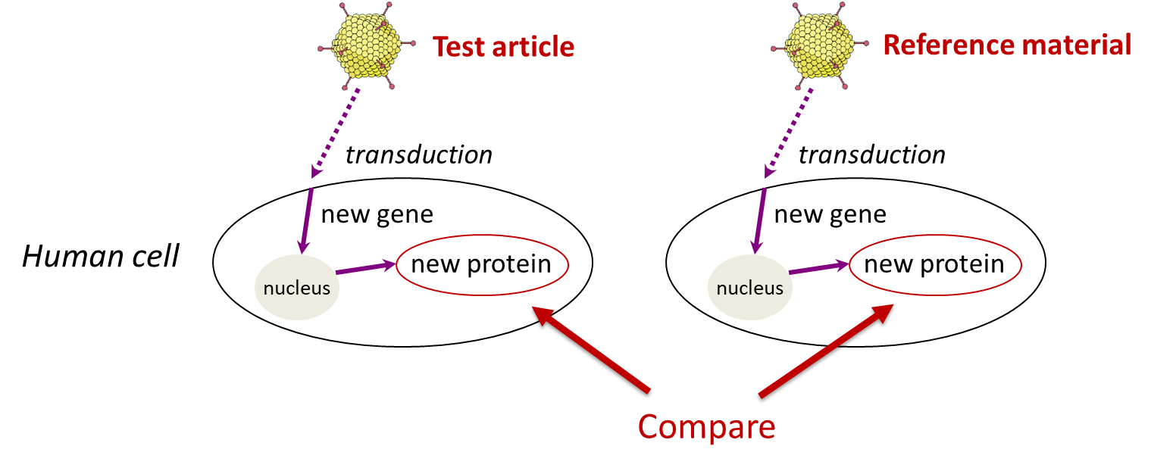
Reference materials for measuring potency of gene therapy vectors
Using a vector reference material
  Measure amount and/or activity of transgene protein produced after transduction of cells by test article, relative to a vector reference material

Slide 19
Establishing and bridging Reference materials

Slide 20
New potency assurance draft guidance contents

Slide 21
Advice on reference materials
Use a RM for relative potency whenever possible
  RM can be a well-characterized lot of product
Establish a protocol for qualifying RM lots
  Additional characterization of RM lot
  Monitor RM stability
  Have a plan to bridge replacement RM lots
Use a CM during each assay run as a system suitability test
  Qualify new lots of CM in multiple potency assay runs relative to the RM
  Assign an expected potency range to the CM

Slide 22
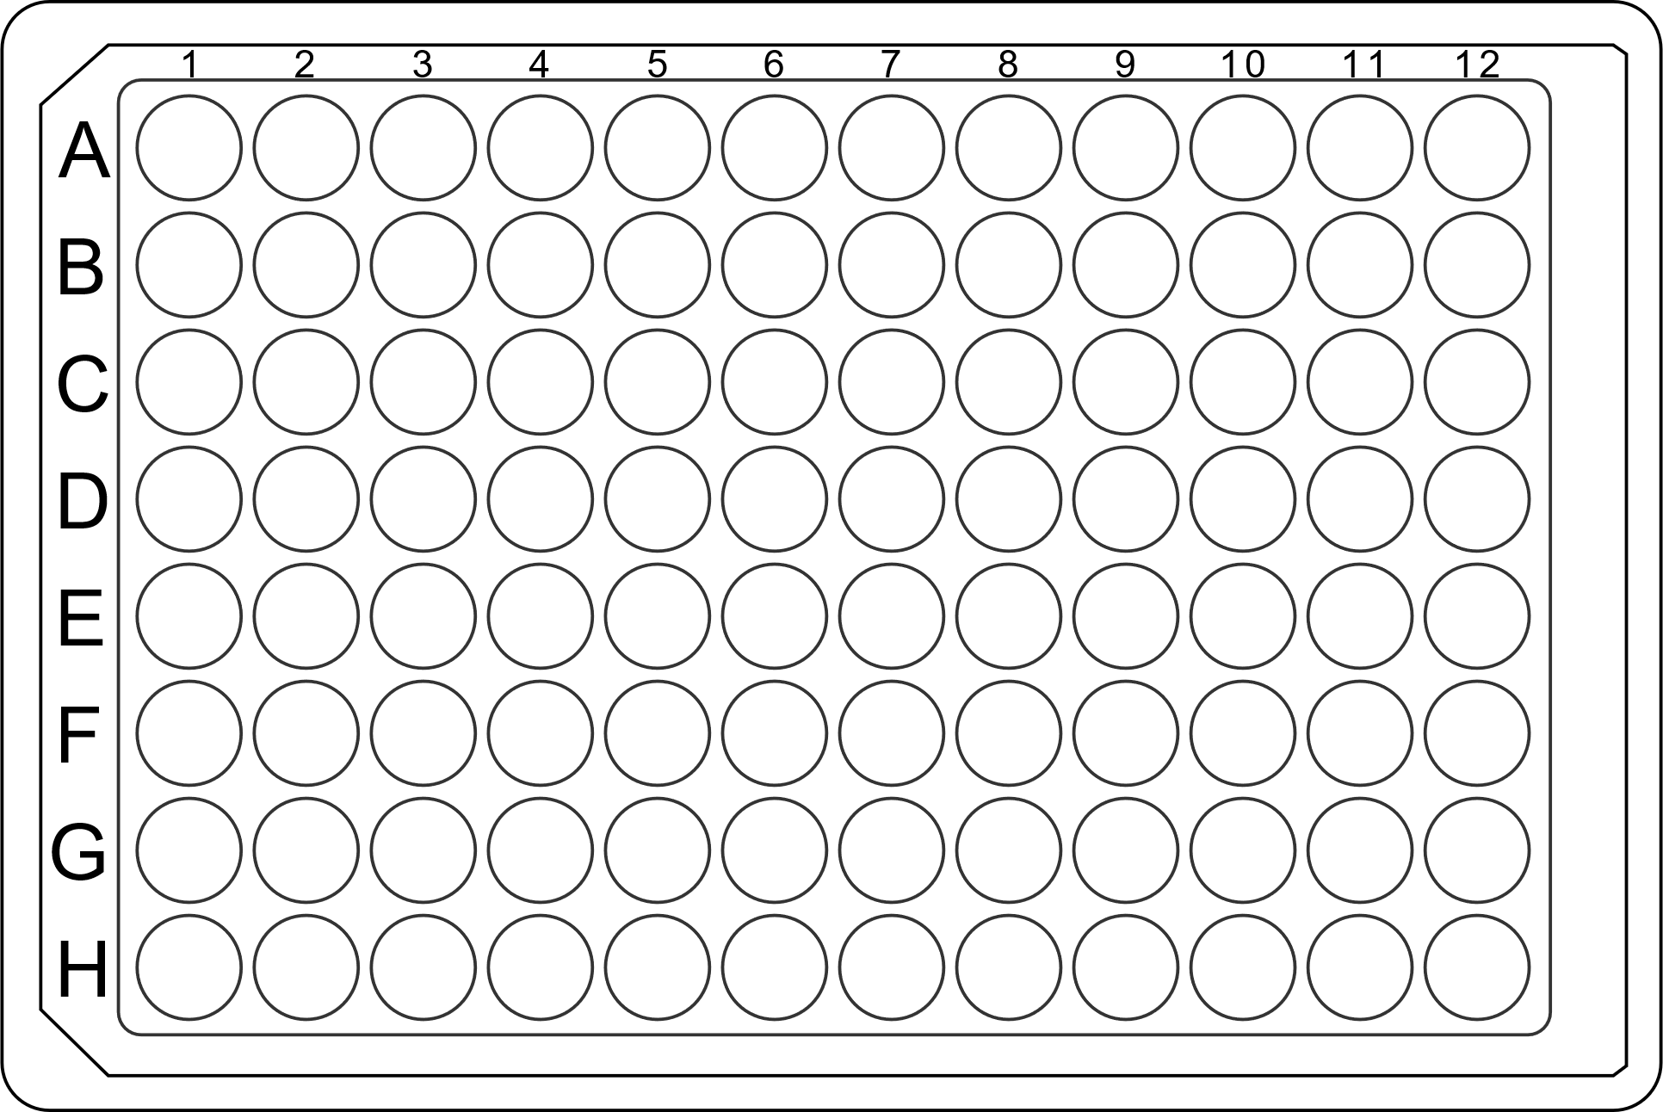
Typical plate layout for a relative potency assay
RM
CM
TA1
TA2
TA3
Dilutions
RM: reference material
CM: control material
TA: test article
Negative controls

Slide 23
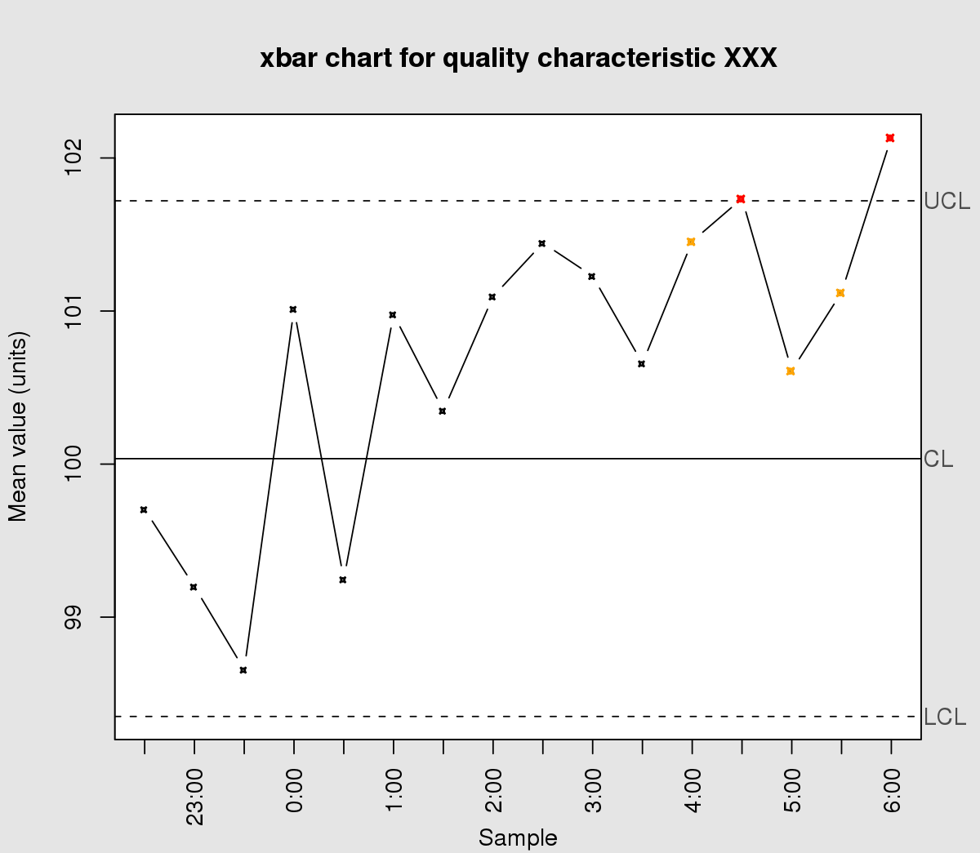
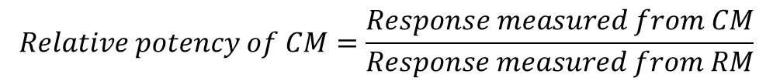
Usefulness of CM for detecting trends
Relative potency of control material
$$Relative potency of CM=\frac{Response measured from CM}{Response measured from RM}$$
Most likely diagnosis:
The potency of the reference material is declining
Date of test

Slide 24
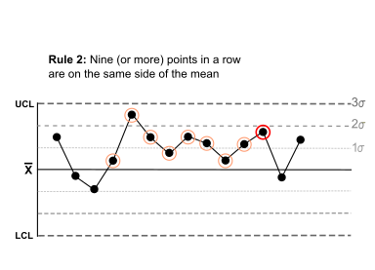
Usefulness of a CM during transitions to a new lot of RM
Best not to change both the RM and CM at the same time
If the new RM is shifted, this may be detected as a shift in the CM values
  For example, Nelson rule 2:
Control chart for CM
New RM introduced

Slide 25
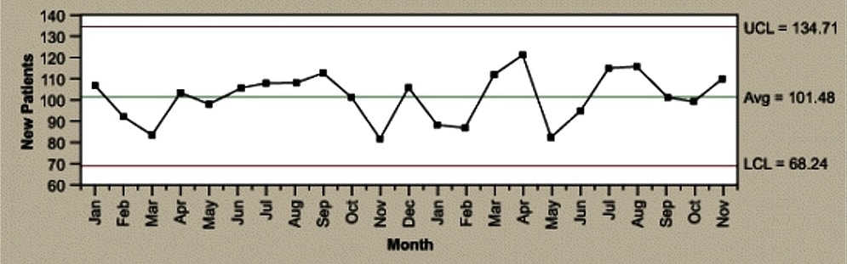
Usefulness of CM for confirming intermediate precision of the assay
Longitudinal data from a single CM lot
  The SD of these independent measurements = the intermediate precision of the assay, measured under real-world conditions
These longitudinal data typically give a better estimate of intermediate precision than during the assay validation study
  Larger n
  More realistic real-world assay conditions

Slide 26
Initial reference material
May not be CGMP manufactured
  Development or engineering lot
  DS or DP lot
  Sometimes used during assay development
Used for release or characterization of early nonclinical and clinical lots
Is the initial RM representative of clinical lots?
  Changes in manufacturing process, formulation
  Stability

Slide 27
Maintaining continuity of potency measurements
Retain samples of all reference materials and clinical lots, because:
  Manufacturing processes change
  Assays change
  Retrospective measurements are impossible without retained samples
In pivotal clinical studies, the lots should consistently be potent
  Manufacturing process changes that alter potency can make the clinical data challenging to interpret
  Even phase 1 clinical study data sometimes contribute to the primary evidence of clinical effectiveness
    For cellular and gene therapy products being developed for rare diseases

Slide 28
Importance of a representative RM
For AAV vectors, differences in the manufacturing process may lead to different measured potencies
Empty capsids may interfere in AAV potency assay
  Changes in downstream purification may alter the full:empty capsid ratio
  Empty capsids compete for the same cellular receptors as full capsids
  May cause non-parallel response curves between test article and RM
Differences in the upstream manufacturing process may also alter potency
  For example, manufacturing AAV using baculovirus, vs. manufacturing AAV by plasmid transfection in 293 cells
    The reasons for these differences in potency are poorly understood

Slide 29
Bridging reference materials
Two possible outcomes when bridging:
  New RM is assigned the same potency value as the old RM
  New RM is assigned a potency value that is different from the old RM
In both cases, we must know the potency value of the new RM with high confidence
  Need a small confidence interval for the potency value of the new RM
Run new and old RMs in n independent assay runs to measure the potency of the new RM
  Use power calculation to prospectively determine the appropriate n
How to determine whether the value of the new RM is close enough to the old RM?
  Equivalence testing, with an appropriate pre-defined equivalence margin
  If the CI of the difference in the old and new RM doesn’t exceed the equivalence margin, then the new RM can be assigned the same value as the old RM

Slide 30
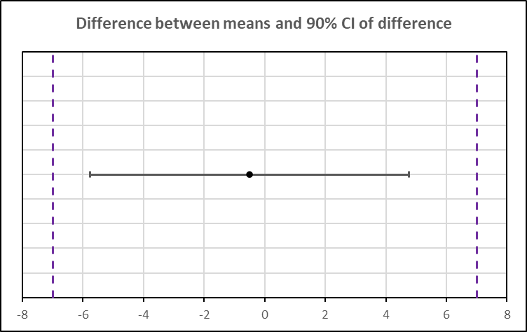
Does the new RM have the same potency as the old RM?
Decide how close is close enough
  Justify a pre-defined equivalence margin to use in a TOST test
  For example, the 90% CI of the difference in means between the new and old RMs must fit within the range of ± 7%
Determine how many times to run the assay with the new RM vs. the old RM
  Perform a power calculation using the assay intermediate precision
  Typically, 30 or more independent assay runs

Slide 31
Does the new RM have the same potency as the old RM?
(continued)
Procedure:
  If the new RM passes the TOST equivalence test
    The 90% confidence interval of the difference between the new RM and old RM should not exceed the pre-defined equivalence margins
    Assign the new RM to have the same value as the old RM
  If not:
    The potency of the new RM is assigned to be the mean measured potency value
    Or, start again with a new lot

Slide 32
Summary
New draft guidance on potency assurance for cellular and gene therapies
  Potency assays can be progressively implemented during development
  Useful assays have good intermediate precision
  These assays rely on well-controlled in-house reference materials
We recommend:
  Reference materials for relative potency assays
  Control materials for all potency assays
  Defined procedures for bridging new lots of RM and CM
  Retain samples of all RM, CM and lots used during clinical studies

Slide 33


Contact Information
Anurag Sharma
Anurag.Sharma@fda.hhs.gov
Regulatory Questions:
OTP Main Line – 240 402 0685
Email: OTPRPMS@fda.hhs.gov
OTP (OTAT) Learn Webinar Series:
http://www.fda.gov/BiologicsBloodVaccines/NewsEvents/ucm232821.htm
CBER website: www.fda.gov/BiologicsBloodVaccines/default.htm
Phone: 1-800-835-4709 or 240-402-8010
Consumer Affairs Branch: ocod@fda.hhs.gov
Manufacturers Assistance and Technical Training Branch: industry.biologics@fda.gov
Follow us on Twitter: https://www.twitter.com/fdacber
www.fda.gov

