Slide 1
NIST MEP Advisory Board
May 2014

Slide 2
EXIT
MEP Advisory Board meeting
You are here
phones
Portrait
Room
W
EXIT
M
M
W
Cafeteria
Courtyard
EXIT

Slide 3
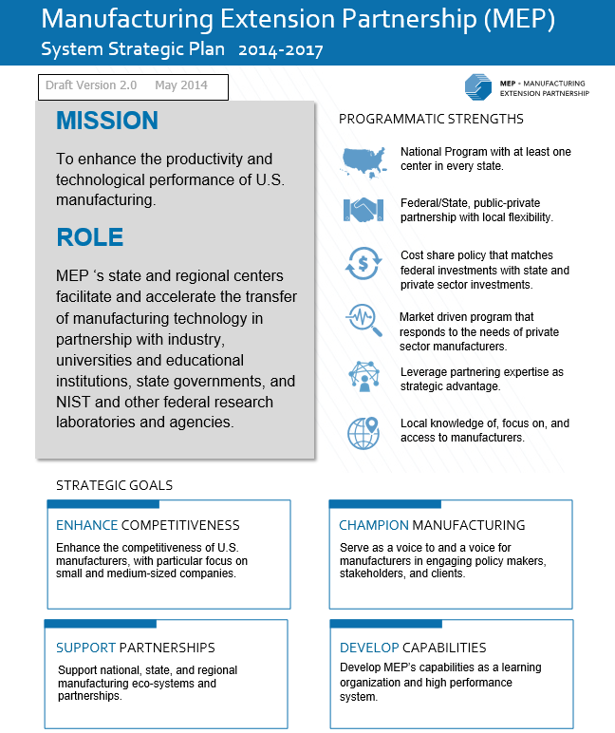
MEP System
Strategic Plan
Gary Yakimov and Jeff Lucas
May 20, 2014

Slide 4
Today’s Agenda
About the Process
Charge, Legislative Mandate, Actions to Date, etc.
Strategic Plan
  Mission and Role
  Programmatic Strengths
  Strategic Goals
  Strategic Objectives
Today’s Discussion
  Table Work
Next Steps

Slide 5
About the Process :
Guiding Principles from Advisory Board Subcommittee
Include inputs from:
  Centers: Directors and Board Chairs
  States
  Manufacturers – include large firms
  Associations
  Administration priorities
  Other key stakeholders
Plan should be high-level with strategic and operational metrics
Develop a process for measuring performance and reporting

Slide 6
Legislative Mandate
TITLE 15 - COMMERCE AND TRADE
CHAPTER 7 - NATIONAL INSTITUTE OF STANDARDS AND TECHNOLOGY
Sec. 278k. Regional Centers for the Transfer of Manufacturing Technology
The objective of the Centers is to enhance productivity and technological performance in U.S. manufacturing. This will be accomplished through:
The transfer of manufacturing technology and techniques developed at NIST to Centers, and, through them, to manufacturing companies in the United States;
The participation of individuals from industry, universities, State governments, other Federal agencies, and when appropriate, NIST in cooperative technology transfer activities;
Efforts to make new manufacturing technology and processes usable by U.S.-based small and medium sized companies;
The active dissemination of scientific, engineering, technical, and management information about manufacturing to industrial firms, including small and medium-sized manufacturing companies;
The utilization, when appropriate, of the expertise and capabilities that exists in Federal laboratories other than NIST;
Providing to community colleges information about the job skills needed in small and medium-sized manufacturing businesses in the regions they serve.

Slide 7
About the Process : Actions to Date
June 2013
Pat Gallagher’s Charge to Board
Sept 2013
1st Advisory Board Subcommittee Call
Centers’ Input – Strategic Planning Process in Portland
Full Advisory Board Update
Oct – Dec 2013
Weekly Strategic Planning Team (SPT) Meetings
Meeting with states at National Governor’s Association (NGA) Forum
Center Workgroup for Reporting and Evaluation Meeting
Advisory Board Subcommittee Calls
Regional Center Board Chair Calls
Association and Federal Agency Mtgs.
Review of Center Strategic Plans
Environmental Scanning (reports, etc.)

Slide 8
About the Process : Actions to Date, cont.
January 2014
Develop SWOT Analysis
Board Planning Session @ Charlotte
System Planning Session @ Charlotte
February – March 2014
Development of Strategic Principles
American Small Manufacturers Coalition (ASMC) Planning Session @ Washington, D.C.
April – May 2014
Developed a Draft Plan
Feedback from Centers, Center Board Chairs, Others
Discussion with Center Workgroup for Reporting and Evaluation
Board / System Meetings May 20-22

Slide 9
About the Process :
Data Collection – External Sources
Federal Agencies
  Commerce, Defense, Energy, Labor, Environmental Protection Agency, National Science Foundation, Small Business Administration, others still planned
States & Centers
  NIST-sponsored NGA Policy Academy: AK, AR, DE, KY, MA, MT, NC, OK, PA, VT, WV
  Regional Calls with MEP Center Board Chairs
  System Planning Session in January
  Additional Follow-up Planned
Associations
  Alliance for American Manufacturing, Association for Manufacturing Technology, Fabricators & Manufacturers Association, National Association of Manufacturers, ASMC, International Economic Development Council , State Science and Technology Institute
Various Reports and Studies
  National Academies of Science

Slide 10
About the Process :
National Academy of Sciences Recommendations
Recommendations to NIST Management
  Focus on driving overall improvement of MEP centers rather than focusing on outcomes of individual projects
  Use resources to leverage maximum beneficial outcomes for U.S. manufacturing sector rather than focusing on reaching maximum numbers of manufacturers
  Continue to encourage lean manufacturing
  Continue efforts to enhance growth and innovation strategies while addressing the challenges inherent in this transition
  Improve the collection and analysis of performance data
  Be more flexible in the management of funding to MEP centers

Slide 11
About the Process :
National Academy of Sciences Recommendations
Recommendations to Administration
  With the adoption of improvements recommended by NAS, Federal funding for the MEP Program should be at a level commensurate with its mission, and take into account relevant international benchmarks
  The fixed-federal match of one-to-two from the states and centers should be changed to a match approach with more flexibility for NIST management and the centers
  Any efforts to establish programs to support manufacturing should thoroughly assess existing U.S. resources, organizations, and institutions already engaged in applied research and should take into account lessons from U.S. and international best practices

Slide 12
Programmatic Strengths
National program with at least one center in every state and Puerto Rico.
Federal/state, public-private partnership with local flexibility.
Cost share policy that matches federal investment with state and private sector investment.
Market driven program that responds to the needs of private sector manufacturers.
Leverage partnering expertise as a strategic advantage.
Local knowledge of, focus on, and access to manufacturers.

Slide 13
Programmatic Weaknesses
Local variation requires substantial customization
Lack of consistency/clarity around local flexibility
Vulnerabilities in leadership and workforce
Not currently turning data into intelligence
Target market difficult to serve profitably
Ongoing challenges of technology adoption and commercialization

Slide 14
Strategic Plan

Slide 15

Manufacturing Extension Partnership (MEP) System Strategic Plan 2014-2017
MISSION
To enhance the productivity and technological performance of U.S. manufacturing.
ROLE
MEP ‘s state and regional centers facilitate and accelerate the transfer of manufacturing technology in partnership with industry, universities and educational institutions, state governments, and NIST and other federal research laboratories and agencies.
PROGRAMMATIC STRENGTHS
National Program with at least one center in every state.
Federal/State, public-private partnership with local flexibility.
Cost share policy that matches federal investments with state and private sector investments.
Market driven program that responds to the needs of private sector manufacturers.
Leverage partnering expertise as strategic advantage.
Local knowledge of, focus on, and access to manufacturers.

Slide 16
Manufacturing Extension Partnership (MEP) System Strategic Plan 2014-2017
ENHANCE COMPETITIVENESS
CHAMPION MANUFACTURING
Enhance the competitiveness of U.S. manufacturers, with particular focus on small and medium-sized companies.
Serve as a voice to and a voice for manufacturers in engaging policy makers, stakeholders, and clients.
SUPPORT PARTNERSHIPS
DEVELOP CAPABILITIES
Support national, state, and regional manufacturing eco-systems and partnerships.
Develop MEP’s capabilities as a learning organization and high performance system.

Slide 17
ENHANCE THE ECONOMIC COMPETITIVENESS OF U.S. MANUFACTURERS
STRATEGIC OBJECTIVES
Deliver services that create value for all manufacturers, particularly focusing on small and mid-sized manufacturers (“SMEs”).
  Increase focus on very small, rural, emergent, and under-served SMEs
Enhance competitive position through both Top-Line and Bottom-Line approaches.
  Identify best mix of programs, products, and services to meet client needs at the center-level
  Identify and disseminate emerging needs of SMEs through proactive technology forecasting
Enable centers to make new manufacturing technology, techniques, and processes usable by U.S. based small and medium-sized companies.
  Improve understanding between and working relationships with federal research facilities and educational institutions (including but not limited to NIST)
  Support research and development consortia such as Manufacturing Innovation Institutions
  Develop resources to serve non-traditional segments (e.g. “Maker Movement”)
  Utilize technology road mapping

Slide 18
SERVE AS A VOICE TO AND A VOICE FOR MANUFACTURING
STRATEGIC OBJECTIVES
Advocate for the importance and inclusion of SMEs in the economic competitiveness policies and programs of the U.S. government.
  Communicate the role of production in innovation
  Strengthen and enhance supply chains through work with national organizations, OEMs and SMEs
  Inform discussions on disruptive technologies
  Support workforce and human capital development efforts through strategic partners that address the needs of SMEs, including those focused on an improved image of manufacturing
Increase Role of National and Center Boards.
  Increase connectivity between national/center Boards
  Ensure Board members serve as manufacturing advocates
  Educate stakeholders on the need for cost share adjustment and adequate system funding
  Strengthen Board governance and accountability
Develop “Data as a Service” for Competitive Advantage.
  Utilize various communication channels including, NIST to Centers, Centers to NIST, Centers to Clients, NIST and Centers to Policy Makers/Stakeholders, to turn MEP data into strategic knowledge
  Produce "Emerging Trends in Brief”, short white papers to inform Centers and clients on the emerging topics of the day
  Ensure the use of MEP Data in decisions about both client service delivery and national/state policy discussions

Slide 19
SUPPORT NATIONAL, STATE, AND REGIONAL MANUFACTURING ECO-SYSTEMS AND PARTNERSHIPS
STRATEGIC OBJECTIVES
Provide Centers with local flexibility and adaptability to operate based on regional priorities and client needs.
  Permit local choice on decisions to incorporate and deliver on the full range of MEP programs and services
  Ensure the continued ability of MEP to communicate successes and impacts across the entirety of the system at a national level
Inform the development of federal and state strategies, and align those strategies to the needs of MEP Centers and manufacturers.
Support national policy goals.
  Align program strategies to Administration/DOC/NIST strategies
  Participate in federal inter-agency collaborations
  Support workforce development and human capital through partnerships with existing organizations while leveraging the manufacturing expertise within MEP Centers

Slide 20
ENHANCE THE ECONOMIC COMPETITIVENESS OF U.S. MANUFACTURERS
STRATEGIC OBJECTIVES
Promote System Learning.
  Conduct organizational learning through identification and communication of best practices, information exchange, peer learning groups, and national conferences and system meetings
  Develop an Employee Exchange program between NIST and Centers
  Accelerate succession planning at NIST MEP and Center levels
Evolve MEP Performance System.
  Continue to monitor system performance through directly reported client impacts
  Supplement the understanding of system performance by developing measures of regional value creation and contributions to regional manufacturing eco-systems
  Provide opportunity for center-specific metrics
Continue administrative reforms.
  Reduce Center reporting burden and Increase operational understanding and efficiency
  Maintain the program’s strong accountability to financial stewardship and serving the public mission
  Improve internal processes within the management of MEP as well as in partnership with “Business of NIST” units including legal, human resources, grants, and contractual services.
Refresh the performance of the MEP system and Centers by initiating a carefully planned, systematic, multi-year re-competition of the Centers.
  Align national strategies with the MEP Center and with the state's policy priorities and strategies in economic development.
  Rebalance Center funding to ensure adequate and appropriate $/SME funding ratios across the system.

Slide 21
Feedback from Center Board Chairs
Overall response very positive
Strong appreciation for the format and simplicity
Consensus positives
  Focus on local flexibility
  Identification of the need for system learning opportunities
  Support of partnerships as the means to achieve many objectives
  Engaging Boards in this way has been a huge step forward

Slide 22
Feedback from Center Board Chairs
Consensus Gaps/Opportunities
  Specific measures and implementation initiatives (acknowledged)
  Lack of specifics on workforce
  Unclear how previous Next Generation Strategies are now viewed
  Clarification of role/relationship between NIST MEP and Centers in implementation

Slide 23
Feedback from Center Board Chairs
Feedback Already Integrated
  Addition of timeframe for plan
  Revision of the “Champion Manufacturing” goal to reflect systems’ role as “a” voice rather than “the” voice

Slide 24
Feedback from Center Directors
Overall response “cautiously” positive
Strong appreciation for the format and simplicity
Consensus positives
  Focus on local flexibility
  Identification of the need for system learning opportunities

Slide 25
Feedback from Center Directors
Consensus Gaps/Opportunities
  Concrete expectations for center implementation
  Measures of success and their relationship to center accountability
  Lack of emphasis on innovation
  Not clear how we will address technology transfer
  Not clear how we will address very small/rural and what incentives will be

Slide 26
Feedback from Manufacturing Associations
Calls with partners at both National Association of Manufacturers (NAM) and Fabricated Metal Association (FMA)
Positive reactions from both
Sharing of document immediately prompted brainstorming of new partnering opportunities

Slide 27
Moving to Implementation Planning
Any Questions?
Board Endorsement
Today’s Discussion
  Think Ahead Questions from Webinar

Slide 28
Strategies to Achieve Objectives
GOAL: Enhance the competitiveness of U.S. manufacturers, with particular focus on small and medium-sized companies
“How can the MEP system enable centers to make new manufacturing technologies usable by U.S. based small and mid-sized companies?” (Helpful hint: Consider sub-bullets such as working with federal research facilities, educational institutions, research consortia, non-traditional resources, technology road mapping, etc.)

Slide 29
Strategies to Achieve Objectives
GOAL: Support national, state, and regional manufacturing eco-systems and partnerships
“How can the MEP system support workforce development and human capital through partnerships with existing organizations while leveraging the manufacturing expertise within MEP centers?”

Slide 30
Strategies to Achieve Objectives
GOAL: Serve as a voice to and a voice for manufacturers in engaging policy makers, stakeholders, and clients.
“How might we increase the connectivity between the National and center boards and help board members at all levels become greater advocates for manufacturing?”

Slide 31
Strategies to Achieve Objectives
GOAL: Develop MEP’s capabilities as a learning organization and high performance system
“As we evolve the MEP performance system, how can we best implement a process that allows for the identification of center-specific metrics, and what might be quantitative metrics for rewarding centers for regional economic value creation (beyond client specific impacts?”)

Slide 32
Strategies to Achieve Objectives
GOAL: Develop MEP’s capabilities as a learning organization and high performance system
“How can the MEP system increase its capabilities as a learning organization?”

Slide 33
Next Steps
  Additional input / iteration on details, implementation
  Setting milestones and metrics
  Implementation Plan Development – September 2014 Meeting(s)

Slide 34
MEP Director Update on Activities
Phil Singerman
May 20, 2014

Slide 35
NIST MEP Strategic Competitions

Slide 36
Manufacturing Technology Assistance Centers - MTAC

Slide 37
M-TAC Pilot Projects
MEP initiated 5 M-TAC Pilot Projects in 2014 that bring together teams of experts in specific technology & supply chain areas to assist small manufacturers with technology acceleration, transition, commercialization within the context of specific supply chains
M-TAC Pilot Projects:
  work with specific supply chains to understand their technological needs and trends
  identify where manufacturers most need assistance in adopting or adapting technology
  provide small manufacturers technology transition, commercialization services
  test and demonstrate business models to allow small manufacturers to access technology transition and commercialization services they need to most effectively compete within those supply chain markets
Awards issued to 5 MEP Centers on February 18th
Period of Performance: March 1, 2014 – February 28, 2015
Projects being coordinated by NIST MEP and sharing learnings and best practices
Project helping to inform MEP strategy for Supply Chain Technology Acceleration beginning in 2015

Slide 38
Manufacturing Technology Acceleration Centers (M-TACs) Pilot Project Competition
PROJECT #1 - Transportation M-TAC
MEP Centers: California Manufacturing Technology Consulting (CMTC) (lead), GENEDGE (VA), IMEC (IL) , MANEX (Northern CA)
PROJECT #2 - Southeast Automotive M-TAC (SAMTAC)
MEP Centers: Georgia Tech Research Corporation (Georgia MEP) (lead), ATN (AL), Innovate MEP MS, SC MEP, UT CIS
PROJECT #3 - Food Processors M-TAC
MEP Centers: Oregon MEP (lead), Impact Washington, Idaho TechHelp
PROJECT #4 - Defense / Aerospace M-TAC
MEP Centers: University of Texas @ Arlington (TMAC) (lead), All 7 TMAC locations in TX
PROJECT #5 - Great Lakes M-TAC
MEP Centers: University of Wisconsin-Stout Manufacturing Outreach Center (lead), Wisconsin MEP

Slide 39
Business-to-Business (B2B) Networks: Supporting Industry Collaboration

Slide 40
National Innovation Marketplace
NIST MEP Advisory Board requested that we evaluate all third party contracts
Specifically, National Innovation Marketplace (NIM)
  Establish an open exchange to:
    BUY and MARKET Innovations
    SELL and REQUEST Solutions
    PUBLISH and HIRE Expertise
  Ceased operations on 4 December 2013
Multiple states had statewide innovation marketplaces and commitments to use them and NIM.

Slide 41
NIST MEP Response
  NIST MEP evaluation of NIM showed the single, nationwide contractor approach was not optimal.
Requested and received permission from the Congress to redirect FY 2013 TIP carryover funds to a new set of B2B Networks to provide virtual, regional marketplaces with appropriate technology frameworks supported by face-to-face interactions.
Federal funding opportunity in process for Centers to build on existing networks in their regions.

Slide 42
B2B Networks FFO
$2.25 million available for up to nine (9) pilot projects ($250,000-500,000/project)
Two (2) year period of performance
Real-time Business Opportunity Scouting/Matching
  Business (procurements, purchases, suppliers needed)
  Technology (needs, have)
  Supplier (capabilities, capacities)
Active content management
Substantial face-to-face interactions
Build on existing networks at the state or regional level to learn what works.

Slide 43
Examples
New York – FuzeHub (www.fuzehub.com)
  State has a $2 million solicitation on the street to expand, support this network
Michigan – Pure Michigan Business Connect (www.puremichiganb2b.com)

Slide 44
Advisory Board Role
Advise and consent (legislative authority)
  If we use 15 USC 272b(1) & b(4), approval is not required but the Board should be informed about what we’re doing.

Slide 45
Budget Update

Slide 46
NIST MEP Appropriations History
(Dollars in Millions)
FY 2010 $124.7
FY 2011 $128.4
FY 2012 $128.4
FY 2013 $120.0
FY 2014 $128.0
FY 2015 (requested) $141.0

Slide 47
NIST MEP Spend Plan
(Dollars in Millions)
FY 2013 FY 2014
(actuals) (budgeted)
Existing Center Renewals $89.9 $89.4
Additional Available Center Funding 3.3 10.6
Strategic Competitions 3.0 6.7
Support to Centers 9.0 5.5
NIST MEP (Labor,Benefits,Other) 8.5 9.4
NIST Overhead 4.9 4.3
$118.6 $125.9
Carryover/contingency 4.4 2.1
TOTAL $123.0* $128.0
*Includes $3 million transfer from AMTech

Slide 48
NIST MEP Spend Plan
(Dollars in Millions)
FY 2014 FY 2015
(budgeted) (projected)
Existing Center Renewals $91.0 $103.0
Additional MEP Center Funding 6.6 - -
Re-baselining/Minimum Cooperative Agreement Threshold .6
One-Time Supplemental 6.0
MEP Center Re-competition 4.5 4.3
Strategic Competitions 6.5 1.3
Support to Centers (Contracts, Third Party Agreements) 5.4 5.0
NIST MEP (Staff Labor, Benefits, Supplies, Travel, etc.) 9.5 9.7
NIST Overhead 4.5 4.7
TOTAL $128.0 $128.0

Slide 49
FY2015 Budget
President’s Budget Request: Invests in America’s Long Term Growth and Competitiveness - Strengthens U.S. Manufacturing and Innovation. The Budget provides $141 million, a $13 million increase over the 2014 enacted level for MEP, with the increase focused on expanding technology and supply chain capabilities to support technology adoption by smaller manufacturers to improve their competitiveness. (President’s Fiscal Year 2013 Budget of the United States Government, p. 52)
Congressional Action to Date: House Appropriations Committee included $130M for MEP in their recent action.

Slide 50
NIST MEP Recompetition Plan

Slide 51
The Budget for Fiscal Year 2015
National Institute of Standards and Technology: Industrial Technology Services/Hollings Manufacturing Extension Partnership (MEP)…
  “In FY 2013, MEP began a broad based strategic planning process and developed an operational reform agenda intended to optimize program effectiveness, enhance administrative efficiency, and provide greater financial accountability. In FY2014, NIST management directed MEP to initiate a carefully planned, systematic, multi-year re-competition of the national system of Centers.”

Slide 52
Government Accountability Office (March 2014)
MEP: “Most Federal Spending Directly Supports Work with Manufacturers, but Distribution Could Be Improved”
What GAO Recommends:
  “GAO recommends that Commerce’s spending on cooperative agreement awards be revised to account for variations across service areas in demand for program services and in MEP centers’ cost of providing services. Commerce agreed with GAO’s recommendation.”

Slide 53
MEP in 2014 Legislation
HR4186- FIRST Act of 2014
HR4159- America Competes Reauthorization Act of 2014
Sponsored by Rep. Larry Bucshon (R-IN8), Subcommittee on Research and Technology- held consideration and mark-up, refered to full Committee on Science, Space, and Technology
Created 50/50 cost-share for all grantees, no matter how many years into their agreement they are.
Officially allowed for financial support after the 6th year
After 10 consecutive years of financial assistance, there would be an automatic recompetition
NIST must present to Congress a plan to institute these changes
Center Advisory Boards are changed to Oversight Boards with a similar membership to existing Boards. Each Oversight Board will have Bylaws including a conflict of interest policy. No member may serve on more than one Oversight Board or as a Contractor to the Center.
Officially allowed for financial support after the 6th year
Established an 8th year review
After 10 consecutive years of financial assistance, there would be an automatic recompetition
NIST must present to Congress a plan to institute these changes
An independent assessment will occur within 3 years of the changes
NIST must present to Congress comparing the recompeted centers and the longstanding centers.
A Manager’s Substitute Amendment from Lamar Smith has been drafted that includes the 50/50 cost share to the items outlined above. A mark-up by the House Science Committee is scheduled for Wednesday.
Sponsored by Rep. Eddie Bernice Johnson (D-TX30), Referred to the Subcommittee on Research and Technology

Slide 54
Re-Competition Process
Planning to re-compete 6-10 states during demonstration phase
States selected based on objective criteria below
Issue single FFO for all eligible states in July-August
Proposals due after 75 days

Slide 55
Re-Competition Benefits to States
Increased funding to bring $/SME up to national average
Immediate readjustment of the cost share to 1:1 for the first three years of the award *
A five year award reducing the annual renewal paperwork**
A reduction in the number of panel reviews from every two years to one at the third year
Resetting of the funding levels to reflect the national recognition of the importance of manufacturing and the regional distribution of manufacturing activity***
Reduction and simplification of reporting requirements
Opportunity to re-align Center activities with State economic development strategies
*Congressional action needed to make the readjustment permanent
**Congressional action could allow a five year renewal for a 10 year award
***Administration support for increased federal funding

Slide 56
Draft Criteria for Selection of States for Pilot Program
Threshold Criteria
  States where MEP program has not been re-competed within last 10 years
  States where NIST $/SME is below MEP national average
Quantitative Criteria
  Importance of manufacturing to the State’s economy
  Importance of the State’s manufacturing sector to national economy
Qualitative Criteria
  State support for manufacturing and MEP
  States where MEP has gone through a recent “refresh” (e.g., recent change in organizational leadership or structure)
  Federal program requirements such as audit repayment obligations, high risk/agency review status.

Slide 57
Meetings with State Officials
Purpose
  To share info with States about the status of MEP’s strategic planning effort
  To better understand State priorities and activities related to manufacturing and the MEP
  To discuss the upcoming re-competition, including rationale, process, benefits, etc.

Slide 58
Meetings with State Officials
Meetings Completed:
  Colorado, New Hampshire, Texas, Oregon, Indiana, Michigan
Meetings Scheduled:
  Virginia, Connecticut, North Carolina, Tennessee

Slide 59
NIST MEP Director Position

Slide 60
NIST MEP and the Next Generation Strategies:
Workforce
Mark Troppe and Stacey Wagner
May 20, 2014

Slide 61
MEP and Workforce: Historical Context
1990s / Workforce Working Group
The “definition problem”
2000s / lots of “workforce” activity in centers
    Training
    Layoff aversion
    Partnerships with WIBs and Community Colleges
    Training within Industry
    Workforce eco-system building activities (e.g., image, pipeline, working with schools)
Workforce as part of NGS, NIST MEP active, but…
New strategic plan – opportunity to define NIST MEP role

Slide 62
MEP and Workforce: Why?
  Workforce services constitute important component of holistic look at the company
  Ad-hoc center activity on workforce was sub-optimal from a system perspective
  Importance of establishing some fundamentals to guide our approach (e.g., non-duplication, fill gaps, leverage expertise and relationships, etc.)
  Timing

Slide 63
MEP and Workforce: Why Now?
Secretary Pritzker’s Agenda
White House Jobs Driven Checklist
National Need/National Interest In Skilled Workforce
Rationale For 1:1 Cost Share –
    Experiment with new services that deliver payoffs beyond metrics or revenues
    Public mission

Slide 64
Next Generation Strategies: Workforce
U.S. Department of Commerce’s Commitment to “the Skills Agenda”
    The U.S. Department of Commerce serves as the voice of American business, promoting job creation, economic growth, sustainable development and improved standards of living for Americans.
    “Workforce” is a first-time priority for the Agency and the Secretary is committed to having Commerce activities include helping workers develop the skills they need to do the jobs of a 21st century global economy.*
Secretary Pritzker to White House Business Council on Manufacturing April 2014

Slide 65
Next Generation Strategies: Workforce
NIST MEP’s Tasks within the Commerce Department’s 2014 Strategic Plan Include:
  Accelerate the development of industry-led skills strategies that result in a productive workforce for employers and in high quality jobs for workers.

Slide 66
Next Generation Strategies: Workforce
MEP is aligned with the multi-agency Jobs-Driven Checklist
Federal Jobs Driven Checklist | NIST MEP NATIONAL LEVEL | MEP CENTERS LOCAL LEVEL
Employer Engagement | SMARTalent AMP 2.0 JIAC MiiA Standardizing FFO language | SMARTalent MEP Center Workforce Services Strategic Consulting Participation in CARs and Grants
Connected Training and Education Strategies | SMARTalent ANSI Certification Effort AMP 2.0 Interagency WF Working Group Secretary’s workforce policy team | SMARTalent MEP Center Workforce Services Community Colleges
Labor Market Career Information | SMARTalent AMP 2.0 | SMARTalent Workforce Investment Boards
Public-Private Partnerships | MFG DAY AMP 2.0 | CARs and Grants MFG DAY activities
Work-based Learning | Apprenticeship Council AMP 2.0 NAM Skills Certification System | Internships and Apprenticeships Talent Pipeline Development
Innovative Solutions | SMARTalent | Regional Collaborations for WFD, outreach to engage youth and schools in videoing, robotics, internships from the classroom, etc.

Slide 67
Next Generation Strategies: Workforce
NIST MEP’s Strategic Workforce Focus:
    SMARTalent
          Firm-level business/workforce alignment
          Data capture for trends, solutions, benchmarking
    Taxonomy of Centers Workforce Services
          Catalogue of Centers WF Services and Successes
          Where NIST MEP can lend most effective support
    Peer Learning Expansion
          WF Working Group
          Access to Data

Slide 68
Next Generation Strategies: Workforce
Supporting MEP Centers from the Federal Level:
SMARTalent:
        Continuing to develop and roll out Talent Management Software Application
          Aligns business goals with workforce investments
          Allows centers to consult on SMM workforce challenges in a business-integrated way
          Will capture trends in the way manufacturing operations are staffed to inform SMMs and education and training

Slide 69
Next Generation Strategies: Workforce
Skills:
        Working with NNMI and NSF ATE on understanding the skills and credentials needed for the future manufacturing workforce
        Involving MEP Centers in cross-agency initiatives such as BCTEP to identify and train in sustainable manufacturing methods and energy efficiency

Slide 70
Next Generation Strategies: Workforce
Partnerships:
        Community Colleges
        Workforce Investment Boards
        MFG DAY
        AMP 2.0
        Other Federal Agencies

Slide 71
Next Generation Strategies: Workforce
Aligned Funding and Activities:
        Jobs and Innovation Accelerator Challenge
        Make It In America
        FFO Language And Goal-sharing

Slide 72
Next Generation Strategies: Workforce
Certification:
        Member of ANSI-George Washington University leadership group on certifications standards
        Disseminate information from The Manufacturing Institute on Skills Certification
        Participate on U.S. Department of Labor’s Registered Apprenticeship Committee

Slide 73
Next Generation Strategies: Workforce
At the Local Level, We Help Centers With Their Work:
        SMARTalent Implementation
        Layoff Aversion Assistance with WIBs
        Community College Training Partnerships
        Manufacturing Image Activities
        Conveying Value Of Certifications And Skills
        More Partnership Opportunities
        Encouraging Innovation

Slide 74
Center Governance Structures & Business Models
A National System in which centers are both unique & similar
May 20, 2014

Slide 75
Cover
Governance Structures
Operational Model Choices
Discuss Challenges & Opportunities
Three Centers Present

Slide 76
Center Governance Structure
Legal structure of recipient (“holder”) organization of the Cooperative Agreement
How Small and Medium-sized Manufacturers (SMEs) are involved in oversight and leadership

Slide 77
Center Governance Structures
Basic Governance Structure |  |  | Sub-Structure
501c3 | 32 |  | Primarily MEP Focused | 26
 |  |  | “Associated" 501C3 | 4
 |  |  | Program of Host Organization | 2
University | 19 |  | Outreach of College/Business Unit | 10
 |  |  | Part of “Outreach Center" | 9
State Agency | 7 |  | Flow funding to Sub-recipients | 3
 |  |  | Deliver Services Directly | 4
 | 58
 |  |  | **FL, AK (to be awarded this year)

Slide 78
Some Drivers/Influences
Operational Structure |  | 501c3 |  |  | University |  |  | State Agency
 |  | "Primarily MEP" | “Associated" | "Hosted" |  | Program | “Outreach Center" |  | Sub-Recipients | Direct Delivery
Manufacturers Input/Direction |  | Board Members | Board Members | Advisory Board |  | Advisory Board | Broad Adv Board |  | Local | Advisory Board
Center Director Reporting |  | Board of Directors | Board of Directors & Stakeholders | Staff Leadership |  | Dean/VP | Staff Leadership |  | Econ Dev Office | Econ Dev Office
Fiduciary Responsibility |  | Board of Directors | Board of Directors | Board of Directors |  | University | University |  | State | State
IMEC
GaMEP
NYSTAR

Slide 79
Challenges & Opportunities
NIST Alignment – Manufacturers Input
Operational Flexibility
Governance Structure
Independence of State Relations & Fundraising
Branding in Market
Cash Flow of Operations

Slide 80
Operational Choices
Market Coverage | Rural |  | Urban
Sales & Delivery | Staff both Sell & Deliver |  | Separate Sales & Delivery Staff
 | Primarily Direct Delivery by Center |  | Primarily "brokered" services by 3rd parties
Partnerships | Center Covers Region/Outreach & Delivery |  | Partners Cover Sub-regions/Outreach & Delivery
Financial Viability | Funding model lower client revenues |  | Funding model higher client revenues
 | (mix of state, federal, clients fees, in-kind) |  | (mix of state, federal, clients fees, in-kind)

Slide 81
Range of Operational Choices
Rural Markets
Urban/Metro Markets
“Sell & Do” Staff
Separate Sales/Del Staff
Direct Delivery
“Broker” 3rd Parties Delivery
Center Employees Cover Region
Partners Provide Coverage

Slide 82
Financial Aspects of Center Model
Increasing Match Requirement
  1:1 first 3 years
  3:2 year 4
  2:1 year 5+
NIST funding reimbursed based on actual expenses incurred, not revenues raised

Slide 83
Financial Sources Model
Sources of Funding | Percent of Source | Example
NIST MEP | 33% | $1,000,000
State Funding | 33% | $1,000,000
Client Revenues | 33% | $1,000,000
Totals | 100% | $3,000,000
Please note:
Assumes Center at 2:1 “Match” Level

Slide 84
Financial Sources Model
Sources of Funding | Percent of Source | Example
NIST MEP | 33% | $1,000,000
State Funding | 25% | $ 750,000
Client Revenues | 38% | $1,150,000
In-Kind | 3% | $ 100,000
Totals | 100% | $3,000,000
Please note:
Assumes Center at 2:1 “Match” Level

Slide 85
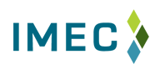


3 Centers Presenting
Dave Boulay, President
Karen Fite, Director
Matt Watson, Director

Slide 86
Illinois Manufacturing Excellence Center
“A catalyst for transforming
the state of manufacturing”
Dave Boulay, President

Slide 87
Vision & Strategic Goals
Within the next 3 years, IMEC will be a recognized leader in driving manufacturing competitiveness, offering comprehensive services and building strategic partnerships.
Expand our service capability
Increase market penetration and awareness
Systematically develop strategic partnerships
Strengthen financial viability
Build a loyal and innovative team

Slide 88
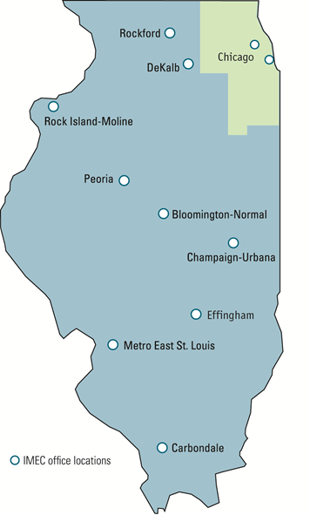
About IMEC
501c3 created in 1996
Two agreements
  Downstate: 1996
  Chicago: October 2010
Nearly 20,000 companies
  Two-thirds in Chicagoland

Slide 89





Slide 90
Governance Structure
Board of Directors
  12-17 voting manufacturing leaders
  4 non-voting university leaders
  Officers and committees
Dotted-line to Provost at Bradley
Hiring through universities
Financial: collaborative with Bradley

Slide 91
Business Model
Market understanding – Rural vs. Urban
  Elk Grove Village and Effingham
Sales and Delivery Structure
Broker and Direct Delivery
Partnerships
  Regional Managers for coverage
  Affiliate relations
  Strategic partners

Slide 92
Financial Source Model
Sources of Funding | Percent of Source | Amount
NIST MEP | 39% | $ 3,509,823
Client Revenues | 26% | $ 2,304,844
State Funding | 6% | $ 555,731
Foundation | 6% | $ 525,000
In-Kind | 23% | $ 2,045,484
Totals | 100% | $ 8,940,882
Please note:
Blended match Downstate and Chicago start-up

Slide 93
Georgia Tech
Georgia Manufacturing Extension Partnership
GaMEP
Karen Fite, Director

Slide 94
Governance Structure
University Based
  Extension / Outreach Service
  Connections to the Applied Research Centers
Operational Flexibility
  University & Departmental Administrative Support
  Contracting and Cash management is handled
  University Strategic Plans
  Connection to University Resources

Slide 95
Governance Structure, con’t
NIST / MEP Alignment
  Advisory Board
  GaMEP Group Managers
State Relations
  Jointly managed with GT Government Liaison
HUGE Market Credibility
  Challenge – state resources should be at no-cost

Slide 96
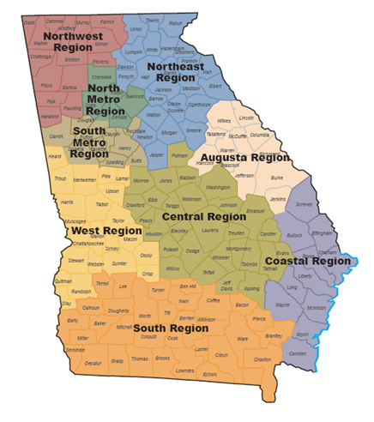
Business Model
Market Understanding
  Nine Regional Managers
  Manufacturing Survey
  CEO / Plant Manager Forums & Lean Consortiums
Sales & Delivery Model
  Internal & Joint responsibilities
  Partnerships

Slide 97
GaMEP Revenue Sources
Sources of Funding | Percent of Source | Example
NIST MEP | 33% | $2,552,258
State Funding | 36% | $2,754,516
Client Revenues | 24% | $1,800,000
Sponsored Projects | 7% | $ 550,000
In-Kind | 0% | $ 0
Totals | 100% | $7,656,774

Slide 98
New York’s MEP Center

Slide 99

State Agency
Empire State Development - State Agency
  Division in Empire State Development (ESD)
  ESD Programs (Non-NYSTAR)
    Start-Up NY
    ESD Grants
    Excelsior Jobs Credit
    Jobs Development Authority Loans
    Environmental Investment Program
    Innovate NY

Slide 100
NYMEP / NYSTAR
State Agency
  NYSTAR Programs
    Centers of Advanced Technology (CATs)
    Centers of Excellence
    Hot Spots & Incubators
    High Performance Computing
    New/renewed Gaming Hubs, Facility Development, & Technology Transfer
  NYSTAR Advisory Committee (Coming Soon)

Slide 101
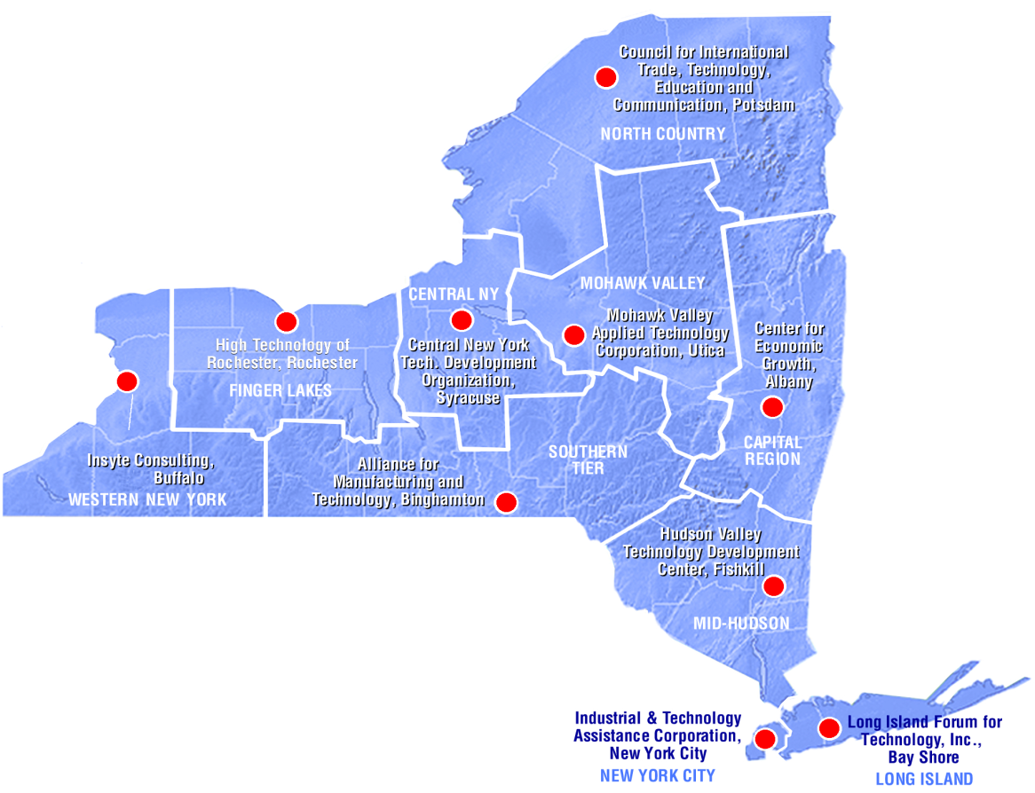
A Look at New York State
Region | Sq. Miles | Under 500
Capital | 5,184 | 861
Central | 3,582 | 741
Finger Lakes | 4,682 | 1,535
Hudson Valley | 4,552 | 1,731
Mohawk Valley | 5,150 | 518
North Country | 11,421 | 330
Southern Tier | 6,172 | 608
Western NY | 4,969 | 1,658
Long Island | 1199 | 3,214
New York City | 303 | 5,952
Statewide | 47,214 | 17,148

Slide 102
NYMEP – Finances & Staffing
Pros-
Easily achieve match
Cons
Focus on who can pay
Funding Sources | Amount | %
NIST MEP | $ 5,468,093 | 31%
NYS | $ 3,773,000 | 21%
Prog Income (last yr) | $ 7,929,536 | 45%
In-kind (last yr) | $ 519,849 | 3%
Total | $ 17,690,478
Staffing Across NYS | FTEs
Management Staff | 12.00
Technical Specialists | 48.20
Sales Staff | 18.94
Other Support Staff | 21.65
Total Staff: | 100.79
Pros-
Great local knowledge
Cons
High Management & support

Slide 103
NYMEP Governance Structure
NYSTAR
  Regional Centers (10 SRAs)
  Provide financial & program support
  Develop direction & goals
  Challenges – Gov’t, 10 Directors
  Opportunities – Gov’t, Regional

Slide 104
NYMEP Governance Structure (Con’t)
  10 Regional Centers (501C3s)
  Independent Boards
    Mixed fiduciary/advisory
    Manufacturers voice– need more
    7 Primarily MEP

Slide 105

NYMEP - Connecting Manufacturers to Resources

Slide 106
NYMEP
Questions?

