Slide 1
Hollings Manufacturing Extension Partnership
Industry Day 2016
Carroll Thomas, Director

Slide 2
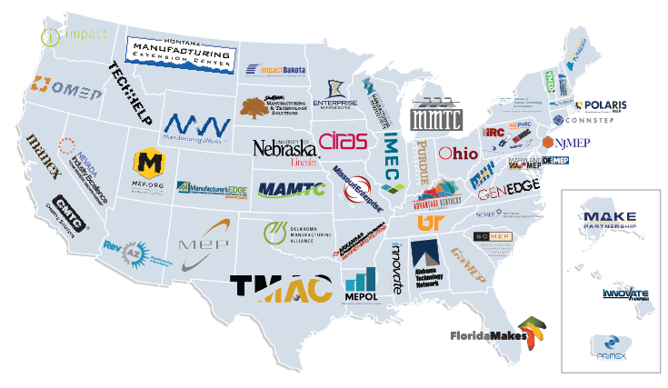
National Network
ROLE
MEP’s state and regional centers facilitate and accelerate the transfer of manufacturing technology in partnership with industry, universities and educational institutions, state governments, and NIST and other federal and research laboratories and agencies.
MISSION
To enhance the productivity and technological performance of U.S. Manufacturing.

Slide 3

Profile of Current MEP Contracts
Contracts that directly benefit & support the MEP Center system
  These contracts provide products and services that MEP Centers can directly use with their manufacturing clients such as export assistance and technology acceleration.
Administrative contracts & contracts that indirectly support the MEP Center system
  These administrative contracts are used primarily to conduct surveys of MEP Center manufacturing clients, perform independent financial analysis of MEP Center financials and conduct statutorily required panel reviews.
MEP Total Number of Contracts:
  Small Disadvantaged Business
  8(a)
  Woman-Owned Small Business - 8(m) program
  HUBZone Small Business
  Veteran-Owned Small Business
  Service Disabled Veteran-Owned
Notes:
Total number of contracts – MEP executed 34 contractual actions in FY15
How many 8A - 2
How many women owned - 15
How many small business – 12
How many Vet – 2

Slide 4

The Future Outlook for MEP Contracts
Assistance to provide more direct support to MEP system through improved marketing & branding and technology solutions.
Research and studies that result in more efficiency and effectiveness of the program.
Contact: Autumn Hernandez
autumn.hernandez@nist.gov

