Slide 1
Introduction to the
Materials Data Curation System
MARY BRADY, Alden Dima, Guillaume Sousa Amaral, Sharief Youssef, Philippe DESSAUW, MARCUS NEWROCK, CARMELO Montanez-RIVERA
National institute of standards and technology
Software systems division
Information technology laboratory

Slide 2
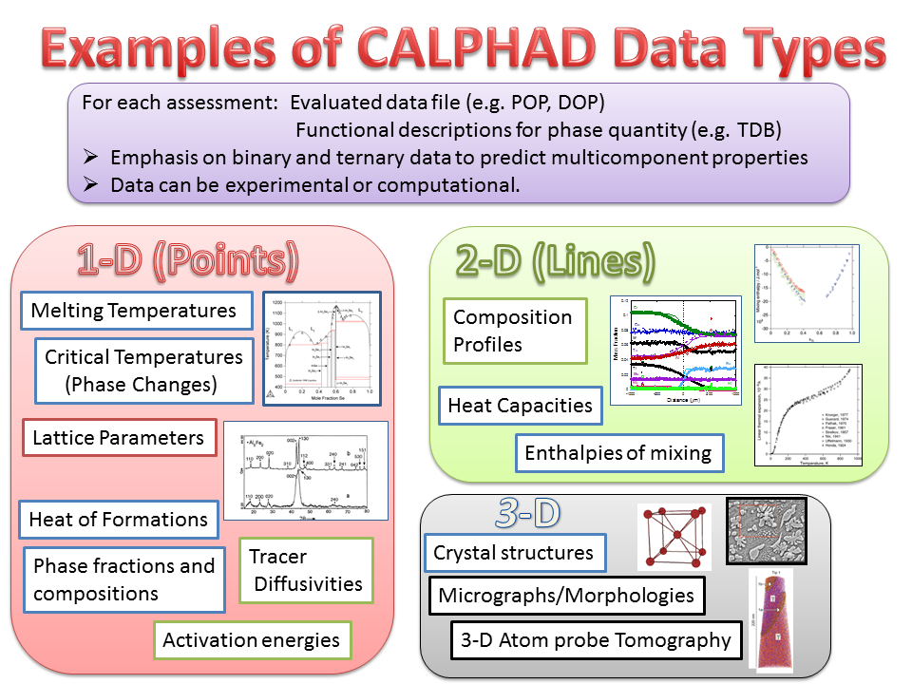
C. Campbell and A. Dima (NIST), MGI and Big Data

Slide 3
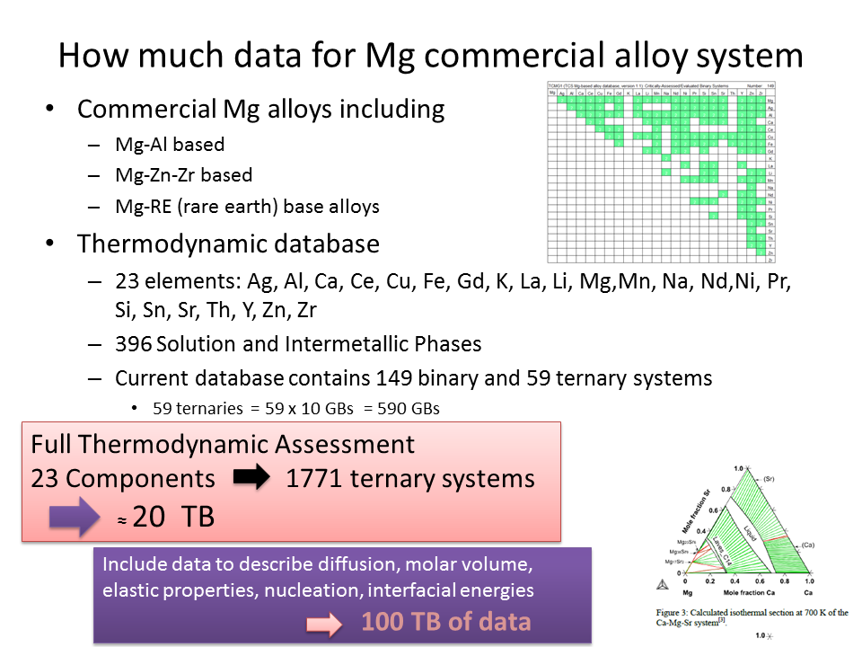
C. Campbell and A. Dima (NIST), MGI and Big Data
Much of the existing data is stored using ad-hoc means
Database = Collection of files

Slide 4
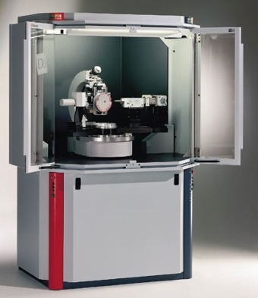

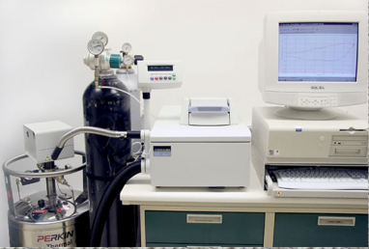

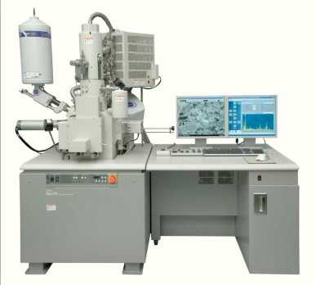
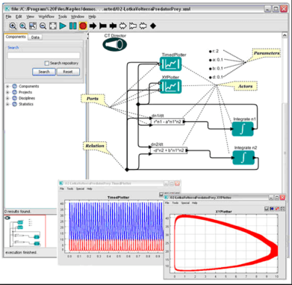
Materials Data Desiderata
Other Data/ Users
Data
User defined tools
Data to Share
Interface with workflow tools
Curated Data
(Data to share)
Interface with workflow tools
Send Data via API
Interface with workflow tools
Curation of Raw Data
Send Data via API
Send Data via AIP

Slide 5




Move Data to Digital Object Architecture
Traditional stove-pipe data vs Fused information on the Net
Platform-Centric
Net-Centric
Users
2
3
Federated Set of Type Registries
1
4
ID
ID
ID
ID
4
Terms:…
ID
Type
ID
Type
Type
10100
11010
101….
Visualization
I Agree
Type
Type
Payload
Type
Payload
Payload
Payload
Rights
Payload
Payload
Data Set
Dissemination
Data Processing
Typed Data
Services
  Content Is: Application specific, Not Visible to the Web, Not authoritative upon download
Content does not support: Interoperability, Dynamic relationships, Value adding
Architecture lacks coherent preservation strategy
  Content Is: Persistent, Visible, Authoritative, Extensible, Reusable, Interoperable
Content supports: Dynamic relationships, Value adding
Supports digital preservation strategy
Source: Inspired by Margaret Myers, James Erwin
5

Slide 6
The Problem with Proprietary Formats
Networked information has to be usable on diverse systems
Public information cannot be restricted to one vendor or cede control of its format
Information should be reusable in many different ways to minimize wasted time and effort
Proprietary formats, no matter how well documented, can be changed or withdrawn arbitrarily
http://xml.silmaril.ie/whyxml.html

Slide 7
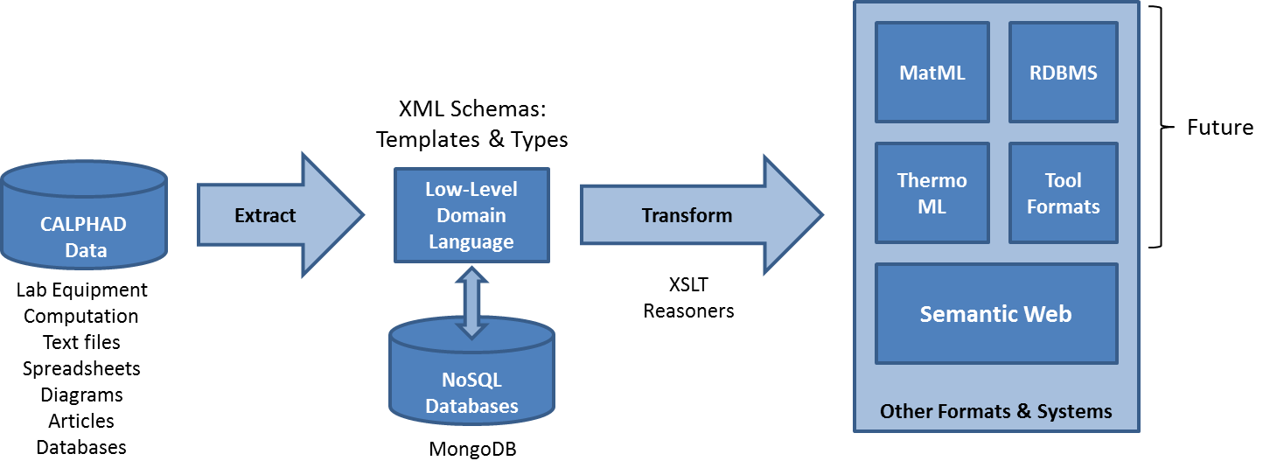
Curator Approach

Slide 8
Why XML?
Format for information identification, storage and transfer
  Robust
    Proven standard
  Durable
    Plain-text file format will outlast proprietary binary ones
  Manipulable
    Can combine disparate sources
    Can be converted into any other format
  Free
    "free beer"
    "free speech"
http://xml.silmaril.ie/whyxml.html

Slide 9
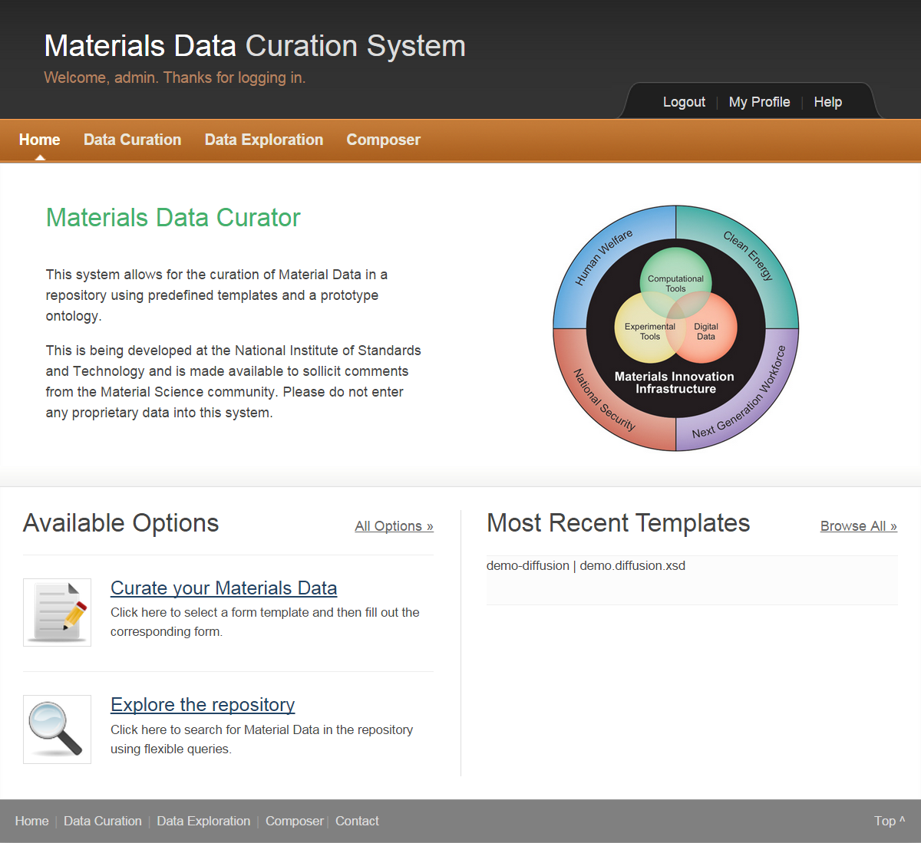
Materials Data Curation System
Web-based
  Python/Django/MongoDB
  REST API
  XML-based
  SPARQL queries
Store data in XML-based templates
  Web forms
  Web API
Store, manage, compose data templates
Table input
https://github.com/usnistgov/MDCS

Slide 10
Materials Data Curation System
Data Curation (enhanced)
Data Exploration (new)
Composer (new)
  Templates
  Types
Administrative Dashboard (enhanced)
RESTful API (new)
Exporter (future)
  POP, CSV, HTML, Script

Slide 11
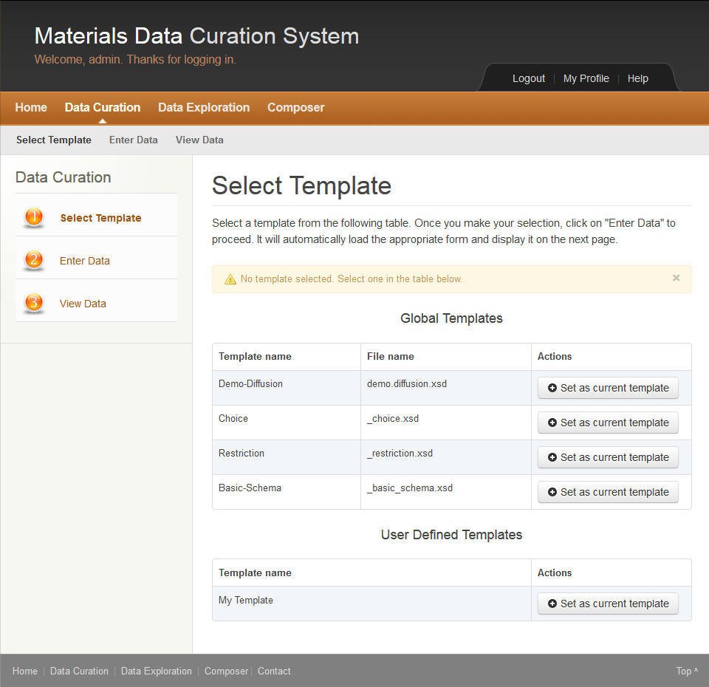
Data Curation
Three Steps to Curate:
Select Template
  Global Templates
  User Defined Templates
Enter Data
  HTML Generated
  Based on Templates
View Data
  Requires Validation
  Download in XML format
  Can save to Repository

Slide 12
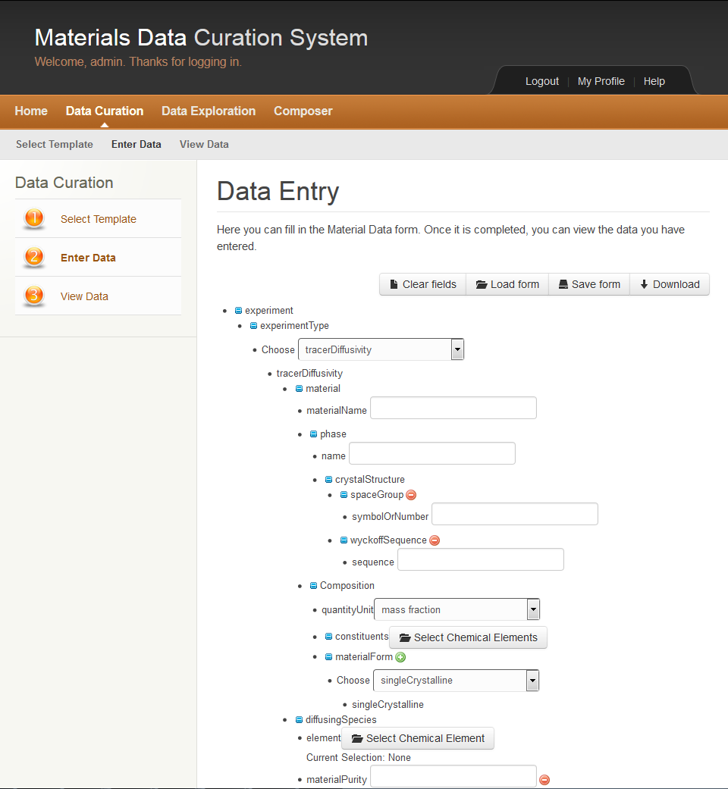
Data Curation
Three Steps to Curate:
Select Template
  Global Templates
  User Defined Templates
Enter Data
  HTML Generated
  Based on Templates
View Data
  Requires Validation
  Download in XML format
  Can save to Repository

Slide 13
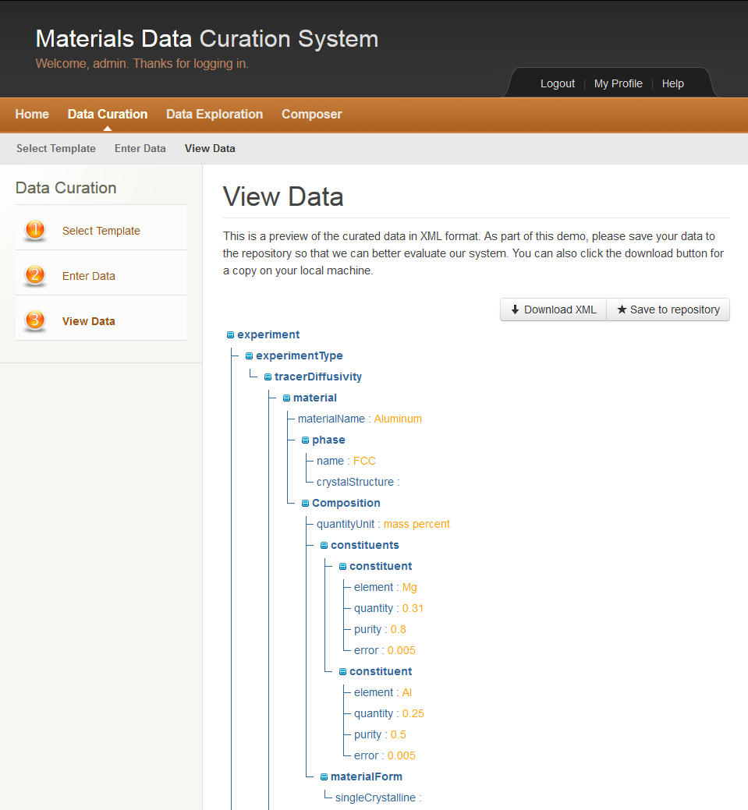
Data Curation
Three Steps to Curate:
Select Template
  Global Templates
  User Defined Templates
Enter Data
  HTML Generated
  Based on Templates
View Data
  Requires Validation
  Download in XML format
  Can save to Repository

Slide 14
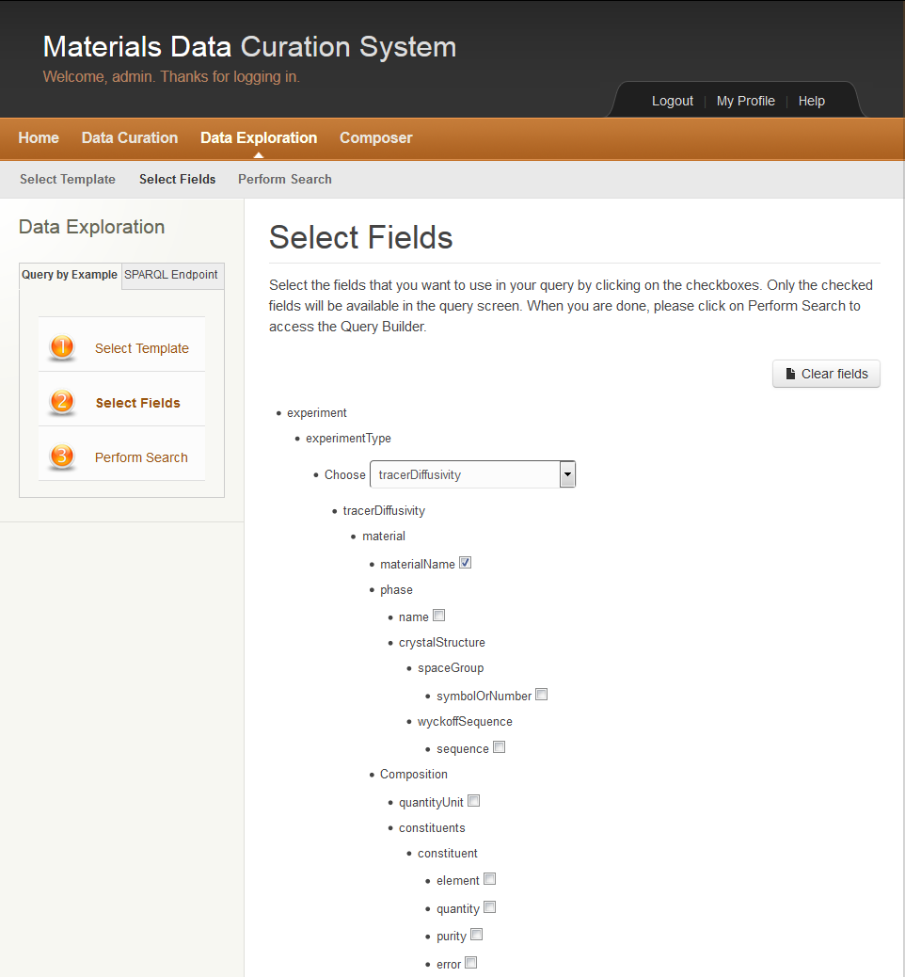
Data Exploration
Three Steps to Explore:
Select Template
  Global Templates
  User Defined Templates
Select Fields
  Specific fields to search against
Perform Search
  Query By Example
  SPARQL Queries

Slide 15
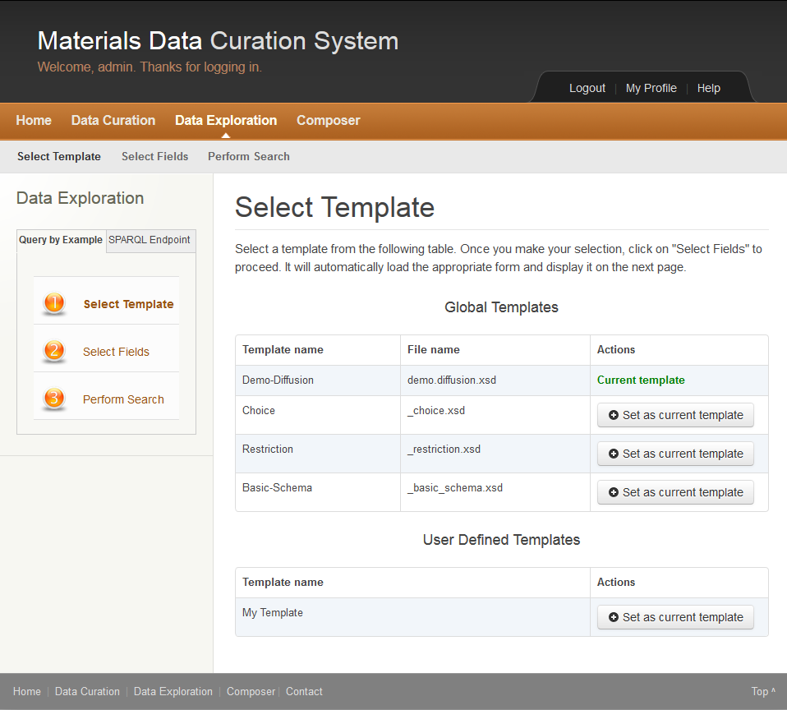
Data Exploration
Three Steps to Explore:
Select Template
  Global Templates
  User Defined Templates
Select Fields
  Specific fields to search against
Perform Search
  Query By Example
  SPARQL Queries

Slide 16
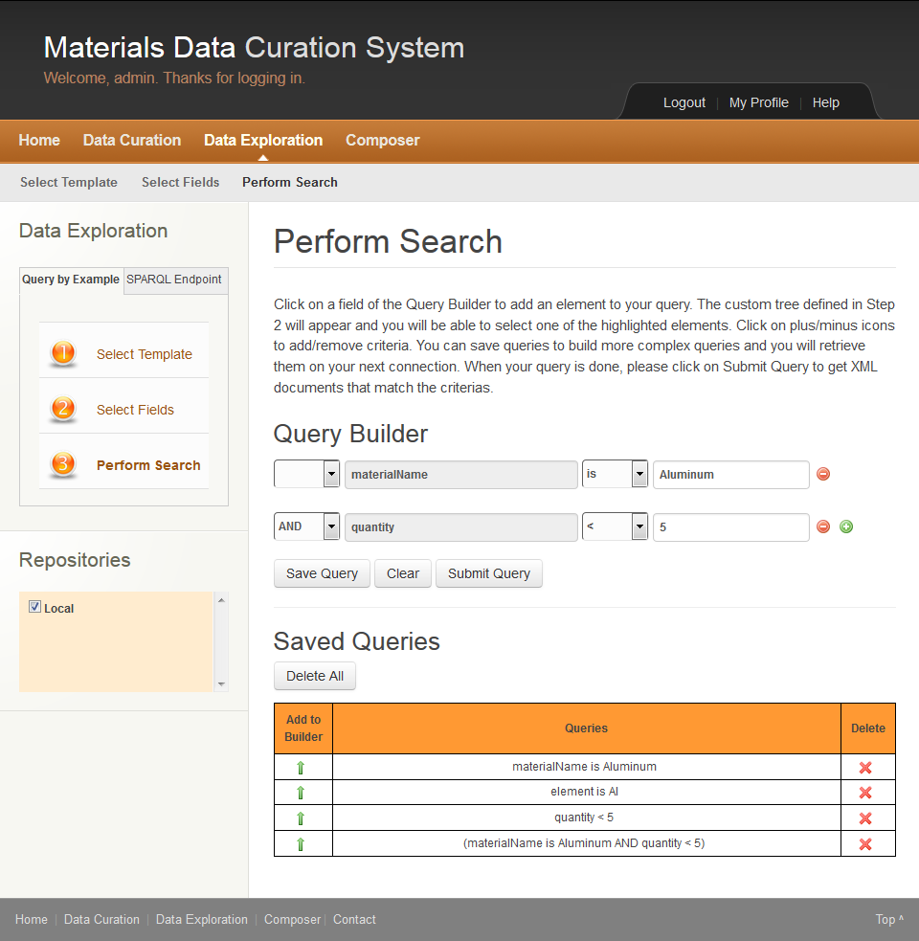
Data Exploration
Three Steps to Explore:
Select Template
  Global Templates
  User Defined Templates
Select Fields
  Specific fields to search against
Perform Search
  Query By Example
  SPARQL Queries

Slide 17
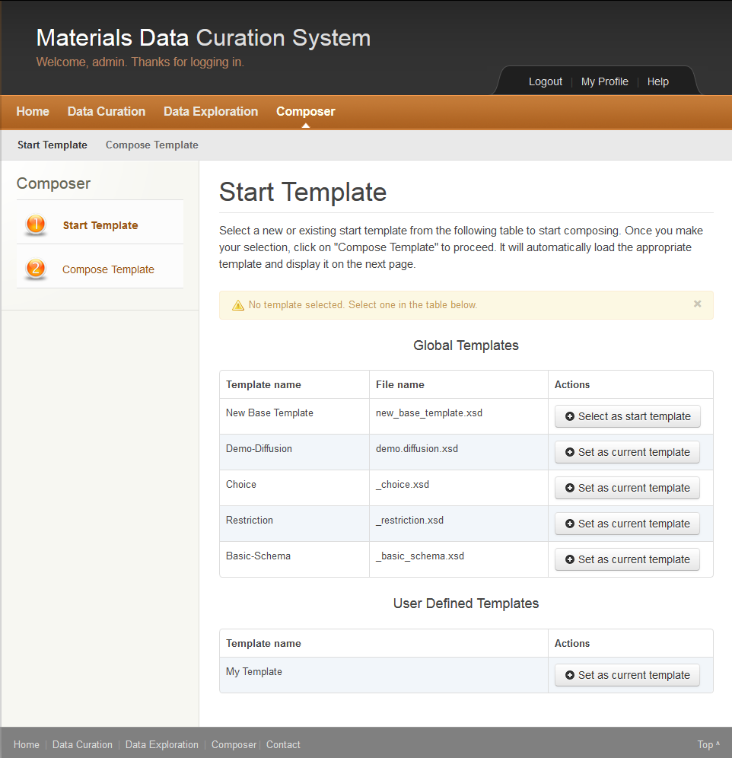
Composer
Two Steps to Compose:
Start Template
  Global Templates
  User Defined Templates
Compose
  Based on Selected Template
  Add/Delete Elements and Attributes
  Save to a new User Defined Template

Slide 18
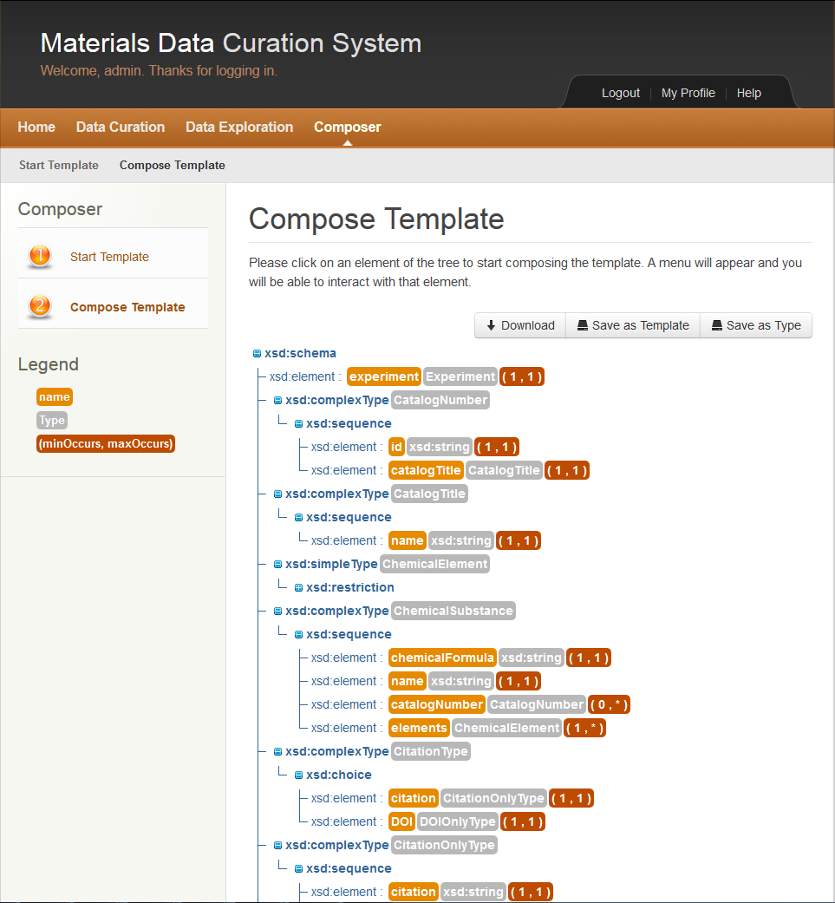
Composer
Two Steps to Compose:
Start Template
  Global Templates
  User Defined Templates
Compose
  Based on Selected Template
  Add/Delete Elements and Attributes
  Save to a new User Defined Template

Slide 19
Administrative Dashboard
Access Controlled
Management of:
  Users and Groups
  Templates
  Types
  Modules
  Repositories for Federation of Queries
  Website Content
RESTful API enabled

Slide 20
RESTful API
Curate
Explore
  Query by Example
  SPARQL
Templates
Types
Saved Queries
Repositories
Users
Select
Select All
Add
Update
Delete
Restore
Versioning

Slide 21
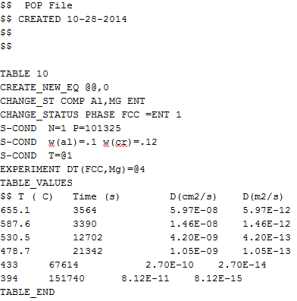
Exporter (Future)
Three Steps to Export:
Select search result to export from
  One search result
  Multiple search results
Create or upload XSLT mapper to file type
  Web based
Export data into file type desired
  POP, CSV, HTML, Script
Search Results
Result1
Result2
Transform
XSLT1
XSLT2
Output Format
POP file
CSV
HTML
Script
Result3

Slide 22
Collaborators and Contributors
Carelyn Campbell
Ursula Kattner
Zachary Trautt
Chandler Becker
L. Cate Brinson
He (Richard) Zhao
Raymundo Arroyave
Daniel Sauceda
Luke Johnson

Slide 23
Demo

